Slide 1


Slide 2
Oracle Eclipse Update
Greg Stachnick
Sr. Director of Product Management – Oracle Eclipse Development Tools
greg.stachnick@oracle.com

Slide 3
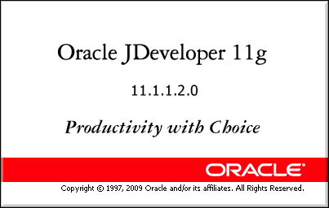

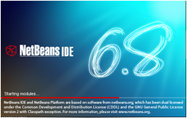

Oracle Java Developer Tools Strategy
Productivity with Choice
Productivity
with
Choice
Notes:
Complete and integrated tooling for the platform
End-to-end framework, Java EE, SOA, WebCenter, database
Visual and declarative, based on industry standards
Productivity
Provide highly-productive visual environment for the Oracle Platform targeted at different types of developers
Choice
Choice of implementation technologies
Choice in development style
Choice of deployment platforms and databases
Choice of IDE solutions (JDeveloper, Eclipse, NetBeans)
With JDeveloper, Oracle can offer the most complete tooling for the Fusion Middleware platform. This is our strategic end-to-end IDE; Oracle use JDeveloper and ADF to build Fusion in house.
Core Eclipse is a popular platform but offers less than JDeveloper does out of the box and needs help, OEPE continues to provide this additional functional layer for Java, Java EE and open source development.
NetBeans IDE will provide an open source alternative to the Eclipse plug-in model – a more seamlessly integrated IDE focused on the cutting edge of Java SE, EE, ME and Java FX development.

Slide 4
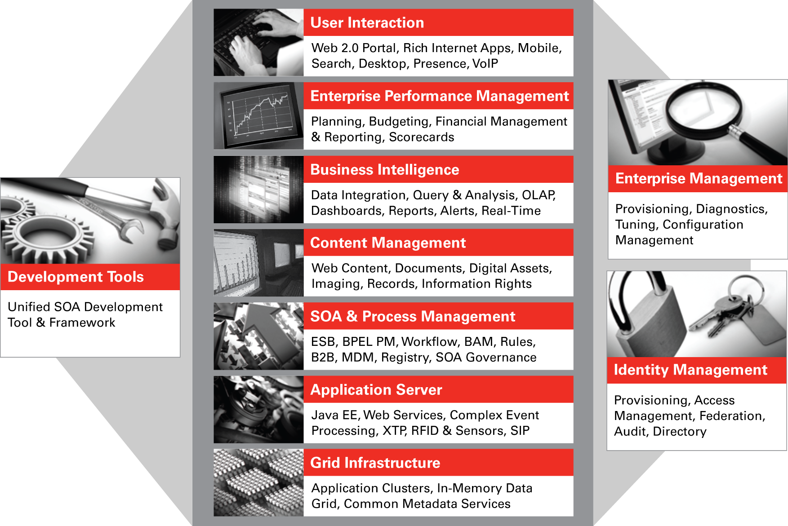
Oracle Fusion Middleware
Complete, Integrated, Best of Breed, Hot Pluggable
Notes:
4

Slide 5

Oracle Enterprise Pack For Eclipse
Certified Plug-in to Eclipse IDE
  Oracle Enterprise Pack for Eclipse is a set of free Eclipse plug-ins for the Java EE developer creating applications for Oracle runtimes.
Target Audience
  Java SE, Java EE, Java Web Application, Web Services Developer who deploys to WebLogic Server and Oracle Database
Key Differentiators
  AppXRay: Detect potential runtime errors at design time
  Understand large existing J2EE applications
  Unify all Oracle Eclipse development efforts
Oracle Restricted and Confidential

Slide 6

OEPE Packaging, Distribution, Licensing
Free commercial license (OTN License)
  Support is covered by WebLogic Server support contract
  Support sold standalone for OEPE as well
Download latest version from OTN
  All In One bundle of Eclipse and OPE Plug-ins
  Plug-ins zip for existing Eclipse users
Install from Eclipse Update Sites
  Update sites available for install on demand of OEPE components
  Easiest way to obtain future updates
Supports latest Eclipse version
  Available for Eclipse 3.5 SR1 (Galileo)
Agile and Frequent Release Schedule
  Quarterly feature releases
Notes:
OTN License
OEPE 11g is licensed under the Oracle Technology Network license
http://www.oracle.com/technology/software/popup-license/enterpriseforeclipse-license.html
Pricing
OEPE 11g is a FREE product and requires no license key
OEPE Support is covered by Weblogic Server support contracts
Standalone OEPE Support is available
OEPE standalone support is a 24x7 support service that provides direct access to Oracle experts for product-specific questions about installing and operating Oracle Enterprise Pack for Eclipse.
OEPE standalone support is priced at 218.90 USA (Dollar) per Named User Plus per annum.
6

Slide 7



OEPE 11g at a glance
WebLogic Server
Java Web Apps
Web Services
Spring
AppXRay
Oracle DB Tools
ORM Workbench
FastSwap
Remote deploy, debug
JSP Debug
Shared Java EE Libraries
WebLogic DD editors
Visual Web App design
JSP, JSF, JSTL, CSS, HTML
Smart editor
Tag Drop wizards
JAX-WS
JAXB
Client Gen
Test Client
Advanced validation
WebLogic SCA
Spring IDE
Spring DAO generation
Spring Facets
Generate JAX-WS from bean
Visualize Dependencies
As you type validation
Code navigation
Code completion
Oracle DTP Plug-in
SQL Query
DDL Generation
E/R Diagrams
Entity Generation
Entity Editor
EclipseLink
OpenJPA
Kodo
JSF
Web Tools
WTP JSF
Dali
WPE
EclipseLink
Eclipse Platform
JDT
APT
Debug
Notes:
Virtual EAR technology dramatically improves iterative development performance for large applications.
Virtual EARs allow the source and generated artifacts to be kept in separate physical locations but linked together through mappings in a descriptor file. The descriptor file contains entries that map physical locations to relative locations inside the "virtual EAR".
The descriptor file is generated automatically: there is no need to manually configure the virtual EAR. Layout the projects the way it makes sense for you and the necessary structure will be set up to minimize the time it takes to publish/deploy during iterative development.

Slide 8
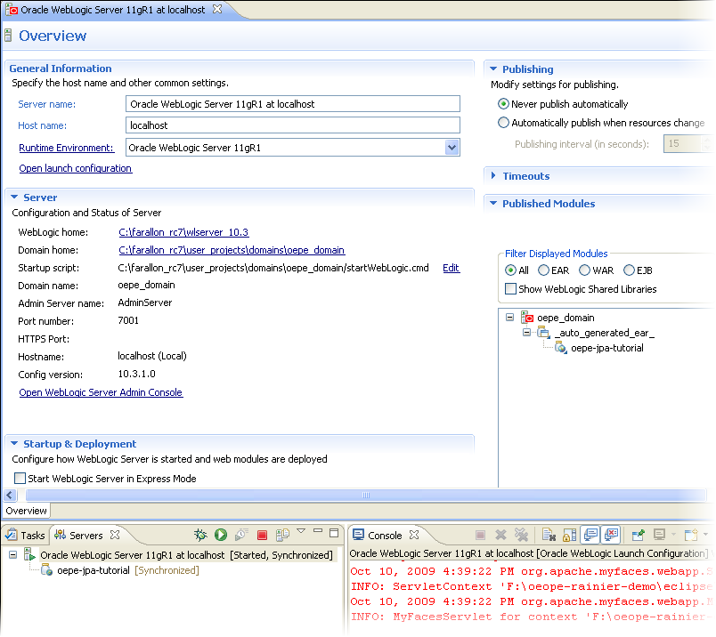
WebLogic Server Tools
WebLogic Server Adapter
  Supports WLS 8.1 and newer
  Run/Deploy/Debug Locally and Remotely
  Shared Libraries Support
  FastSwap
  WebLogic SCA Tools
Runtime Migration Tools
Server Administration Editor

Slide 9
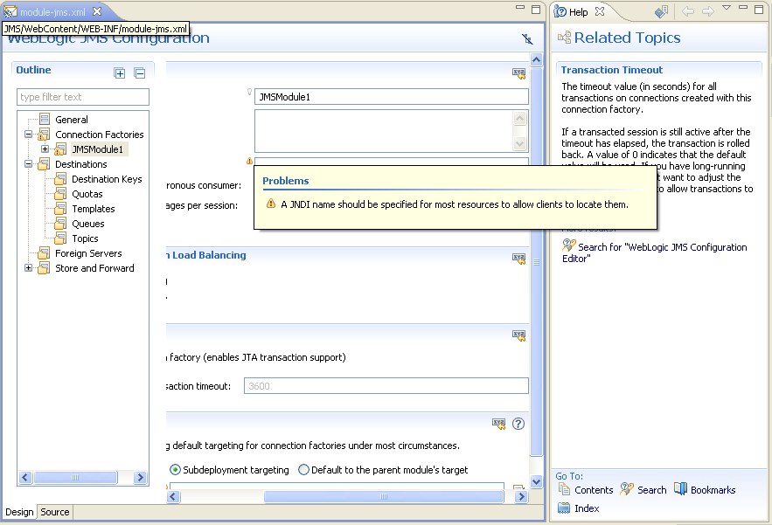

WebLogic Server Configuration
Design views and wizards for common WLS deployment descriptors:
  *.-jms.xml
  weblogic.xml
  weblogic-application.xml
  weblogic-ejb-jar.xml
  JSR 88 Deployment Plans
Validation of schema structure and property values
Wizards suggest appropriate defaults
Integrated Context Sensitive Help for each descriptor element
Available for WLS 9.x and 10.x
New!
Notes:
New Editor for JMS Module configuration
Suggests Best Practices for JMS Configuration
Validates JMS Properties
Context Sensitive Help and Links to WebLogic Server Help
WebLogic Server deployment support:
System Module (recommended)
Package in an EAR
Available for WLS 9.x and 10.x

Slide 10






AppXRay
Design time dependency analysis, validation and visualization
Java / Java EE
AppXRay™
WebLogic Server
Artifact
HTML
CSS
JSF
JSP
JSTL
Struts
Presentation
Web Services
Spring, ORM, DB
Java
Variable
Resource
bundles
POJO
Web
Services
XML
schema
Component
EclipseLink
EJB 3
JPA
Spring
DAO
Data Access
External Resources
Notes:
Oracle’s AppXRay™ provides as-you type, compiler level awareness of much more than java at design time, offering unique capabilities in code and annotation completion, code navigation, dependency visualization, consistency checking with generated classes and configuration files, pre-build error checking, and validation that understands your entire application.
Provides design-time compiler awareness for:
Java, HTML, CSS
JSP/JSTL, Struts, Tiles, JSF
Java Resource Bundles, Variables

Slide 11
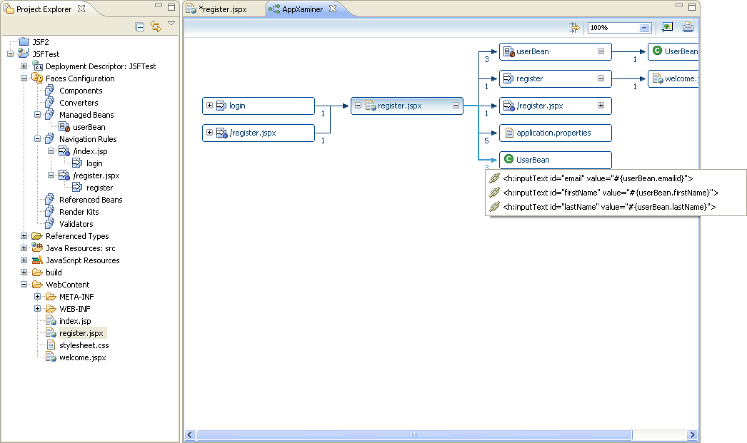
AppXRay: AppXaminer
Developers who inherit code or applications developed by others will appreciate AppXaminer. View the relationships between all design time artifacts with a simple right click gesture, then filter out what you don’t want to see. AppXaminer allows navigation through specific instances of dependences as well.

Slide 12
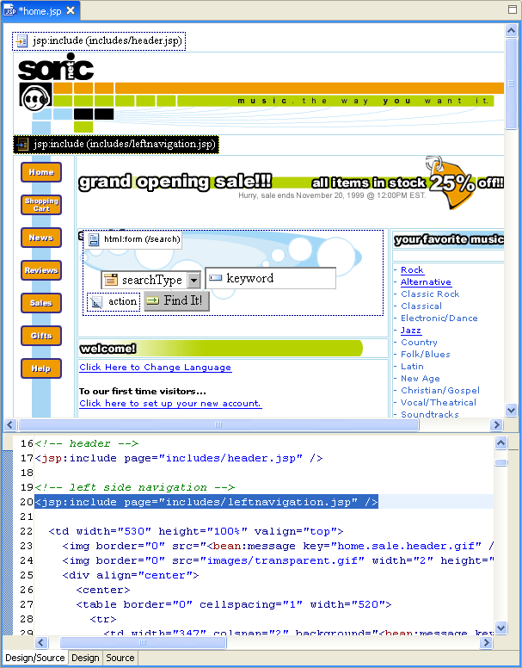
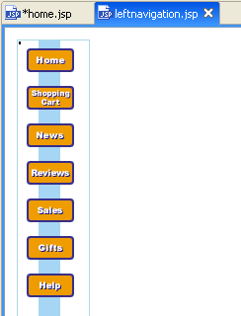
Enhanced Visual Web Development
Visual Page Construction
  WYSIWYG Editing
    HTML, JSP, and JavaServer Faces
    Design-time rendering of bundles/css
    Drag and Drop Tag Editors
  Tag and Data palettes
  Smart Editors
Design views for common descriptors
  Web Applications
    web.xml
    faces-config.xml
  JavaServer Faces page flow development
  Tag Development

Slide 13
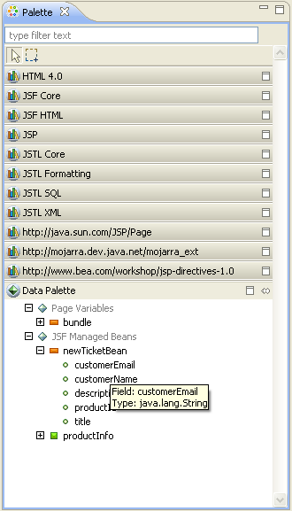
Tag and Data Palette
Enhances WTP Palette for improved Drag and Drop
  Supports all taglibs in project
    HTML, JSP, JSTL, JSF, Custom Tags
  New tag drop wizards for easy tag configuration
Data Palette displays Variables available to current page
  JSF Managed Beans
  Page, Session, Application Scoped Variables
Drag and Drop support for Variables

Slide 14
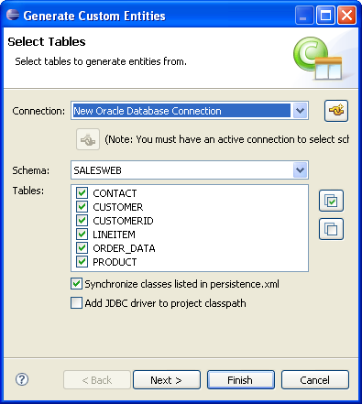
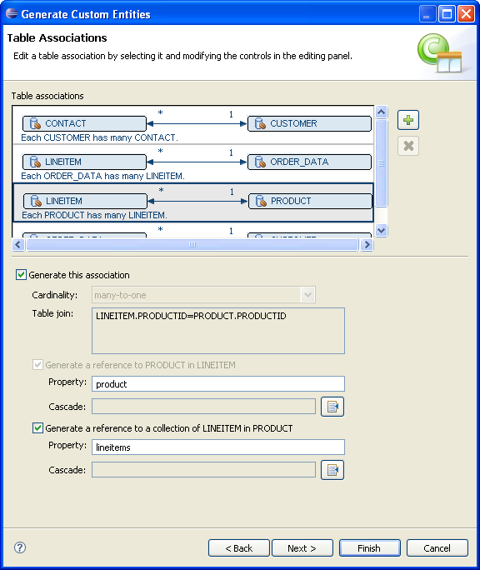
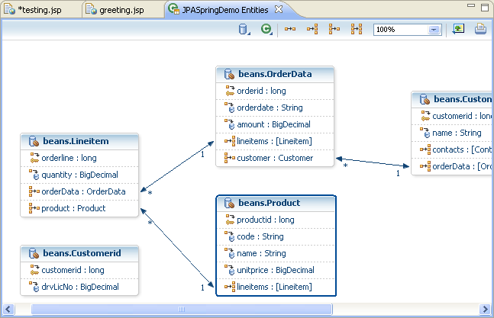
Java Persistence & ORM Tools
ORM Creation and Management Tools
Entity Generation
  Start from schema
  Start from Java
  Meet in the middle
DDL Generation
Entity Graphical Editor + JPA Details View
Annotation validation and completion
Supports EclipseLink, TopLink, and Generic JPA Providers

Slide 15
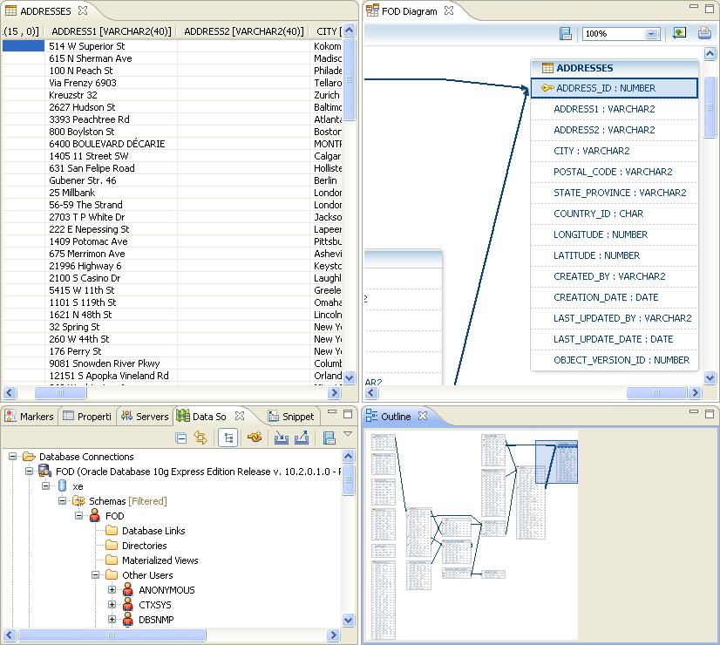
Oracle Database Tools
Eclipse DTP Adapter
Supports Oracle DB 10g & 11g
SQL Query Editor
Schema Creation
Data Manipulation
Entity Diagrams
Support for Stored Procedures, Synonyms, Views, Sequences

Slide 16
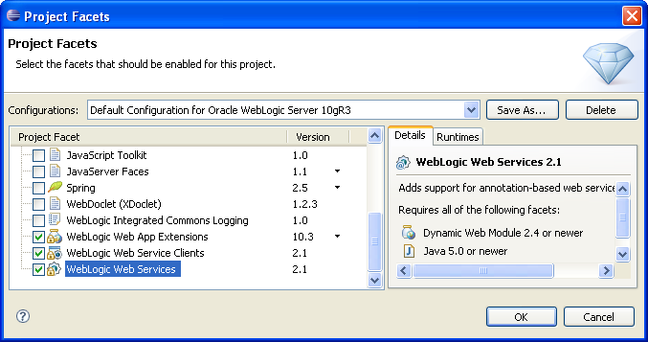
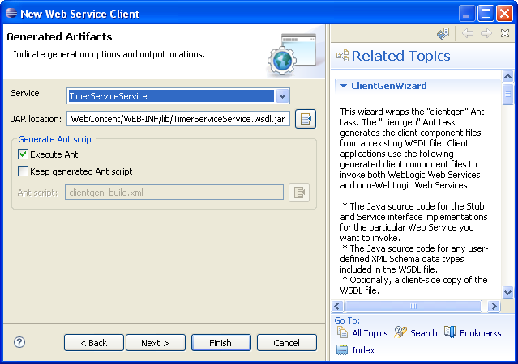
JAX-WS Web Services Tools
Create JAX-WS based Web Service Projects
  New Facets for Weblogic Web Service development
  Use Weblogic Shared Libraries
Supports basic Web Service Development patterns
  Start from Java
  Start from WSDL
  Generate Web Service Clients
Integrated Web Service Test Client
Editors for WSDL, Web Service Bindings, and Handlers
Spring Web Service Generation
Integrated Context Sensitive Help for each Wizard

Slide 17
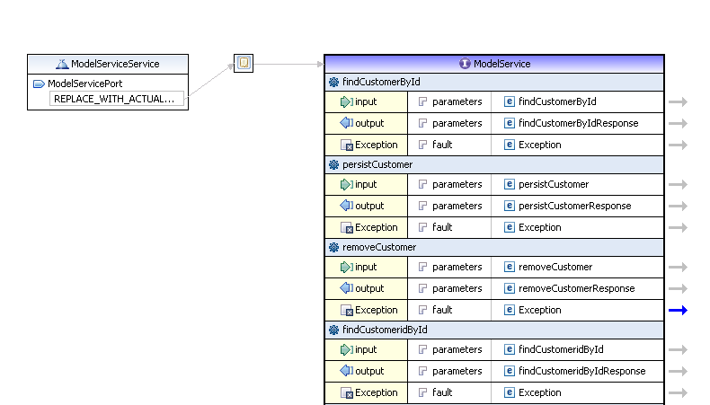
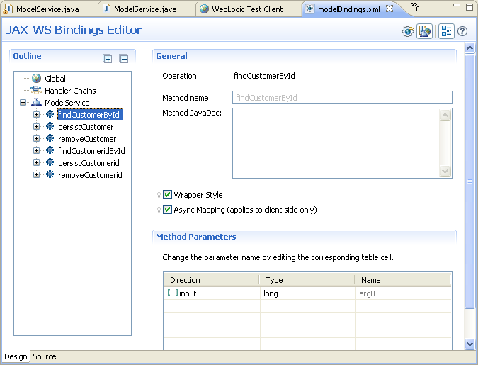
WebLogic Web Service Editors
WSDL Editor
  Design operations, messages, ports, bindings
Schema Editor
JAX-WS Bindings Editor
  Editor for JAX-WS Bindings
  Define Logical and SOAP Handlers
  Customize Endpoint Interface, Methods, Generated JAXB Types
Web Service Client Proxy Templates
  Simplifies Web Service Client access from JSP and Java Classes

Slide 18
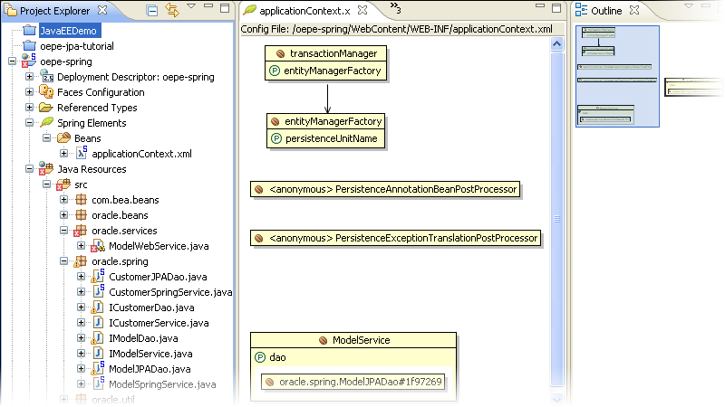

OEPE Spring Tools
Support for Spring 2.x and 3.0
Bundled and Integrated SpringIDE 2.2
  Provides editing and validation for applicationContext.xml
New Spring Facet improves Spring Project Configuration
  Adds OEPE’s Spring and SpringIDE support to a project
  Configures Spring libraries for Project Classpath
Spring ORM Generation Wizards
  Create Spring DAO and Service classes from existing JPA Entities
  Spring DAO classes include basic CRUD operations for data access

Slide 19

Oracle’s Strategic Role in Eclipse
#2 Code Committer to Eclipse Projects
Web Tools Project Leadership
  JavaServer Faces, Web Page Editor
  Dali JPA Tools
  EclipseLink
  Facet Project Framework
Community Leadership
  Strategic developer status, Council representation, Development process
Other Notable Oracle Enterprise Pack for Eclipse Contributions
  Weblogic Server Plugins
  Oracle Database Tools
  Library Provider Framework
  Sapphire Modeling Framework
  Java Annotation Processor

Slide 20

Looking to Eclipse 3.6 Helios
GA Date: June 23, 2010
Main Theme – Java EE 6 Enablement
  JavaServer Faces 2.0
  Facelets
  JPA 2.0 certified EclipseLink
  JPA 2.0 Dali Tools
Additional Enhancements
  Improved Web Page Editor
  Tag and Data Palette
  Tag Drop Editors
  Smart Property Sheet for JSF

Slide 21
The following is intended to outline our general product direction. It is intended for information purposes only, and may not be incorporated into any contract. It is not a commitment to deliver any material, code, or functionality, and should not be relied upon in making purchasing decisions.
The development, release, and timing of any features or functionality described for Oracle’s products remains at the sole discretion of Oracle.

Slide 22
WebLogic Server Administration
New Tools for WebLogic Scripting Tool (WLST)
Full Jython/Python development based on PyDev IDE
Project/Facet Configuration for WLST
Define and Reuse WLST Templates
Graphical Mbean Explorer
Eclipse Integrated WLST Console
JavaDoc style help for WLST commands
WLST Debugger

Slide 23
OEPE 11g Demo
Notes:
23
Please note that the agenda is a guideline and so you can update the slide and flow as you see fit.
You will need to run through the housekeeping notes supplied by the events team as well (lunch location, etc.)
Important Note for ODD events in North America: You should highlight for attendees that if they haven't already installed the database on their machine, they should start the install now to save time. The database CD is included in the bags they received at registration. Any issues that they have with installation can be addressed during the breaks and if someone's unable to install the database for whatever reason, there is a wireless router on one of the provided machines which serves as a database server. Also let students know that they'll receive the DVD containing the tools and soft copy of instructions for the hands on session just after the last presentation. This keeps their attention through the sessions and the installs only take a few minutes. Also, the winner of the iPod Nano and other fabulous prizes will be drawn at 4:50. This keeps their attention on the hands on session ☺.
Note that the iPod raffle is included in North American cities only.
Outside North America, if you are including a hands-on session, you might want to co-mingle the slides and hands-on labs.

Slide 24
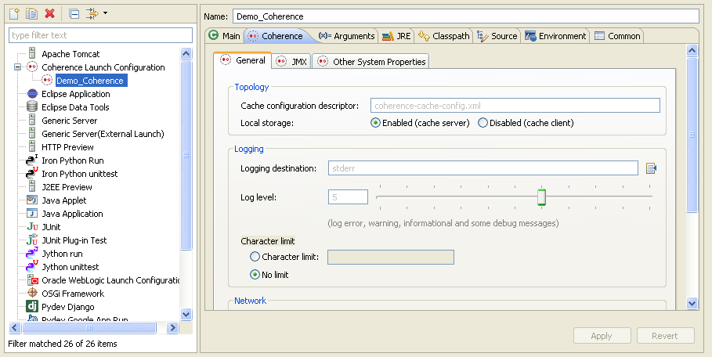
Oracle Coherence Tools
Coherence Project Config
  Facets
  Library Management
  Descriptor Generation
Runtime Configuration
  Launch Config Editor
  Run/Deploy/Debug from IDE
Configuration Support
  tangosol-coherence-override.xml editor
  Validation
  Context Sensitive Help Integration

Slide 25
Oracle Eclipse Tools Roadmap
Q1 2009
Feb 2010
April 2010
Oct 2010
Sept 2009
July 2010
Q2 2010
OEPE 11g (11.1.1.3)
Support for WebLogic Server 10.3.2 and older
WebLogic SCA Tools
Web Service Client Templates
Web Service Validators
Eclipse 3.4/3.5 Support
OEPE 11g (11.1.1.4)
AppXRay
WYSIWYG Web Page Development
HTML, JSP, JSF Support
Apache Trinidad Support
New Tag and Data Palette
Tag Drop Editors for JSP/JSF/custom tags
Smart Editor Property Sheet
JMS Deployment Descriptor Editor
Eclipse 3.5 Support
OEPE 11g (11.1.1.5)
Support for WebLogic 10.3.3 and older
AppXRay Enhancements
Additional JSF tag support
WebLogic SCA Validation and Modeling Enhancements
Eclipse 3.5 Support
OEPE 11g (11.1.1.6)
Eclipse 3.5/3.6 Support
Coherence Server Adapters
Coherence Descriptor Editors
WLST Editor
Glassfish Server Tools
JPA 2.0 Tools Support
JSF 2.0 Tools Support
Annotations Smart Editor
Improved Web Page Rendering
Support for latest WebLogic Server and older
OEPE 11g (11.1.2?)
Oracle ADF Faces Tools
Team Productivity Features
Visual JPA Entity Modeling
Oracle Database modeling
Web Services Security
Stored Procedure Development
Eclipse 3.6 Support
More features TBD
Oracle Proprietary & Confidential.
Internal use only or with NDA: Copyright 2008
The timing as well as the proposed features or functionality of any future product or service offering are subject to change at the sole discretion of Oracle.

