Slide 2

Extending Oracle E-Business Suite Release 12.1 and above using
Oracle Application Express – Revision 2
September, 2014
Notes:
This is a Title Slide with Picture slide ideal for including a picture with a brief title, subtitle and presenter information.
To customize this slide with your own picture:
Right-click the slide area and choose Format Background from the pop-up menu. From the Fill menu, click Picture and texture fill. Under Insert from: click File. Locate your new picture and click Insert.

Slide 3
Notes:
This is a Safe Harbor Front slide, one of two Safe Harbor Statement slides included in this template.
One of the Safe Harbor slides must be used if your presentation covers material affected by Oracle’s Revenue Recognition Policy
To learn more about this policy, e-mail: Revrec-americasiebc_us@oracle.com
For internal communication, Safe Harbor Statements are not required. However, there is an applicable disclaimer (Exhibit E) that should be used, found in the Oracle Revenue Recognition Policy for Future Product Communications. Copy and paste this link into a web browser, to find out more information.
http://my.oracle.com/site/fin/gfo/GlobalProcesses/cnt452504.pdf
For all external communications such as press release, roadmaps, PowerPoint presentations, Safe Harbor Statements are required. You can refer to the link mentioned above to find out additional information/disclaimers required depending on your audience.

Slide 4

Agenda
Oracle Application Express Overview
Building and Deploying Applications
Extending Oracle EBS R12 using Oracle APEX
Integration Examples
Q&A
Skip Overview

Slide 5
Introduction
Oracle Application Express

Slide 6
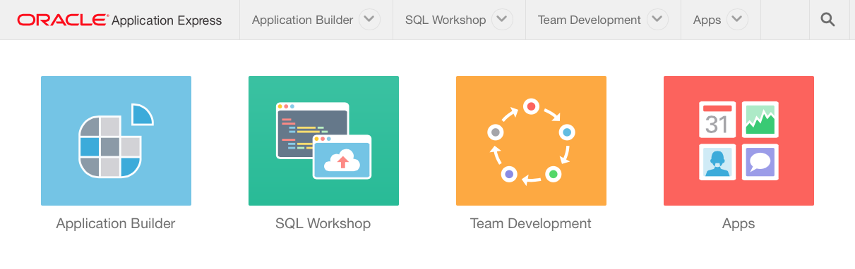
Oracle Application Express
Database-centric development tool for Oracle Database application development
Targeted at Web-based developers who know SQL and PL/SQL
Develop Desktop and Mobile applications
100% Browser-based Development and Runtime
Declarative framework for rapid application definition, and full application life cycle.
On premise, on laptop, on cloud, on RAC, any platform Oracle DB is available
Notes:
You do not need any client software – simply a web browser and URL to access development environment and to run applications

Slide 7
History
Also known as Oracle APEX (a'peks)
HTML DB 1.5
First Release
HTML DB 1.6
UI Themes
APEX 2.1
Oracle XE
APEX 2.2
Supporting DB Objects for full app installation and upgrade
APEX 3.1
Interactive Reports
APEX 4.0
Websheets
Dynamic Actions
Plug-Ins
Team Development
APEX 4.2
Mobile
HTML5
Packaged Apps
APEX 4.2 Dot Releases
Improved Packaged Apps
4.2.1
4.2.2, 3, 4
4.2.5
2004
2005
2006
2007
2008
2009
2010
2011
2012
2013
2014 / 5
HTML DB 2.0
SQL Workshop
APEX 3.0
Flash Charts
PDF Printing
Access Migration
APEX 3.2
Oracle Forms to APEX Conversion
APEX 4.1
Data Upload
Error Handling
ROWID
Application Express 5.0*
Universal Theme
Page Designer
UI Modernization
HTML5 Plugins
Development initiated August 1999
*Available in Early Adopter Only (apexea.oracle.com)
Notes:
Generally release a new version of APEX annually
* Next release will be APEX 5.0 – See Statement of Direction for more details
[http://www.oracle.com/technetwork/developer-tools/apex/application-express/apex-sod-087560.html]

Slide 8

Fully supported no-cost feature of the Oracle Database
Supported as a no-cost feature of the Oracle Database
  No cost feature of database 10gR2 (10.2.0.4 +), 11gR1, 11gR2, 12c
  Any number of developers, applications, any number of end-users
  Specialized Oracle Support Team – Included with Database Maintenance Agreement
  All database editions: EE, SE, SE1, XE
  Exadata, ODA, RAC, Partitioning, Compression, InMemory, Multitenant…
Distribution
  Distributed with all editions of Oracle database 11g and 12c
  Available as a download from OTN
Oracle Cloud Services
  “Oracle Database Cloud Service” aka schema since October 2012.
  Sold as a fully managed service with 1GB free trial, and 5, 20, 50 GB paid services.
  Available as “development only” customer evaluation service on http://apex.oracle.com

Slide 9
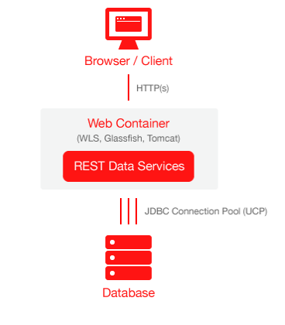
Architecture
Simple 2-Tier Architecture
Mid tier = Oracle REST Data Services
    Directs calls to APEX Apps to the APEX run-time engine
    Accepts RESTful Web Service call URIs and directs them to the appropriate SQL statement or PL/SQL block
    Recommended mid tier for Oracle APEX.
    Can also use Embedded PL/SQL Gateway (EPG)
    and Oracle HTTP Server (OHS).
Application Meta Data stored in the Oracle DB
    Oracle Application Express is written largely in PL/SQL
    Pages dynamically rendered using database metadata
    No code generation or file based compilation
(Proxies client requests to APEX engine in DB)
Notes:
Simple architecture where browser goes through web listener to database – Web listener only used to pipe requests and send responses; no business logic
Each page request or submission dynamically reads metadata for the page, performs the necessary query or processing and returns the results.
As soon as you update the metadata can run immediately as no need to perform any code generation or file compilation

Slide 10
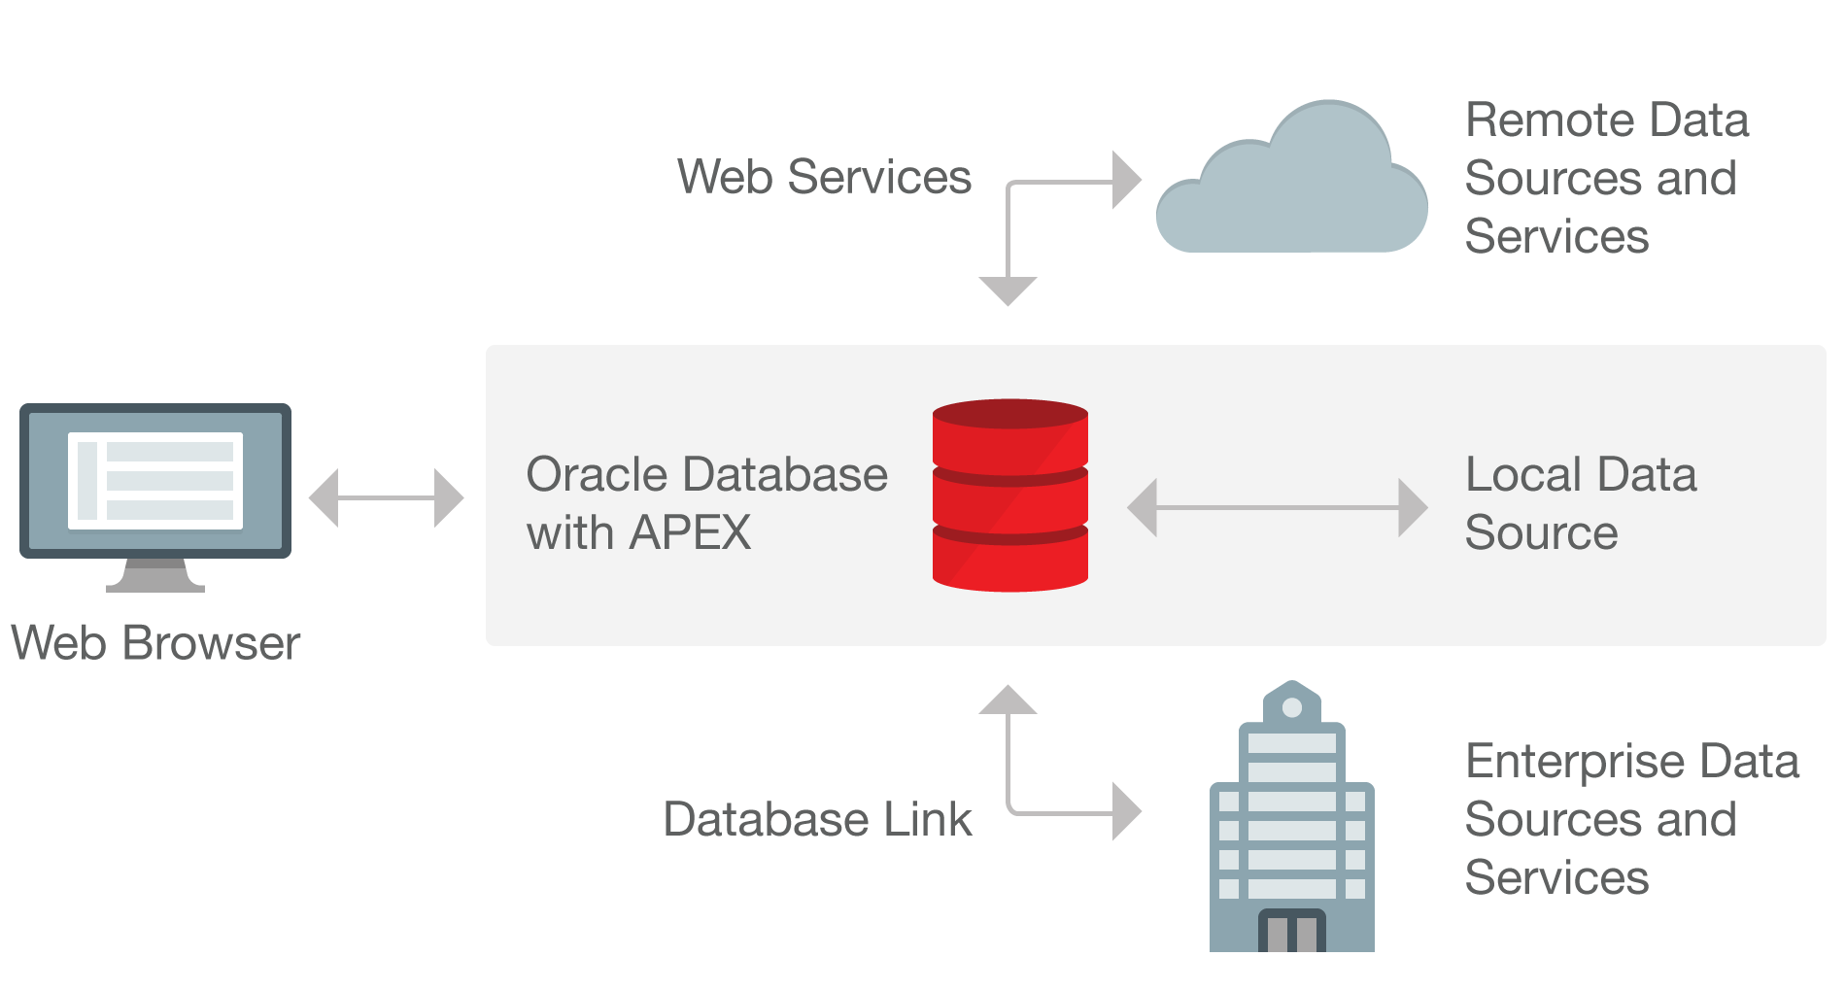
Data Sources
Utilize the Oracle Database / Web Services
Notes:
Application Express is best suited being co-located with the data it is maintaining
Can also integrate into a SOA environment using Web Services or utilize DB Links to other Oracle databases

Slide 11
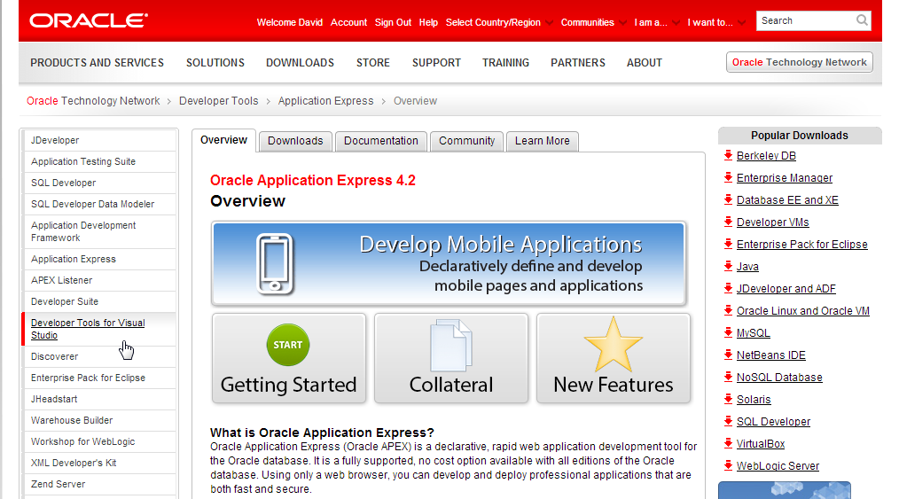
Collateral
Oracle Technology Network → http://otn.oracle.com/apex
Notes:
APEX OTN Site is rigorously maintained and has an extensive array of information
Increasing number of Case Studies and other general information like Getting Started page
Collateral includes technical information, white papers, videos, and presentations
Deployment has details on installation, upgrades, deploying applications, UI, security and performance
Download Tab has the latest APEX version, Known Issues, etc
Community Tab lists consulting companies, commercial applications, public websites, hosting companies and community articles

Slide 12
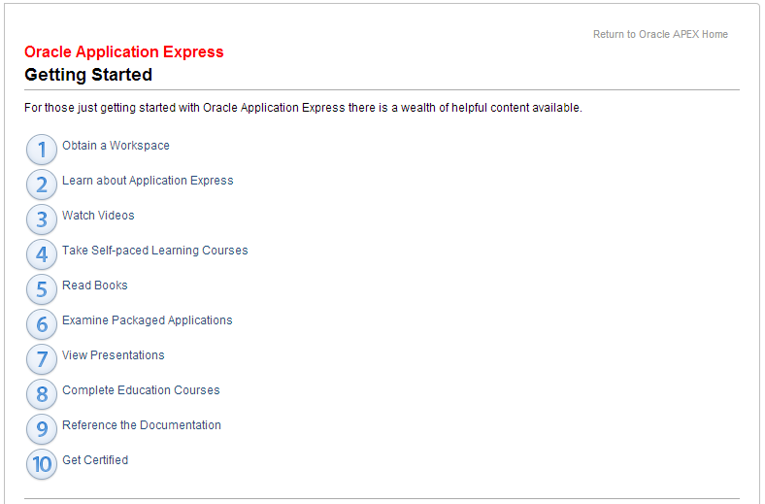

Collateral – Getting Started
Oracle Technology Network → http://otn.oracle.com/apex
Notes:
APEX OTN Site is rigorously maintained and has an extensive array of information
Increasing number of Case Studies and other general information like Getting Started page
Collateral includes technical information, white papers, videos, and presentations
Deployment has details on installation, upgrades, deploying applications, UI, security and performance
Download Tab has the latest APEX version, Known Issues, etc
Community Tab lists consulting companies, commercial applications, public websites, hosting companies and community articles

Slide 13
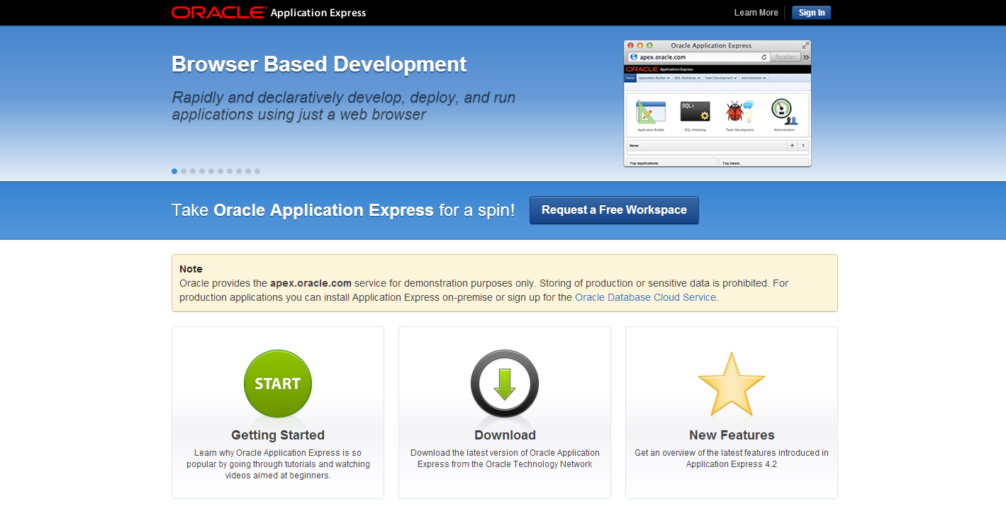
Hosted Service
Free for “Development Only” → http://apex.oracle.com
Notes:
Apex.oracle.com is a free “Development Only” service.
Service has been running for over 10 years allowing developers to “kick the tires” with the latest version of APEX
Over 15,000 workspaces and > 6 million page views / week
Sign-up for an account to be able to start playing with APEX in minutes

Slide 14
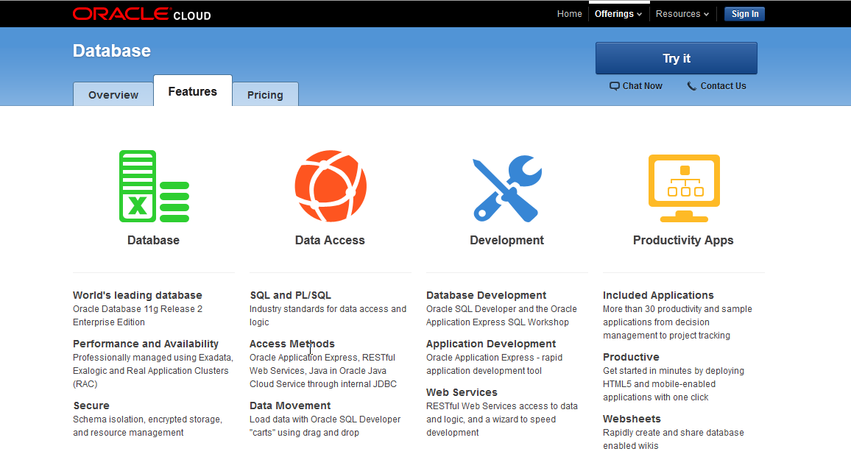
Hosted Service
Oracle Database Cloud Service → http://cloud.oracle.com
Notes:
When you sign up for Oracle Database Cloud Service you get a slice of an Oracle Database.
The development tool of choice for the Oracle Database Cloud Service is Oracle Application Express.
In fact when you log into the service you are presented with the Application Express Builder.

Slide 15
Pseudo Demo Flow: Building and deploying an Application
Oracle Application Express

Slide 16
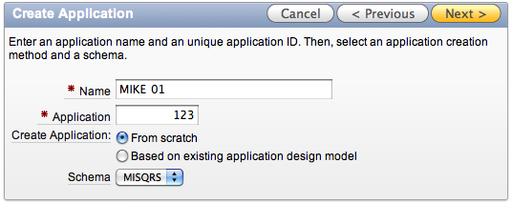
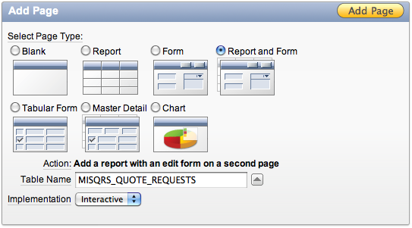
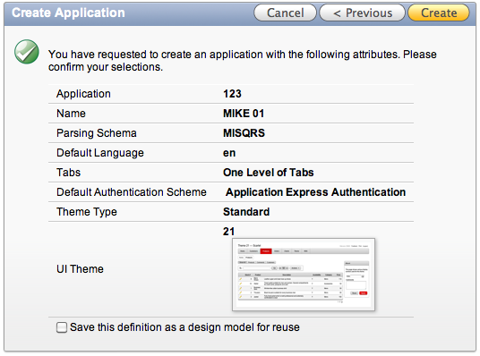
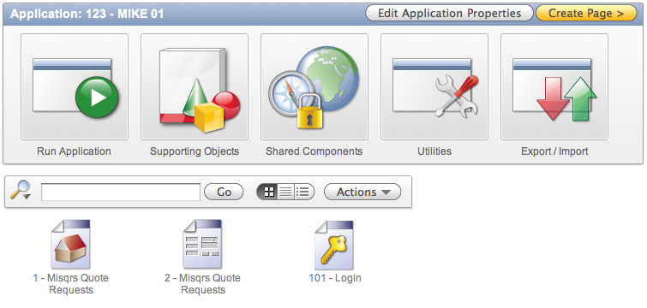
Building Applications
Application Builder → Build Application Wizard
1. Initiate Create App Wizard
2. Add Pages
Create a report and form on a table
3. Confirm and Create
4. Run the Application

Slide 17
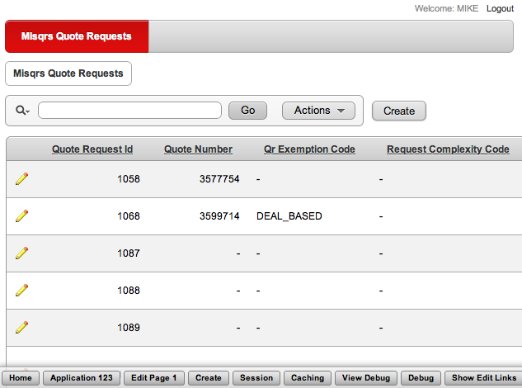
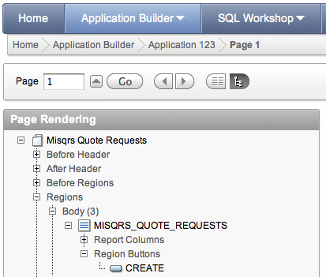
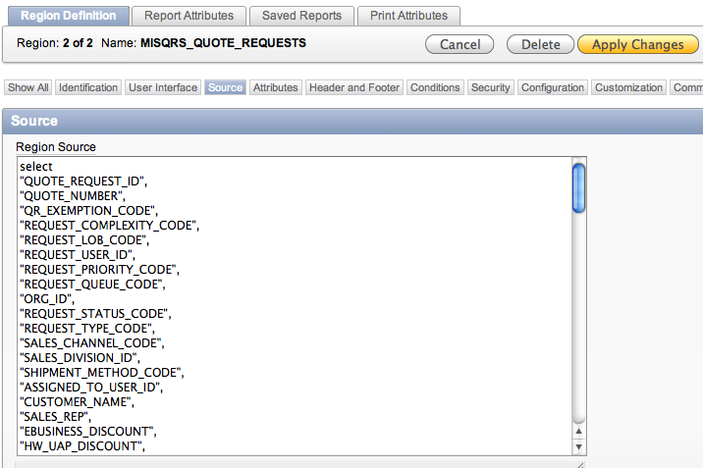
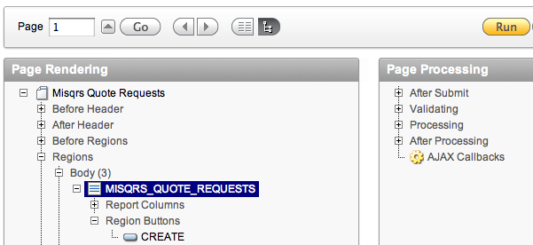
Building Applications – Editing an Application
Iterate from Runtime → Development → Runtime → Repeat
1. From Runtime click ‘Edit Page x’
2. Select page component
3. Edit component, click ‘Apply Changes’
4. Click ‘Run’ to view changes

Slide 18
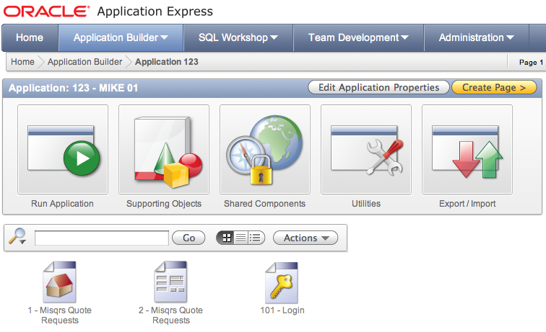




Building Applications – Deploying an Application
Very easy to deploy to Test / Production once development complete
1. Export Application
2. Export generates a SQL Script
4. DBA Runs Script in Production
3. Provide File to DBA
@f123.sql

Slide 19
Extending Oracle E-Business Suite Release 12 using Oracle Application Express
Oracle Application Express

Slide 20
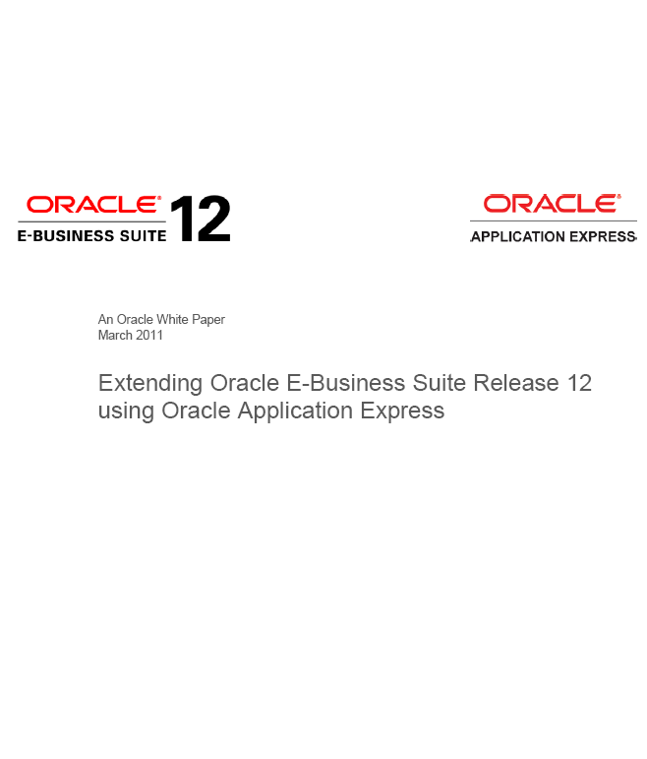
Oracle White Paper
Outlines best practices for developing fully supported E-Business Suite R12 Extensions
Provides certified / supported architecture
Includes detailed steps for configuration, integration and security
Downloadable sample application and code
Collaboration between Oracle E-Business Suite and Oracle Application Express development teams
OTN: http://www.oracle.com/technetwork/developer-tools/apex/learnmore/apex-ebs-extension-white-paper-345780.pdf
Oracle Support Link: https://metalink.oracle.com/metalink/plsql/showdoc?db=NOT&id=1306563.1

Slide 21
Use Cases
Custom Application Development
  Real time queries on EBS, with option to update EBS data using APIs
  Deliver net new business functionality (not covered by EBS)
  Additional reporting and analysis
  Custom data collection / workflows
  Personalization of complex EBS workflows
  Modernization of custom Oracle Forms applications
Customization of Existing EBS Pages and Process Flows
  Oracle APEX is NOT capable of supporting this use case

Slide 22


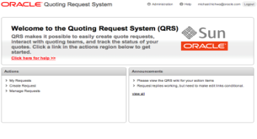
Certified Middle-Tier Configuration – Release 12.1
Web Browser
Middle Tier
Database Tier
Application Server
Oracle Database Server
Oracle E-Business Suite
Oracle Application Express
Oracle HTTP Server
Oracle WebLogic
Server*
Oracle REST
Data Services
EBS Requests
APEX Requests
* Oracle Glassfish Server or Apache Tomcat can be substituted for Oracle WebLogic Server

Slide 23
Alternate Middle-Tier Configuration – Release 12.1
Web Browser
Middle Tier
Database Tier
Application Server
Oracle Database Server
Oracle E-Business Suite
Oracle Application Express
Oracle HTTP
Server
Application Server
Oracle WebLogic
Server*
EBS Requests
APEX Requests
Oracle REST
Data Services
* Oracle Glassfish Server or Apache Tomcat can be substituted for Oracle WebLogic Server

Slide 24
Certified Middle-Tier Configuration – Release 12.2
Web Browser
Middle Tier
Database Tier
Application Server
Oracle Database Server
Oracle E-Business Suite
Oracle Application Express
Oracle WebLogic
Server
Application Server
Oracle WebLogic
Server*
EBS Requests
APEX Requests
Oracle REST
Data Services
* Oracle Glassfish Server or Apache Tomcat can be substituted for Oracle WebLogic Server

Slide 25

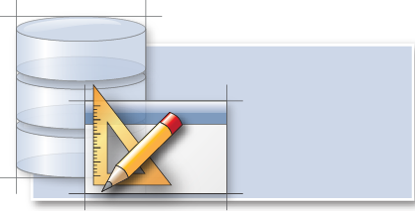

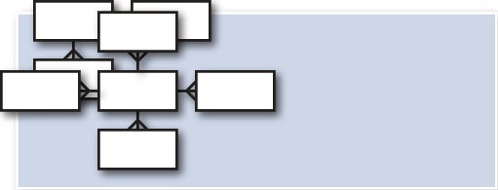

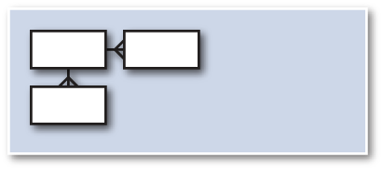

Certified Database Configuration
Oracle E-Business Suite Database
APEX Application
APEX_040200 Schema
APEX
Engine
APPS Schema
Grant Select
APEX_EBS_EXTENSION Schema
APEX Workspace
Standard published EBS APIs
Notes:
Applications are installed into APEX Workspaces
APEX Workspaces provide access to one or more database schemas
Application obtains rights and privileges of the workspace schema

Slide 26
Alternate Database Configuration
Local Database
APEX Application
APEX_EBS_LOCAL Schema
APEX_040200 Schema
APEX
Engine
APEX Workspace
APEX_EBS_DBLINK Database Link
Oracle E-Business Suite Database
Grant Select
APPS Schema
APEX_EBS_EXTENSION Schema
Standard published EBS APIs
Notes:
Applications are installed into APEX Workspaces
APEX Workspaces provide access to one or more database schemas
Application obtains rights and privileges of the workspace schema

Slide 27
Development Considerations
APEX development performed on development instance of EBS
Not using APPS schema allows applications to run with least privilege
Privileges on APPS tables selectively granted to APEX DB schema
Look and feel can mimic EBS or use a different user interface theme
EBS Menus can be used to provide links to APEX Applications
APEX Authentication can use EBS authentication (SSO, OAM, Custom)
APEX Authorization Schemes can enforce EBS roles and responsibilities
Both SOAP and RESTful web services can be used within applications
EBS and/or APEX can be patched without impacting the other tool

Slide 28
Deployment Considerations
Deployment is performed connected to APEX schema, not APPS
Deployment or patching of APEX applications performed using
SQL*Plus script(s)
Database resource manager can constrain APEX resource consumption
SQL within applications is run as the APEX user
APEX client info is set for each session, with application and page details
DBAs can correlate slow SQL, based on the APEX client info, to a SQL statement defined in a specific APEX application and page
Monitoring of APEX can be done using Oracle Enterprise Manager

Slide 29
Comparing Application Express and Other Oracle Products
Oracle BI Publisher
BI publisher is a reporting engine <> Oracle APEX is an application development tool
Oracle APEX uses BI Publisher to produce rich PDF output
OBIEE
OBIEE is query only <> Oracle APEX allows insert, update, delete
OBIEE supports many databases <> APEX supports only Oracle
Oracle APEX is frequently used to add update capabilities alongside OBIEE applications
Application Development Framework (ADF) and Mobile Application Framework (MAF)
All are designed to build modern HTML Web Applications
All can be used to build desktop and mobile applications
Oracle APEX is the primary tool for SQL professionals <> ADF is the primary tool for Java professionals
Oracle Forms
Both are declarative, and leverage developers’ SQL and PL/SQL skills
Oracle APEX runs Native HTML Web Applications <> Forms uses Java Applets to run on the Web
Oracle APEX is often used to redevelop legacy Oracle Forms applications

Slide 30
Example Integrations
Oracle Application Express

Slide 31
Oracle’s E-Business Suite GSI [Internal Only – Intranet App]
Extending our internal deployment used to run Oracle business
Oracle’s E-Business Suite Global Single Instance (GSI) is used by the
whole organization, in every region
Extensions are built against GSI with Oracle Application Express
to meet Oracle’s own business requirements
Special approvals need to be requested in order to modify GSI in any way other than by using Oracle Application Express extensions
Specifications for generally applicable requirements are then sent back to E-Business Suite Development Team based on the relevant Application Express extension

Slide 32
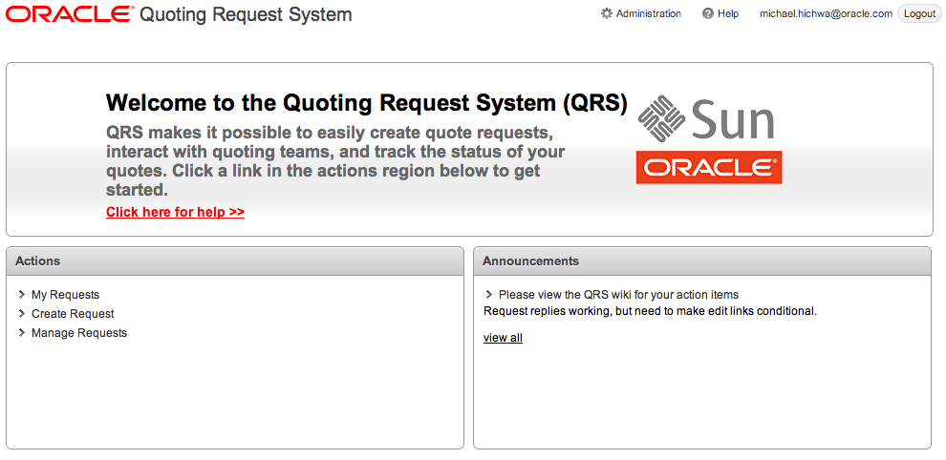
Quote Request System (QRS) [Internal Only – Intranet App]
Stand-alone application integrated with E-Business Suite
Integrated with Oracle’s E-Business Suite Global Single Instance (GSI)
APEX authentication tied to EBS roles and responsibilities

Slide 33
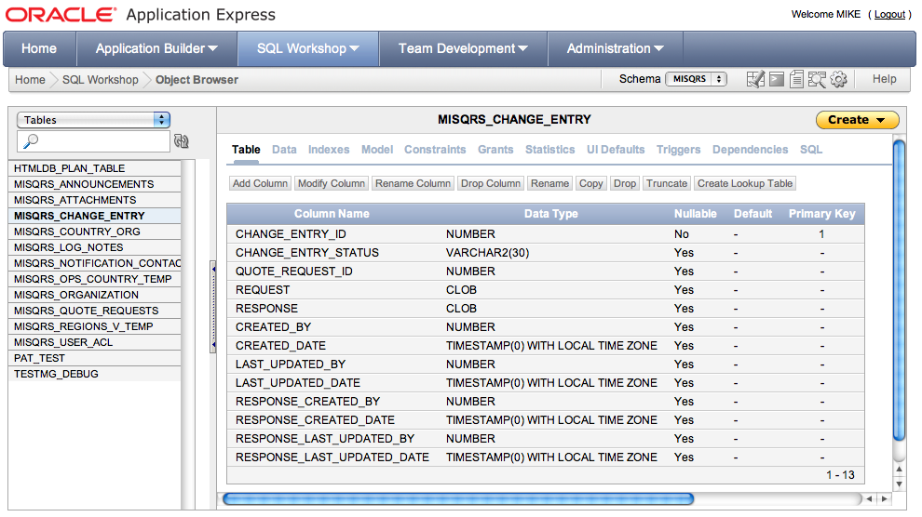
Quote Request System (QRS)
Non-EBS (local) database objects used by QRS are maintained by
APEX Developers, outside of EBS database objects

Slide 34
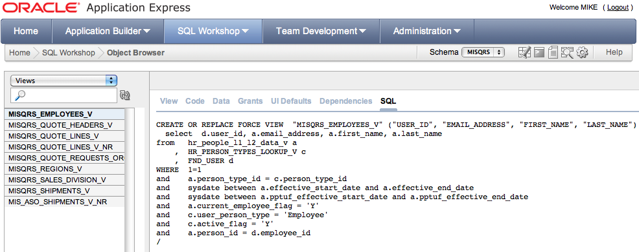
Quote Request System (QRS)
Local database views reference APPS tables
APEX Developers only see what the MISQRS schema has been granted
- Not all EBS database objects, or even all columns within an APPS table

Slide 35
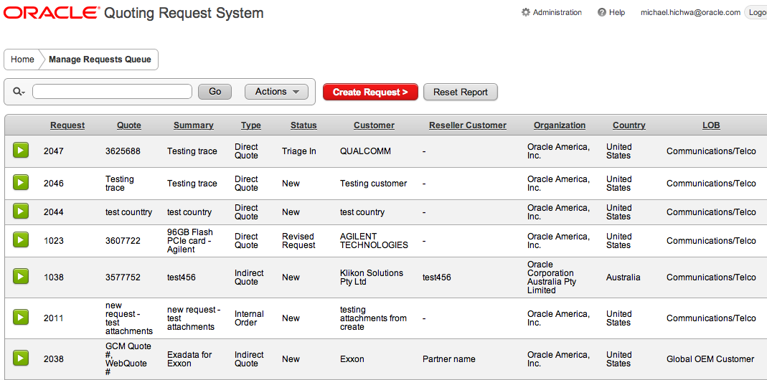
Quote Request System (QRS)
Data can readily be retrieved from both local APEX tables and EBS tables

Slide 36
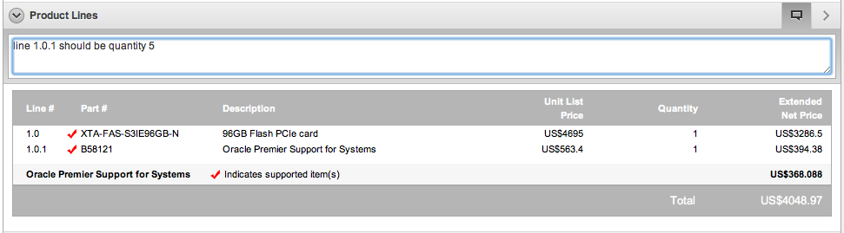
Quote Request System (QRS)
Details of quote pulled directly from EBS Quoting
Page allows comments to be placed by Sales to Quoters
Change requests and quote responses all stored in local APEX tables
Quote updates sent back to GSI via EBS APIs

Slide 37
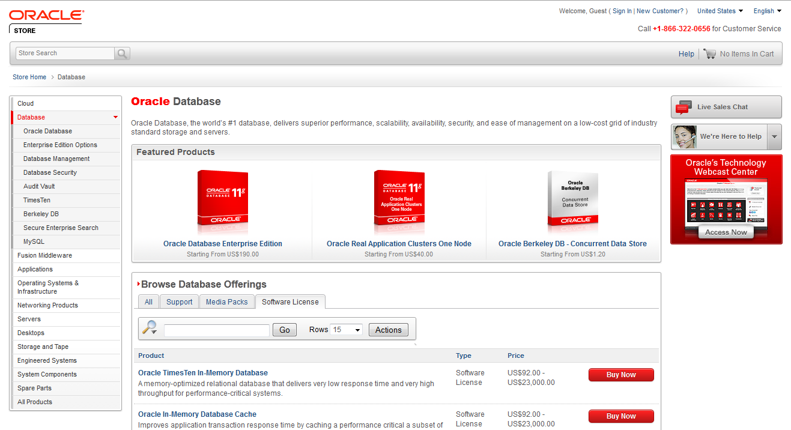
Oracle Store [Internet Application]
http://shop.oracle.com
Notes:
The Oracle Store and Partner Store [http://partner.oracle.com] are two great examples of APEX applications running on the Internet.
The Oracle Store handles orders for over 150 countries and can be shown in 13 languages.
When you choose a country different business rules are invoked within the ordering process.
The APEX application interfaces with over 12 major back-office systems such as Manufacturing & Distribution, Marketing, EBS, etc.

Slide 38
Oracle Store [Internet Application]
http://shop.oracle.com
Used by the public to order Oracle products
Integrates with
> 12 back-end systems
Multi-lingual
Different business logic for each country
Notes:
The Oracle Store and Partner Store [http://partner.oracle.com] are two great examples of APEX applications running on the Internet.
The Oracle Store handles orders for over 150 countries and can be shown in 13 languages.
When you choose a country different business rules are invoked within the ordering process.
The APEX application interfaces with over 12 major back-office systems such as Manufacturing & Distribution, Marketing, EBS, etc.

Slide 39
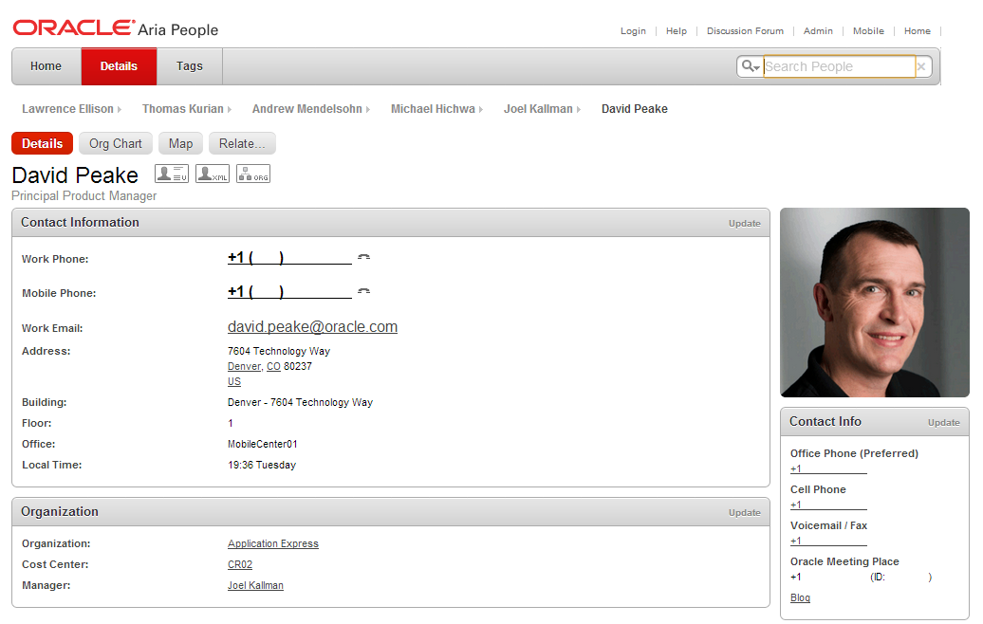
HR Directory [Internal Only – Intranet Application]
ARIA People
Nightly download of HR data
Employees can update profile, upload picture, add links ...
Used to contact employees, see Org. Chart, etc.
Average ~ 1.5 million
page views / day
Average 40,000 distinct IPs
Median execution time of
0.05 seconds
Notes:
The Oracle Learning Library provides a wealth of training collateral for Oracle customers.
The application includes an extensive set of administrative screens to allow content owners to upload and maintain various types of content and links.

Slide 40

Customer Reference
United States Army
EBS Extension
Extended E-Business Suite 11i
Migrated to E-Business Suite R12.1
EBS Responsibilities tied to Army Rank
APEX Extension completes complex assignment by selecting Rank rather than manually maintaining responsibilities.

Slide 41

Customer Reference
Farwest Steel
EBS Extension
Extended E-Business Suite (EBS)
Stand-alone application for quoting and order entry of complex engineer-to-order assemblies
Salesmen log into APEX not EBS
Tightly integrated with EBS for BOM, routings, workorders, invoicing, and security

Slide 42


