Slide 2

Oracle Application Express 5
New Features
<Name>
<Title>
<Organization>
<Date>

Slide 3
Notes:
This is a Safe Harbor Front slide, one of two Safe Harbor Statement slides included in this template.
One of the Safe Harbor slides must be used if your presentation covers material affected by Oracle’s Revenue Recognition Policy
To learn more about this policy, e-mail: Revrec-americasiebc_us@oracle.com
For internal communication, Safe Harbor Statements are not required. However, there is an applicable disclaimer (Exhibit E) that should be used, found in the Oracle Revenue Recognition Policy for Future Product Communications. Copy and paste this link into a web browser, to find out more information.
http://my.oracle.com/site/fin/gfo/GlobalProcesses/cnt452504.pdf
For all external communications such as press release, roadmaps, PowerPoint presentations, Safe Harbor Statements are required. You can refer to the link mentioned above to find out additional information/disclaimers required depending on your audience.

Slide 4
Agenda
1
Oracle Application Express Overview
Page Designer
User Interface and Universal Theme
Mobile Enhancements
Functional Improvements
Security Enhancements
2
3
4
5
6

Slide 5
1
Oracle Application Express Overview
Page Designer
User Interface and Universal Theme
Mobile Enhancements
Functional Improvements
Security Enhancements
2
3
4
5
6

Slide 6



Oracle Application Express
Database-centric web application development framework
Develop desktop and mobile web apps
Visualize and maintain
database data
Leverage SQL Skills and database capabilities
Notes:
Used to build desktop and mobile applications for the Oracle Database.
Quickly build reports, forms, charts, calendars, etc. on top of the data in your database
IT Developers and “citizen-developers” who know a little SQL can readily build applications.
Application Express can also take advantage of the large majority of Oracle Database features.

Slide 7

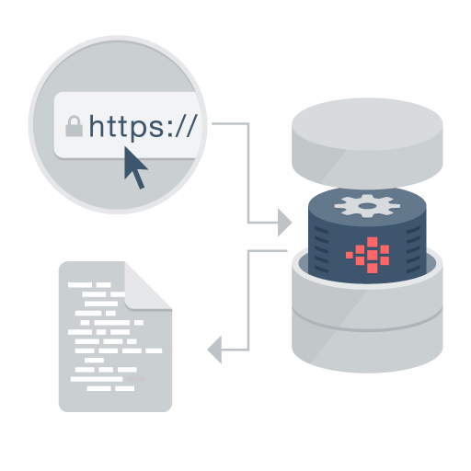

Oracle Application Express
Distinguishing Characteristics
Page generation is efficient with only one request and one response.
Data processing done in the Database
App Development IDE is a web browser. No client software needed
App definitions are stored in the database as meta data.
Declarative – No code generation
Notes:
Simply use a web browser and the URL to access the development environment, or the URL and user credentials to run the application
You don’t need any client software
Declarative framework stores application definitions in Oracle database tables within the APEX Engine
No need for file-based compilation or code generation
All of the data (page) processing is performed by PL/SQL acting directly on the data schemas in the Oracle Database.
Therefore, very efficient as data manipulated directly in the database and results sent back as HTML pages

Slide 8




Oracle Application Express
Develop faster, release more frequently
Go from prototype to production in minutes
Develop
Customize
Deliver
Notes:
At the core of Application Express is an engine that provides a variety of fundamental application capabilities and operations. Application authentication, page/object-level access control, database interaction (queries/updates etc), form validation, session management and protection, and more is available as standard components that can be utilised from every application without custom development.
Application objects such as forms, reports, charts, navigation etc are defined declaratively, enabling applications to be functionally complete in a short period of time, increasing agility in application development.

Slide 9


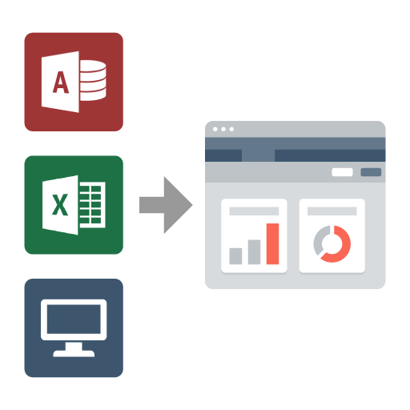
Oracle Application Express
Use Cases
Developing opportunistic & self service web apps
Extending enterprise application solutions
Migrating file based and client server apps to the web
Notes:
Widely used to rapidly build applications that are needed ASAP to meet changing business requirements and maximize competitive advantage.
Primarily designed to be used by all employees / partners / customers rather than back-office systems.
Used for extending COTS Software to streamline for your business processes or meet organization specific requirements
Webify spreadsheets and MS Access applications to provide true multi-user, secure, robust, “single-source of truth” applications.
Also commonly used to modernizing old legacy client-server applications

Slide 10

Oracle Application Express
No cost feature of the Oracle Database
No-cost fully supported feature
Any number of developers, apps, & end-users
Specialized Oracle Support Team
11gR1, 11gR2, 12c
All DB editions: EE, SE, SE1, XE
Included with Oracle Cloud Services
Schema and PDB services 5, 20, 50 GB
Dedicated DBaaS services
No cost evaluation http://apex.oracle.com
Easy to install
Included by default with all editions of Oracle database
Download latest release from http://otn.oracle.com/apex
Notes:
Oracle Application Express is a feature of the Oracle Database with no licensing costs for development or deployment of Application Express applications.
The Oracle Database Maintenance Agreement also covers support for Application Express.
When you sign up for the ODCS – Schema Service you are provided with a slice of the Oracle Database with Application Express as the development environment (already pre-configured and ready to start developing with)
Application Express is released more frequently than the Oracle DB so important to get the latest version of Oracle Application Express from OTN.

Slide 11
History
Also known as Oracle APEX (āʹpěks)
HTML DB 1.5
First Release
HTML DB 1.6
Themes
APEX 2.1
Oracle XE
APEX 2.2
Packaged Applications
APEX 3.1
Interactive Reports
APEX 4.0
Websheets
Dynamic Actions
Plug-Ins
Team Development
APEX 4.2.x
Mobile
HTML5
Packaged Apps
2004
2005
2006
2007
2008
2009
2010
2011
2012-14
2015
HTML DB 2.0
SQL Workshop
APEX 3.0
Flash Charts
PDF Printing
Access Migration
APEX 3.2
Oracle Forms to APEX Conversion
APEX 4.1
Data Upload
Error Handling
ROWID
APEX 5.0
Page Designer
Universal Theme
Modal Dialogs
Notes:
Originally named HTML DB when first released over 10 years ago.
Application Express is released approximately once a year.
See Statement of Direction for future direction on OTN under Learn More
[http://www.oracle.com/technetwork/developer-tools/apex/application-express/apex-sod-087560.html]

Slide 12





Oracle Application Express
3 Tier Architecture
Apache
OHS
ORDS
Schemas
Oracle APEX
Web Logic Server
WLS
Oracle
Database
Browser
Mid Tier
Database Tier
Notes:
Simple architecture where page requests and submissions made from the browser are tunnelled through the mid-tier to execute in the Oracle Database and returned as HTML responses to the browser.
No data manipulation or processing is performed in the mid-tier, instead the APEX engine (inside the Oracle DB) accepts the page, and interacts with the data schemas in the DB.
The mid-tier can be either the preferred Oracle REST Data Services (ORDS) running in a Java Server {either Oracle Web-Logic Server (WLS), Oracle Glassfish, or Tomcat} or Oracle Embedded PL/SQL Gateway (EPG) which is part of the Oracle DB, or Oracle HTTP Server (OHS) with mod_plsql.
It is common for OHS to be installed in front of ORDS to act as a proxy and serve images.

Slide 13

Oracle Application Express (APEX 5)
#ORCLAPEX
Development Community; Very involved, enthusiastic worldwide community
~ 400,000 developers Based on developer downloads, support tickets, check for updates data
Consulting companies, hosting companies, books, applications, success stories and quotes: http://apex.oracle.com/community
75+ active bloggers: http://www.odtug.com/apex
Very active Forum: https://community.oracle.com/community/database/developer-tools/application_express
Notes:
There are a large number of consulting companies, and bloggers around the world.
APEX has one of the most active OTN Forums where you can get your questions answered.

Slide 14




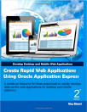




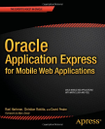
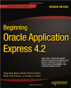






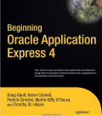
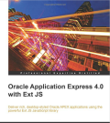
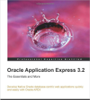
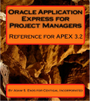


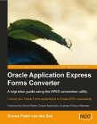

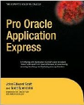
Books
Notes:
The number of books on APEX is impressive for a single Oracle tool
This number continues to grow with several new books in the pipeline for APEX 5

Slide 15
Useful Links
Collateral, Resources and Hosted Services
Oracle Technology Network http://otn.oracle.com/apex
APEX Community http://apex.oracle.com/community
Oracle Learning Library http://www.oracle.com/oll
Hosted evaluation site http://apex.oracle.com
APEX Cloud Service http://cloud.oracle.com
Notes:
These are the primary URLs you need to get more information on Oracle Application Express!

Slide 16
Agenda
1
Oracle Application Express Overview
Page Designer
User Interface and Universal Theme
Mobile Enhancements
Functional Improvements
Security Enhancements
2
3
4
5
6

Slide 17
Page Designer
Powerful browser-based IDE
Multiple trees to view the page components
Visualization of the page within the Grid Layout, and associated Gallery, allowing you to drag and drop components
Update multiple attributes without leaving the page in the Property Editor
Highly configurable user interface:
Customize and refine view of page specific to current focus
Slideable panels
Hide / show groupings
Notes:
Page Designer revolutionizes the way developers can enhance and maintain page definitions within Application Express.
The left panes has numerous trees to show the rendering, dynamic actions, processes and shared components.
The middle pane includes the Grid Layout and Gallery where you can easily drag and drop new components
The right pane holds the Property Editor where you can update any of the select4ed components’ attributes, without needing to bring up a separate page
For text sections used to enter SQL, HTML, CSS or text you can pop-up the Code Editor which includes find/replace, auto-completion and even SQL validation
There are numerous ways you can customize the user interface to make it easier to concentrate on the sections you are currently working on.

Slide 18
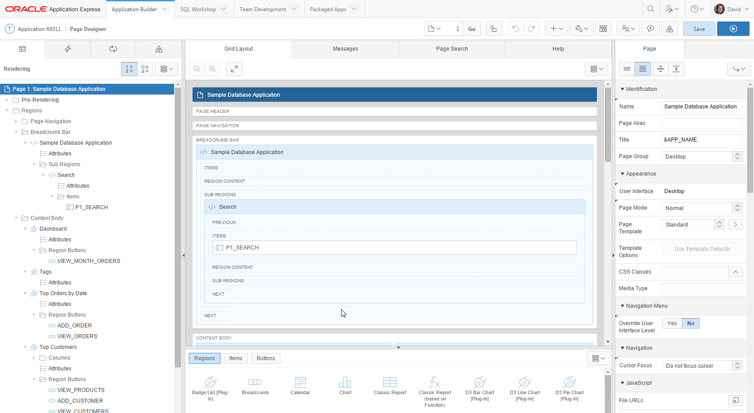
Notes:
Design Principles
Create new elements using drag & drop or menu shortcuts
Update multiple page elements at once
Utilize “Undo” and “Redo” to revert changes made
“Save” and “Run” commits all pending changes to database
Left Panel
Rendering, Processing and Shared Components grouped in an accordion in the left panel instead of horizontally across the page
Dynamic Actions introduced as a new grouping
Create, move and duplicate elements using drag & drop or the improved context sensitive menus
All element types can be deleted directly from the tree
Click on one or more elements to highlight elements in the Grid Layout and to populate common element details in the Property Editor
Central Panel
Grid Layout: Create, move, copy and delete components using drag and drop
Gallery: shows components that can be dragged into the page
Messages: Display errors and warnings associated with changes made
Page Search: Allows performing a page search.
Help: Displays context sensitive help based on the current focus
Property Editor - Right Panel
Displays the details for the currently selected element(s)
Bulk editing of common properties when multiple elements are selected
Improved usability for defining properties, including
instant input feedback
cascading context sensitive selections
easier definition of common property types
Improves productivity by making the definition of elements easier and more intuitive

Slide 19
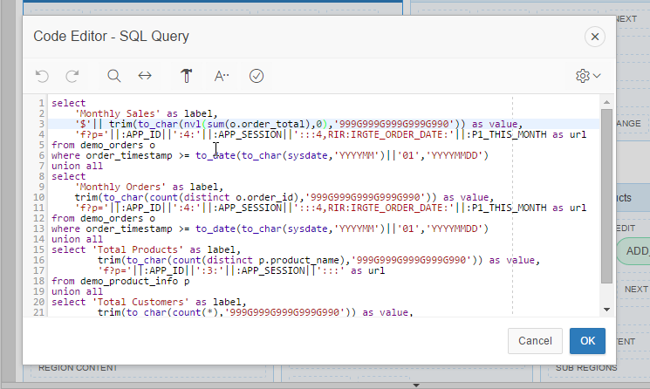
Code Editor
Available for maintaining SQL, PL/SQL, JavaScript, HTML, CSS, and large text sections
Syntax Highlighting
Undo / Redo
Find/Replace
Auto completion
Code validation
Used in Page Designer, Component View and SQL Workshop
Notes:
The Code Editor provides many of the features of advanced editors, such as syntax highlighting, undo and redo, and find / replace functions.
However it also includes ‘auto completion’ and ‘code validation’, which obtain valid database object names from the data dictionary of your underlying schema(s).

Slide 20
Agenda
1
Oracle Application Express Overview
Page Designer
User Interface and Universal Theme
Mobile Enhancements
Functional Improvements
Security Enhancements
2
3
4
5
6

Slide 21

Redesigned APEX User Interface
Modern HTML5 UI
Complete redesign of APEX UI templates, using HTML5 and grid layout
New artwork – replacing CSS sprites with SVG based vector graphics
Using icon fonts for most smaller icons in Page Designer, menu bars and buttons

Slide 22

Universal Theme
Overview
New default theme for APEX applications
Uses responsive HTML5 templates
Grid-layout for HTML forms
Modern flat-look
Ships with a variety of pre-built theme styles
Older themes still available as legacy themes, and will remain part of the product for backwards compatibility
Notes:
Rather than having numerous themes with a large number of templates in each, there is just a single desktop theme and a consolidated number of templates.
With the Universal Theme it is now quicker and easier to build beautiful, responsive, elegant applications out-of-the-box.

Slide 23

Universal Theme
Template Options
Declarative CSS modifiers for HTML5 templates
Enables developers to declaratively apply styles like borders, padding, icons, colors, size, etc.
Uses easy-to-understand, descriptive names
Available for most template types:
Page, Region, Report, Breadcrumb, List, Item, Button
Significantly reduces the number of required templates for a theme
Notes:
Rather than having a large array of different templates, and developers needing to define new templates, to meet how a page is displayed - now you can declaratively select different template options to easily meet your layout requirements.

Slide 24
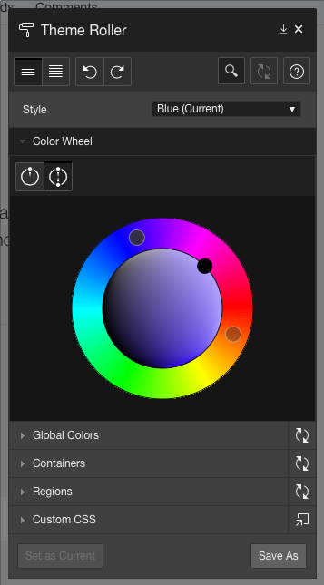
Universal Theme
Theme Styles and Theme Roller
Theme Styles provide a variety of different color schemes and styles for a single theme
Defined as CSS file that is included in addition to the theme’s base CSS file
Universal Theme includes several pre-built styles
Additional styles can be easily generated using the built-in Theme Roller utility
Notes:
Theme Styles allow a single theme to have various color schemes.
Developers can readily define different color schemes and modify certain display characteristics, such as button and item rounding using Theme Roller.
Hey can then readily save the style and apply it to their application without needing to write any CSS.
Developers can even allow end-users to select different styles as shown in P-Track Administration.

Slide 25
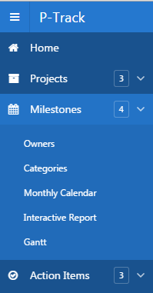
Universal Theme
List-based navigation
Alternative to using traditional tabs
Available as top navigation menu and side menu
Implemented as standard APEX lists
Supports multi-level hierarchical menu structures
Provides accessible pull-down menus
Type of navigation determined by themes – Universal Theme uses lists
Migration of older one-level tabs to lists when switching themes
Notes:
APEX 5 introduces the ability to define Navigation Lists
Multi level drop-down menus can be based on either static or dynamic lists.

Slide 26
Universal Theme
Theme subscriptions
Extends existing templates subscription model
Subscribes all templates and template options to a master theme
Templates are read-only in subscribing themes
Templates can be copied within a theme – local copies are editable
When creating new applications, themes are subscribed to the base theme by default
Ensures upgradeability of included base-themes in the future

Slide 27
Agenda
1
Oracle Application Express Overview
Page Designer
User Interface and Universal Theme
Mobile Enhancements
Functional Improvements
Security Enhancements
2
3
4
5
6

Slide 28

Mobile Development
Rapidly build Web-based Mobile Applications
Declarative support for building mobile web applications
APEX Applications support multiple user interfaces: Desktop and Smartphone; Desktop only; or just Mobile
Mobile pages use jQuery Mobile through a jQuery Mobile based theme and templates
Mobile Pages are lighter weight than Desktop Pages
Can respond to touch-based events
HTML5 charts and HTML5 item types
Notes:
Developers can build mobile Web-based applications just as easily as they can build Desktop applications from the Application Builder.
A single application can support both Desktop and Mobile user interfaces.
The jQUery Mobile framework allows APEX applications to run on any mobile browser and any size form factor
While desktop pages can be run on a mobile device the user experience is not optimal.
Desktop pages are generally much heavier (= takes longer to load) and do not respond to touch events like tap , swipe and orientation changes
The Mobile UI includes numerous special HTML5 components such as Lists, reports, and even item sub-types

Slide 29
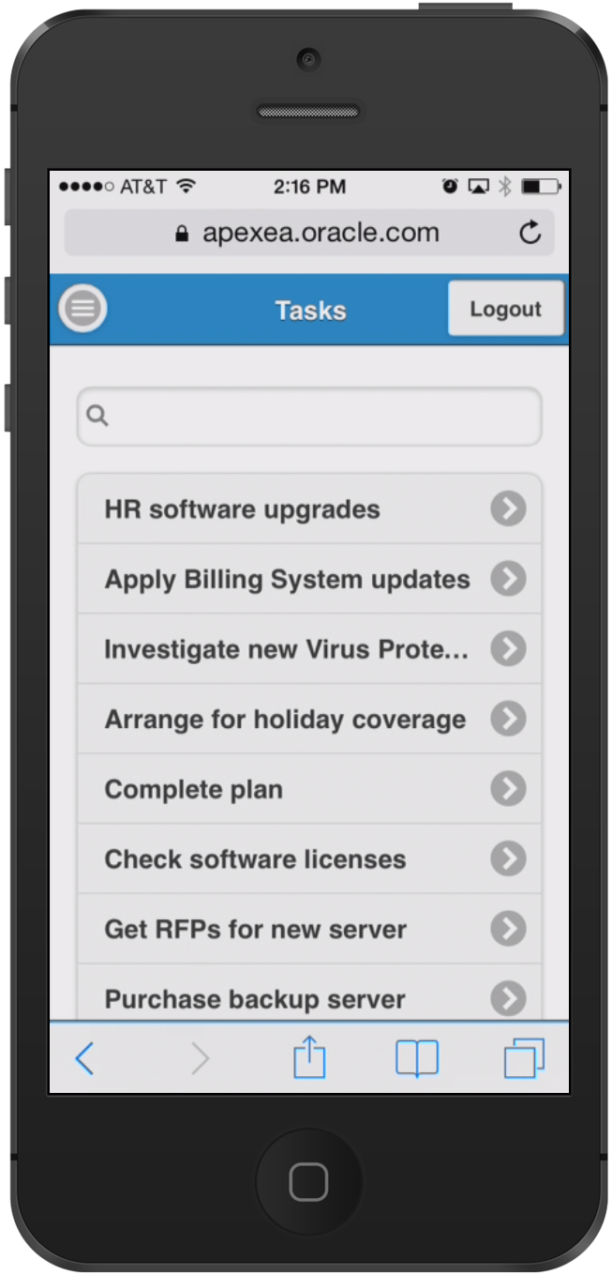
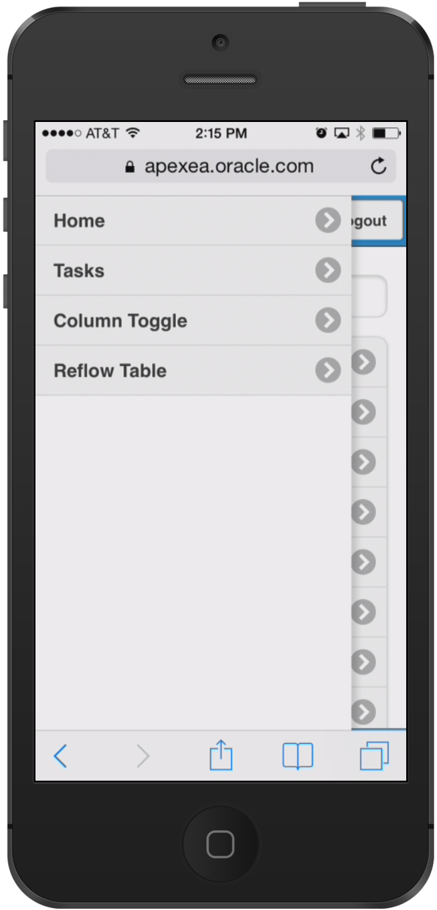
Navigation Menus and Slide Panels
All top level pages added to Navigation List
Navigation lists in Mobile apps are implemented as menu panels
Shown on the left with menu button shown in top bar
Custom panels using “Panel” region template
Choice of display modes: Overlay, Reveal, Push
data-role="panel"
Notes:
Navigation Menus are displayed as Panels and take up minimal space

Slide 30
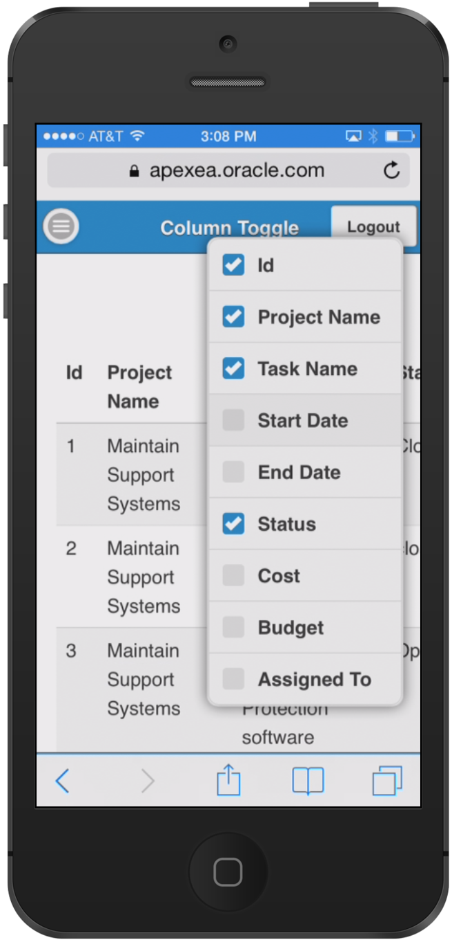
Column Toggle Report
Selectively hides columns at narrower widths as a sensible default
Offers a menu to let users manually control which columns they want to see
Column Toggle Popup contains a dynamically generated list of columns based on the table markup
Developers can set column priorities (1 – 6)
Notes:
If run on narrow devices (cell phone in portrait) will generally only show some of the columns.
If same page run on tablet in landscape will show many more items.
Developers can define which columns disappear last (Priority 1) through to disappear first (Priority 6)

Slide 31
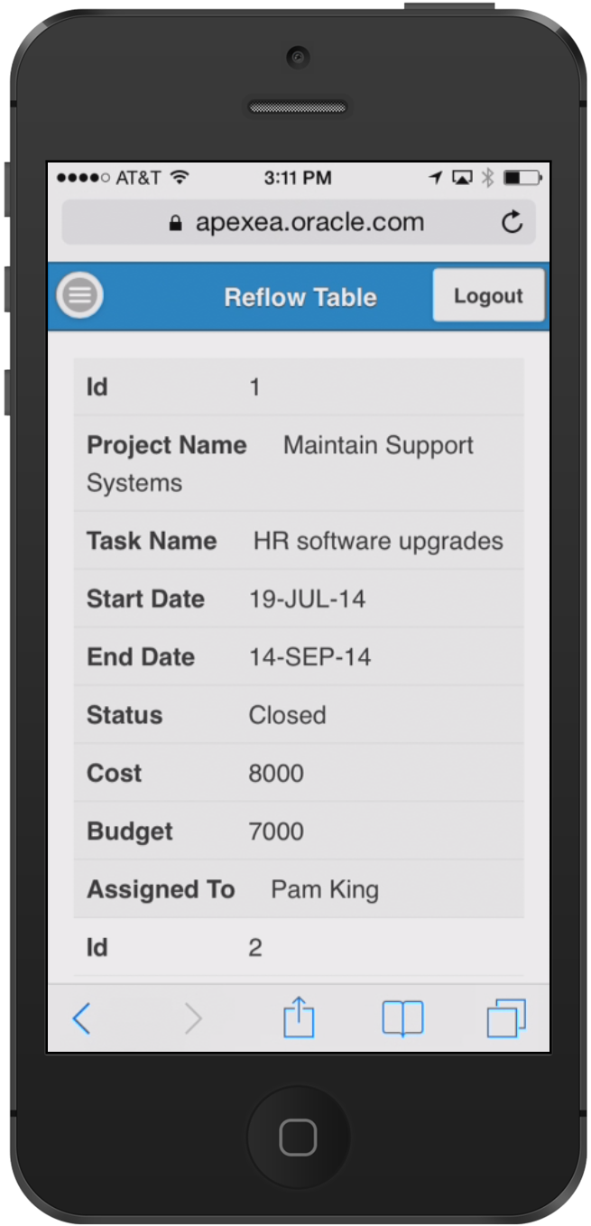
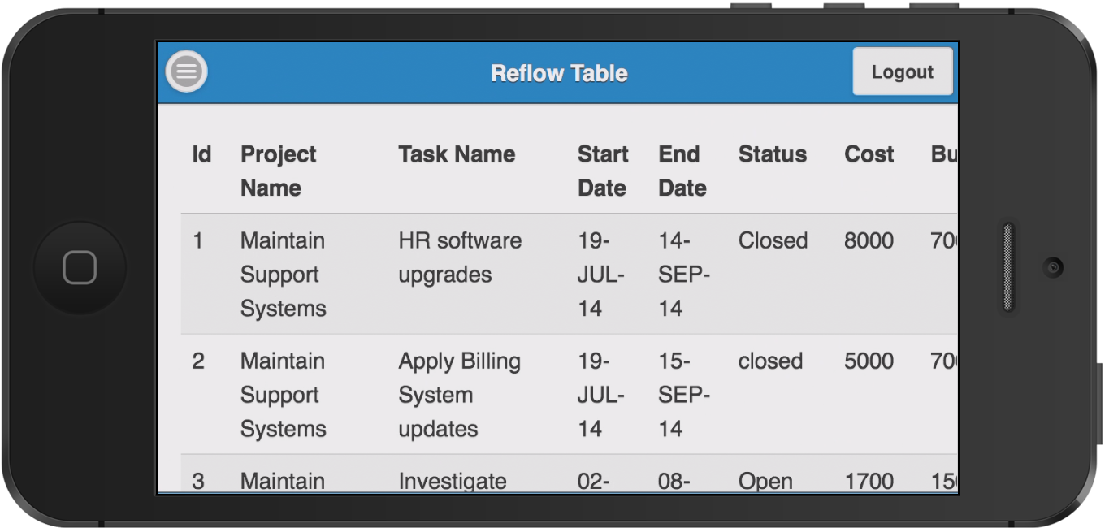
Reflow Table Report
Collapsing table data into label/data pairs for each row
Stacked presentation style default
Media query used to switch to tabular style presentation above a specific screen width
Notes:
If the display is too narrow to display the report data it will automatically switch to displaying multiple rows for each record so that users can still easily read each row on a narrow device.

Slide 32
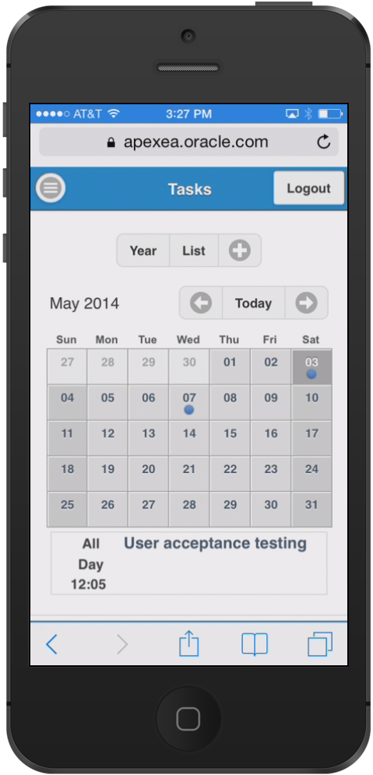
Mobile Calendar
New Calendar Region type for Desktop and Mobile
Monthly-, Weekly-, Daily- and List View
Supports touch events
Customization through CSS
Notes:
The calendar page rendering is different between desktop and mobile user interfaces.
The mobile display closely mimics native calendars on mobile devices and are intuitive for end-users to use.
The blue dots indicate dates which have records.
Clicking on one of those dates lists the records below the calendar.

Slide 33
Agenda
1
Oracle Application Express Overview
Page Designer
User Interface and Universal Theme
Mobile Enhancements
Functional Improvements
Security Enhancements
2
3
4
5
6

Slide 34
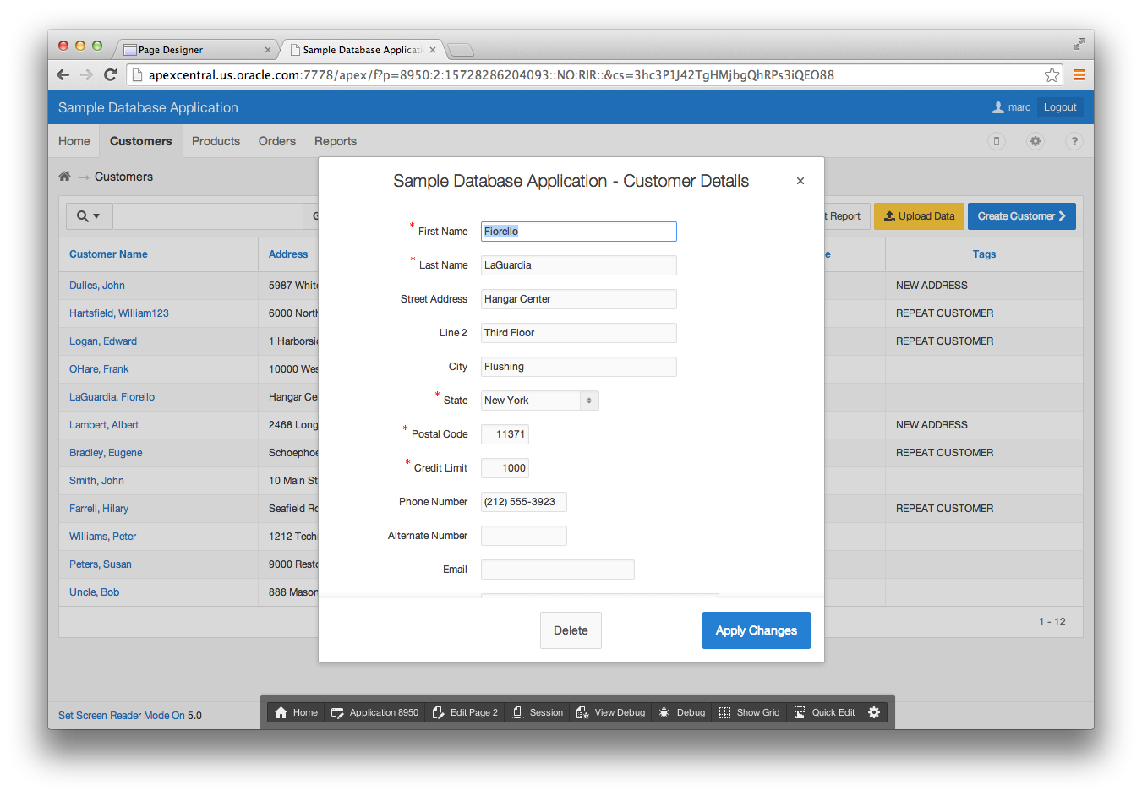
Modal Dialogs
Replacement for Popup Windows
A modal dialog is a stand-alone page, not a region on a page
Any page be created as a dialog page
Supports all the functionality of a regular page, incl. computations, validations, processes, and branches
Notes:
Support for Desktop and Mobile User Interfaces
Fully Accessible
Customizable dimensions and positioning
Dialog pages can branch to full pages (close dialog and standard branch) or to other dialog pages (e.g. wizard)
Dialog pages can open other dialogs (stacked dialogs)
Create Application and Create Page wizards allow to optionally create form pages as modal, i.e. report and form, list view and form, master-detail open forms as modal dialogs
Form pages created with close dialog process – allows same form to be opened from different parents without requiring complex branching
Dynamic actions on parent pages created to refresh content after closing of modal dialog form

Slide 35
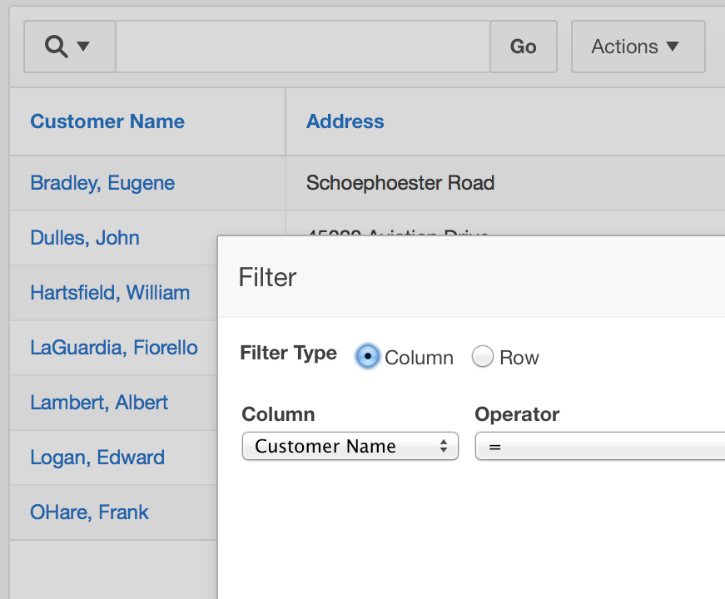
Interactive Report Enhancements
Multiple IRRs & UI Enhancements
Create multiple Interactive Reports on a single page
Modal dialogs replace “push-down” dialogs that were previously used for filters, formatting, save, export, etc.
New HTML5 HTML structure – lighter weight and accessible
Frozen filter-bar stays in place when scrolling

Slide 36
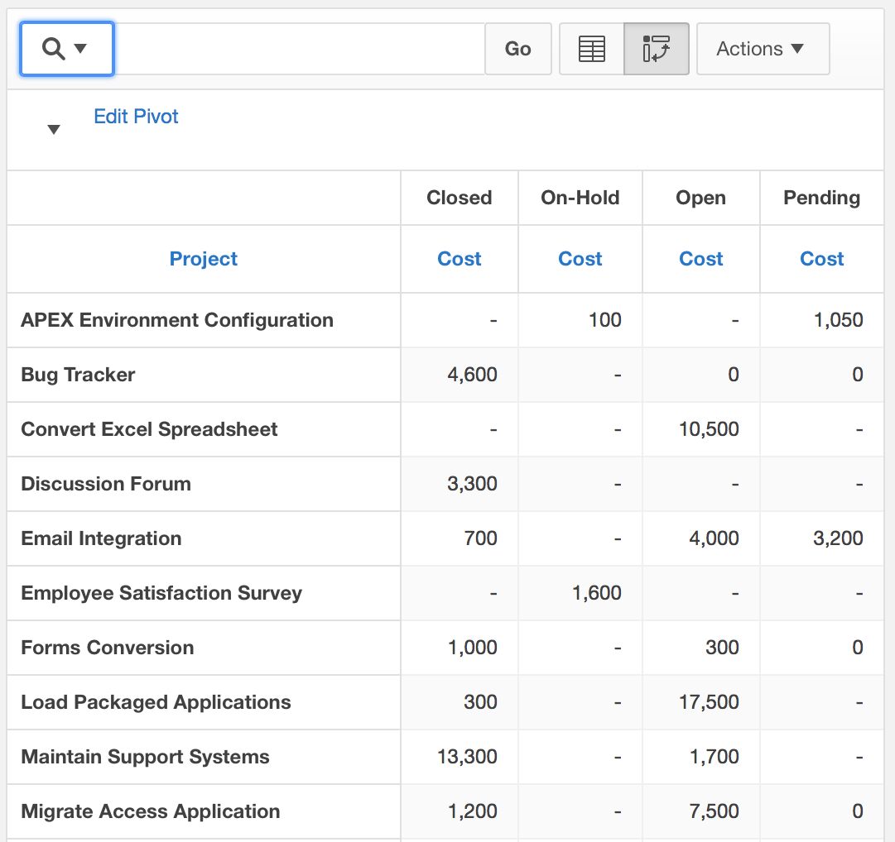
Interactive Report Enhancements
Pivot Reports
Easy creation of pivot reports on existing data
Select one or more columns as pivot columns and one or more columns as the row columns
Apply aggregation functions to columns, assign labels and format masks

Slide 37
New Calendar
New calendar region type
Based on Full Calendar jQuery Plug-In
Provides full-size calendar with monthly, weekly, daily and list view
Support duration based events with start and end date
Drag & drop capabilities allow for rescheduling of events
Customization of look & feel through CSS

Slide 38
Static files / Relative URL references
Upload application and workspace images into database
Supports relative file URL references
ZIP files automatically unzipped and placed in folder structure
Supports versioning / Caching
Can be used to store theme style CSS files and include in export

Slide 39
Agenda
1
Oracle Application Express Overview
Page Designer
User Interface and Universal Theme
Mobile Enhancements
Functional Improvements
Security Enhancements
2
3
4
5
6

Slide 40
Browser Security Options
Browser Cache: prevent back button from showing old page content after logout (APEX 4.1)
Embed in Frames: prevent other apps from embedding and remote controlling your application (APEX 4.1)
Define custom HTTP headers at instance and application level (APEX 5.0)

Slide 41
Authentication and Authorization
Flexible authentication - change the authentication of the development environment itself - LDAP, SSO, HTTP Header Variable, etc. (APEX 5.0)
Authorizations and conditions for on demand processes (APEX 4.2)
Assign workspace groups to other groups (APEX 5.0)
Set group membership for session on login, including external groups (APEX 5.0)
Is In Group authorization (APEX 5.0)

Slide 42
Improvements to avoid Cross-Site Scripting (XSS)
HTML Expression attribute for report columns with substitution support instead of concatenating strings in the query (APEX 4.1)
Restricted Characters attribute for items rejects malicious input (APEX 4.2)
More restrictive HTML-Escaping and APEX_ESCAPE API (APEX 4.2)
New escaping syntax, e.g. &P1_ITEM!JS. for fine grained control (APEX 5.0)

Slide 43
Instance Lockdown and Workspace Isolation
Limit emails (APEX 4.1)
Resource manager support (APEX 4.2)
Limit file uploads (APEX 5.0)
Limit debug output (APEX 5.0)
Limit concurrent requests per session and per workspace (APEX 5.0)
Limit workspace access by hostname (APEX 5.0)

Slide 44
Cryptography Improvements
Stronger session cookie (APEX 4.2)
SH-1/SH-2 for checksums (APEX 5.0)
Improved hashing algorithm for workspace user passwords (APEX 5.0)
New applications/forms are checksum protected by default (APEX 5.0)
Support DB 12c DBFIPS_140 mode (APEX 5.0)
DBFIPS_140 enables Transparent Data Encryption (TDE) and DBMS_CRYPTO PL/SQL package program units to run in a mode compliant to the Federal Information Processing Standard ("FIPS mode”)

Slide 45
Summary
Oracle Application Express
Notes:
Closing Summary on key take-aways

Slide 46
Oracle Application Express
Summary
Used by real customers for real applications: Used for both opportunistic and mission critical apps that service tens of thousands of users.
Well Established Product : First released over 10 years ago
Continually growing: Oracle install base is adopting Oracle APEX for increasing numbers of projects, and is increasingly an approved corporate IT standard.
Notes:
Used extensively; with a long successful history > 10 years-old
Rather than being a tool that grows from the ground-up thru developer word-of-mouth,
increasingly Corporate Architects are using APEX as a strategic tool being pushed down to their development communities

Slide 47
Oracle Application Express
Summary
Aligned with industry trends: Strong support for HTML5 development frameworks, Modern & responsive CSS3 UI, integrated JavaScript libraries, Browser-based, self-service provisioning, flexible development and deployment including cloud services.
Consistent with Oracle developers skill set: SQL, PL/SQL, Oracle Database. Proficiency in the Oracle database easily translates into an ability to develop web applications.
Notes:
Given APEX is released approximately once a year, as new trends arise, APEX can quickly adopt these best (proven) trends
Most organizations have sizable teams of developers with SQL / Oracle Database skills.
These people can readily start building APEX applications given how easy and quick it is for them to learn how APEX works.

Slide 48


