Slide 1

Using Oracle Application Express to
Build Highly Accessible Web Applications

Slide 2
The following is intended to outline Oracle’s general product direction. It is intended for information purposes only, and may not be incorporated into any contract. It is not a commitment to deliver any material, code, or functionality, and should not be relied upon in making purchasing decisions.
The development, release, and timing of any features or functionality described for Oracle’s products remains at the sole discretion of Oracle.
Notes:
2
2

Slide 3
Agenda
Oracle’s Accessibility Commitment
Application Express Overview
Accessibility Overview
Building for Accessibility
Accessibility and Application Express
Testing
Into the Future
Questions

Slide 4


Oracle Corporation
The world’s most complete, open, and integrated
business software and hardware company
Scale
  370,000 customers in 145 countries
  20,000 partners
  104,500 employees
  10 million developers in Oracle online communities
  Over 100 U.S. Federal government organizations
  38 U.S. States run Oracle Applications
  24 of the 100 largest U.S. School Districts run Oracle Applications
  11 of the 15 largest U.S. Counties run Oracle Applications
  35 of the 50 largest U.S. Cities run Oracle Applications
Innovation and Investment
  29,000 developers and engineers
  15,500 customer support specialists, speaking 27 languages
  20,000 implementation consultants
  1.5 million students supported annually
  870 independent Oracle user groups with 355,000 members
Notes:
Charles Phillips screen
08/31/12
4

Slide 5

Oracle Corporation
#1 in 50 product or industry categories
Technology
Database
Database on Linux
Database on SAP
Database on Solaris
Data Warehousing
Embedded Database
Development Language – Java
Middleware
Application Servers
Identity and Access Management
Hardware
Tape Storage
Unix Server
Applications
CRM
Enterprise Performance Management
Project Portfolio Management
Transportation Management
Industries:
Communications
Construction
Discrete Manufacturing
Life Sciences and Healthcare
Public Sector
Professional Services
Retail
Transportation
Notes:
5

Slide 6

Oracle’s Commitment to Accessibility
"Oracle is committed to creating accessible technologies and products that enhance the overall workplace environment and contribute to the productivity of our employees, our customers, and our customers’ customers.”
- Safra Catz, President and CFO

Slide 7
APPLICATION EXPRESS
Overview

Slide 8
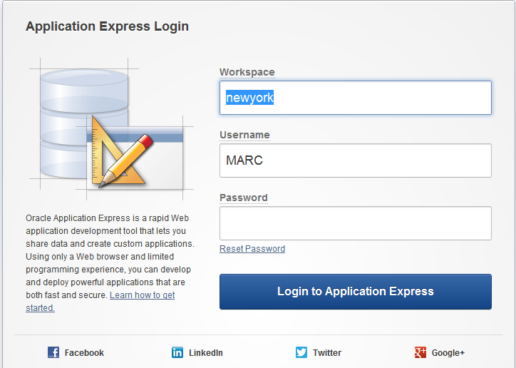
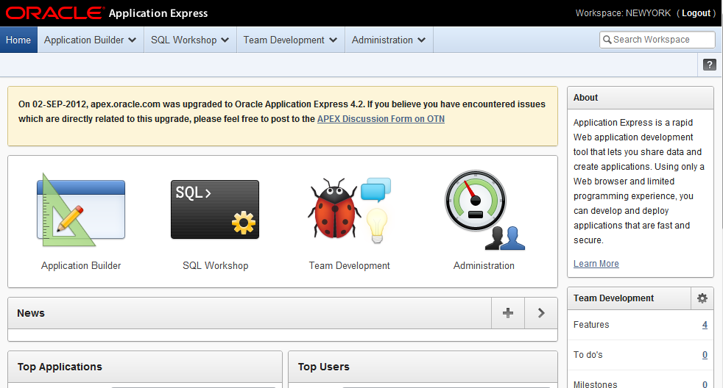
Oracle Application Express (Oracle APEX)
Browser Based Application Development
Notes:
8
8
Discussion Points:
Will give a brief overview of the product. APEX is a RAD tool that allows for the creation of secure & professional looking applications, based on an Oracle database. APEX utilizes a Web browser, communicating through a Web Listener to the Oracle database. Only a modern Web Browser is required. APEX Pages are rendered using HTML (which, with APEX 4.1 and our new themes, is using HTML5, which leads to cleaner & more well defined documents) within the browser.
Database-centric – Can very rapidly build applications on top of existing Oracle tables and views
Browser Based – No client software required
Declarative – Utilizes extensive wizards to produce applications; easy to enhance and maintain as design presented consistently in declarative framework
Oracle DB – Built directly into the Oracle DB so easy to integrate with other DB features
Fully Supported – Dedicated Oracle Support team which specializes in Oracle Forms and APEX only.
“No-cost” option – Can develop as many applications with as many users as you like within existing Oracle DB license terms
Unique Rapid Application Development (RAD) tool for the Oracle Database
Browser based for Development, Deployment & Use
Declaratively build professional Web 2.0 applications that are fast and secure
Leverages full Oracle database capabilities and existing SQL & PL/SQL skills
Fully supported, “no-cost” standard component with all editions of the Oracle Database

Slide 9

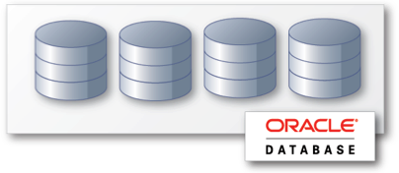
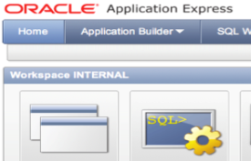

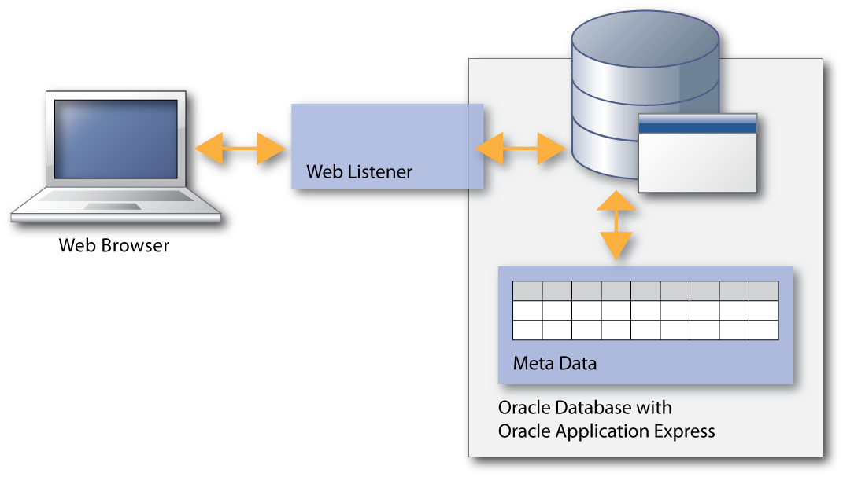

Oracle Application Express (Oracle APEX)
Benefits
Rapid Browser Based Development
Leverage SQL Skills
Point your browser and start developing
Build reports and charts using SQL
Self Service Provisioning
Runs within Database
Out-of-the-box elastic private cloud service
Simple to manage, highly scalable
Notes:
9
Discussion Points:
Develop/deploy where it’s most convenient & cost effective
Runs anywhere Oracle can be installed
Multi-tenant workspaces within consolidated Oracle DB
Just to list a few of the benefits of APEX:
It's browser-based, so only a URL is required to access an instance
Using SQL & PL/SQL skills, you can build great looking applications, which also taking advantage of the Oracle Database features such as FlashBack!
APEX is highly scalable & secure – essentially offering all of the security of working with an Oracle Database
APEX transparently manages session state in the database, providing users with stateful behaviour. It offers a Multi-tenant environment, where developers can work in a dedicated work area, known as a workspace, where applications can be developed against one or more schemas.

Slide 10
Oracle Application Express (Oracle APEX)
Architectural Overview
Simple 2-Tier Architecture
Pages dynamically rendered using database Metadata
No code generation or file based compilation
Runs Everywhere Oracle Database Runs
Notes:
10
Discussion Points:
Oracle Application Express Listener Release 1.1.4 is now available. For those of you unfamiliar with this product, Oracle APEX Listener is a J2EE based alternative for Oracle HTTP Server (OHS) and mod_plsql. The J2EE implementation offers increased functionality including a web based configuration, enhanced security, and file caching. The APEX Listener also provides flexibility by supporting deployments using Oracle Web Logic Server (WLS), Oracle Glassfish Server and OC4J.
The Oracle Application Express architecture requires some form of Web server to proxy requests between a Web browser and the Oracle Application Express engine. The APEX Listener was created to satisfy that need but its use goes beyond that of Application Express configurations. The use of the Oracle APEX listener simplifies the deployment process because there is no Oracle home required as connectivity is provided using an embedded JDBC driver.
Why use the APEX Listener
Allows easy integration with Java-based middleware
Can be used for Application Express or any Oracle web-toolkit application
Ease of configuration
Lightweight
When combined with Glassfish, just unzip and you are good to go

Slide 11
Accessibility Overview
What is it, and why is it important?

Slide 12
What is Web Accessibility?
#1 The goal
Equal Access
Notes:
To provide equal access to users with disabilities.

Slide 13
What is Web Accessibility?
#2 “The Four Principles of Accessibility”
Perceivable
Operable
Understandable
Robust
Reference: Introduction to Understanding WCAG 2.0
Notes:
Perceivable – Information and user interface components must be presentable to users in ways they can perceive.
This means that user must be able to perceive the information being presented (it can’t be invisible to all of their senses).
Operable – User interface components and navigation must be operable.
This means that users must be able to operate the interface (the interface cannot require interaction that a user cannot perform).
Understandable – Information and the operation of user interface must be understandable.
This means that users must be able to understand the information as well as the operation of the user interface (the content or operation cannot be beyond their understanding)
Robust – Content must be robust enough that it can be interpreted reliably by a wide variety of user agents, including assistive technologies.
This means that users must be able to access the content as technologies advance (as technologies and user agents evolve, the content should remain accessible).

Slide 14
Why Accessibility is Important
Procurement and Discrimination Laws
Section 508 of the Rehabilitation Act of 1973,
amended 1998 (U.S.)
  In effect as of 2001
  New revision expected sometime in 2013 or 2014
Mandate 376 (E.U.)
  Largely aligned with revised Section 508 for content and timing
Accessibility for Ontarians with Disabilities Act (Canada)
Americans with Disabilities Act (U.S.)
Disability Discrimination Act, and Equality Act (U.K.)
Twenty-First Century Communications and Video Accessibility Act (U.S.)
The list goes on and on, worldwide…

Slide 15
Why Accessibility is Important
It makes good business sense
  Up to 16% of the population is disabled, either
  through birth, ageing, illness, or the result of an accident
  Accessible products remove obstacles between a company and its existing or potential customers
  It allows employers to recruit from a broader pool
  of talent
  Generally improves product for everyone
  (Universal Design)
  And…it’s the Right Thing To Do

Slide 16
Building for accessibility
It’s not just a checklist!

Slide 17
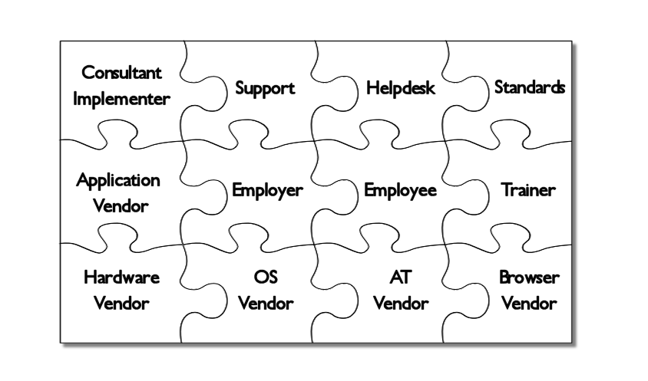
The Ecosystem
Many pieces have to fit together just right
Notes:
Oracle software is just one piece of the puzzle; all elements must be addressed in order for any individual user to be successful:
Consultant/Implementer: must know the best practices of the toolset, and must have thorough knowledge of the accessibility standards
Support and Helpdesk: must be familiar with accessibility features of each product, the interaction with AT, and the needs of users with disabilities
Standards: must be open, complete, reasonable, and testable
Application Vendor, Hardware Vendor, OS Vendor, Browser Vendor, and AT Vendor: must all design the product to the same standards
Employer: must provide reasonable accommodations to employees, such as training, AT, and work adjustments
Employee: must learn the application and the AT
Trainer: must be familiar with the application and AT, including the ability to create custom scripts if needed.

Slide 18
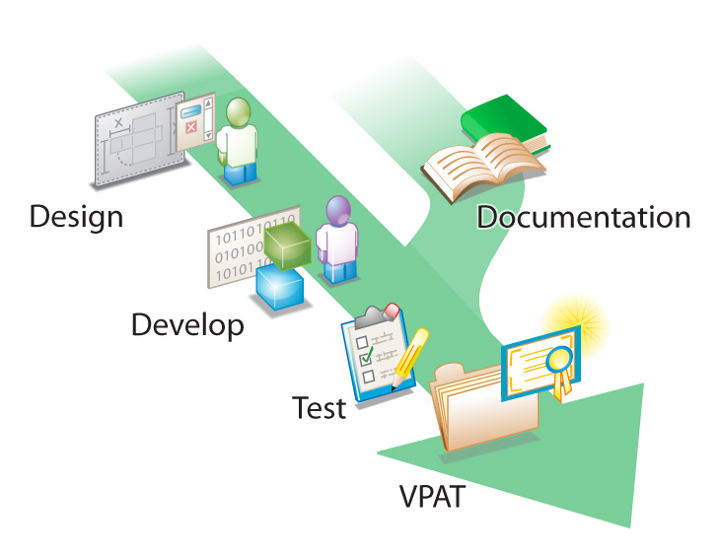
Oracle Accessibility Guidelines
Process
Notes:
It’s not just a checklist, the process of building accessible applications at Oracle affects all stages of the development cycle and involves considerable investment in time and resources. From Design right through to the VPAT (a product’s statement of conformance to Section 508 of the U.S. Federal Rehabilitation Act).

Slide 19
Accessibility and apex
How Application Express helps you to address accessibility

Slide 20
Accessibility and Application Express
How APEX helps you address accessibility
The power of themes and templates
  Solid templates provide a solid base
  Theme 21 underwent accessibility testing for 4.1.1
Declarative
  Exposes declarative attributes that help you define
  important properties
    Page titles, form field labels, button labels,
    table column headers, etc.
Metadata based
  Easier to identify possible violations

Slide 21
Accessibility and Application Express
How APEX helps you address accessibility
Accessibility Modes
  Screen Reader
  High Contrast
Adopting modern standards
  HTML 5 / WAI-ARIA to help write more semantic code
  & make richer content accessible
Further information
  APEX 4.2 VPAT (Conformance statement for APEX)
  User Guide > Accessibility in Application Express

Slide 22
Testing
Developing a robust testing strategy

Slide 23
Testing
Developing a robust testing strategy
What do you test?
  Theme testing first
  (we tested theme 21 in APEX 4.1.1)
  Cover primary application flows, and pages representative of common functionality
  Include custom code, e.g. PL/SQL based regions,
  custom HTML, etc.
  APEX Metadata audits

Slide 24
Testing
Developing a robust testing strategy
What types of testing should you do?
  Keyboard-only
    For users unable to use a mouse, including screen reader users
  Using automated tools / toolbars
    To identify definite failures and present other mark-up to you
    in a way that helps you determine compliance
  Assistive Technology (AT) testing
    Such as screen reader testing for users with low vision or who are totally blind (After keyboard-only and automated tools)
  Colour contrast
    For users with low vision, or colour vision deficiency
  Windows High Contrast mode
    For users with low vision, or colour vision deficiency
  User (very important)

Slide 25
Testing
Developing a robust testing strategy
Ensure testing is valid
  Unplug your mouse for keyboard-only testing.
  Turn off your monitor and unplug your mouse for screen reader testing. You just need a keyboard and speakers!
  Engage with users with disabilities
Raise awareness of standards and testing practices across your team

Slide 26
Into the future
What’s planned for future versions of Application Express

Slide 27
Into the Future
What’s planned for future versions of APEX
White paper on how to build accessible applications with APEX underway
Planned removal of modes (bug #14198613)
Further adoption HTML 5, WAI-ARIA & WCAG 2.0
Incorporate jQuery UI 1.9
Metadata auditing
Ongoing framework / theme improvements and fixes
Minimise VPAT exclusions
Community feedback
  Feature Requests

Slide 28
Summary
Accessibility is not just a checklist
Get your templates and themes right up front
Know the current problems in
Application Express
Plan out your testing strategy and include
real users
Spread awareness across your team
Watch out for the white paper!

Slide 29


Slide 30



