Slide 2

Oracle Application Express 5
Mobile Development
<Name>
<Title>
<Organization>
<Date>

Slide 3
Notes:
This is a Safe Harbor Front slide, one of two Safe Harbor Statement slides included in this template.
One of the Safe Harbor slides must be used if your presentation covers material affected by Oracle’s Revenue Recognition Policy
To learn more about this policy, e-mail: Revrec-americasiebc_us@oracle.com
For internal communication, Safe Harbor Statements are not required. However, there is an applicable disclaimer (Exhibit E) that should be used, found in the Oracle Revenue Recognition Policy for Future Product Communications. Copy and paste this link into a web browser, to find out more information.
http://my.oracle.com/site/fin/gfo/GlobalProcesses/cnt452504.pdf
For all external communications such as press release, roadmaps, PowerPoint presentations, Safe Harbor Statements are required. You can refer to the link mentioned above to find out additional information/disclaimers required depending on your audience.

Slide 4
What I want you to take away from today…
The difference between “Native” and “Web-based” mobile applications
The advantages of Mobile-first applications
You can build Web-based mobile applications very quickly and easily with Oracle Application Express

Slide 5
Agenda
1
Mobile Development Techniques
jQuery Mobile Overview
Building Mobile Apps with Oracle Application Express 5.0
Testing and Debugging your Mobile App
Deploying Mobile Apps
2
3
4
5

Slide 6
1
Mobile Application Development
jQuery Mobile Overview
Building Mobile Apps with Oracle Application Express 5.0
Testing and Debugging your Mobile App
Deploying Mobile Apps
2
3
4
5

Slide 7


Mobile Application Development
Native Apps
Apps built for a specific platform
Using platform specific language and tools
Pros:
Full access to device’s hardware and APIs
Potentially better performance
Offline use
Cons:
Separate codebase for different platforms
Expensive to build, maintain and distribute

Slide 8



Mobile Application Development
Mobile Web Apps
Apps developed using HTML/CSS/JavaScript
Pros:
Can be accessed by any device with a web browser
Uses standard Web technologies
Easy to deploy and update on the server
Media Capture, HTML5 Geolocation APIs
Cons:
Limited access to device specific hardware and APIs
Requires permanent Internet connection

Slide 9

Mobile Application Development
Hybrid Apps
Apps developed using Web technologies – deployed as native app
Wrapped in platform-specific container using e.g. PhoneGap / Cordova
Pros:
Single code base due to use of Web technologies
Access to device specific APIs
Cons:
Subject to store approval – best suited for apps installed locally on device
Security model requires whitelisting of outside domains

Slide 10

Mobile Application Development
Mobile Development with Oracle Application Express
Build mobile web apps using standard APEX tools
Introduced with APEX 4.2 in 2012
jQuery Mobile framework used to render mobile UI
Supports wide variety of mobile platforms
Responsive features scale to different screen sizes
Responds to touch events and orientation change
Easy to modify UI look & feel through ThemeRoller

Slide 11

Mobile Application Development
Universal Theme vs. Mobile Theme
Universal Theme allows for building pages that scale to different screen sizes
jQuery Mobile theme designed to build dedicated mobile pages, either for mobile-only apps or to complement desktop pages
Both use responsive design techniques for optimal use of screen real estate
jQuery Mobile theme provides out-of-the-box support for touch events, orientation change, native form elements
jQuery Mobile pages generally lighter weight and optimized for smaller screen / lower bandwidth use

Slide 12
1
Mobile Development Techniques
jQuery Mobile Overview
Building Mobile Apps with Oracle Application Express 5.0
Testing and Debugging your Mobile App
Deploying Mobile Apps
2
3
4
5

Slide 13

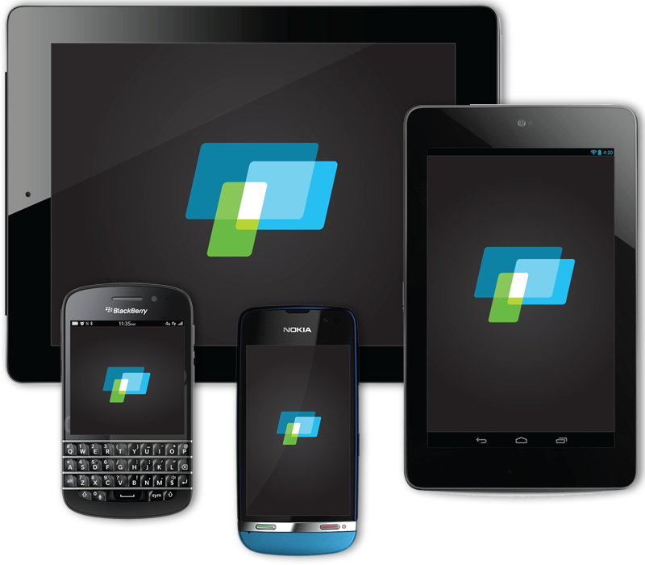
jQuery Mobile
jQuery Mobile Philosophy
One Code Base, All Platforms
Works everywhere
Built on standards
Built on top of jQuery Core
Mobile-first not Mobile-Only

Slide 14
jQuery Mobile
Features
Unified user interface across all popular mobile platforms
User Experience based on device capabilities
Lightweight size and minimal image dependencies for speed
Accessibility features like WAI-ARIA integrated in framework
Support for screen readers and other assistive technologies
AJAX based page load and HTML5 pushstate used for smooth / native-like page transitions

Slide 15
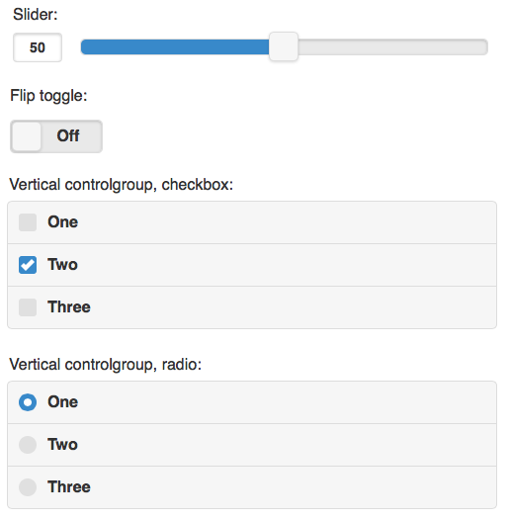
jQuery Mobile
Touch-friendly form inputs and UI widgets
Form inputs enhanced to be touch-friendly
Touch-friendly UI widgets
Auto-enhances forms to become touch-friendly
Auto-grows textareas
Designed to be touch-first

Slide 16
jQuery Mobile
New Features jQuery Mobile 1.3/1.4
Panel Widget
Responsive Design
Reflow Table, Column Toggle, Responsive Grids
Default Theme Improvements
New default theme - Flat look, two swatches, everything defaults to swatch A
Switching icons from sprites to SVG with fallback
Review of all Widgets (widget factory, performance)
jQuery Mobile 1.4 Upgrade Guide:
http://jquerymobile.com/upgrade-guide/1.4/

Slide 17
1
Mobile Development Techniques
jQuery Mobile Overview
Building Mobile Apps with Oracle Application Express 5.0
Testing and Debugging your Mobile App
Deploying Mobile Apps
2
3
4
5

Slide 18
Building Mobile Apps with APEX 5.0
Overview
Build mobile apps with the tools you know
Declarative wizards, drag & drop page layout
Works on any browser: Desktop, Laptop, Tablet, Smartphone
Supports Forms, Reports, HTML5 charts, Calendars, List Views, etc.
Build mobile-only apps or apps with Desktop and Mobile pages
Auto-detection takes user to appropriate pages based on device used

Slide 19
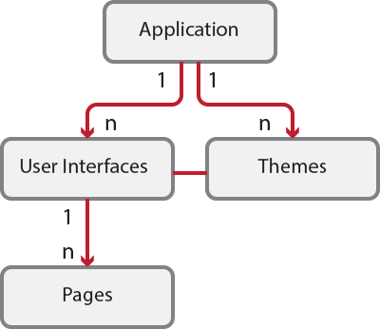
Building Mobile Apps with APEX 5.0
User Interfaces
Apps can have multiple User Interfaces
Each User Interface is associated with one Theme
Individual Pages can have only one User Interface
User Interface defines:
Login URLs
UI specific home pages
Global Pages
Auto Detection

Slide 20
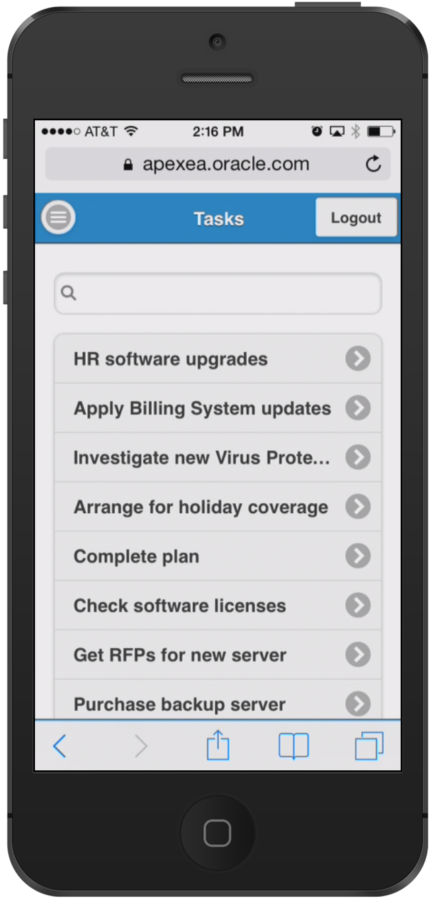
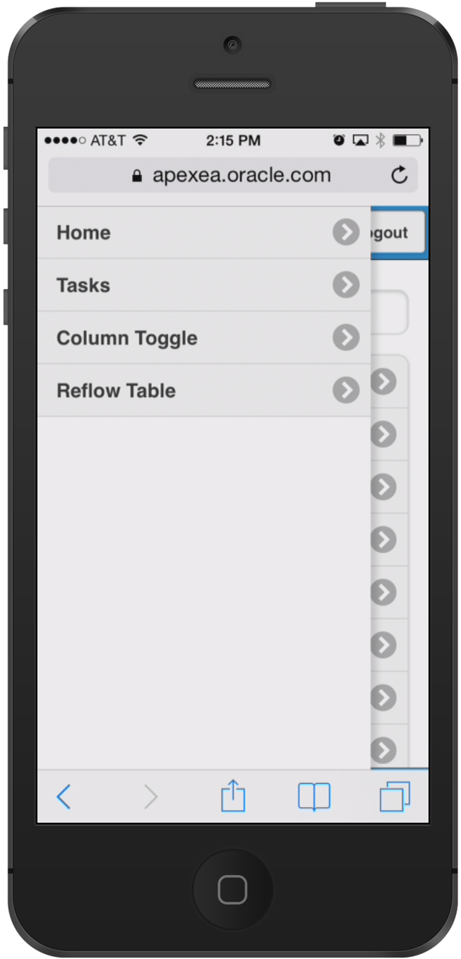
Building Mobile Apps with APEX 5.0
Navigation menus and slide panels
All top level pages added to Navigation List
Navigation lists in Mobile apps are implemented as menu panels
Shown on the left with menu button shown in top bar
Custom panels using “Panel” region template
Choice of display modes: Overlay, Reveal, Push
data-role="panel"

Slide 21
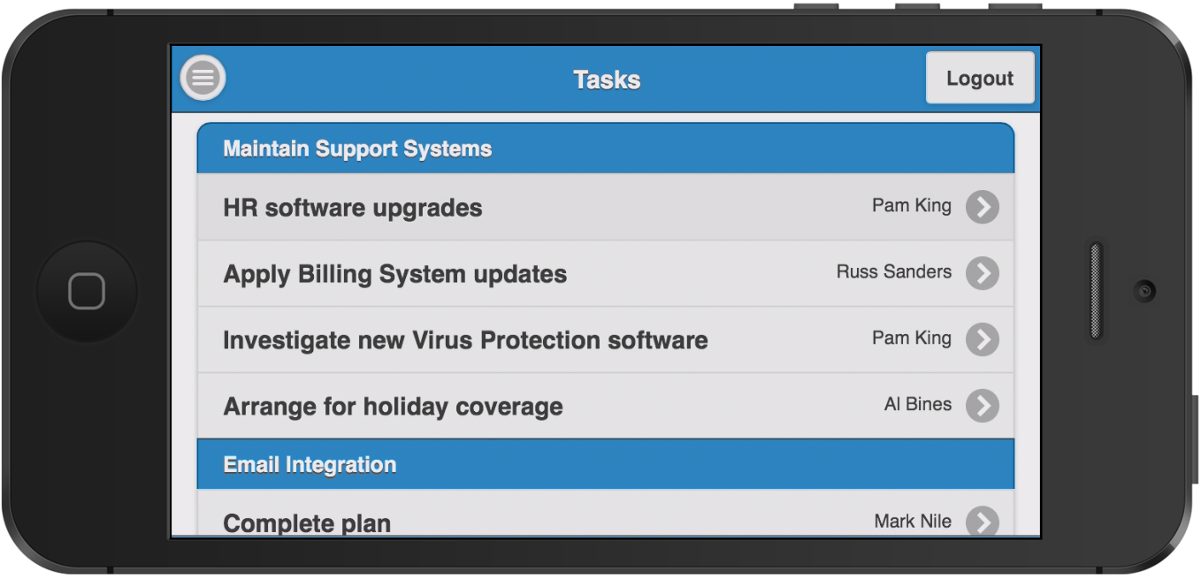
Building Mobile Apps with APEX 5.0
List View
Default View for data display, navigation, drill-down view
Based on unordered list
Automatic Dividers
Custom formatting options
Declarative Search Options, supporting server- and client side search
data-role="listview"

Slide 22
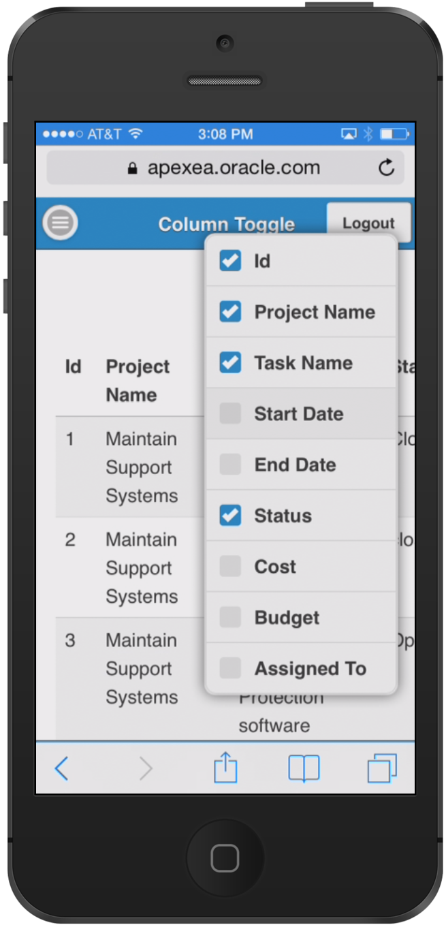
Building Mobile Apps with APEX 5.0
Column Toggle Report
Selectively hides columns at narrower widths as a sensible default
Offers a menu to let users manually control which columns they want to see
Column Toggle Popup contains a dynamically generated list of columns based on the table markup

Slide 23
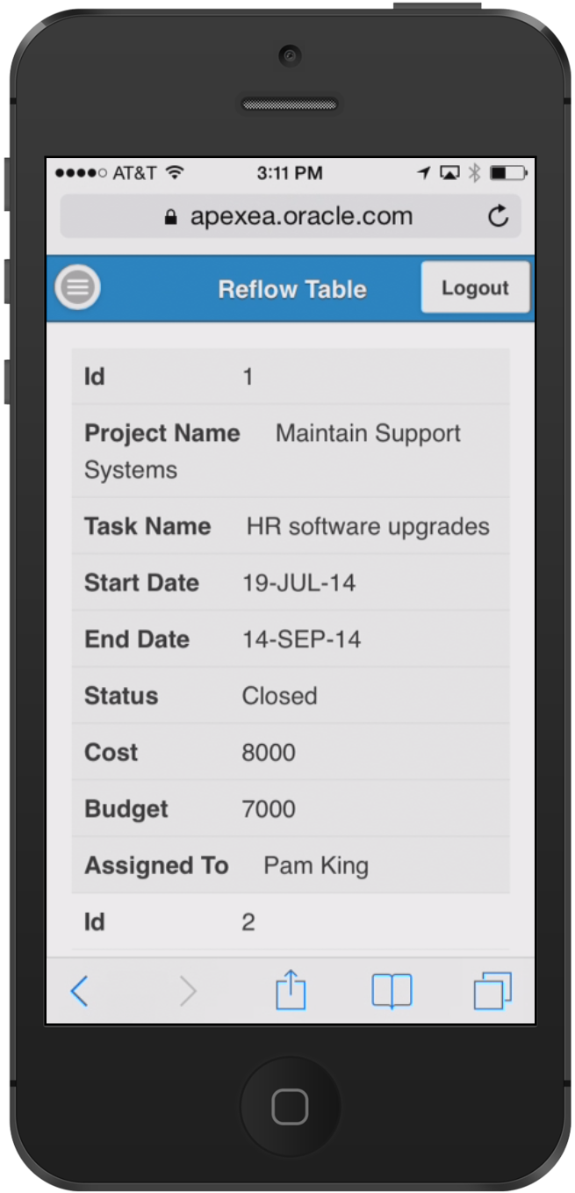
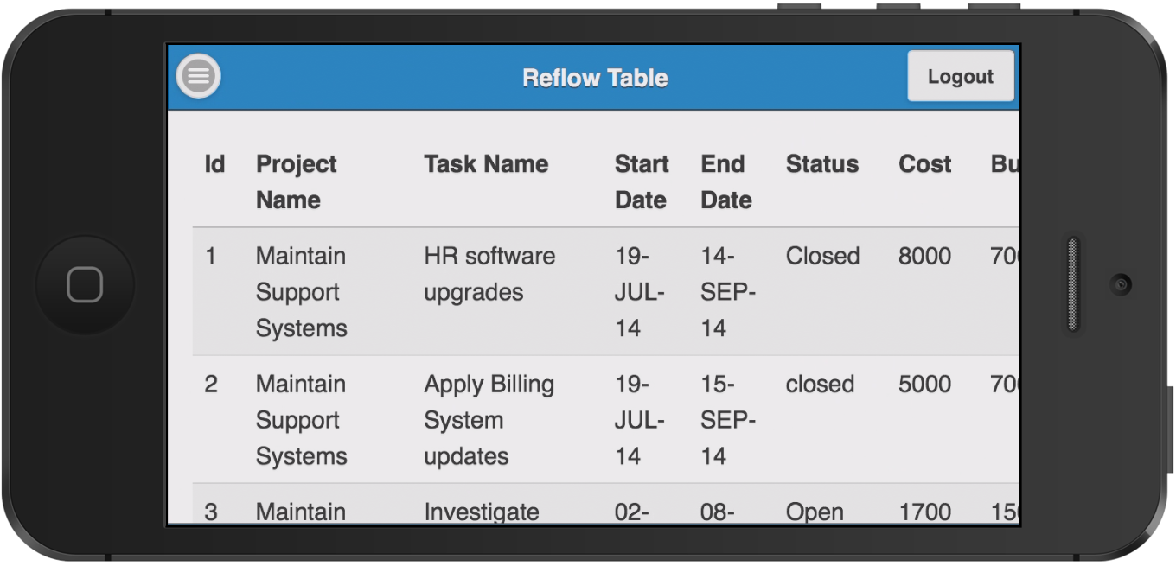
Building Mobile Apps with APEX 5.0
Reflow Table Report
Collapsing table data into label/data pairs for each row
Stacked presentation style default
Media query used to switch to tabular style presentation above a specific screen width

Slide 24
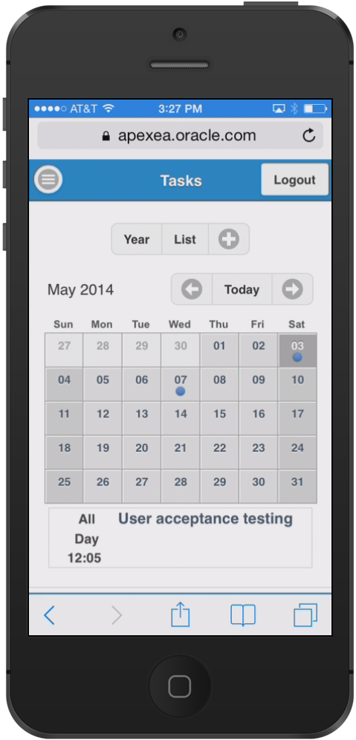
Building Mobile Apps with APEX 5.0
Calendar
New Calendar Region type for Desktop and Mobile
Monthly-, Weekly-, Daily- and List View
Supports touch events
Customization through CSS

Slide 25
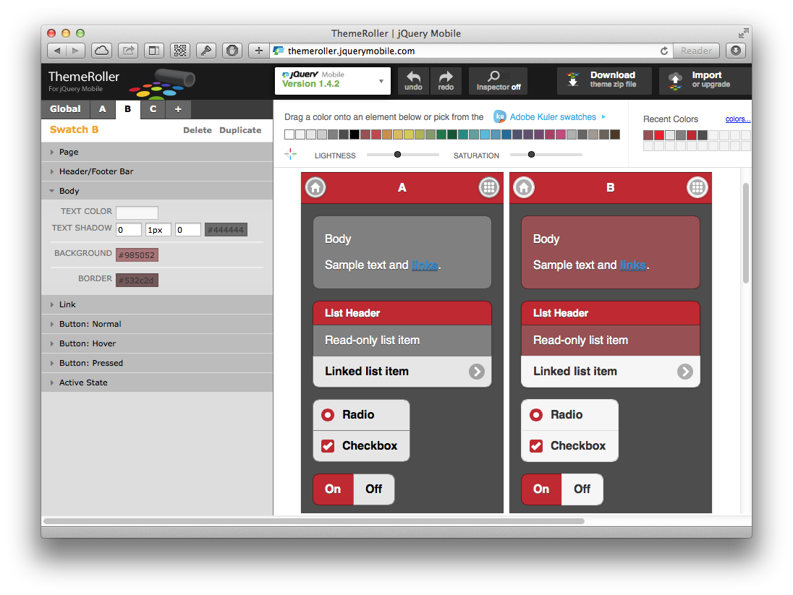
Building Mobile Apps with APEX 5.0
ThemeRoller
Mobile theme provides a variety of theme styles
Create custom styles using Themeroller
Upload Themeroller file as application or workspace files
Define new theme style using your own Themeroller layout

Slide 26
1
Mobile Development Techniques
jQuery Mobile Overview
Building Mobile Apps with Oracle Application Express 5.0
Testing and Debugging your Mobile App
Deploying Mobile Apps
2
3
4
5

Slide 27
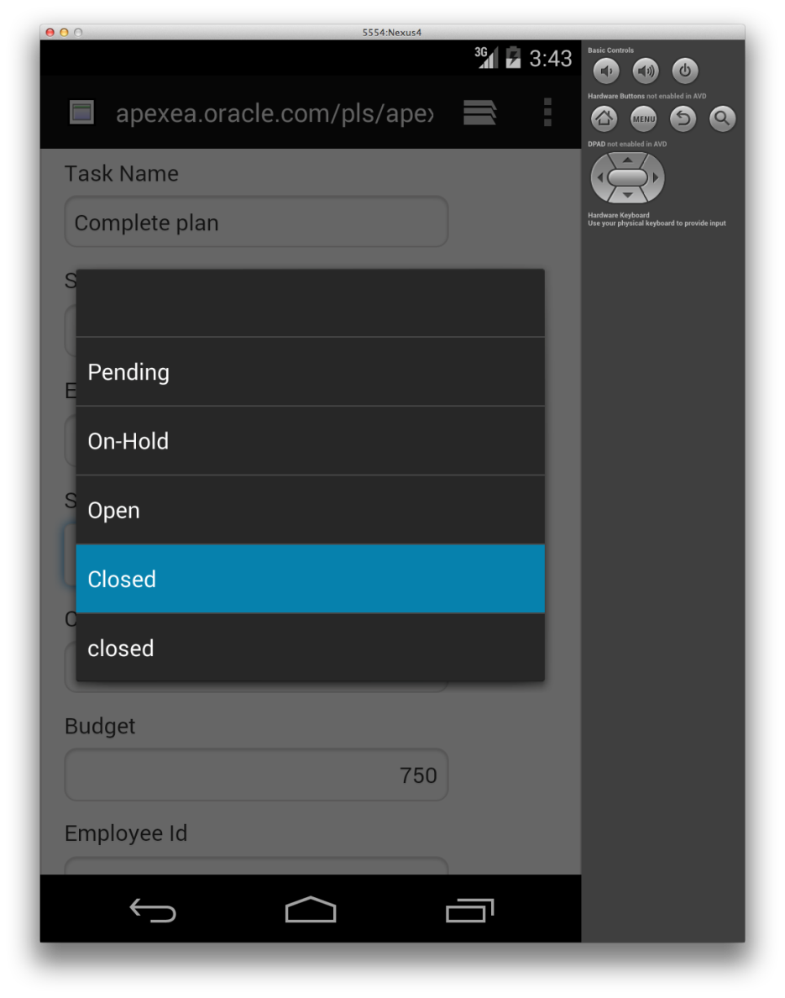
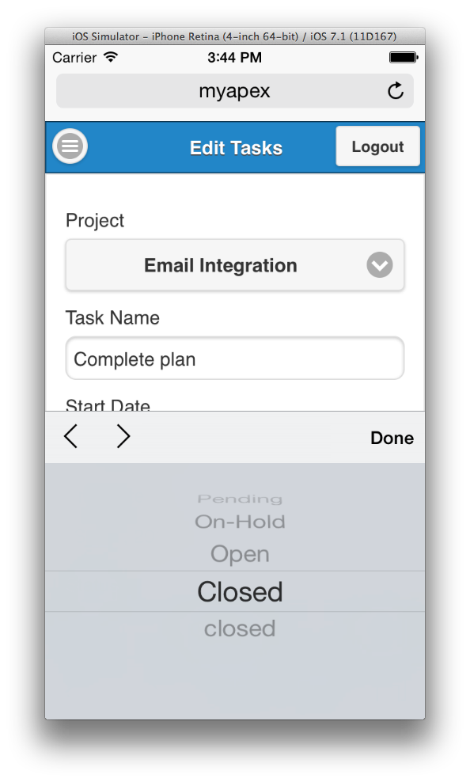
Testing and Debugging
Running your APEX Mobile app using a Simulator
Use resized standard Desktop browser for basic functional testing
Use platform-specific development tools like Xcode or Android Developer Tools to test mobile features: native form controls, orientation change, simulate different devices, screen resolutions, High DPI, etc.
Also include testing on real, physical devices for full access to hardware functions

Slide 28
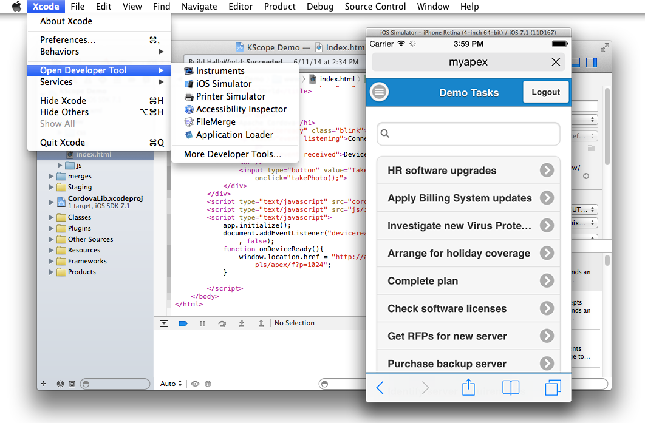
Testing and Debugging
Using Xcode
Access iOS Simulator from Xcode menu or directly
Simulate different iPhone and iPad models, Retina and non-Retina, different iOS versions
iOS Simulator located at:
/Applications/Xcode.app/Contents/Applications/iPhone Simulator.app

Slide 29
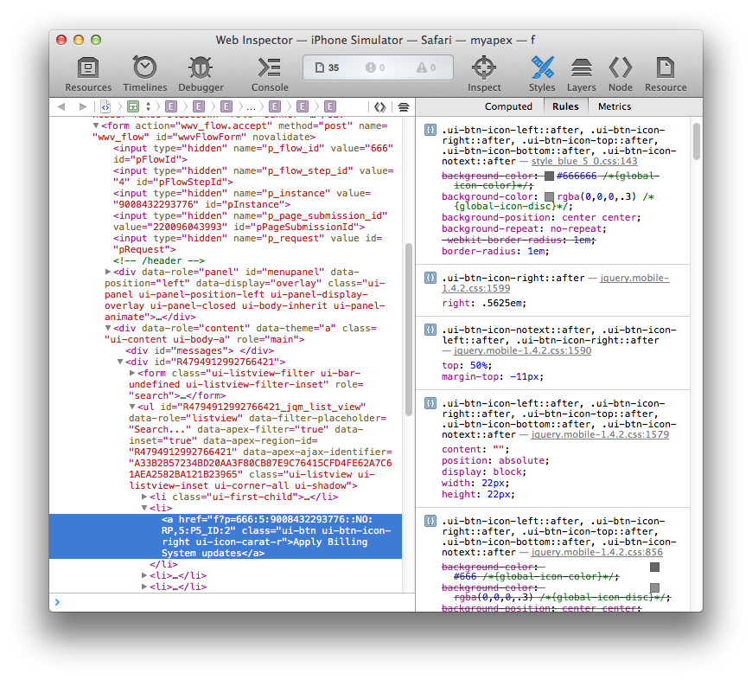
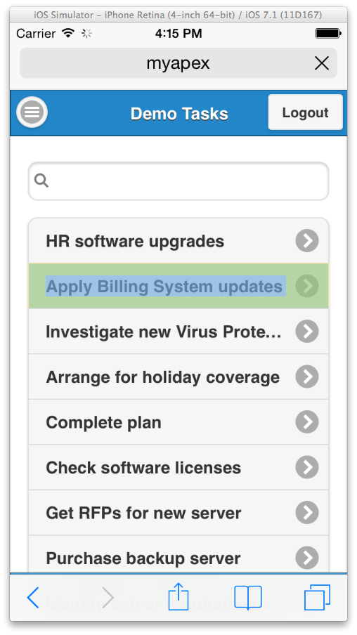
Testing and Debugging
Debugging and Web Inspector
Use Safari Web Inspector with browser in iOS simulator
Also works with actual USB connected iOS device
Access to resources, debugger, console, etc.

Slide 30
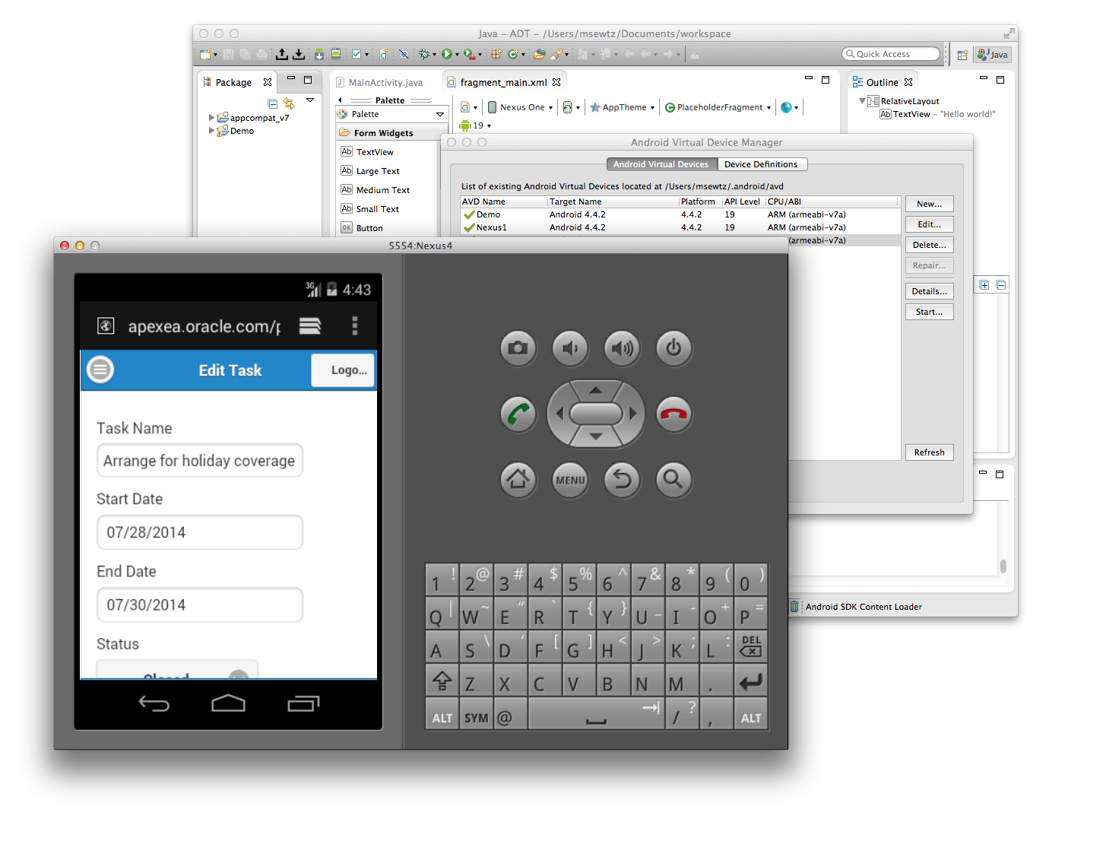
Testing and Debugging
Android Developer Tools (ADT)
Get the Android SDK
Includes Eclipse + ADT plug-in
Includes Android Emulator
Start Android Virtual Device Manager
Create virtual devices using different screen sizes, DPI and Android OS versions

Slide 31
1
Mobile Development Techniques
jQuery Mobile Overview
Building Mobile Apps with Oracle Application Express 5.0
Testing and Debugging your Mobile App
Deploying Mobile Apps
2
3
4
5

Slide 32

Deploying Mobile Apps
Mobile Apps are accessed through web browser on device
In-house applications
Deploy to APEX instance in the company internal network
Access from outside the network via VPN
Public-facing applications
Deploy on APEX instance that is accessible from the Internet
Deploy to public-facing site or hosted sites like the Oracle Cloud

Slide 33
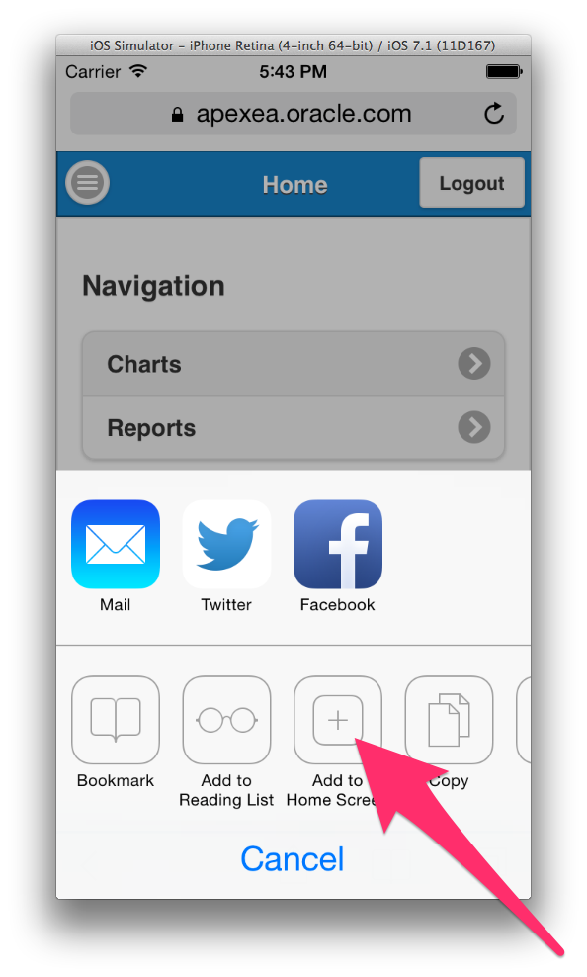
Deploying Mobile Apps
Add to Home Screen
Users open Mobile Web Apps by opening a URL in the Web browser of their device
App specific URLs can be made available through mobile dashboards, portals, or communicated through email
Apps that are frequently used can be bookmarked
For easy and quick access to mobile Apps, use Add-To-Home-Screen function to place icon on the home screen of your device

Slide 34
Deploying Mobile Apps
Deploying Hybrid Apps using Cordova / PhoneGap
Set of device APIs that allow access to native device functions from JavaScript
Combined with a UI framework like jQuery Mobile this allows a smartphone app to be developed with just HTML, CSS, and JavaScript
JavaScript APIs consistent across multiple device platforms thus apps are portable to other device platforms with minimal to no changes
Apps made available for installation from each device's app store

Slide 35


