Slide 2

Oracle Application Express 5
Overview
<Name>
<Title>
<Organization>
<Date>

Slide 3
Presenter Instructions
Almost every slide includes “Notes” to outline the major talking points.
This slide deck is way too long for a one hour overview session.
Before presenting, review the deck and remove slides as appropriate.
If you are also planning to do demonstrations (recommended) than you should remove approximately ½ of the slides.
For internal people use http://apex.oraclecorp.com or APEX installed on your laptop for demonstrations.
For external people you can use http://apex.oracle.com or APEX installed on your laptop for demonstrations.

Slide 4
Recommended Demonstrations
Building an Application from a spreadsheet:
  Install the Sample Reporting application from Packaged Applications
  {This will install EBA_DEMO_IR_PROJECTS Table}
  Go to SQL Workshop and ‘Download’ the table data and save as a XLS
  Bring up the file in Excel and ensure the dates and amounts (Cost, Budget) are of the correct format
  During Demo -
  From APEX Application Builder > Create Application “From Spreadsheet”
  Run application and demonstrate IRs, editing records (single source of truth)
  Show Page Designer
    Can change Status to LOV – Static values = Open;Closed;Pending;On-Hold
  ‘Add Page’ with Calendar

Slide 5
Recommended Demonstrations
Building an Application on an Existing Table:
  Ensure EMP and DEPT tables defined in schema
  {Optional} define User Interface defaults for EMP Table (and DEPT table)
    Change Table Display Name; Change Titles for each column
    Define LOV for Job, Department; Pop-Up LOV for Manager
  During Demo –
  From Application Builder > Create Desktop Application
  Add Page – Report and Form; Select Table EMP
  Add Dynamic Action on P3_JOB = ‘Salesman’ to Enable / Disable P3_COMM
  {Optional} Add new Page Item P3_LOCATION;
  Add Dynamic Action on P3_DEPT of Type = Set Value
  SQL Query: select loc from dept where deptno = :P3_DEPTNO
  with Page Item to Submit = P3_DEPTNO accepting on Item = P3_LOCATION

Slide 6
Recommended Demonstrations
Building an Application on an Existing Table (Continued …)
  During Demo –
  {Optional} Demonstrate Plug-Ins
    Add RATING (Number) and PHONE (Varchar2(15))Columns to EMP Table
    Add new columns to IR report SQL Query (Page 2)
    Add ‘Star Rating’ and ‘Text Format’ Plug-In from repository
    Add new items to Form P3_RATING and P3_PHONE; Source = Database Column
    {Note by adding the plug-ins before adding the form items you can select them as part of creating the items}

Slide 7
Recommended Demonstrations
Packaged Applications:
  Install the P-Track application from Packaged Applications and Unlock application
  Install Universal Theme Sample Application
  During Demo -
  Show the Packaged Apps Home and Gallery
  Run P-Track application and demonstrate Navigation Menu, Responsiveness (make browser window smaller until menu and right-side bar collapse)
  From Developer Toolbar click Theme Roller
    Change the colors and navigate to different pages; then Save as a new name
  From Menu select Administration > Configuration > Theme Style
    Change the Theme Style to the style you just saved
  Run Universal Theme Sample Application
    Using Lists - Show the different layouts available just be changing the Template Options

Slide 8
Notes:
This is a Safe Harbor slide!
If you are *not* an Oracle employee this slide should be deleted.
For Oracle employees the Safe Harbor slide must be used if your presentation covers material affected by Oracle’s Revenue Recognition Policy

Slide 9
Introduction
Oracle Application Express
Notes:
Introduction to Application Express to provide some base understanding of what APEX is and how it is architected.

Slide 10



Oracle Application Express
Database-centric web application development framework
Develop desktop and mobile web apps
Visualize and maintain
database data
Leverage SQL Skills and database capabilities
Notes:
Used to build desktop and mobile applications for the Oracle Database.
Quickly build reports, forms, charts, calendars, etc. on top of the data in your database
IT Developers and “citizen-developers” who know a little SQL can readily build applications.
Application Express can also take advantage of the large majority of Oracle Database features.

Slide 11
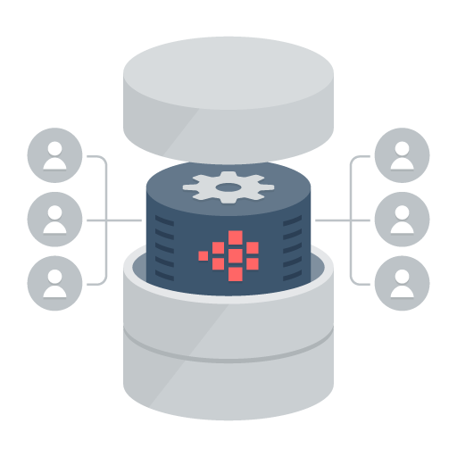
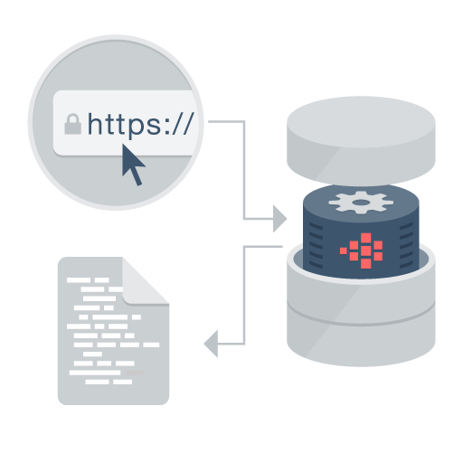

Oracle Application Express
Distinguishing Characteristics
Page generation is efficient with only one request and one response.
Data processing done in the Database
App Development IDE is a web browser.
No client software needed
App definitions are stored in the database as meta data.
Declarative – No code generation
Notes:
Simply use a web browser and the URL to access the development environment, or the URL and user credentials to run the application
You don’t need any client software
Declarative framework stores application definitions in Oracle database tables within the APEX Engine
No need for file-based compilation or code generation
All of the data (page) processing is performed by PL/SQL acting directly on the data schemas in the Oracle Database.
Therefore, very efficient as data manipulated directly in the database and results sent back as HTML pages

Slide 12




Oracle Application Express
  Develop faster, release more frequently
Go from prototype to production in minutes
Develop
Customize
Deliver
Notes:
At the core of Application Express is an engine that provides a variety of fundamental application capabilities and operations. Application authentication, page/object-level access control, database interaction (queries/updates etc), form validation, session management and protection, and more is available as standard components that can be utilised from every application without custom development.
Application objects such as forms, reports, charts, navigation etc are defined declaratively, enabling applications to be functionally complete in a short period of time, increasing agility in application development.

Slide 13


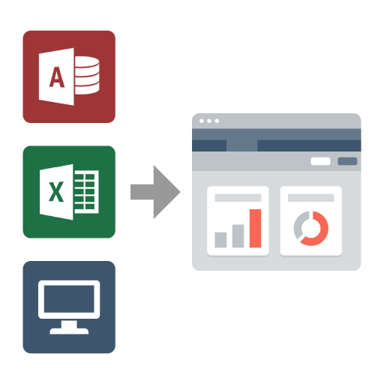
Oracle Application Express
Use Cases
Developing opportunistic & self service web apps
Extending enterprise application solutions
Migrating file based and client server apps to the web
Notes:
Widely used to rapidly build applications that are needed ASAP to meet changing business requirements and maximize competitive advantage.
Primarily designed to be used by all employees / partners / customers rather than back-office systems.
Used for extending COTS Software to streamline for your business processes or meet organization specific requirements
Webify spreadsheets and MS Access applications to provide true multi-user, secure, robust, “single-source of truth” applications.
Also commonly used to modernizing old legacy client-server applications

Slide 14

Oracle Application Express
No cost feature of the Oracle Database
No-cost fully supported feature
  Any number of developers, apps, & end-users
  Specialized Oracle Support Team
  11gR1, 11gR2, 12c
  All DB editions: EE, SE, SE1, XE
Included with Oracle Cloud Services
  Schema and PDB services 5, 20, 50 GB
  Dedicated DBaaS services
  No cost evaluation http://apex.oracle.com
Easy to install
  Included by default with all editions of Oracle database
  Download latest release from http://otn.oracle.com/apex
Notes:
Oracle Application Express is a feature of the Oracle Database with no licensing costs for development or deployment of Application Express applications.
The Oracle Database Maintenance Agreement also covers support for Application Express.
When you sign up for the ODCS – Schema Service you are provided with a slice of the Oracle Database with Application Express as the development environment (already pre-configured and ready to start developing with)
Application Express is released more frequently than the Oracle DB so important to get the latest version of Oracle Application Express from OTN.

Slide 15



Application Express in the Oracle Cloud
Database Cloud Service – Multitenant and Single Tenant
Schema / PDB
Full Instance
Customers who want a “slice” of the database for development and deployment of departmental apps. Don’t want to manage any aspects of the database.
Database Schema or PDB available as a monthly Subscription by Size (5, 20, 50, 250*, 500GB*, 1TB*)
Oracle Managed Database
Highly available and scalable infrastructure
Also underpins the BI, Document, Mobile, Java and other Cloud offerings
Customers who want a dedicated database for dev/test or production applications. Want control of database while automating many routine tasks.
Full database available as a metered service (Hourly or Monthly)
Choice of customer or Oracle Managed Database
Choice of general purpose or mission-critical infrastructure
Choice of editions to meet different customer requirements
* Planned for a future release.
Notes:
Schema Servicer Underpins
BI Service (APEX)
Documents
Mobile Cloud Service
Developer Service
Java SaaS Extension
Planning and Budgeting
Developer
Messaging (just infrastructure DB)
Data (just infrastructure DB)
Process
Integration
Social Network
Application Builder (formerly known as Breeze)
Enterprise Performance Reporting (formerly known as Financial Reporting)
Data Enrichment

Slide 16
History
Also known as Oracle APEX (āʹpěks)
HTML DB 1.5
First Release
HTML DB 1.6
Themes
APEX 2.1
Oracle XE
APEX 2.2
Packaged Applications
APEX 3.1
Interactive Reports
APEX 4.0
Websheets
Dynamic Actions
Plug-Ins
Team Development
APEX 4.2.x
Mobile
HTML5
Packaged Apps
2004
2005
2006
2007
2008
2009
2010
2011
2012-14
2015
HTML DB 2.0
SQL Workshop
APEX 3.0
Flash Charts
PDF Printing
Access Migration
APEX 3.2
Oracle Forms to APEX Conversion
APEX 4.1
Data Upload
Error Handling
ROWID
APEX 5.0
Page Designer
Universal Theme
Modal Dialogs
Notes:
Originally named HTML DB when first released over 10 years ago.
Application Express is released approximately once a year.
See Statement of Direction for future direction on OTN under Learn More
[http://www.oracle.com/technetwork/developer-tools/apex/application-express/apex-sod-087560.html]

Slide 17





Oracle Application Express
3 Tier Architecture
Apache
OHS
ORDS
Schemas
Oracle APEX
Web Logic Server
WLS
Oracle
Database
Browser
Mid Tier
Database Tier
Notes:
Simple architecture where page requests and submissions made from the browser are tunnelled through the mid-tier to execute in the Oracle Database and returned as HTML responses to the browser.
No data manipulation or processing is performed in the mid-tier, instead the APEX engine (inside the Oracle DB) accepts the page, and interacts with the data schemas in the DB.
The mid-tier can be either the preferred Oracle REST Data Services (ORDS) running in a Java Server {either Oracle Web-Logic Server (WLS), Oracle Glassfish, or Tomcat} or Oracle Embedded PL/SQL Gateway (EPG) which is part of the Oracle DB, or Oracle HTTP Server (OHS) with mod_plsql.
It is common for OHS to be installed in front of ORDS to act as a proxy and serve images.

Slide 18
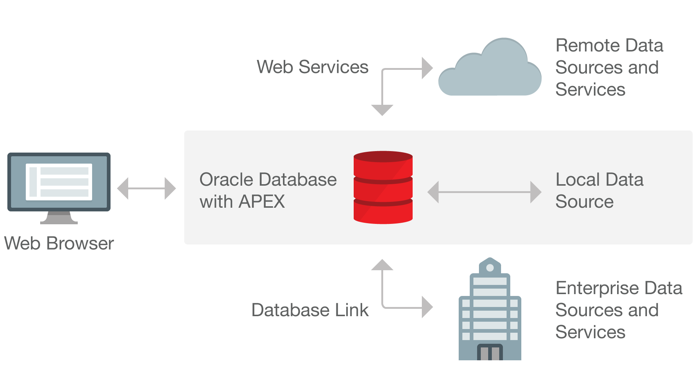
Data Sources
Utilize the Oracle Database / Web Services
Notes:
Application Express is best suited to being co-located with the data it is maintaining / reporting on.
You can also integrate into a SOA environment by consuming Web Services (both REST and SOAP) or utilize DB Links to other databases.
If using ORDS you can also emit Web Services from the Oracle Database.

Slide 19
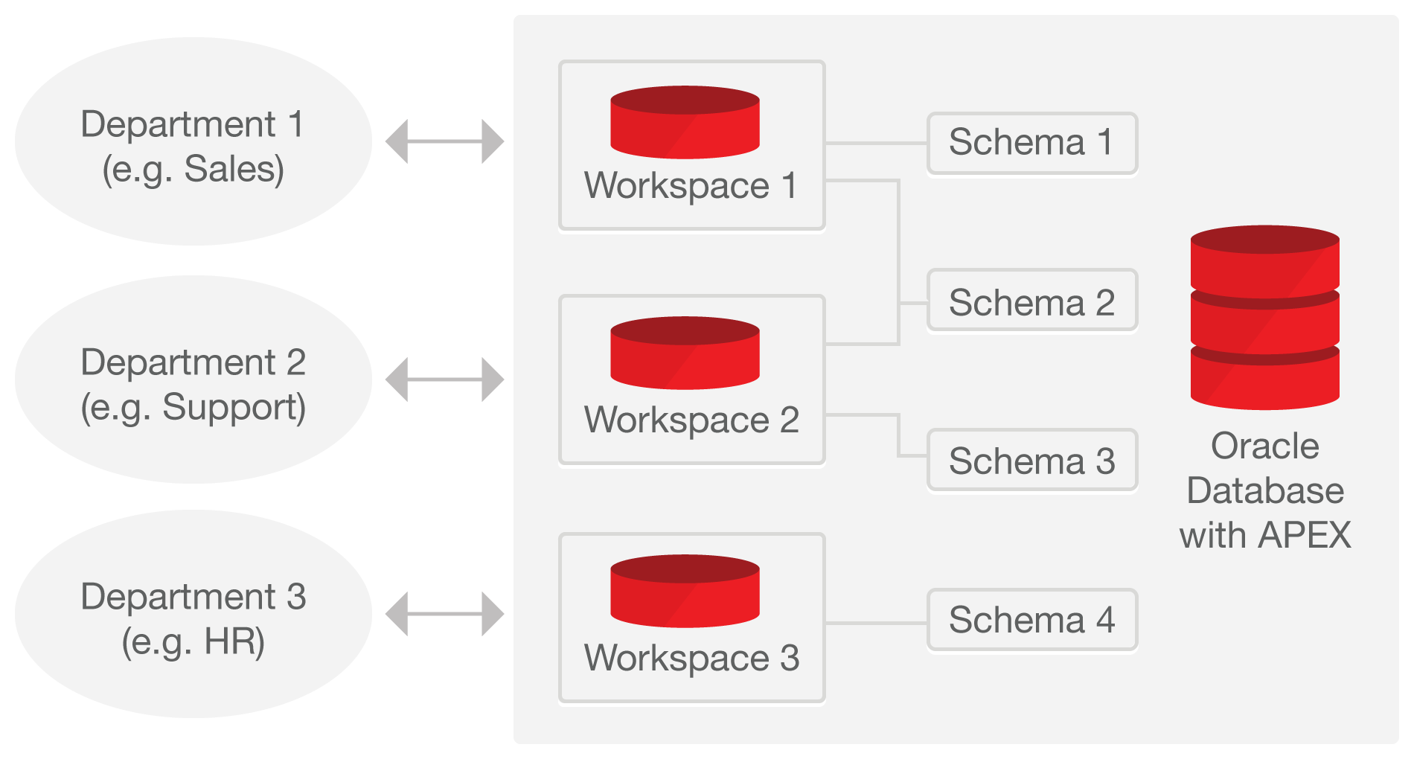
Single Database Instance / Multiple Workspaces
Easily managed with optional self-service provisioning
Workspaces used to define application definitions / Schemas hold data
Many-to-many relationship between Workspaces and Schemas
Instance Administrators manage the environment and schema access
Departments can request more space, and access to a new schema
For example, http://apex.oraclecorp.com
has over 3,000 Workspaces for every line of business in Oracle
Notes:
There is a many-to-many relationship between workspaces and schemas
Within your organization you can have a single Oracle Database support many departments with each having their own workspaces where they build applications
Each of these workspaces can be granted access to one or more schemas as appropriate
DBAs manage the infrastructure <--> Departments responsible for building their own applications

Slide 20



Development / Deployment Options
Local
Install on stand-alone laptops using Oracle Express Edition (XE) or full database version
Simply upgrade APEX to the required version
Can work completely disconnected
On-Premise
Typically run by the IT Department
IT generally both production operations service, and a service provider
Departments responsible for application development
Cloud
Deploy Internet applications
Leveraged for fast application development, user acceptance and training.
Prototyping & Proof-of-Concept
Consulting companies develop for deployment on customer premise
Browser based application development framework enables efficient development & deployment
Shoot someone a URL – Check this out – Application Development
Notes:
Given APEX can run ‘anywhere you can install the Oracle Database’ you have great flexibility → Simply provide the appropriate URL to develop / run applications
Import an APEX application into any other Oracle Database where you have the same version or later of Application Express installed
Start developing on your laptop running Oracle XE or on the cloud and then simply export the application
Deploy on the Oracle Database Cloud Service and then once your application gets wide utilization move it to your private cloud.

Slide 21
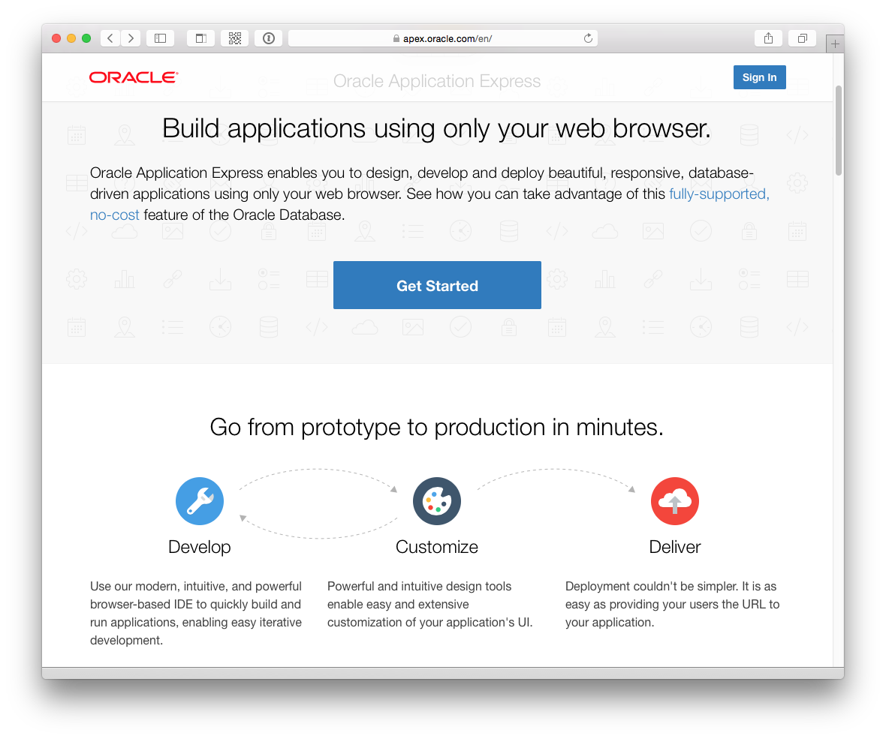
Oracle Hosted Sites
External = apex.oracle.com
Internal = apex.oraclcorp.com
apex.oracle.com
Total Page Views (1 week): 3,624,894
Distinct Applications: 7,006
Distinct Users: 8,428
Number of Workspaces: 23,243
Number of Applications: 85,707
apex.oraclecorp.com
Total Page Views (1 week): 3,088,137
Distinct Applications: 2,509
Distinct Users: 24,637
Number of Workspaces: 3,306
Number of Applications: 17,452
Notes:
These statistics show just how active these services are on a weekly basis.
The external “development-only” service has over 20,000 workspaces running in a single instance of APEX.
The internal service is accessed by approx 20% of Oracle’s workforce each week

Slide 22

Oracle Application Express (APEX 5)
#ORCLAPEX
Development Community; Very involved, enthusiastic worldwide community
~ 400,000 developers
Based on developer downloads, support tickets, check for updates data
Consulting companies, hosting companies, books, applications, success stories and quotes:
http://apex.oracle.com/community
75+ active bloggers:
http://www.odtug.com/apex
Very active Forum:
https://community.oracle.com/community/database/developer-tools/application_express
Notes:
There are a large number of consulting companies, and bloggers around the world.
APEX has one of the most active OTN Forums where you can get your questions answered.

Slide 23




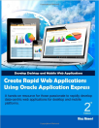




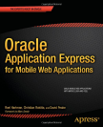
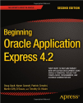
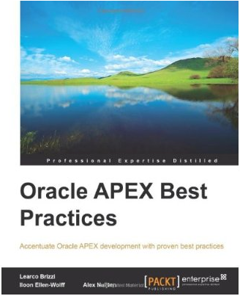


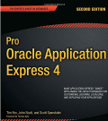
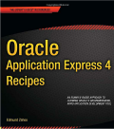
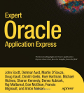
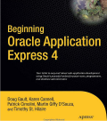
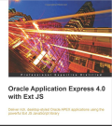
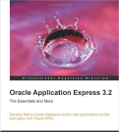
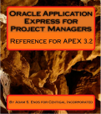


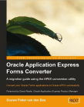

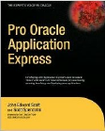
Books
Notes:
The number of books on APEX is impressive for a single Oracle tool
This number continues to grow with several new books in the pipeline for APEX 5

Slide 24
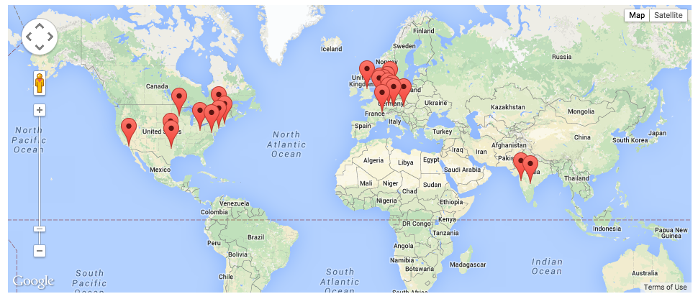
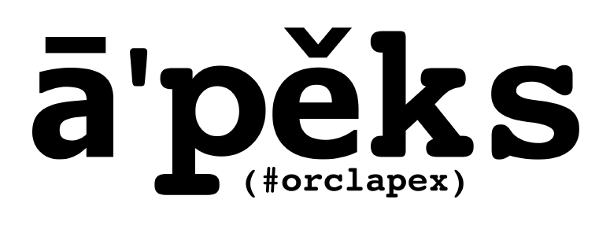
Oracle Application Express Meetups
http://apexmeetups.com
24 Groups
> 900 Members
> 50 Meetups
… and growing
Notes:
There are a number of APEX Meetup groups around the world.
If there is not a meetup in your area, consider starting your own group!

Slide 25
Useful Links
Collateral, Resources and Hosted Services
Oracle Technology Network http://otn.oracle.com/apex
APEX Community http://apex.oracle.com/community
Oracle Learning Library http://www.oracle.com/oll
Hosted evaluation site http://apex.oracle.com
APEX Cloud Service http://cloud.oracle.com
Notes:
These are the primary URLs you need to get more information on Oracle Application Express!

Slide 26
Product Components
Skip
Oracle Application Express
Notes:
Overview of the major APEX Components – What is included in the tool at a high level

Slide 27
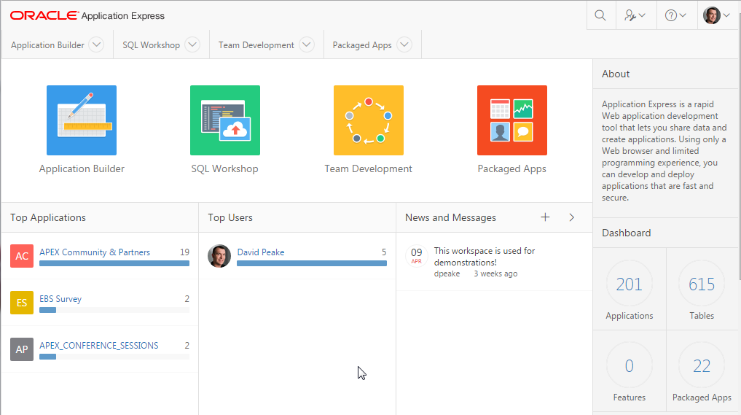
Oracle Application Express – Home Page
Comprehensive Development IDE, Web Application Development, and SQL Database Development
Notes:
Home page where developers can get an overview of current development activity and access the major product components

Slide 28
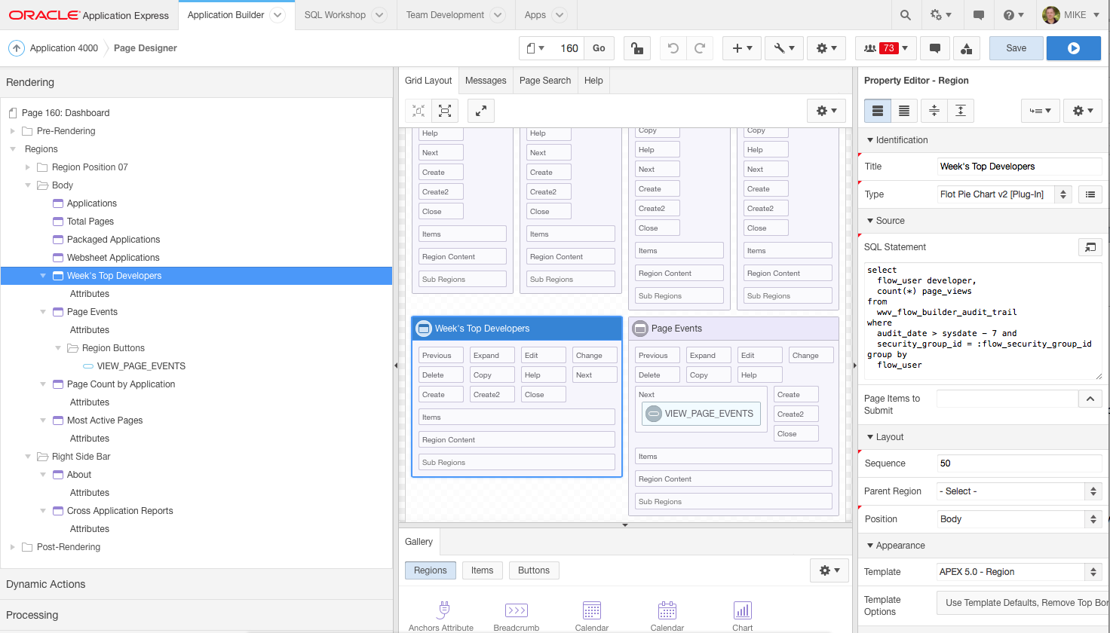
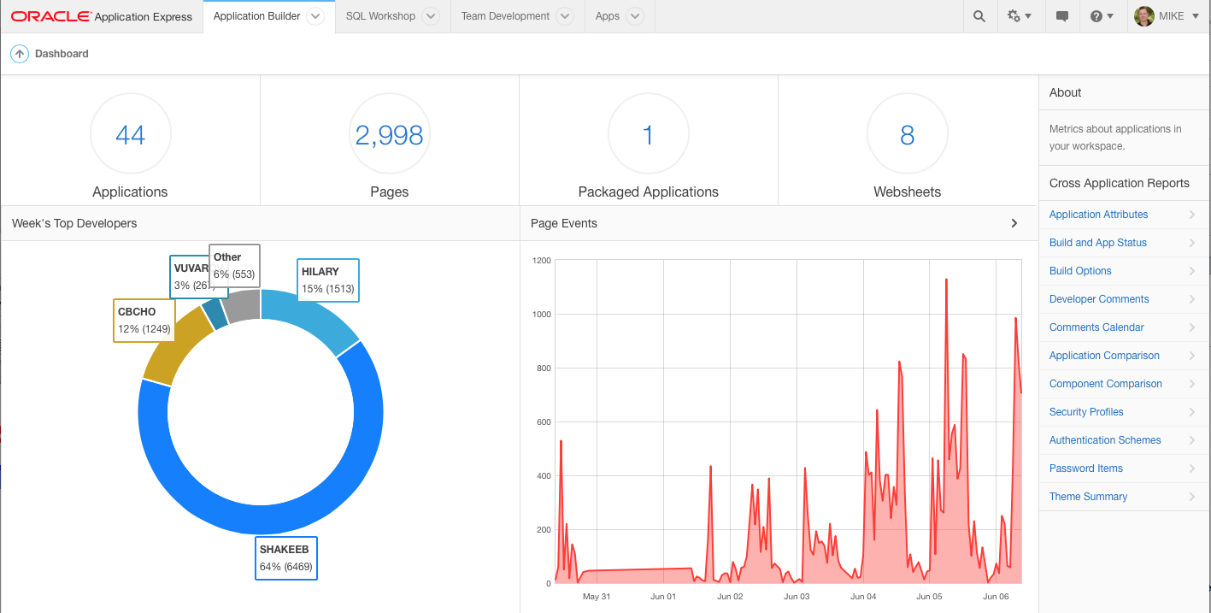
Oracle Application Express – Application Builder
Integrated Development Environment (IDE) with Application Development Graphical “Page Designer”
Features tight SQL and PL/SQL integration
Notes:
Developers will spend the majority of their time in the Application Builder defining, enhancing and maintaining applications.

Slide 29
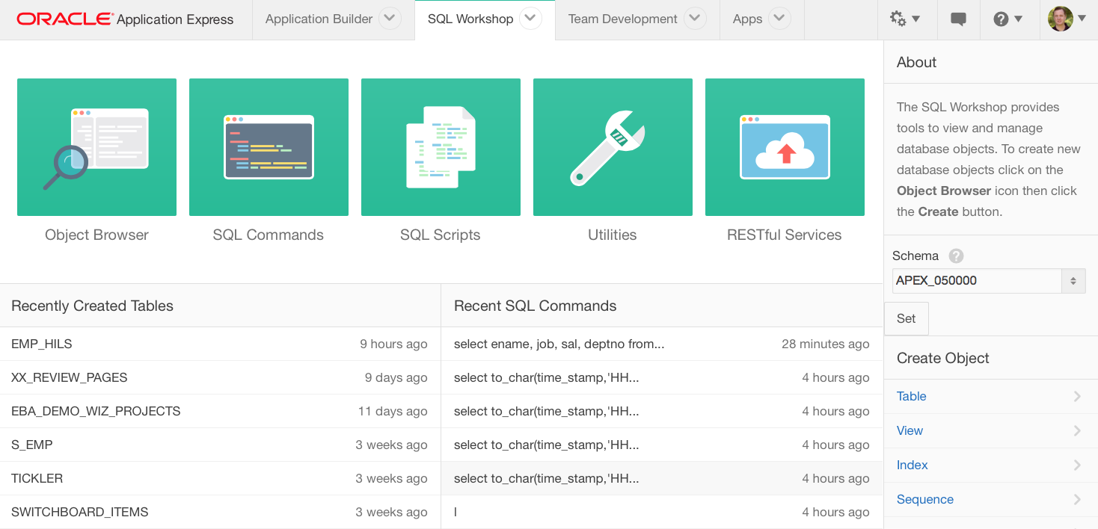
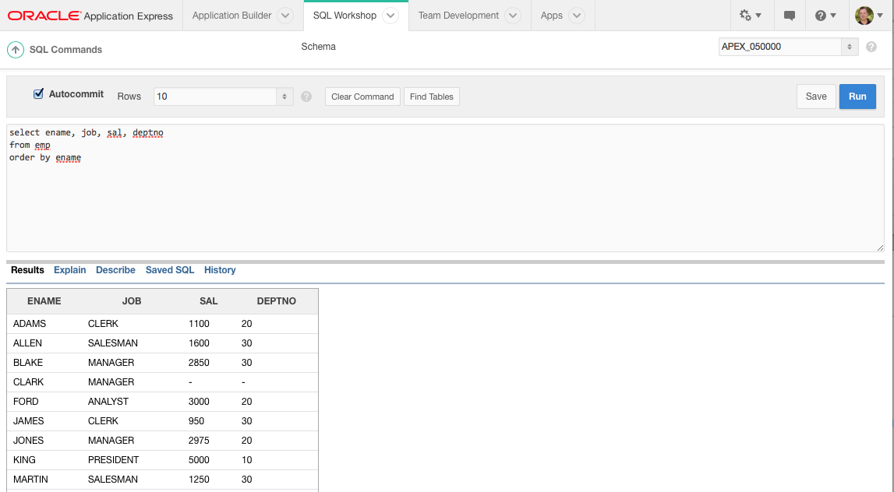
Oracle Application Express – SQL Workshop
Browser based maintenance of database objects and data
Designed to meet application developers’ needs, especially in hosted environments
Notes:
SQL Workshop is sometimes the only means developers can maintain DB objects as they may not have direct access to the schema(s) via SQL*Net, especially if they are using a hosted service.
The functionality available through SQL Workshop is a subset of SQL Developer and is designed specifically for developers to be able to maintain their DB objects.

Slide 30
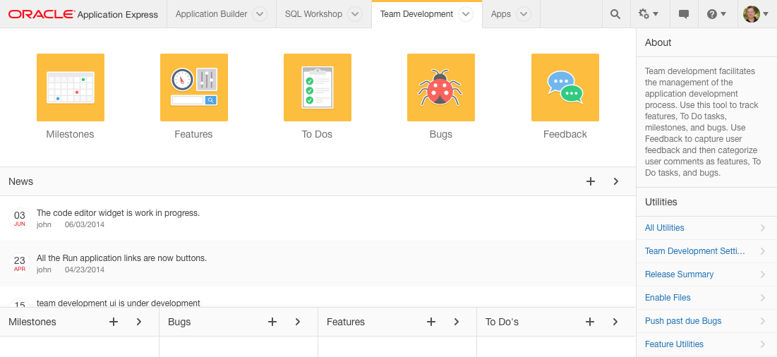
Oracle Application Express – Team Development
Collaborate with colleges, track project details with associations to application pages.
Life cycle development: design, develop, deploy, view customer feedback, enhance, re-deploy.
Notes:
Team Development provides the ability to manage the full lifecycle of your application development.
Features, To-Dos, and Bugs can be assigned to specific applications and pages.
Feedback allows developers to easily gather comments, enhancements, and bugs directly from their user community and includes important session state information to assist the developers with diagnosis.
Team Development is used extensively by the APEX Development Team to manage the development of new releases of Application Express which itself is built with APEX.

Slide 31
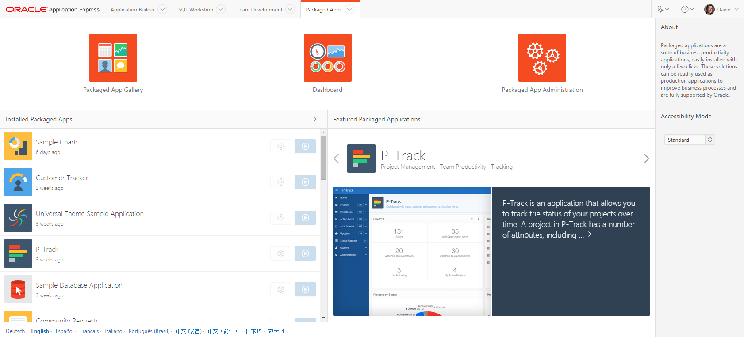
Oracle Application Express – Packaged Applications
Robust suite of productivity and sample applications.
Illustrates best practices and design patterns.
Template to start customization (e.g. unlock your packaged app).
Upgraded with every release.
Notes:
Install with just a few clicks and start using or “unlock” and customize to meet specific needs.
When “locked” then fully supported by Oracle Support and can upgrade as new releases made available.
Use the apps as learning tools to understand how to implement specific functionality and utilize within your own applications.
There are over 30 plug-ins across all of the apps which you can easily use in your own applications.

Slide 32
Application Builder > Page Designer
Powerful browser-based IDE
Multiple trees to view the page components
Visualization of the page within the Grid Layout, and associated Gallery, allowing you to drag and drop components
Update multiple attributes without leaving the page in the Property Editor
Highly configurable user interface:
  Customize and refine view of page specific to current focus
  Slideable panels
  Hide / show groupings
Notes:
Page Designer revolutionizes the way developers can enhance and maintain page definitions within Application Express.
The left panes has numerous trees to show the rendering, dynamic actions, processes and shared components.
The middle pane includes the Grid Layout and Gallery where you can easily drag and drop new components
The right pane holds the Property Editor where you can update any of the select4ed components’ attributes, without needing to bring up a separate page
For text sections used to enter SQL, HTML, CSS or text you can pop-up the Code Editor which includes find/replace, auto-completion and even SQL validation
There are numerous ways you can customize the user interface to make it easier to concentrate on the sections you are currently working on.

Slide 33
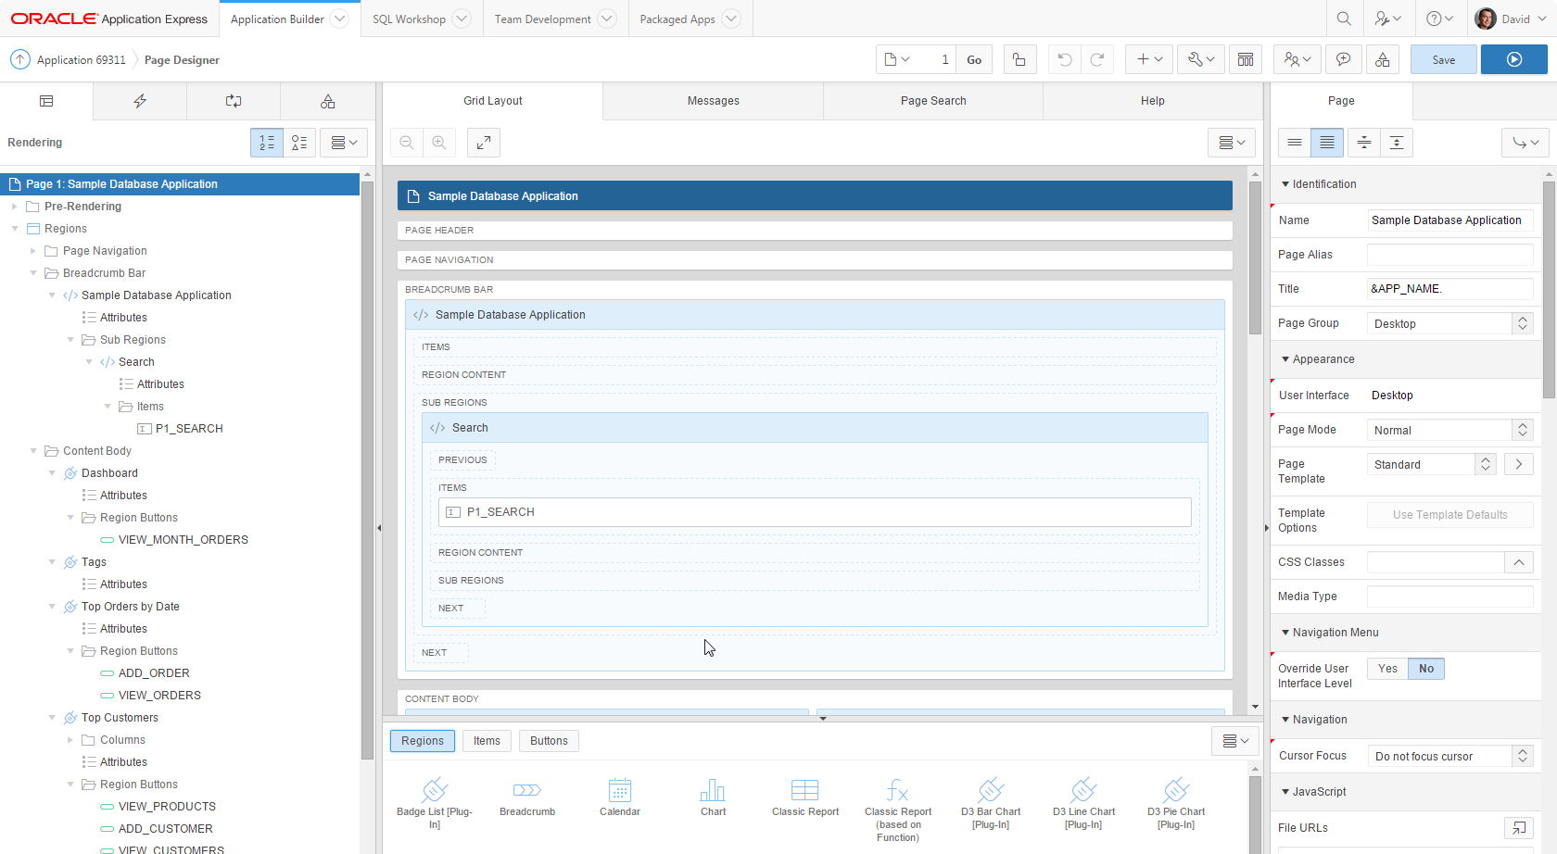
Notes:
Design Principles
Create new elements using drag & drop or menu shortcuts
Update multiple page elements at once
Utilize “Undo” and “Redo” to revert changes made
“Save” and “Run” commits all pending changes to database
Left Panel
Rendering, Processing and Shared Components grouped in an accordion in the left panel instead of horizontally across the page
Dynamic Actions introduced as a new grouping
Create, move and duplicate elements using drag & drop or the improved context sensitive menus
All element types can be deleted directly from the tree
Click on one or more elements to highlight elements in the Grid Layout and to populate common element details in the Property Editor
Central Panel
Grid Layout: Create, move, copy and delete components using drag and drop
Gallery: shows components that can be dragged into the page
Messages: Display errors and warnings associated with changes made
Page Search: Allows performing a page search.
Help: Displays context sensitive help based on the current focus
Property Editor - Right Panel
Displays the details for the currently selected element(s)
Bulk editing of common properties when multiple elements are selected
Improved usability for defining properties, including
instant input feedback
cascading context sensitive selections
easier definition of common property types
Improves productivity by making the definition of elements easier and more intuitive

Slide 34
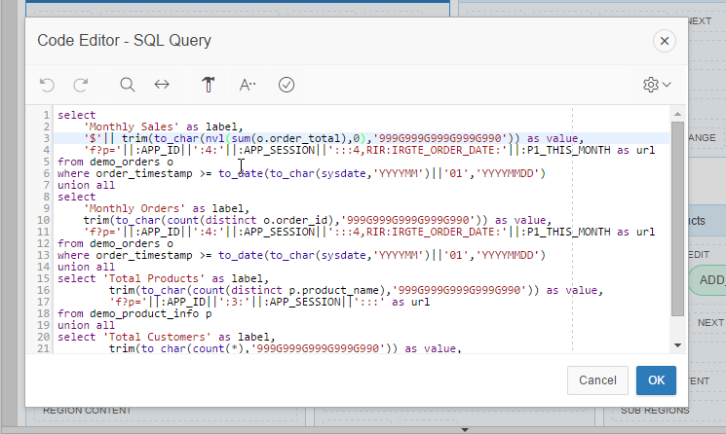
Application Builder > Code Editor
Available for maintaining SQL, PL/SQL, JavaScript, HTML, CSS, and large text sections
Syntax Highlighting
Undo / Redo
Find/Replace
Auto completion
Code validation
Used in Page Designer,
Component View and
SQL Workshop
Notes:
The Code Editor provides many of the features of advanced editors, such as syntax highlighting, undo and redo, and find / replace functions.
However it also includes ‘auto completion’ and ‘code validation’, which obtain valid database object names from the data dictionary of your underlying schema(s).

Slide 35

Universal Theme
Overview
New default theme for APEX applications
Uses responsive HTML5 templates
Grid-layout for HTML forms
Modern flat-look
Ships with a variety of pre-built theme styles
Older themes still available as legacy themes, and will remain part of the product for backwards compatibility
Notes:
Rather than having numerous themes with a large number of templates in each, there is just a single desktop theme and a consolidated number of templates.
With the Universal Theme it is now quicker and easier to build beautiful, responsive, elegant applications out-of-the-box.

Slide 36

Universal Theme
Template Options
Declarative CSS modifiers for HTML5 templates
Enables developers to declaratively apply styles
like borders, padding, icons, colors, size, etc.
Uses easy-to-understand, descriptive names
Available for most template types:
  Page, Region, Report, Breadcrumb, List, Item, Button
Significantly reduces the number of required templates for a theme
Notes:
Rather than having a large array of different templates, and developers needing to define new templates, to meet how a page is displayed - now you can declaratively select different template options to easily meet your layout requirements.

Slide 37
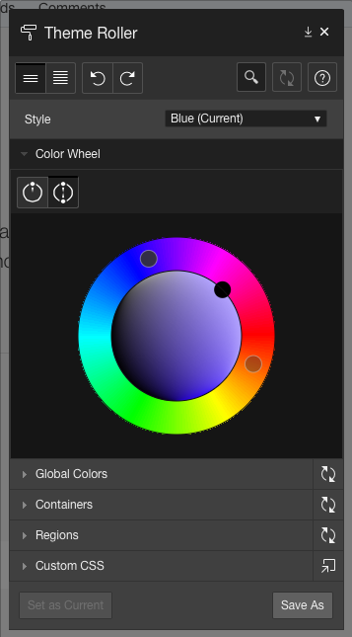
Universal Theme
Theme Styles and Theme Roller
Theme Styles provide a variety of different color schemes and styles for a single theme
Defined as CSS file that is included in addition to the theme’s base CSS file
Universal Theme includes several pre-built styles
Additional styles can be easily generated using the built-in Theme Roller utility
Notes:
Theme Styles allow a single theme to have various color schemes.
Developers can readily define different color schemes and modify certain display characteristics, such as button and item rounding using Theme Roller.
Hey can then readily save the style and apply it to their application without needing to write any CSS.
Developers can even allow end-users to select different styles as shown in P-Track Administration.

Slide 38
Features
Skip
Oracle Application Express
Notes:
Breakdown of major feature functions within APEX

Slide 39
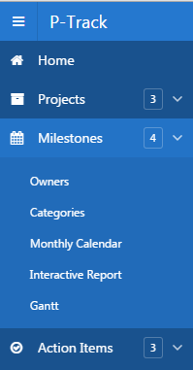
List-based Navigation Menus
Alternative to using traditional tabs
Available as top navigation menu and side menu
Implemented as standard APEX lists
Supports multi-level hierarchical menu structures
Provides accessible pull-down menus
Type of navigation determined by themes – Universal Theme uses lists
Older one-level tabs are migrated to lists when switching to the Universal Theme
Notes:
APEX 5 introduces the ability to define Navigation Lists
Multi level drop-down menus can be based on either static or dynamic lists.

Slide 40
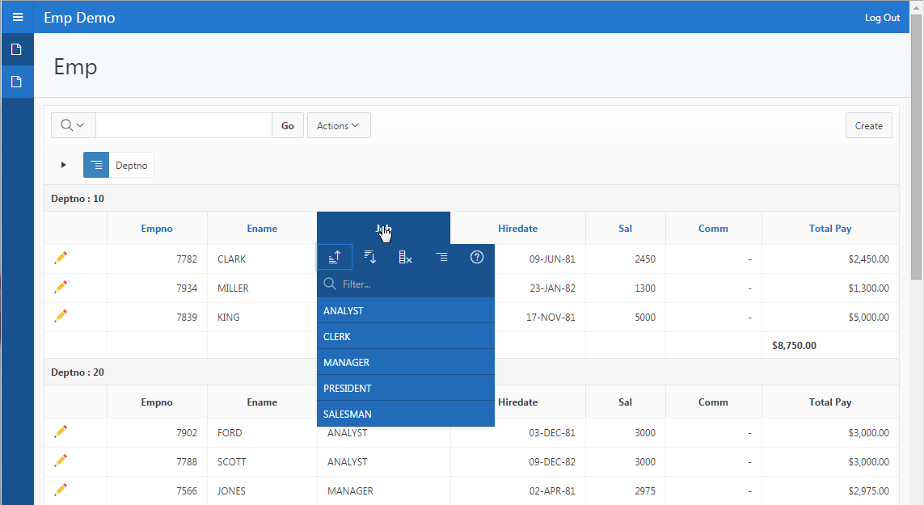
Interactive Reports
Powerful Reporting capabilities → End-user customizable
Notes:
Developers define the base report using a SQL statement.
Then end-user have can readily manipulate the data displayed to meet their own reporting requirements.
They can add filters, computations, aggregations, highlights and breaks.
End users can also define charts, group-by and pivot reports based on the data.
The Oracle Database option Audit Vault replaced 300 reports with just 30 Interactive Reports, yet provided a huge increase in reporting features.

Slide 41
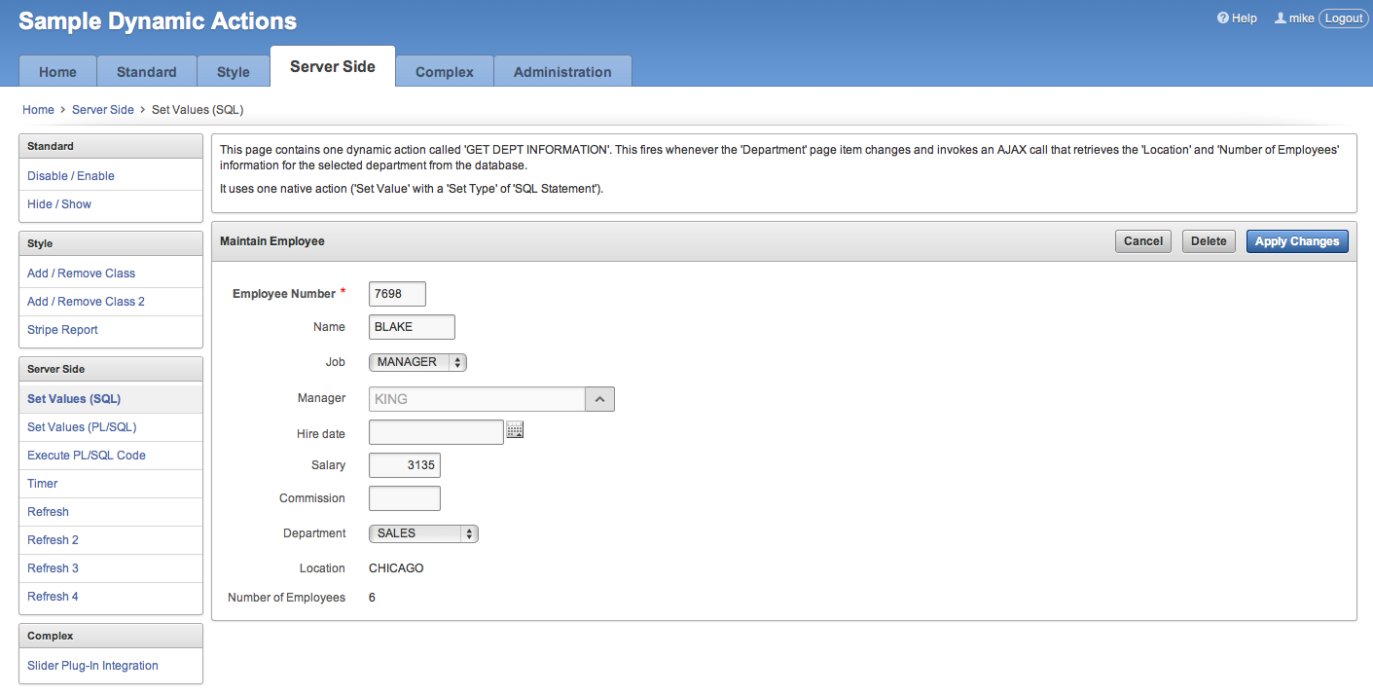
Dynamic Actions
Declaratively define rich client-side interactivity without writing JavaScript or AJAX
Notes:
Not every developer is an expert in JavaScript and AJAX, in fact the majority do not have that skillset.
However, Dynamic Actions allow anyone to *declaratively* define client side behaviors.
Rather than writing numerous lines of JS, developers can simply enter conditions, specify the actions, and then select the elements affected.
Behind the scenes the APEX engine generates the required JS and AJAX to implement the desired behavior.

Slide 42
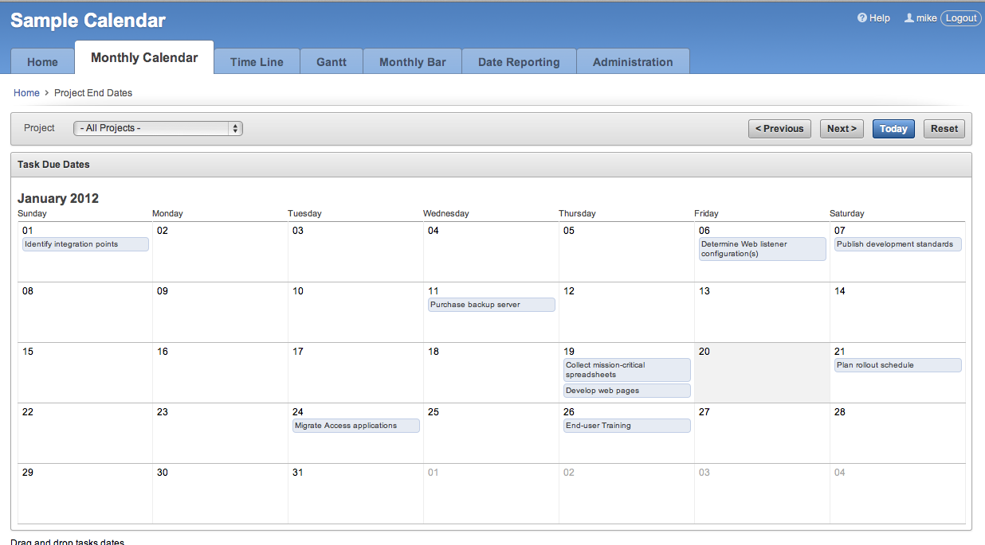
Calendars
Different views, drag and drop capability, with mobile specific templates
Notes:
The built-in Calendar region is based on FullCalendar.
You can define duration based events and use drag and drop to update the underlying table directly from the calendar.

Slide 43
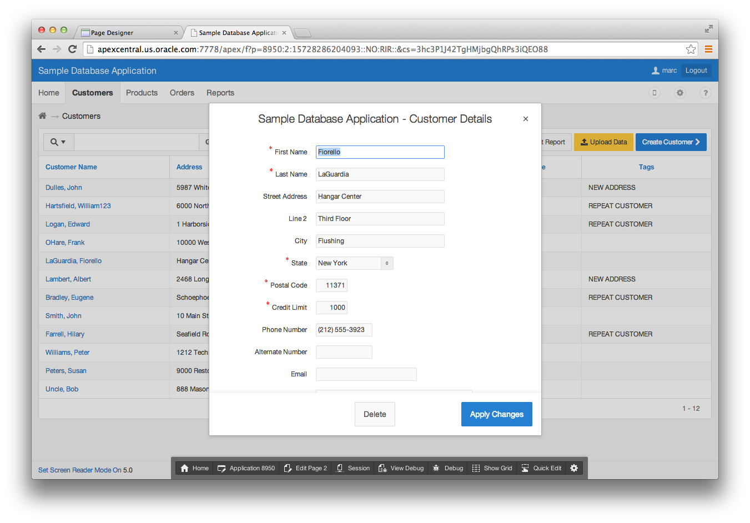
Modal Dialogs
Readily switch between normal, modal, and non-modal page mode
Replacement for Popup Windows
A modal dialog is a stand-alone page, not a region on a page
Supports all the functionality of a regular page, incl. computations, validations, processes, and branches
Notes:
Customizable dimensions and positioning
Dialog pages can branch to full pages (close dialog and standard branch) or to other dialog pages (e.g. wizard)
Dialog pages can open other dialogs (stacked dialogs)
Dynamic actions on parent pages created to refresh content after closing of modal dialog form

Slide 44
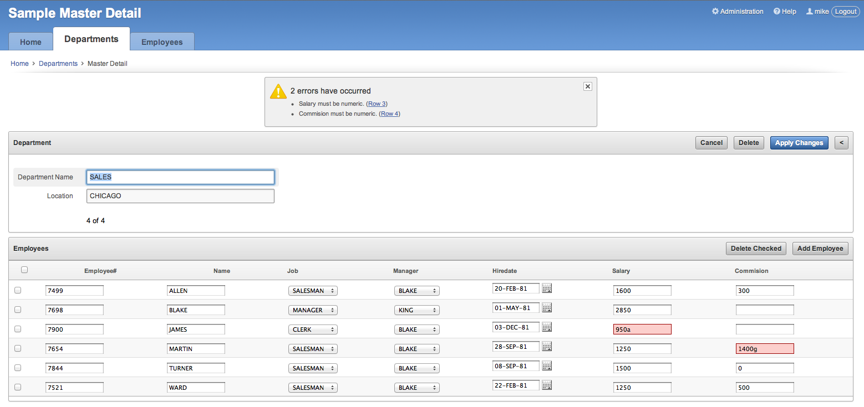
Master – Detail Forms
Combining a form (parent) and tabular form (child) with declarative validations
Notes:
Declaratively define Master-Detail pages.
The current Statement of Direction for APEX 5.1 includes the ability to extend this model to cover Master-Detail-Detail and Parent-Child-Grandchild relationships declaratively as well.

Slide 45
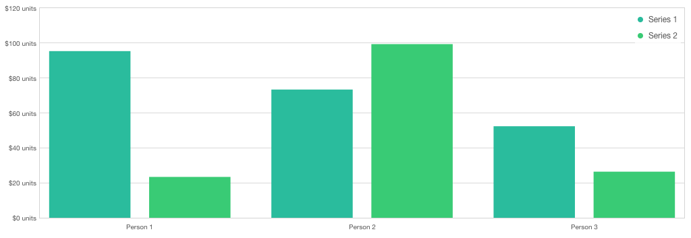
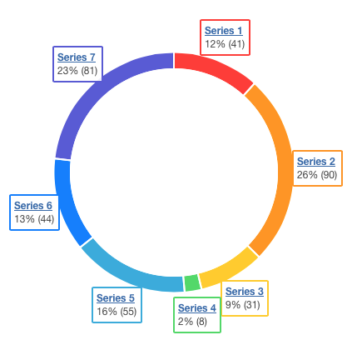
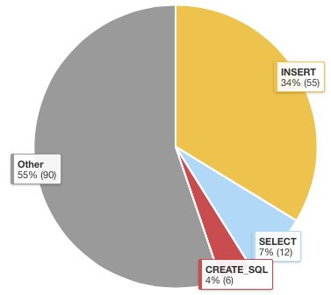
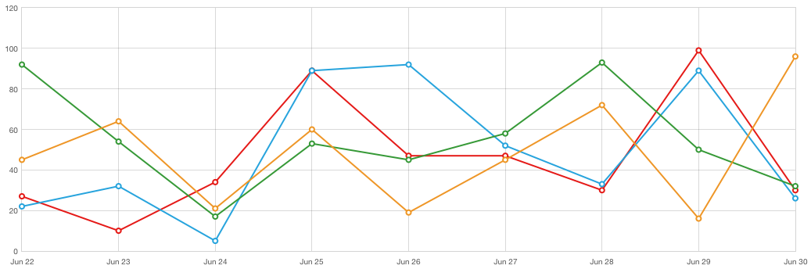
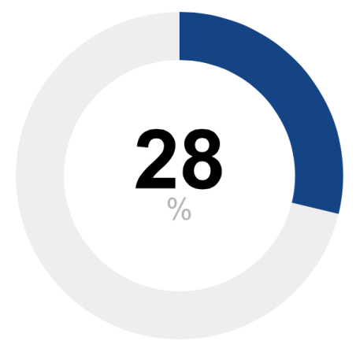
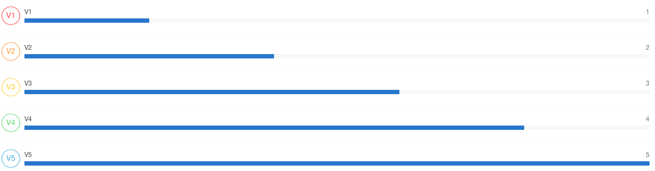
Charting
Large selection of chart types built with Flash, HTML5, or CSS3
Notes:
The built in charting capabilities are developed by AnyCharts and use “Flash-preferred” – If flash is not avilable, such as on an iPad, then they will render in HTML5.
For Mobile applications the AnyChart regions are always presented using HTML5.
There is also a range of different charting plug-ins available through the Packaged Apps.
Install the Sample Reporting Application to review the majority of these plug-ins and implement them into your own application as required.

Slide 46
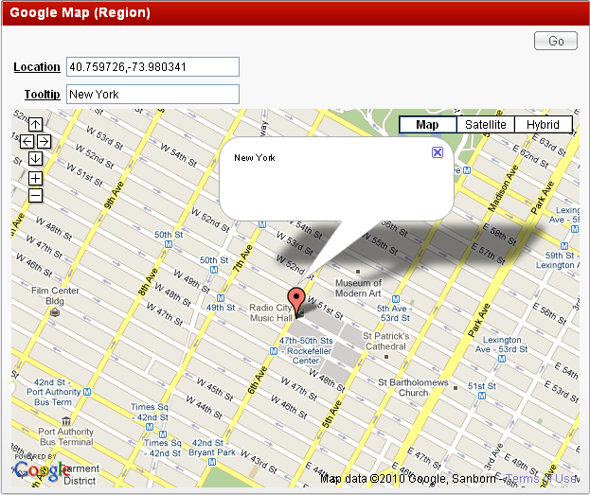

Plug-Ins
Extend applications with custom components such as items and regions
Notes:
Plug-ins allow you to readily incorporate custom item types, regions, authentication, authorization, and dynamic actions.
There are a number provided by the APEX Development Team, and over 150 developed by developers from the APEX Community.

Slide 47
RESTful Web Services
Emit RESTful Web Services from the database for use in your SOA environment
Interaction with data sources through
use of Uniform Resource Identifiers (URIs)
Ability to create services which implement any SQL statement or PL/SQL procedure
Data returned in JSON or CSV format, or additionally through PL/SQL
Standard method of accessing data in the Oracle Cloud
Notes:
For those using Oracle REST Data Services (ORDS) to serve their APEX Pages, then you can also use ORDS to emit Web Services from the Database.

Slide 48
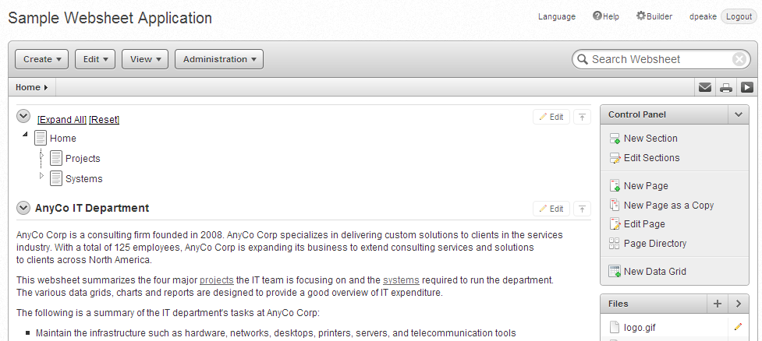
Websheets
Allow end-users to build / maintain WIKI like pages with database capabilities
  Database enabled WIKI
  Annotations
  (easily add files, links,
  notes, and tags)
  Use [[SQL ]] tag
  Presentation mode
  Multi user
Notes:
Websheets are similar to WIKIs in that they are designed for end-users to collaborate on content.
However, Websheets also includes the ability to define reports, and incorporate SQL that runs on the underlying Database schema(s).

Slide 49
Mobile Application Features
Skip
Oracle Application Express
Notes:
Details on APEX Mobile Applications

Slide 50

Mobile Development
Rapidly build Web-based Mobile Applications
Declarative support for building mobile web applications
APEX Applications support multiple user interfaces:
Desktop and Smartphone; Desktop only; or just Mobile
Mobile pages use jQuery Mobile through a
jQuery Mobile based theme and templates
Mobile Pages are lighter weight than Desktop Pages
Can respond to touch-based events
HTML5 charts and HTML5 item types
Notes:
Developers can build mobile Web-based applications just as easily as they can build Desktop applications from the Application Builder.
A single application can support both Desktop and Mobile user interfaces.
The jQUery Mobile framework allows APEX applications to run on any mobile browser and any size form factor
While desktop pages can be run on a mobile device the user experience is not always optimal.
Desktop pages are generally much heavier (= takes longer to load) and do not respond to touch events like tap , swipe and orientation changes
The Mobile UI includes numerous special HTML5 components such as Lists, reports, and even item sub-types

Slide 51
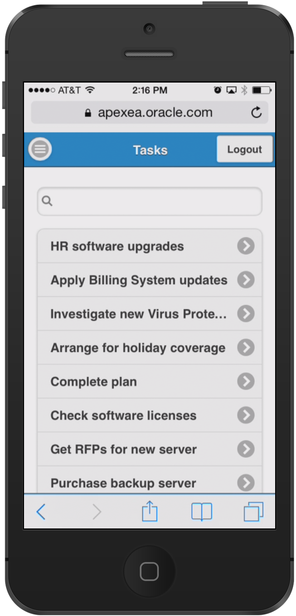
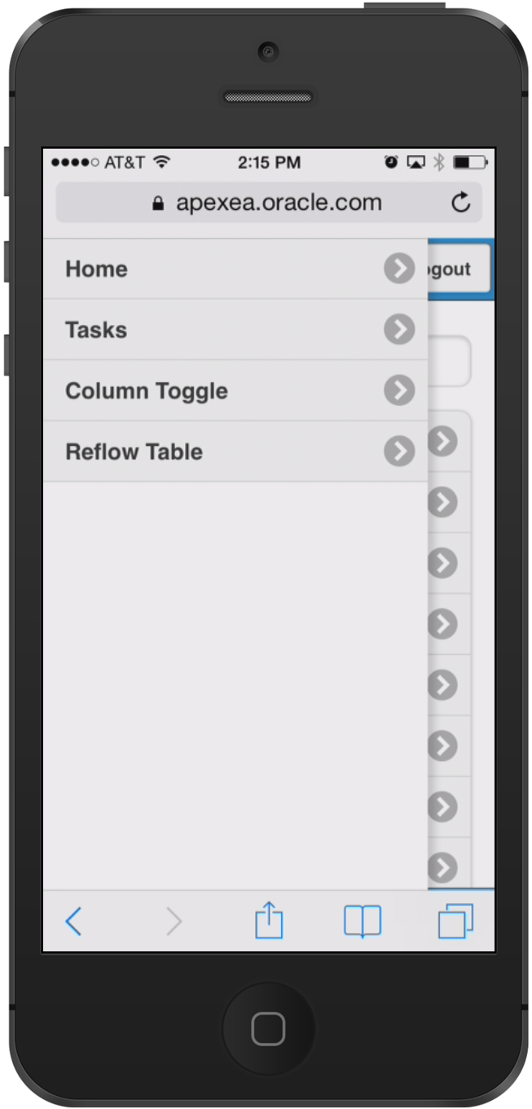
Mobile Navigation Menus and Slide Panels
All top level pages added to Navigation List
Navigation lists in Mobile apps are
implemented as menu panels
Shown on the left with menu button shown in top bar
Custom panels using “Panel” region template
Choice of display modes: Overlay, Reveal, Push
data-role="panel"
Notes:
Navigation Menus are displayed as Panels and take up minimal space

Slide 52
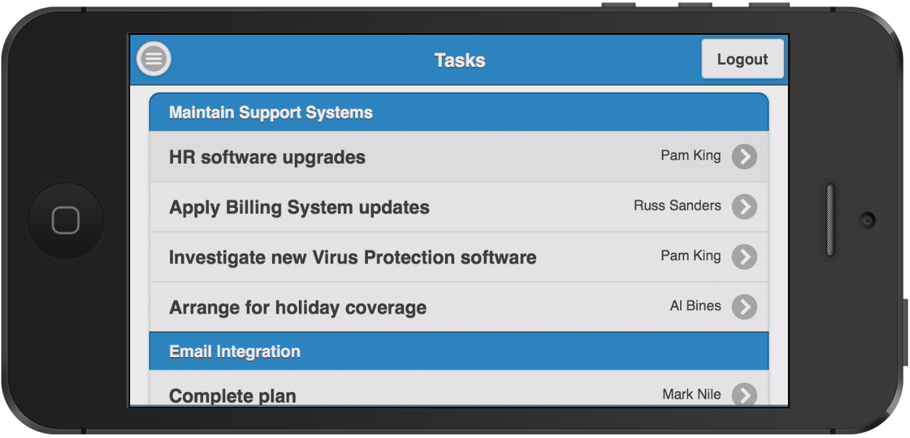
Mobile List View
Default View for data display,
navigation, drill-down view
Based on unordered list
Automatic Dividers
Custom formatting options
Declarative Search Options,
supporting server- and client side search
data-role="listview"
Notes:
List Views are very popular on mobile devices as show a small amount of information very clearly.
Also given each row is a suitable size it is easy to select the correct record with the primary pointing device on mobile devices = Index Finger

Slide 53
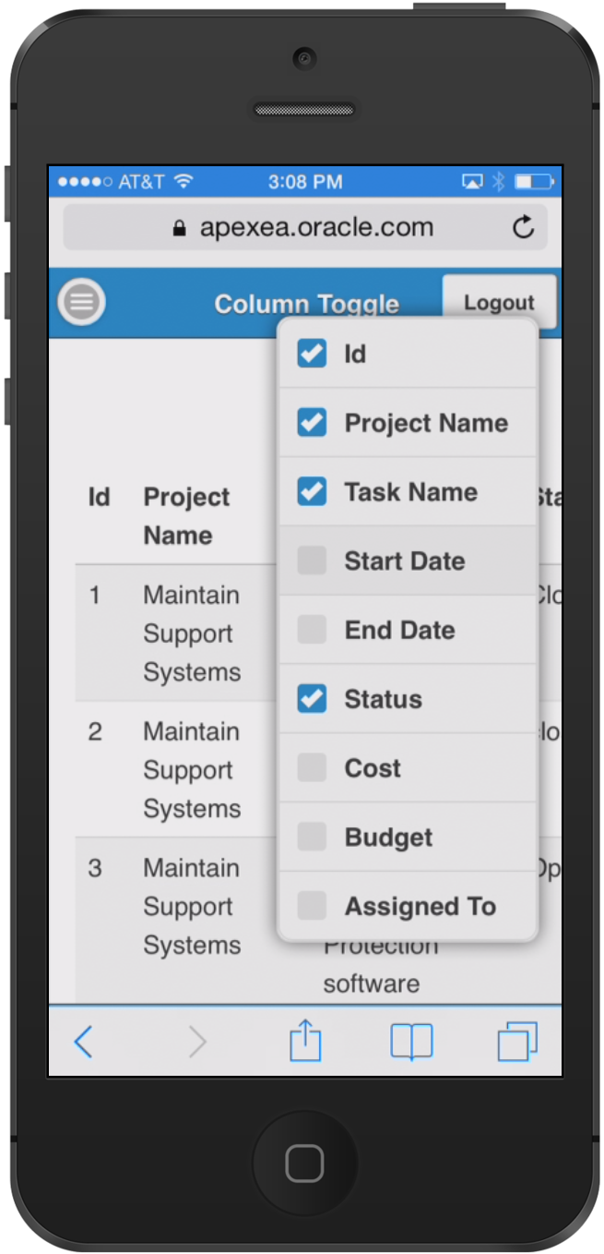
Mobile Column Toggle Report
Selectively hides columns at narrower widths
as a sensible default
Offers a menu to let users manually control
which columns they want to see
Column Toggle Popup contains a dynamically
generated list of columns based on the table markup
Developers can set column priorities (1 – 6)
Notes:
If run on narrow devices (cell phone in portrait) will generally only show some of the columns.
If same page run on tablet in landscape will show many more items.
Developers can define which columns disappear last (Priority 1) through to disappear first (Priority 6)

Slide 54
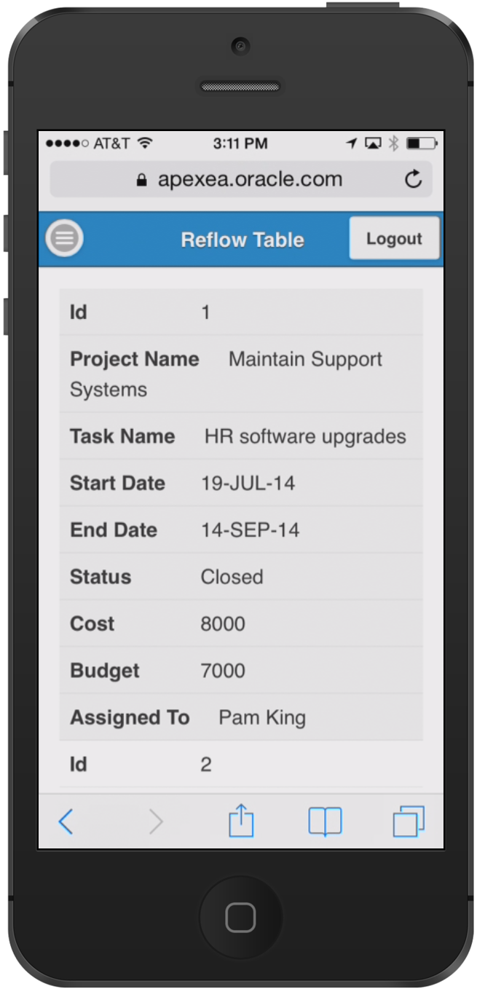

Mobile Reflow Table Report
Collapsing table data into label/data pairs for each row
Stacked presentation style default
Media query used to switch to tabular style
presentation above a
specific screen width
Notes:
If the display is too narrow to display the report data it will automatically switch to displaying multiple rows for each record so that users can still easily read each row on a narrow device.

Slide 55

Mobile Calendar
New Calendar Region type for Desktop and Mobile
Monthly-, Weekly-, Daily- and List View
Supports touch events
Customization through CSS
Notes:
The calendar page rendering is different between desktop and mobile user interfaces.
The mobile display closely mimics native calendars on mobile devices and are intuitive for end-users to use.
The blue dots indicate dates which have records.
Clicking on one of those dates lists the records below the calendar.

Slide 56

Using jQuery ThemeRoller with Mobile applications
Mobile theme provides a variety
of theme styles
Create custom styles using
Themeroller
Upload Themeroller file as
application or workspace files
Define new theme style using
your own Themeroller layout
Notes:
Application Express 5 only includes a single Mobile theme which is blue.
Using jQuery ThemeRoller developers can readily define new color schemes and implement them into their APEX application.

Slide 57
Security Features
Skip
Oracle Application Express
Notes:
Details on Security Features provided to help harden APEX applications

Slide 58
Browser Security Options
Browser Cache: prevent back button from showing old page content after logout (APEX 4.1)
Embed in Frames: prevent other apps from embedding and remote controlling your application (APEX 4.1)
Define custom HTTP headers at instance and application level (APEX 5.0)

Slide 59
Authentication and Authorization
Flexible authentication - change the authentication of the development environment itself - LDAP, SSO, HTTP Header Variable, etc. (APEX 5.0)
Authorizations and conditions for on demand processes (APEX 4.2)
Assign workspace groups to other groups (APEX 5.0)
Set group membership for session on login, including external groups
(APEX 5.0)
Is In Group authorization (APEX 5.0)

Slide 60
Improvements to avoid Cross-Site Scripting (XSS)
HTML Expression attribute for report columns with substitution support instead of concatenating strings in the query (APEX 4.1)
Restricted Characters attribute for items rejects malicious input (APEX 4.2)
More restrictive HTML-Escaping and APEX_ESCAPE API (APEX 4.2)
New escaping syntax, e.g. &P1_ITEM!JS. for fine grained control (APEX 5.0)

Slide 61
Instance Lockdown and Workspace Isolation
Limit emails (APEX 4.1)
Resource manager support (APEX 4.2)
Limit file uploads (APEX 5.0)
Limit debug output (APEX 5.0)
Limit concurrent requests per session and per workspace (APEX 5.0)
Limit workspace access by hostname (APEX 5.0)

Slide 62
Cryptography Improvements
Stronger session cookie (APEX 4.2)
SH-1/SH-2 for checksums (APEX 5.0)
Improved hashing algorithm for workspace user passwords (APEX 5.0)
New applications/forms are checksum protected by default (APEX 5.0)
Support DB 12c DBFIPS_140 mode (APEX 5.0)
  DBFIPS_140 enables Transparent Data Encryption (TDE) and DBMS_CRYPTO PL/SQL package program units to run in a mode compliant to the Federal Information Processing Standard ("FIPS mode”)

Slide 63
Pseudo Demo Flow: From Provisioning a Development Environment to creating and running an Application
Skip
Oracle Application Express
Notes:
If you are not giving a demo, or is this for non-technical audiences then this Pseudo Demo flow gives an idea of how easy it is to create, run and enhance apps.

Slide 64

1: Gain Access to an APEX “Workspace” aka Database Schema
Notes:
You do not need any client software – simply a web browser and URL to access the development environment and also to run applications

Slide 65

2: Create a new Application
Notes:
Once you are logged into the Application Builder you can quickly start building Web applications

Slide 66

3: Select the type of Application to Create
Application Builder - Create Application Wizard
Notes:
The most common choices are Desktop or Mobile applications.
Developers and “power-users” also use the ‘From a Spreadsheet’ to take a spreadsheet and generate a table in the Oracle Database and a report and form based on that new table.

Slide 67

4: Name your Application and add Pages
Application Builder - Create Application Wizard
Notes:
Within the wizard you can add any number of pages to your initial application design before generating the application

Slide 68

5: Confirm your selections and Press “Create Application”
Application Builder - Create Application Wizard
Notes:
All wizards include a summary screen you should check to ensure the details are correct before completing the wizard.

Slide 69

6: Application Generated → Edit or Run Immediately
Notes:
Once you complete the ‘Create App Wizard’ the application is available in Application Builder allowing you to enhance it further or run it immediately

Slide 70

7: Run the Application
Simply share the URL with end-users
Notes:
When you run an application it opens a new tab / window in your browser.
You can readily share that URL with the end-users together with their user credentials and they can start using the application.
End-Users also don’t require any client tools to run APEX applications just a Web browser.

Slide 71
8: Review the Data
Take advantage of the many built-in features, such as Interactive Reports
Notes:
The wizards generate many application components for you.
Interactive Reports are simple for developers to define – Simply enter a SQL Statement
Yet provide a range of capabilities for the end-user to manipulate the way the data is displayed.

Slide 72

9: Update the Data
… and easy to use Forms. {Note the Developer Toolbar}
Notes:
The forms generated include all the enterable columns and additional capabilities such as date pickers for date columns and built-in validations for number columns.
The Developer Toolbar is not displayed to end-users, but only to developers who run the application from the Application Builder.
This toolbar allows developers to readily jump back into the application definition, review the session state data, or debugging information, or even initiate Theme Roller where they can change the color scheme used in their app

Slide 73

10: Enhance the Application
Iterate → Run → Review → Repeat
Notes:
From the Developer Toolbar a developer can readily jump directly back into a specific page, make some changes, and then run the page again.
They don’t need to generate or compile any files – just edit > run > review > repeat as often as necessary

Slide 74
Leveraging Oracle Database Features
Skip
Oracle Application Express
Notes:
Given Application Express lives inside the Oracle Database it can readily utilize other Database features

Slide 75


Oracle Application Express (APEX 5)
Security features of the Oracle Database
Works with APEX
Transparent Data Encryption
Database Vault
Audit Vault
Database Firewall
Key Vault
Data Redaction
Data Masking
Auditing
75
Notes:
Oracle Database 12c provides multi-layered security spanning preventive, detective, and administrative controls. This includes transparent data encryption, data redaction, data masking, privileged user controls, privilege usage analysis, conditional auditing and real application security. Combined with Oracle Audit Vault and Database Firewall, Oracle Database 12c provides unprecedented controls to help organizations address existing and emerging security and compliance requirements.

Slide 76

Oracle Database as a Service
High Availability features of the Oracle Database
Works with APEX
Real Application Clusters
Data Guard
Active Data Guard
Golden Gate
Secure Backup
Online Reorganization
Edition-Based Redefinition
Flashback, Total Recall
Automated Rolling Upgrade of Database
Failover to the Cloud
76

Slide 77






Oracle Application Express (APEX 5)
High Performance features of the Oracle Database
Works with APEX
Multi version read consistency
Row level locking
In-Memory
Compression
Partitioning
Hadoop, Big Data SQL, R
Cost based query optimizer
Scale-out with Oracle RAC
Exadata Smartscan & Infiniband
77

Slide 78




Oracle Application Express (APEX 5)
Simplified consolidation and deployment with Oracle Multitenant
Works with APEX
PDB Deployment
PDB Cloning
PDB Self Service App
PDB Migration
High Density Consolidation
Automated Provisioning and Configuration
PDB Resource Management
78
Notes:
A new feature of Oracle Database 12c, Oracle Multitenant, delivers a new architecture that allows a multitenant container database to hold many pluggable databases (PDBs). An existing database can simply be adopted with no application changes required.

Slide 79



Oracle Application Express (APEX 5)
Database Application Development Features
Works with APEX
SQL and PL/SQL
Java in the Database
Analytics
Text
Regular Expressions
Spatial
Pattern Matching
Database XML
SQL
PL/SQL
Database JSON
AQ
79

Slide 80
Examples of how Oracle uses Oracle APEX
Skip
Oracle Application Express
Notes:
Application Express is critical to Oracle’s own business practices.
The following are some of the examples of how APEX is used by Oracle itself.

Slide 81

Oracle Store [Internet Application]
http://shop.oracle.com
Notes:
The Oracle Store and Partner Store [http://partner.oracle.com] are two great examples of APEX applications running on the Internet.
The Oracle Store handles orders for over 150 countries and can be shown in 13 languages.
When you choose a country different business rules are invoked within the ordering process.
The APEX application interfaces with over 12 major back-office systems such as Manufacturing & Distribution, Marketing, EBS, etc.

Slide 82

Oracle Learning Library [Internet Application]
http://www.oracle.com/oll
Notes:
The Oracle Learning Library provides a wealth of training collateral for Oracle customers.
The application includes an extensive set of administrative screens to allow content owners to upload and maintain various types of content and links.

Slide 83

HR Directory [Internal Only – Intranet Application]
ARIA People
Nightly download of HR data
Employees can update profile, upload picture, add links ...
Used to contact employees, see Org. Chart, etc.
Average ~ 1.5 million
page views / day
( > 50 page views / sec for hours )
Median execution time of
0.04 seconds
Notes:
Arguably one of the most used applications within Oracle – this APEX applications allows any Oracle employee to search the organization to find contacts, etc.

Slide 84

Oracle Application Express – Success Story
ORACLE TEAM USA
Portals and Mobile Solutions
“Sailors have access to an Oracle Application Express–based mobile app that automates the 250-item checklist necessary to prep the boat for sailing. “It’s a perfect use of database and mobile technology,” says Burns. “Oracle Application Express is really a powerful tool for widespread mobile data access.”
Ian “Fresh” Burns
Design Team Coordinator
Oracle Team USA
Notes:
Since Oracle first started an America’s Cup team with BMW Oracle Racing right thru to the latest ORACLE TEAM USA which successfully defended the America’s Cup In SF (2104)
Application Express has been used extensively by the teams to help manage the large volumes of data, and complex processes, they deal with to race these high performance yachts.
http://www.oracle.com/technetwork/issue-archive/2013/13-sep/o53oracle-teamusa-1996101.html
http://www.oracle.com/us/corporate/customers/customersearch/oracle-team-usa-1-exadata-cs-2076612.html?ssSourceSiteId=otnen

Slide 85
Customer References
Skip
Oracle Application Express
Notes:
The following provides just a few of the many customers who are using APEX to gain competitive advantage

Slide 86

Customer Reference
ACGI Software
Software as a Service
40 major Cloud based products including: Membership, Events, Subscriptions, Fundraising, Certification, and Bookstore
420,000 distinct users last year
Run 70+ production databases
Primarily for professional and trade associations
Based in USA

Slide 87


Customer Reference
CampusIT (Ellucian)
Higher Education
Commercial application
Hosted solution for students, academics and administrators
Deployed on Oracle Real Application Clusters (RAC)
> 400,000 users
Based in Ireland / USA

Slide 88

Customer Reference
Cornerstone Brands
Call Center Application
Migrated from client-server based solution
Portfolio of magazines
> 800 call center operators
Reduced training from weeks to days
Improved UI design led to faster call handling
Increased up-sell from dynamic pop-ups
Based in USA

Slide 89

Customer Reference
Purdue Pharma
Custom ERP & Mobile
Built bespoke ERP / CRM system for their sales organization
Maintain customers, review sales , and place orders
> 600 mobile users
Running on iPads and Laptops
Based in USA

Slide 90

Customer Reference
Worldwide Express
3rd Party Logistics Provider
Ordering / Tracking / Billing system
      For Customers & 100+ Franchisees
      300 Reports
Internal AR, CRM, Freight Desk system
Complex billing engine built in 3 months
20,000 transactions / day
Work with 50 trucking carriers, including UPS
Based in USA

Slide 91

Customer Reference
Farwest Steel
EBS Extension
Extended E-Business Suite (EBS)
Stand-alone application for quoting and order entry of complex engineer-to-order assemblies
Salesmen log into APEX not EBS
Tightly integrated with EBS for BOM, routings, workorders, invoicing, and security
Based in USA

Slide 92

Customer Reference
Northgate IS
Public Sector Applications
Oracle Forms based solution was losing competitiveness
Migrated 3,500 Oracle Forms to Oracle APEX
> 5,000 APEX pages
Market Leader (170+ local authorities, > 10,000 end users)
Numerous commercial applications, including: Housing, Revenue and Benefits, EU Blue Card, HGV Road Levy
Based in UK

Slide 93

Customer Reference
Yellowstar Solutions
Logistics Application
Large complex commercial application
Desktop and Mobile solution
Primarily for the trucking industry
Manages payloads, billing, and customer management
Based in The Netherlands

Slide 94
Summary
Oracle Application Express
Notes:
Closing Summary / key take-aways

Slide 95
Oracle Application Express
Summary
Used by real customers for real applications: Used for both opportunistic and mission critical apps that service tens of thousands of users.
Well Established Product : First released over 10 years ago
Continually growing: Oracle install base is adopting Oracle Application Express for increasing numbers of projects, and is increasingly an approved corporate IT standard.
Notes:
Used extensively; with a long successful history > 10 years-old
Rather than being a tool that grows from the ground-up thru developer word-of-mouth, increasingly Corporate Architects are using APEX as a strategic tool being pushed down to their development communities

Slide 96
Oracle Application Express
Summary
Aligned with industry trends: Strong support for HTML5 development frameworks, Modern & responsive CSS3 UI, integrated JavaScript libraries, Browser-based, self-service provisioning, flexible development and deployment including cloud services.
Consistent with Oracle developers skill set: SQL, PL/SQL, Oracle Database.
Proficiency in the Oracle database easily translates into an ability to develop web applications.
Notes:
Given APEX is released approximately once a year, as new trends arise, APEX can quickly adopt these best (proven) trends
Most organizations have sizable teams of developers with SQL / Oracle Database skills.
These people can readily start building APEX applications given how easy and quick it is for them to learn how APEX works.

Slide 97


