Slide 1






Cover Oregon
HIX Delivery Metrics
April 16, 2013

Slide 2
Overall Status
Updated: April 16th, 2013
R
Area | Status | Comments
i17 Development | R | Velocity slowed this week, trending at 51% against target of 71% for 4/30 (72% of goal). Causes: 1) No longer stubbing interfaces, changes have a greater impact, more thrashing, 2) Changing requirements – external data, interfaces Freeze on Changes as of 4/10.
Change Control | Y | 86 Changes to-date
Issue/Defect Mgmt | Y | 276 Total Issues (15 Blockers, 100 Critical)
HIX Scope/Delivery Issues/Items Causing Delay:
Interface testing taking up a lot more time than anticipated due to state of delivered interfaces.
Account Management - developing off of process flow vs. fully documented use cases.
“Shaking and Baking the Requirements” session scheduled for 4/18.
Interface hand-off process implemented - need to drive compliance to the process

Slide 3
Delivery Status (continued)
Updated: April 9th, 2013
R
Reminder - Core 4/30 scope includes the following:
  EE (minus tribal members, minus Medicaid)
  SHOP (employer & employee)
  AM (minus authorized users)
  PM (minus dental plans, minus carrier verification and dashboard)
  Any FM we can accomplish
  Any CS we can accomplish

Slide 4
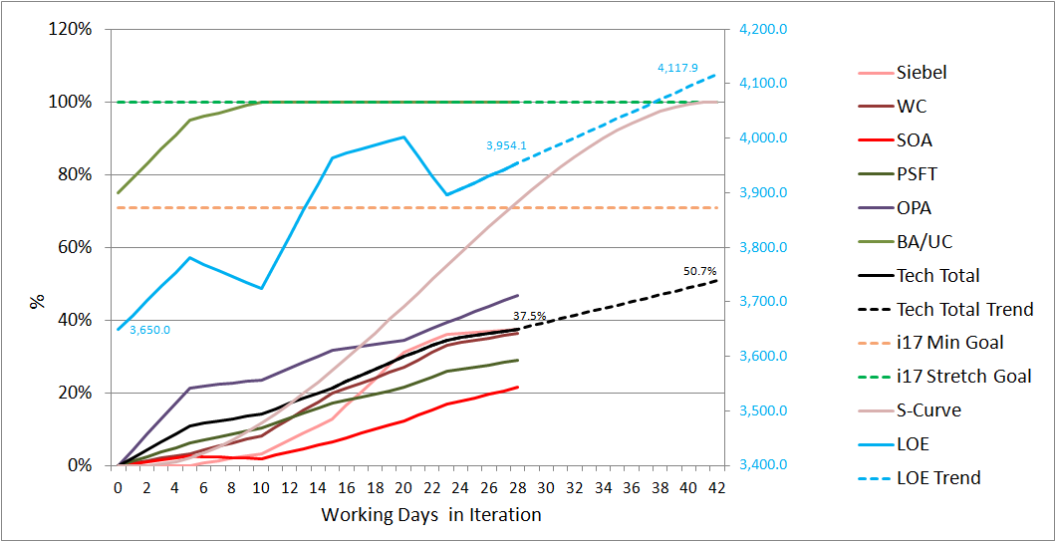
Development Velocity
Updated: Data as of April 10, 2013
R
i17 LOE Velocity only
LOE changes due to discovery during development, CRs
Working on additional views

Slide 5
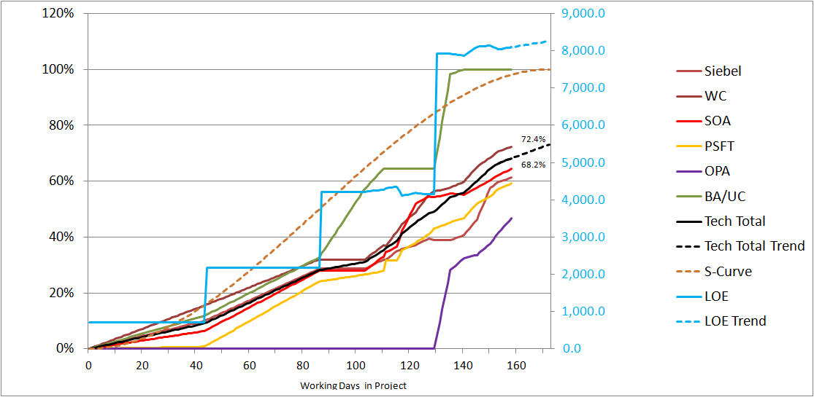
Development Velocity
Updated: Data as of April 10, 2013
R
Consolidated LOE (i14 to i17)

Slide 6
Functional Area
Updated: Data as of April 14 , 2013
R
Percent Complete by Functional Area (4/14/13)
Functional Area | LOE | LOE Complete | % Complete
Account Mgt | 194.04 | 106.61 | 54.95%
Community Partners | 245.46 | 66.73 | 27.19%
Customer Service | 513.09 | 296.83 | 57.85%
Eligibility | 678.72 | 364.10 | 53.65%
Enrollment | 449.06 | 255.86 | 56.98%
Financial Management | 1763.12 | 1078.10 | 61.15%
Plan Mgt | 426.22 | 224.56 | 52.69%
SHOP | 1625.84 | 1163.50 | 71.56%
Tribal | 413.09 | 351.02 | 84.97%
Global | 592.79 | 447.08 | 75.42%
All Functions | 6901.41 | 4354.40 | 63.09% *
* Should be at 68.2% - analyzing the calculations

Slide 7
Change Control
Updated: April 15th, 2013
Y
Freeze as of April 10 for 4/30 delivery.
Processed 8 new change requests: 7 Major and 1 Minor
1 Major request covers multiple Account Management process flows used in lieu of complete use case packages; the use cases packages are still to be delivered
Total
Changes:
Type | Status as of 4/15 | Previous Week | WoW Change
Major | 56 | 49 | +7
Minor | 30 | 29 | +1
TOTAL | 86 | 78 | +8
Artifact | Status as of 4/15 | Previous Week | WoW Change
Use Case Doc | 51 | 47 | +4
BRD | 16 | 15 | +1
Data Def Doc | 16 | 14 | +2
UI | 34 | 33 | +1
Types of
Changes:
JIRA ticket resolution requiring changes to UCs, etc. and
Changes coming through Scope Management Meeting.
7

Slide 8
JIRA/Issue Status
Updated: April 15th, 2013
Y
JIRA clean-up continues – meeting with BA’s, improving reporting process
Includes FS tickets
Issue Count By Area
Issue Count By Age
Type | As of 4/15 | Prev Week | WoW Change
Blockers | 15 | 14 | +1
Critical | 100 | 98 | +2
Major | 128 | 143 | -15
Minor | 33 | 31 | +2
Trivial | 0 | 0 | 0
Total Open JIRA | 276 | 286 | -10

Slide 9
Appendices

Slide 10
Issues/Risks Log

Slide 11
I-17 Dev Prioritization
Direction Guidance
AM
PM
TIME
Top to Bottom
Left to Right
Some parallel
FM
(Psft)
CS
Lower
priority
EE
SHOP
TP
Eligibility
Employer
Entity
Plan Selection
Employee
Enrollment
Change in Circumstance
Tribal Member
Medicaid
CP

