Slide 1
Building Low-Code SaaS Extensions with Oracle APEX
Integration, the Fusion Apps REST Catalog & Enterprise Best Practices

Slide 2
Safe harbor statement

Slide 3
01
Why extend Fusion with APEX
02
Architecture & what's new
03
Connect APEX & Fusion
04
FA REST Catalog
05
Enterprise best practices
06
Use cases & takeaways

Slide 4






THE NEED
Why Do We Need FA / SaaS Extensions?
Industry-specific needs
Custom workflows
UI enhancements & dashboards
Regulatory changes
Reporting & analytics
ML & custom LLMs
4
Copyright © 2026, Oracle and/or its affiliates

Slide 5



THE CONCEPT
What Are APEX Fusion Extension Applications?
Seamless Fusion integration
Oracle Fusion Cloud Applications
HCM • ERP • SCM • CX - existing apps & business data
Single Sign-On (SSO)
REST APIs + SSO
Ready-to-use applications
Oracle APEX Extension Application
Custom dashboards, workflows, reports - low-code, secure
Fusion security enforced
5
Copyright © 2026, Oracle and/or its affiliates

Slide 6
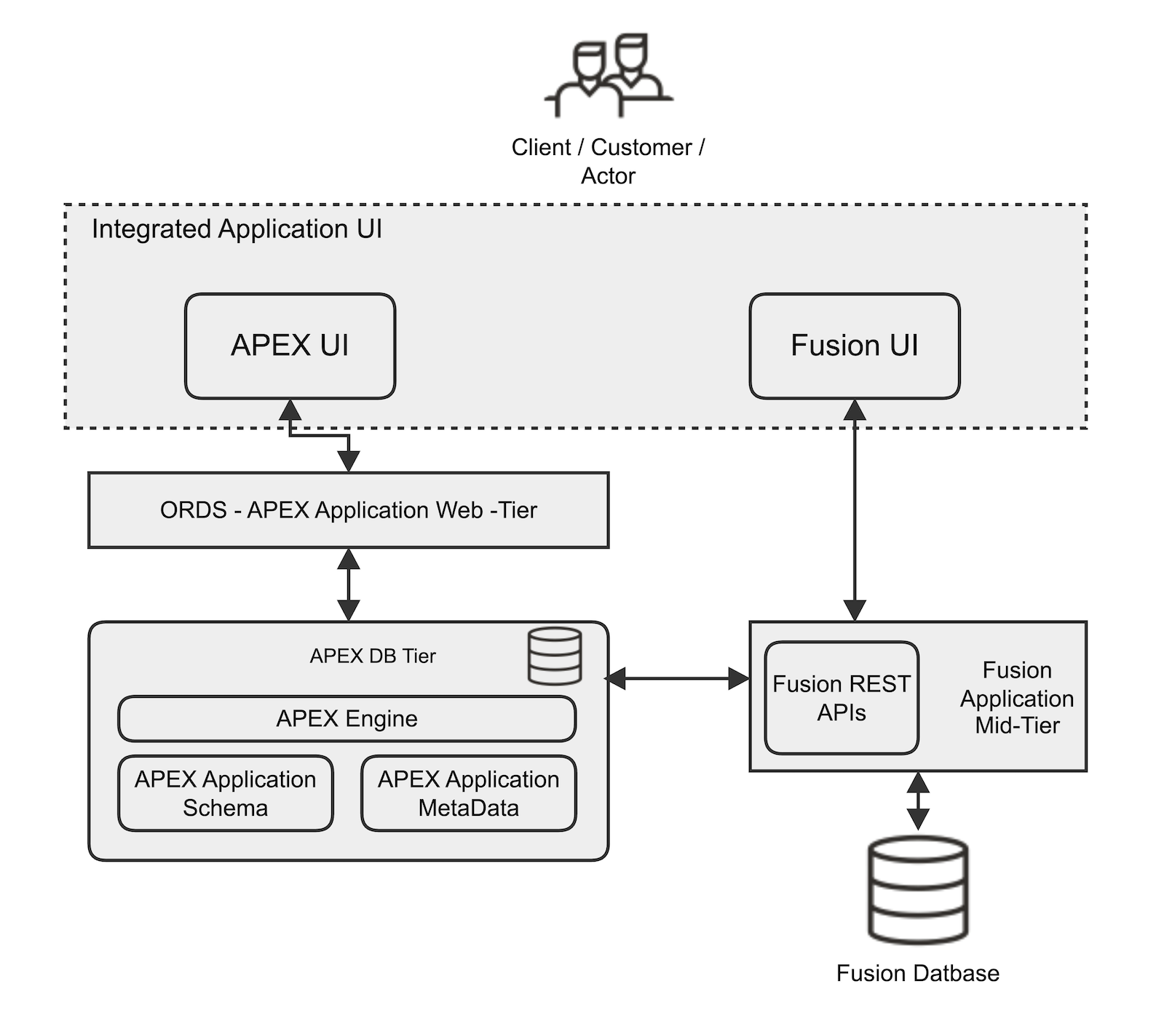
ARCHITECTURE
Fusion Application Extension Architecture
Deployment Topologies
Oracle Database and Fusion in the same OCI region in Oracle Cloud
1
Oracle Database and Fusion Applications in different OCI regions
2
Oracle Database on-premises
3
Oracle Database in a third-party cloud
4
Reference OCI services: OCI IAM • OCI GenAI • Object Storage • Autonomous Database

Slide 7


PLATFORM CAPABILITIES
What's New in Oracle APEX 24.2 for Fusion Cloud Apps
Integrate APEX with Fusion Applications
Fusion Integrated Starter App
Oracle Cloud Apps (BOSS) REST Service
Sample Utility App

Slide 8
GETTING CONNECTED
SaaS Extensions Made Easy - 3 Simple Steps
1
Establish a Database Connection
2
Integrate APEX with Fusion Applications
3
Create a Starter Application
Connect your APEX-hosted database with the SaaS OCI PaaS tenancy
Create the connection between the database connection & your Oracle SaaS instance
Generate a Fusion-integrated starter app in APEX
Developer Services > Database Tools > Connections
Connections > More Actions > “Integrate APEX with Fusion Applications”
App Builder > Create App > “Create Fusion Integration”
What happens behind “Integrate APEX with Fusion Applications”?
IDCS client application
(with OAuth)
Database
credential
Synonym created &
execute access granted
Auth scheme
attributes updated

Slide 9
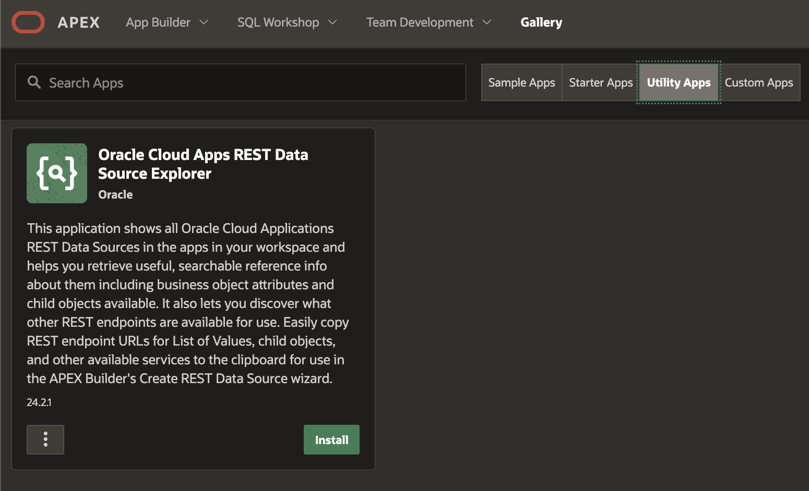
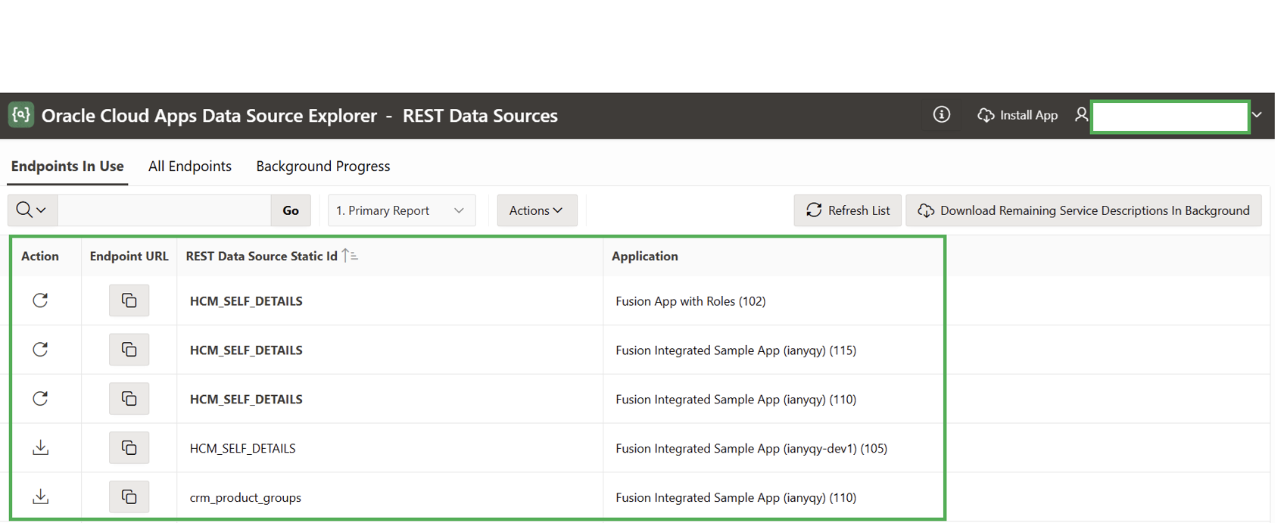
OPTIONAL TOOLING
Sample Utility App - REST Data Source Explorer
Gallery > Utility Apps > Oracle Cloud Apps REST Data Source Explorer

Slide 10


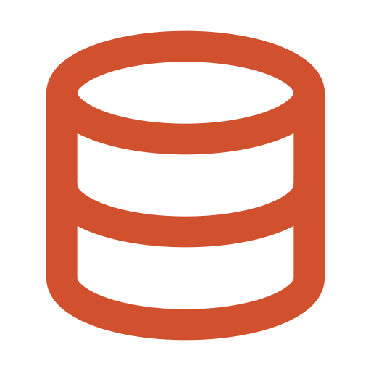
FASTER EXTENSION DEVELOPMENT
The Fusion Apps REST Catalog
Import Catalogue
Pick APIs
Create REST Data Source

Slide 11
ONE CENTRAL SWITCH
Flexible Remote Server - Point at Your Fusion Host
1
Edit the Remote Server
procedure my_server_config(
p_info in apex_plugin.t_remote_server_info,
p_config out apex_plugin.t_remote_server_config )
is
begin
p_config.base_url := 'https://{YourFusionHost}';
end;
2
Add the PL/SQL block
3
Repeat for the authentication server
Verify the REST Data Source afterwards to confirm it operates against your Fusion environment as intended.

Slide 12
BUILDING FOR THE ENTERPRISE
Best Practices for Fusion Extensions
Connecting APEX to Fusion is the easy part. Building extensions that stay secure, perform at scale, and survive every Fusion upgrade takes discipline.
Design principles • Integration & security • Performance & operations • Development standards
• AI patterns • Anti-patterns

Slide 13

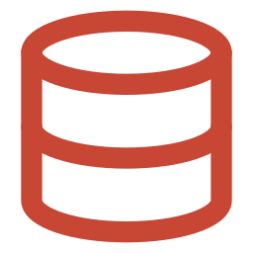



BEST PRACTICES - FOUNDATIONS
Design Principles & Data Strategy
Extend, don't customize
Fusion is the system of record
Loose coupling
Modular services
Data strategy: cache reference data only. Look-ups, codes, and hierarchies can be cached locally for speed - but avoid copying HR, Payroll, or Finance transactions into the extension. Transactional truth stays in Fusion; where local storage is unavoidable, protect it in the database (e.g. VPD).

Slide 14

BEST PRACTICES - CONNECTIVITY
Integration & Security
Integration best practices
Security checklist
REST first
OCI IAM / IDCS
OAuth 2.0 everywhere
OAuth for every call
Retry logic
Web
Pagination
Authorization Schemes
Logging
Audit

Slide 15



BEST PRACTICES - RUN AT SCALE
Performance, Scalability & Operations
Performance
Scalability
Operations
Background jobs & batch APIs
Stateless apps
Monitoring
SQL tuning
Connection pooling
Centralized logging
Lazy loading
Async jobs
APEX Activity Reports
Caching
API throttling
Alerting

Slide 16


BEST PRACTICES - BUILD QUALITY IN
Development Standards & Workflow
Reusable packages
Error handling
Wrap Fusion REST interactions in PL/SQL packages shared across apps - one place to fix, one place to evolve.
Consistent exception handling and user-friendly messages; never surface raw REST errors to end users.
Version control
REST Data Sources
Export APEX apps and database objects to Git; automate deployments across environments.
Prefer declarative REST Data Sources (catalog-created where possible) over hand-coded API calls.
Workflow: Use APEX Workflow for approvals that belong to the extension - and reuse Fusion's own approval flows where they already exist. Duplicating a Fusion approval in APEX creates two sources of truth.

Slide 17

BEST PRACTICES - WHAT TO AVOID
Anti-Patterns That Break Extensions
Duplicating Fusion
Hardcoded credentials
Database links into Fusion
Tight coupling

Slide 18




BEST PRACTICES - AI-READY EXTENSIONS
AI Patterns on Fusion Data
Chat assistants
Approval summaries
Semantic search
Document Q&A
The stack: OCI Generative AI for models, Autonomous Database for vector storage, APEX AI capabilities for the UI - all calling Fusion through the same secure REST layer.

Slide 19
KEY TAKEAWAYS
The Journey - and the Principles to Carry Through It
1
2
3
4
5
Connect
Create
Import
Build
Operate
Fast, low-code, and secure - extend Fusion without modifying the core system.
Extend - don't customize
API-first
Secure by design
Fusion = source of truth

Slide 20
Oracle APEX 26.1 + FA Extension Use-cases
AI-powered exception dashboards for
AP/AR invoice
Custom approval
workflow extensions for HCM/Procurement
AI Agent-driven
self-service portals (HR/supplier queries)
Business-user report builder for GL/Project reports
Supplier/vendor onboarding bulk approve/reject app
Budget vs. actuals variance analyser with
AI insights
Multi-tenant partner/franchise portals
Interactive expense
audit console with
bulk actions
AI-assisted data quality/cleanup
utility for master data
Real-time inventory/order exception cockpit

Slide 21

Learn More
Primary site
oracle.com/apex
APEX Community
apex.oracle.com/community
Blogs
blogs.oracle.com/apex
APEX in Oracle-Cloud
apex.oracle.com/go/apex-on-cloud
Training and Certifications
apex.oracle.com/education
Oracle APEX + AI
apex.oracle.com/go/ai

Slide 22
Thank You

