Slide 1

Oracle APEX 26.1 – New Features

Slide 2
Safe Harbor

Slide 3
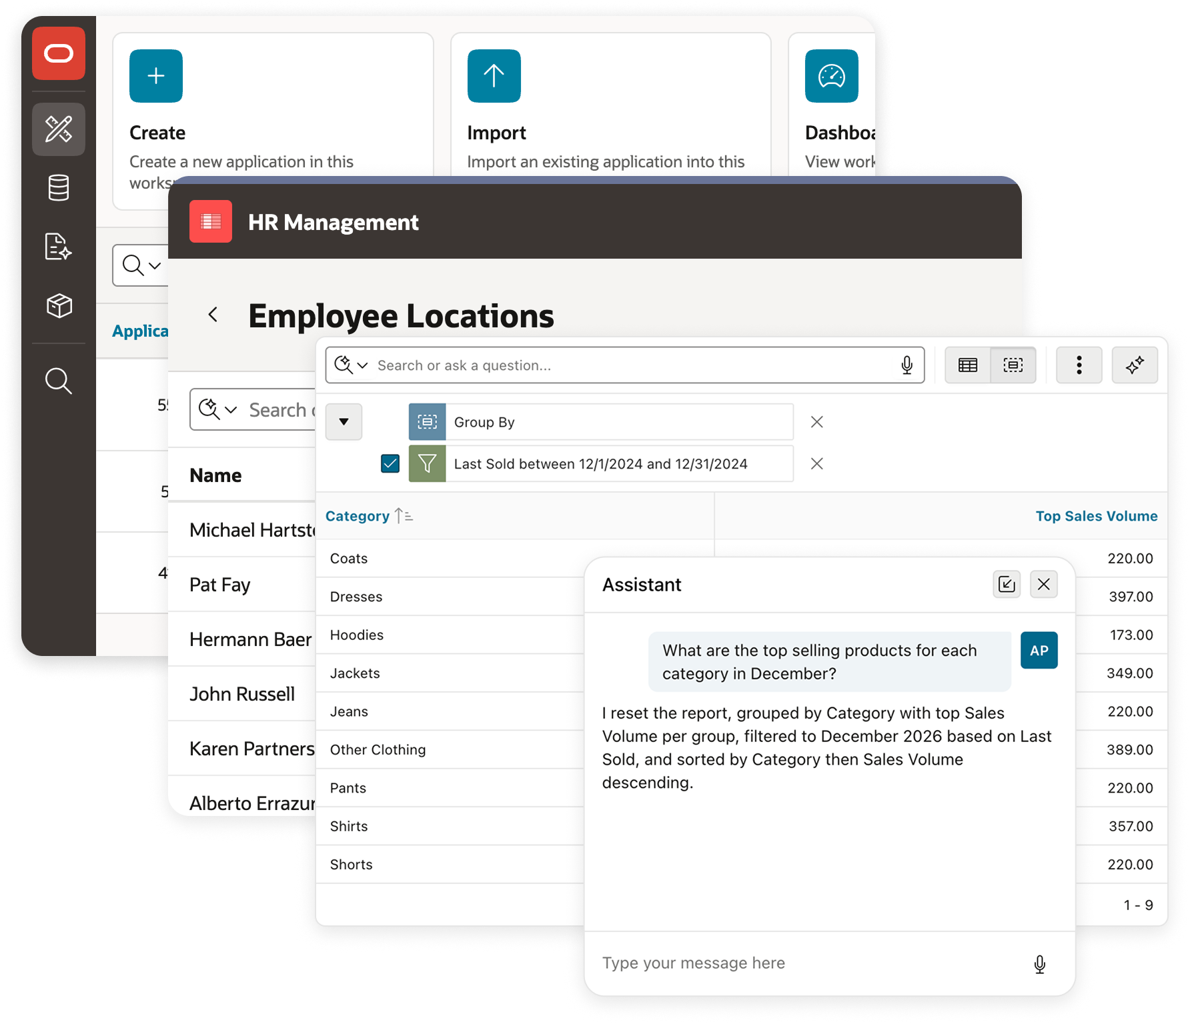
Generate Intelligent Enterprise Apps You Can Trust with Oracle APEX
Oracle APEX is trusted worldwide to deliver mission-critical, data-driven applications that are secure, scalable, and built on the Oracle Database.
Its declarative low-code platform helps teams build enterprise applications faster, with a clear application model that is easier to understand, maintain, and ready for AI-assisted development.
Oracle APEX is a fully supported no-cost feature of the Oracle Database, inheriting all of the enterprise-grade security and governance capabilities.
Developers build and deploy applications knowing that data access, user management, and application behavior are managed within a consistent, enterprise-ready environment.

Slide 4
Oracle APEX AI Application Generator 26.1
One of the most significant APEX releases ever –
Enterprise Low-Code built for the AI era
APEX 26.1 brings AI into a declarative platform designed for trust.
Instead of generating large volumes of arbitrary application code, AI in APEX generates application intent: structured, declarative metadata
If you generate it, you own it: APEX gives teams a way to own AI-generated business applications by making the generated artifacts understandable, transparent, and governed from the start.
Combines proven enterprise-grade capabilities with powerful AI capabilities at both design time and runtime.

Slide 5
Oracle APEX 26.1: Three Major Innovations
Open Application Specification Language (APEXlang)
Most important APEX update since introduction. Engineered from ground up to fully exploit generative AI. An open application specification that any AI agent or LLM can generate to.
AI Interactive Reports Natural Language Reporting
Providing natural language capabilities to the popular APEX reporting component — turning conversational input into declarative trusted report settings.
AI Agents and AI Tools
Build intelligent agents that take safe, declarative action across your applications — an assistant that acts within governed boundaries.

Slide 6
Oracle APEX 26.1 Availability
Download from OTN today
Try Oracle APEX 26.1 for free at oracleapex.com
Rollout across OCI regions and all Oracle multi-cloud deployments beginning in the coming weeks.
What's New in Oracle APEX 26.1
oracle.com/apex/whats-new
Full documentation, release notes, APEXlang resources, videos, and feature deep dives are available from oracle.com/apex

Slide 7
Oracle Database and Oracle REST Data Services Requirements
Oracle APEX release 26.1 requires an Oracle Database release 19c with Database Release Update 19.18 (January 2023) or newer.
On Oracle AI Database 26ai, APEX requires at least Database Version 23.26.0 (October 2025).
APEX runs on all database editions, including Enterprise Edition (EE), Standard Edition 2 (SE2), and Oracle AI Database 26ai Free.
Oracle APEX 26.1 requires Oracle REST Data Services (ORDS) 26.1.1 or newer.

Slide 8
Open Application Specification Language (APEXlang)

Slide 9
Open Application Specification Language (APEXlang)
232
Component Types
Page, item, facet, region, …
APEXlang is an open, declarative, human-readable text representation of APEX application metadata.
Applications export as structured .apx files that can be stored in source control, diffed, merged, scanned, and reviewed with standard developer tooling.
SQLcl can generate, export, validate, and import APEXlang; Oracle SQL Developer for VS Code can edit it natively.
Static IDs make application metadata stable enough for meaningful diffs and AI-assisted review.
The result: APEX apps become easier to automate without giving up APEX governance.
168
188
Application Properties
Region Properties
2,608
Distinct properties
Many used by multiple components
183
866
Components
Component properties
105
Component Types that can be referenced by static-id
171
176
Page Item Properties
JET Chart Properties

Slide 10
Open Application Specification Language (APEXlang)
Why it matters now:
APEXlang gives AI agents — including OpenAI Codex, Anthropic Claude, and others — an Oracle-supported interface for generating and modifying APEX applications.
Developers can work through the APEX Application Builder as they do today, or they can work entirely through AI agents and standard editors.
Both paths produce the same governed artifact.

Slide 11
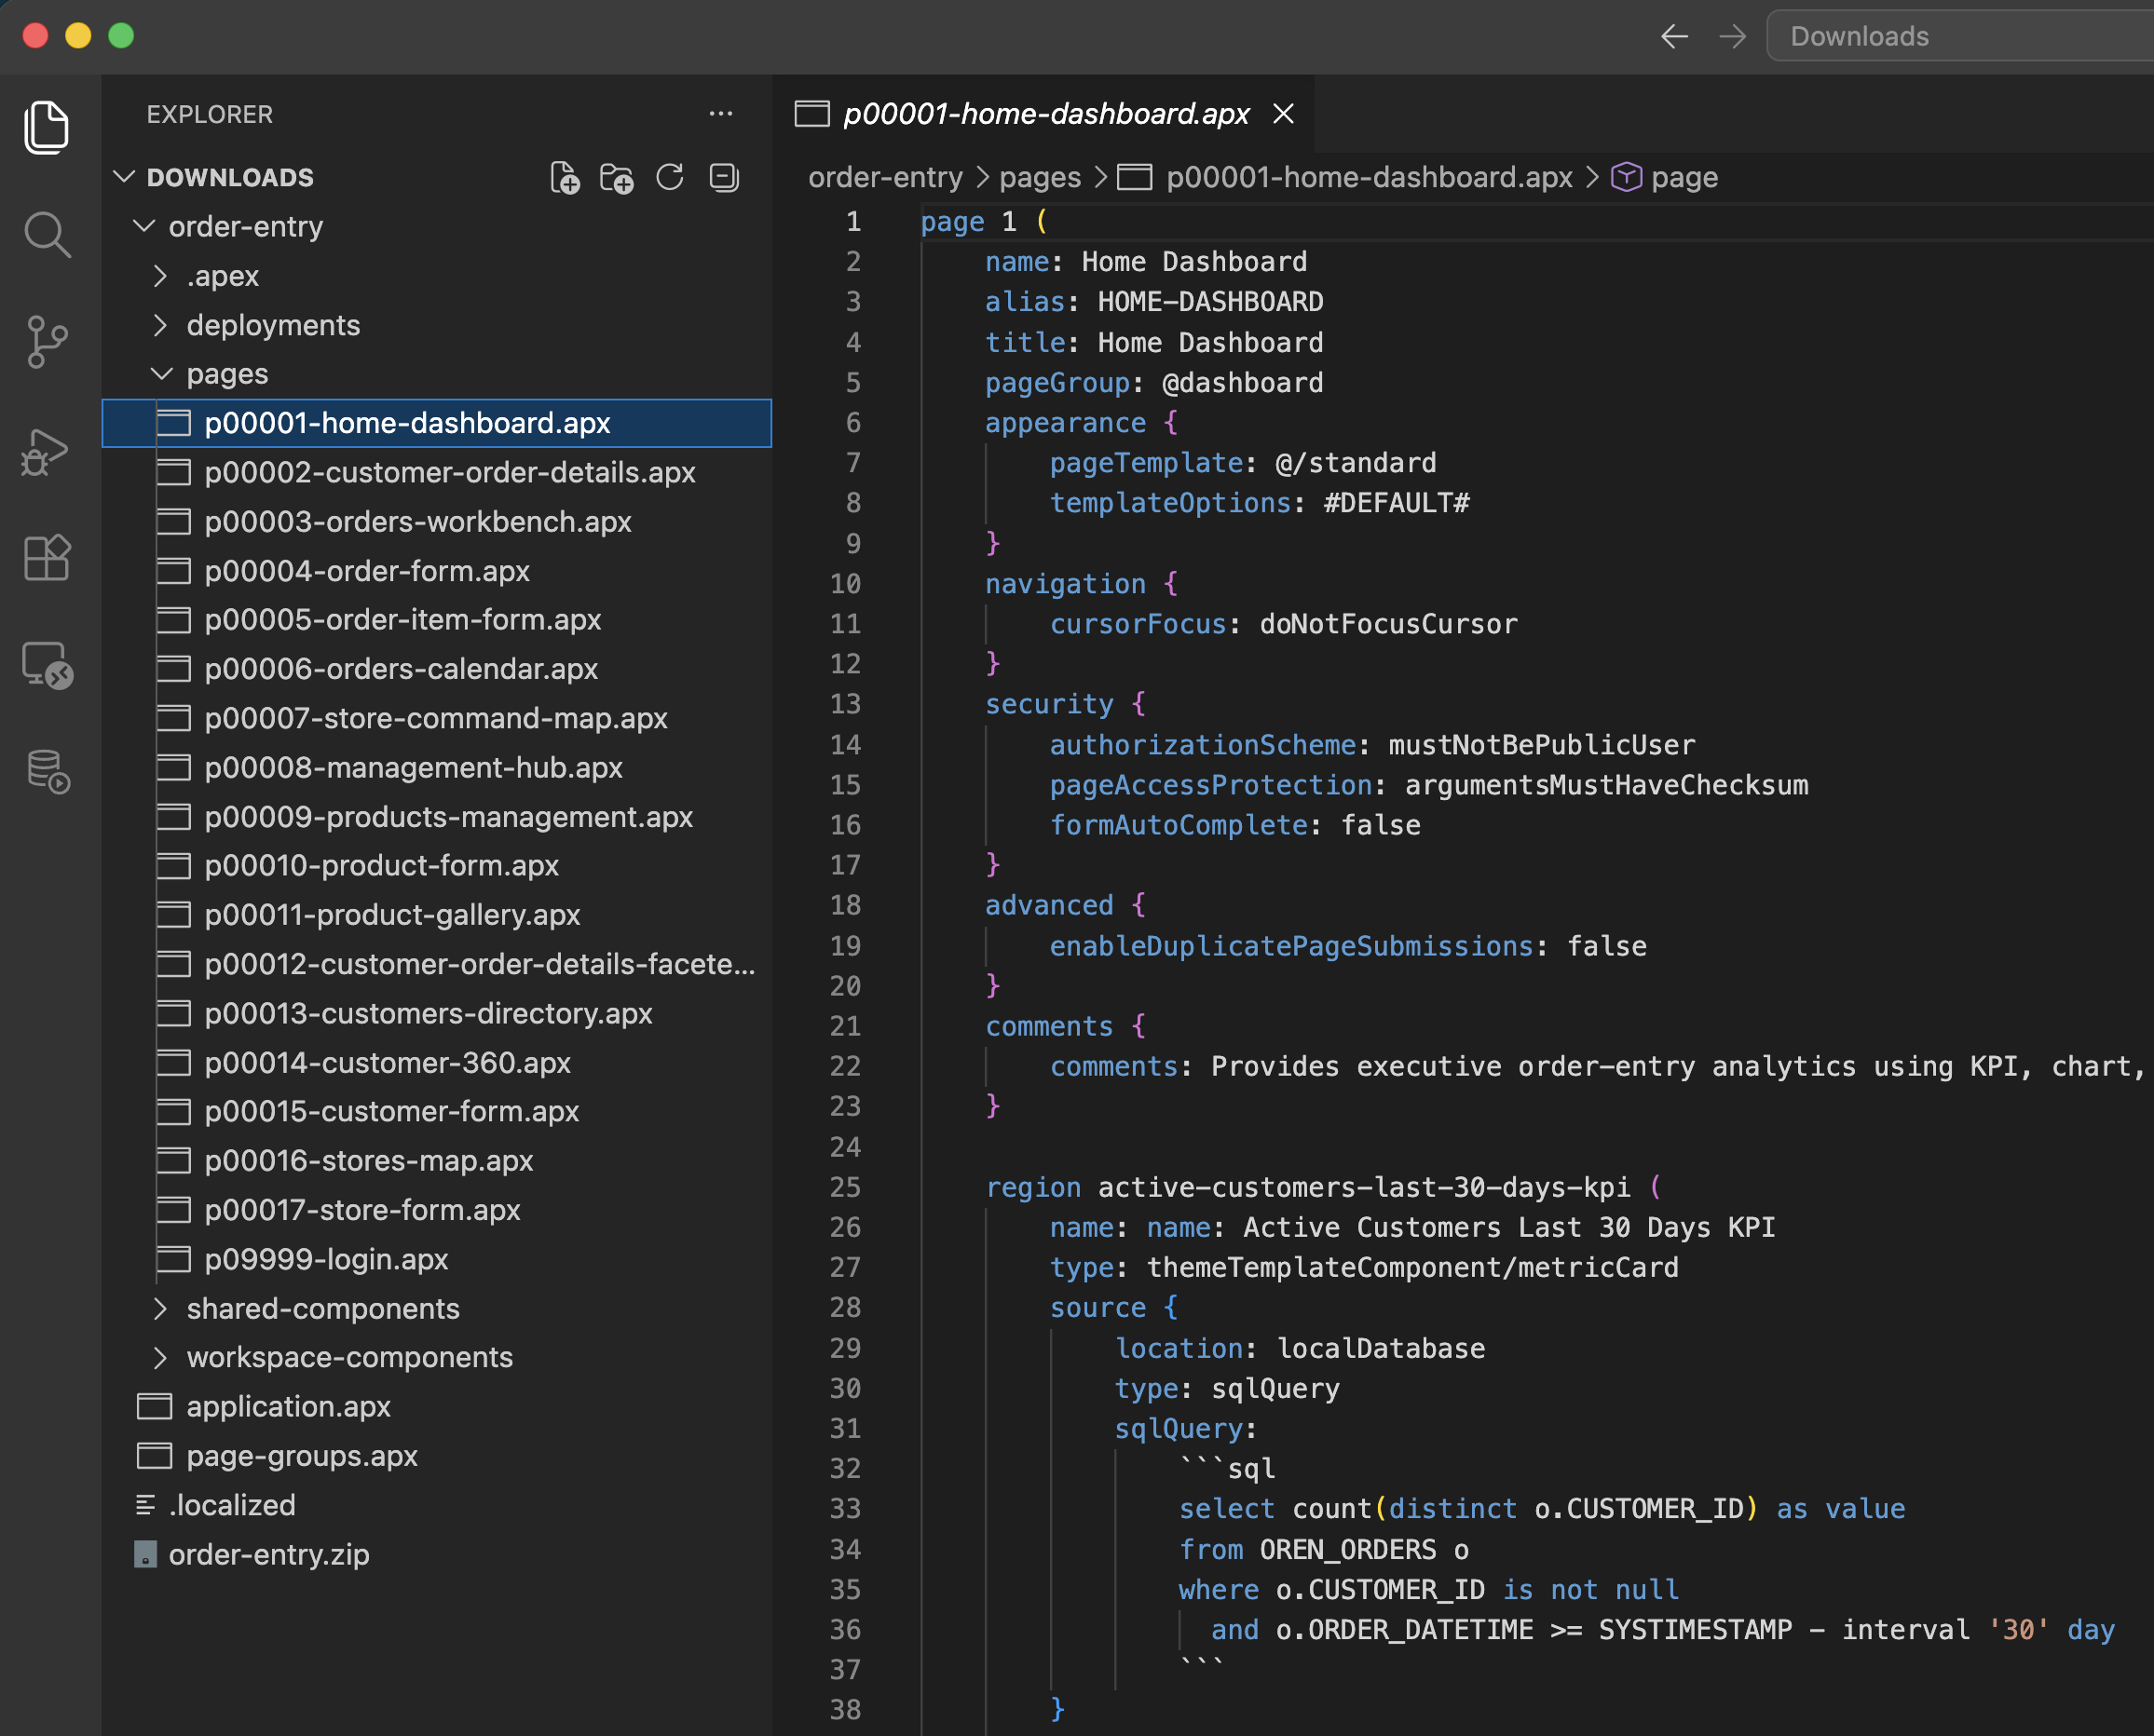
Open Application Specification Language (APEXlang)
Ecosystem integration:
APEXlang is natively supported in Oracle SQL Developer for VS Code, inheriting industry-standard source control, editing, and AI tooling.
Oracle SQLcl provides command-line and automation support for CI/CD pipelines and headless environments.

Slide 12
Open Application Specification Language (APEXlang)
What makes it open:
APEXlang is extensible, can be programmatically generated, is fully documented, has a public grammar, is human-readable and supported.
It is not open-source but it is also not opaque and can be generated using any AI agent.
When an AI assistant cannot read or write your application format, you are locked-out of the most significant productivity shift in a generation.

Slide 13






Open Application Specification Language
APEXlang describes APEX application intent as readable, validatable source.
Human readable
Source controlled
Validatable
.apx files are plain text and structured for review.
Package files work with Git, diffs, review, and merge.
Compiler feedback catches issues before import.
AI ready
Native assets
Portable
Documented syntax gives agents a clear generation target.
SQL, CSS, JS, and images remain first-class files.
The same source can move across APEX environments.
With APEXlang, the generation target is application intent, not low-level implementation code.

Slide 14


Learn More….
Blog Series
YouTube Playlist
apex.oracle.com/go/apexlang-blog-series
apex.oracle.com/go/apexlang-yt

Slide 15
AI Agents and Tools

Slide 16
AI Configurations Agents
AI Agents bring a new level of power and flexibility to APEX 26.1. Create an AI Agent and define one or more AI Tools to help users accomplish tasks—from retrieving data to running server-side or client-side code to automating actions.
Tool Execution Modes
You control how each tool participates: augment the initial system prompt during a conversation, or have it called on demand by the AI Service as needed.
Managed Agent Loop
The APEX engine handles the “agent loop” automatically, so you focus on just the parts specific to your application—no boilerplate orchestration required.
AI Agents add conversational AI to applications, helping users retrieve information, run actions, and complete tasks through natural-language interactions.

Slide 17
AI Tools – Capabilities and Infrastructure
Plugin Support and Reusable Tools
Intuitive plugin support and reusable tool definitions let you build once and deploy across applications—reducing duplication and accelerating delivery of intelligent features.
Server and Browser Capabilities
AI Tools support both server-side and client-side (browser) execution, making it simple to deliver intelligent, interactive experiences wherever your users need them.
Enhanced Infrastructure and Developer Resources
Improved infrastructure and expanded developer resources ensure you can innovate and extend AI capabilities with confidence across your APEX applications.

Slide 18
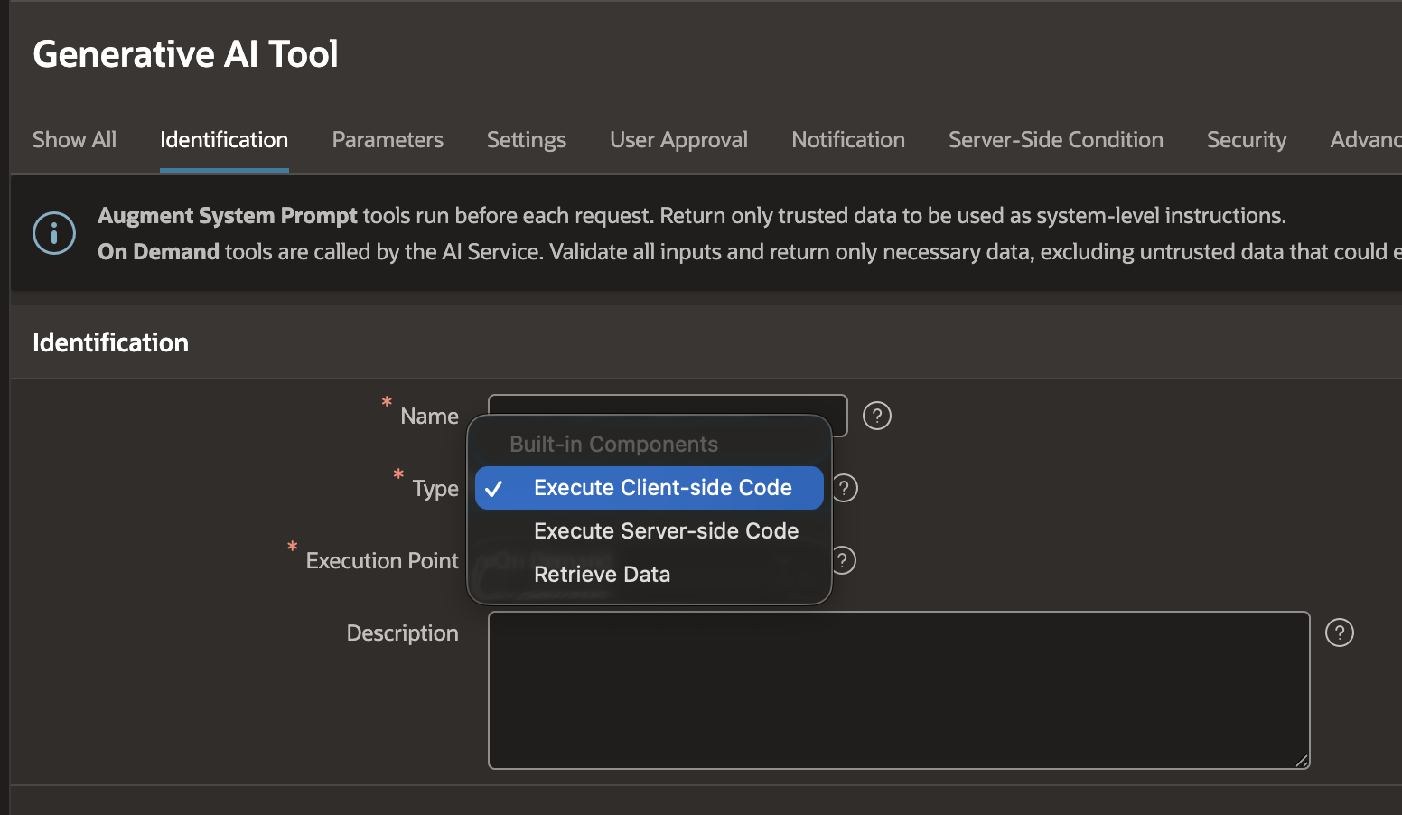
AI Agents Tools
Expose additional capabilities that help the AI Service retrieve data or perform tasks.
Type:
Retrieve Data
Execute Server-side Code
Execute Client-side Code
Execution Point
On Demand
Augment System Prompt
Notes:
01
Retrieve Data
SQL Query, Function Body returning a CLOB, or static text.
Read
02
Execute Server-side Code
PL/SQL or JavaScript (MLE). Override result via set_tool_result in APEX_AI.
Write / Act
03
Execute Client-side Code
End-user input or browser APIs in async context. Custom plug-ins extend the set.
Browser

Slide 19
The AI Agent Loop: From Prompt to Response
A five-step loop — user asks, APEX assembles context, model reasons, APEX executes tools, response returned.
1
User asks
2
Context
3
Model
4
APEX runs
5
Response
App UI or APEX_AI API
System prompt + augmentation + tool list
Direct answer or tool call request
SQL
PL/SQL
JS (MLE)
Text or structured JSON
Tools are developer-defined. The model never directly queries tables or runs arbitrary code.

Slide 20
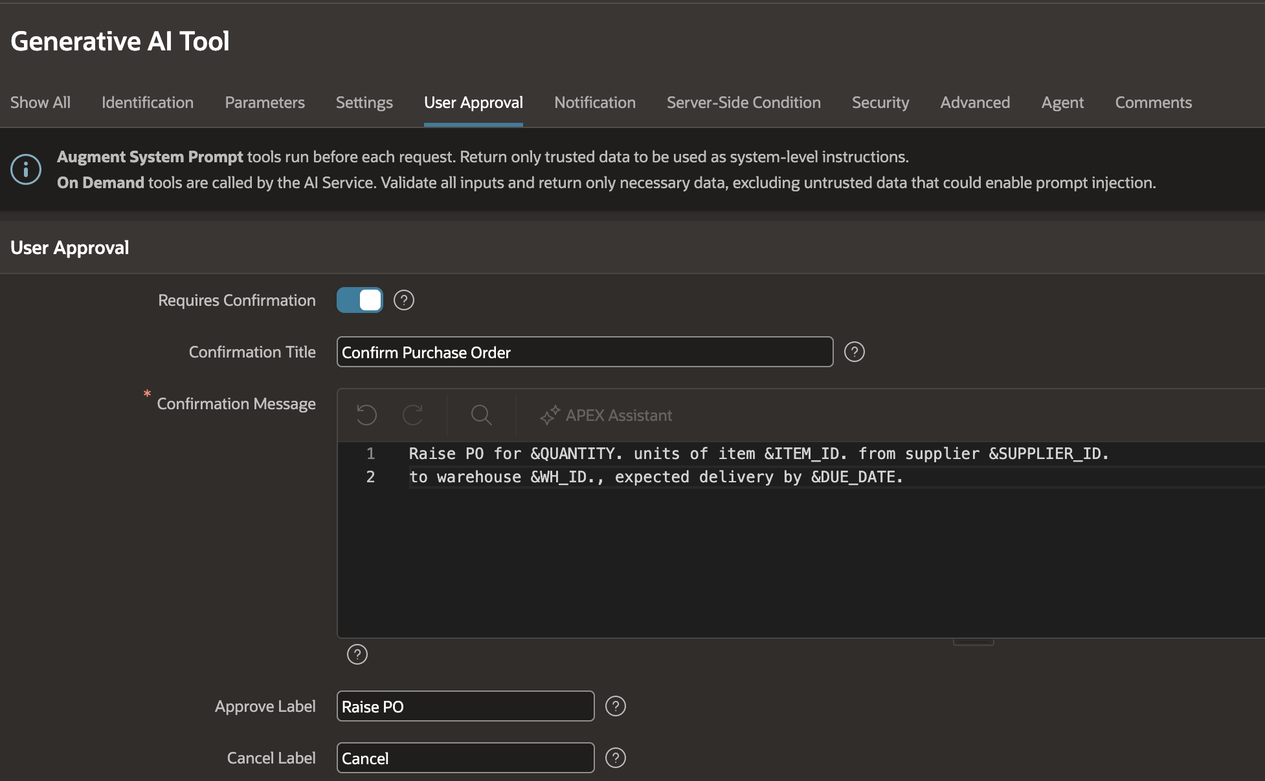
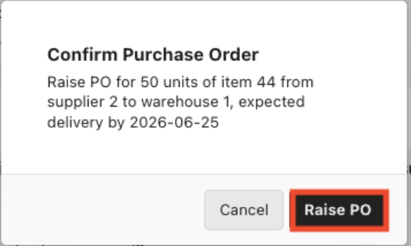
AI Tool Approvals: Human-in-the-Loop Guardrails
Sensitive On Demand tools can require explicit approval before execution.
Agent calls tool
APEX shows dialog
User approves or denies execution
Result returns to the AI model
Notes:
01
Retrieve Data
SQL Query, Function Body returning a CLOB, or static text.
Read
02
Execute Server-side Code
PL/SQL or JavaScript (MLE). Override result via set_tool_result in APEX_AI.
Write / Act
03
Execute Client-side Code
End-user input or browser APIs in async context. Custom plug-ins extend the set.
Browser

Slide 21
Natural Language Reporting with AI Interactive Reports

Slide 22
Talk To Your Data. Trust The Results: AI Interactive Reports
Users explore data in plain language — APEX translates to native IR settings, never generates free-form SQL.
Natural Language support for Interactive Reports
New capability in APEX 26.1 that enables users to apply formatting, filters, highlights, and visualizations without needing to navigate menus. It allows users to conversationally explore their data.
Specific Benefits
Allows users to ask natural language questions of the data
The interpretation of the users’ intent is indicated as “chips”
Chips are editable and can be changed conversationally or via UI
All data reported is always accurate
Conversational features
Apply filters
Apply highlights
Apply sorting
Show/hide columns
Apply control breaks
Perform Group Bys
Aggregate data
Pivot
Chart data (Bar / Pie / Line)
Pagination
Save Reports
Reset report state
Configure Generative AI Service → set in App AI Attributes → Default Search Mode becomes "Search with AI"

Slide 23
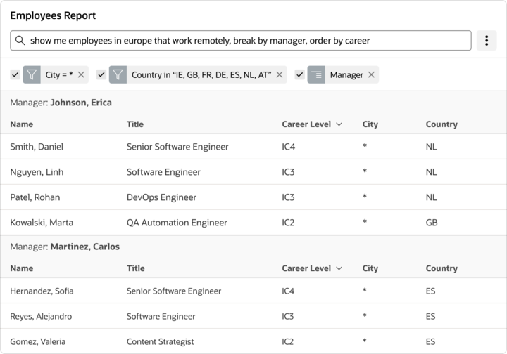
Oracle APEX AI Interactive Reports
Users ask natural language questions that are restricted to data in a pre-defined data view
AI is used to convert the question into filters, aggregations, and other settings that are shown to users and can be easily understood and edited

Slide 24


Learn More….
AI IR Blog
AI IR Hands-on Lab
apex.oracle.com/go/ai-ir-blog
apex.oracle.com/go/ai-ir-lab

Slide 25
Oracle APEX Data Reporter: Self-Service Reporting for Trusted Data

Slide 26
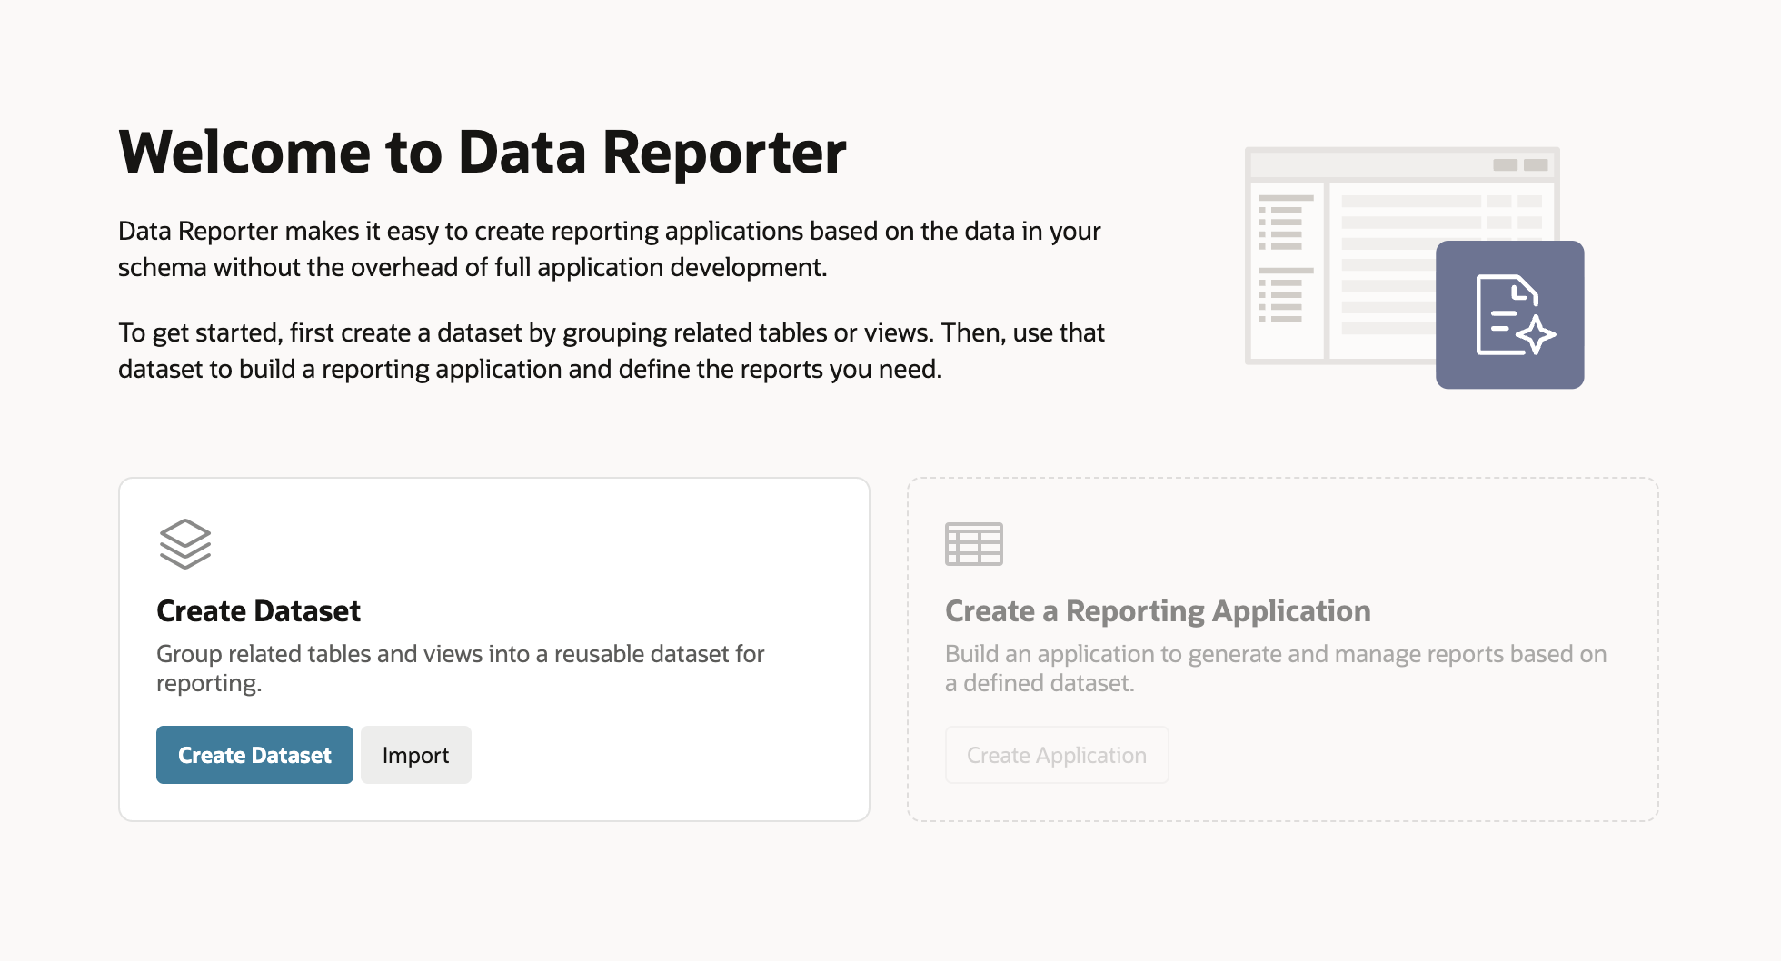
Data Reporter
A dedicated APEX reporting module for business-led, governed self-service reporting
A new reporting experience in APEX that lets business users create and manage reports without APEX application development expertise
No SQL required for report creation
Administrators define trusted datasets and control access, while Editors build and publish reports through a streamlined self-service interface.
Private drafts before publishing
Published reports can be shared by URL, making it easy to deliver trusted reporting across the organization.
Notes:
No Page Designer for report authors
No SQL required for report creation
Private drafts before publishing
Developers define the safe reporting foundation

Slide 27
Data Reporter: Security & Scalability
How the feature stays safe as usage scales
Datasets
Curated workspace-level collections of tables/views, bound the data available to report authors
Reporting Applications
Package one or more datasets with identity, authentication, AI settings, and end-users
Roles
Editors create and manage reports
Viewers only see an interact with published reports
Lifecycle
Admins can synchronize changed objects, monitor activity, and move through export/import

Slide 28
Other Platform Enhancements

Slide 29
What’s Inside
Seven areas of Platform Enhancements
01
Developer Experience
02
Translations
Builder UI, search, and richer diffs
Text Messages plus CSV and XLIFF files
03
Workflow
04
Universal Theme
Parallel paths, APIs, and tenant context
Iris style, components, and directives
05
Security
06
Map Region
CSP, Fusion roles, and workspace SMTP
Vector tiles, background maps, and JS APIs
07
Components
Reports, buttons, actions, and data entry
Notes:
01
Retrieve Data
SQL Query, Function Body returning a CLOB, or static text.
Read
02
Execute Server-side Code
PL/SQL or JavaScript (MLE). Override result via set_tool_result in APEX_AI.
Write / Act
03
Execute Client-side Code
End-user input or browser APIs in async context. Custom plug-ins extend the set.
Browser

Slide 30



Developer Experience
Refined Builder Experience
Workspace Search
Context-Rich Diff Views
A cleaner, more modern Builder UI featuring updates across Page Designer, shared components, navigation, dialogs, and other Builder pages — making everyday development smoother.
Quickly find workspaces from the sign-in and workspace selection screen, and sort by recent login to surface the workspaces you use most.
Review changes with more context in Working Copy diff views — component names, types, and APEXlang syntax highlighting make edits easier to understand at a glance.

Slide 31
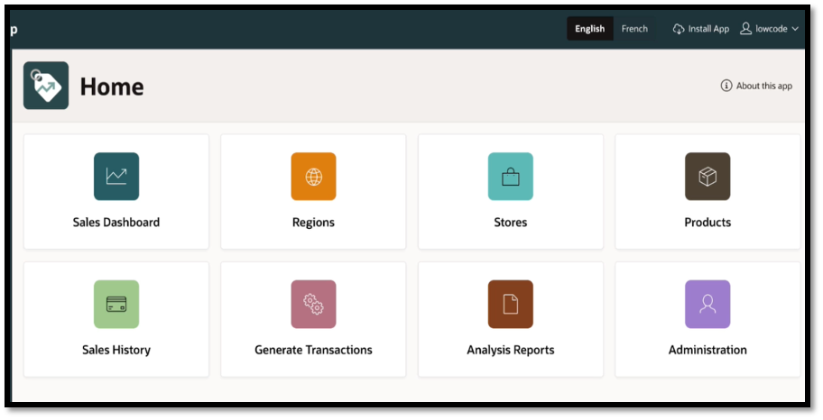
Translations
Simplified Localization: Manage multiple languages in a Single Application
Seed Translatable Text
Convert application text into reusable Text Messages so labels and other user-facing strings can be managed in one place and kept in sync as the application evolves.
Standard Translation Formats
Export and import translated text messages using CSV, XLIFF, or ZIP files to support manual translation workflows and external localization services.

Slide 32
Text Message Translations
Deploy a single application that serves multiple languages — no translated copies to maintain.
Primary App
Source application
Single Application
for different languages
Translation Method:
Text Message-Based
Import Text Messages
Load translated text messages into application
Add Languages
Define target languages
Translate the content
in files
Convert to Text Messages
Extract application text into text messages
Export Text Messages
a. ZIP or Individual files
b. XLIFF or CSV format
Primary App (101)
Source application
Text Message-Based
Use text messages for translation
Add Languages
Add and manage target languages
Text Messages
Extract translatable text from the app
Export
zip, individual, XLIFF or CSV
Translate & Import
Translate files and import back
Single Application
One app, multiple languages

Slide 33
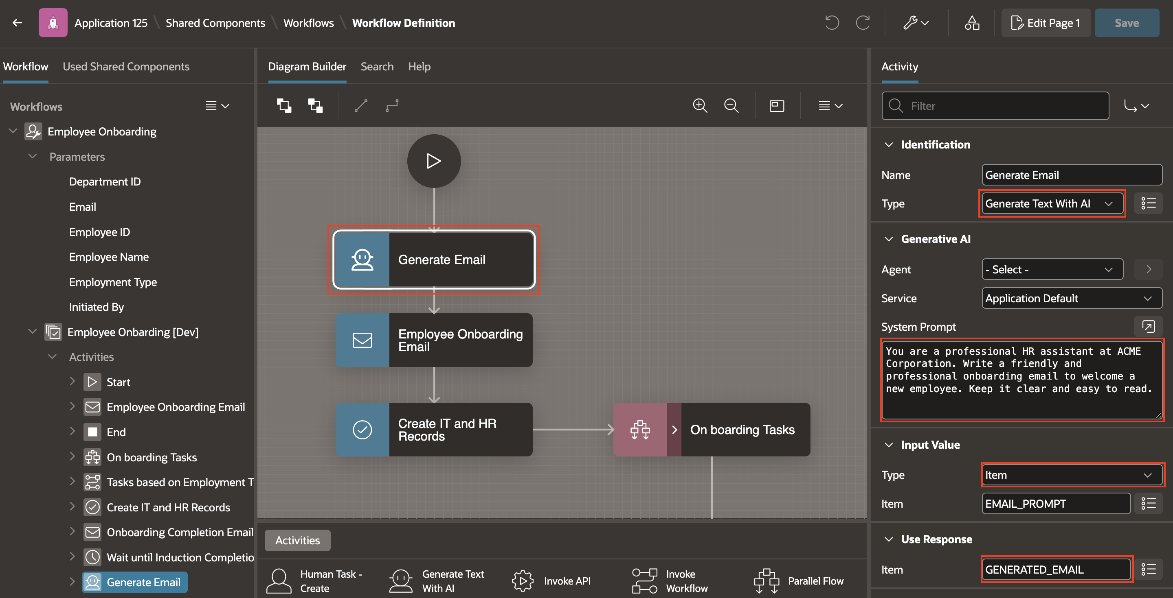
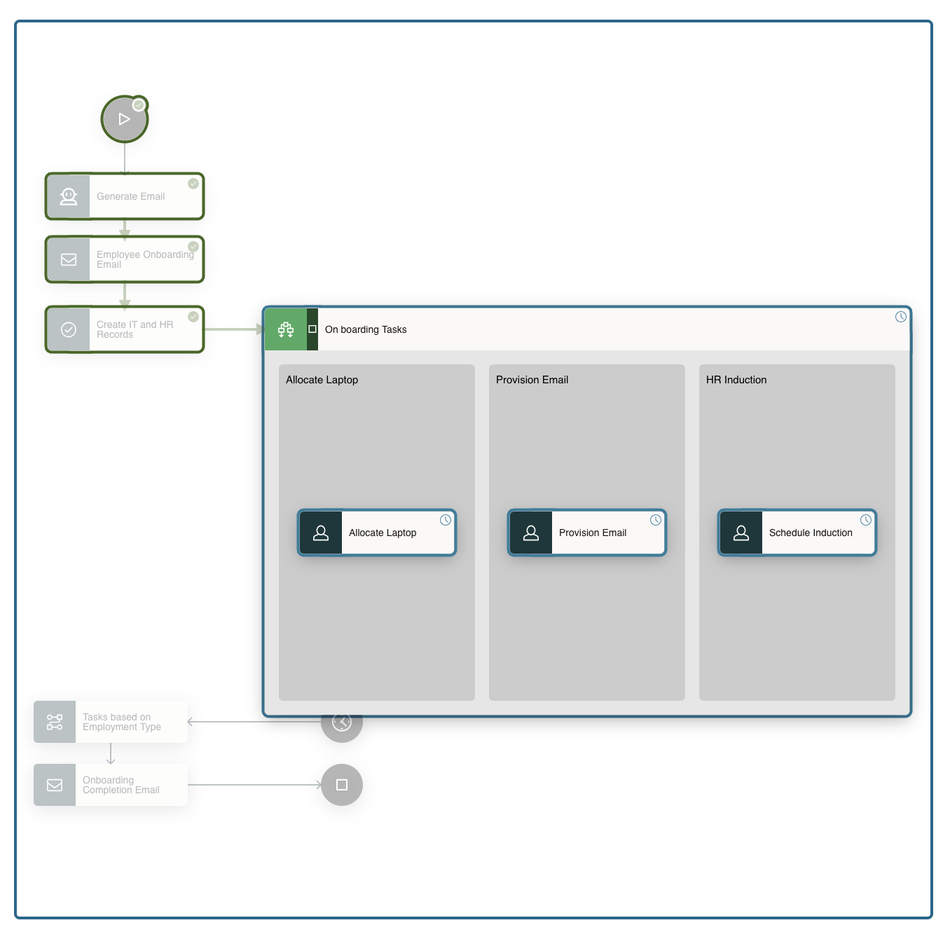
Workflow Parallel Flows: Branch, Execute, Converge
APEX Workflow 26.1 adds parallel branch execution, AI integration, and automatic upgrade resume.
Parallel Flow
Parallel Flow runs multiple branches at the same time and completes only when all branches finish - enabling more flexible, scalable workflow designs. If any branch fails, the whole flow fails.
AI + Runtime
"Generate Text with AI" Activity writes output into the Workflow state. Use this activity to perform ready-made AI actions like summarizing, translating, generating tags, or drafting emails.
App exports can include runtime instances; APEXlang exports do not. Upgrade-suspended workflows resume automatically.
Workflow APIs
Simplify workflow administration with APIs for deleting instances, resuming suspended workflows after upgrades, setting task due dates, refreshing admin roles, and exporting workflows.

Slide 34
How Tenant Isolation Works in Workflows and Tasks
APEX captures the session Tenant ID at workflow/task creation, persists it, and filters all runtime views automatically
APEX Session
Tenant ID
Start Workflow or Create Task
Persist
tenant_id
Filter Runtime
Views
Workflow Instance Tables
Custom Queries
Workflow instance rows persist Tenant ID — Workflow Console filters by current tenant automatically.
Review custom reports or APIs querying workflow/task tables — add tenant filter if needed.
Unified Task List
Workflow Console
End users see only tasks assigned within their tenant scope.
Administrators see only their tenant's workflow instances and history.
Task Instance Tables
Developer Validation
Task instance rows persist Tenant ID — Unified Task List filters by current tenant automatically.
Create Tenant A and B sessions — verify zero cross-tenant visibility in Console and Task List.

Slide 35




Universal Theme Enhancements
Universal Theme + Iris Style
Rich Template Components
More Powerful Template Directives
Introduces the new Iris style with an updated Oracle-branded look, accessibility improvements, and expanded icon support through Font APEX 2.5.
Build richer, more flexible user interfaces with client-side partials, template directives, autocomplete support, and improved template component capabilities.
Extend template directive support across item, region, list, and page templates while improving the overall authoring experience for developers.

Slide 36



Security and Compliance
CSP Enhancements
Move closer to full Content Security Policy compliance by removing unsafe-hashes and replacing inline display behavior with safer class-based rendering.
Fusion Extensions Security
Align APEX extension security with Fusion roles and policies, controlling access to both Fusion data and custom APEX data in mashup applications.
Workspace-level SMTP
Configure workspace-specific SMTP credentials via Web Credentials, while retaining instance-level email server config for declarative delivery.

Slide 37

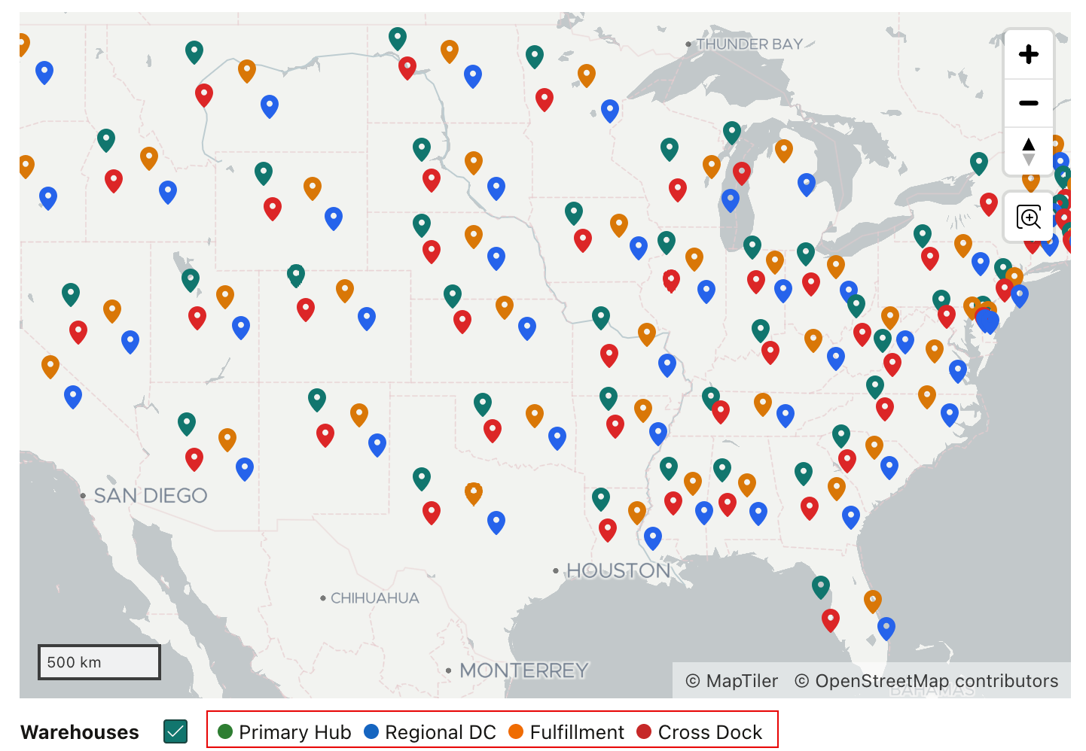

Map Region Enhancements
Vector Tile Layer Support
Use vector tile layers to render large geospatial datasets more efficiently with smoother interaction and improved scalability across zoom levels.
Advanced Background Maps
Configure custom background maps using raster tiles, vector tiles, and OGC map services for more flexible and modern map presentation experiences.
JavaScript Map Control
Use new JavaScript APIs to control map behavior, styling, and interaction more precisely in custom APEX applications.

Slide 38


Component Updates
More Powerful Interactive Reports
Row selection capability and improved filtering support for template component columns, making reports more interactive than ever.
Declarative Menu Buttons
Add menus directly to buttons from Page Designer to create cleaner action menus and more flexible UIs without custom JavaScript.
Enhanced Dynamic Actions
Declarative support for buttons and menus, plus new actions: Show Success, Show Error, and Wait Popup for richer interaction flows.
Faster Data Entry Experiences
Paste from clipboard into Interactive Grids and enable infinite scrolling for LOV and autocomplete fields to improve data entry workflows.

Slide 39
Dynamic Actions: Declarative Power, Less JavaScript
20+
3
new types
new Dynamic Actions
Trigger Actions
Page Messages
Actions, Buttons, Cards, and Menus define DAs directly in Page Designer
Show Success Message
Show Error Message
Clear Errors
Developer Check: Retest Items to Submit/Return paths, validation messages, and long-running PL/SQL flows after enabling new DA types.
2
2
new DAs
new DAs
IR Dialogs
AI Inputs
Invoke IR Dialog is a declarative DA for opening Interactive Report dialogs such as Select Columns, Filter, Highlight, and Download without relying on the Actions menu or custom JavaScript.
Open AI Assistant and Generate Text with AI expose Items to Submit
Server-side Code shows item-level spinners.
Notes:
APEX 26.1 makes common page behaviours declarative - reducing custom JavaScript across the board.

Slide 40
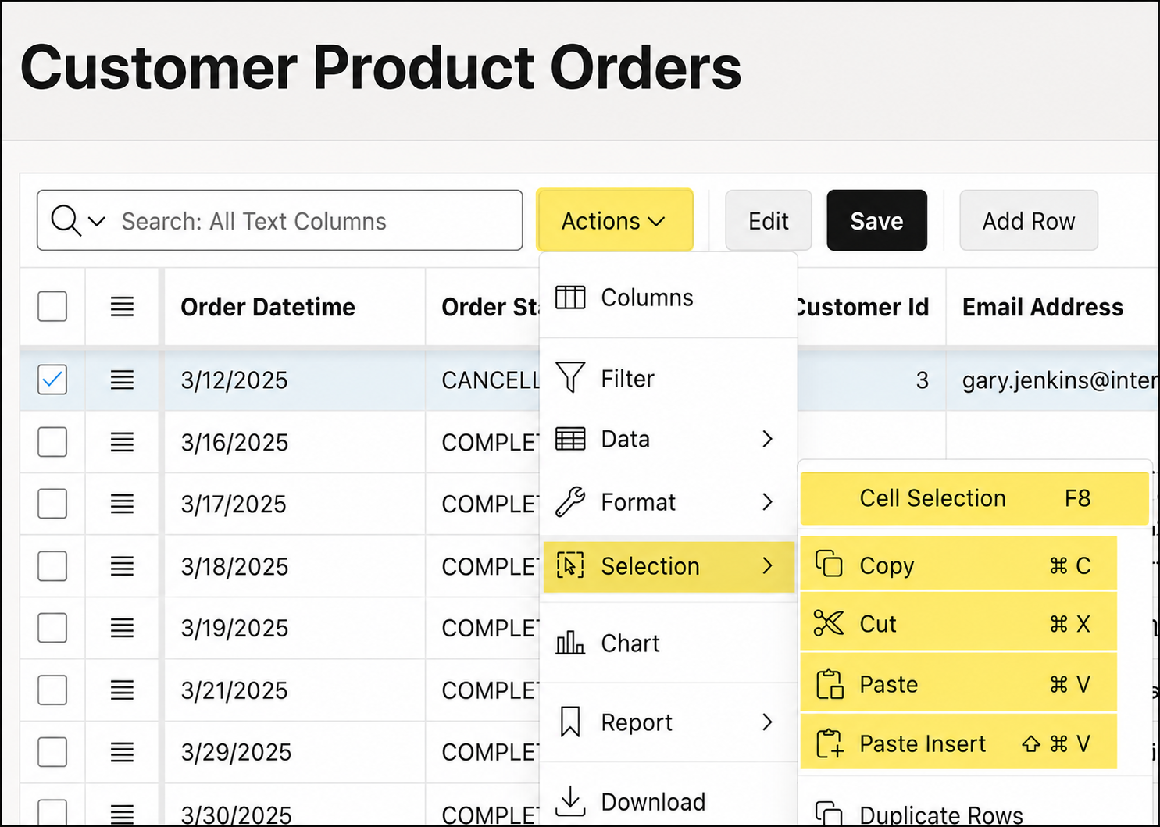
Interactive Grid: Key Enhancements
Copy and Paste
Copy · Cut · Paste · Paste Insert - full clipboard support. Range movement works outside edit mode.
View Selector
Switch between Grid, Icon, and Detail views. Combine with Faceted Search and Smart Filters.
Column CSS & Formatting
Interactive Grid columns also support CSS classes - unify styling across IR and IG components.

Slide 41
There's a Lot More in APEX 26.1
90+ features across AI, development, platform, UX, APIs, and security.
AI & Intelligence
Builder & Development
Data & Integration
• APEXlang
• AI Agents & AI Tools
• AI Interactive Reports
• Data Reporter
• Major AI Provider Support
• APEX_AI Attachments
• Interactive Report Row Selection
• Refreshed Builder UX
• Universal Theme 26.1
• Iris Theme Style
• Template Component Filtering
• Search & Smart Filters
• Faceted Search Exclude
• Workspace Search on Login
• Context-Rich Diff Views
• Upgrade App Wizard
• Builder Extension Backlinks
• Custom Link Attributes
• Built-in Sample Data Sets
• Message-Based Translations
• Seed Translatable Text
• Translation Import / Export
• Parallel Workflows
• Workflow API Enhancements
• Tenant-Aware Workflows
• Workflow Instance Titles
• Workflow Runtime Enhancements
Dynamic Actions & UI
REST & Security
APIs & Platform
• Declarative Menu Buttons
• Trigger Actions
• Dynamic Action Button/Menu
• Show Success Dynamic Action
• Show Error Dynamic Action
• Wait Popup Option
• Paste from Clipboard to Grid
• Infinite Scroll for LOV
• REST Body Template Directives
• Dynamic OAuth Scopes
• Signed Assertions
• OAuth2 Password Credential
• OAuth2 Refresh Tokens
• Map Region Enhancements
• Vector Tile Layers
• Content Security Policy
• Fusion Extensions Security
• JavaScript Map Control APIs
• Bounding Box Support
• Font APEX 2.5
• Template Component Enhancements
• Template Directive Enhancements
• Advanced Background Maps
• REST Data Source Enhancements
• OData CRUD Support
• Dynamic REST Source Params
• Instance Admin Enhancements
and more… see oracleapex.com/26.1 for the complete list

Slide 42
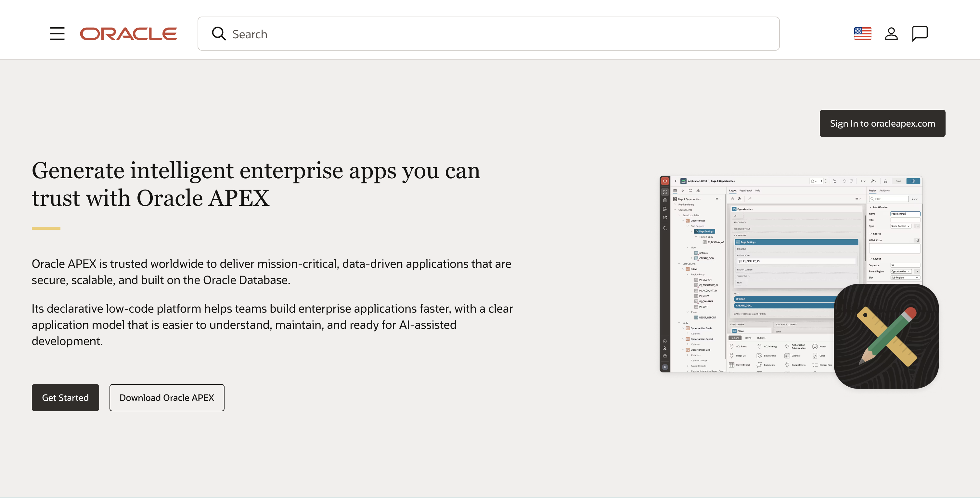
Everything about Oracle APEX
https://www.oracle.com/APEX/

Slide 43
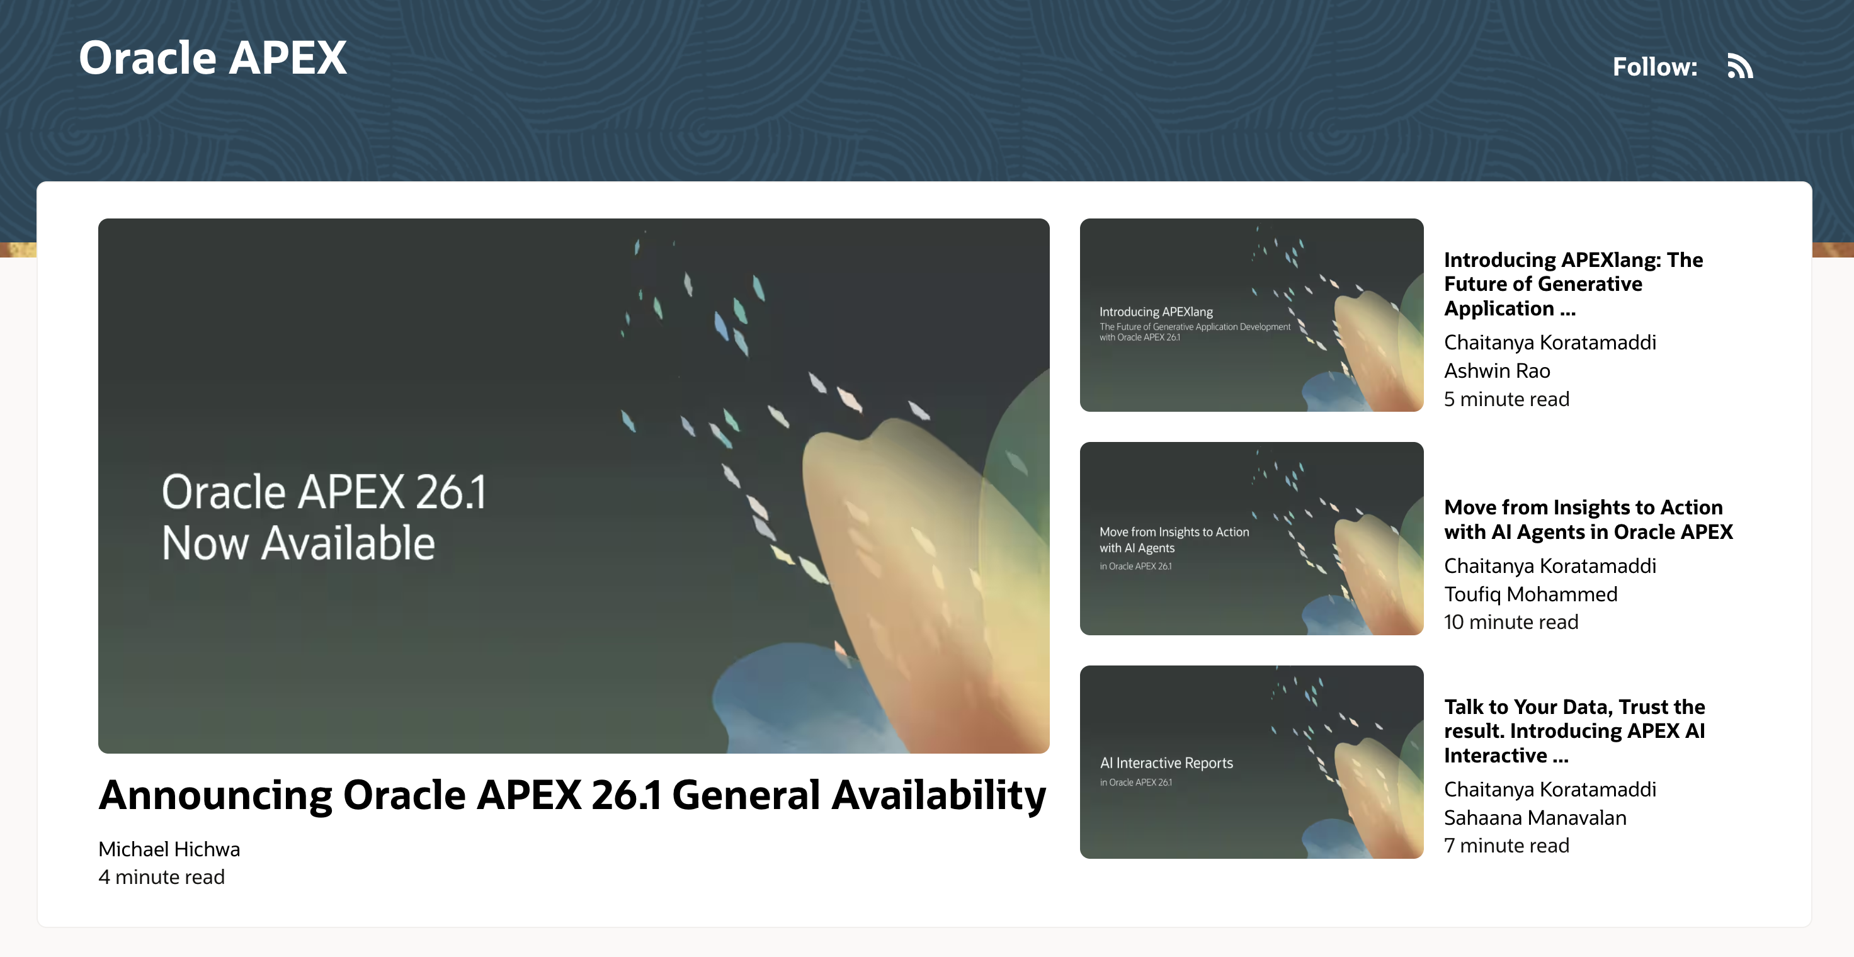

Oracle APEX Blogs
https://blogs.oracle.com/APEX/

Slide 44
Get Started / Q&A
Download Oracle APEX 26.1
Try it free at oracleapex.com
Review release notes and docs at oracle.com/apex
Explore APEXlang, AI Interactive Reports, AI Agents, and Data Reporter

