Slide 1

Oracle APEX 23.2
New Features
Name
Presenter’s Title
Organization, Division or Business Unit
Month 00, 2024

Slide 2
“ We're now building a lot of our applications in APEX. And our productivity gains are, again, a factor of 10. And we build the applications in one tenth the time, or one tenth the amount of people, or at one tenth the cost. But these are not typical low-code applications. These are applications that can scale to millions of users and all over the world.”
- Larry Ellison
Founder & CTO, Oracle
2
Copyright © 2024, Oracle and/or its affiliates
Oracle Q4 FY23 earnings call - June 12, 2023

Slide 3

What’s New in Oracle APEX 23.2?
Collaborative Development with Application Working Copy
End-to-End Process automation with native workflow
New and Updated Components
Developer Experience
General Builder Improvements
Additional Updates and Enhancements
apex.oracle.com

Slide 4
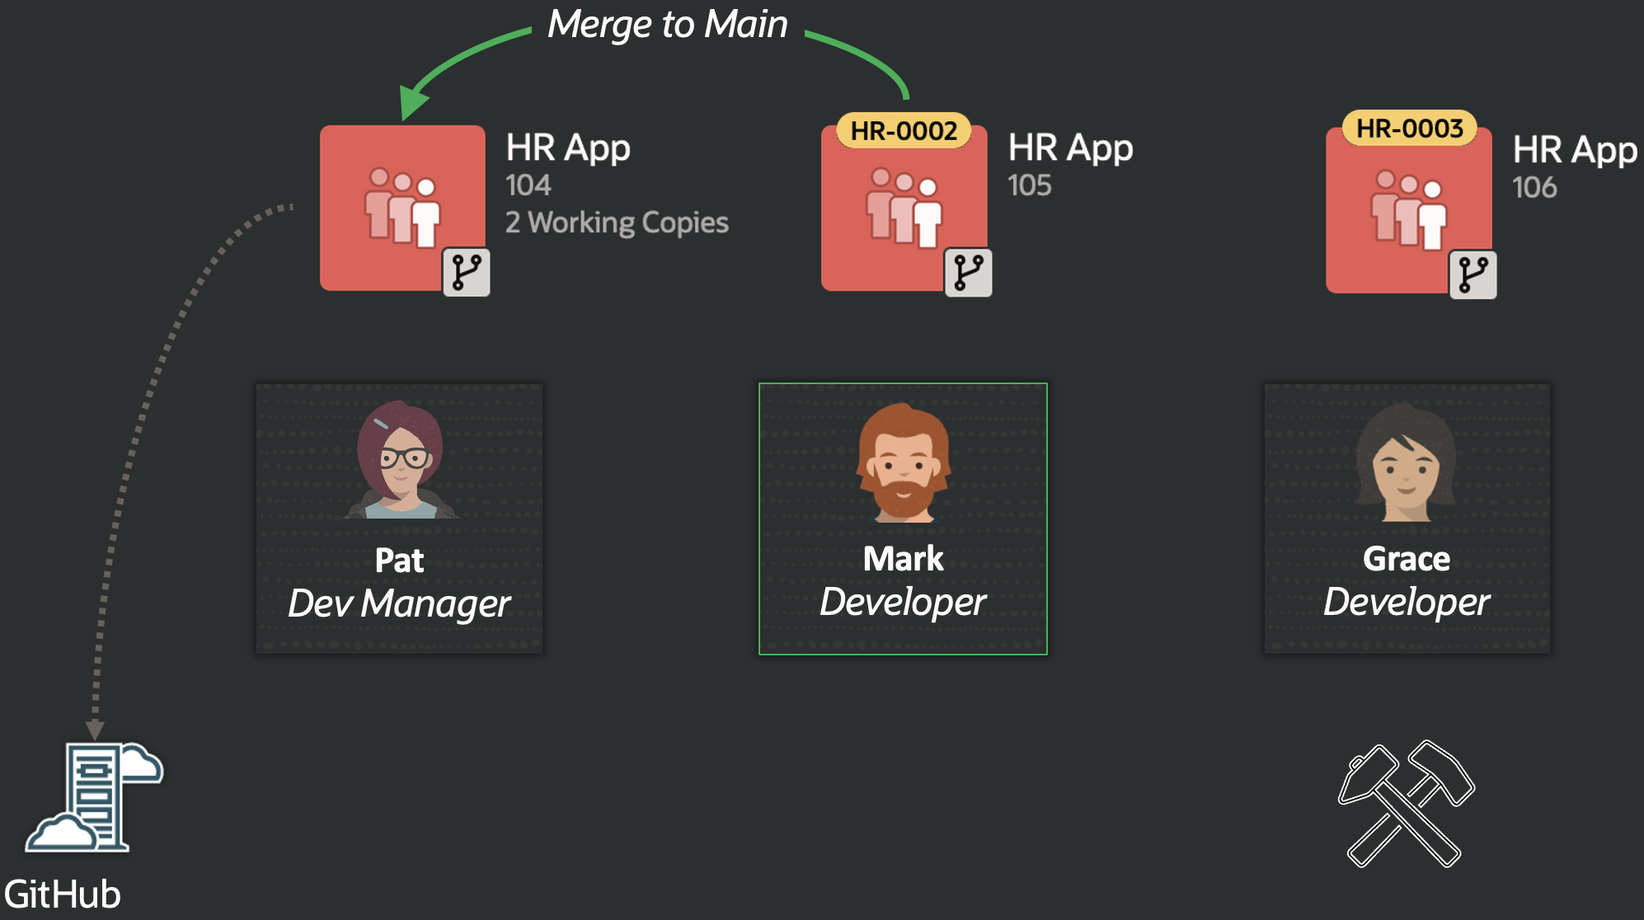
Application Working Copy
Enables multiple developers to work on different features in isolation of each other on the same application and then periodically merge their changes
Beneficial for single developers who already have an application in production and want to keep new changes separate from application maintenance changes until they are ready to be moved through dev/test/production
Allows developers to create a working copy of an existing application, diff changes between the copy and main application, and then merge changes back into the main application

Slide 5
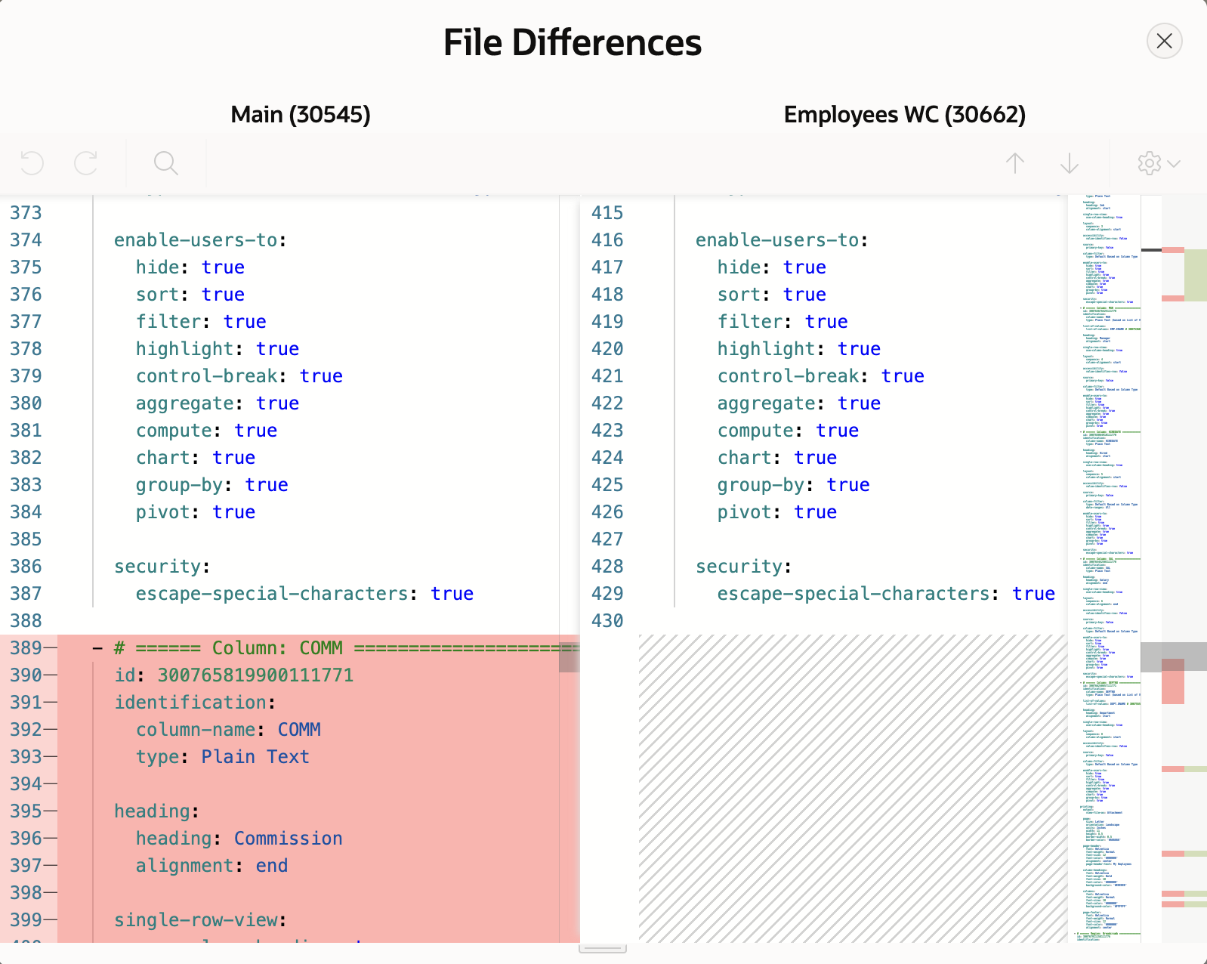
Application Working Copy
Creating “Working Copy” is very similar to copying an application
Comparison of changes is done by performing a split YAML export of both applications
A merge conflict occurs when a page or shared component in the main application has changed and has the same component in the working copy
Conflicts will be manually identified when viewing the file differences
Developers have the choice of merging in full or by choosing which components they would like to merge
Option to perform a full backup, so developer can revert to backup in case of merge issues

Slide 6
Application Working Copy

Slide 7
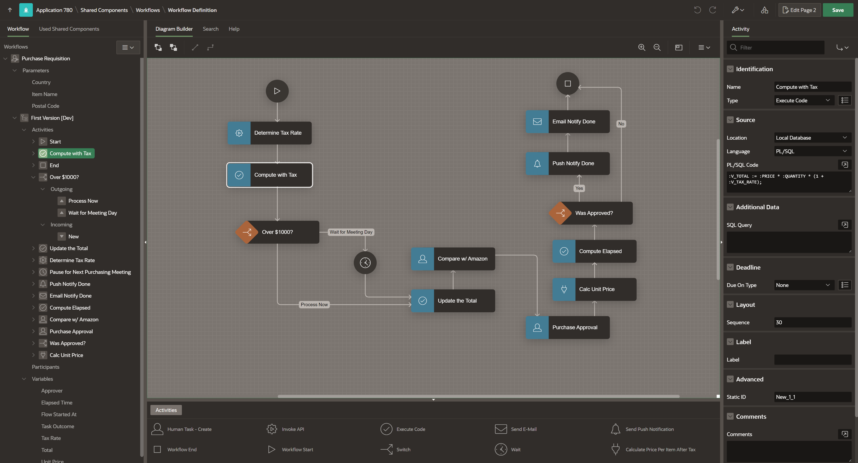
End-to-End Process automation with native workflow

Slide 8
Workflow
Workflow is the automation of a business process, in whole or part, during which documents, information or tasks are passed from one participant to another for action, according to a set of procedural rules (e.g. sequence flow, transition conditions etc.).
APEX Workflow provides the following capabilities:
      Visual Workflow Designer to create and author sequential workflows
      Workflow Console for the monitoring and administration of Workflows
      Workflow Runtime (Engine) for the execution of Workflows
  Manage workflows by creating workflow models in the Workflow Designer.
  Activate workflows and monitor them through the Workflow Admin Console.
  Use page processes to initiate workflows.

Slide 9
APEX Workflow – Design Principles
Simple
APEX Workflow is simple to use with a flat learning curve. No prior Process knowledge is required to use APEX Workflow
Extensible
APEX Workflow is extensible. Activities are implemented as Process Type plugins. Customers can create their own plugins and natively use them in APEX Workflow as Activities
Integrated
APEX Workflow is fully integrated in the current APEX development experience and shares code with APEX Page Designer. This makes it intuitive to use for APEX developers
Intelligent
APEX Workflow is designed to use Oracle Machine Learning

Slide 10
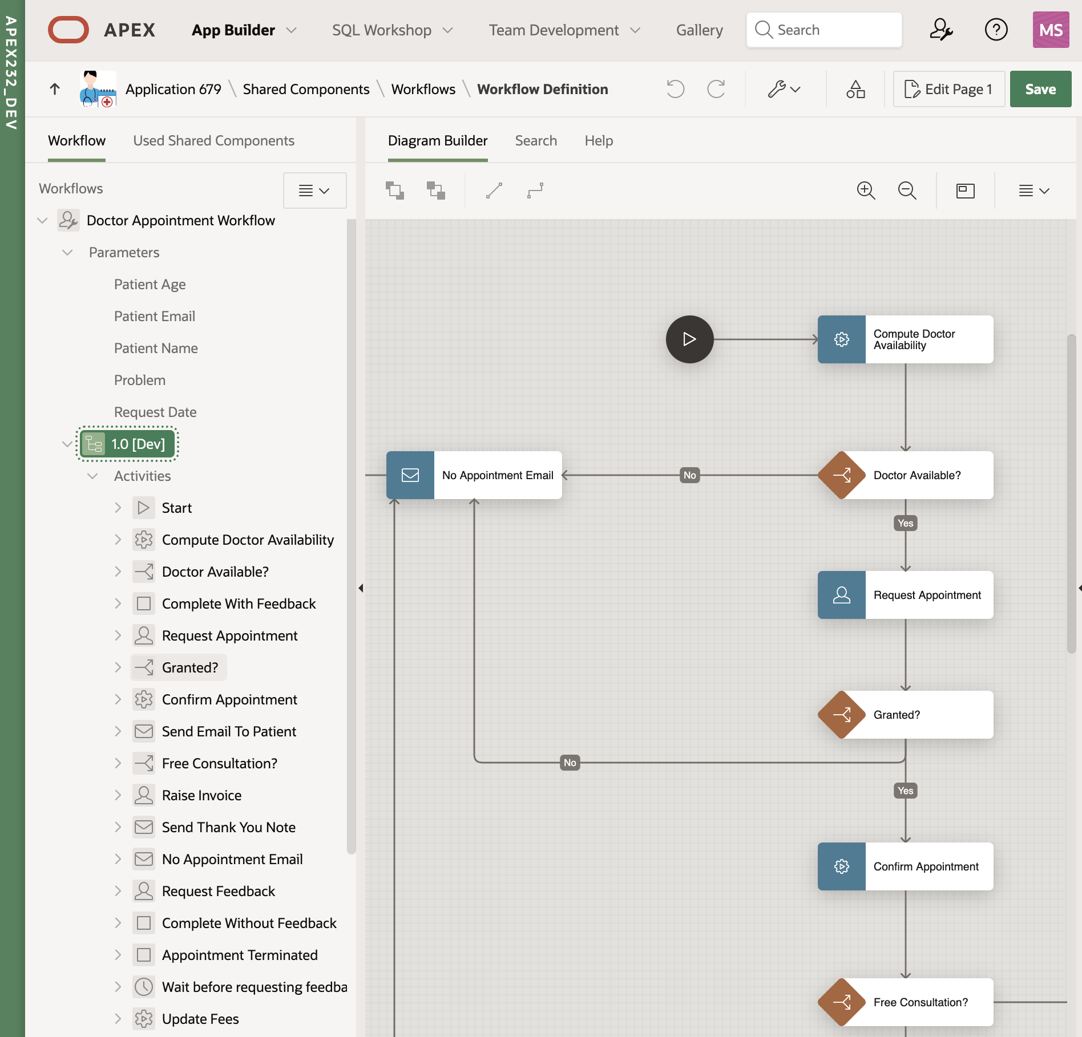
Designing Workflows
The Workflow Designer is a graphical user interface for modeling of Oracle APEX Workflows.
The Workflow Designer shows all Workflow Definitions within the APEX Application in a tree.
Workflow Definitions can be expanded to show additional information like the Workflow Input Parameters, Workflow Activities, Transitions, and Variables.
The Central Pane of the Workflow Designer also has a Diagram Builder for modeling workflows.

Slide 11
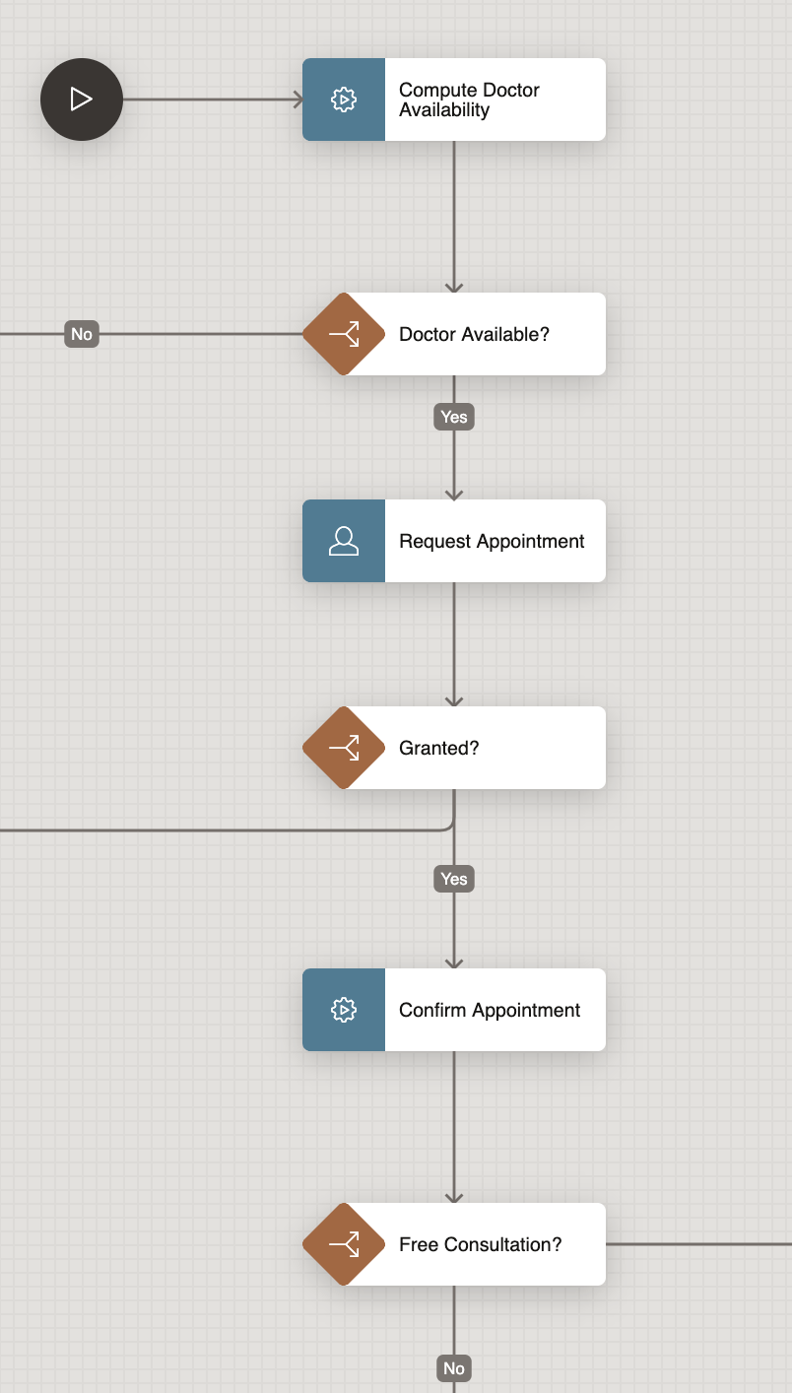
Workflow Activities
Workflow Activities are the “boxes” within a Workflow Definition.
They specify which kind of work is performed in “Workflow Execution” when the Activity is activated.
In the APEX Ecosystem, each workflow activity corresponds to a process type plugin. All workflows have:
      Exactly one Start Activity in the beginning
      At least one End Activity in the end
      Existing Native Process Type Plugins like Execute Code, Send E-Mail, Human Task – Create (Approval), Send Push Notifications, are available as Workflow Activities.
      Workflow Specific Process Type Plugins are Workflow Start, Workflow End, Wait and Workflow Switch.

Slide 12
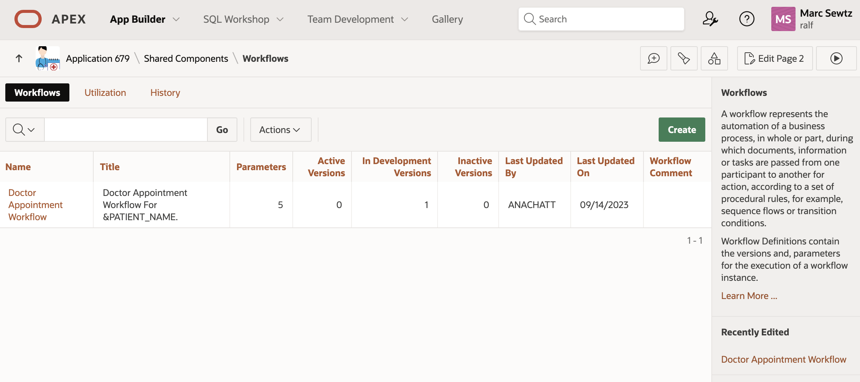
Workflow Reports
Workflow Report page shows the summary of all Workflows in the Application.
Clicking on the Workflow Name,
opens the Workflow Designer with
the specific workflow highlighted.
The Workflow Utilization Report
shows all pages and page
components where Workflows are
used in a specific application.
The Workflow History Report shows recent modifications made to Workflows.

Slide 13
Monitoring Workflows
The Workflow Console allows workspace users to view and manage their workflow instances
When configuring the Workflow Console, you have different Report Contexts to choose from:
      My Workflows, for users who are specified as Workflow Owner for the workflow.
          Shows all workflow instances with the user as a workflow owner.
          Sorts by descending creation date, with newly created workflows at the top of the list.
      Admin Workflows, for users who are workflow administrators of the workflow(s).
          Shows all workflows that have the user specified as a workflow administrator
      Initiated by Me, for users who have initiated workflows.
          Shows all workflows that the user has initiated.

Slide 14
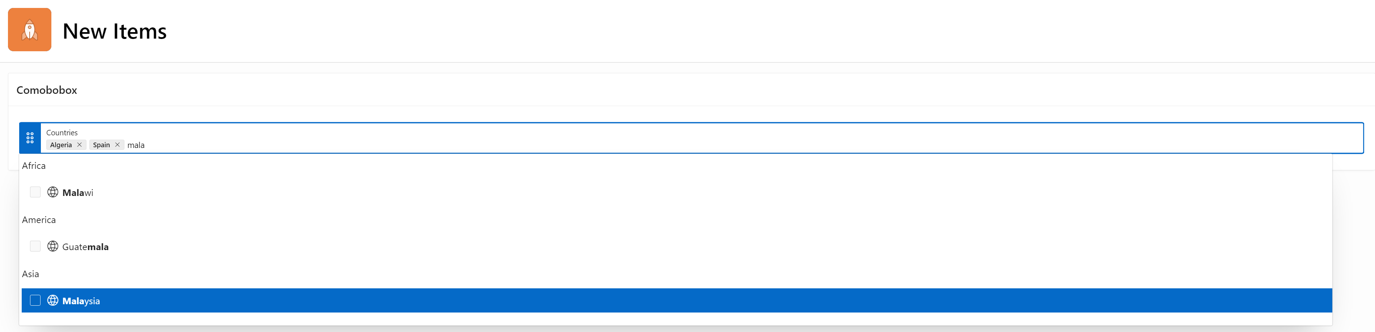
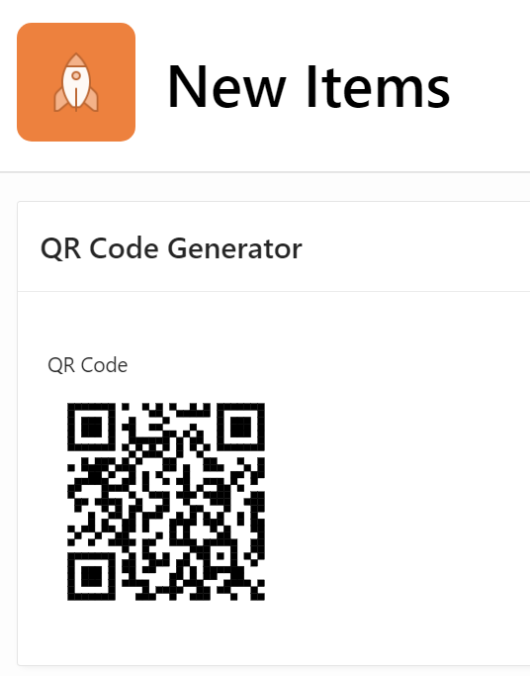
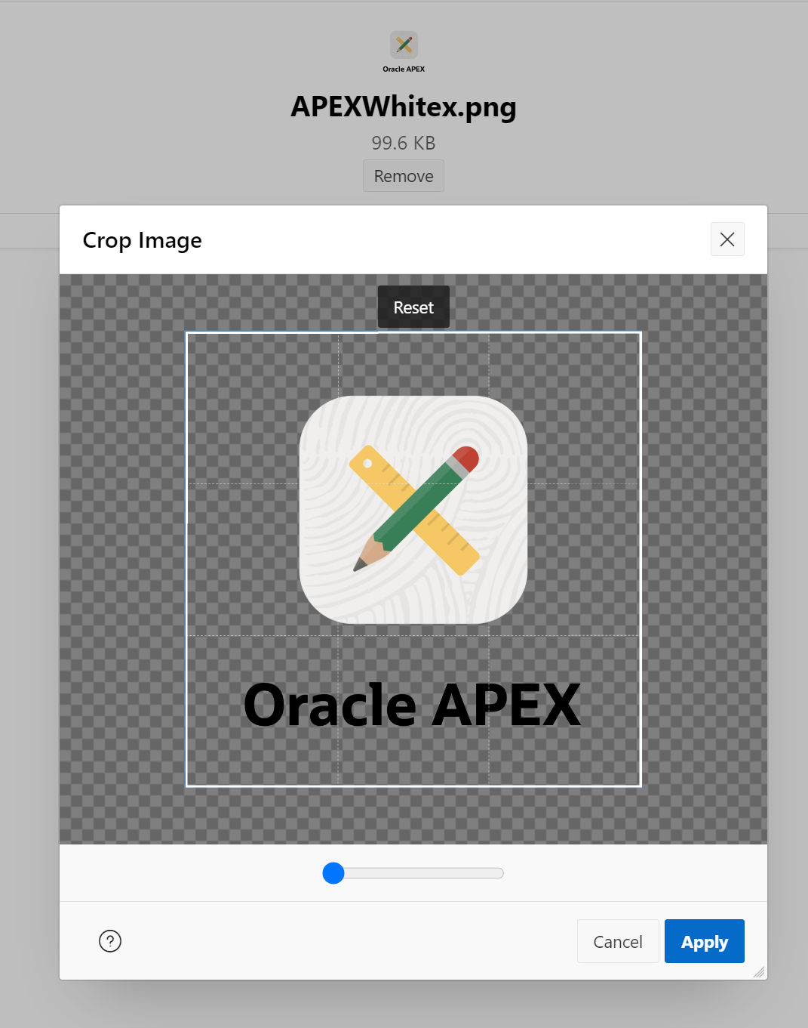
New and Updated Components

Slide 15
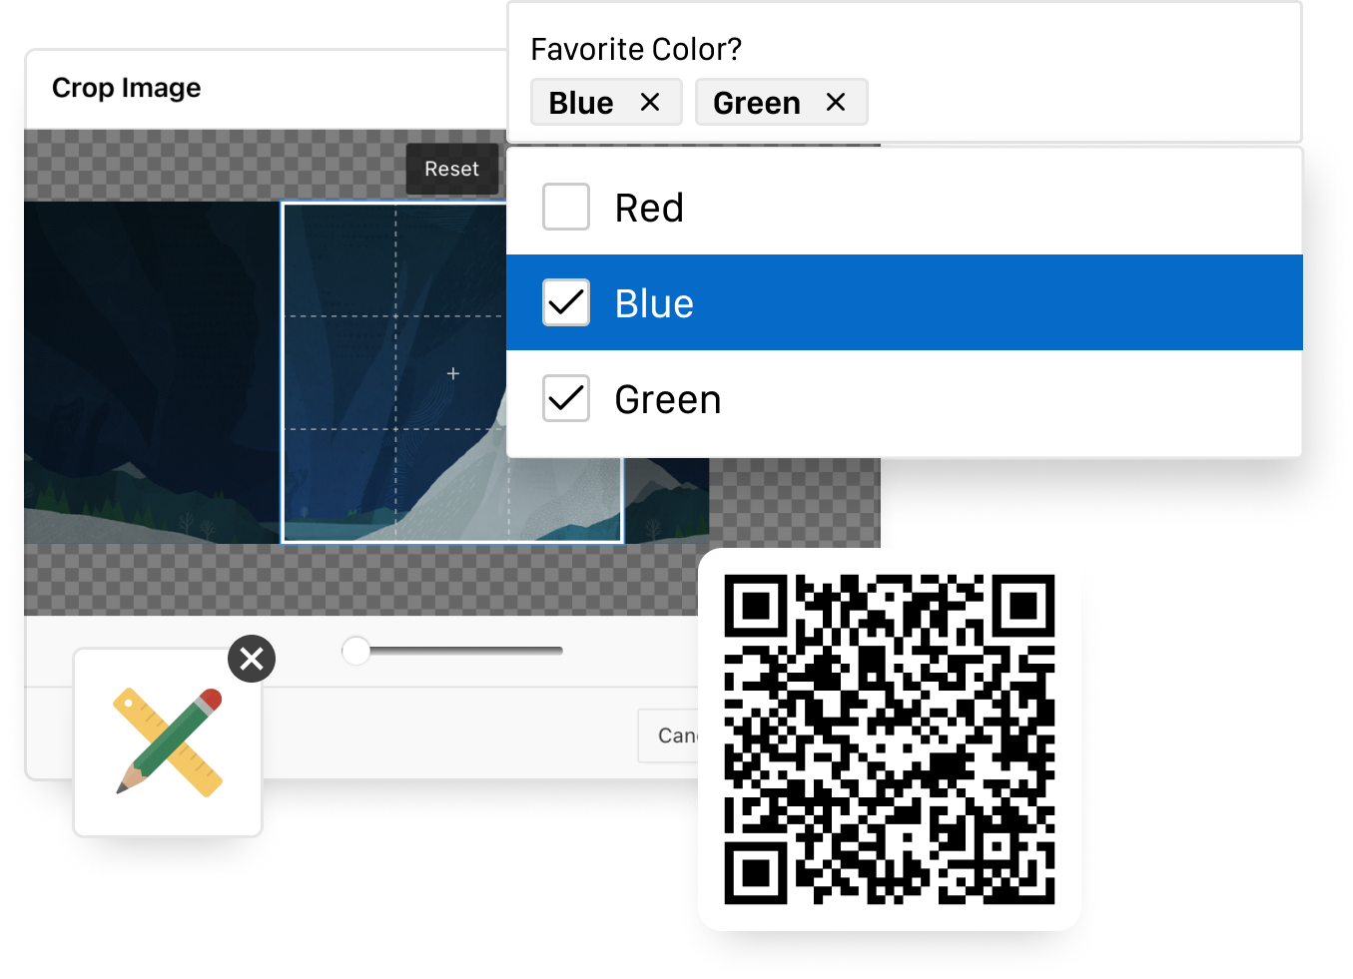
New and Updated Components – New Page Items
Combobox
    A new Combo Box item type, which has a One and Many configuration
    Supports custom HTML for the choices with Template Directives
    Multi-select, The user can select more than one option and the dropdown is kept opened
Image Upload
      File Browse renamed to Image Upload
      Ability to crop and/or resize images client-side
      You can also configure whether to use the main or selfie camera for mobile devices.
QR Code Generator
The new QR Code item type lets you easily embed scannable QR codes that contain text, URL, phone, email, SMS, or location data.
You can also use the associated QR Code API for embedding QR codes within reports, emails, or other parts of your application.

Slide 16
New and Updated Components
Custom Map Backgrounds
    Maps now support custom background tiles enabling you to visualize your spatial data in more ways than ever before.
    Map backgrounds are defined in Shared Components and can be used across all map components. You can subscribe, refresh, and publish your Map Backgrounds just like any other Shared Component.
    Map backgrounds can be defined as Raster, Vector, and OGC WMS tile layers, and can be further customized with additional parameters
Faceted Search Enhancements
    Arbitrary Facets Support: Flexible filtering of report columns on input-based facets, with support for comparison operators extended to include not equals, does not contain, and does not start with.
    Sort by Descending: Developers can control the sort direction for distinct LOV based facets.

Slide 17
New and Updated Components
Template Component Updates
    Template Components render faster and support any number of attributes, enabling developers to build even more sophisticated UI components.
    Developers can now create Template Component plug-ins without the constraint of only 25 attributes.
    With improvements to compilation time, Template Components now render even faster, creating the optimal user experience.
    Several updates to the Template Components shipped with Universal Theme provide developers with more versatility in how to use Template Component across their applications.

Slide 18
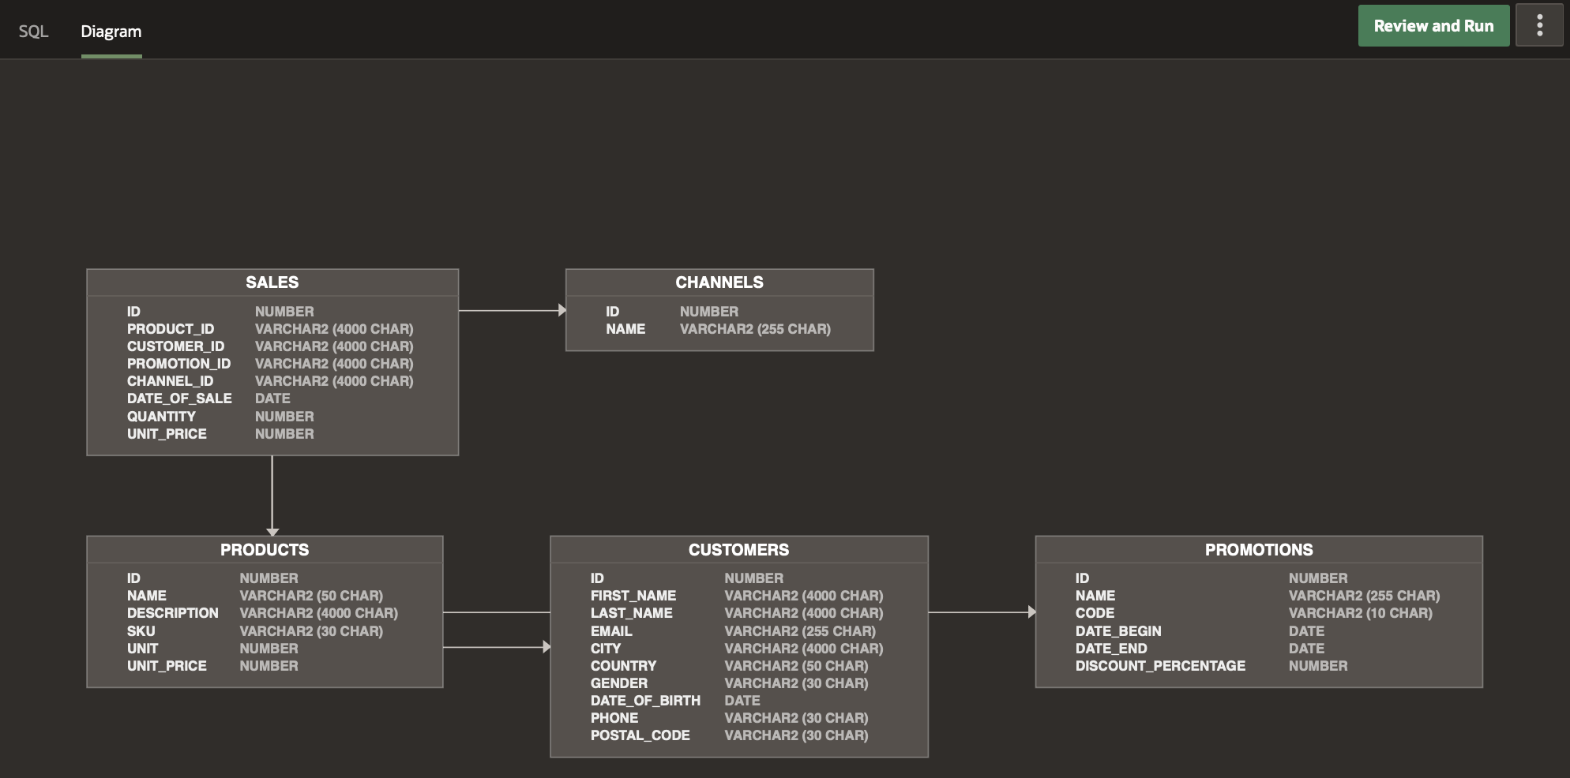
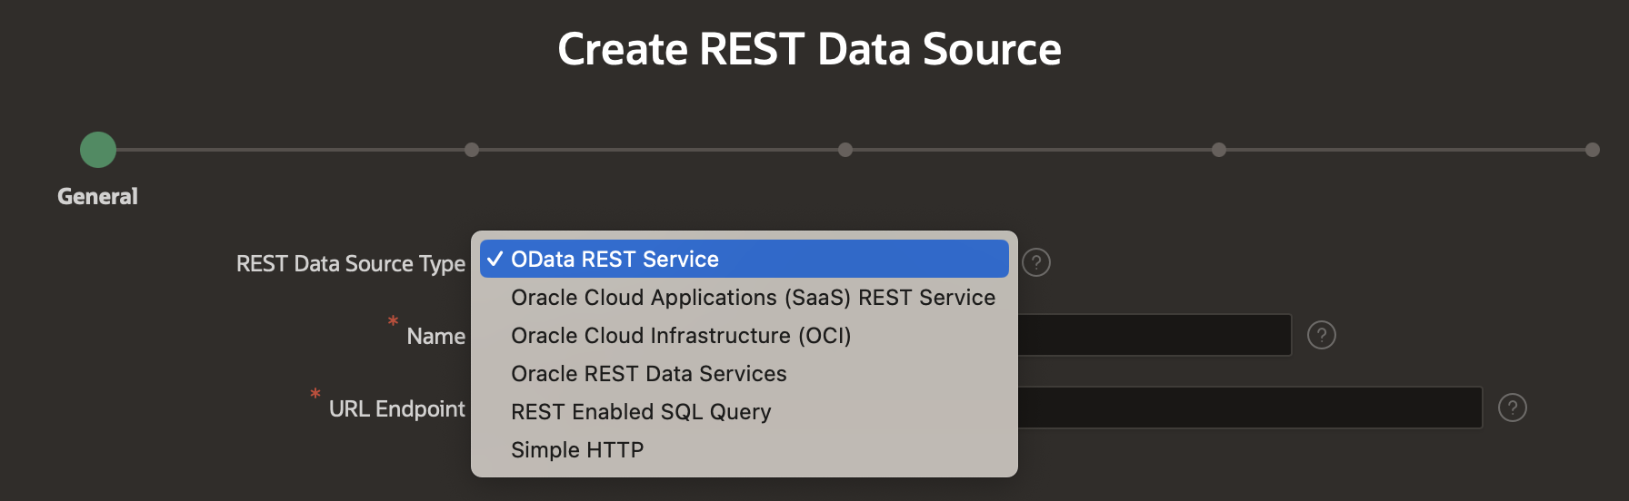
Developer Experience

Slide 19
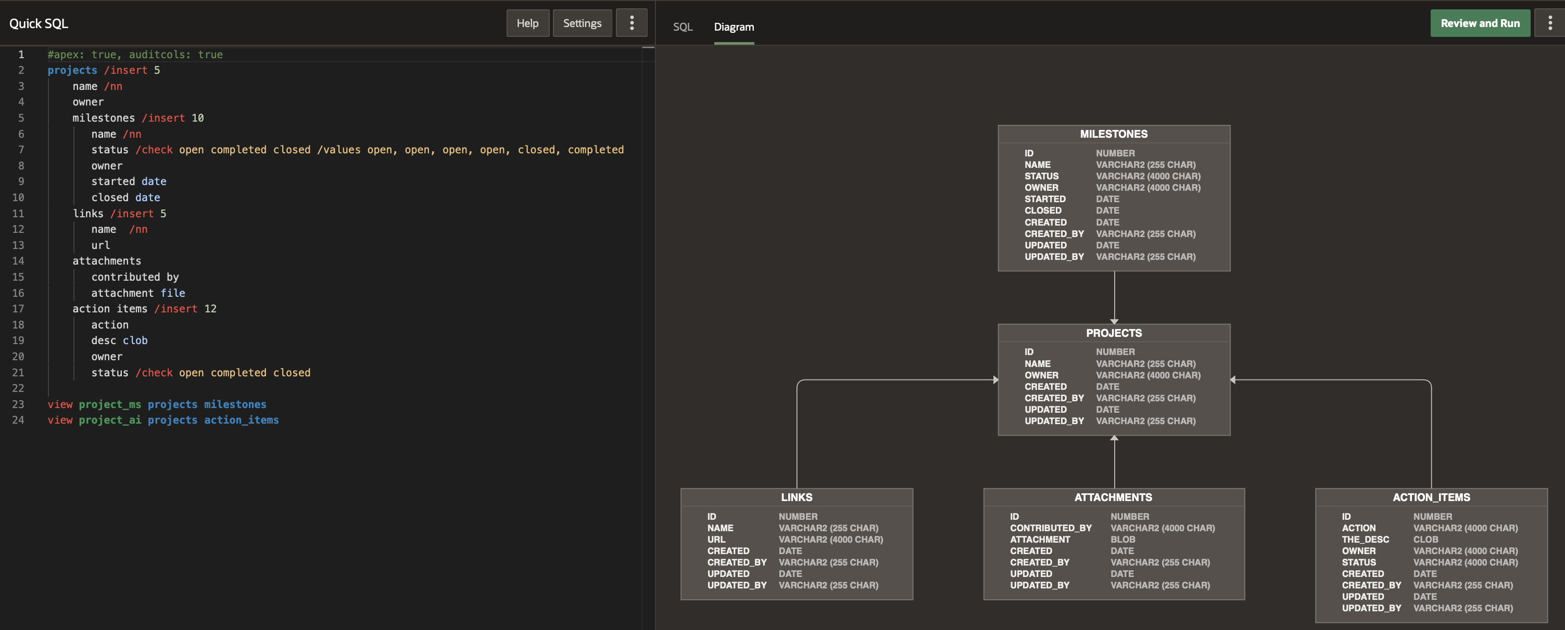
Developer Experience
Quick SQL Updates
    Visualize your data model's tables, columns, datatypes, and relationships in an intuitive entity relationship diagram accessible via the new Diagram tab.
    The generated SQL script and ER diagram refresh instantly whenever you pause your typing.
    Save time and cognitive cycles with the revamped review and run, simpler saving, and streamlined help.

Slide 20
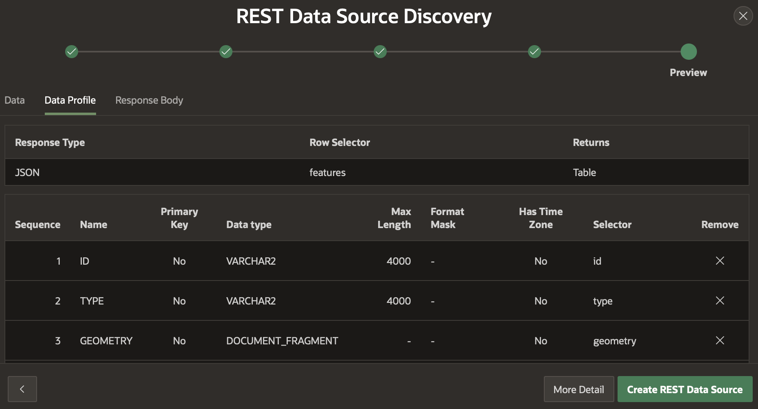
Developer Experience
REST Data Source Enhancements
    Data-type aware REST Source Parameters
    Regular expression validation for REST Source Parameters and Data Profile columns
    You can now create a REST Data Source Catalog which contains all of the endpoints based on an OpenAPI definition.
    REST Source Plug-in enhancements
    Native OData REST Source Type: The OData Connector has now been integrated as a native component within APEX, allowing developers to incorporate data from REST services that adhere to the OData protocol without the need to install any plug-ins.

Slide 21
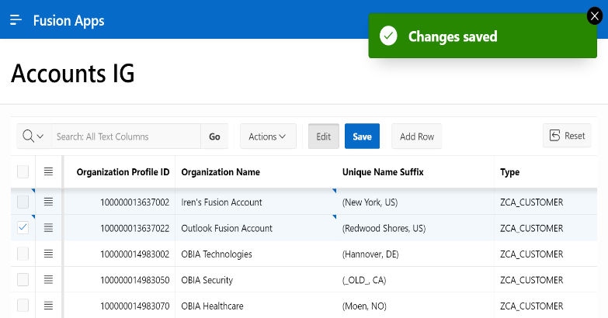
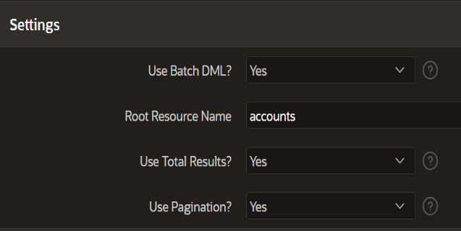
Developer Experience
Support for Fusion Apps Extensions

Slide 22
Developer Experience
Support for Fusion Apps Extensions
    You can now create REST data sources to query, insert, update, and delete data from Fusion Apps REST APIs.
    Once your REST Data Sources are defined, you can use any APEX regions connected to the Fusion Apps REST APIs and build custom experiences using the power of SQL.
    Intuitively present FA REST API validation errors like native APEX ones
    Quickly build Query-by-Example pages and Cascading LOVs using filter parameters
    Intelligently avoid common errors using auto-discovered additional info hints on data profile columns
    Directly pass filtering/ordering to the backend, request only necessary data, and use bulk operations
    Efficiently paginate search results with total results when needed (X - Y of Z)
    Iteratively develop against in-progress FA Business Object customizations in a sandbox
    Consistently use APEX$RESOURCEKEY with any approach FA REST allows to uniquely identify rows

Slide 23
Developer Experience
Improved Share Components Subscriptions
    Extend subscription functionality to all shared components
    Subscribed components are now read-only
    Automatic dependency resolution
    New Subscription Status column available across Shared Components reports
    Bulk refresh and deletion – Easily view subscribed shared components that are out of sync and refresh them
Workflow and Approvals Enhancements
    Action Tasks: Define human tasks that require a participant's input or acknowledgement without an explicit approval outcome.
    Optionally allow parameters to change value during a human task and react to the event using the Update Parameter action and new APIs.
    Business administrators can now remove task participants in addition to adding new ones.

Slide 24
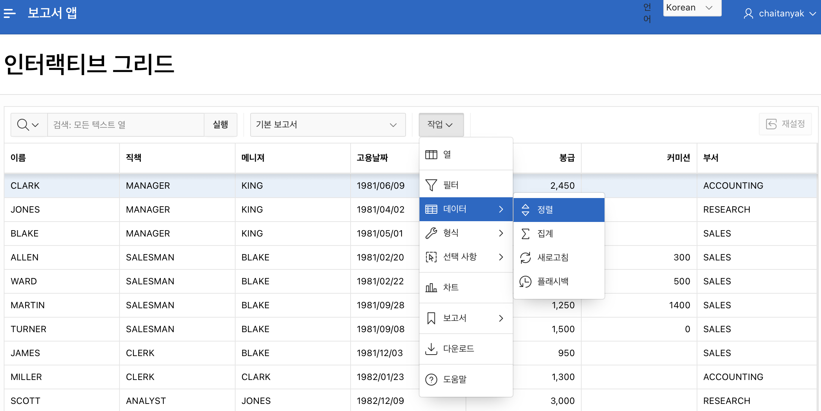
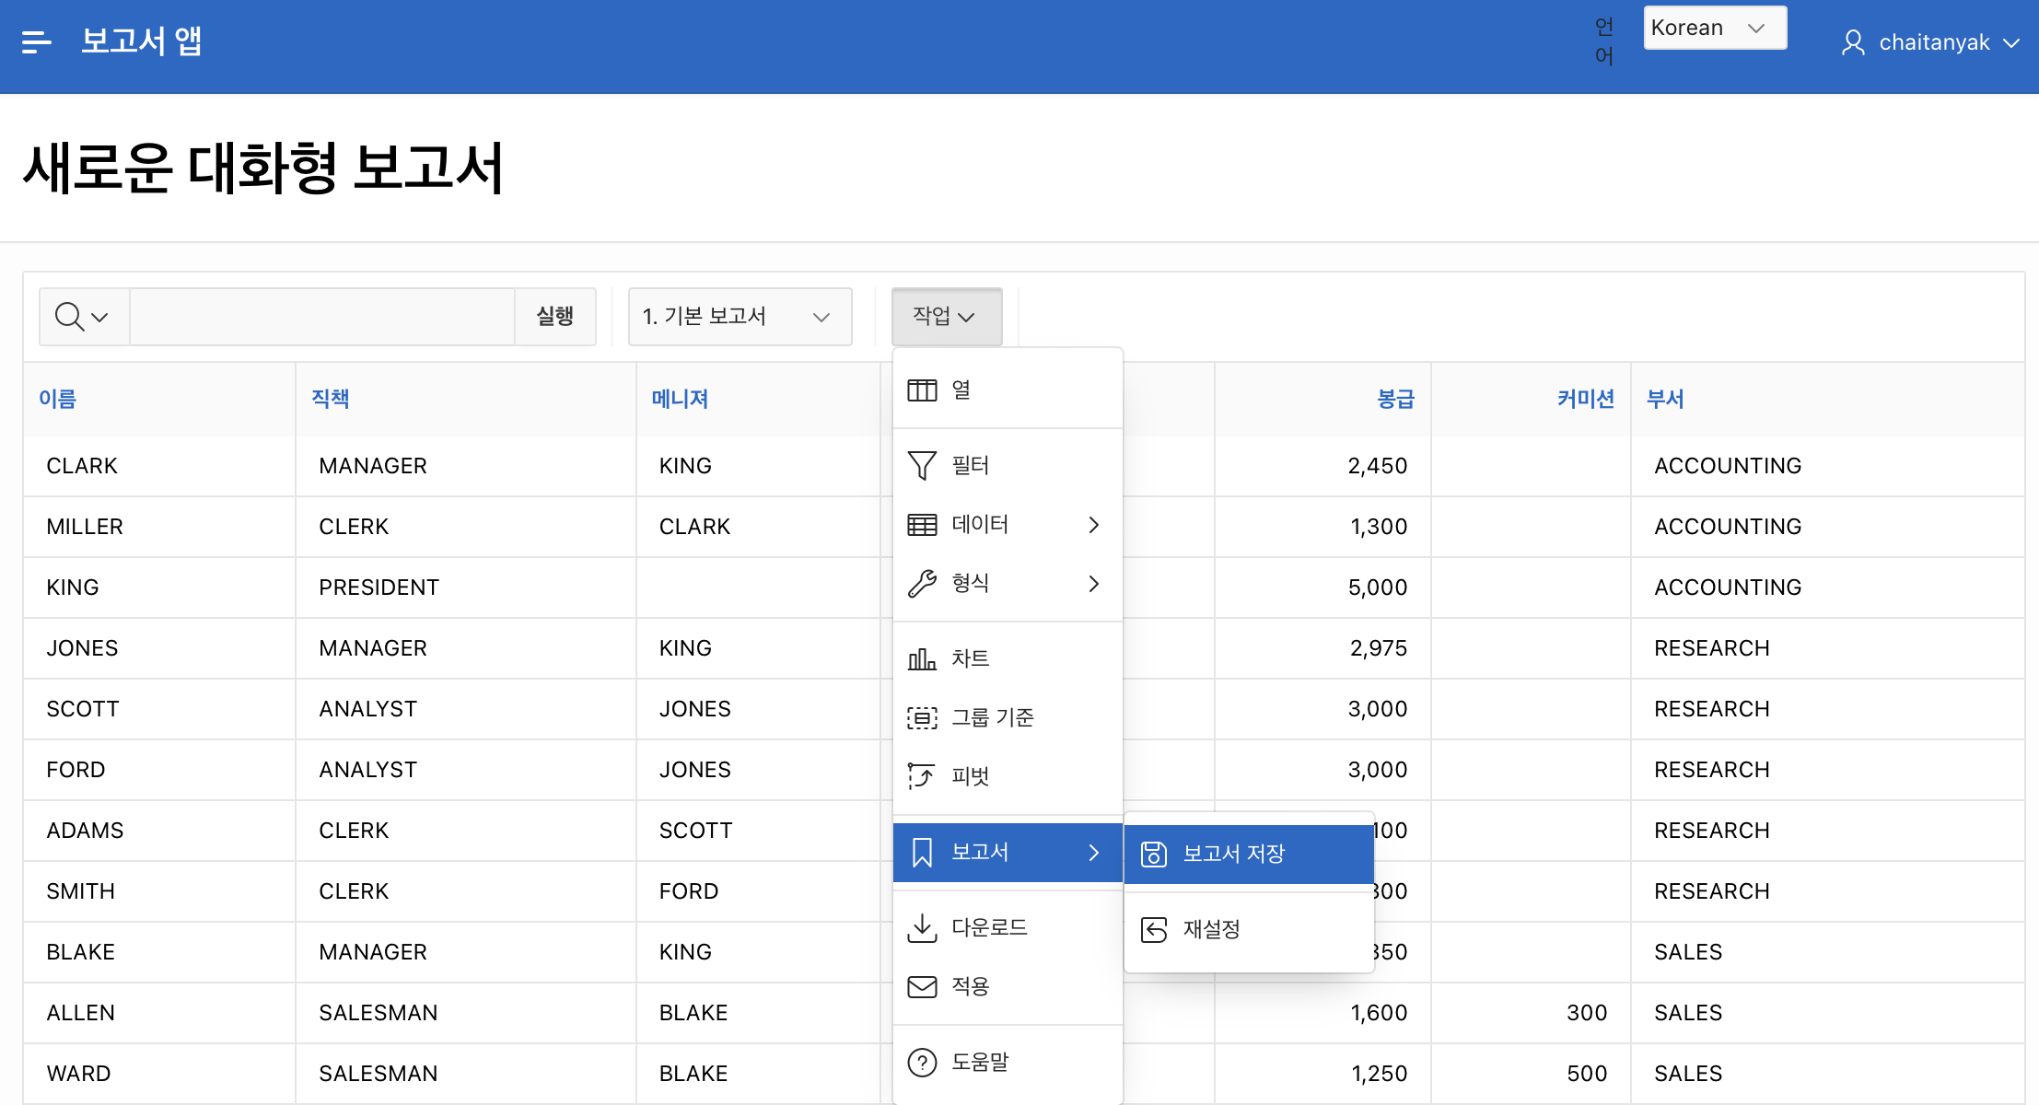
Developer Experience
Translating Default Reports
You can now translate Default reports ( Primary Default or Alternative Report ) for interactive report and interactive grid regions.
Saved default reports can be translated via application translation process. The translatable XLIFF file includes translating default report settings.

Slide 25
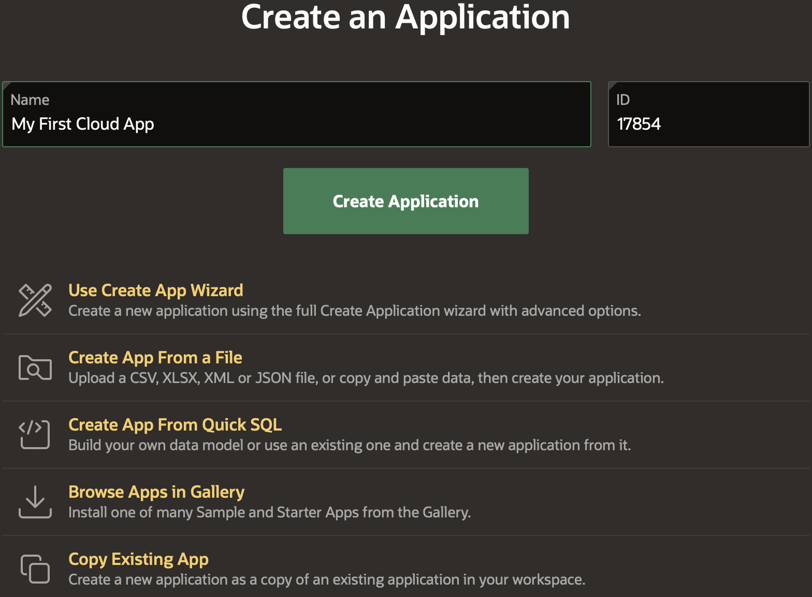
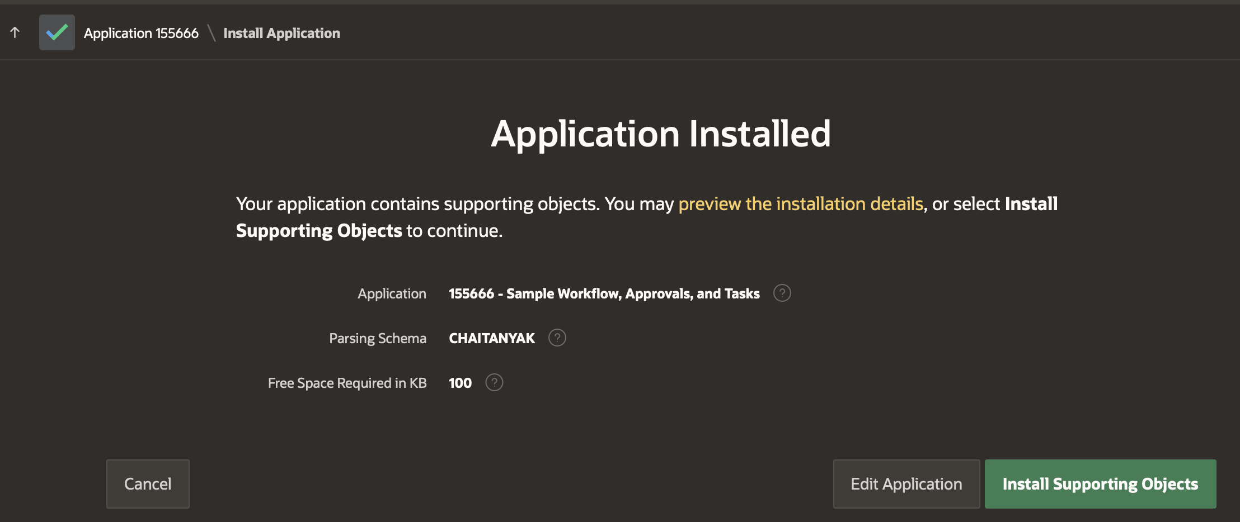
General Builder Improvements

Slide 26
General Builder Improvements
Simplified Create App Wizard
    Enter an app name and use the Create Application button on the first page of the Create App process without having to go through the whole wizard
    The list of additional create options now have a new look, and there are options to use the full Create App wizard or Quick SQL in addition to the existing entries
Improved UX of App Export and Import
    The import and export wizards have been simplified to create a more intuitive, enhanced user experience.
    Export apps, pages, or components using the new, standardized navigation system for different types of exports, then import them into your workspaces and applications in just a few steps.
Builder Extension Links
    Add additional menu entries to the Builder UI for your workspace
    All entries/URLs will be opened in a new browser tab

Slide 27
General Builder Improvements
Comment and Uncomment from Context Menu in Page Designer
    New Comment and Uncomment options in the Rendering Tree Context Menu in Page Designer allows toggling any component's Build Option attribute directly from the Context Menu in Page Designer, saving many clicks during the development process.
Application Gallery Improvements
  Install an app without using the Install dialog, and configure background app installations for an instance so you can do other tasks while an app installs or so you can install multiple apps in sequence.
  A new update option allows you to get the most recent version of a previously installed app already without needing to remove it.
Accessibility Improvements across the Builder
  General accessibility enhancements to the development environment and numerous accessibility-focused bug fixes have been made to create a better user experience for all users.

Slide 28
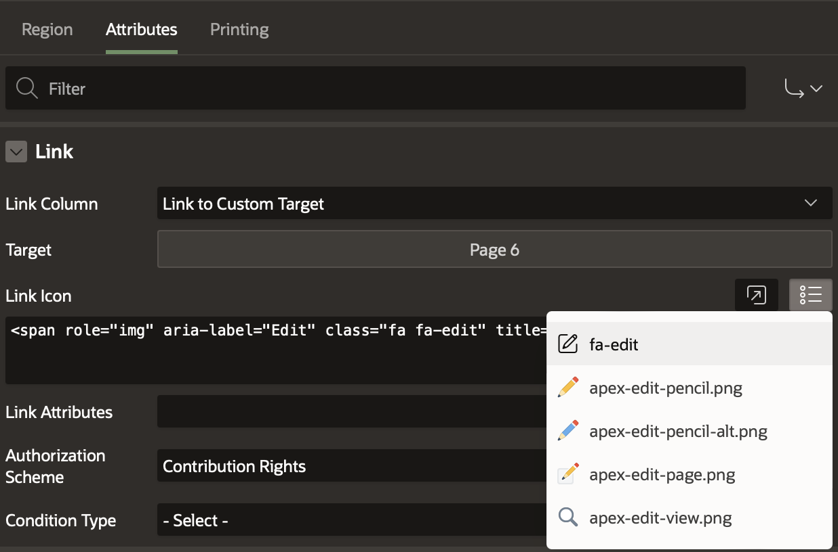
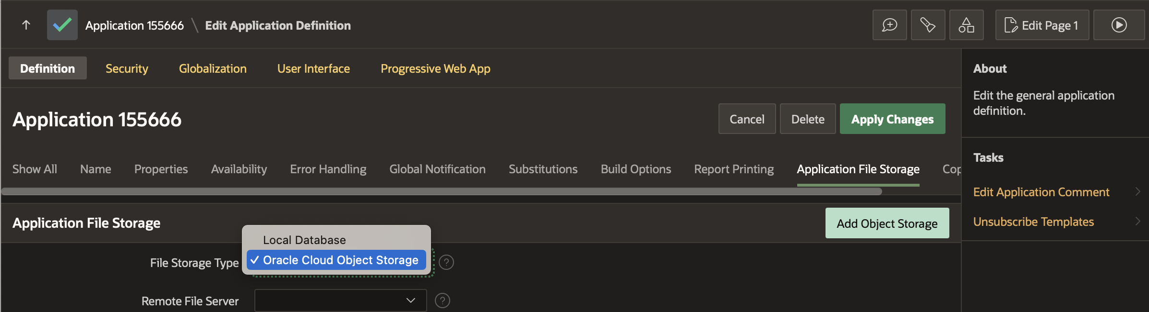
Additional Updates and Enhancements

Slide 29
Additional Updates and Enhancements
Show Success Messages After Close Dialog
The Close Dialog process has a new attribute called Show Success Messages. When switched on, success messages are shown in the top level frame of the page.
Store Static Resources in Object Storage
A new Application File Storage option in Application Definition makes Object Storage available as the location for storing application static resources such as images, CSS, and JavaScript.
Default Interactive Report Link Edit Icon
When choosing a custom target for an interactive report attributes, the link icon will default to fa-edit if the application contains Font APEX. fa-edit is also added to the quick pick list.
Ubiquitous Database Search for Oracle Database 23c
A new search type in the APEX Search Configuration wizard provides support for the new Oracle Database 23c feature, Ubiquitous Database Search.

Slide 30
Additional Updates and Enhancements
Background Execution Chain Context
Associate a context value with a background execution chain and optionally serialize execution based on it.
Disable and Restrict Apps with new Instance Parameters
New parameters in the APEX_INSTANCE_ADMIN API makes it possible to disable and restrict apps in your APEX workspace. Disable some or all apps with the DISABLE_APPS_LOGIN parameter, or restrict access to back-office apps with the RESTRICT_APPS_HEADER parameter, which identifies the HTTP request header and determines which apps are permitted for public use.
New Dataset for Arabic and Italian Languages
The EMP and DEPT dataset has been added for both the Arabic and Italian languages, accompanied by a blueprint for easily building sample applications on the underlying dataset.

Slide 31
Additional Updates and Enhancements
Populate List Item Sub Entries with List Reference
Child Items of a Static List Item can now be populated by a reference a List, with the ability to nest lists up to 10 levels. The referenced List can be static or Dynamic, and identifying List and Sublist relations can easily be done in the List Utilization report.
Enhancements to Template Directives
Template Directives are now available for use inside the Text, Textarea, and HTML Template Component attributes in Page Designer, as well as in assignments of a {with/} and {apply/} block.
Improvements to Background Processing
Background page processing just got better with improved serialization, better integration with APEX error handling, and allowing transactional and non-transactional submissions.
Refreshed Redwood Light
Tweaks to colors, backgrounds, textures, padding, and additional styling give the Redwood Light theme a refreshed look and feel.

Slide 32
JavaScript Library Upgrades
Oracle JET 15.0.7
jQuery 3.6.4
jQuery Migrate 3.4.1
FullCalendar 6.1.8
MarkedJS 5.1.2
DOMPurify 3.0.5
Terser 5.19.2
MapLibre 2.4.0
TinyMCE 6.7.1
PrismJS 1.29.0
csso 5.0.5
cropperjs 1.5.13
CKEditor5 36.0.0
jQuery UI 1.13.2

Slide 33
Learn More…
What’s New in Oracle APEX 23.2
apex.oracle.com/go/whats-new-232
Oracle APEX 23.2 New Features videos playlist
apex.oracle.com/go/232-playlist
Updated and New Hands-on Labs
apex.oracle.com/hols

Slide 34

Oracle APEX Training and Certification

Slide 35
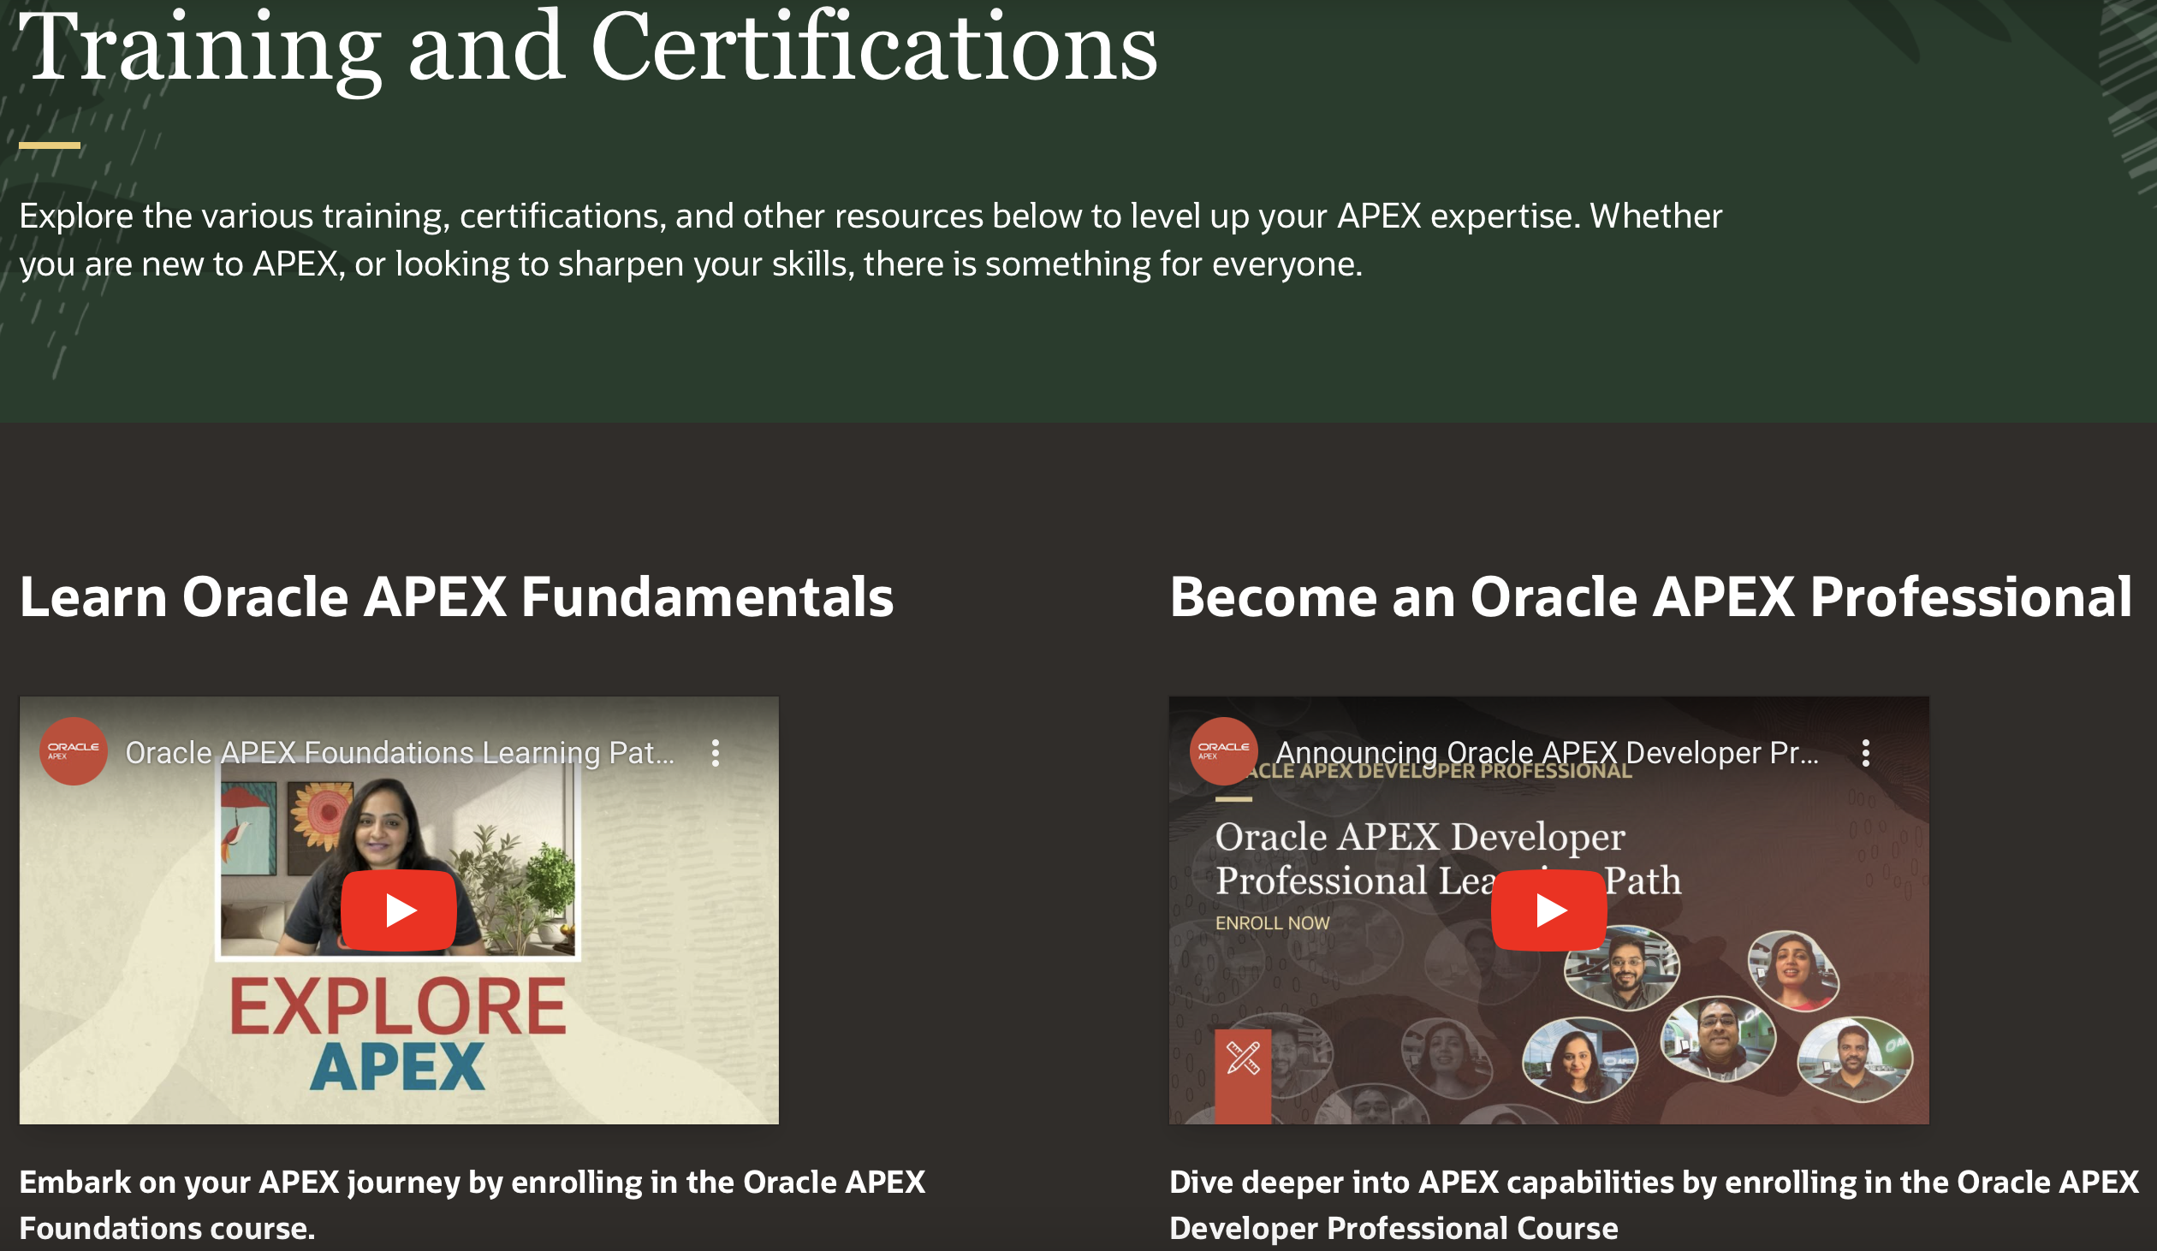
Oracle APEX Training & Certification
apex.oracle.com/go/training
APEX Foundations
apex.oracle.com/go/foundations
APEX Developer Professional
apex.oracle.com/go/professional
Get Certified
apex.oracle.com/go/professional

Slide 36







Learn the Fundamentals of Oracle APEX
Oracle APEX Foundations Course
Learn the fundamentals of low-code app dev with Oracle APEX
3.5 + hour expert training delivered by the APEX Product Team
Enroll and learn for FREE Today on Oracle University!!
apex.oracle.com/go/foundations
Available on LinkedIn Learning
www.linkedin.com/learning/oracle-apex-foundations
Don't forget to share your badge on social media and tag us using #orclAPEX

Slide 37
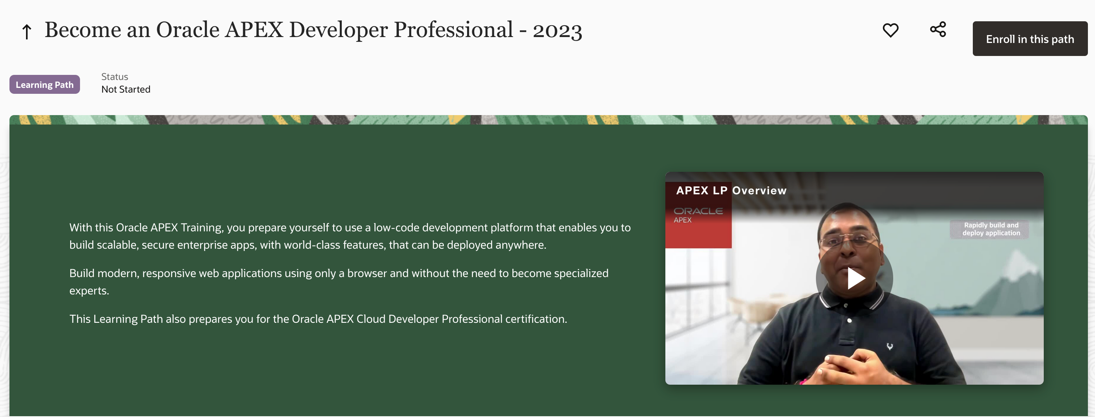


Become an Oracle APEX Professional
Oracle APEX Developer Professional Course
Soup-to-nuts covering complete low-code app dev with Oracle APEX
13 hours of expert training delivered by the APEX Product Team
Hands-on-Labs to practice along with the training videos
Enroll and learn for FREE Today on Oracle University!!
apex.oracle.com/go/professional

Slide 38
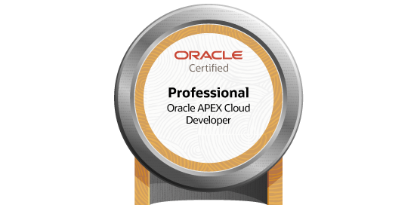
Get Oracle APEX Certified
apex.oracle.com/go/professional
Become an Oracle APEX Cloud Developer Certified Professional:
Complete Oracle APEX Developer Professional course
Perform Oracle APEX Developer Professional Hands-on-Labs
Prepare for Oracle APEX Cloud Developer Professional Exam
Register and pass the Oracle APEX Cloud Developer Professional online certification exam

Slide 39
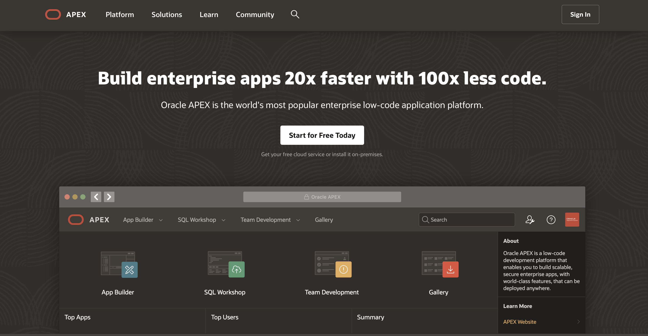
Everything about Oracle APEX
apex.oracle.com

Slide 40
Thank you

