Slide 1

Oracle APEX 26.2 – New Features

Slide 2
Safe Harbor

Slide 3
Speaker

Slide 4

What’s New in Oracle APEX 26.2?
APEXlang Enhancements
More Capable AI, with More Control
A Smarter, More Modern Interactive Reports Experience
Deep Data Security Integration
Additional Platform Enhancements

Slide 5
APEXlang Enhancements and New Features

Slide 6
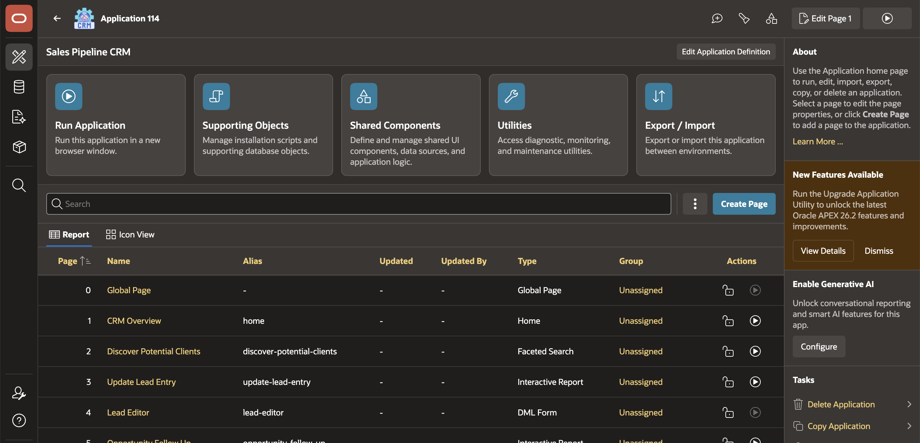
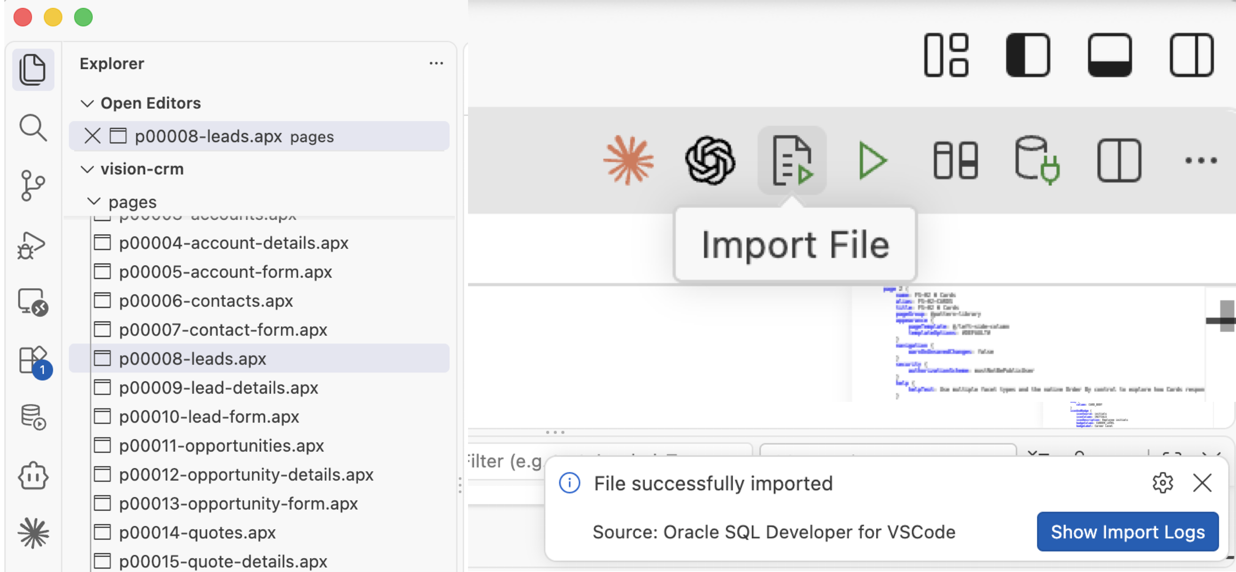



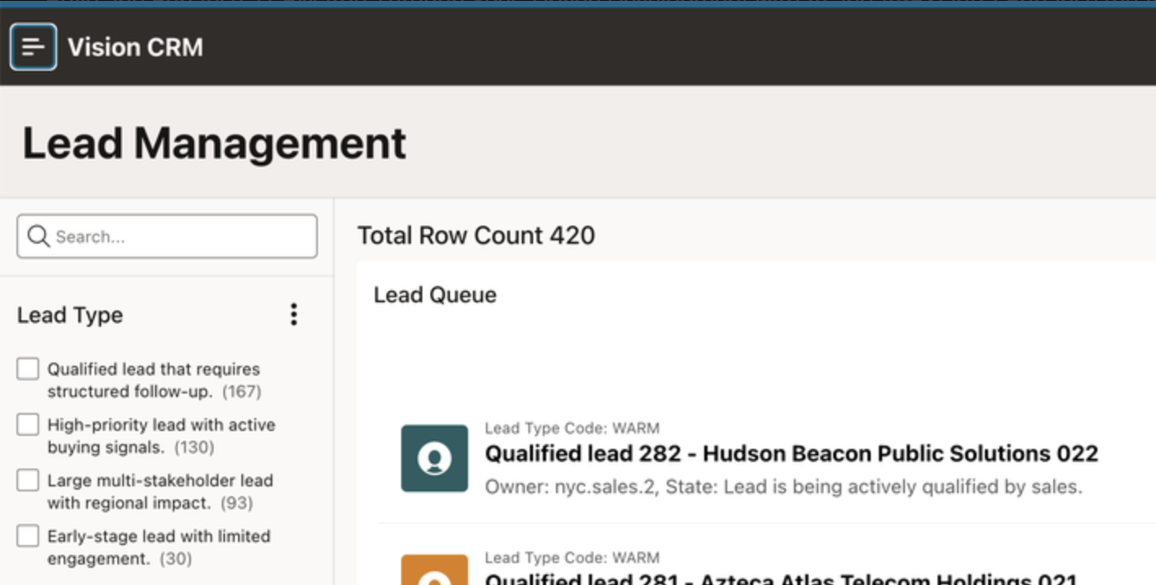





APEXlang File level Import
Import single .apx file
Developer 2
Developer 1
Faster imports for targeted changes
A shorter development and testing cycle
Less risk of affecting
unrelated application
components
Better support for
parallel development
Easier troubleshooting through a smaller
change scope
Notes:
APEXlang now supports importing selected single files/pages, allowing developers to apply a focused set of changes instead of importing a full application.
This shortens the development and testing cycle because teams can validate only the components that changed.
It also reduces the chance of affecting unrelated parts of the application.
The feature is especially useful when multiple developers work in parallel, since each developer can move a smaller, clearly defined change set.
If an issue occurs, the reduced scope also makes troubleshooting easier.
Overall, selected file import gives teams a faster and more controlled way to move APEXlang changes between environments.

Slide 7
APEXlang Enhancements: Application Translations
Translation repository preserves application-based translations
Translation data now included with the application through APEXlang exports in Oracle APEX 26.2.
Translation repository data is included as SQL artifacts, preserving links between translated text and application components.
Works for new installations and application replacements, keeping translations connected to regions, items, buttons, and shared components.
Simplifies multilingual CI/CD workflows by preserving existing XLIFF translation work across environments.
Oracle APEX Application
⌂
</>
Translation
Repository
APEXlang
Export
Application Translations
English
French
XLIFF
XLIFF
XLIFF
German
Japanese
Existing XLIFF workflows remain connected to application components
7
Copyright © 2026, Oracle and/or its affiliates
Notes:
Translation data now included with the application: In Oracle APEX 26.2, APEXlang exports include application-based translation data. This allows the translated application content to move with the main application definition instead of being managed as a disconnected deployment artifact.
Translation repository data is preserved as SQL artifacts: The export represents translation repository data as SQL artifacts. These artifacts preserve the association between translated text and the corresponding APEX components, including component identifiers and translation metadata.
Translations remain connected during installation or replacement: When teams install a new application or replace an existing application from an APEXlang export, APEX restores the translation data with its component relationships. Translations remain associated with components such as regions, page items, buttons, and shared components.
Multilingual CI/CD workflows become easier to manage: Teams can move an application through development, testing, and production environments while retaining translation work previously imported from XLIFF files. This reduces the need to rebuild or manually reconnect application translations after deployment.
Key message : APEXlang can now carry both the application definition and its application-based translations through the delivery lifecycle, helping multilingual applications remain consistent across environments.

Slide 8
APEXlang Enhancements: Subscription Mapping
Subscription maps to parent application IDs across workspaces
Supports subscription mapping for APEXlang imports
Detects different master application IDs across workspaces
Reuses the existing subscription-mapping step in App Builder
Prevents unresolved subscriptions during application deployment
Source Workspace
Target Workspace
Parent App
(ID 100)
Map to
Parent Application
App (ID 200)
Page
Shared
Component
Page
Shared
Component
Map to Existing Application
Source Application
Target Application
100
→
200
Page
→
⌄
Shared Component
→
⌄
App Builder brings APEXlang imports into the established mapping workflow
8
Copyright © 2026, Oracle and/or its affiliates
Notes:
Supports subscription mapping for APEXlang imports: Oracle APEX 26.2 extends the subscription-mapping capability to applications imported in APEXlang format. This helps preserve component subscriptions when moving an application between environments.
Detects different master application IDs across workspaces: A subscribed component refers to its master application by application ID. That ID can be different in development, testing, and production workspaces. During import, APEX identifies when the referenced master application ID does not match the target environment.
Reuses the existing subscription-mapping step in App Builder: When mapping is required, the APEXlang import process uses the familiar App Builder subscription-mapping step. The developer can associate the source master application with the corresponding application in the target workspace.
Prevents unresolved subscriptions during deployment: Mapping the correct master application allows subscribed components to remain connected after import. This reduces manual correction and helps prevent deployments from leaving components with unresolved or incorrect subscription references.
Key message : APEXlang imports now handle application subscriptions more reliably across environments, even when master application IDs are different.

Slide 9
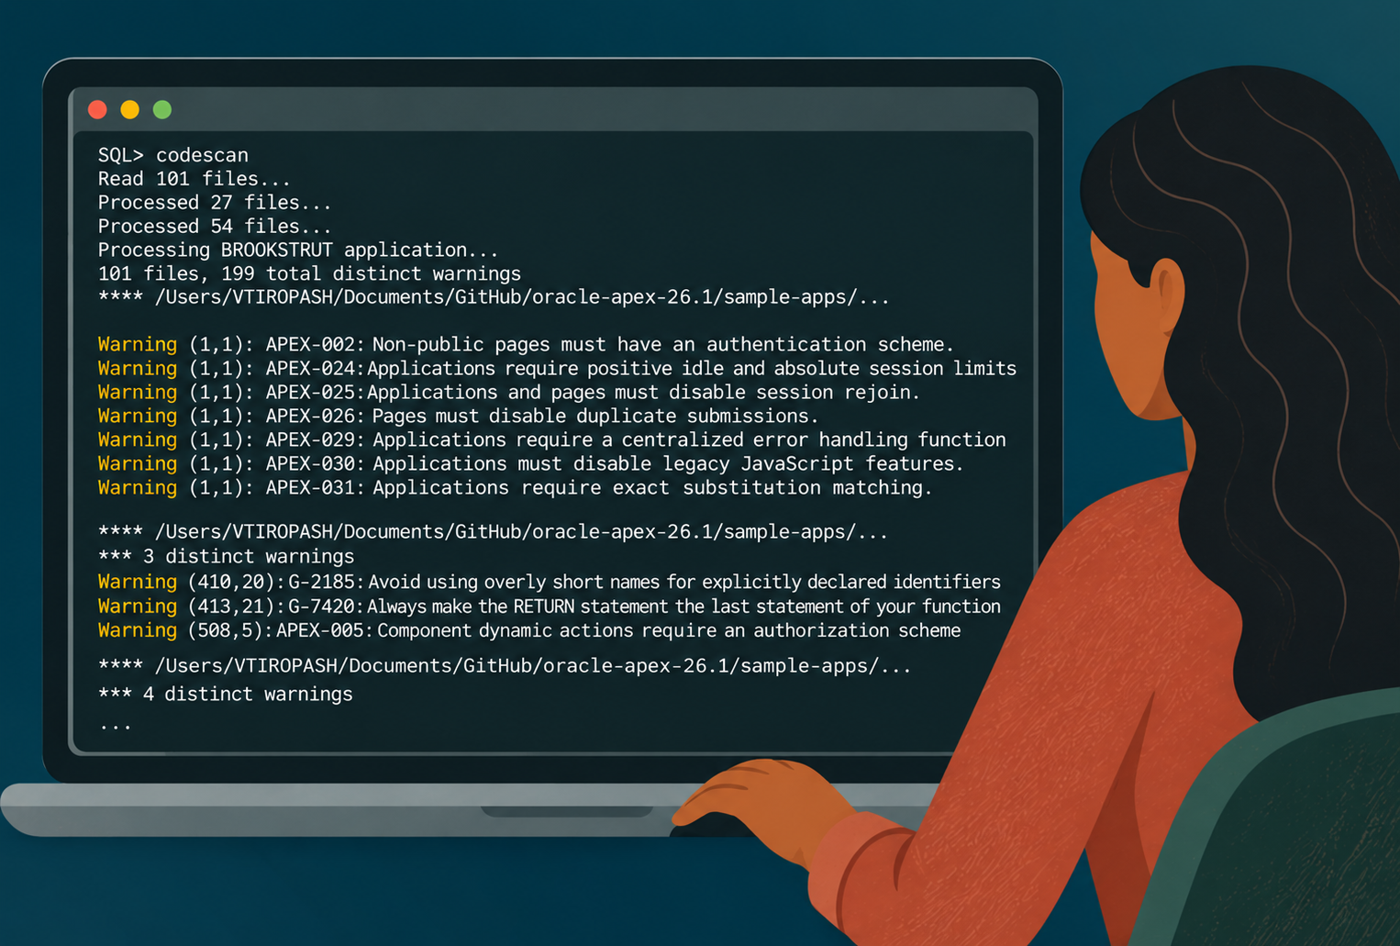


APEXlang static analysis
Scan exported .apx files with SQLcl CodeScan to identify supported security-configuration findings before deployment
Scan the application export
.apx
SQL> codescan -ext .apx export-dir
Supported checks include
Authorization requirements
Hidden-item value protection
Session limits and security defaults
Notes:
APEXlang static analysis helps developers identify supported security-configuration findings before deployment.
After exporting an application as .apx files, run SQLcl CodeScan against the export directory using codescan -ext .apx export-dir.
Supported checks include authorization requirements, hidden-item value protection, and application settings such as session limits and security defaults. Findings identify the source file, line, and column so developers can locate and review the relevant configuration.
They complement broader security testing and review.

Slide 10
AI Services and AI Agents:
More Capable, More Controllable

Slide 11
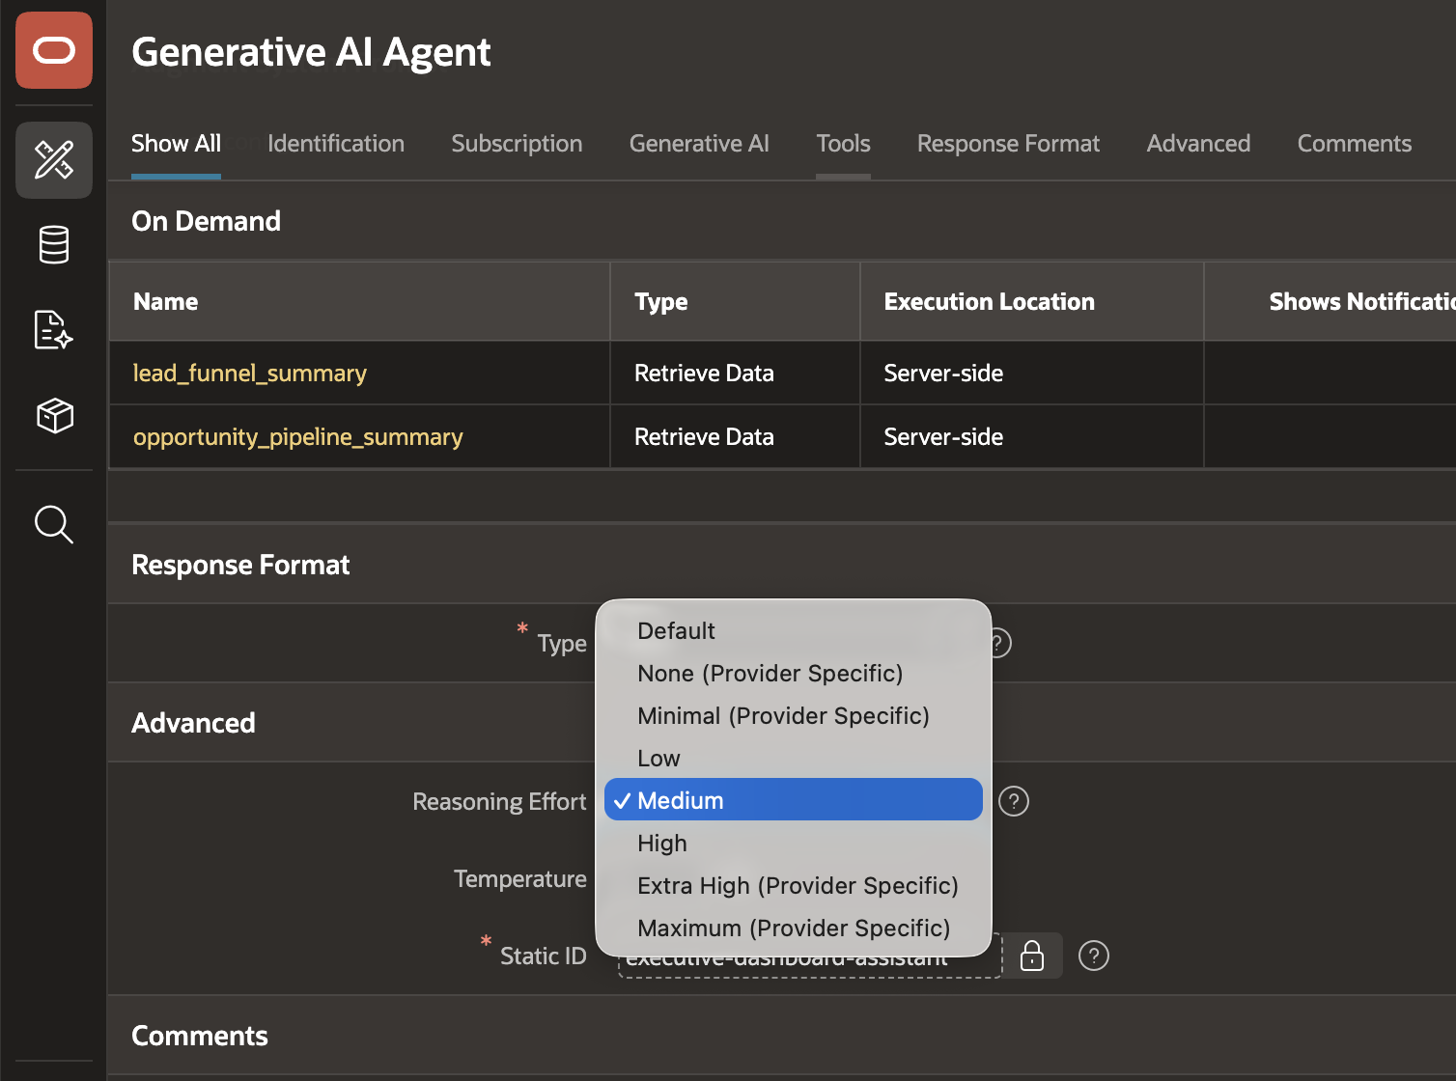

AI Agents Reasoning effort
Low
Medium
High
Configure reasoning effort for each AI Agent
Adjust effort programmatically or for individual requests
Balance response quality with latency and token use
Supported effort levels depend on the provider, API, and model
Notes:
APEX 26.2 adds control over the reasoning effort used by an AI Agent.
Developers can choose an appropriate effort level, such as low, medium, or high, and can adjust it programmatically or for an individual request.
This provides a practical way to balance response quality against latency and token usage. The available levels depend on the selected provider, API, and model.

Slide 12
Expanded AI provider API support
Anthropic
Select the Provider API on a Generative AI Service
Responses support for OpenAI and compatible providers, including supported OCI models
OpenAI
Meta Llama
Interactions support for Google Gemini
ORACLE
APEX
Google Gemini
OCI models
Dedicated OCI configuration fields simplify service setup
Mistral AI
Notes:
APEX also expands support for provider-specific APIs.
Developers select the provider API when configuring a Generative AI Service. The release supports the Responses API for OpenAI and compatible providers, including supported OCI models, and the Interactions API for Google Gemini. Dedicated OCI configuration fields make OCI service setup more direct. These options let teams choose the model and API behavior that best fits each use case.

Slide 13
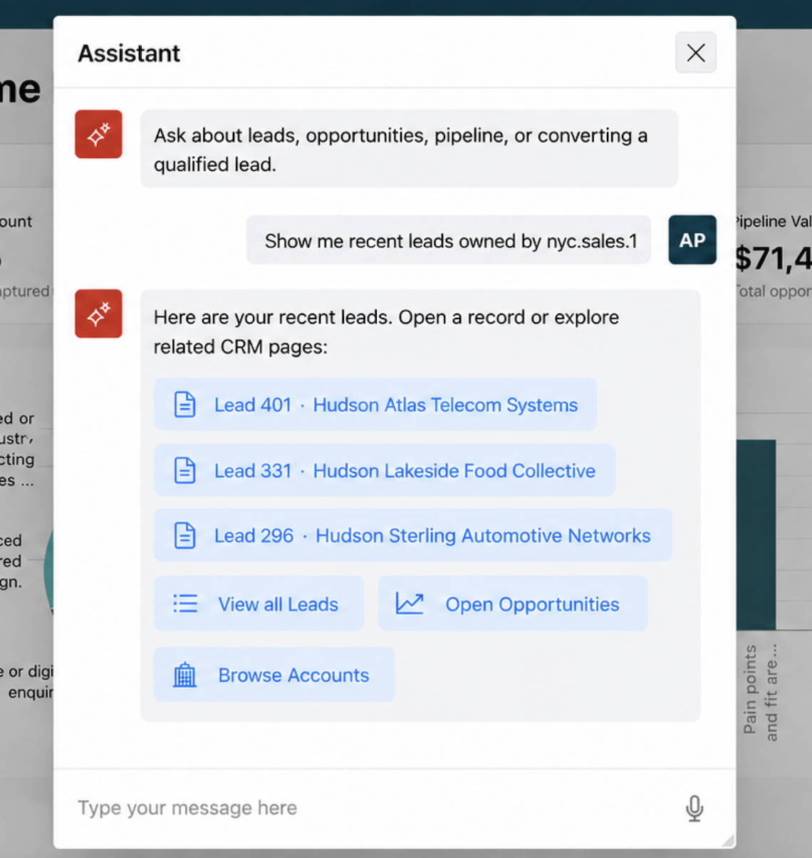




Navigation in AI Agents
Define available navigation targets and parameters
AI responses can include links to relevant
application pages
Application code constructs the final URL
Final URLs and session information stay out
of model messages
Notes:
Developers define available navigation targets and parameters: The application exposes only approved destinations and identifies the values the AI may return for each target.
AI responses can include links to relevant application pages: A response can guide the user from an answer to a related report, form, or detail page in the same application.
Application code constructs the final URL: The model returns a target reference and parameters, while trusted application code prepares the actual APEX URL and checksum.
Final URLs and session information stay out of model messages: Session-specific URL details are created inside the application and do not need to be included in the content sent to the model.

Slide 14
A Smarter, More Modern Interactive Reports Experience

Slide 15
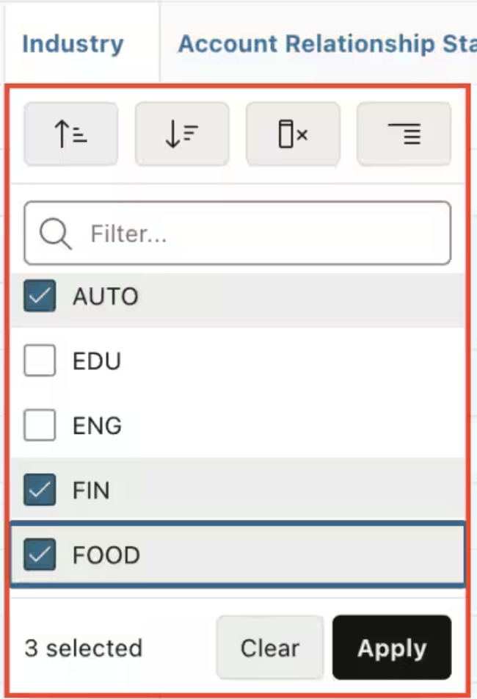
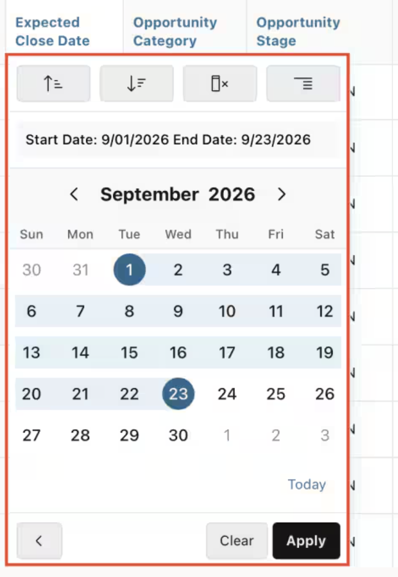
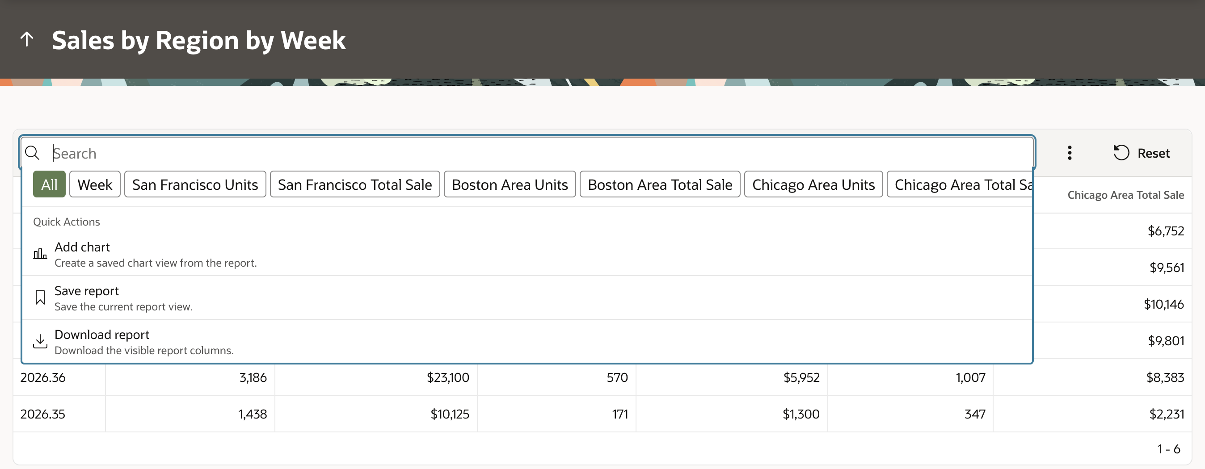
Interactive Reports Enhancements
User-friendly experience, computation using plain language, and faster everyday commands
Modern Report Interface
Refreshed search controls and quick actions
Multi-select filters and date-range filtering
15
Drag-and-drop column ordering
15
Copyright © 2026, Oracle and/or its affiliates
Notes:
Interactive Reports – Moder Interface
Modern interface: Refreshed styling, spacing, controls, and responsive layouts make report features easier to use.
Search and filter chips: View, modify, or remove active filters and report settings directly.
Multi-select header filters: Select several column values and update existing selections without creating conflicting filters.
Numeric filters: Filter numbers using minimum values, maximum values, or ranges.
Date filters: Choose presets, exact dates, or date ranges, with existing selections preserved.
Report layout: Drag-and-drop column ordering, improved frozen columns, and reorganized Actions simplify customization.

Slide 16
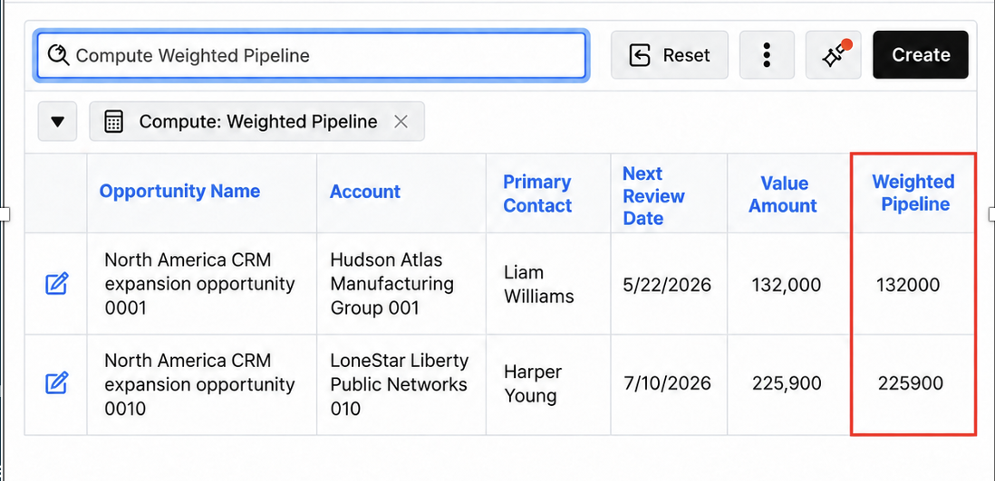
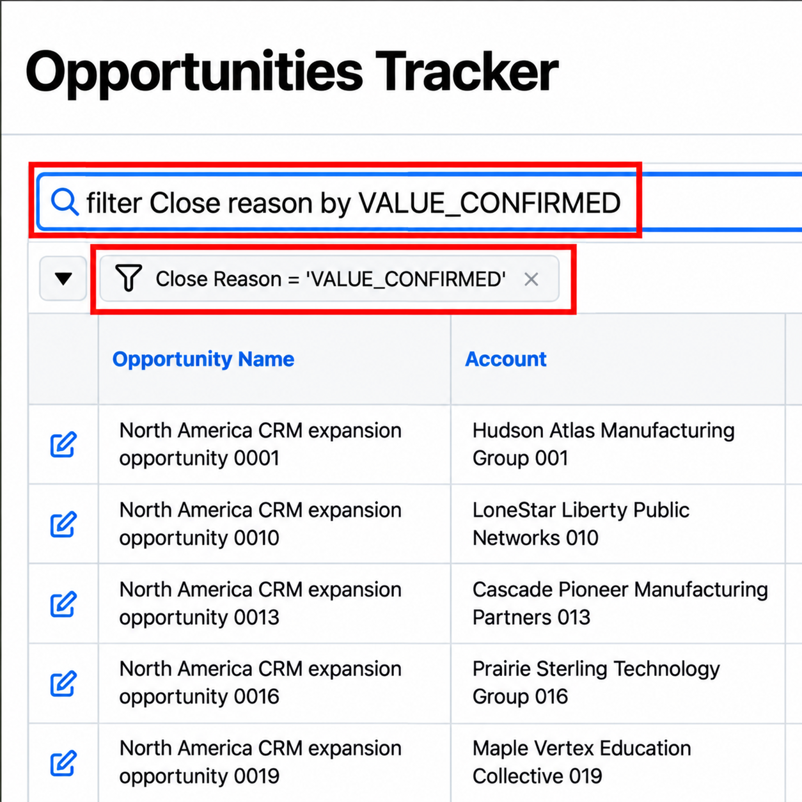
Interactive Reports Enhancements
Compute columns with AI IR
Text Templates in AI IR
Creates a standard computed column
Not every report request requires AI interpretation
Review, edit, save, or remove it
AI IR uses key phrases
Uses eligible columns in the current report
Faster response for short and predictable actions
Notes:
Next, Compute columns is enabled in AI IR. A request such as “profit equals revenue minus cost” becomes a standard computed column using eligible columns in the current report. The user can review, edit, save, or remove the result through familiar controls.
. Third, not every AI IR request require AI interpretation. Many Interactive Report actions are short, explicit, and predictable. APEX 26.2 supports configurable key phrases for these common requests.
Key phrases are defined through APEX Text Messages using meaningful placeholders. When a request matches a supported template, APEX validates the requested columns and values against the current report before applying the action.

Slide 17
Deep Data Security Integration

Slide 18
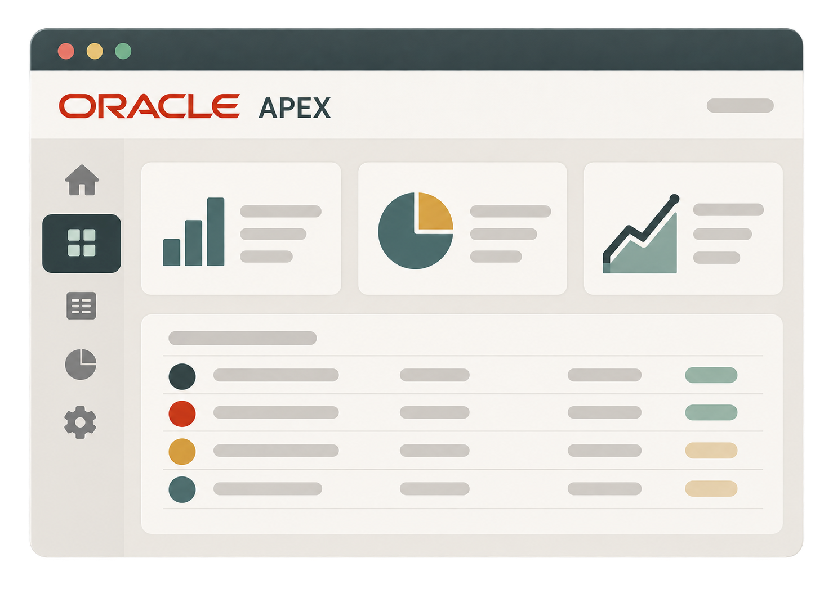

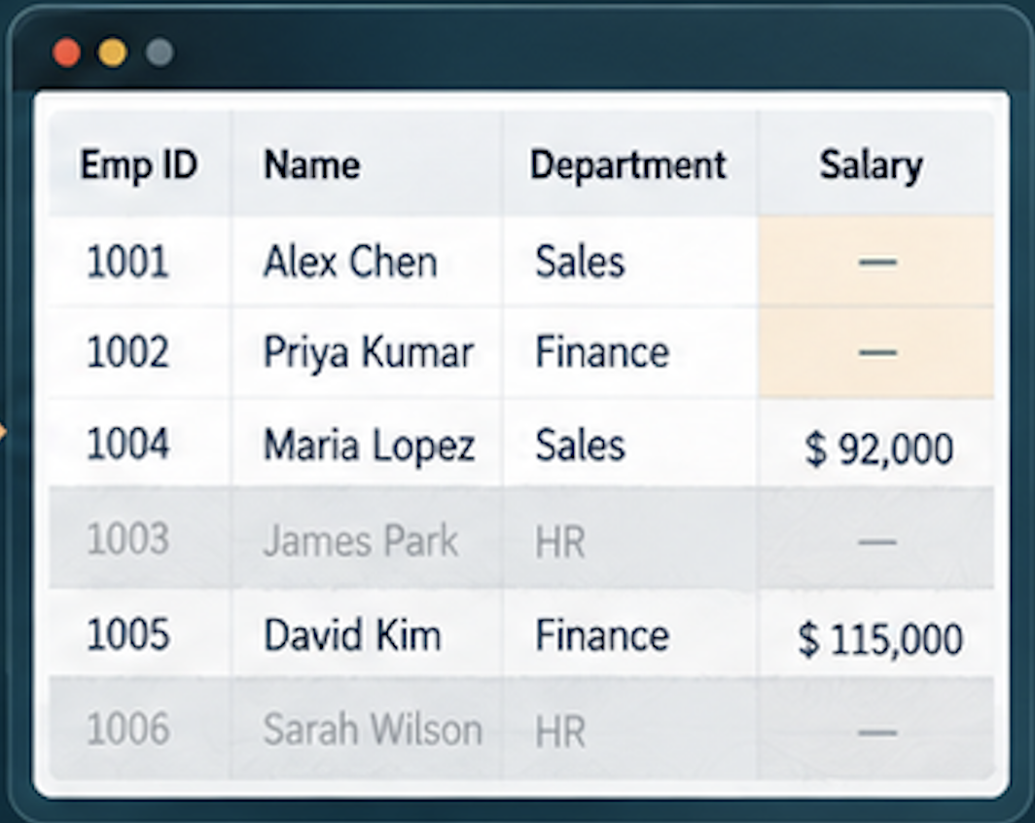







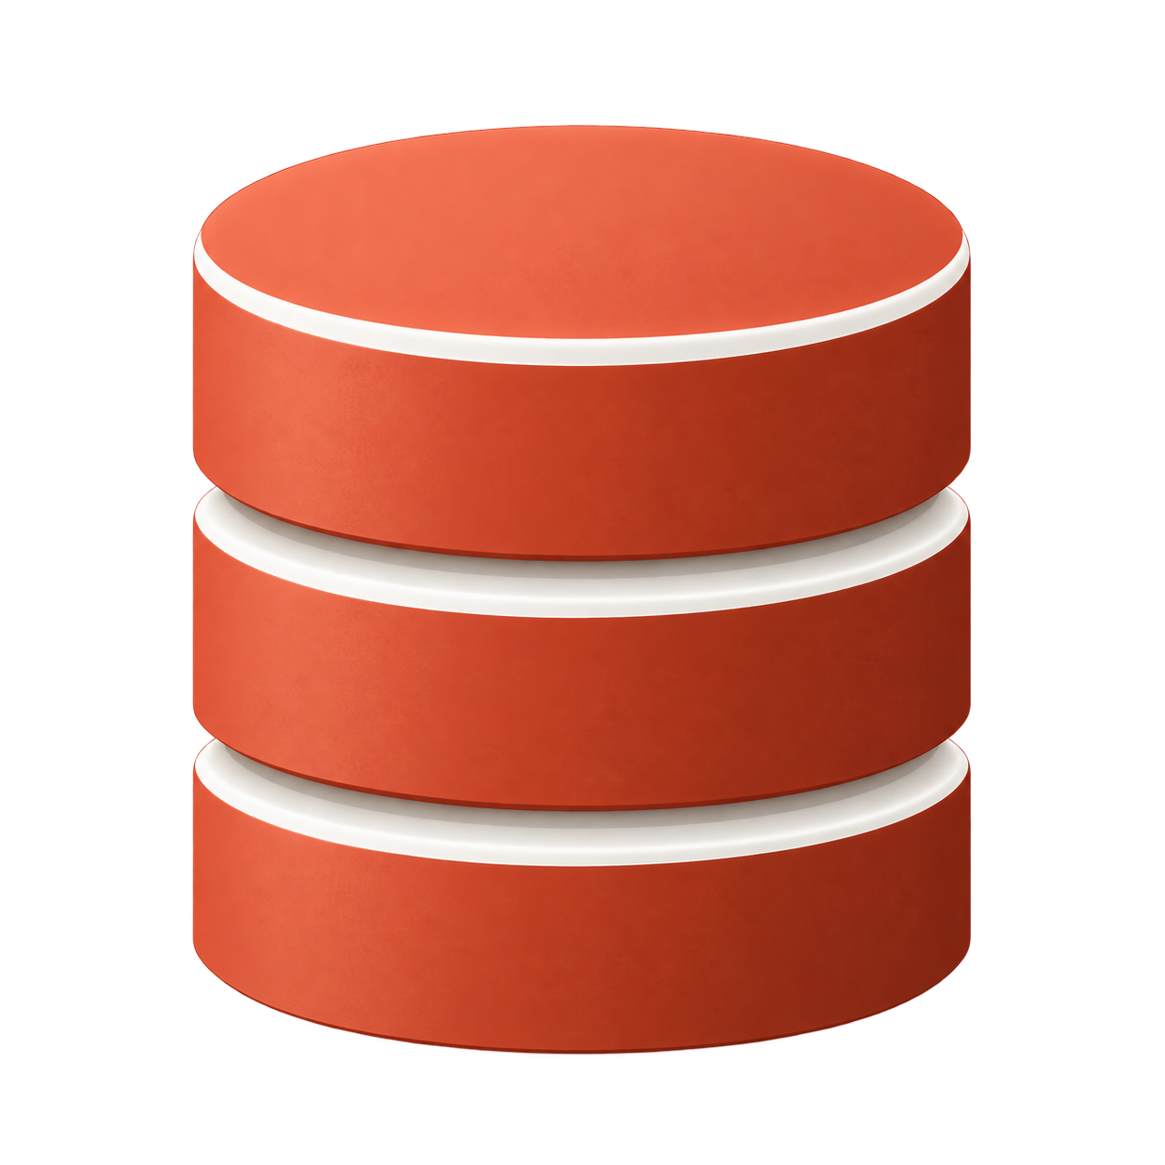





Deep Data Security for Oracle APEX
Database-enforced authorization
ORACLE
AI Database 26ai
Identity Provider (IDP)
End-user
security context
OCI IAM
or
Data roles
Microsoft
Entra ID
Data grants
End-user
identity
(token)
Application
identity
(token)
Authentication and group/role information
One policy
across supported
access paths
Verified user and
application identity
Database enforcement
reduces dependence
on application code
and repeated filters
For reports, forms
and AI Agent tools
Notes:
Oracle Deep Data Security, or Deep Sec, moves fine-grained data authorization into Oracle AI Database, where the data resides.
Many applications enforce access through report filters, page conditions and custom authorization code. As applications and access paths multiply, those rules can become duplicated or inconsistent. An AI agent can also construct SQL dynamically, which makes application-only guardrails insufficient.
Deep Sec lets security teams and Developers express authorization as declarative SQL data grants. These grants can control which rows a user sees, which columns are available and even individual values at the intersection of a row and column.
Oracle APEX 26.2 propagates two verified identities. Social Sign-In supplies the end-user identity. APEX separately obtains a token representing the registered application. Oracle AI Database validates both, establishes an end-user security context and applies the relevant data roles and data grants to application SQL.
Deep Sec complements APEX authorization. APEX authorization still controls pages, buttons and actions. Deep Sec controls what SQL may read or change in the database.

Slide 19
Additional Platform Enhancements

Slide 20
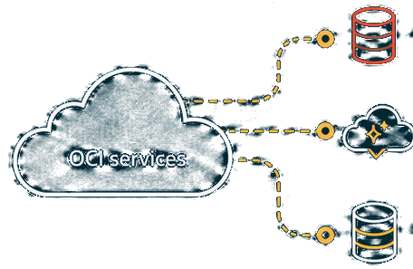






DBMS_CLOUD credentials with OCI Native Authentication
Call OCI services from APEX without storing an individual user’s API keys
Object Storage
Generative AI
APEX application
Managed resource identity
Other OCI services
Makes a request to an
OCI service
Securely authenticates
the APEX application
No individual
user API keys in
APEX credentials
Improved
security and
governance
Centralized
identity and
access control
Simpler setup
and management
Notes:
APEX applications can call OCI services using OCI native authentication without storing an individual user's API keys in APEX credentials.
When the application makes a request, a managed resource identity securely authenticates it to OCI. The application can then access authorized services such as Object Storage, Generative AI, or other OCI services.
This approach removes the need to maintain personal API keys inside the application. It improves security and governance because access is tied to a centrally managed identity rather than an individual account. Identity and access control remain in OCI, and administrators can manage service permissions in one place. The result is a simpler setup with fewer credentials to rotate and a clearer model for controlling which OCI resources an APEX application may use.
APEX 26.2 extends database-backed Web Credentials to OCI Native Authentication: A Web Credential can reference an OCI identity managed through the database instead of storing an APEX-managed signing secret.
Use Autonomous Database Resource Principal or Database Tools Identity: Customers can choose the managed identity approach that matches their Autonomous Database or Database Tools architecture.
Avoid entering an OCI user's API private key in APEX: The application references the managed database credential, reducing dependence on a private key owned by an individual user.
OCI IAM policies define access to target services: Administrators still grant the managed identity only the OCI permissions required for services such as OCI Generative AI.

Slide 21
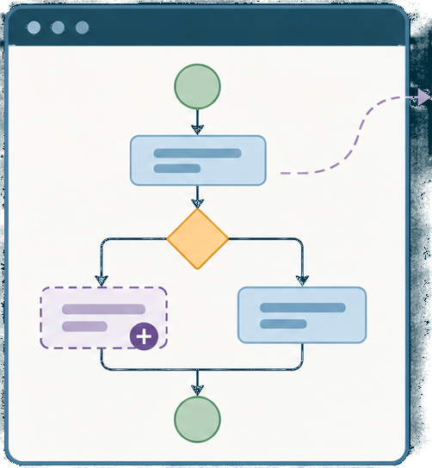
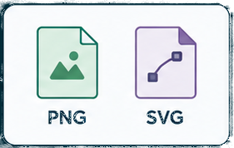





Workflow Modeling
Draft activities capture
unfinished process steps
Teams can save and review
the overall workflow early
PNG and SVG export make
diagrams easier to share
Draft activities must be
implemented before activation
Notes:
Draft activities capture unfinished process steps: Designers can represent a planned step, decision, or wait before its executable implementation has been selected and configured.
Teams can save and review the overall workflow early: Business and development teams can discuss the full process model while some activities are still being defined.
PNG and SVG export make diagrams easier to share: The workflow diagram can be exported for design reviews, documentation, and conversations outside App Builder.
Draft activities must be implemented before activation: A workflow version containing Draft activities cannot be activated, so every placeholder must be replaced with executable workflow logic first.

Slide 22
Simpler Fusion Applications integration
ORACLE
ORACLE
APEX
Fusion Applications
ADF
services
→
HCM
SCM
Other ERP
BOSS
services
The starter app
extends its existing
ADF integration to
BOSS services
One APEX application
can use both
service types
Authentication
obtains tokens for the
configured resource
scopes
Faster start for
Fusion extensions
Less manual
authentication setup
Ready for additional
service scopes
Notes:
The Fusion Applications starter app extends its existing ADF service integration to support BOSS services.
Authentication obtains tokens for the resource scopes configured for the selected services, reducing the amount of manual authentication setup. The generated examples also reflect the services available in the connected Fusion environment, giving developers a more relevant starting point. This helps teams begin Fusion extensions faster and add further service scopes as the application grows. The main benefit is a more consistent integration path from Fusion services into an APEX application.

Slide 23
Other enhancements in APEX 26.2
Improvements for development, workflow, administration, and integration
Human Tasks
Working Copies
Manage Instance
RESTful Services
Actionable task
failures
Application and
Working Copy APIs
Enhanced Mail
Queue report
REST Workshop
moves
A Fail event can trigger Task
Actions when a Human
Task enters ERRORED,
including notifications or
configured PL/SQL.
Public APIs lock or unlock
applications and create
Working Copies for trusted
command-line and CI/CD
workflows.
Additional reporting context
helps instance administrators
investigate queued mail,
delivery failures, and
workspace patterns.
REST Workshop is
removed. Use SQL
Developer Web to create
and manage ORDS REST
APIs; existing services
remain intact.
Notes:
First, APEXlang static analysis can scan exported .apx files with SQLcl CodeScan and identify supported security-configuration findings before deployment.
Second, Human Tasks gain actionable failure handling. A Fail event can trigger Task Actions when a task enters the ERRORED state, including notifications or configured PL/SQL.
Third, public APIs support locking and unlocking applications and creating Working Copies. These APIs enable trusted command-line and CI/CD workflows.
Fourth, the enhanced Mail Queue report provides more context for investigating queued mail, delivery failures, and patterns across workspaces.
Finally, REST Workshop has been removed. Developers should use SQL Developer Web to create and manage ORDS REST APIs. Existing REST services remain intact, so the change affects the management experience rather than the services already deployed.

Slide 24


Additional Learning Resources
blogs.oracle.com/apex/
Announcing Oracle APEX 26.2 General Availability
Introducing File-Level Import with APEXlang in Oracle APEX 26.2

Slide 25


Additional Learning Resources
Working with Generative AI Provider APIs and Reasoning Effort
What’s New in Interactive Reports and AI Interactive Reports

Slide 26

Additional Learning Resources
Using DBMS_CLOUD Credentials with Resource Principal and DBTools Identity

Slide 27
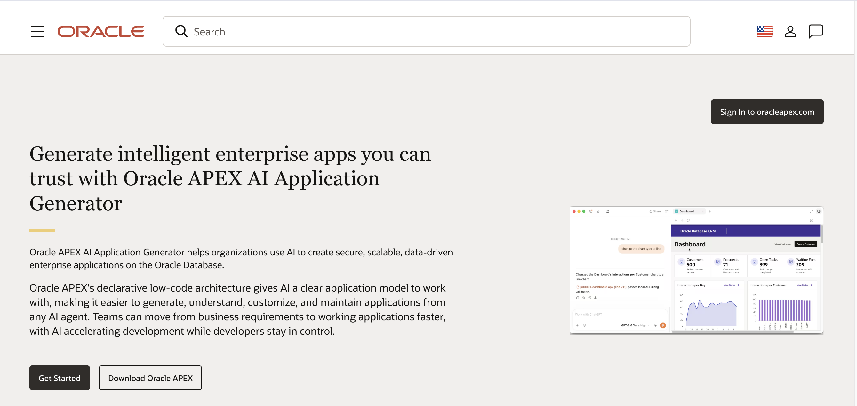
Everything Oracle APEX
oracleapex.com
27
Copyright © 2026, Oracle and/or its affiliates

Slide 28

Oracle APEX Professional Learning Path (apex.oracle.com/go/professional-ai-lp)
Learning path consists of two key courses
Oracle APEX Developer Professional
Master the fundamentals of building powerful low-code applications. Learn to create secure, scalable web and mobile apps with industry best practices.
https://apex.oracle.com/go/professional
Oracle APEX: Empowering Low Code Apps with AI
Unlock the future of development by integrating AI and GenAI capabilities into your APEX applications for smarter, more intuitive solutions.
http://apex.oracle.com/go/ai-learn
#ORACLE
#LOWCODE
#ORCLAPEX
#ORCLAPEXCERTIFIED
#ORACLECERTIFIED
#AI
#GENAI
28
Copyright © 2026, Oracle and/or its affiliates

Slide 29
Thank You

