Slide 1
Oracle APEX
Build Scalable and Secure Low-Code Apps

Slide 2
Safe harbor statement

Slide 3
What is a Low-Code Application Platform?
Learn more at apex.oracle.com

Slide 4

What is a Low-Code Application Platform?
Low-Code application platform (LCAP) is used to rapidly develop and deploy custom applications by abstracting and minimizing hand coding.
At a minimum, an LCAP must include low-code capabilities (such as a model-driven or graphical programming approach with scripting) to develop a complete application consisting of user interfaces, business logic, workflow, and data services.
- Gartner
Learn more at apex.oracle.com

Slide 5



Why low code?
Speed
  Easy to learn
  Faster development
Innovation
  More time to focus on making better apps
Agility
  Respond to user requests more quickly
Learn more at apex.oracle.com

Slide 6
Low-Code Application Platform (LCAP) Market
Large and fast-growing market
The global low code development platform market size was valued at USD 22.25 billion in 2023 and is projected to grow from USD 28.75 billion in 2024 to USD 264.40 billion by 2032, exhibiting a CAGR of 32.0% during the forecast period (2024-2032).
“By 2025, 70% of new applications developed by enterprises will use low-code or no-code technologies, up from less than 25% in 2020.”
$264.40B
32.0% CAGR
Source: Fortune Business Insights – “Low Code Development Market Share, 2024-2032”, May 2024
$28.75B
$22.25B
……….
Source: Gartner, September 2021
2023
2024
2032
Low-Code Dev Platform Market Size
Source: Fortune Business Insights – “Low Code Development Market Share, 2024-2032”, May 2024
Learn more at apex.oracle.com

Slide 7
What is Oracle APEX?
Learn more at apex.oracle.com

Slide 8

“As a developer and someone who writes SQL every day, I know how challenging it can be to remember table names, column names, and syntax I don't frequently use. Having an AI assistant to determine column names contextually, JOINS, and generate complex syntax is a real game changer.”
Michael Hichwa
Senior Vice President
Learn more at apex.oracle.com

Slide 9


What is Oracle APEX?
Oracle’s Strategic Low-Code Application Platform
21 Million +
apps created till date
APEX is the world’s most popular enterprise low-code application platform.
It enables you to build scalable and secure enterprise apps with world-class features 20X faster with 100X less code.
Oracle APEX delivers the most productive way to develop and deploy Mobile, Web, and Desktop apps everywhere - cloud and on-premises.
7,000+
APEX apps created daily
850,000+
APEX developers worldwide
100,000+
customers across 150 countries
90%
of Fortune 500 use Oracle APEX

Slide 10



The Oracle APEX Advantage
Quickly create apps that meet business objectives
Focus on the intent of the app – not how to code it, and spend less time on maintenance going forward
Add AI to your apps
Add AI capabilities to apps even if you’re not an AI expert – giving users flexible options for using apps, and shortening their learning curve
Build enterprise-ready applications
Get the security, scalability, performance and reliability of Oracle Database.
APEX is included with Oracle Database at no extra cost

Slide 11



Oracle APEX
Database-centric web application development framework
Develop desktop and mobile web apps
Visualize and maintain
database data
Leverage SQL Skills and database capabilities
Learn more at apex.oracle.com
Notes:
Used to build desktop and mobile applications for the Oracle Database. Oracle APEX enables you to design, develop, and deploy beautiful, responsive, database-driven applications, either on-premises or in the cloud.
Quickly build reports, forms, charts, calendars, etc. on top of the data in your database
IT Developers and "citizen-developers" who know a little SQL can readily build applications.
Oracle APEX can also take advantage of the large majority of Oracle Database features.

Slide 12

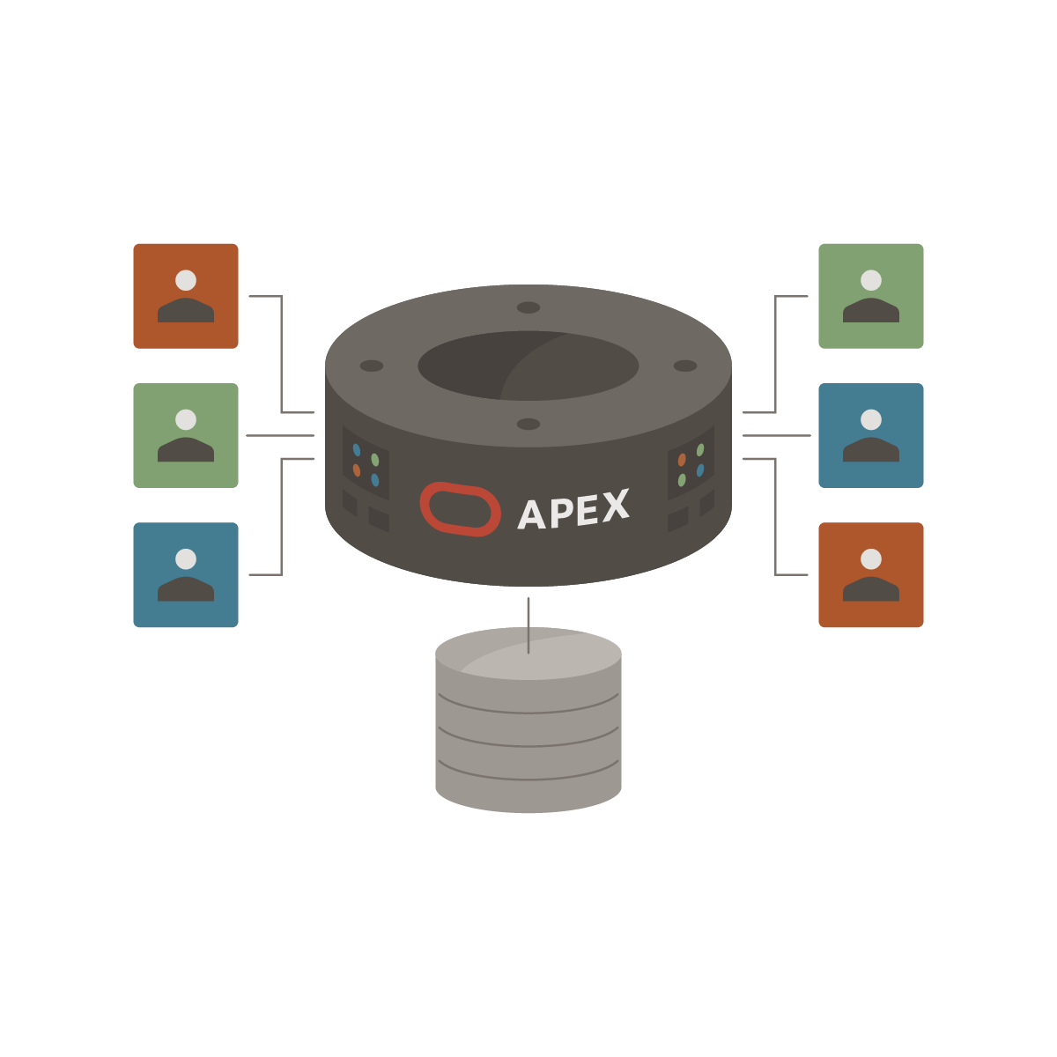
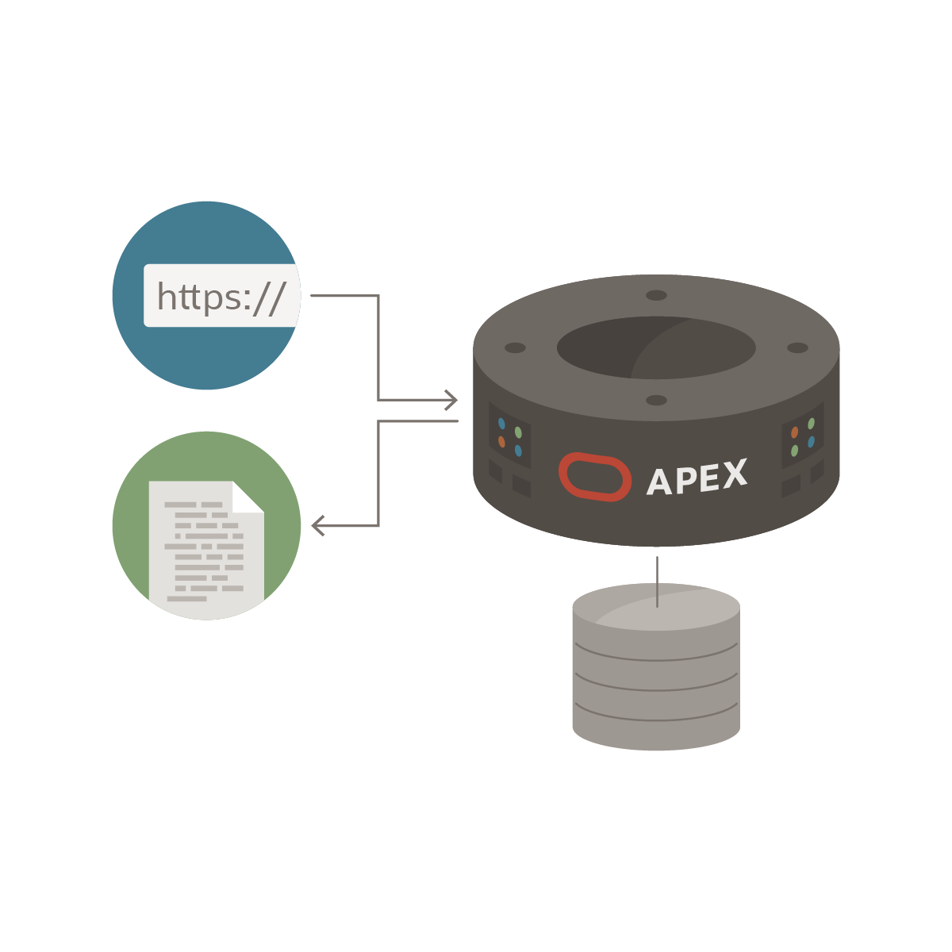
Distinguishing Characteristics
App Development IDE is a web browser
No client software needed
App Definitions are stored in the database as meta data
Declarative – No code generation
Page generation is efficient with only one request and one response
Data processing done in the Database
Learn more at apex.oracle.com
Notes:
Simply use a web browser and the URL to access the development environment, or the URL and user credentials to run the application
You don’t need any client software
Declarative framework stores application definitions in Oracle database tables within the APEX Engine
No need for file-based compilation or code generation
All of the data (page) processing is performed by PL/SQL, which acts directly on the data schemas in the Oracle Database.
Therefore, very efficient as data is manipulated directly in the database, and results are sent back as HTML pages

Slide 13
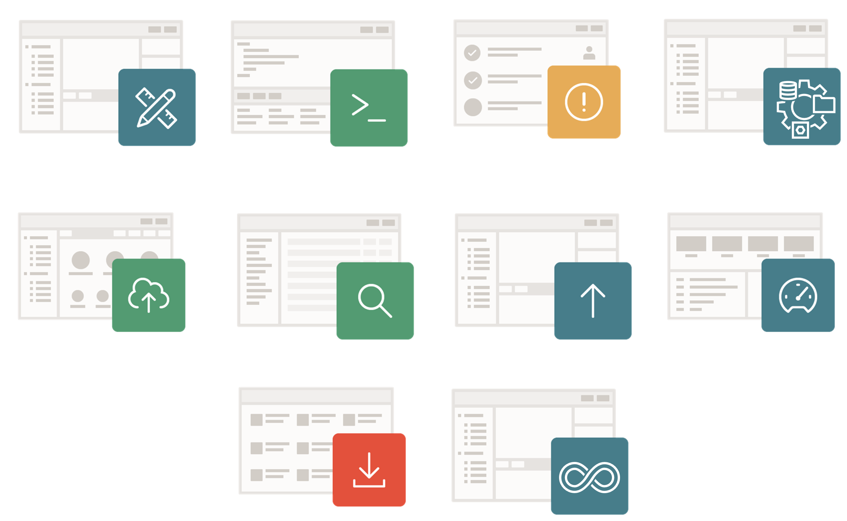
Oracle APEX
Comprehensive Low-Code Platform
Build powerful cloud and mobile apps using a web browser
Generate Applications using AI
Import/export data
Publish REST APIs
Integrate local and remote data
Automate & Integrate processes and apps
App Builder
SQL Workshop
Team Development
Workflow
RESTful Services
Object Browser
Data Loading
Monitor
App Gallery
DevOps Tools

Slide 14
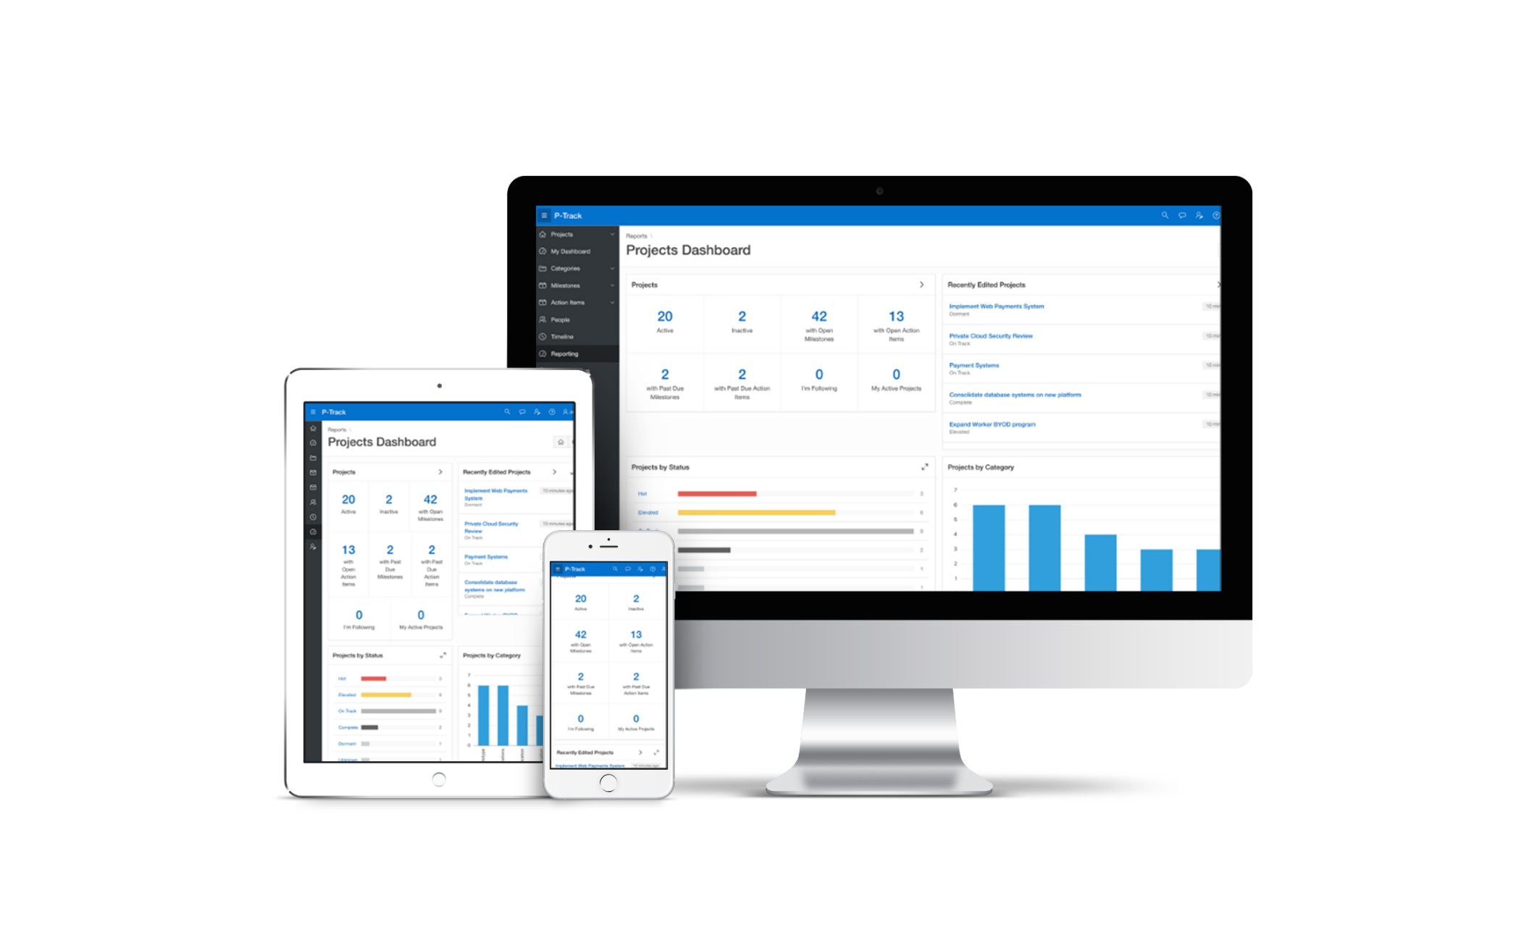
User Interface for Any Device
Modern, intuitive, accessible UI for any device
fully customizable and responsive apps
Learn more at apex.oracle.com
Notes:
Out of the box the apps developed using APEX are fully responsive and can run on any size device without additional coding – From a large desktop to a smartphone.

Slide 15


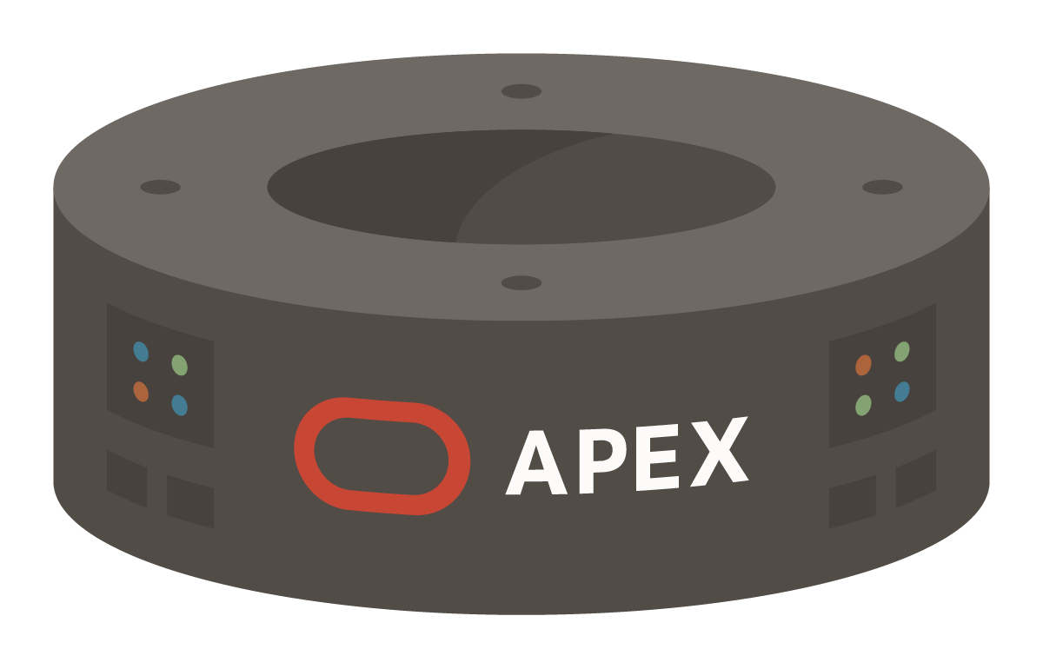


APEX Architecture
1 - URL
ORDS
Oracle REST Data Services
4 - HTML
GET
User views details
2 - JDBC
6 - JDBC
3 - APEX
7 - APEX
POST
User clicks a link
Make change and submit
Branch
8 – Branch to URL
Database
REST
5 – HTTPS POST
GET
User clicks a link which sends HTTPS GET request to ORDS
ORDS makes a database JDBC call to the APEX Engine
APEX generates HTML page (full page or partial)
ORDS returns the generated HTML back to the browser
POST
User clicks a button which does an HTTP POST to ORDS
ORDS makes a database JDBC call to the APEX Engine
APEX processes the request
APEX determines URL and branches
Learn more at apex.oracle.com
Notes:
Oracle APEX is best suited to being co-located with the data it is maintaining/reporting on – Local Data Source.
Oracle APEX provides the ability to execute SQL not only in the "local" Oracle database (where APEX runs in), but also on a remote Oracle instance. This is based on the REST Enabled SQL feature introduced with ORDS When the REST Enabled SQL feature is active on an ORDS instance, SQL statements can be passed in JSON format using HTTP POST requests. Execution results are being passed back as a self-describing JSON response. Clients thus can communicate with the Oracle database using open protocols and without SQL*Net. A prerequisite for using REST Enabled SQL is to have at least ORDS 17.4 installed. Older ORDS versions (3.0.x) do not support REST Enabled SQL.
Oracle APEX provides declarative support for REST Services in APEX components. That means developers can create a component, such as an interactive report, directly on an external REST service. You can register an external REST Service as a Web Source Module in Shared Components and then use it as the data source for a report and form.
You can also integrate into a SOA environment by consuming Web Services (both REST and SOAP) or utilizing DB Links to other databases.

Slide 16









Browser Requests
Detailed processing from URL entered to page response
Application Definition
Authentication & Authorization
Regions, Buttons, Items
Session State
Processes
Dynamic Actions
START
AJAX
https://ords/r/mycompany/hr-app
Friendly URLs
Oracle Database APEX Engine
Rendered Page
Branches
Processes
Validations
Computations
Session State
Authentication & Authorization
Application Definition
Learn more at apex.oracle.com

Slide 17





APEX Data Sources
Oracle REST Data Services
(Weblogic, Jetty, Tomcat)
External APIs - Web Sources
(REST, SOAP)
HTTP(s)
JDBC
Local Data Source
(SQL, PL/SQL)
Database Links
(SQL*NET)
JDBC
Remote Databases
REST Enabled SQL
[REST / HTTP(s)]
JDBC
Learn more at apex.oracle.com
Notes:
Oracle APEX is best suited to being co-located with the data it is maintaining/reporting on – Local Data Source.
Oracle APEX provides the ability to execute SQL not only in the "local" Oracle database (where APEX runs in), but also on a remote Oracle instance. This is based on the REST Enabled SQL feature introduced with ORDS When the REST Enabled SQL feature is active on an ORDS instance, SQL statements can be passed in JSON format using HTTP POST requests. Execution results are being passed back as a self-describing JSON response. Clients thus can communicate with the Oracle database using open protocols and without SQL*Net. A prerequisite for using REST Enabled SQL is to have at least ORDS 17.4 installed. Older ORDS versions (3.0.x) do not support REST Enabled SQL.
Oracle APEX provides declarative support for REST Services in APEX components. That means developers can create a component, such as an interactive report, directly on an external REST service. You can register an external REST Service as a Web Source Module in Shared Components and then use it as the data source for a report and form.
You can also integrate into a SOA environment by consuming Web Services (both REST and SOAP) or utilizing DB Links to other databases.

Slide 18
Single Database Instance and Multiple Workspaces
Oracle Database with APEX
Workspaces used to define application definitions / Schemas hold data
The many-to-many relationship between Workspaces and Schemas
Instance Administrators manage the environment and schema access
Departments can request more space and access to a new schema
For example, Oracle’s internal-only service https://apex.oraclecorp.com/en/
has over 9000 Workspaces, covering every line of business in Oracle
Schema 1
Schema 2
Schema 3
Schema 4
1
2
3
Workspace 1
Workspace 2
Workspace 3
Dept. 1
e.g. Sales
Dept. 2
e.g. Support
Dept. 3
e.g. HR
Learn more at apex.oracle.com

Slide 19
Product Timeline
Learn more at apex.oracle.com

Slide 20

Oracle APEX Release History – 5-Year Review
APEX 20.1
  April 23, 2020
  APEX + Redwood
  Friendly URLs
  Native PDF Printing
APEX 21.1
  May 12, 2021
  Maps Region
  New Application Data Loading
  Native Markdown Support
APEX 22.1
  May 3, 2022
  Approvals & Unified Task List
  Simplified Page Creation
  Readable Application Export in JSON or YAML
  PWA Service Worker Customization
APEX 23.1
  May 17, 2023
  Template Components
  PWA Push Notifications
  Modernized Object Browser
APEX 24.1
  June 17, 2024
  AI-Assisted Development
  Document Generator Integration
  Workflow and Approval Enhancements
  Working Copy Enhancements
APEX 20.2
  October 21, 2020
  Cards Region
  Automations
  REST Data Source Synchronization
APEX 21.2
  November 4, 2021
  Smart Filters
  Progressive Web Apps
  Geocoding and Map Items
APEX 22.2
  November 10, 2022
  Application Search
  Invoke API Processes
  New and Updated Components
  PWA, and Mobile Updates
APEX 23.2
  November 14, 2023
  Application Working Copies
  Workflows
  New Page Items
  Custom Map Backgrounds
APEX 24.2
  Jan 15, 2025
  AI Configurations and RAG Sources
  Integrating with Fusion Applications
  JSON Data Sources
  Workflow and Approval Enhancements
Learn more at apex.oracle.com

Slide 21
Oracle APEX is Available Everywhere
Oracle Cloud
APEX Service
All workload types of Autonomous Database
Oracle Base Database Service
Oracle Exadata Cloud Service
Always Free APEX Service
Always Free Autonomous Database
On-Premises
All Oracle editions
Oracle Exadata
Oracle Database Free
Other Clouds
Autonomous Database on Azure
Amazon RDS for Oracle Database
All other major clouds via VM
Oracle APEX is a fully supported no-cost feature of Oracle Autonomous Database and all Oracle Database editions.
Learn more at apex.oracle.com

Slide 22
Oracle APEX on OCI
Learn more at apex.oracle.com

Slide 23




Oracle APEX on ADBS: Workload-Optimized Instances
Oracle Autonomous Database Serverless with APEX
Data Warehouse (ADW)
Full ADBS service optimized for data warehousing and analytic workloads
Transaction Processing (ATP)
Full ADBS service optimized for transactional and mixed workloads
One-click, data-preserving operation:
JSON Database
Specialized JSON service, limited relational storage, low price
APEX Service
Specialized APEX service, no SQL*Net connectivity, low price
= Workload Type Conversion
Learn more at apex.oracle.com
Notes:
Oracle APEX with Autonomous Database
This unmatched combination provides the best low-code tool for building enterprise apps with the most performant, and secure database cloud service
“Low Code” development ha`s so many advantages and now that it is combined with fully managed, pre-configured cloud services, Developers can start developing immediately and concentrate on solving business problems without all of the distractions.

Slide 24



Oracle APEX Application Development Service
Easy to use, fully managed, enterprise-class service on Oracle Cloud
+
+
APEX Application Development & Deployment
Oracle Autonomous Database
Exadata Cloud Infrastructure
Best low-code environment on best cloud database on best database infrastructure
24
Learn more at apex.oracle.com

Slide 25

Oracle APEX Application Development Service
Fully managed, mission-critical stack for as low as $122.39/month
$120.08 for 2 ECPUs and $2.31 for 20 GB per month
Automatically scales up and down - supports dozens to millions of users
Automatically Scales Compute and Storage
Supports hundreds of thousands of page views per hour
Lower costs
Pay-per-use subscription model
All-inclusive pricing—no per application, per user fees
The free version you can use for an unlimited time
Try APEX Service on Oracle Cloud Free Tier!
Learn more at apex.oracle.com

Slide 26



Development / Deployment Options
Local
On-Premise
Cloud
Install on stand-alone laptops using Oracle Express Edition (XE) or the full database version
Simply upgrade APEX to the required version
Can work completely disconnected
Typically run by the IT Department
IT generally both production operations service, and a service provider
Departments responsible for application development
Deploy Internet applications
Leveraged for fast application development, user acceptance, and training
Prototyping & Proof-of-Concept
Consulting companies develop for deployment on customer premise
Browser based application development framework enables efficient development & deployment
Shoot someone a URL – Check this out – Application Development
Learn more at apex.oracle.com
Notes:
Given that APEX can run ‘anywhere you can install the Oracle Database, you have great flexibility. Simply provide the appropriate URL to develop/run applications.
Import an APEX application into any other Oracle Database where you have the same version or later of APEX installed.
Start developing on your laptop running Oracle XE or on the cloud, and then export the application.
Deploy on the Oracle Database Cloud Service, and then once your application gets wide utilization, move it to your private cloud.

Slide 27
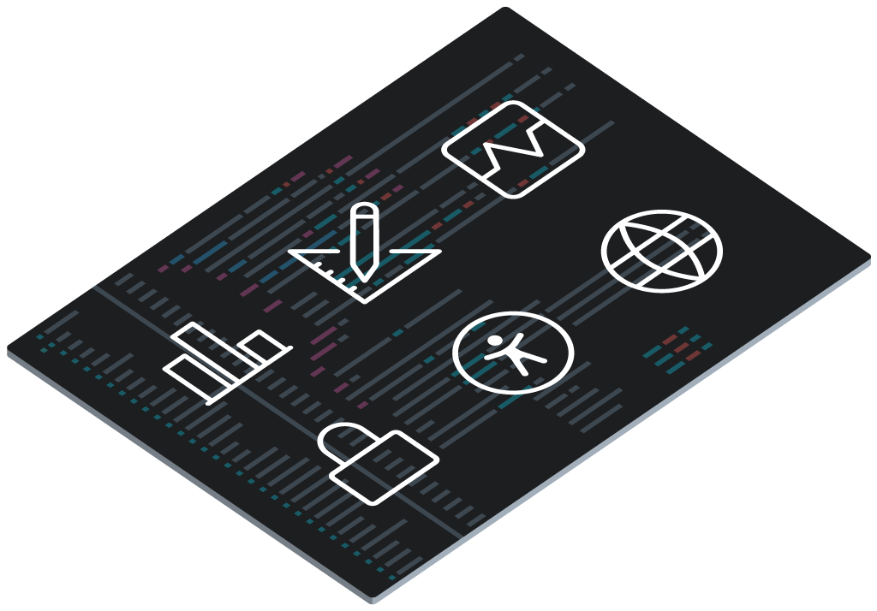
What does APEX do for you?
User Interface
Data Access
Visualization
Security
Globalization
Performance
Learn more at apex.oracle.com
Notes:
So what does APEX do for you?
If you look at an APEX app, it may seem pretty simple.
But it's a facade.
Behind APEX is a wealth of functionality which is provided for you.
To deliver any quality app for the enterprise, here are some facets that you must take into account.
User Interface - providing you with a fully customizable and responsive design.
Data Access is completely handled and you can plug in your own APIs
Wealth of rich visualizations, fully responsive.
Create secure applications by default. And as the security landscape changes, we improve APEX too.
Full globalization support - translate an APEX app into any language.
Performance and monitoring (and debugging)
These facets are important to any application and we’ve proven this over the years with thousands of customers.

Slide 28
AI-Assisted Development
Learn more at apex.oracle.com

Slide 29
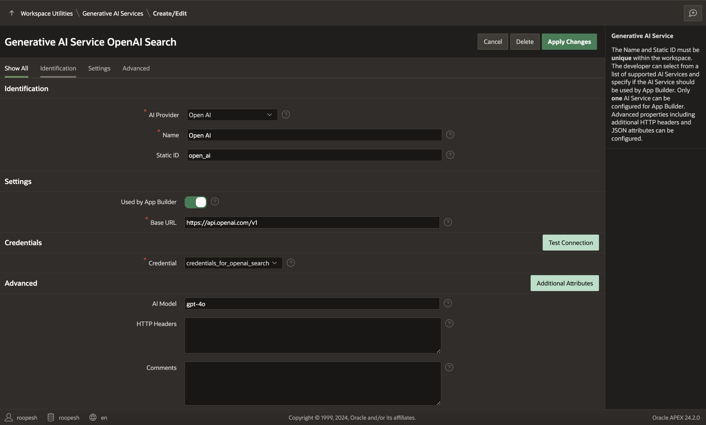
Generative AI Service
An abstraction to popular commercial Generative AI products like OCI Generative AI, Open AI, and Cohere
Authenticates using Web Credentials in Oracle APEX
Users can Validate Information before setting up a connection
Used by App Builder, AI Assistant & APEX_AI PL/SQL API
Can be enabled/disabled on APEX at Instance and Workspace levels
Notes:
An abstraction to popular commercial Generative AI products like Open AI, Cohere , and others
Authenticates using Web Credentials in Oracle APEX
Users can Validate Information before setting up a connection
Used by App Builder, AI Assistant & APEX_AI PL/SQL API
Can be enabled/disabled on APEX at Instance and Workspace levels

Slide 30
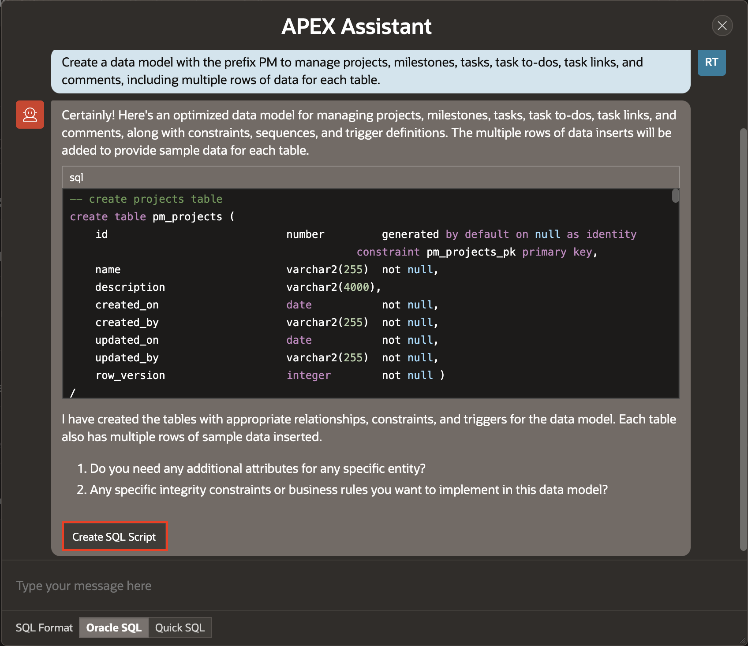
Create a Data Model from a Prompt
New in APEX 24.2
Create your Own Schemas from a Prompt
Generate scripts either in Oracle SQL or Quick SQL format
Build a Data Model and generate Sample Data
Notes:
An abstraction to popular commercial Generative AI products like Open AI, Cohere , and others
Authenticates using Web Credentials in Oracle APEX
Users can Validate Information before setting up a connection
Used by App Builder, AI Assistant & APEX_AI PL/SQL API
Can be enabled/disabled on APEX at Instance and Workspace levels

Slide 31
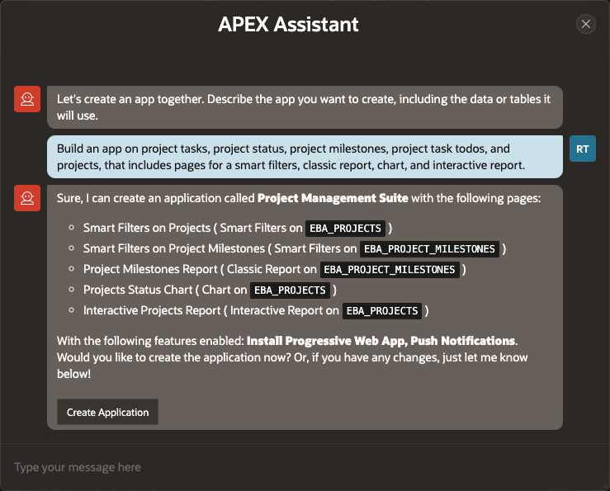
Create App from a Prompt
Generate Application Blueprint based on a Prompt
Leverages APEX Dictionary Cache to identify relevant tables.
Further, enhance the generated blueprint with additional instructions

Slide 32
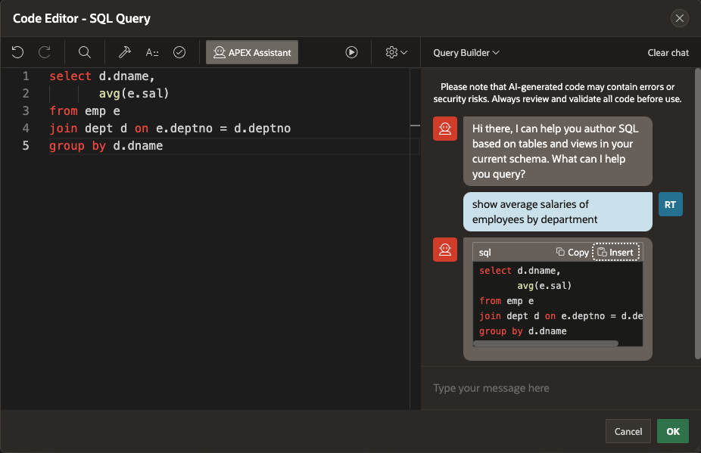
APEX Assistant in Code Editors
APEX Assistant in Code Editors leverage Generative AI Services
Leverages APEX Dictionary Cache to identify relevant tables
Generate SQL Queries for form and report regions using the Query Builder mode
Generate PL/SQL, JavaScript, HTML, and CSS Code using the General Assistance mode
Improve & Explain Quick Actions help improve and understand the selected code

Slide 33
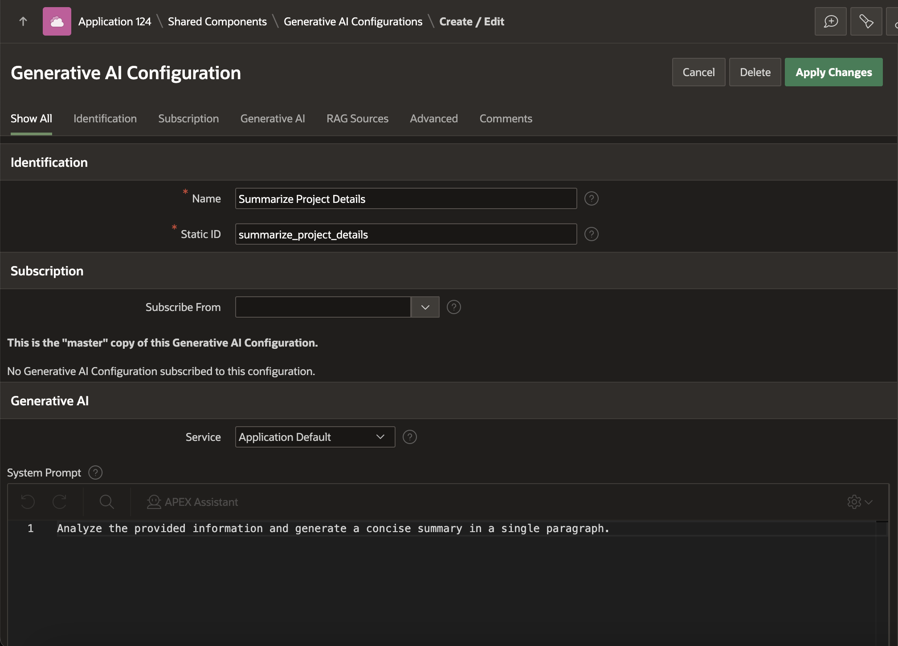
What are AI Configurations?
New in APEX 24.2
AI Configurations centralize key Generative AI settings.
Customizable System Prompt, Welcome Message, and RAG Sources.
Use it in both the Show AI Assistant and Generate Text with AI Dynamic Actions
Accessible via the APEX_AI PL/SQL API for seamless integration.

Slide 34
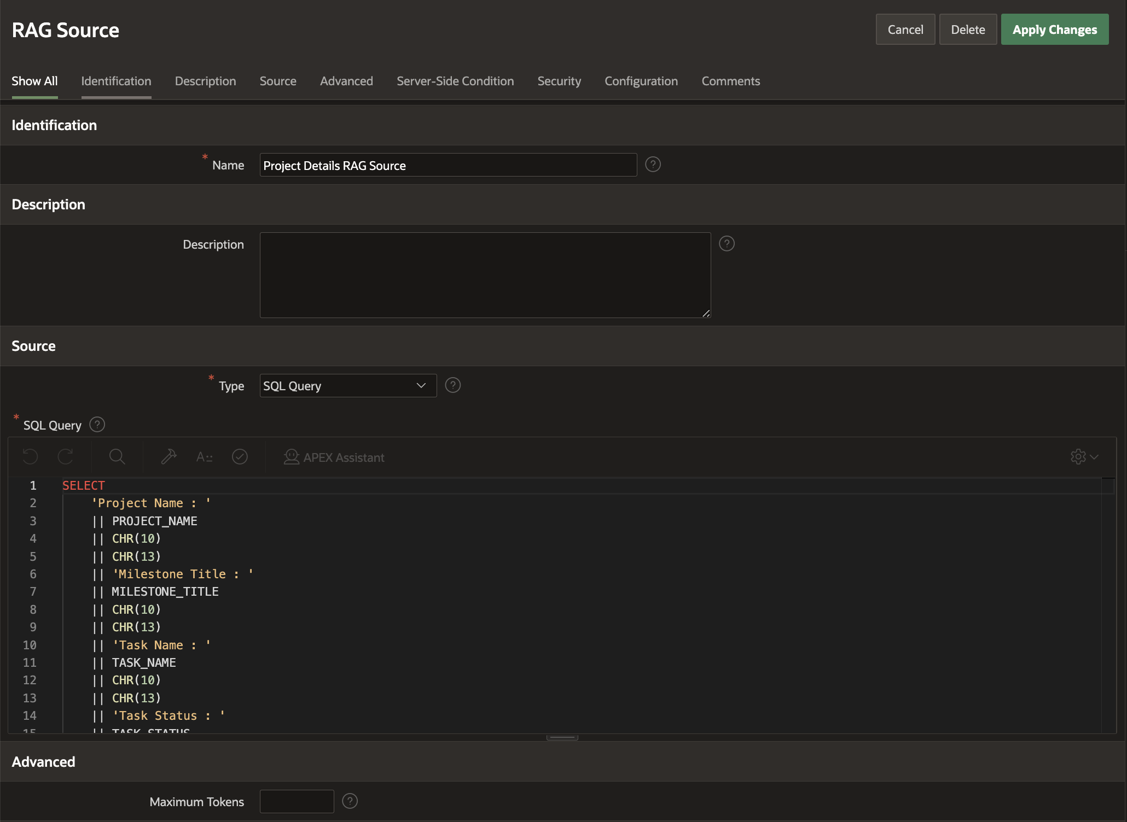
RAG Sources - Overview
New in APEX 24.2
Use RAG Sources to enrich AI conversations with application-specific data.
Can include SQL Queries, Function Bodies Returning CLOB, or Static Text.
Use Authorization Schemes or Server-side Conditions to control which RAG data is included.
Use APEX$AI_ALL_USER_PROMPTS and APEX$AI_LAST_USER_PROMPT bind variables for custom RAG logic
Utilize the AI Configuration in Show AI Assistant and Generate Text with AI Dynamic Actions

Slide 35
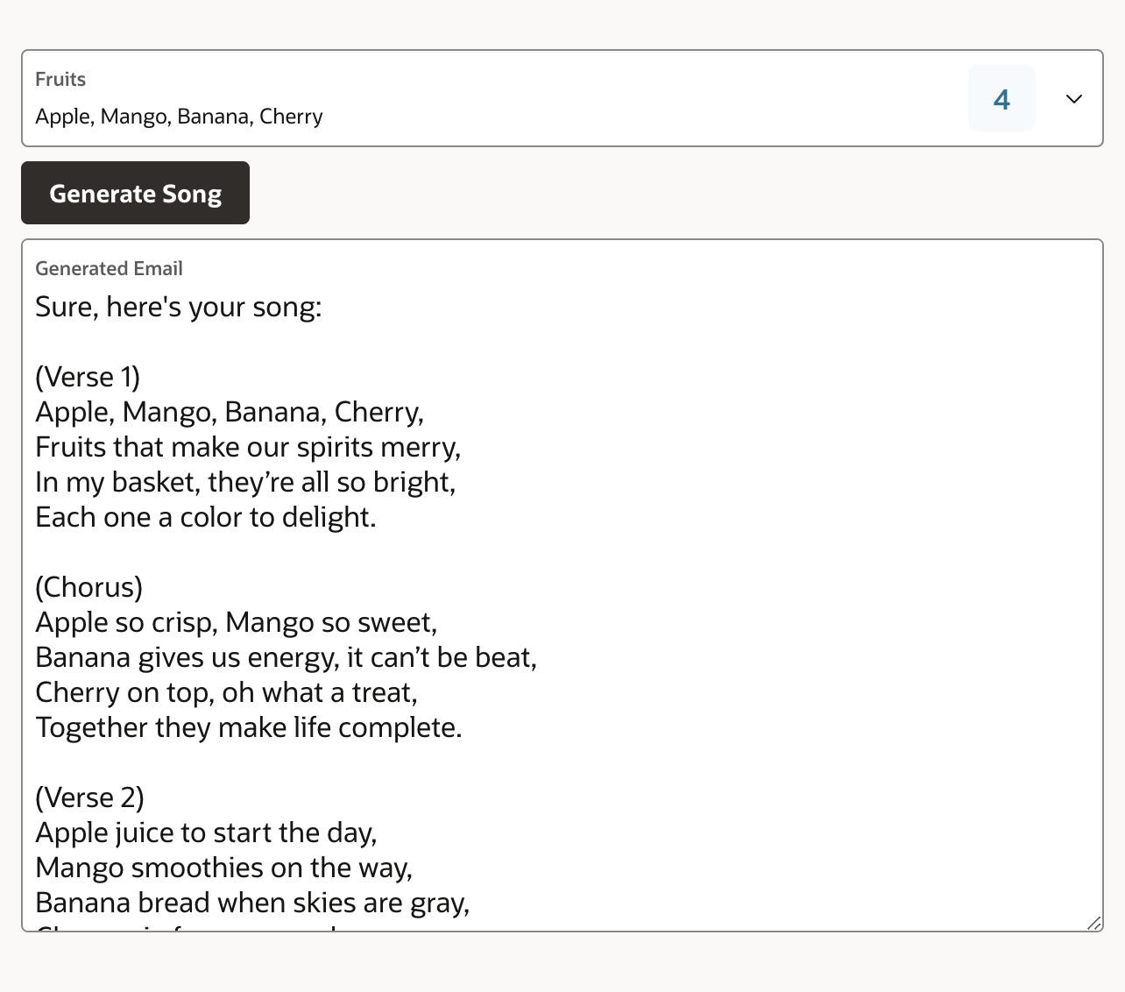
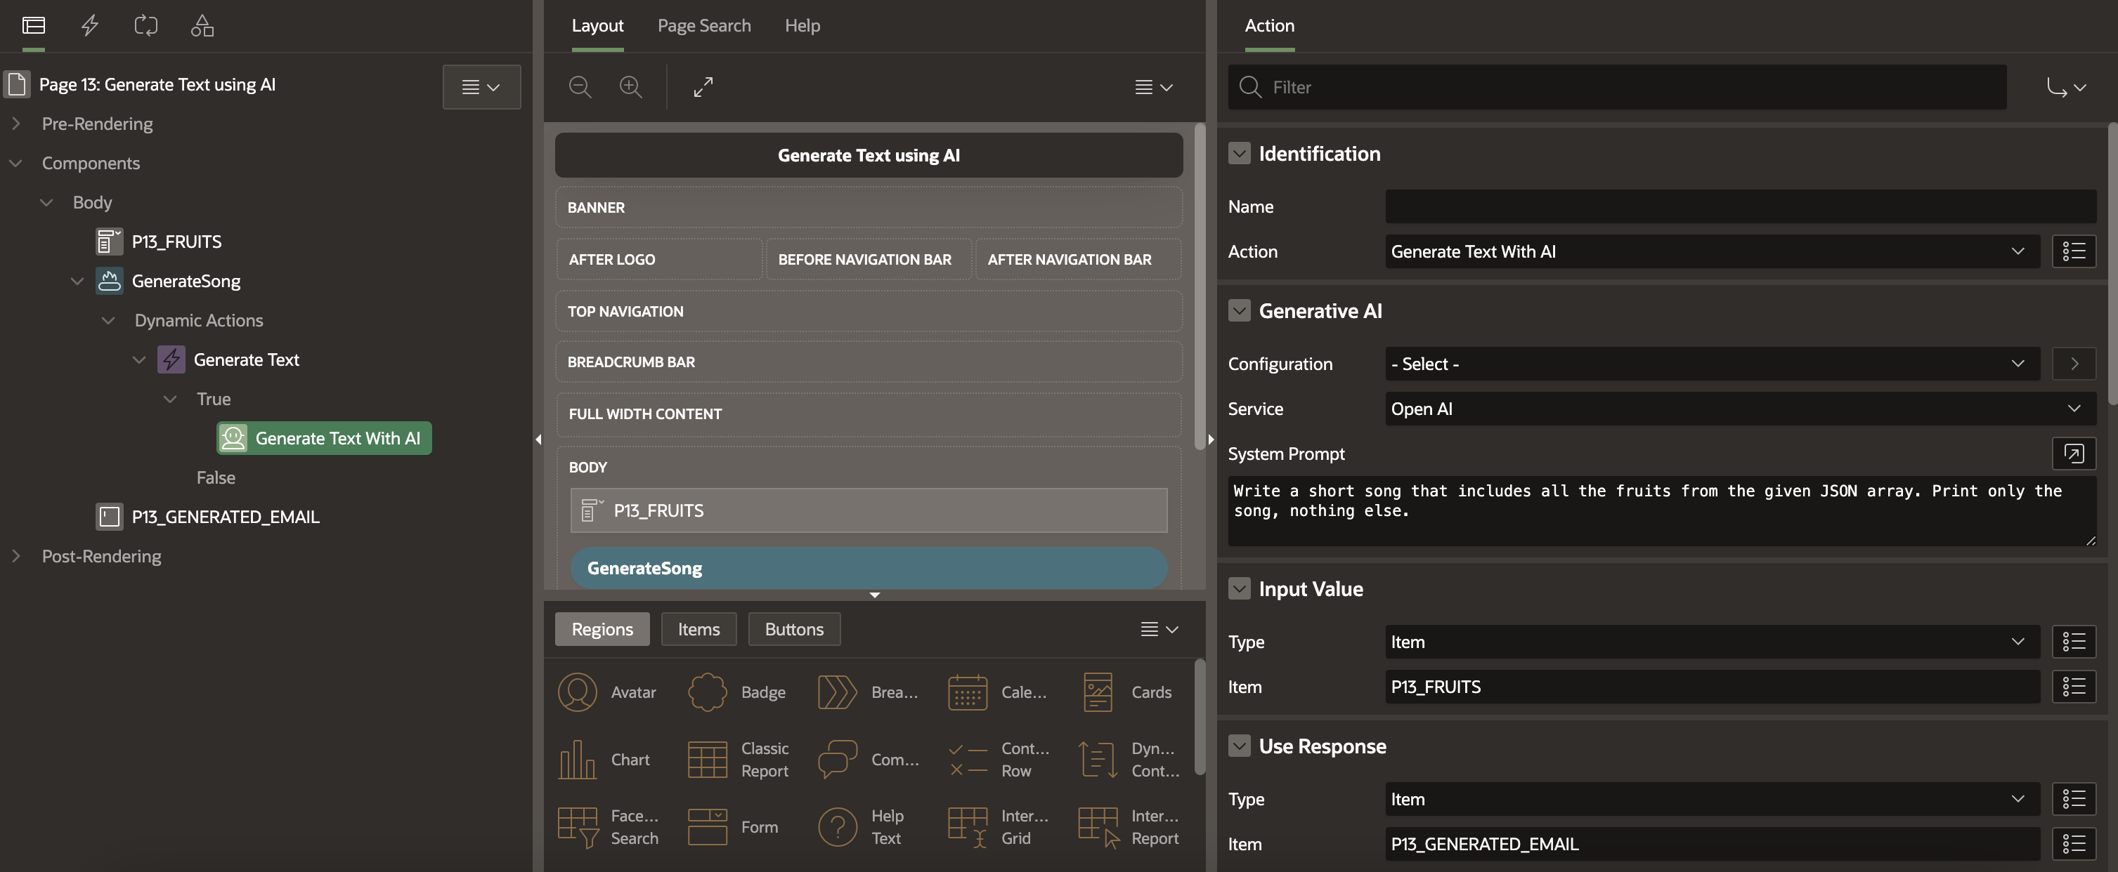
Generate Text with AI - Overview
New in APEX 24.2
    Generate a one-time response based on user content
    Leverages Generative AI services
    Can also leverage centralized settings defined in AI Configurations
    Configurable
    System Prompt, Input Value, and Use Response attributes

Slide 36
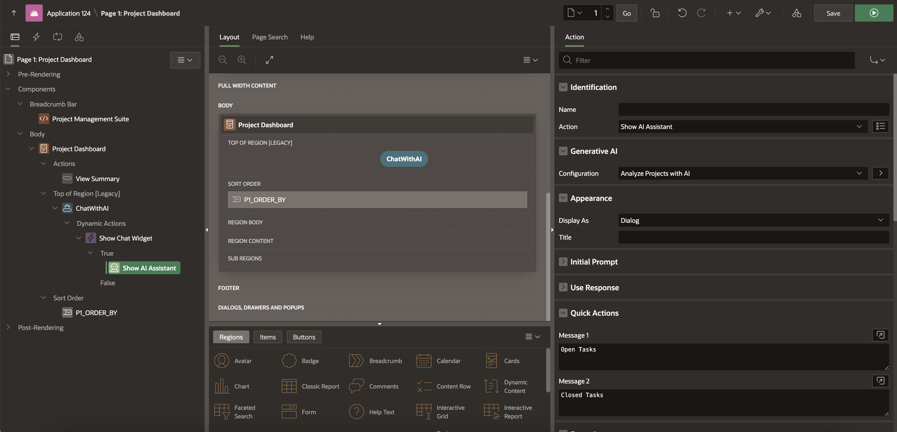
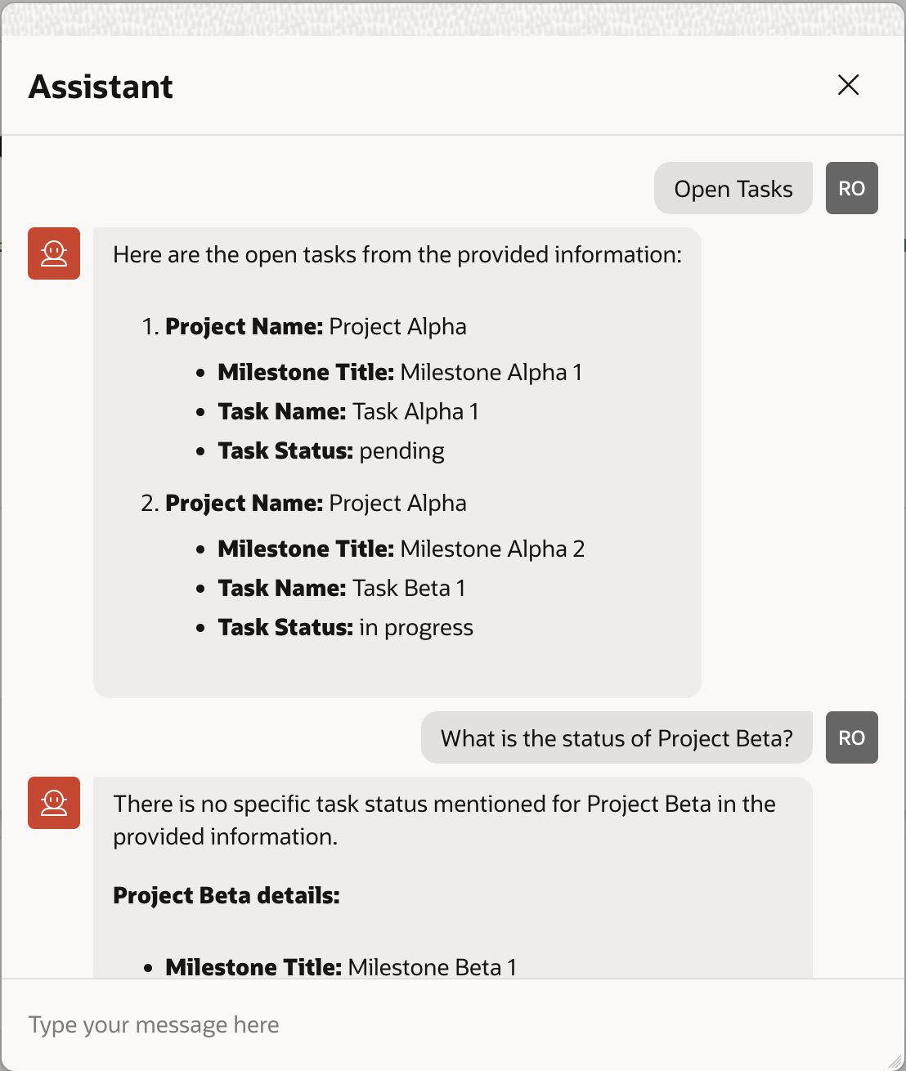
Show AI Assistant Dynamic Action - Overview
Enhanced in APEX 24.2
    A Native Dynamic Action in Oracle APEX which opens an AI Chat User Interface
    Leverages Generative
    AI Services configured
    under Workspace Utilities
    Leverages Generative
    AI Services configured
    under Workspace Utilities
    Configurable
    System Prompt and Welcome Message
    Rendered Inline
    or as a Dialog

Slide 37
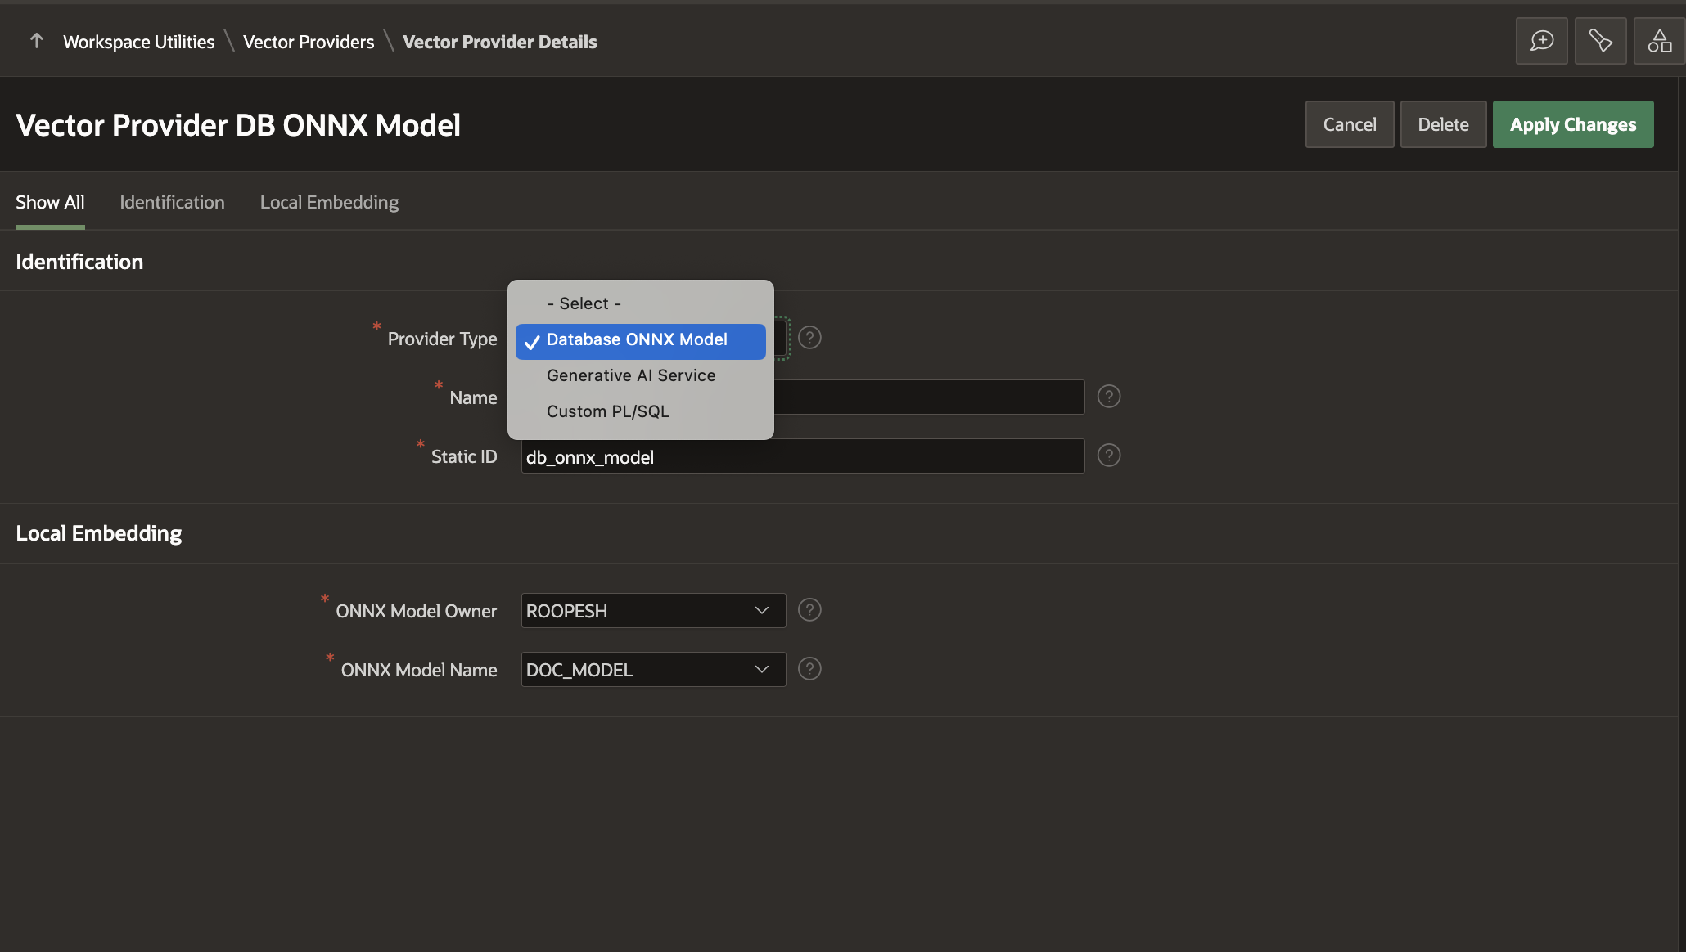
What are Vector Providers?
New in APEX 24.2
A Vector Provider enables you to convert text into an embedding
Available Provider Types: Database ONNX Model, Generative AI Service, Custom PL/SQL
Vector Providers are stored at the Workspace level
Use APEX_AI.GET_VECTOR_EMBEDDINGS PL/SQL API to generate embeddings
Available exclusively on Oracle Database 23ai

Slide 38
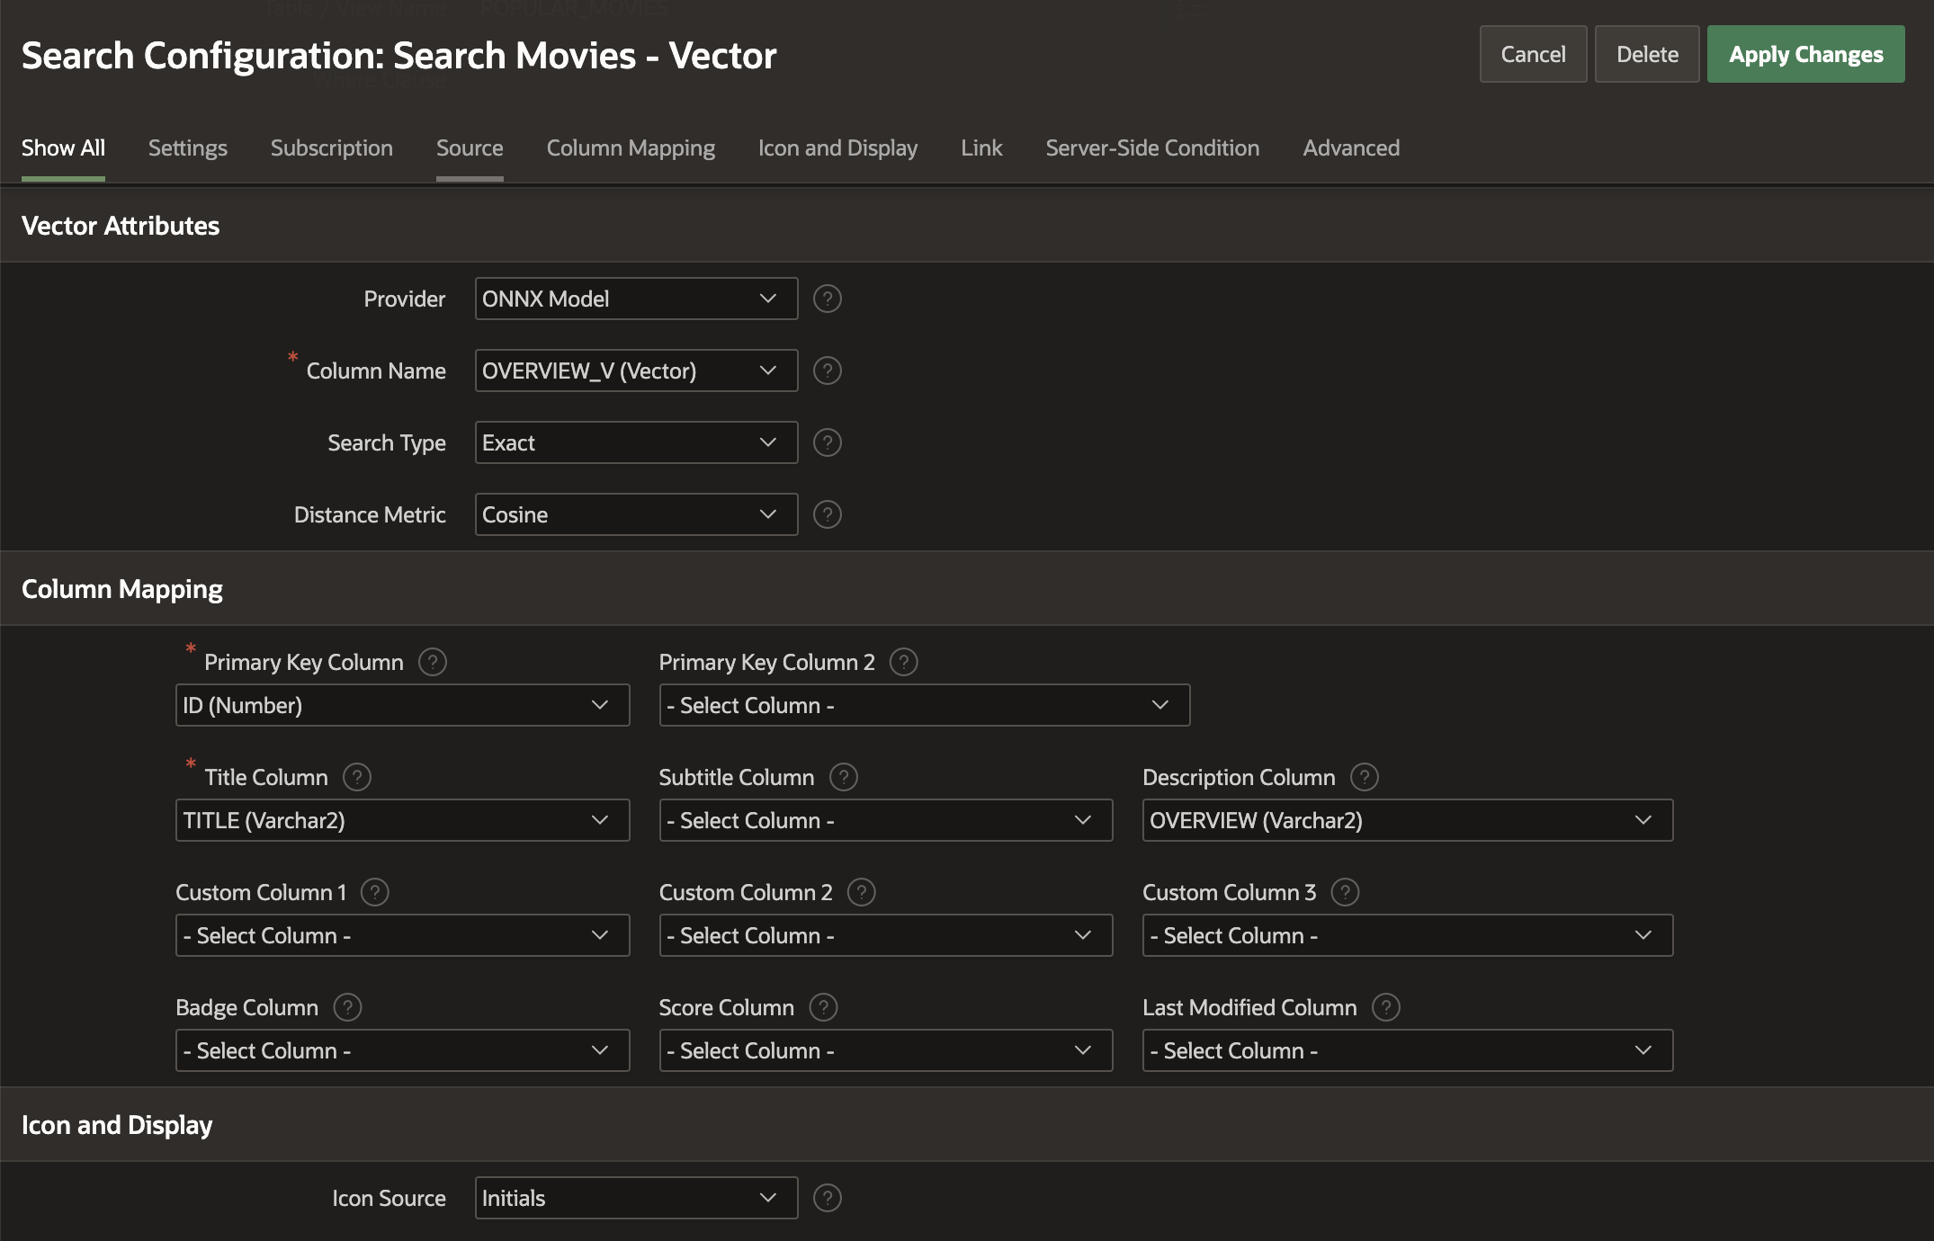
Vector Search Support in Search Configurations - Overview
New in APEX 24.2
Available exclusively on Oracle Database 23ai
Create Search Configurations on the table with Vector Data type columns
Configure Index Usage, Distance Metrics, Max Vector Distance, and Max Results
Results are returned based on Vector Similarity

Slide 39
APEX + AI Video Links
Build AI-Powered Enterprise Apps Faster with Oracle APEX
apex.oracle.com/go/apex241-launch
Create and Maintain SQL Using Natural Language with APEX AI Assistant: Demo
apex.oracle.com/go/apex-assistant-video
Power Semantic Search with Oracle APEX and AI Vector Search: Demo
apex.oracle.com/go/apex-vs-video

Slide 40
Security
Learn more at apex.oracle.com
Learn more at apex.oracle.com

Slide 41

Oracle APEX – Security
Oracle APEX is designed to build highly secure web apps out of the box. A new instance admin security parameter enables the use of database credentials instance-wide.
In a world of constantly changing web standards and increasingly resourceful attackers finding new ways to hack sites, our focus on security means that your applications stay protected.
Authentication and Authorization
Session Management
Secure by Default
Support for SSO
APEX Advisor
Learn more at apex.oracle.com

Slide 42

Authentication and Authorization
Authentication is the process of identifying who is accessing the application, while Authorization defines whether the user has permission to use an application or parts of it.
Authentication Schemes
Oracle APEX comes with a comprehensive set of built-in authentication schemes that make it simple to integrate .
Authorization Schemes
Define access to your application, pages and page components with authorization schemes. Use the built-in Application Access Control to manage users and roles. Authorization can be applied to Items, Regions, Pages, process, etc.,
Extensibility
Developers can easily extend Oracle APEX by writing custom authentication and authorization schemes in SQL and PL/SQL.
Learn more at apex.oracle.com

Slide 43

Session Management
Server-side session management is used for a user's interactions with an application. This is linked to a secure session cookie, which is an intrinsic part of Oracle APEX.
Session Control
Sessions are defined by a browser cookie value and an ID in the URL, which are long random values that an attacker can not guess to take over a user's session. Built-in timeouts guarantee that the session automatically terminates when a user is away for too long.
Item Session State
Application and page items save their values in the session state, optionally in an encrypted form. Developers can access and manipulate the values in SQL and PL/SQL via bind variable syntax, which prevents SQL Injection.
Collections
Oracle APEX Collections are non-scalar, multi-row, and multi-column session data. Developers can manage collections via PL/SQL APIs and views.
Learn more at apex.oracle.com

Slide 44

Secure by Default
While providing developers with full control, Oracle APEX generates applications with highly secure settings right out of the box.
Parameter Tampering Protection
Oracle APEX uses checksums to prevent users from manipulating parameters in the URL and when saving changes.
XSS Prevention
Cross-site scripting (XSS) occurs when attackers save malicious data on a website and the site renders this data as code that executes in the user's browser.
Oracle APEX components escape all output by default to prevent this class of attacks.
Advisor and other tools
Developers can run the Oracle APEX Advisor to check their applications for settings that make them less secure or inconsistencies that attackers could exploit.
Learn more at apex.oracle.com

Slide 45
Use Cases
Learn more at apex.oracle.com

Slide 46


Transform Your Spreadsheets to Web Apps in Minutes
Upload your spreadsheet and convert it into a cloud application with a few clicks!
Features
Drag and Drop an XLS, CSV, XML, or JSON file
Create a table in the Autonomous Database
Upload data into the new table
Create an App based on the new table
Spreadsheet
Solutions
Single source-of-truth
Send out a URL, not a file
Secure, scalable, multi-user app
Extend with Charts, Calendars, Validations, and more
APEX Application
Learn more at apex.oracle.com
Notes:
I already went into the problems with spreadsheets and how easily you can use to demo moving those spreadsheets into web apps
This is the first Sales Play for OD that we have provided sales collateral for – Links at the end of the deck

Slide 47

Rapid Application Development
Build new business and productivity apps
Features
Build apps in days/weeks not months/years
Use powerful wizards to create fully featured apps
Easily modify to meet changing requirements
Rapidly iterate to a production-ready app
Low-code capabilities allow non-IT professionals to also build or help build apps
Solutions
Opportunistic
Simplistic, tactical apps to meet immediate need
Webify paper processes
Generally developed by one or two people
Learn more at apex.oracle.com
Notes:
Many customers are struggling to get the most out of the data they have
Using APEX on Autonomous is the best way for them to rapidly increase the ROI on their data
## AIS Automation; Dartmouth College; Larger Than Life (3 devs, Mobile, mini ERP); Chicago Park District (Project Mgmt, work orders, funding); Sullivan Petro (80% less data entry)

Slide 48

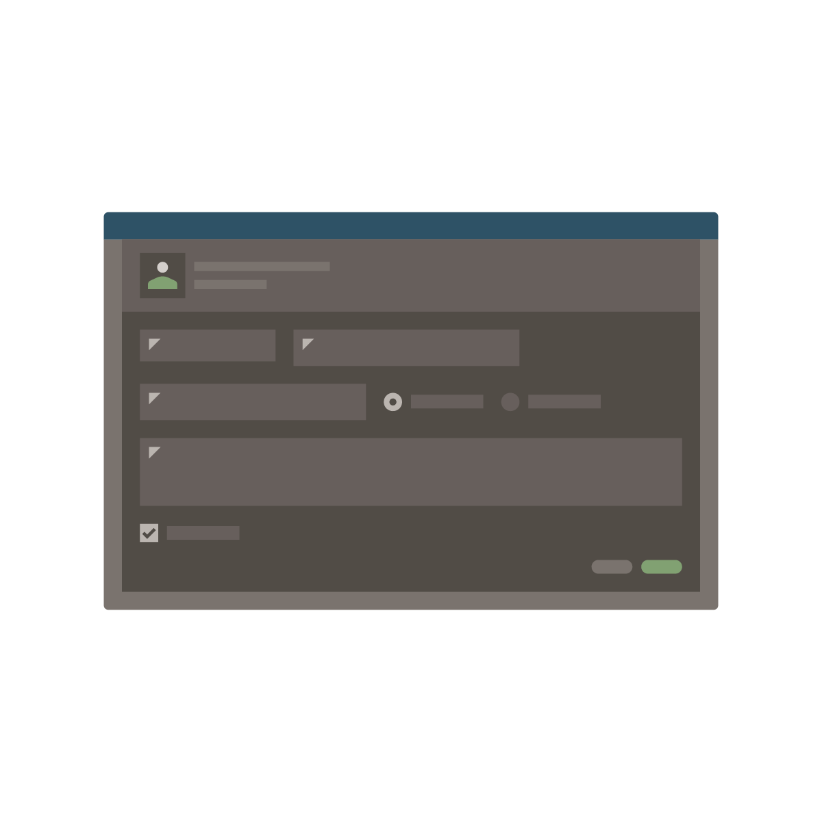
Modernizing Oracle Forms
Evolve your Forms Apps to APEX apps and unlock limitless possibilities!
Features
APEX is the natural evolution of Forms
Both are based on SQL and PL / SQL
Re-use DB packages, procedures, functions
Easily train Forms Developers into developing with APEX
Forms App
Solutions
Proof-of-concept using the subset of Forms apps
Organization-wide apps, rather than back-office
External apps for customers/partners
Mobile-first apps
Net new requirements
APEX Application
Learn more at apex.oracle.com
Notes:
If talking to a Forms customer ask what there plans are.
If looking to move off push APEX as it is by far the easiest way to modernize their legacy Forms apps
## Virtual Trader; Carnival Cruises

Slide 49

Extending Enterprise Systems
Enhance your existing apps by building APEX apps!
Features
Extend ERPs and other enterprise software
Provide organization-specific dashboards
Improved workflows
Fill gaps
Existing Apps
Solutions
Meet non-standard requirements
Optimize common business functions
Enhance data capture
Integrate disparate data sources
See: Extend E-Business Suite using APEX
Official Technical paper
APEX Application
Learn more at apex.oracle.com
Notes:
All ERPs / COTS have GAPS!!!!!!!
Used for extending Cloud ERP, FA, EBS, COTS Software to streamline for your business processes or meet organization specific requirements
Can readily lift and shift EBS with APEX extensions to the cloud
## Uni New Mexico; Stanford – Peoplesoft; Swarthmore College – Ellucian Banner
OTAUG = SIG

Slide 50
Mission Critical Enterprise Systems
Features
Quickly build custom mission-critical apps
Corporate data reporting and maintenance
Merge separate data silos
Build organization-wide self-reporting apps
Solutions
Simple deployment
Single installation runs any number of apps
Scale to hundreds of thousands of users
Leverages enterprise features of Oracle Autonomous
Learn more at apex.oracle.com
Notes:
As proven by the many APEX mission-critical apps within Oracle (such as the Oracle Store and ARIA People),
your customers can readily build enterprise class aps
## Utah DOT; Oracle Store, Einstein, ARIA People

Slide 51
Product Components
Learn more at apex.oracle.com

Slide 52
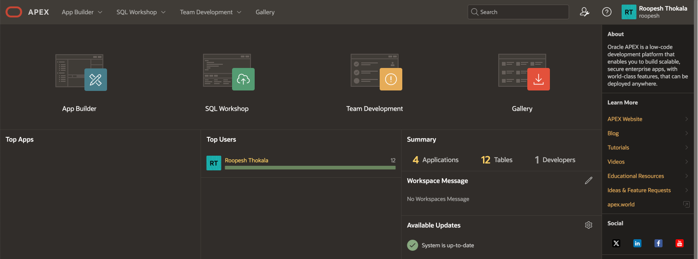
Home Page
Comprehensive Development IDE, Web Application Development, and SQL Database Development
Learn more at apex.oracle.com

Slide 53
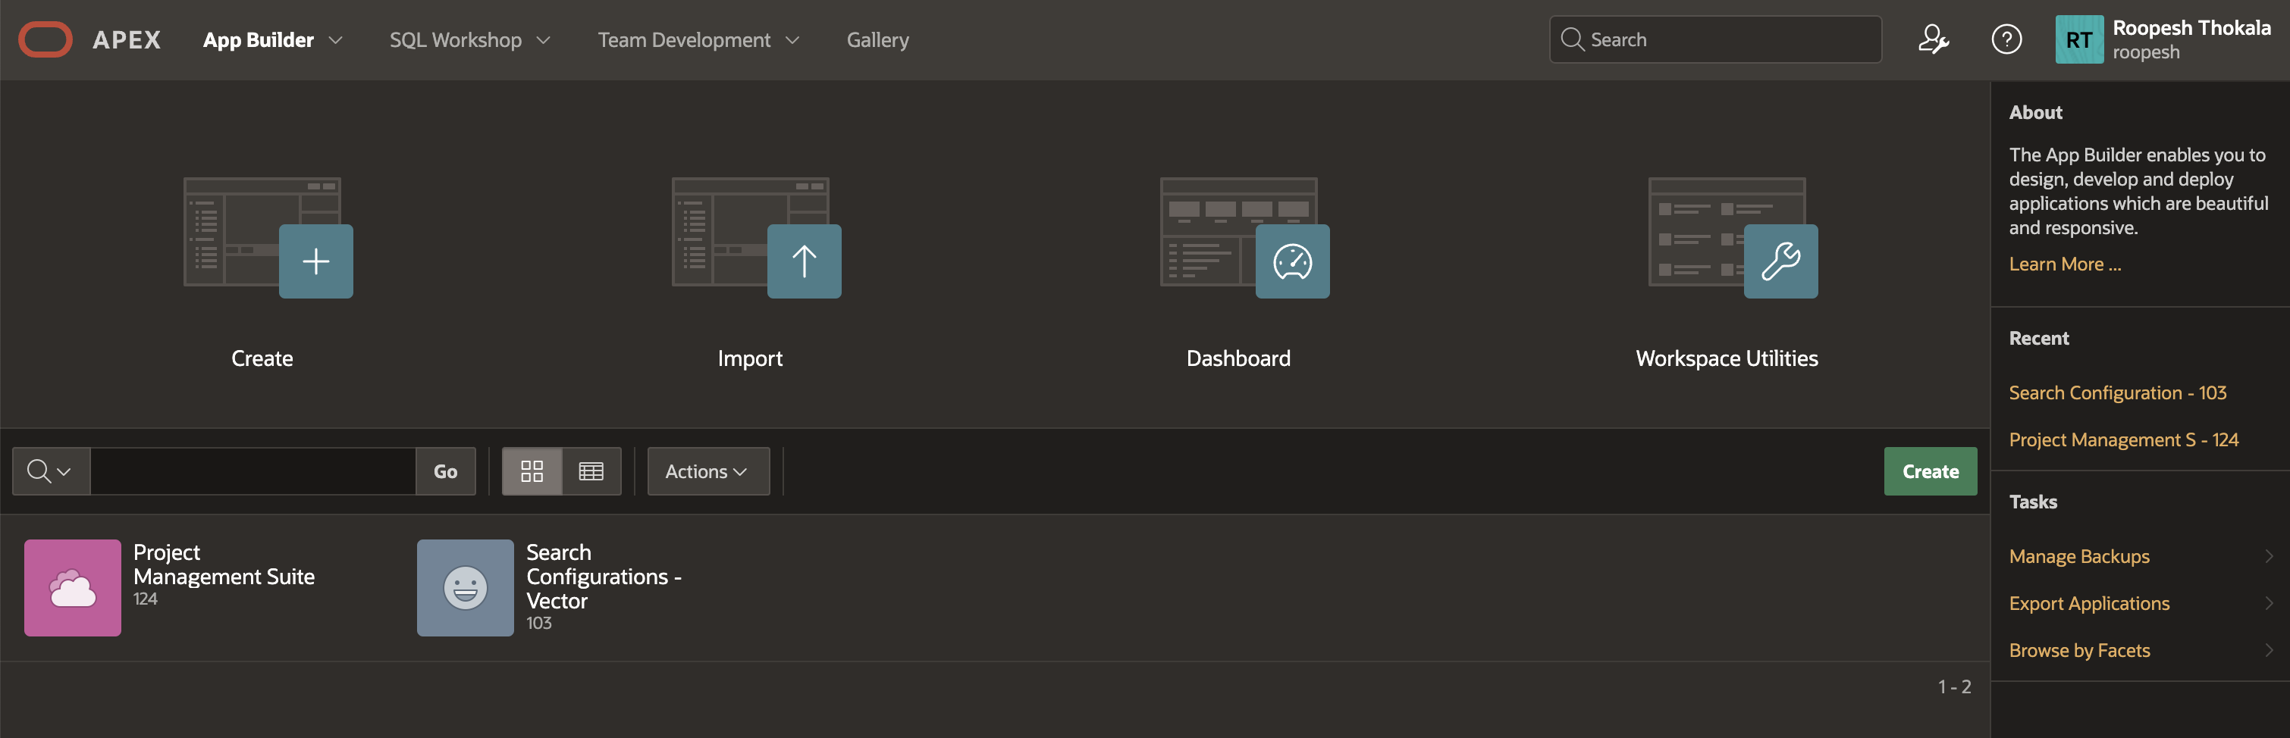
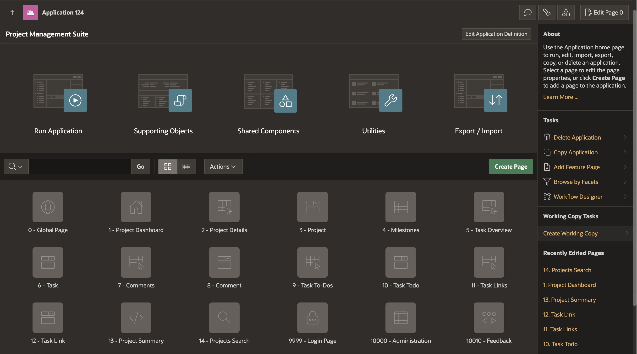
App Builder
Integrated Development Environment (IDE) with Application Development, and Graphical "Page Designer" Features tight SQL and PL/SQL integration
Learn more at apex.oracle.com

Slide 54
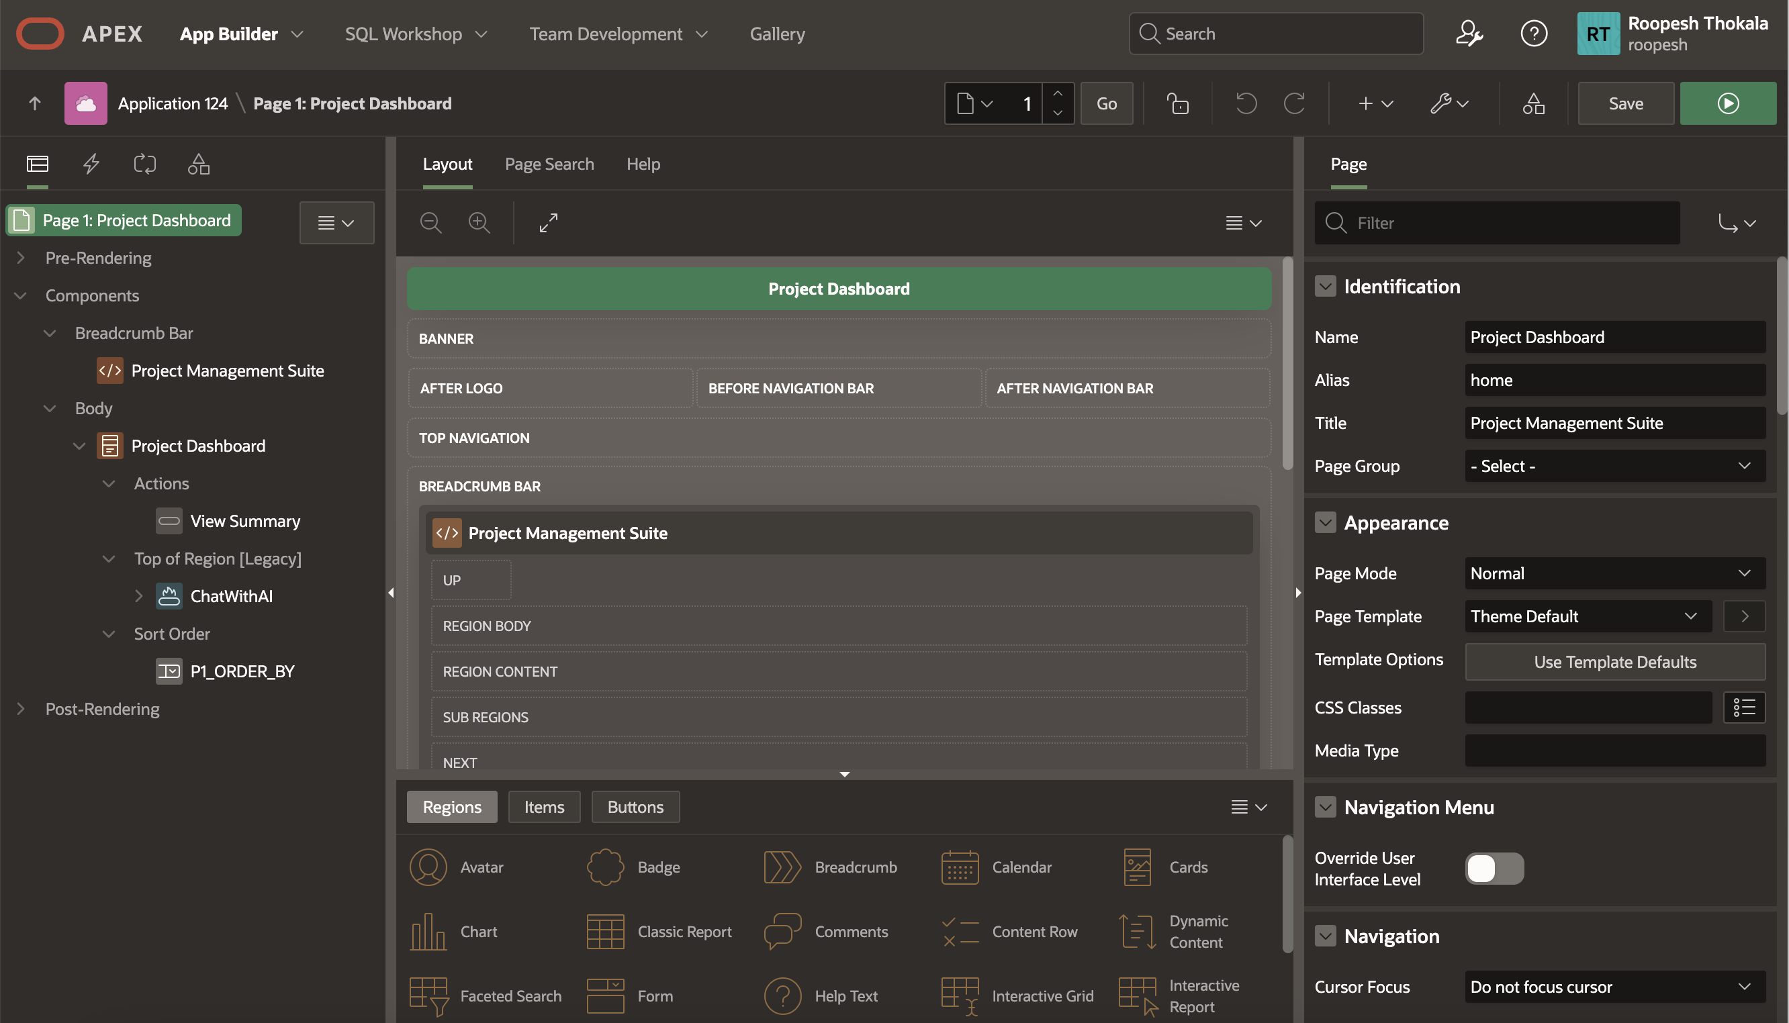
App Builder – Page Designer
Page Designer is a comprehensive Integrated Development Environment (IDE) equipped with a toolbar and multiple panes, offering a full range of features for efficient development.
Learn more at apex.oracle.com
Notes:
Design Principles
Create new elements using drag & drop or menu shortcuts
Update multiple page elements at once
Utilize “Undo” and “Redo” to revert changes made
“Save” and “Run” commits all pending changes to database
Left Pane
Rendering, Processing and Shared Components grouped in an accordion in the left panel instead of horizontally across the page
Dynamic Actions introduced as a new grouping
Create, move and duplicate elements using drag & drop or the improved context sensitive menus
All element types can be deleted directly from the tree
Click on one or more elements to highlight elements in the Grid Layout and to populate common element details in the Property Editor
Central Pane
Grid Layout: Create, move, copy and delete components using drag and drop
Gallery: shows components that can be dragged into the page
Messages: Display errors and warnings associated with changes made
Page Search: Allows performing a page search.
Help: Displays context sensitive help based on the current focus
Property Editor - Right Pane
Displays the details for the currently selected element(s)
Bulk editing of common properties when multiple elements are selected
Improved usability for defining properties, including
instant input feedback
cascading context sensitive selections
easier definition of common property types
Improves productivity by making the definition of elements easier and more intuitive

Slide 55
App Builder – Page Designer
Multiple trees to view the page components
Visualization of the page within the Grid Layout and associated Gallery, allowing you to drag and drop components
Update multiple attributes without leaving the page in the Property Editor
Advanced Code Editor for defining SQL, HTML, CSS, and text sections
Highly configurable user interface:
    Customize and refine the view of the page specific to the current focus
    Slideable panels
    Drag and drop tabs
Learn more at apex.oracle.com
Notes:
Page Designer revolutionizes the way developers can enhance and maintain page definitions within APEX.
The left pane has numerous trees to show the rendering, dynamic actions, processes and shared components.
The middle pane includes the Grid Layout and Gallery where you can easily drag and drop new components
The right pane holds the Property Editor where you can update any of the select4ed components’ attributes, without needing to bring up a separate page
For text sections used to enter SQL, HTML, CSS or text you can pop-up the Code Editor which includes find/replace, auto-completion and even SQL validation
There are numerous ways you can customize the user interface to make it easier to concentrate on the sections you are currently working on.

Slide 56
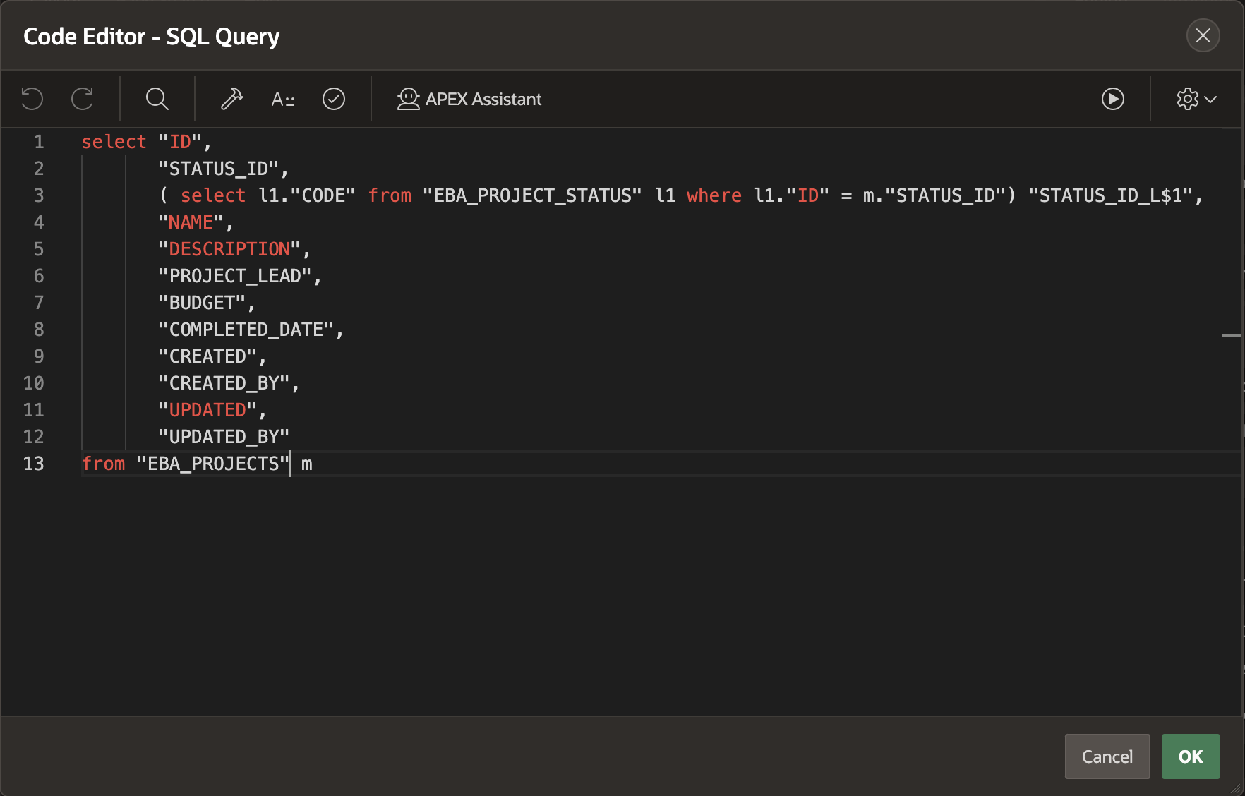
App Builder – Code Editor
Available for maintaining SQL, PL/SQL, JavaScript, HTML, CSS and large text sections
APEX Assistant
Syntax Highlighting
Undo / Redo
Find/Replace
Auto completion
Code validation
Used in Page Designer, Component View
and SQL Workshop
Learn more at apex.oracle.com
Notes:
Developers will spend the majority of their time in the Application Builder defining, enhancing and maintaining applications.

Slide 57
App Builder – Universal Theme
The default theme for Oracle APEX applications
Uses responsive HTML5 templates
Grid-layout for HTML forms
Modern flat-look
Ships with a variety of pre-built theme styles
jQuery Mobile Apps can be transitioned to Universal Theme
Learn more at apex.oracle.com
Notes:
Rather than having numerous themes with a large number of templates in each, there is just a single desktop theme and a consolidated number of templates.
With the Universal Theme it is quicker and easier to build beautiful, responsive, elegant applications out-of-the-box.
In Oracle APEX 18.1, jQuery Mobile and the jQuery Mobile User Interface used in previous releases have been desupported. If you have an existing mobile application that uses the jQuery Mobile User Interface, you should migrate your existing application to the Universal Theme.
Universal Theme is designed to be responsive, so it will look and feel great on any screen-size device. For apps that are primarily designed for use on small screen devices, APEX 18.1 introduces three new region types that were ported from the jQuery Mobile User Interface: List View, Column Toggle Report, and Reflow Report.

Slide 58
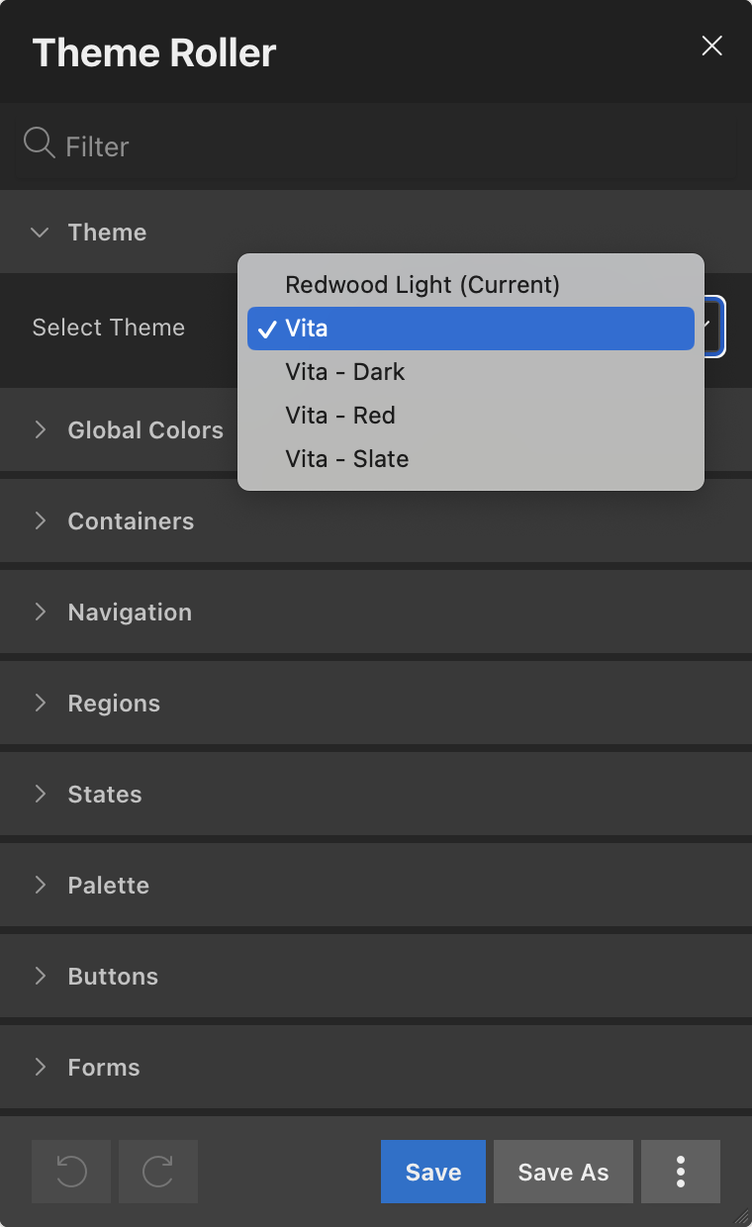
App Builder – Universal Theme
Theme Styles and Theme Roller
Theme Styles provide a variety of different color schemes and styles for a single theme
Defined as CSS file that is included in addition to the theme’s base CSS file
Universal Theme includes several pre-built styles
Additional styles can be easily generated using the built-in Theme Roller utility
Learn more at apex.oracle.com
Notes:
Theme Styles allow a single theme to have various color schemes.
Developers can readily define different color schemes and modify certain display characteristics, such as button and item rounding using Theme Roller.
They can then readily save the style and apply it to their application without needing to write any CSS.
Developers can even allow end-users to select different styles as shown in P-Track Administration.

Slide 59
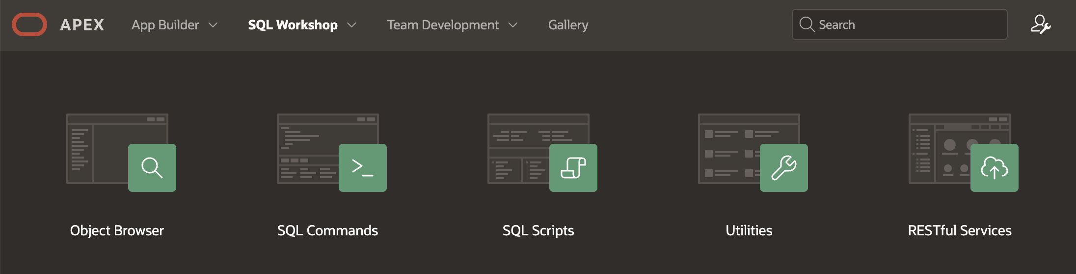
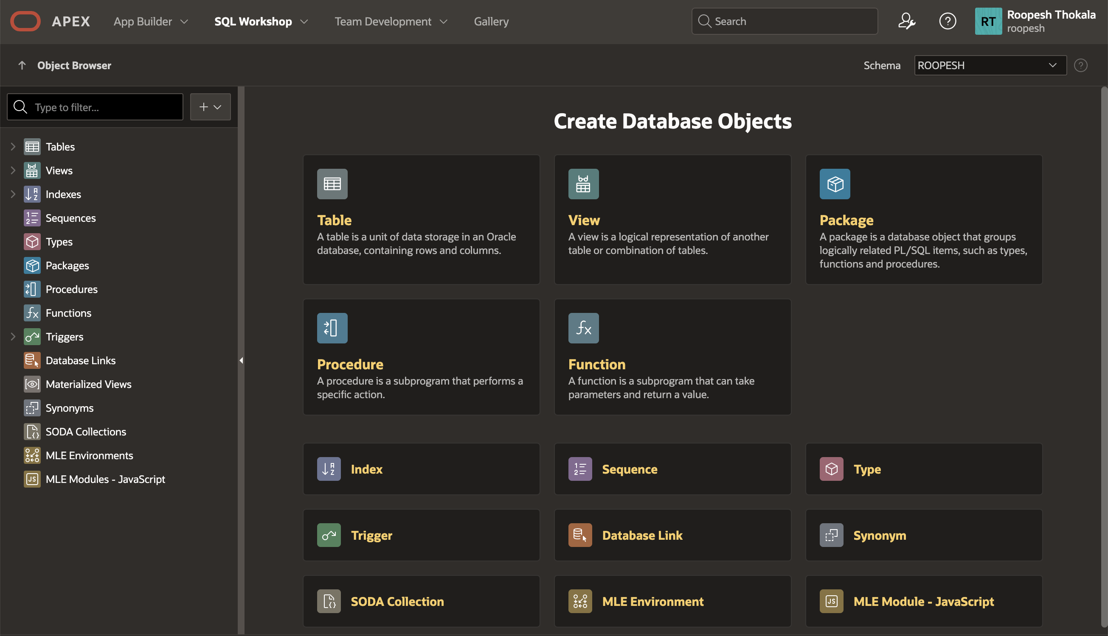
SQL Workshop
Browser-based maintenance of database objects and data
Designed to meet application developers’ needs, especially in hosted environments
Learn more at apex.oracle.com
Notes:
SQL Workshop is sometimes the only means developers can maintain DB objects as they may not have direct access to the schema(s) via SQL*Net, especially if they are using a hosted service.
The functionality available through SQL Workshop is a subset of SQL Developer and is designed specifically for developers to be able to maintain their DB objects.

Slide 60
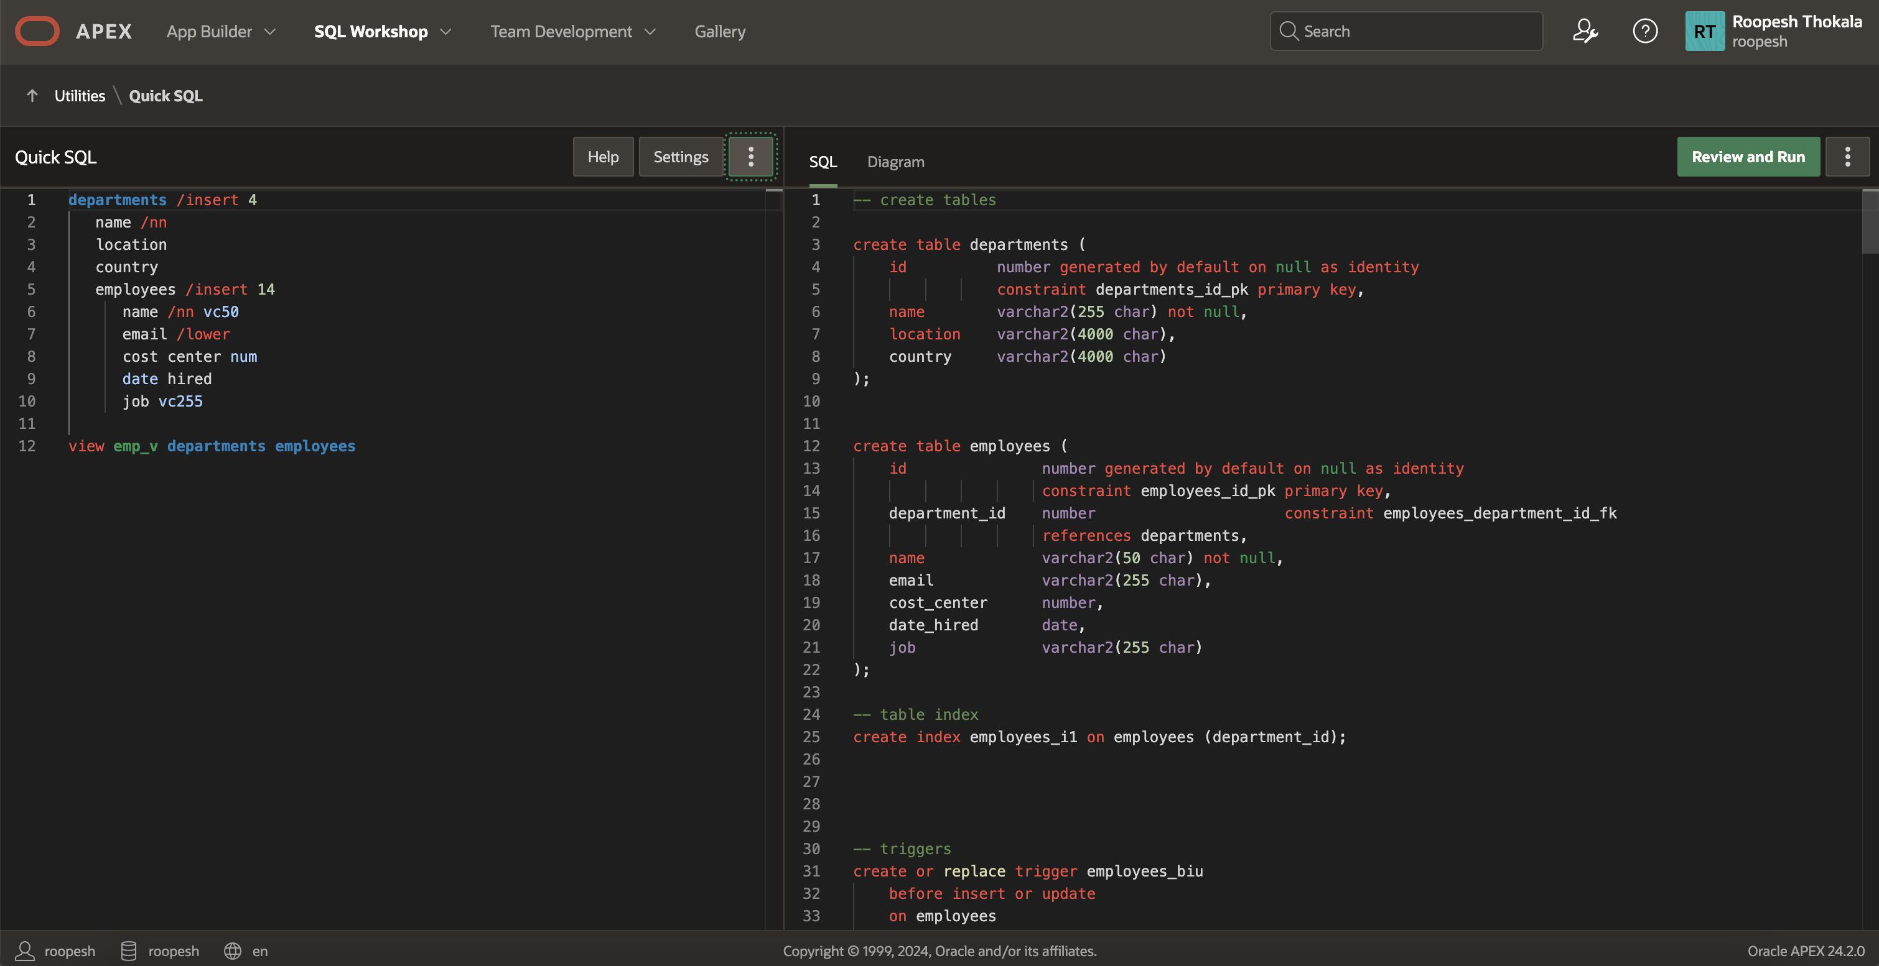
SQL Workshop – Quick SQL
Rapidly design and prototype data models using a markdown-like shorthand syntax
that expands to standards-based Oracle SQL.
Learn more at apex.oracle.com
Notes:
Quick SQL is designed to reduce the time and effort required to create SQL tables, triggers, and index structures.
Quick SQL is not designed to be a replacement for data modeling. It is simply a quick way to develop a script for simple tables and views. Once the SQL is generated it can be tweaked and expanded upon. Quick SQL provides a quick way to generate the SQL required to create a relational data model from an indented text document. You can easily create master detail relationships, check constraints, and even generate sample data.

Slide 61
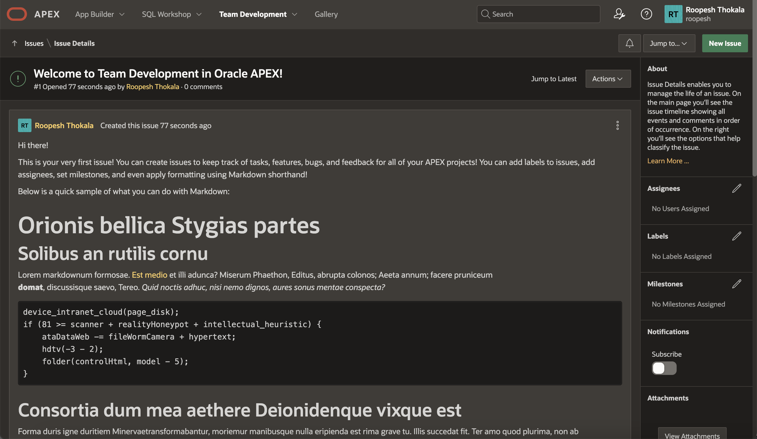
Team Development
Team Development has been reimagined as a new and more flexible way to collaborate
with peers/teammates and track tasks, features, bugs, and feedback.
Learn more at apex.oracle.com
Notes:
Team Development provides the ability to manage the full lifecycle of your application development.
Features, To-Dos, and Bugs can be assigned to specific applications and pages.
Feedback allows developers to easily gather comments, enhancements, and bugs directly from their user community and includes important session state information to assist the developers with diagnosis.
Team Development is used extensively by the APEX Development Team to manage the development of new releases of APEX which itself is built with APEX.
Discover samples that showcase new features and design patterns, add new capabilities with plug-ins, and get pre-built apps that you can use as-is or customize.

Slide 62
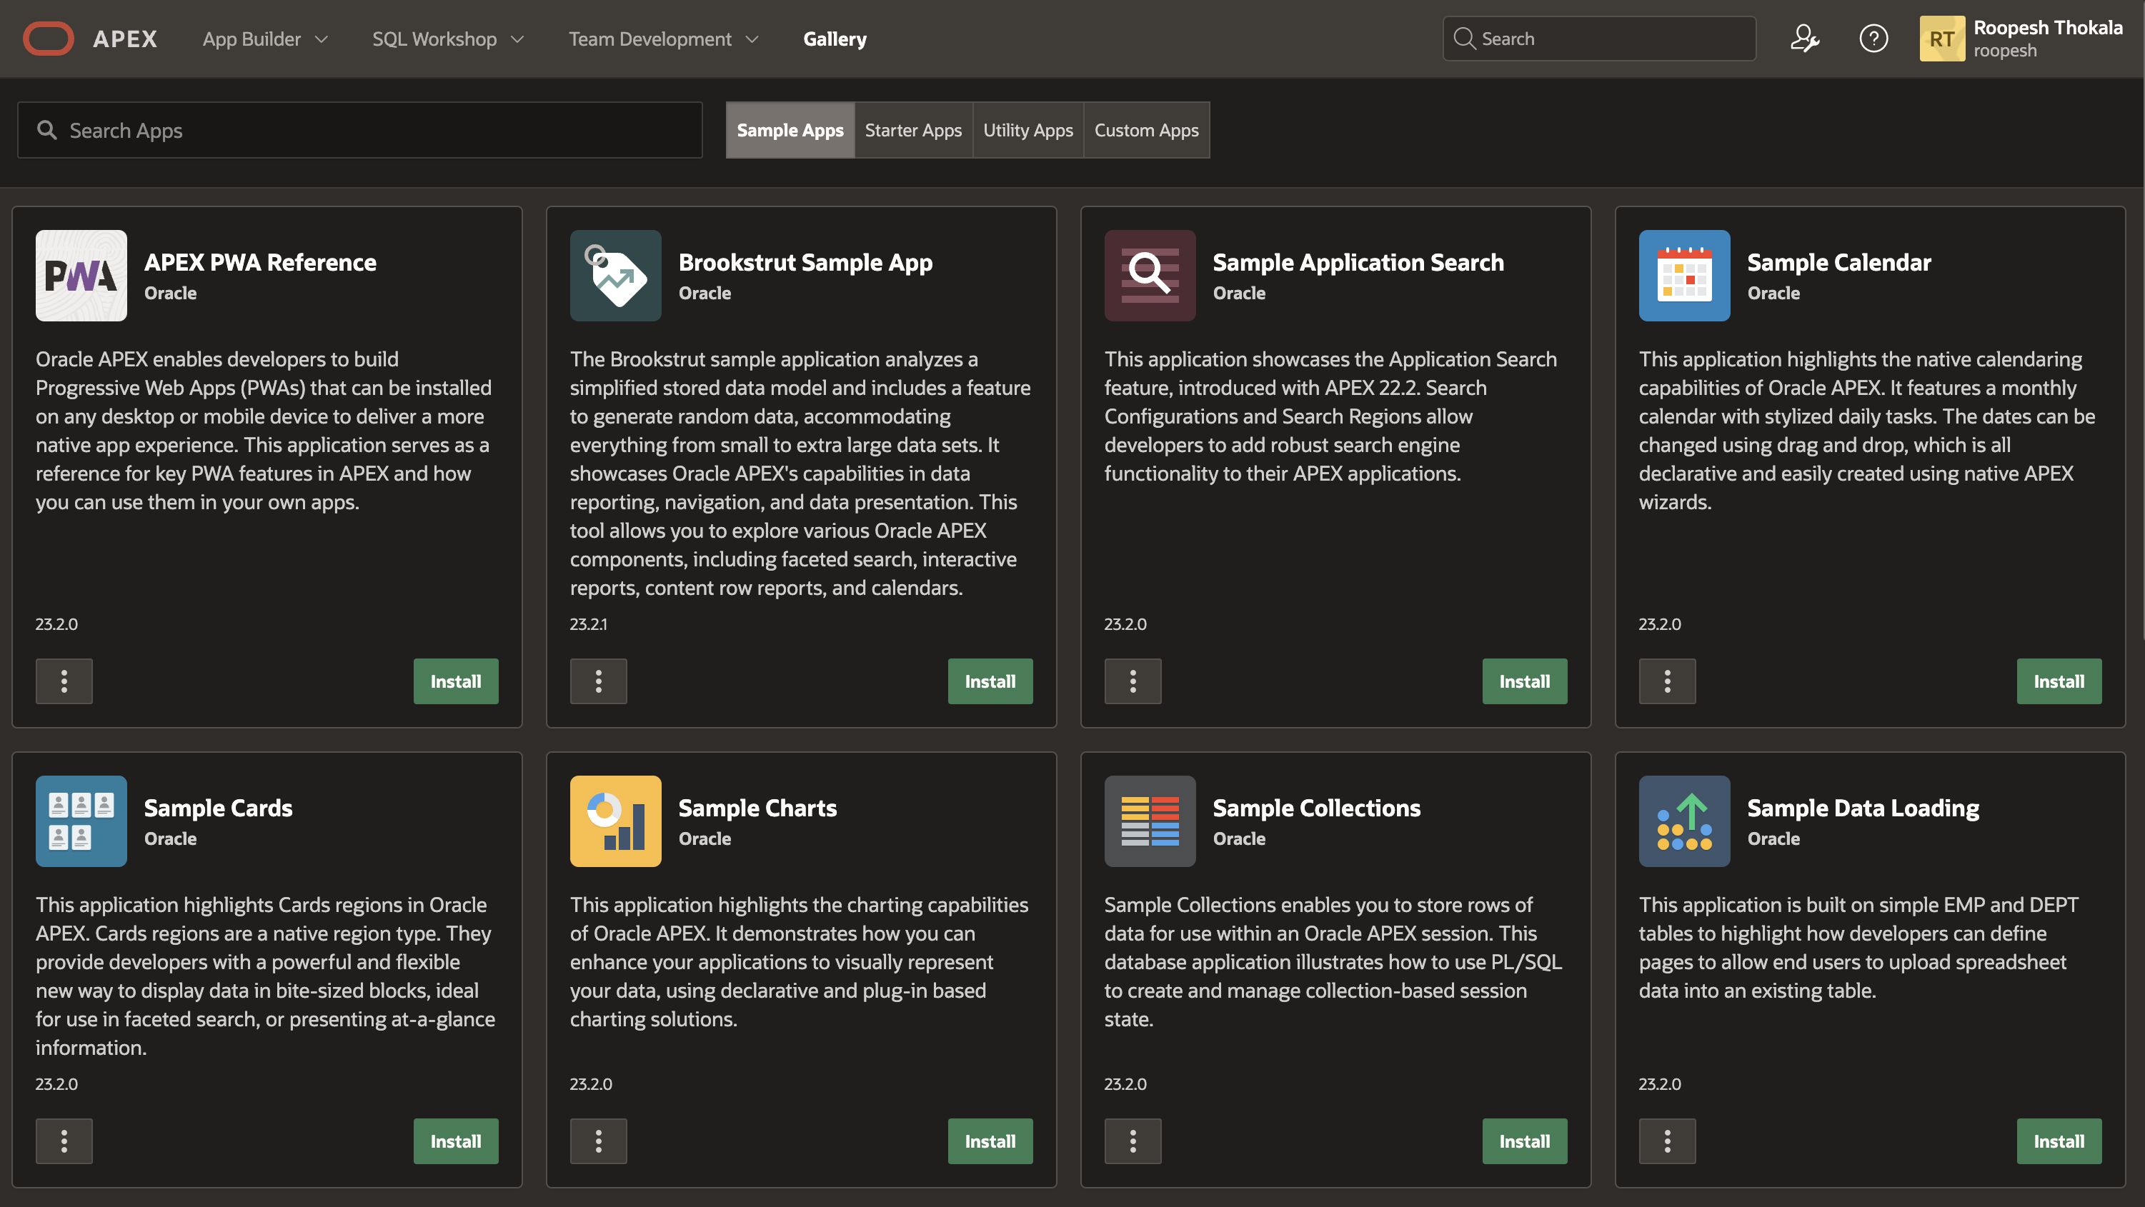
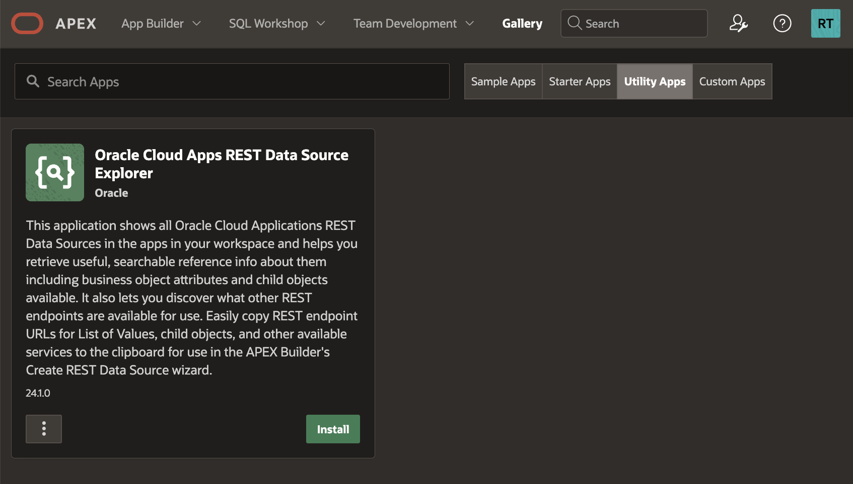
Gallery
Learn more at apex.oracle.com
Notes:
Discover samples that showcase new features and design patterns, add new capabilities with plug-ins, and get pre-built apps that you can use as-is or customize.

Slide 63
Features
Learn more at apex.oracle.com

Slide 64
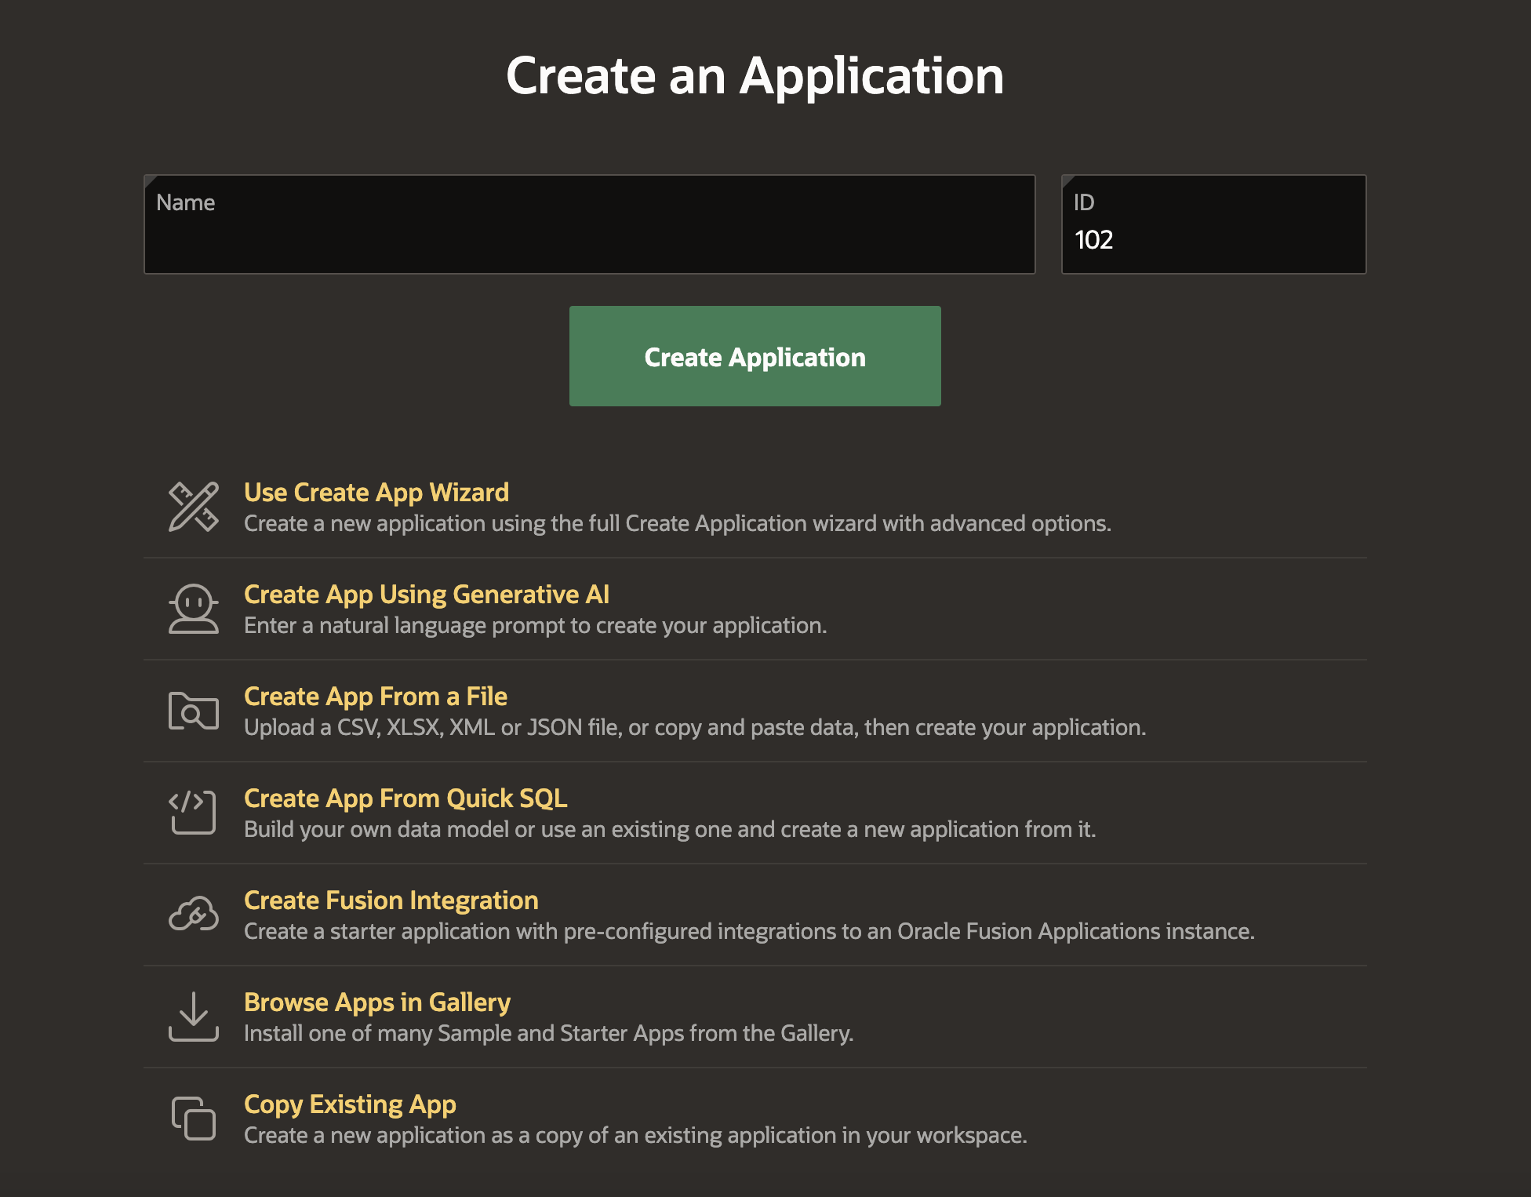
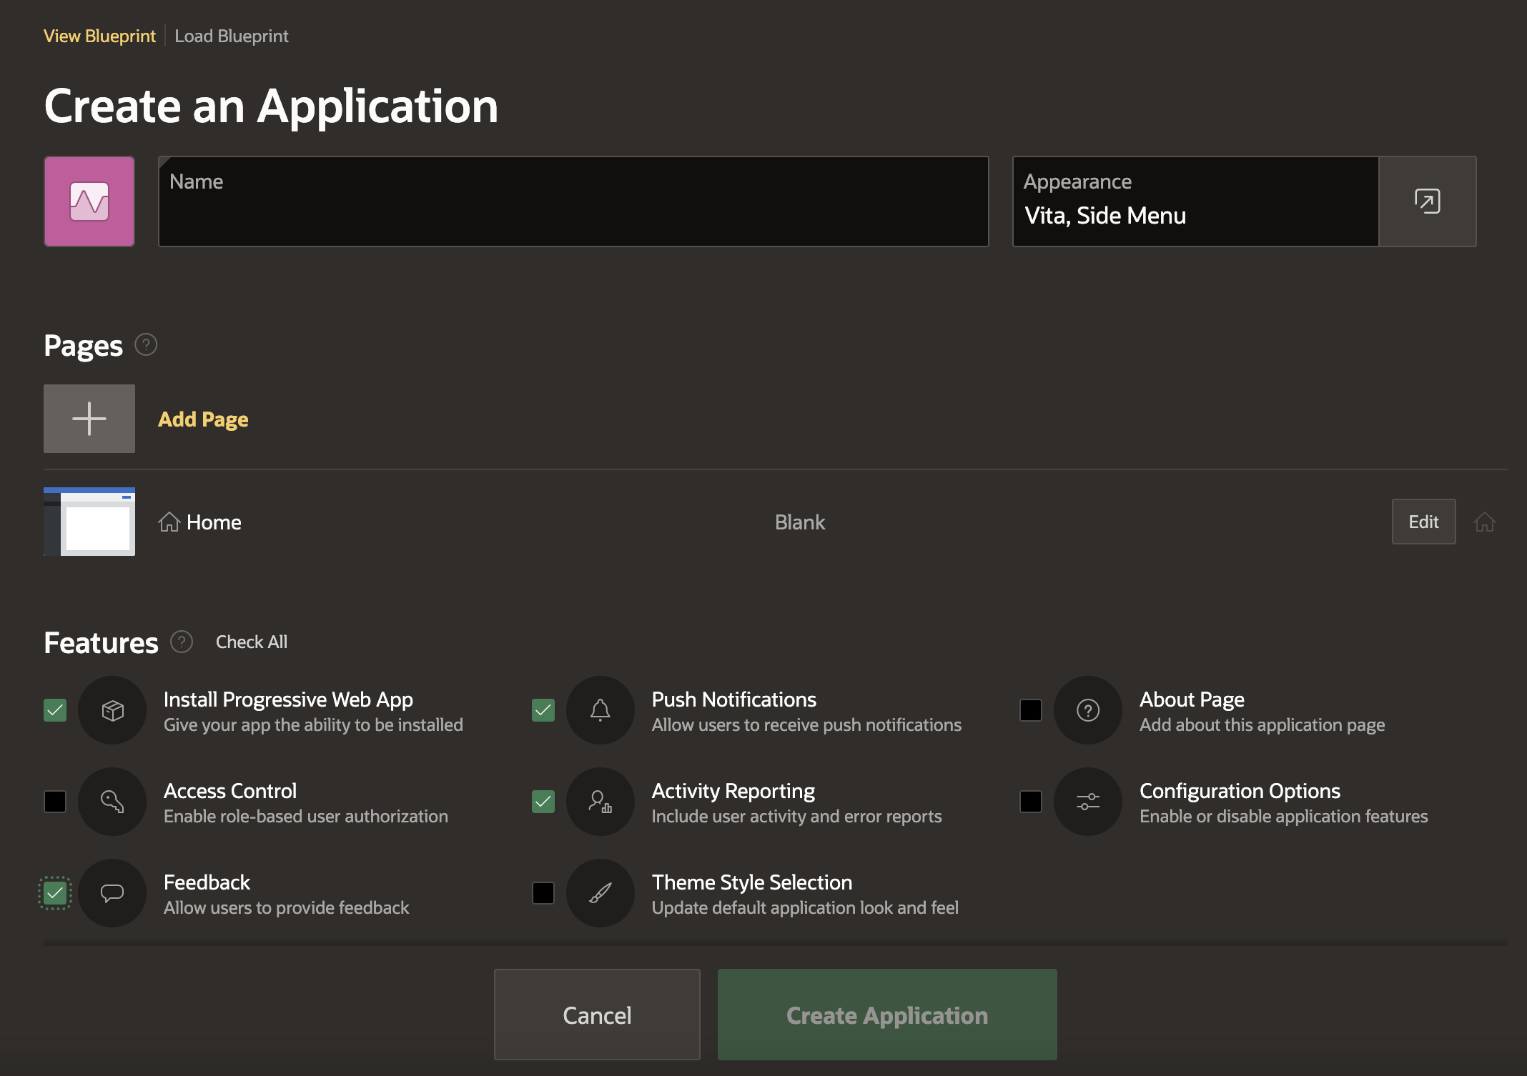
Create Application Wizard
Simple, modern wizard for creating pages.
Allows creation of numerous page types including Dashboards, Master-Detail, etc.
Supports adding common frameworks or "Features" when creating an application such as access control, activity reporting, theme selection, and more
Customize user interface options such as Theme Style, application icon, and page icons
Learn more at apex.oracle.com

Slide 65
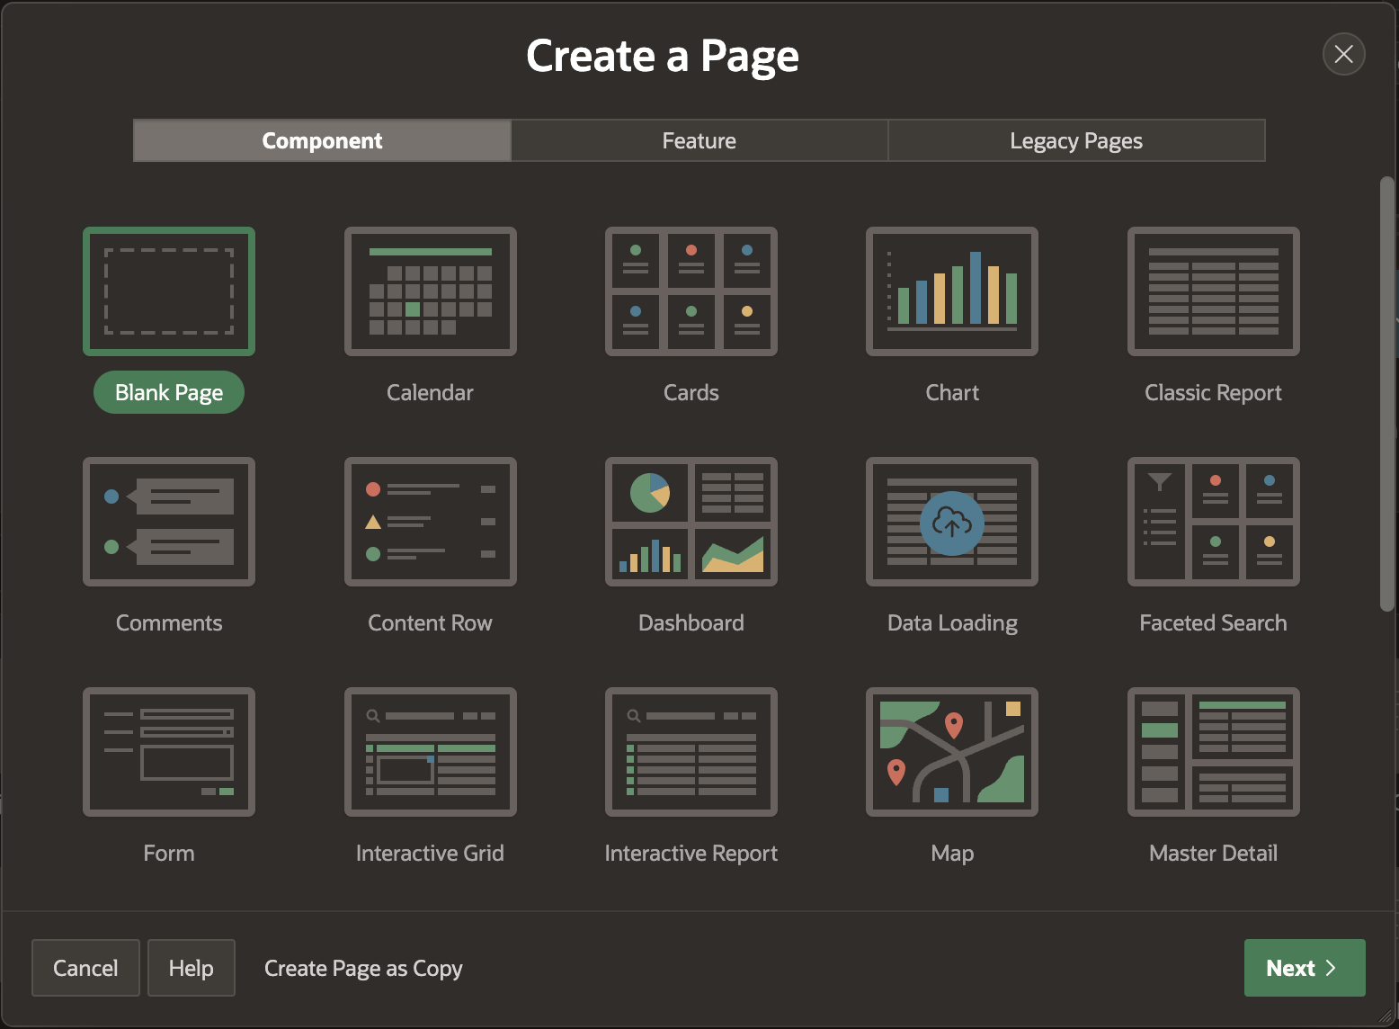
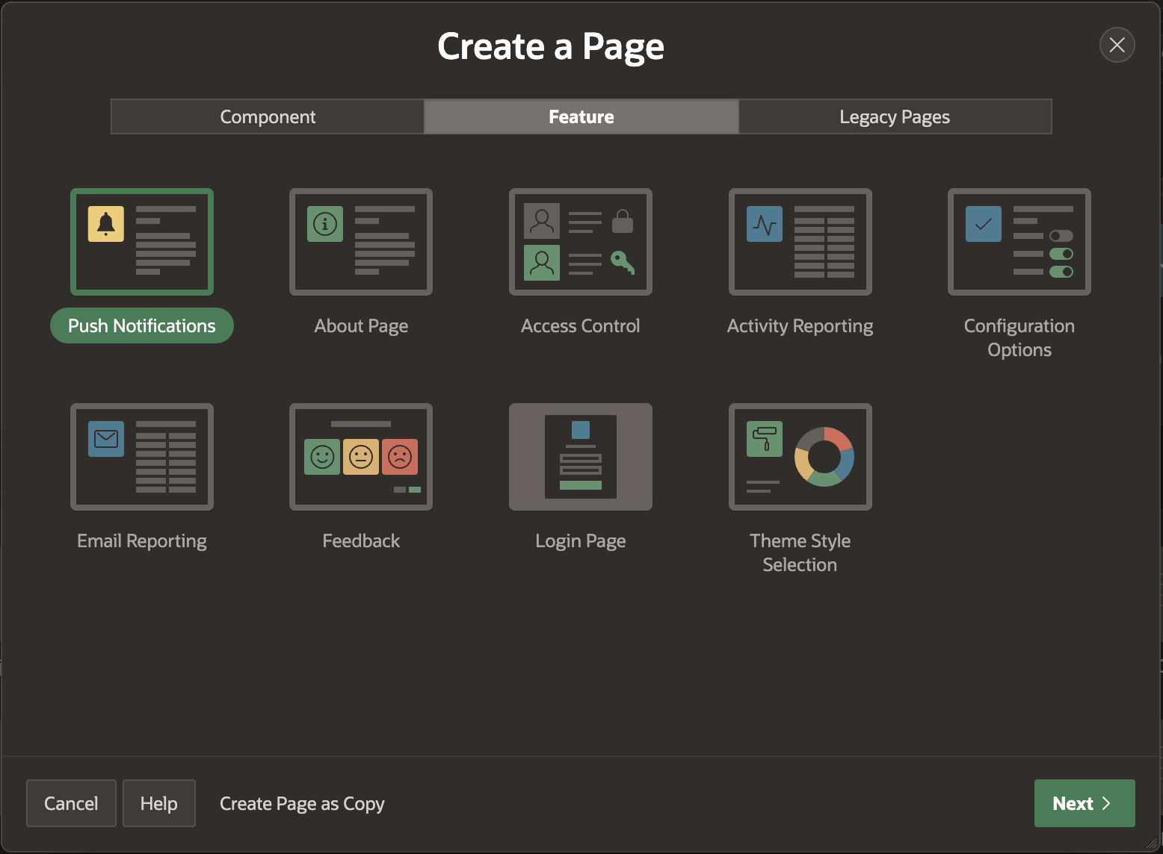
Create Page Wizard
Simple, modern wizard for creating individual pages in an existing app.
It allows the creation of more advanced pages, such as Dashboards, additional Master-Detail page types, List Views, mobile-first reports, and more.
Supports adding common frameworks or "Features" to an existing application such as access control, activity reporting, theme selection, and more
Learn more at apex.oracle.com

Slide 66
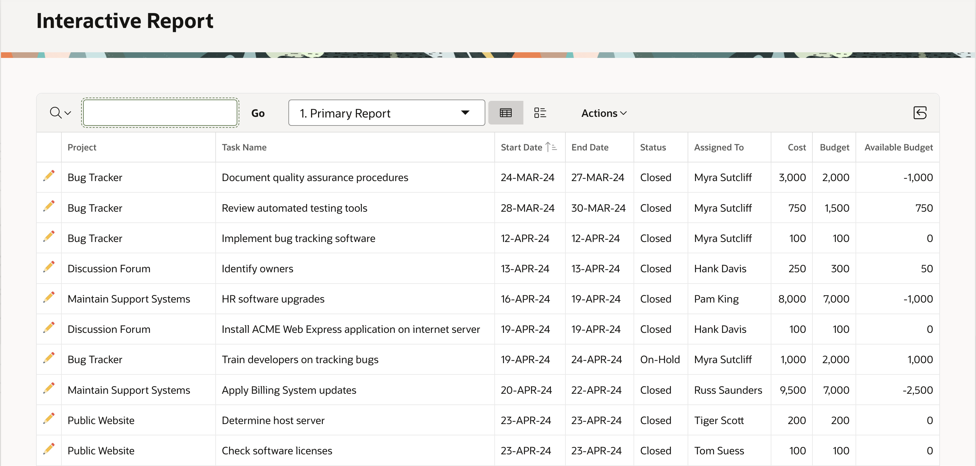
Interactive Reports
Powerful Reporting capabilities → End-user customizable
Learn more at apex.oracle.com
Notes:
SQL Workshop is sometimes the only means developers can maintain DB objects as they may not have direct access to the schema(s) via SQL*Net, especially if they are using a hosted service.
The functionality available through SQL Workshop is a subset of SQL Developer and is designed specifically for developers to be able to maintain their DB objects.

Slide 67
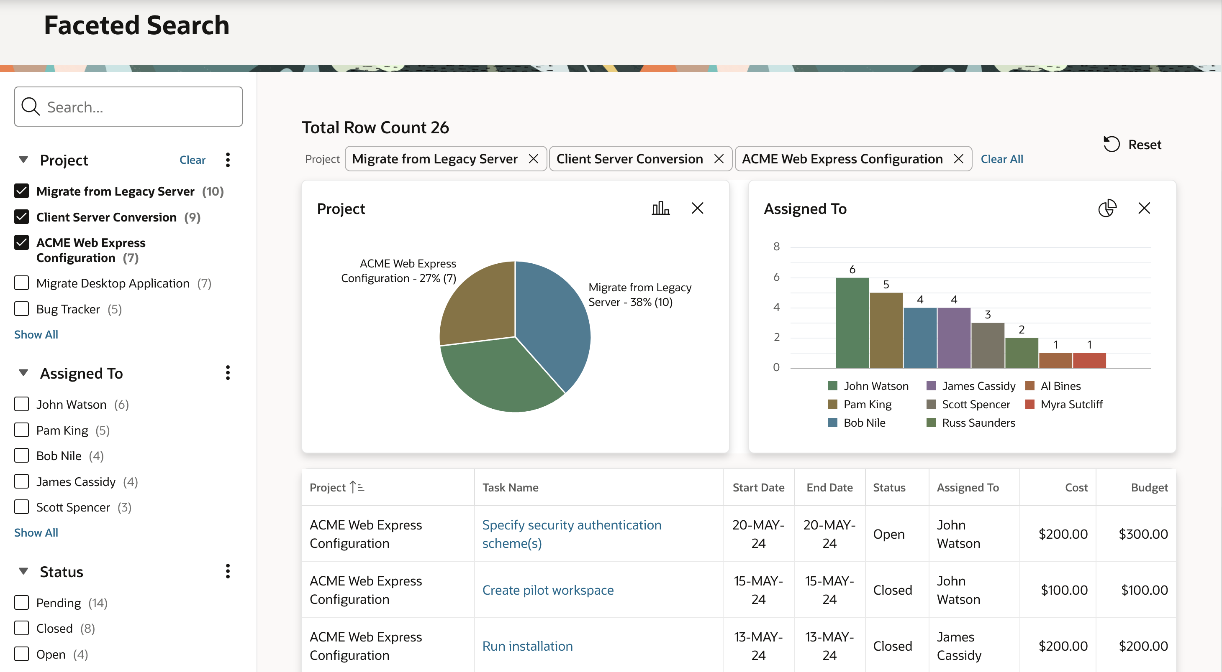
Faceted Search
A powerful way to filter and display your data.
Faceted Search will make it easier for your users to find the data they want.
Learn more at apex.oracle.com
Notes:
Faceted Search is seen pretty often on the internet; typically on shop or sales web sites. The end user can set filters using Facets on the left or upper side of the screen. A facet shows possible values together with the occurrence count within the result set. After the end user changed a facet, results, dependent facets and occurrence counts refresh immediately.
The new Faceted Search feature in APEX 19.2 enables developers to provide fully functional faceted navigation with minimal effort. APEX does all low-level work of coordinating report and facet refresh, generating the required SQL queries to compute counts and integrating the facets with the report region. Developers just declare the report data source, the facets to use with the lists of values to get facet items from.
I
A faceted search page in APEX features a faceted search region and report. The faceted search region displays on the left side of the page and enables users to narrow down the search result by selecting facet values. Narrowing the search result, makes it easier for users to find the data they want. The right side of the results region is a classic report which displays in report or card view. Both the Create Application Wizard and Create Page Wizard support the creation of faceted search pages.

Slide 68
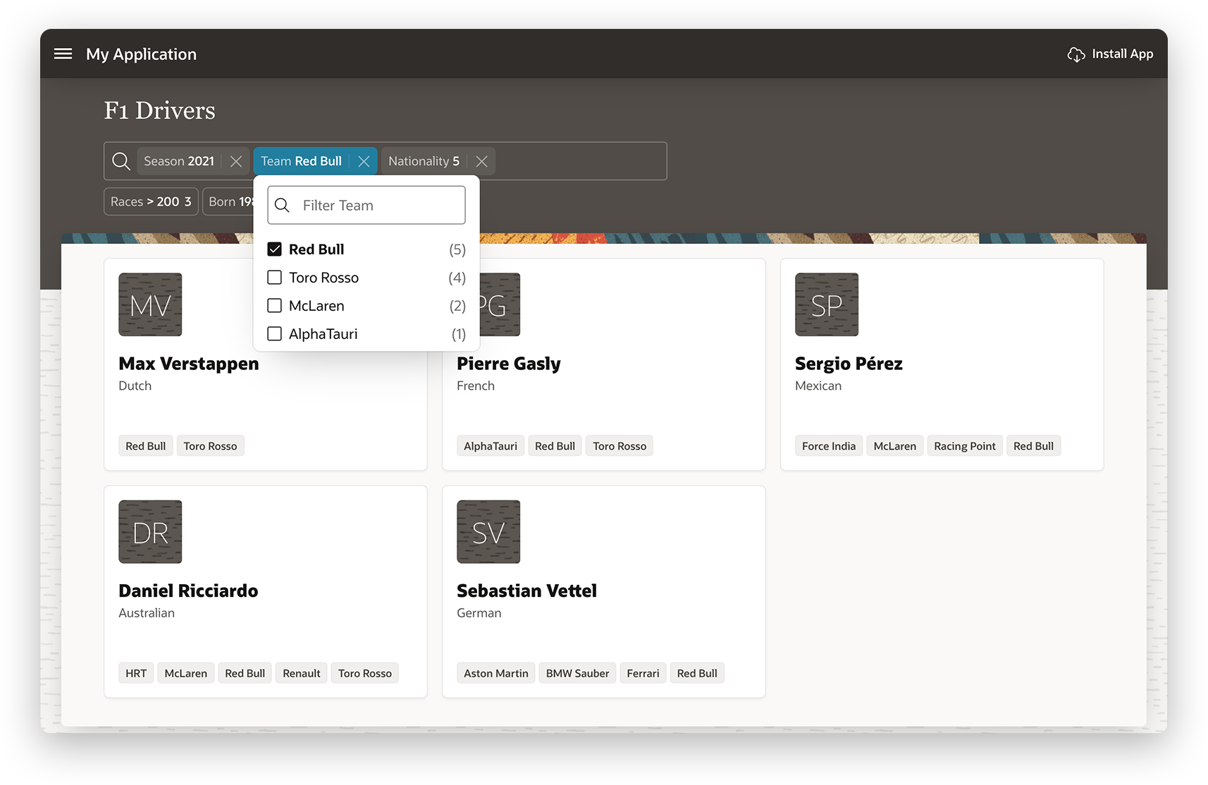
Smart Filters
A new search component that allows users to quickly narrow data down with filter suggestions or search terms
Features a powerful Search Bar that provides built-in auto-complete for your filters, supports searching for multiple terms, and provides easy keyboard navigation.
Filters are evaluated against your data and displayed below the search bar as chips
Learn more at apex.oracle.com
Notes:
Smart Filters is a new search component that allows users to quickly narrow data down with filters suggestions or search terms. Developers can use this component to provide users with a simplified search experience that eliminates clutter and provides a single control to instantly find the information they are looking for.
Powerful Search Bar
Smart Filters features a powerful new search bar that provides built-in auto-complete for your filters, supports searching for multiple terms, and provides easy keyboard navigation.
Search Suggestions
Search suggestions are at the heart of Smart Filters. These suggestions are based on the filters you have defined and are displayed as you type, or as chips below the search bar.
Suggestion Chips
Filters are evaluated against your data and displayed below the search bar as chips, suggesting the top search filters most appropriate for your data set.

Slide 69
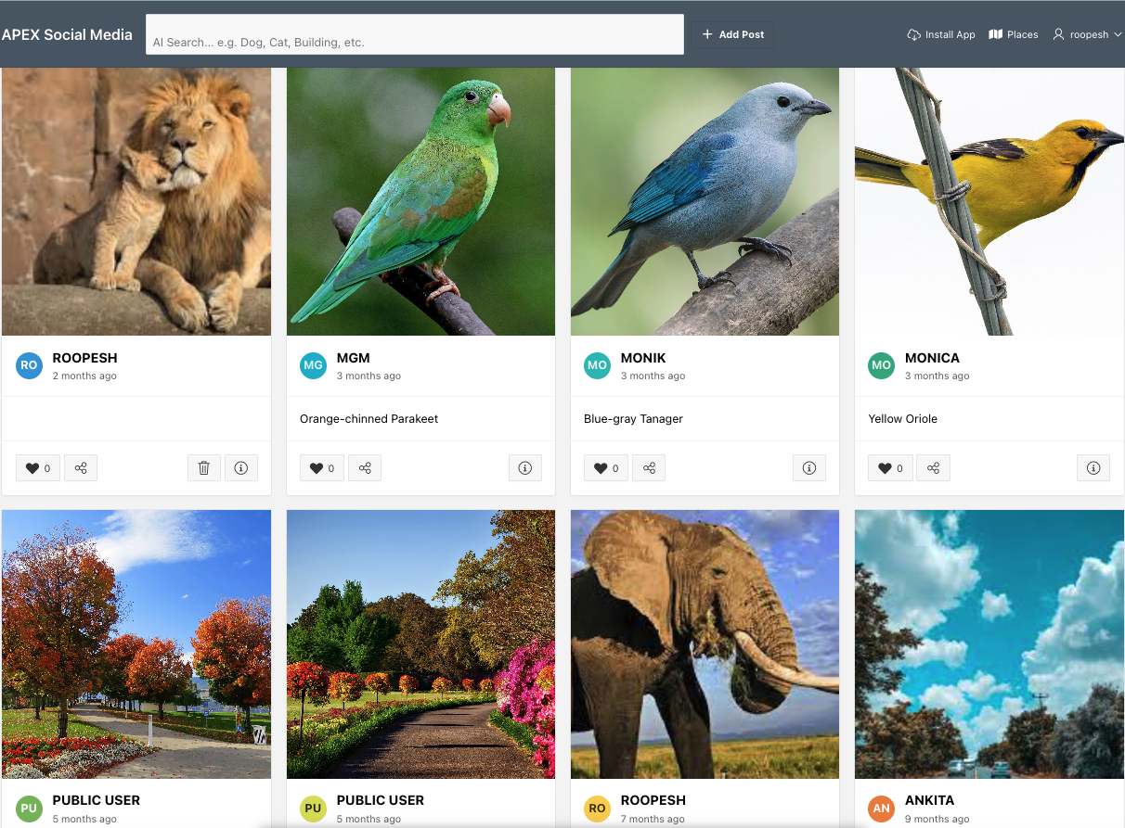
Cards
Create cards as a native region type and control the layout declaratively.
Provides entry to more detailed information and you can include a number of actions declaratively.
Learn more at apex.oracle.com
Notes:
Cards is new report region type in APEX 20.2. In previous releases, we supported creating cards by creating the report as classic report region with specific column aliases and controlling the layout with Cards template. The new Cards region takes away this complexity allows developers to create cards as a native region type and control the layout declaratively with Cards properties. Cards are useful for presenting a variety of information in small blocks. As Cards usually provide entry to more detailed information, you can include number of actions declaratively. You can easily scan for relevant and actionable information using cards.

Slide 70
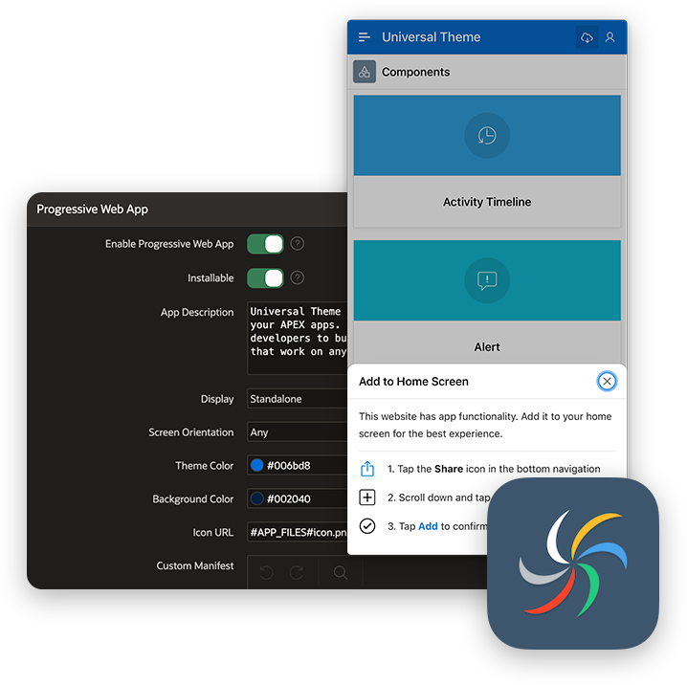
Progressive Web Applications (PWA)
Ability to install an APEX app as a Progressive Web App (PWA)
Serves a customizable offline page when users are offline and can't request the network
Improves page load rendering time with a new browser cache architecture for static files (APEX core files and APEX app files)
Easily send notifications to other devices with real-time updates
Send notifications, fetch geolocation, share APEX data with other apps, access the camera, and more.
Customize your app's appearance, including home screen icons, color schemes, logos, and more.
Learn more at apex.oracle.com
Notes:
Ability to install an APEX app as a Progressive Web App (PWA).
Adds PWA install-ability option to the create app wizard.
Provides installation instructions when needed, tailored for any device and browser.
Serves a customizable offline page when users are offline and can't request the network.
Improves page load rendering time with a new browser cache architecture for static files (APEX core files and APEX app files).
Easily send notification to any device with real-time updates
Send notifications, fetch geolocation, share APEX data to other apps, access the camera, and more.
Customize your app's appearance, including home screen icons, color scheme, logo and more.

Slide 71
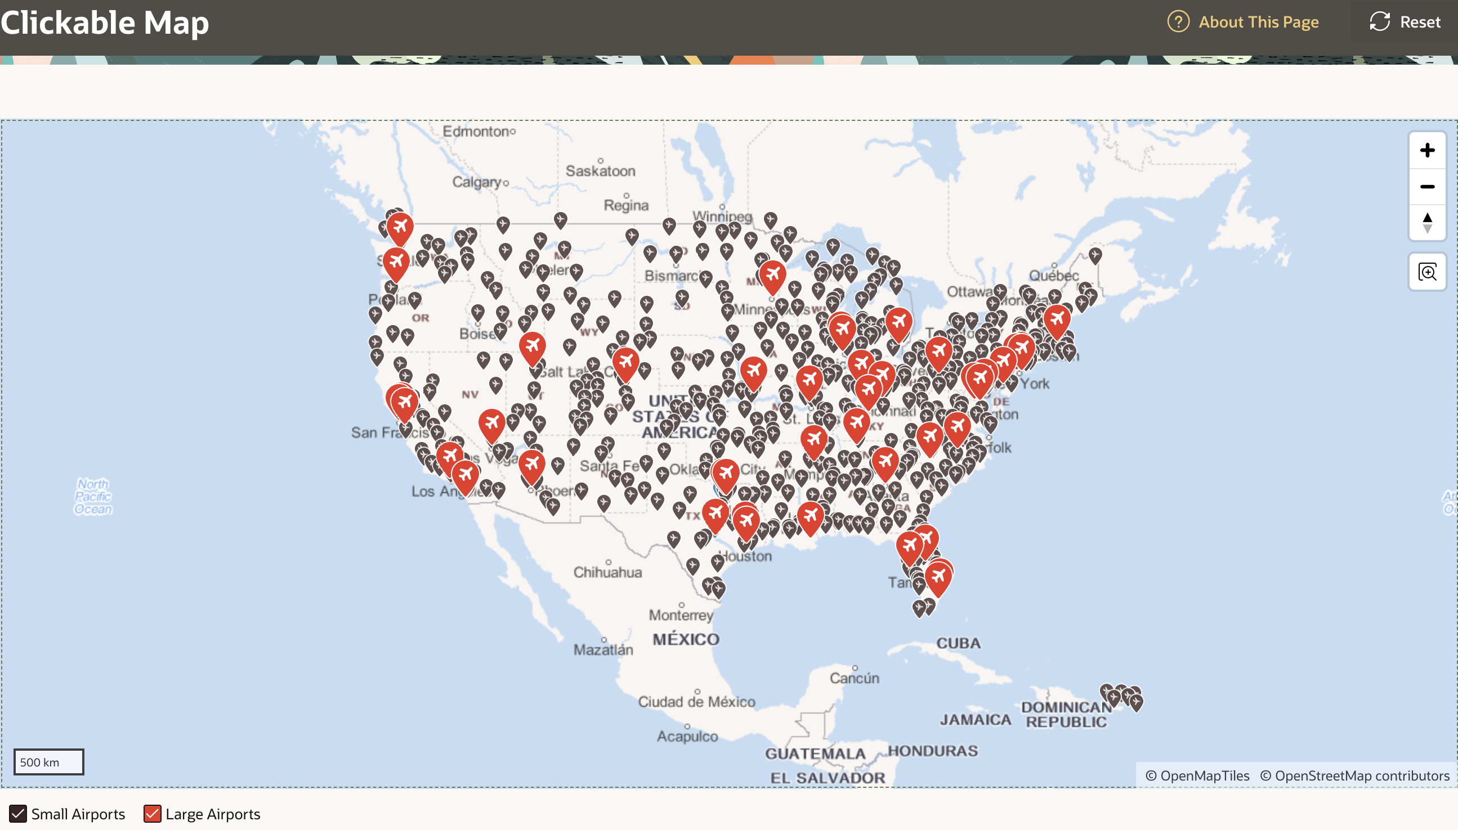
Maps
The native Map component allows you to add powerful, feature-rich, and interactive maps.
It is powered by Oracle e-Location Service, so it is ready to use; no API Key is required.
Create maps with layers for points, lines, polygons, 3D polygons, and heat maps.
Maps now support custom background tiles enabling you to visualize your spatial data in more ways than ever before.
Map Backgrounds can be defined as Raster, Vector, and OGC WMS tile layers.
Learn more at apex.oracle.com
Notes:
Maps is a new region type in APEX 21.1. Displaying spatial data within your APEX apps has never been easier. The all-new native Map component allows you to add powerful, feature rich, and interactive maps to your APEX apps within minutes. They are powered by Oracle eLocation Service so it is ready to use, no API Key required!
Oracle Spatial Support
GeoJSON, simple numeric columns, or columns of the SDO_GEOMETRY type can be mapped with ease. Also leverage Oracle Spatial features such as Spatial SQL functions, indexing, coordinate transformations and much more.
Fully Customizable
You can easily customize the look and feel of your maps, use the built-in color schemes for thematic visualizations and heat maps, and select from a variety of built-in SVG shapes and marker icons to make your maps shine.
Powerful
Create maps with layers for points, lines, polygons, 3d polygons, and heat maps; set them up with faceted search; or go deeper with dynamic actions and the javascript API.
Maps now support custom background tiles enabling you to visualize your spatial data in more ways than ever before. These map backgrounds are defined in Shared Components and can be used across all map components.
Backgrounds as Shared Components
Map Backgrounds are a new kind of Shared Component that can be defined and referenced across your application. Additionally, you can subscribe, refresh, and publish your Map Backgrounds just like any other Shared Component.
Flexible Customization Options
Map Backgrounds can be defined as Raster, Vector, and OGC WMS tile layers, and can be further customized with additional parameters to deliver the most appropriate map for your application.

Slide 72
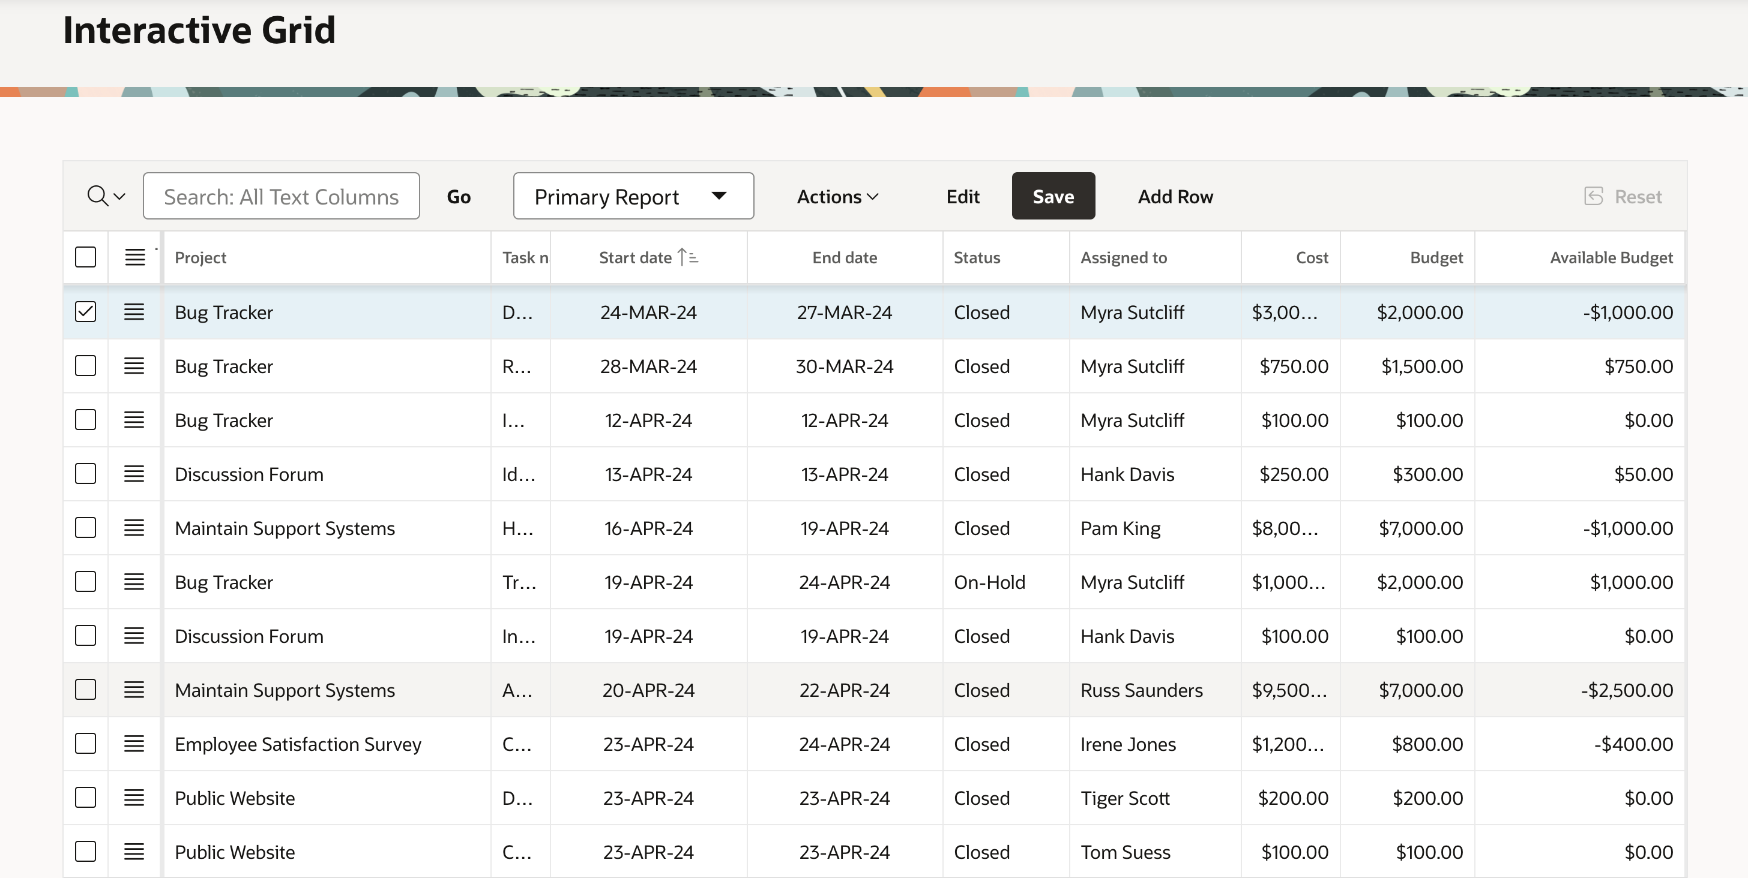
Interactive Grid
Modern, rich & interactive multi-row editing component
Use of existing Item types
Declarative support for Cascading LOVs
and Dynamic Actions
Upgrade utility for Tabular Forms
Master Detail / Detail
Learn more at apex.oracle.com
Notes:
Faceted Search is seen pretty often on the internet; typically on shop or sales web sites. The end user can set filters using Facets on the left or upper side of the screen. A facet shows possible values together with the occurrence count within the result set. After the end user changed a facet, results, dependent facets and occurrence counts refresh immediately.
The new Faceted Search feature in APEX 19.2 enables developers to provide fully functional faceted navigation with minimal effort. APEX does all low-level work of coordinating report and facet refresh, generating the required SQL queries to compute counts and integrating the facets with the report region. Developers just declare the report data source, the facets to use with the lists of values to get facet items from.
I
A faceted search page in APEX features a faceted search region and report. The faceted search region displays on the left side of the page and enables users to narrow down the search result by selecting facet values. Narrowing the search result, makes it easier for users to find the data they want. The right side of the results region is a classic report which displays in report or card view. Both the Create Application Wizard and Create Page Wizard support the creation of faceted search pages.

Slide 73
Interactive Grid
Master Detail Layout – N-levels wide or deep
Learn more at apex.oracle.com
Notes:
An interactive grid presents users a set of data in a searchable, customizable report. In an editable interactive grid, users can also add to, modify, and delete the data set directly on the page.
Interactive Grid includes numerous capabilities for changing how the data is displayed.

Slide 74
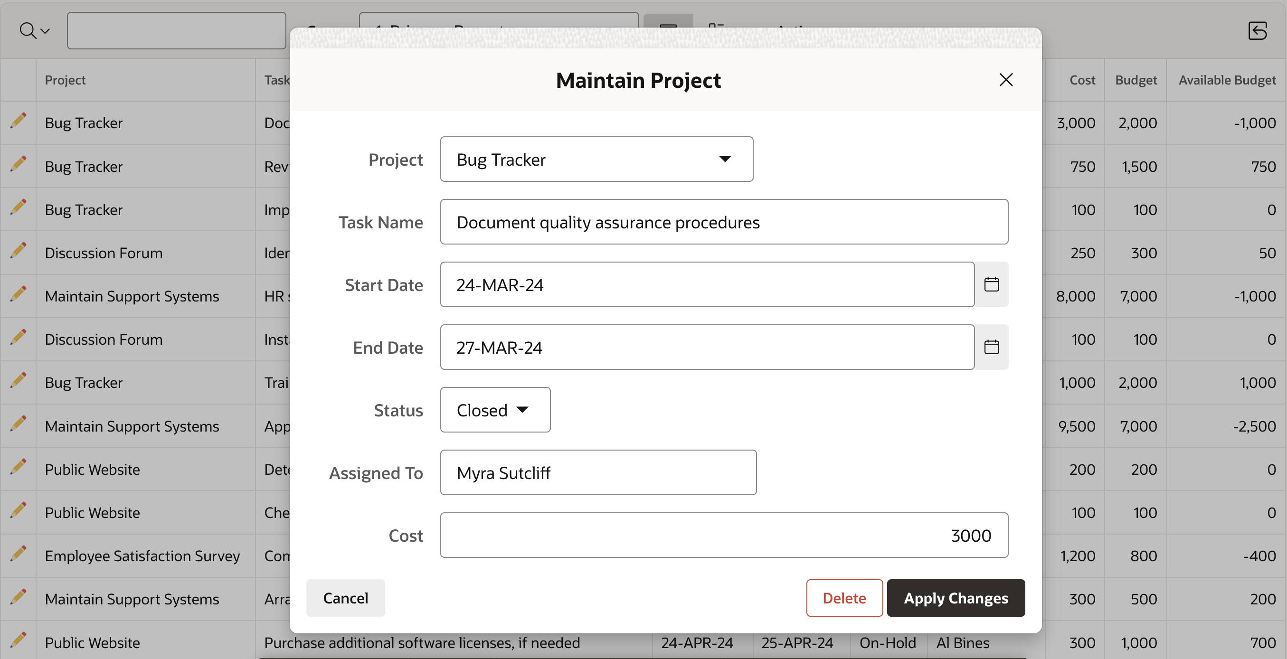
Modal Dialogs
Readily switch between normal, modal, and non-modal page mode
A modal dialog is a stand-alone page, not a region on a page
Any page be created as a dialog page
Supports all the functionality of a regular page, including computations, validations, processes, and branches
Learn more at apex.oracle.com
Notes:
Customizable dimensions and positioning
Dialog pages can branch to full pages (close dialog and standard branch) or to other dialog pages (e.g. wizard)
Dialog pages can open other dialogs (stacked dialogs)
Dynamic actions on parent pages created to refresh content after closing of modal dialog form

Slide 75
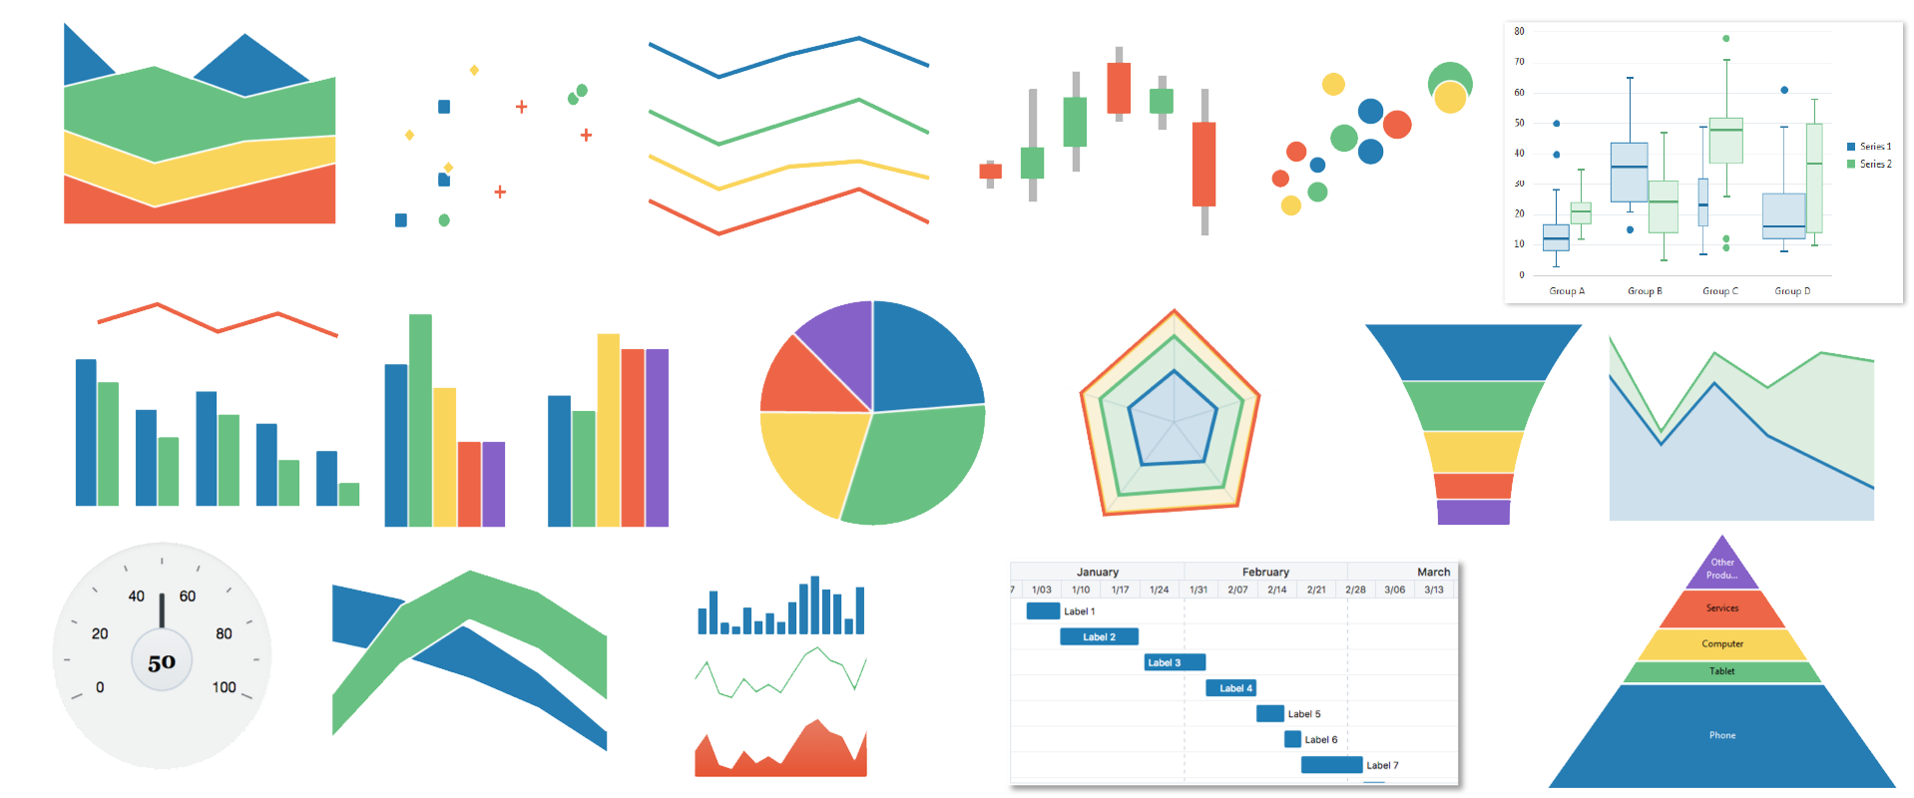
Charting Engine
Learn more at apex.oracle.com

Slide 76
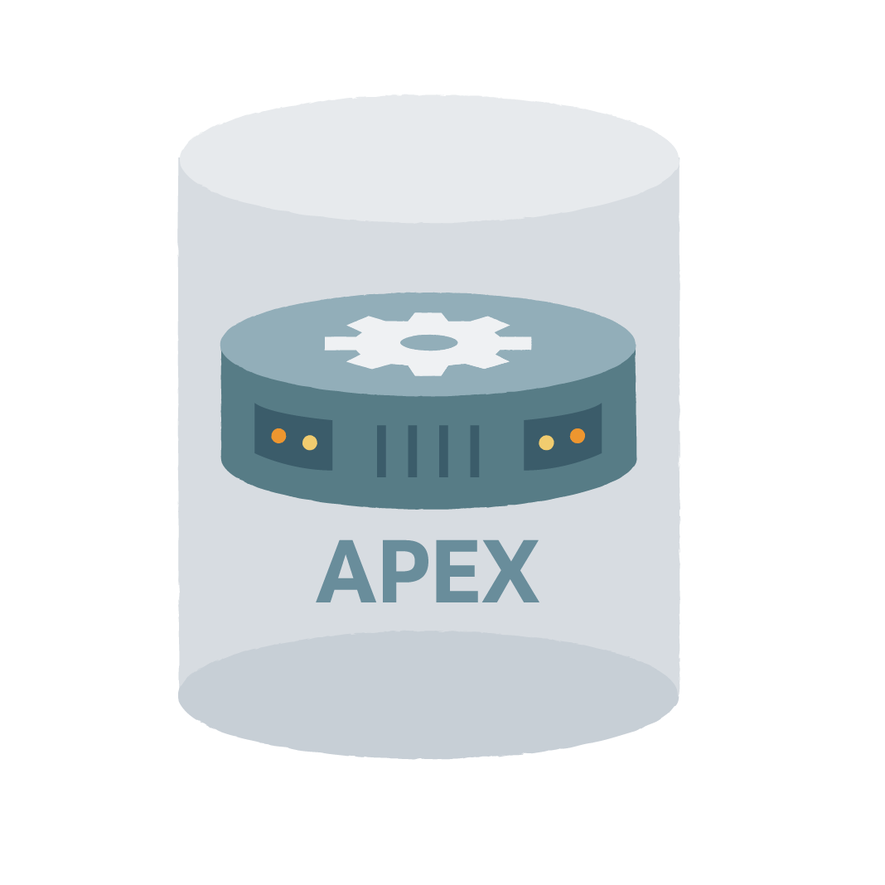

Charting Engine
Easy to use, fully managed, enterprise-class service on Oracle Cloud
Based on Oracle JET Data Visualization Components
Oracle JET (JavaScript Extension Toolkit) is open source
The JavaScript-based solution, data being provided in JSON format
Highly Customizable
  Using 'JavaScript code' to provide function to be called when the chart is initialized
  Using Dynamic Actions to add interactive behavior
Built-in Accessibility Support
Built-in Responsive Design Support
Learn more at apex.oracle.com
Notes:
The data visualization engine of Oracle APEX is powered by Oracle JET (JavaScript Extension Toolkit), a modular open source toolkit based on modern JavaScript, CSS3 and HTML5 design and development principles. This JavaScript charting solution is highly customizable, accessible, interactive, and incorporates automatic responsive design support. With Oracle JET integration into APEX, you can now build charts that are beautiful, fast, highly customizable, and extremely versatile. The Oracle JET data visualization components include customizable charts, gauges, and other components that you can use to present flat or hierarchical data in a graphical display for data analysis.

Slide 77
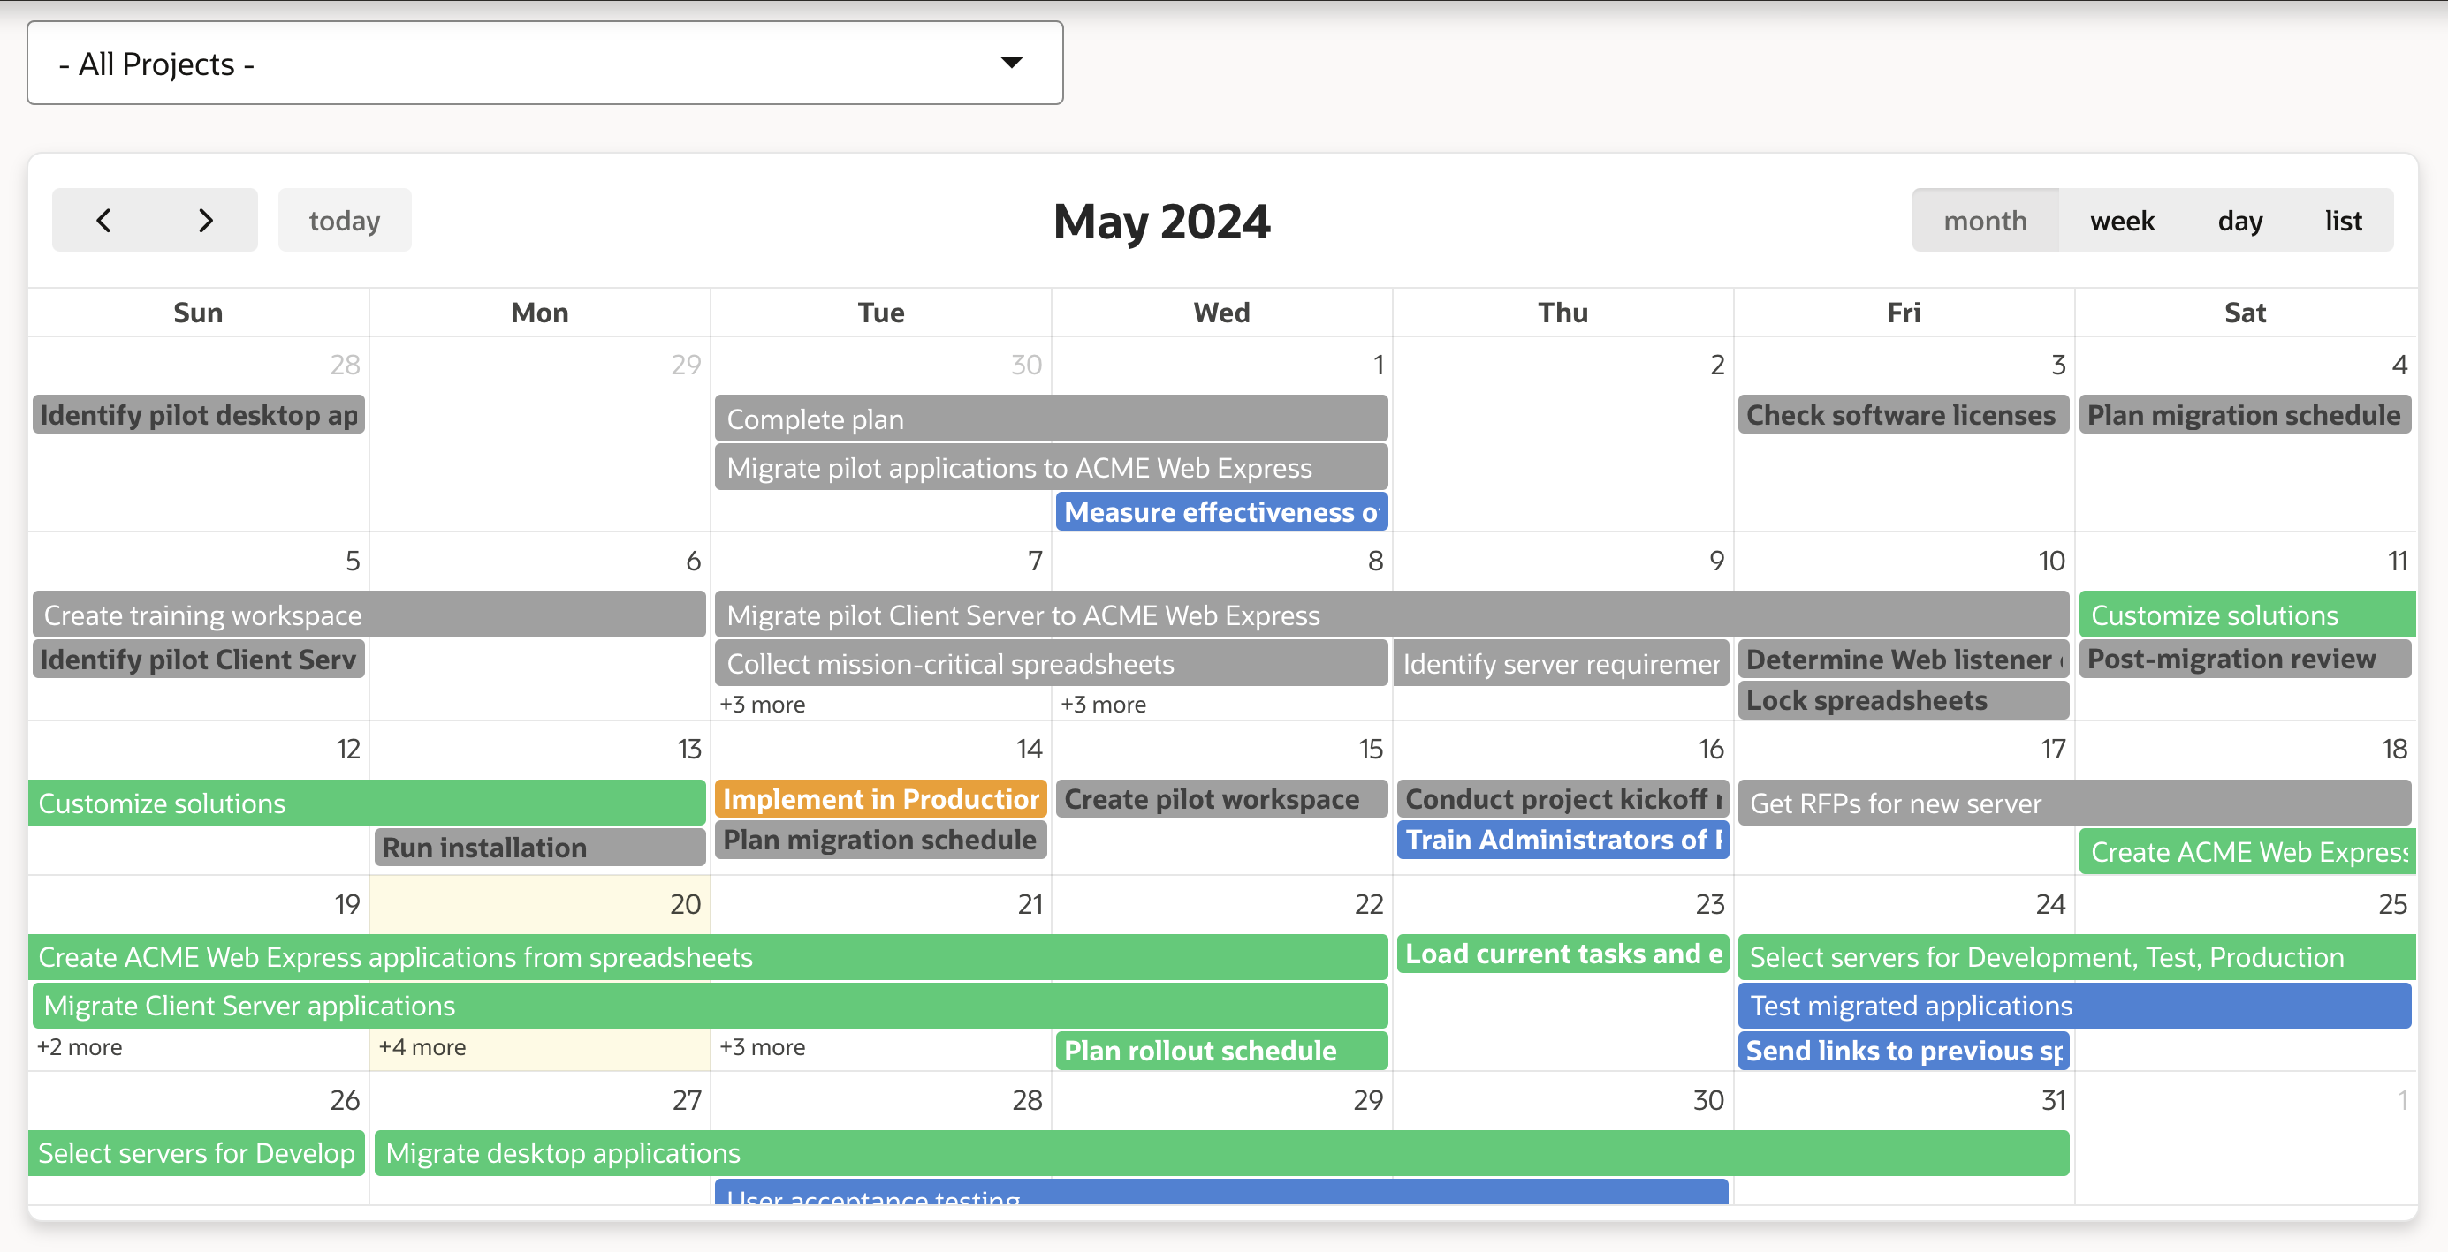
Calendar
Different views, drag and drop capability
Learn more at apex.oracle.com
Notes:
SQL Workshop is sometimes the only means developers can maintain DB objects as they may not have direct access to the schema(s) via SQL*Net, especially if they are using a hosted service.
The functionality available through SQL Workshop is a subset of SQL Developer and is designed specifically for developers to be able to maintain their DB objects.

Slide 78
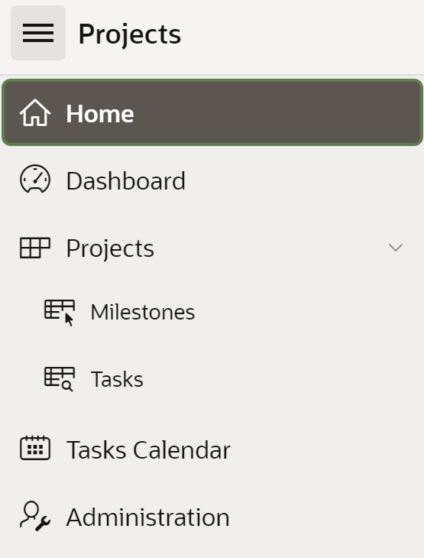
List-based Navigation Menus
Available as the top navigation menu and side menu
Implemented as standard APEX lists
Supports multi-level hierarchical menu structures
Provides accessible pull-down menus
Alternative to using traditional tabs
Learn more at apex.oracle.com
Notes:
Oracle APEX includes the ability to define Navigation Lists. Multi level drop-down menus can be based on either static or dynamic lists.

Slide 79
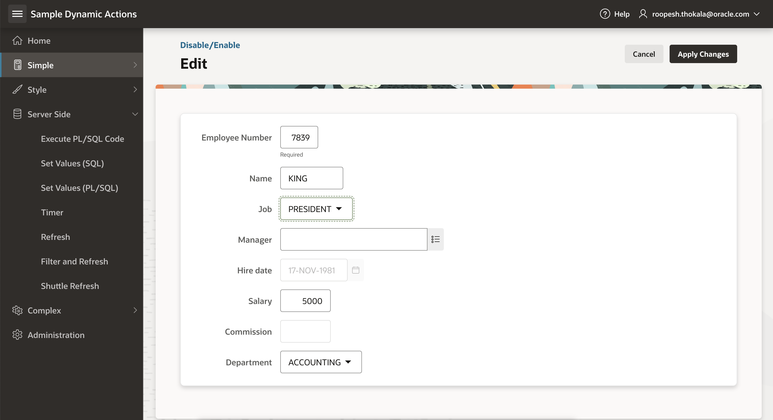
Dynamic Actions
Declaratively define rich client-side interactivity without writing JavaScript or AJAX
Use Dynamic Actions to create complex client-side behaviours without JavaScript
Set conditions for when actions occur and determine which elements are affected and how they are impacted
Create or use existing page components (items, buttons, regions) that trigger the dynamic action
Dynamic Actions also mean that Oracle maintains the code and security assessment of the JavaScript
Learn more at apex.oracle.com
Notes:
Dynamic Actions also mean that Oracle maintains the code and security assessment of the JavaScript
Not every developer is an expert in JavaScript and AJAX, in fact the majority do not have that skillset.
However, Dynamic Actions allow anyone to *declaratively* define client side behaviors.
Rather than writing numerous lines of JS developers can simply enter conditions, specify the actions, and then select the elements affected.
Behind the scenes the APEX engine defines the required JS and AJAX to implement the desired behavior.

Slide 80
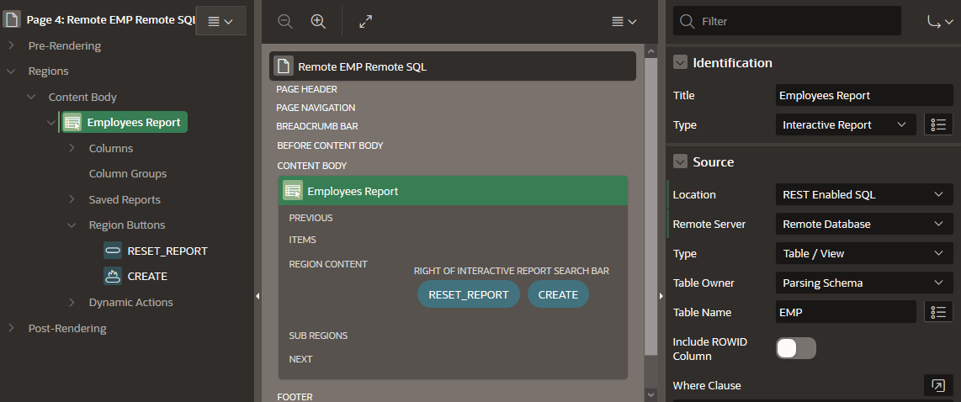
REST Enabled SQL Support
Create and maintain References to REST Enabled SQL Instances (Oracle REST Data Services) in Shared Components: A name, Endpoint URL, and Authentication information
Use a REST Enabled SQL Service and therefore a remote Oracle database as the Data Source for Oracle APEX components like:
          Classic Reports, Interactive Reports
          Reflow Report, Toggle Columns Report
          Tree Region, JET Charts
          CSS Calendar
          PL/SQL Process
Learn more at apex.oracle.com

Slide 81
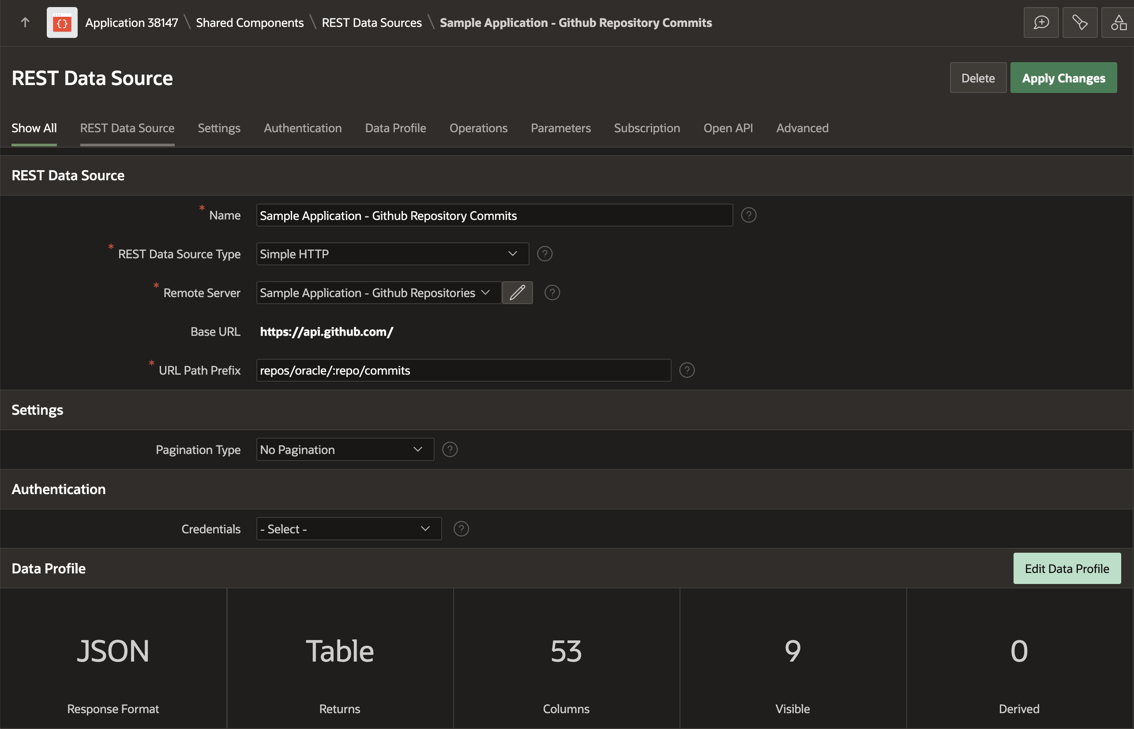
REST Enabled SQL Support
REST Data Sources are a declarative method to define references to external REST APIs and generic JSON data feeds.
REST Data Sources store additional metadata about how to parse response data and map it as a virtual table with rows and columns.
A module can contain one or many
operations which are the references to
a concrete external web service.
Create and maintain REST Data Sources
in Shared Components.
Learn more at apex.oracle.com
Notes:
Web Source Modules enable developers to access to Representational State Transfer (REST) services or generic JSON data feeds in applications applications and use the data in APEX components such as reports, interactive reports, and interactive grids.
Web Source Modules act as a reference to one or multiple external web services. A module can contain one or many Web Source Operations which are the references to a concrete external web service.

Slide 82
Consuming External REST APIs
    Use as data sources for Oracle APEX components such as:
      Interactive Report, Classic Report
      JET Chart, CSS Calendar
      Tree Region, Reflow Report, Toggle Column Report
    Post Processing SQL modifies data before being processed by an Oracle APEX component:
      Apply SQL functions, aggregations, join to local tables, etc.
      Avoid unnecessary HTTP requests by using Caching
Learn more at apex.oracle.com

Slide 83


Native Digital Process Automation & Human Workflow Capabilities
Enhanced in APEX 24.2
Workflows are the automation of business processes, where documents, information, or tasks are passed from one participant to another for action according to a set of rules
End-to-end business process automation:
  System to system
  Human workflow & approvals
Key features:
  Visual workflow designer to create workflows
  Workflow runtime engine to execute workflows
  Workflow console to monitor and administer workflows
  Use the Invoke Workflow feature to reuse workflows and break down complex tasks into smaller, manageable units
  Copy a Workflow definition from one application to another
  Integration via REST APIs
Learn more at apex.oracle.com

Slide 84
Integrating with Fusion Applications
New in APEX 24.2
Quickly start Fusion Applications projects with the new Fusion Integration option, featuring pre-configured SSO, identity propagation, and testable REST setups.
Easily build APEX apps using any Fusion REST APIs, including the latest /api/boss endpoints.
Automatically discover supported API operations and data profiles.
Optimize performance by delegating tasks like filtering and sorting to APIs, transferring only necessary data.
Existing Apps
APEX Application
Learn more at apex.oracle.com

Slide 85

Working Copy
Allows developers to create a working copy of an existing app, diff changes between the copy and main app, and then merge changes back into the main app
Enables multiple developers to work on different features in isolation of each other on the same app
Comparison of changes is done by performing a split YAML export of both applications
Learn more at apex.oracle.com
Notes:
Creating “Working Copy” is very similar to copying an application
Comparison of changes is done by performing a split YAML export of both applications
A merge conflict occurs when a page or shared component in the main application has changed and has the same component in the working copy
Conflicts will be manually identified when viewing the file differences
Developers have the choice of merging in full or by choosing which components they would like to merge
Option to perform a full backup, so developer can revert to backup in case of merge issues

Slide 86



Plug-Ins
Extend applications with custom components such as items and regions
apex.world/ords/f?p=100:700
Learn more at apex.oracle.com

Slide 87
Customer Stories
Learn more at apex.oracle.com

Slide 88








Oracle APEX: World’s Most Popular Enterprise, Low-Code Platform
Source: https://www.oracle.com/customers/?search=APEX
Learn more at apex.oracle.com

Slide 89



APEX Customer Examples
Siemens Mobility
Leader in transportation solutions
Built an integrated project mgmt platform with APEX. Integrates 14+ systems – SAP, Snowflake
Runs on OCI
Built by 3 devs in <3 months
Humanic
Leader in international payroll solutions
Modernized 300+ legacy forms with APEX
Runs APEX on-prem; moving to APEX on OCI
Built by 4 devs in <90 days
Trailcon
Leader in transportation leasing
Automated invoice processing with AI and APEX
Uses OCI AI services, Email and Object Storage
Built by 4 devs in <3 months
Learn more at apex.oracle.com

Slide 90



APEX Customer Examples
Munich RE HealthTech
Leader in digital solutions for the Health Insurance Industry
Built multi-tenant SaaS app supporting data sovereignty in 10+ countries with APEX
Runs APEX on AWS and OCI
Built by 4 devs in <2 months
Nomura Research Institute
First and largest consulting firm in Japan
Built apps for fraud detection, GRC, and exec dashboards with APEX
Runs OCI Dedicated Region
1st app was built by 2 devs in <2 weeks
Syneos Health
Leader in biopharmaceutical solutions
Built clinical trial oversight system with AI and APEX
Runs on a hybrid environment of on-prem and OCI
Built by 4 devs in <3 months
Learn more at apex.oracle.com

Slide 91


Business Challenge:
  NEC Enterprise Solutions is an IT service provider, headquartered in Japan. They needed to revamp its business applications environment to improve partner and customer experiences and boost sales productivity.
NEC boosts productivity and app development with Oracle APEX
Results:
    After evaluating several providers for data-driven, low-code environments, including OutSystems and Mendix, NEC chose Oracle Autonomous Transaction Processing with Oracle APEX on Oracle Cloud Infrastructure based on cost efficiency, ease of use, and the integrated development capabilities.
    APEX low-code development tools helped IT team cut administrative and maintenance efforts
    OCI improved end user access and compliance with guidelines for data governance
“Being on Oracle Cloud Infrastructure, we can develop applications much quicker compared to a traditional development environment. Our US-based colleagues were impressed with the number of applications we’ve built using Oracle Autonomous Database with APEX with just three developers over the past years.”
  Frank Krul
    Manager IT Business Applications, NEC Enterprise Solutions
Products Used:
Oracle Cloud Infrastructure
Oracle Autonomous Database
Oracle APEX
Oracle Identity Cloud Service
  Read story

Slide 92


NIBIO analyzes massive amounts of data with ML models and APEX
Norwegian Institute of Bioeconomy Research (NIBIO) balances conservation efforts with the demands of logging
OCI Data Science, APEX, and Autonomous Data Warehouse enables scientists to analyze a broad range of sensor data from drones, tree planting hardware, and other sources
Quality data used to build and train AI models that improves efficiency of forest operations and support decisions
Hundreds
of years
3D snapshots
Lifespan of trees and forests managed
Help researchers understand forest environment
NIBIO story, Watch video

Slide 93


Business Challenge:
  Germany-based SATLOG helps increase the productivity of fleets across a variety of industries with various delivery requirements. It needed to focus more on higher value development of telematics dashboards based on data volumes growing at rapid rates rather than maintain aging on-prem hardware.
SATLOG modernizes fleet management at scale
Results:
    APEX and Oracle Spatial enabled low-code, easy to use data visualization
    Machine learning automated provisioning, tuning, scaling, patching, and encrypting that reduces costs, time, and risk
    Delivers key business metrics to measure, compare, and optimize costs for order processing, proof of delivery, routes, tour planning, and idle times
“SATLOG achieves better integration and performance making fleets more productive with Oracle Autonomous Transaction Processing and its included Spatial, APEX, and JSON services on Oracle Cloud Infrastructure.”
  Juergen Stausberg
    CEO, SATLOG
Products Used:
Oracle Autonomous Transaction Processing
Oracle APEX
Oracle Spatial Analysis
Implementation Partners: HERE Technologies; MEKRATronics; Continental Tire Pressure System CPC
Read story

Slide 94


Business Challenge:
  Building applications for the healthcare and biotech/pharma industries, with their myriad regulations and privacy concerns, requires a deep understanding of how those businesses work, plus proven data security and HIPAA-compliance chops. Apex Health Innovations had that expertise, but what it needed was a cloud infrastructure and development platform on which to build and deliver those applications rapidly.
Rapid innovation for thousands of customers
Results:
    The team at Apex Health Innovations has realized numerous successes by building and launching powerful, flexible, HIPAA-compliant applications on Oracle Cloud Infrastructure. These include an application that is being used by two of the largest kidney dialysis organizations in the US at more than 3,000 dialysis clinics, and applications that are helping some of the world’s largest pharmaceutical companies plan and execute the development of new therapies.
    Recently, built an application overnight using Oracle APEX that filled the reporting gap between COVID-19 testing labs and organ procurement networks across the US. The quick work helped researchers at Columbia and The Cleveland Clinic assess the prevalence of COVID-19 across the donor population.
“Oracle APEX and Oracle Cloud Infrastructure meant we were able to turn that application from a concept to an application in a 12-hour timespan.”
  Rich Mutell
  Cofounder and CEO, Apex Health Innovations
Products Used:
  Oracle Cloud Compute
  Oracle Cloud Infrastructure
  Oracle APEX
Learn more at apex.oracle.com
94
Read story
Notes:
https://www.oracle.com/customers/apexhealth/
Oracle APEX on Database Cloud Service enabled ApexHealth to turn COVID-19 testing from a concept to an application in just 12 hours.
“When we’re solving a problem for healthcare providers, if Oracle wasn’t the best technology to use, we’d use something different. But it’s great for us, and it feeds all our needs.”
Rich Mutell, Cofounder and CEO, Apex Health Innovations
Business challenges
Building applications for the healthcare and biotech/pharma industries, with their myriad regulations and privacy concerns, requires a deep understanding of how those businesses work, plus proven data security and HIPAA-compliance chops. Apex Health Innovations had that expertise, but what it needed was a cloud infrastructure and development platform on which to build and deliver those applications rapidly.
Why Apex Health Chose Oracle
When the team at Apex Health Innovations sees an opportunity to connect healthcare providers or help streamline a process to improve patient care, the team moves fast. They chose Oracle Cloud Infrastructure so they could deliver the confidence of a secure, high-performance cloud platform—while also impressing clinicians by meeting exacting requirements and leveraging the fast, feature-rich application development environment in Oracle APEX.
Results
The team at Apex Health Innovations has realized numerous successes by building and launching powerful, flexible, HIPAA-compliant applications on Oracle Cloud Infrastructure. These include an application that is being used by two of the largest kidney dialysis organizations in the US at more than 3,000 dialysis clinics, and applications that are helping some of the world’s largest pharmaceutical companies plan and execute the development of new therapies.
Recently, Apex Health Innovations built an application overnight using Oracle APEX that filled the reporting gap between COVID-19 testing labs and organ procurement networks across the US. The quick work helped researchers at Columbia and The Cleveland Clinic assess the prevalence of COVID-19 across the donor population.
“Oracle APEX and Oracle Cloud Infrastructure meant we were able to turn that application from a concept to an application in a 12-hour timespan,” says Rich Mutell, cofounder and CEO of Apex Health Innovations.

Slide 95


Business Challenge:
  Samsonite International is the world’s largest manufacturer of travel luggage and accessories, with globally recognized brands. The company operates multiple cloud platforms, including Oracle Retail, for integrating online and in-store channels.
  Historically, airlines worldwide have relied on thousands of local baggage-repair partners to resolve customer claims, resulting in complex invoice handling. Belgium-based Samsonite Europe began testing a new offering called Bagsupport, with the objective of saving airlines time and money by handling passenger claims and repairs for damaged luggage.
Samsonite Europe scales luggage-damage service with Oracle
Results:
    Moving Bagsupport to Oracle Cloud Infrastructure eliminated the downtime Samsonite had experienced managing the app in its own data center.
    As part of its OCI implementation, Samsonite deployed Oracle Database Backup Cloud Service and Oracle Infrastructure Monitoring Cloud Service and acquired 24/7 access to Oracle support engineers.
    Samsonite also reduced its software and hardware costs while gaining the scalability needed to expand its luggage-as-a-service offering to airlines worldwide.
    Samsonite also reasoned that because Oracle partners iAdvise and Exitas built the Bagsupport app on the Oracle APEX—which runs on Oracle Standard Database Service—that tight integration would ensure smooth enhancements to the app as more airlines come onboard.
“Bagsupport, our luggage-as-a-service application, will take off as a multi-airline service and expand globally, thanks to consistent uptime and the ability to scale with Oracle’s elastic compute infrastructure and global data center network.”
  Dirk de Smyter
  IT Director for Europe, Samsonite International
Products Used:
  Oracle Cloud Infrastructure
  Oracle APEX
95
Learn more at apex.oracle.com
Read story

Slide 96


Business Challenge:
  Headquartered in Singapore, the company was initially focused solely on enterprise clients. However, about five years ago, it started targeting SMEs
  and now intends to scale that business very rapidly in the next 24 months.
  Star CRM realized that without a cost-effective cloud it’s very difficult to deliver its solutions to smaller clients. Hence, the company moved its workloads from local data centers in Kuala Lumpur, Malaysia, to Amazon EC2.
  As an alternative to AWS, the company tried Oracle and APEX on managed third-party APEX hosting providers.
  Star CRM had to make sure that its cloud infrastructure costs did not go
  through the roof. It quickly needed a solution to address the ability to scale.
Star CRM lifts productivity by 40% and reduces costs by 30%
“In terms of cost, we've definitely noticed savings of anywhere between 25% to 30% without any impact on speed or performance moving Oracle APEX to Oracle Database Cloud.”
Sharada Qureshi
COO, Star CRM
Results:
    Star CRM moved its APEX workloads on-premises to Oracle Database Cloud Service on Oracle Cloud Infrastructure (OCI), to have the latest APEX and ORDS installed, managed, and upgraded by Oracle.
    It has eliminated many business issues associated with licensing and scalability on AWS and third-party APEX hosting providers.
    The features and functionalities provided by Oracle APEX on OCI have allowed Star CRM to complete more complex projects for clients, besides reducing development time and costs. This has increased the development team’s productivity by as much as 40%.
“Oracle APEX on OCI has allowed us to reduce development time and costs. This has increased our development team’s productivity by 40%.”
Kareem Qureshi
Founder and CEO, Star CRM
Products Used:
  Oracle Cloud Infrastructure
  Oracle Database Cloud Service
  Oracle APEX
96
Learn more at apex.oracle.com
Read story

Slide 97


Business Challenge:
  Based in Gujarat, India, the IT company, the Soham ERP Solutions offers several products for its 2,000-plus customers, ranging from ERPs to salesforce automation systems to barcode tools. As the pharmaceutical industry grew, Soham ERP’s customers expected improvements in software functionality, experience, and efficiency. Additionally, customers who had adopted the company’s on-premises software wanted help with growth challenges, such as costs associated with server upgrades, database licenses, and investments in IT staff to manage on-premises infrastructure.
  The company decided to migrate to Oracle Cloud Infrastructure (OCI) and low code platform, APEX, paving the way for a more modern approach to application development. However, the decision to choose Oracle was not a foregone conclusion.
Soham ERP builds new app using Oracle Cloud
Results:
    Soham ERP was able to develop a new application, PharmaCloud, using Oracle APEX with Oracle Database Cloud Service on Oracle Cloud Infrastructure. PharmaCloud supports about 100 of Soham’s customers, equivalent to roughly 1,200 concurrent users.
    Before the transition to the cloud, customers would need to invest about $100,000 for on-premises hardware, licensing, and maintenance. Now, that initial cost has dropped to about $20,000, which better aligns costs with benefits.
    Thanks to OCI, Soham has seen a 25% improvement in application performance—leading to faster turnaround time for complex processes—while reducing costs by 40%. Plus, customers can access PharmaCloud from anywhere in the world, from any device.
  “Our more than 100 enterprise customers are thrilled with the performance of OCI. With Oracle APEX and Database Cloud Service, we have faster time to market to build and deploy plus data security. And Oracle Consulting helped us seamlessly convert our existing forms and reports and trained our current staff.”
  Suketu Shah
  Director, Soham ERP Solutions
Products Used:
  Oracle Cloud Infrastructure Oracle Database
  Oracle APEX
97
Learn more at apex.oracle.com
Read story

Slide 98


Business Challenge:
  Tanishq has plans to expand its presence and market share over the next five years. As customer demand for jewellery increased, Tanishq developed an Endless Aisle service for its store managers that allows customers to order products, including those not available in the store
Tanishq Expands Jewellery Business with Oracle Cloud Infrastructure
Results:
    With Oracle Web Application Firewall, Tanishq protects its business against unwanted internet traffic and OCI Flexible Load Balancing allows it to distribute network traffic equally during peak demand across its 500 stores.
    Through Oracle Support Rewards, Tanishq estimates a substantial CAPEX and software support cost savings of up to 30 percent, supporting the company’s future expansion plans.
    Oracle APEX, a no-cost capability provided with Oracle Database, enables Tanishq to manage changing demand for its Endless Aisle service by adding compute and storage resources, and scale back down when it is no longer necessary.
“At Tanishq, we take great pride in offering an unparalleled retail experience taking into consideration our customer's unique needs
and preferences. With the rapid growth in our business, we needed better scalability from our inventory management system. With OCI and Oracle APEX, we can scale up easily and transform our inventory tracking and order fulfilment process enabling us to reduce operational costs. Previously, we operated with a time-consuming manual process that could take up to a few days to generate an inventory report, severely hindering our ability to offer our customers more products”.
Akshay Jawanjal,
Sales Development Director, IWM Cyber Security
Products Used:
  Oracle APEX
  Oracle Cloud Infrastructure
  Oracle Database
  Oracle Web Application Firewall
  OCI Flexible Load Balancing
98
Learn more at apex.oracle.com
Read story

Slide 99


Business Challenge:
  With the long-term vision of "SHIMZ VISION 2030," the Shimizu Group, including Shimizu Corporation, will create value that is ahead of the times through constant self-transformation and challenges that go beyond the framework of the construction business, and through co-creation with diverse partners.
  The company was reviewing business processes and developing various business systems to promote electronic approval, improve business efficiency through information collaboration and data utilization using project databases, and automate and streamline in-house management operations using RPA and workflow systems.
Shimizu Corporation introduces Oracle Cloud Infrastructure to promote digitalization and standardization of construction site operations
    Results:
    With the support of Oracle Japan's consulting department, Shimizu Corporation began developing systems and applications on OCI in October 2021. Develop mobile and web applications using the low-code development tool "Oracle APEX," and integrate and centralize data sent from applications using "Oracle Autonomous Data Warehouse," which uses autonomous functions to reduce database construction and operational management burden.
    Additionally, using Oracle Analytics Cloud, the company is able to visualize data and check progress intuitively. The company was able to build a production environment in just one month by using the autonomous functionality of Oracle Autonomous Data Warehouse to easily set up a database and low-code development using Oracle APEX.
Utilizing Oracle Autonomous Data Warehouse and Oracle Application Express to streamline work related to special safety councils at construction sites. Enables employee productivity improvement and business data aggregation to support digital transformation.
Products Used:
  Oracle APEX
  Oracle Analytics Cloud
  Oracle Cloud Infrastructure (OCI)
  Oracle Autonomous Data Warehouse
99
Learn more at apex.oracle.com
Read story

Slide 100
Oracle APEX in the Real World
Learn more at apex.oracle.com

Slide 101

APEX@Oracle
Learn more at apex.oracle.com

Slide 102

APEX@Oracle
Learn more at apex.oracle.com

Slide 103

shop.oracle.com
Learn more at apex.oracle.com

Slide 104

forums.oracle.com
https://apex.oracle.com/forum
Learn more at apex.oracle.com

Slide 105

asktom.oracle.com
Learn more at apex.oracle.com

Slide 106

apex.oracle.com/go/ideas
Learn more at apex.oracle.com

Slide 107
Oracle APEX Training & Certification
Learn more at apex.oracle.com

Slide 108



Oracle APEX Training & Certification
apex.oracle.com/go/training
APEX Foundations
apex.oracle.com/go/foundations
APEX Developer Professional Learning Path
apex.oracle.com/go/professional-ai-lp
Consists of TWO courses:
    apex.oracle.com/go/professional
    apex.oracle.com/go/ai-learn
Get Certified
apex.oracle.com/go/professional-ai-lp

Slide 109









Learn the Foundations of Oracle APEX
Oracle APEX Foundations Course
Learn the foundations of low-code app dev with Oracle APEX
3.5 + hours of expert training delivered by the APEX Product Team
Enroll and learn for FREE Today on the platform of your choice:
apex.oracle.com/go/foundations
apex.oracle.com/go/foundations-jp
apex.oracle.com/go/learning
apex.oracle.com/go/foundations-coursera
Don't forget to share your badge on social media and tag us using #orclAPEX

Slide 110


Oracle APEX Developer Professional
apex.oracle.com/go/training
Soup-to-nuts covering complete low-code app dev along with the latest advancements of AI with Oracle APEX
21+ hours of expert training delivered by the APEX Product Team
Hands-on-Labs to practice along with the training videos
Enroll and learn for FREE today on Oracle University!!
apex.oracle.com/go/professional

Slide 111



Oracle APEX : Empowering Low Code Apps with AI
Master the integration of cutting-edge AI features to build smarter, more interactive Oracle APEX low-code applications.
3+ hours of expert training delivered by the APEX Product Team
Hands-on-Labs to practice along with the training videos
Enroll and learn for FREE today on Oracle University!!
apex.oracle.com/go/ai-learn

Slide 112


Oracle APEX Professional Learning Path
Learning path consists of two key courses:
Oracle APEX Developer Professional
apex.oracle.com/go/professional
Oracle APEX : Empowering Low Code Apps with AI
apex.oracle.com/go/ai-learn
#Oracle #LowCode #orclAPEX #orclAPEXCertified #OracleCertified #AI #GenAI

Slide 113

Get Oracle APEX Certified !
apex.oracle.com/go/professional-ai-lp
Why should you get certified?
Validates your skills, making you more competitive in job markets that require Oracle APEX low-code development expertise
Ensures you understand best practices for building secure, scalable web and mobile apps with world-class features that can be deployed anywhere—cloud or on-premises.
Showcase your skills in low-code application development
Enhance your expertise in AI-powered low-code app development
Open new career opportunities with Oracle APEX Cloud Developer Professional certification
#Oracle #LowCode #orclAPEX #orclAPEXCertified #OracleCertified #AI #GenAI

Slide 114
Become a Certified Oracle APEX Developer Professional
apex.oracle.com/go/professional-ai-lp
1
2
3
4
5
Register
Login and Subscribe to the Learning Path for Free
Complete the first Course
Complete the Oracle APEX Professional Course along with Hands-on Labs
Complete the Second Course
Complete the Oracle APEX: Empowering Low Code Apps with AI Couse along with the Hands-on Labs
Prepare for the Certification
Take up the Practice Exam and self asses your Skills
Get Certified
Pass the exam and earn your Badge!

Slide 115
Summary
Learn more at apex.oracle.com

Slide 116
Oracle APEX
Summary
Used by real customers for real applications: It is used for both opportunistic and mission-critical apps that service tens of thousands of users.
Well-Established Product: First released in 2004
The most powerful Low-Code Application Development Platform allows developers to focus on solving business problems and delivering superior solutions with less time and effort spent on mundane and repetitive lower-level coding.
Continually growing: Oracle install base is adopting Oracle APEX for increasing numbers of projects, and is increasingly an approved corporate IT standard.
Learn more at apex.oracle.com

Slide 117
Oracle APEX
Summary
Aligned with industry trends: Strong support for HTML5 development frameworks, Modern & responsive CSS3 UI, integrated JavaScript libraries, Browser-based, self-service provisioning, flexible development and deployment including cloud services.
Consistent with Oracle developers skill set: SQL, PL/SQL, Oracle Database.
Proficiency in the Oracle database easily translates into an ability to develop web applications.
Learn more at apex.oracle.com

Slide 118

Learn More…
Primary site apex.oracle.com
APEX Shortcuts apex.oracle.com/shortcuts
APEX Community apex.oracle.com/community
Blogs blogs.oracle.com/apex
APEX on Autonomous apex.oracle.com/autonomous
Database Cloud Services cloud.oracle.com/database
Oracle APEX Education apex.oracle.com/education
Oracle APEX + AI apex.oracle.com/go/ai
Learn more at apex.oracle.com

Slide 119
Thank you
Learn more at apex.oracle.com

Slide 120
Learn more at apex.oracle.com

Slide 121
Learn more at apex.oracle.com

