Slide 1
Inventory Management System With Berkeley DB

Slide 2
What is Berkeley DB?
Berkeley DB is an Open Source embedded database library that provides scalable, high-performance, transaction-protected data management services to applications. Berkeley DB provides a simple function-call API for data access and management.

Slide 3
Berkeley DB vs RDBMS
Function-call interface vs SQL Statement
Because the library runs in the same address space, no inter-process communication is required for database operations.
Berkeley DB uses a simple function-call interface for all operations, there is no query language to parse, and no execution plan to produce.

Slide 4
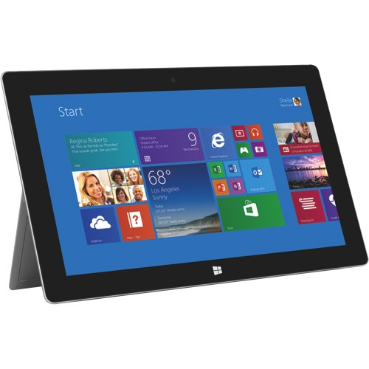

2MB library vs GB application
Inventory Management System with BDB
Inventory Management System with RDBMS

Slide 5
What can you get from this App?
Functionality:
Inventory management
Look up and update items and vendors
Add or remove items and vendors
Add new categories, such as clothes and food
Sales log management
Look up sales records
Add or remove sales records
Daily sales summary
Pattern discoverer
Find the best-selling items
Find the sales peak

Slide 6
Performance:
With Berkeley DB as the underlying storage, this application is built to provide fast, reliable, transaction-protected inventory management.
By keeping the library small and simple, we guarantee that the database system stays fast, because there is very little code to execute.
Deployment and Maintenance:
Users can save money by replacing the local servers in each store with Windows tablets

Slide 7
User Manual

Slide 8
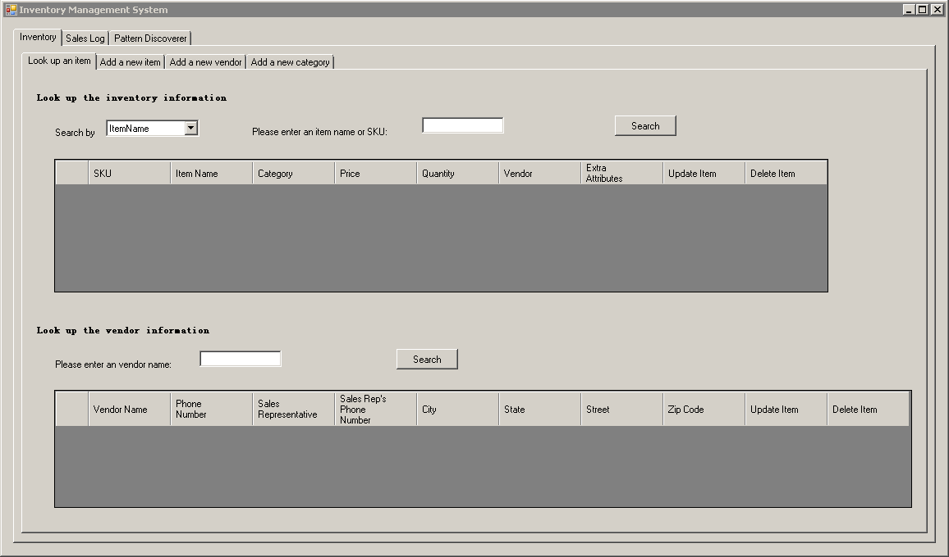
Look up an item and vendor
Notes:
Users can also update items or remove items directly from the data grid view.

Slide 9
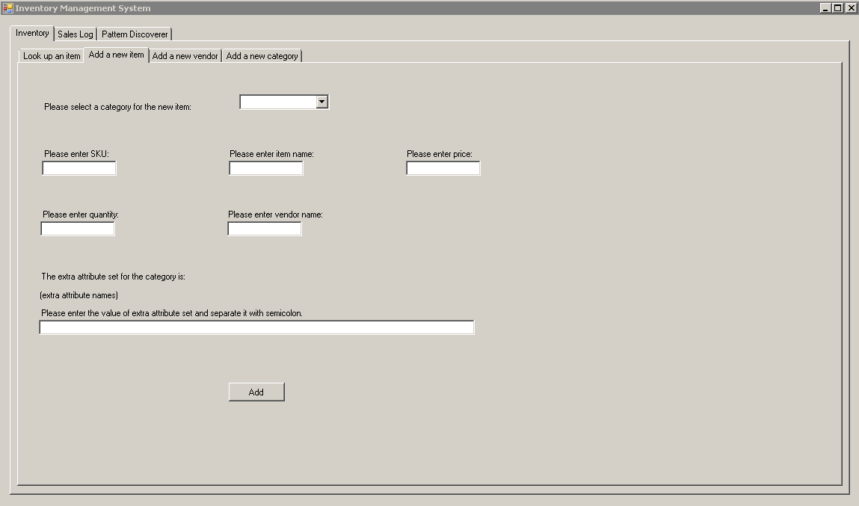
Add a new item

Slide 10
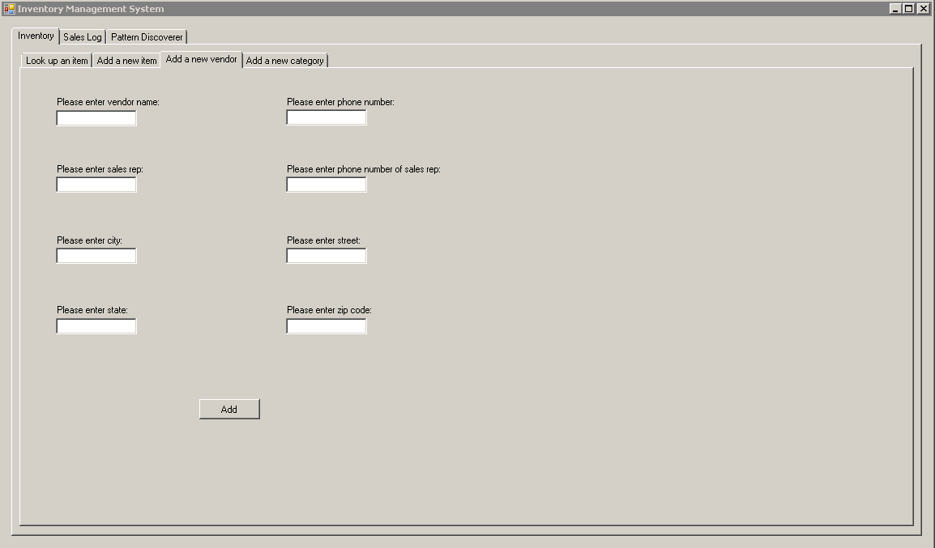
Add a new vendor

Slide 11
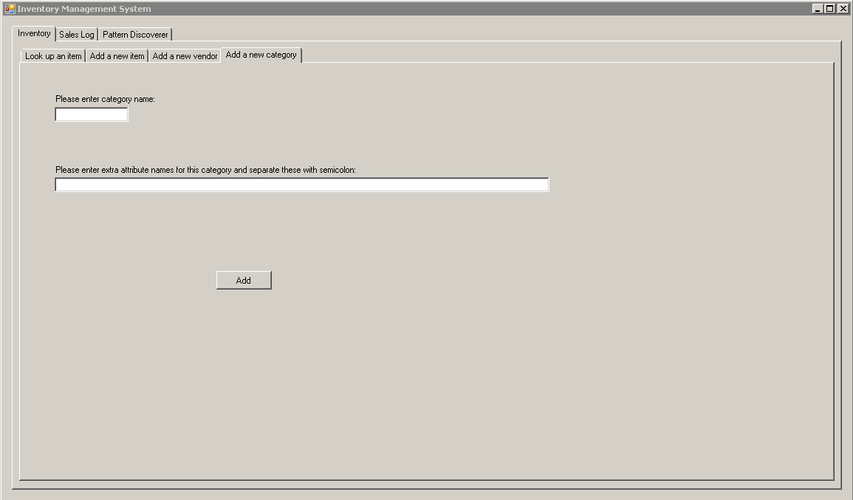
Add a new category

Slide 12
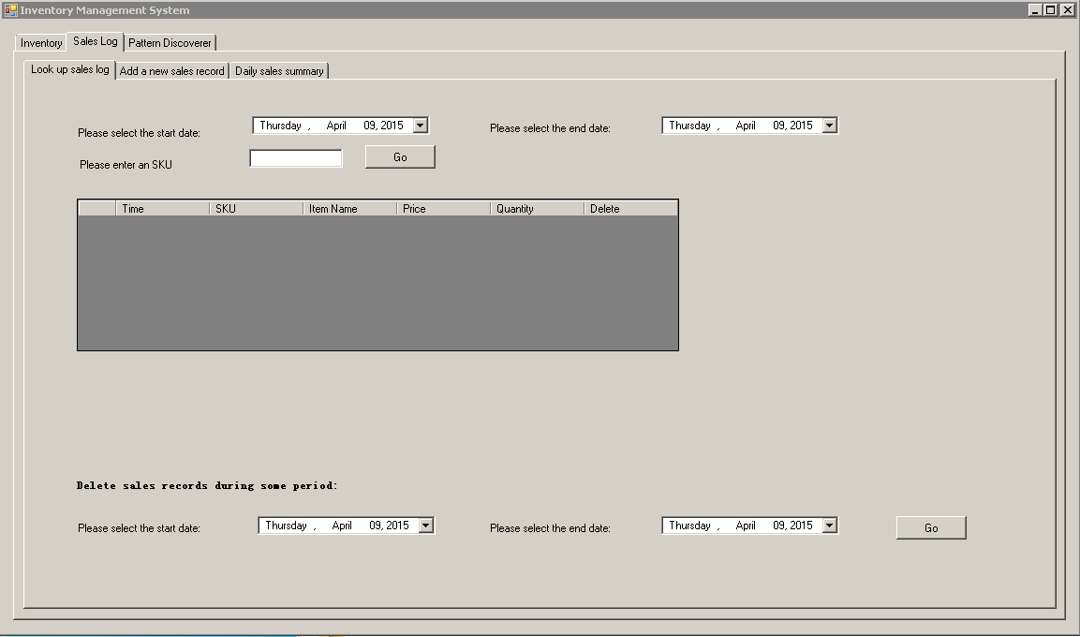
Look up sales log
Notes:
Users can also delete sales log here as they wish.

Slide 13
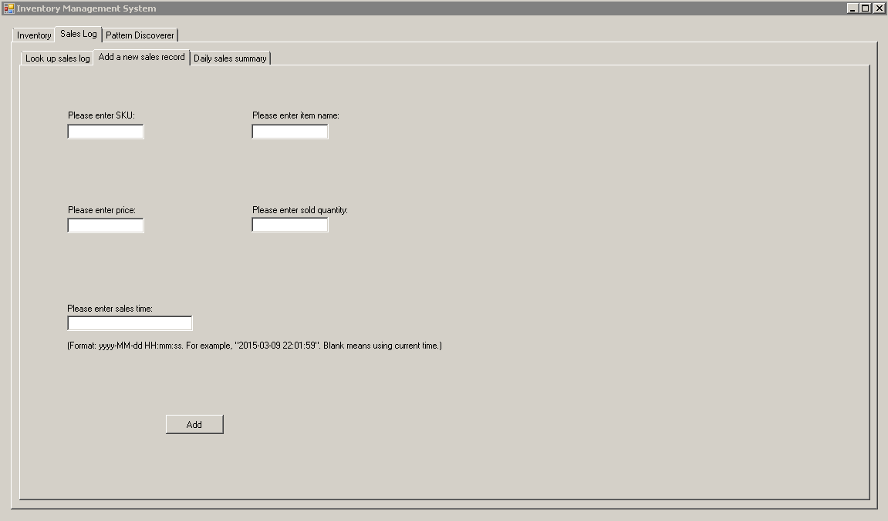
Add a new sales record

Slide 14
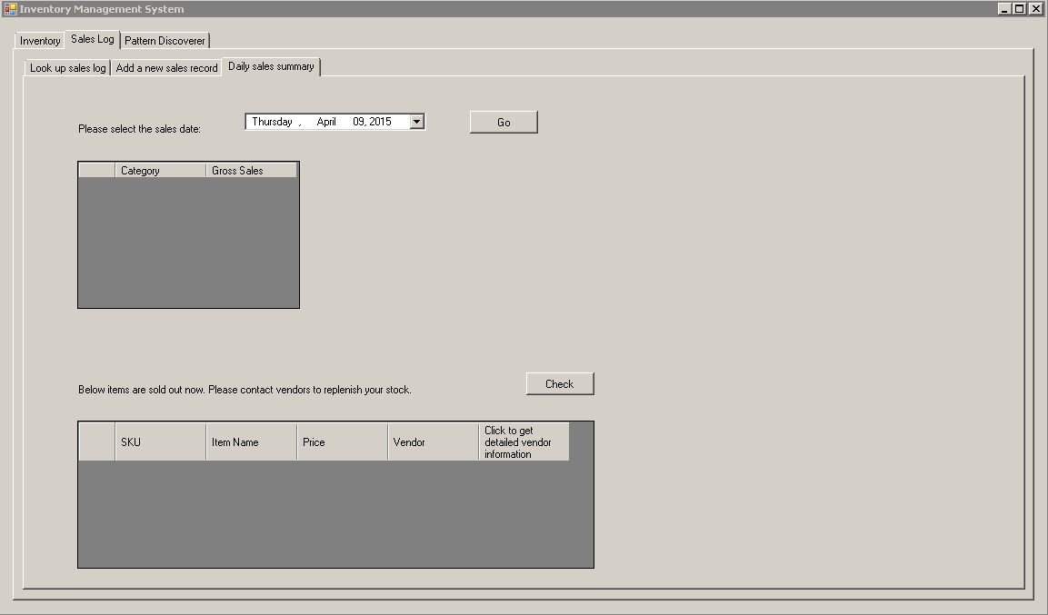
Daily sales summary
Notes:
Users can get the sales summary here. They can also get all the sold-out items here.

Slide 15
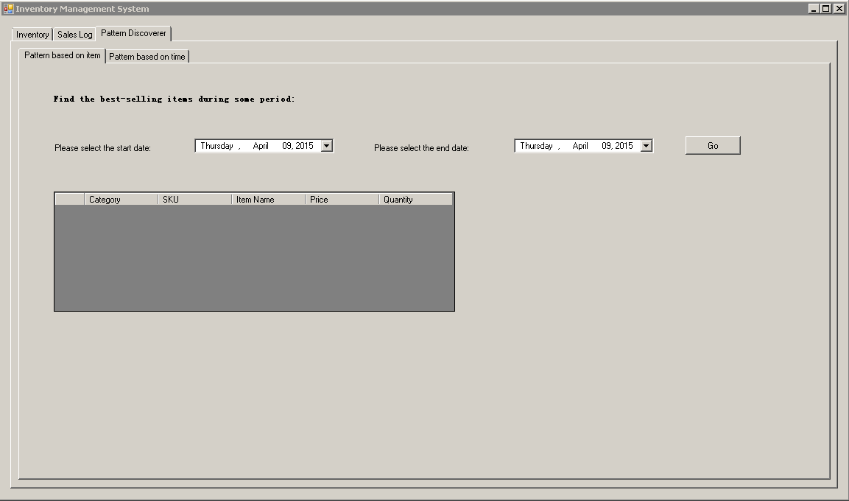
Find pattern based on item

Slide 16
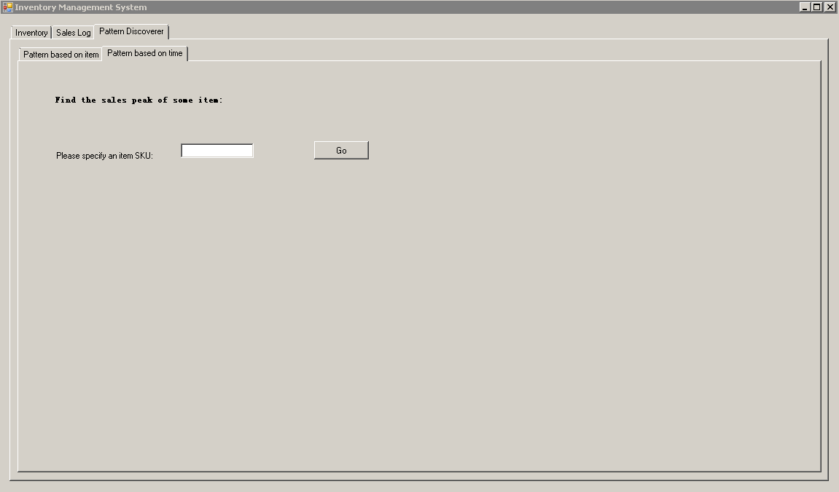
Find pattern based on time

