Slide 1
NEC Testing: Scheduled Maintenance Test for Highly Available Cloud Platform
Takashi Ito,
Senior Software Engineer
NEC Corporation of America

Slide 2
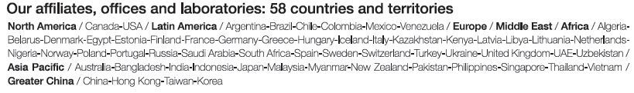
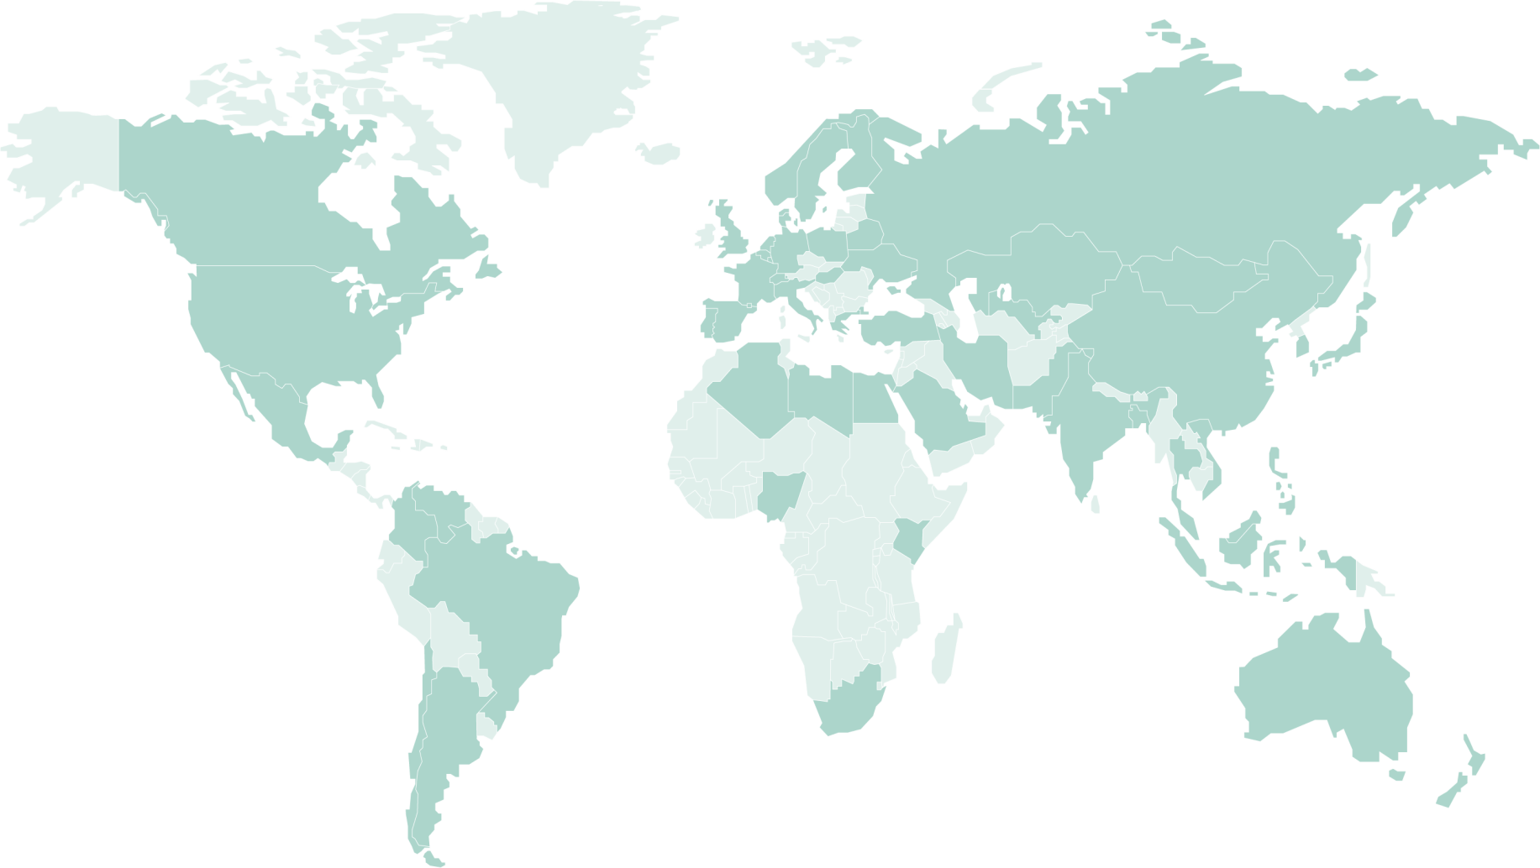
NEC Introduction
Company Name:
Established:
Operations:
NEC Corporation
July 17, 1899
Japanese multinational provider of information technology (IT) services and products
Business activities in over
140
Countries and territories
North
America
Europe, Middle East, and Africa
Greater
China
9
23
18
Asia- Pacific
Latin
America
19
10
25
Billion dollar in FY2014 sales
Notes:
I will present NEC’s testing result of Application Continuity.
First, I will introduce NEC
NEC is Japanese multinational provider of information technology (IT) services and products
NEC is based on Japan, but NEC is doing business worldwide

Slide 3

History of NEC/Oracle alliance
The NEC and Oracle alliance is continuous over a quarter of a century
2015
Zero error solution
enhancement for cloud
2013
Zero error planned DB maintenance
and unplanned DB outage solution
2012
NEC high available Linux DB platform
2008
NEC’s RAC 11gR1 fast failover best practice
2006
NEC’s RAC 10gR2 fast failover best practice
2005
STA (Strategic Technology Alliance) started
2000
Development alliance for mission critical systems
1997
NEC and BEA alliance started
1987
NEC and Oracle OEM contract started(first in Japan)
Notes:
NEC and Oracle started OEM contract at 1987.
We have been done many alliance activity over a quarter of a century.
Our one of focus areas is high availability.
I will explain our latest activity on high availability area today.

Slide 4




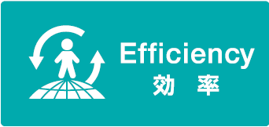








NEC’s Focus: Solutions for Society
Social Value Innovations
Society/ People
Themes for Social Value Creation
Source of values generated by ICT
Real time
Dynamic
Remote
Cloud
Big Data
Cyber Security
SDN
Notes:
Nowadays, NEC is focusing on Solutions for Society, which “Provide infrastructures for an abundant society for all people through ICT.”
NEC provides Solutions for Society by making the best use of Cloud, Big Data, SDN and Cyber Security.
With regard to Cloud, NEC needs to provide a highly available and maintainable Cloud Platform using Oracle products
that encourages our important customers to migrate from on-premises to Cloud.
Because we have been building best practices of Oracle products with NEC’s SI knowledge
and developing mission critical systems using Oracle products for our customers.

Slide 5
Introduction to Tests

Slide 6
Introduction of test
Why NEC tests Scheduled Maintenance?
Important key point for highly available and maintainable cloud platform:
Purpose of the test
Hide scheduled maintenance from clients
Confirm hiding scheduled maintenance from clients
using RAC and FAN and WebLogic Active GridLink
with Oracle Multitenant
Notes:
I will explain “why NEC picks application continuity for testing”.
Because NEC think “Hide unplanned DB outage from client” is important key point for highly available and maintainable cloud platform.
That’s why NEC picks application continuity to confirm hiding unplanned DB outage from client or not.
And NEC think Multitenant and security is also important for cloud.
So NEC test application continuity with Oracle Multitenant and Oracle Security products
to build highly available and maintainable Cloud platform

Slide 7

Test Environment
Oracle DB 12.1.0.2 RAC (Services + FAN + Application Continuity)
Oracle Multitenant (252 PDBs in one CDB)
Oracle WebLogic Server 12.1.3 + Active GridLink
Oracle Data Guard
WebLogic Server
GridLink DS1
GridLink DS2
GridLink DS3
GridLink DS252
…
RAC
Node1
RAC
Node5
RAC
Node6
RAC
Node2
RAC
Node3
RAC
Node4
PDB1
PDB2
PDB3
PDB252
PDB1
PDB2
PDB3
PDB
252
…
…
PDB
252
CDB
Data
Guard
CDB

Slide 8
Test cases
1.PDB service stop
2.RAC node maintenance
RAC
RAC
request
Service for PDB1
request
Service for PDB1
WebLogic
Active GridLink
WebLogic
Active GridLink
FAN
PDB
252
PDB1
PDB
252
No Impact
PDB2
PDB1
PDB3
No Impact
PDB2
Service for PDB2
request
Service for PDB2
PDB3
request
FAN
Maintenance
Maintenance
Client for
Tenant 1
Drain&
Relocate connections
Client for
Tenant 1
Drain&
Relocate connections
Client for
Tenant 2
request
Service for PDB1
CDB
Client for
Tenant 2
request
Service for PDB1
CDB
No Impact
Multitenant
No Impact
Multitenant
request
Service for PDB2
request
Service for PDB2
Use cases
Use cases
Applying Patch Set Update
Configuration change
Hardware maintenance
Gradual connection relocate
Load Balance

Slide 9
Test cases
3.Data Center Maintenance
4. PDB migration by Unplug/Plug
Data Center1
Maintenance
Maintenance
PDB1
PDB
252
PDB
252
PDB2
PDB3
PDB1
PDB2
request
request
Service for PDB1
PDB3
WebLogic
Active GridLink
WebLogic
Active GridLink
request
request
Service for PDB2
No Impact
FAN
No Impact
FAN
request
request
Service for PDB1
CDB1
request
RAC
CDB
Data Guard
request
Service for PDB2
Client for
Tenant 1
Client for
Tenant 1
Drain& Relocate connections
Drain & Relocate connections
PDB1
PDB
252
Unplug/Plug
PDB2
request
PDB3
request
Service for PDB1
PDB1
Client for
Tenant 2
request
Client for
Tenant 2
No Impact
request
No Impact
request
Service for PDB1
Upgrade
request
Data Center2
CDB2
Use case
RAC
CDB
Use case
RAC
Migration from on-premise to cloud
Major version change
Data center hardware replacement
Data Center maintenance

Slide 10
Test Results

Slide 11
1.RAC+Multitenant - PDB service stop
Confirm no impact to all tenant’s clients
No Impact !!!
: request and response
Wait time is less than 1s
Both Nodes
Only Node#1
Both Nodes
WebLogic
Maintenance PDB
Other PDBs
RAC Node#1
FAN
2
FAN
…
Maintenance PDB
Maintenance
Drain Session
RAC Node#2
Other PDBs
1
Stop Service
3
Close
PDB
4
Restart Service
Open PDB(Auto)

Slide 12
2. RAC+Multitenant - Node Maintenance
Confirm no impact to clients
No Impact !!!
: request and response
Wait time is less than 1s
Both Nodes
Only Node#1
Both Nodes
WebLogic
RAC Node#1
FAN
FAN
2
Drain Session
Maintenance
RAC Node#2
Stop Services
3
Stop
Instance
4
Restart Instance
5
Restart Services
1

Slide 13
3.Data Center Maintenance using RAC + Data Guard
Confirm no impact to clients
No Impact !!!
: request and response
FAN
Connection retry
FAN
WebLogic
Upgrade
120 sec
RAC#1
Standby
Primary
3
4
5
Start
Instance
Start
Services
Swichover
2
Drain Session
Maintenance
RAC#2
Primary
Standby
1
Stop Services

Slide 14
4. RAC+Multitenant - PDB migration by Unplug/Plug
Confirm no impact to all tenant’s clients
No Impact !!!
: request and response
Application wait 13s
Application wait 42s
WebLogic
FAN
FAN
Upgrade
Other PDBs
CDB#1
4
2
5
Plug &
Open PDB
…
File copy
６
Start Service
Migration PDB
Drain Session
CDB#2
Other PDBs
1
3
Stop Service
Close &
Unplug PDB

Slide 15
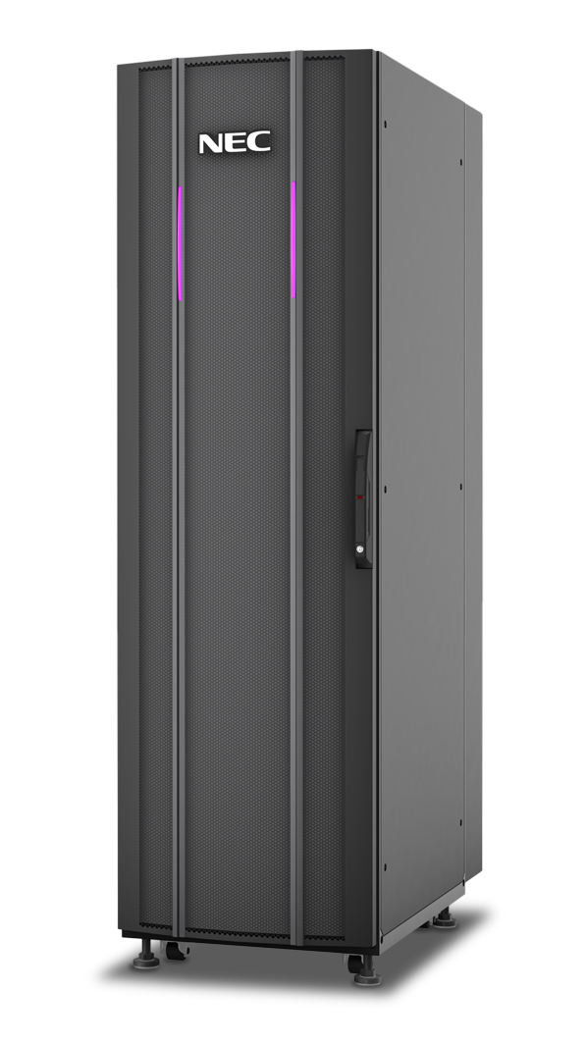



Conclusion
NEC is ready to provide a Highly Available Cloud platform using RAC12c, FAN, Application Continuity, Multitenant, and WebLogic Active GridLink
NEC will provide Solutions for Society on such Cloud Platform with BigData, SDN, Cyber Security and IoT.
Unplanned DB Outage
No Error to WebLogic and Applications
RAC & AC
Active GridLink
Hide the Impact of Unplanned Outages from Your Application [CON8785]
Thursday 10:45 AM - Moscone South—305
Scheduled DB Maintenance
No Impact to WebLogic and Applications
High Available / Maintainable
Cloud Platform
Notes:
This is conclusion. I can’t mention today about planned DB maintenance, but we confirmed no impact to client when planned DB maintenance.
We had another session for this test, so please download documents from OOW site if you have interest.
These all test results meet NEC’s expectation. (planned/unplanned)
So I believe it means NEC is ready to provide a Highly Available Cloud platform using RAC12c, AC, Multitenant, Security options and WebLogic Active GridLink. NEC will provide Solutions for Society on such Cloud Platform with BigData, SDN, Cyber Security and IoT.
And NEC has many tuning and configuration tips for using Application Continuity with Web Logic, Multitenant, Security options.
Please ask NEC for countless Application Continuity’s benefit!!

Slide 16
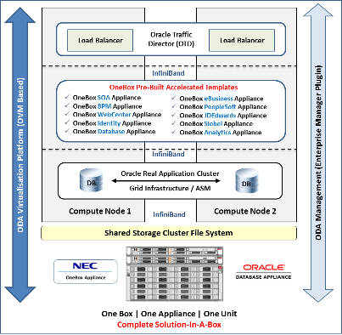
NEC OneBox Appliance solution based on ODA
NEC will add best practices into NEC OneBox.
NEC OneBox Pre-Built Accelerated Templates.
Oracle Traffic Director (OTD)
Oracle Active Grid Link
Oracle WebLogic Enterprise Edition (WLS)
Oracle Enterprise Linux (OEL)
Oracle Virtual Machine (OVM)
Oracle Real Application Cluster (RAC)
Oracle Grid Infrastructure & ASM
Oracle Database Enterprise Edition
Oracle Database Appliance (ODA)
Notes:
This is advertisement.
NEC has just released NEC OneBox Appliance is based on Oracle Database Appliance(RAC).

Slide 17
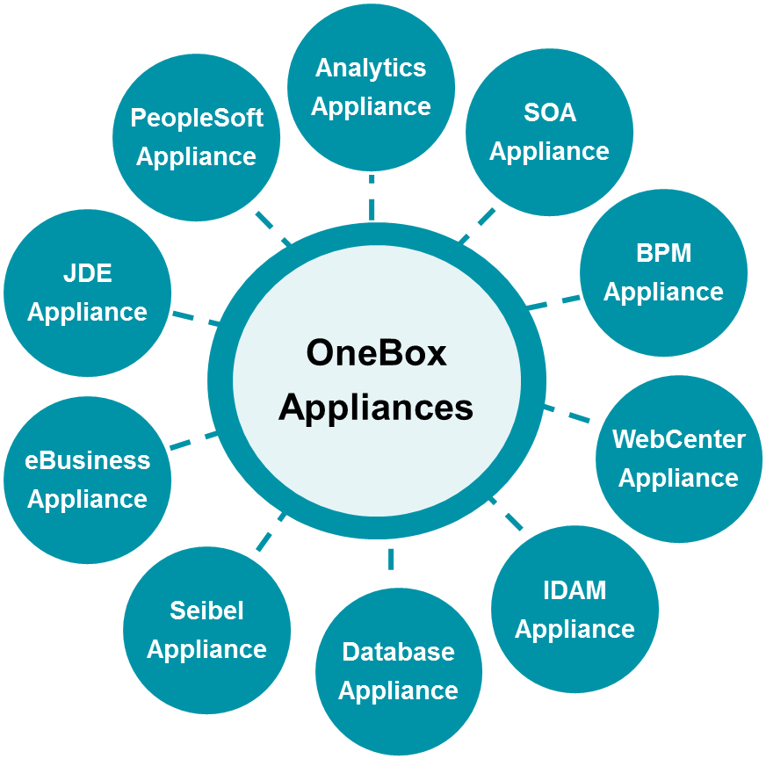
NEC OneBox Appliances - Solutions, Types
NEC OneBox has many Technology & Application Appliance
Technology Appliances:
OneBox SOA Appliance
OneBox BPM Appliance
OneBox WebCenter Appliance
OneBox IDAM Appliance
OneBox Database Appliance
Applications Appliances:
OneBox eBusiness Appliance
OneBox PeopleSoft Appliance
OneBox JDEdwards Appliance
OneBox Siebel Appliance
OneBox Analytics Appliance
Notes:
And NEC developed provisioning templates for a lot of Oracle products.
We will add our best practices into NEC OneBox to provide it for our world wide customers.
That is all my presentation.
Thank you for listening

Slide 18

NEC is ready to provide Highly Available and Maintainable Cloud platform with Application Continuity, Real Application Clusters, Oracle Multitenant, Oracle Security options and WebLogic Server Active GridLink on NEC HW. I believe this platform brings phenomenal value to our cloud customers because it hides unplanned outages and scheduled maintenance from application users.
Yuki Moriyama
Deputy General Manager, NEC Corporation
18

