Slide 2

Oracle Application Express 5
Architecture & Administration
<Name>
<Title>
<Organization>
<Date>

Slide 3
Agenda
1
Oracle Application Express Overview
Architecture
Database Configuration
Managing Instance Settings
Deploying Applications
Tuning / Performance
Reference Material
2
3
4
5
6
7

Slide 4
Overview
Oracle Application Express

Slide 5



Oracle Application Express
Database-centric web application development framework
Develop desktop and mobile web apps
Visualize and maintain
database data
Leverage SQL Skills and database capabilities
Notes:
Used to build desktop and mobile applications for the Oracle Database.
Quickly build reports, forms, charts, calendars, etc. on top of the data in your database
IT Developers and “citizen-developers” who know a little SQL can readily build applications.
Application Express can also take advantage of the large majority of Oracle Database features.

Slide 6
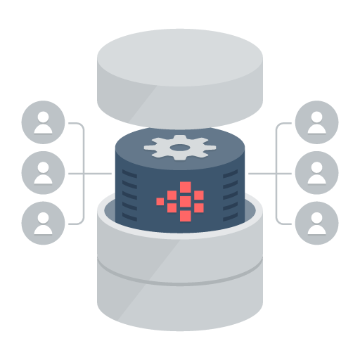
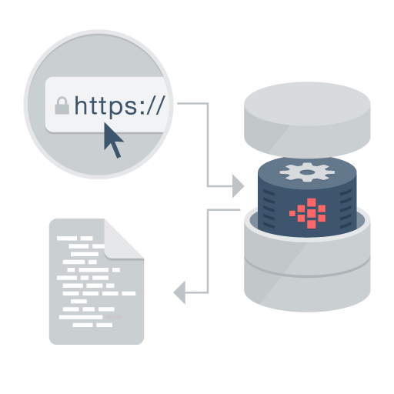

Oracle Application Express
Distinguishing Characteristics
Page generation is efficient with only one request and one response.
Data processing done in the Database
App Development IDE is a web browser. No client software needed
App definitions are stored in the database as meta data.
Declarative – No code generation
Notes:
Simply use a web browser and the URL to access the development environment, or the URL and user credentials to run the application
You don’t need any client software
Declarative framework stores application definitions in Oracle database tables within the APEX Engine
No need for file-based compilation or code generation
All of the data (page) processing is performed by PL/SQL acting directly on the data schemas in the Oracle Database.
Therefore, very efficient as data manipulated directly in the database and results sent back as HTML pages

Slide 7




Oracle Application Express
Develop faster, release more frequently
Pre-built controls for security, authentication, database interaction, validation, session management and more…
Go from prototype to production in minutes
Develop
Customize
Deliver
Notes:
At the core of Application Express is an engine that provides a variety of fundamental application capabilities and operations. Application authentication, page/object-level access control, database interaction (queries/updates etc), form validation, session management and protection, and more is available as standard components that can be utilised from every application without custom development.
Application objects such as forms, reports, charts, navigation etc are defined declaratively, enabling applications to be functionally complete in a short period of time, increasing agility in application development.

Slide 8


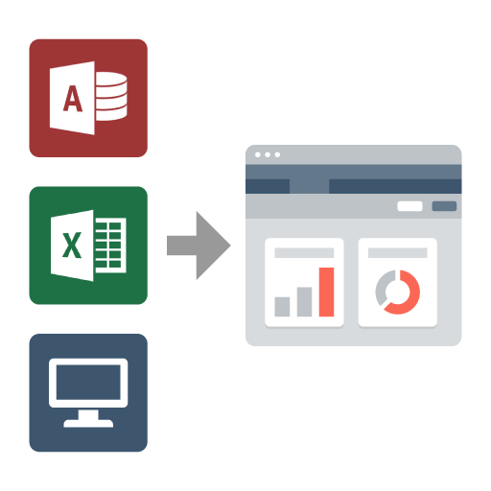
Oracle Application Express
Use Cases
Developing opportunistic & self service web apps
Extending enterprise application solutions
Migrating file based and client server apps to the web
Notes:
Widely used to rapidly build applications that are needed ASAP to meet changing business requirements and maximize competitive advantage.
Primarily designed to be used by all employees / partners / customers rather than back-office systems.
Used for extending COTS Software to streamline for your business processes or meet organization specific requirements
Webify spreadsheets and MS Access applications to provide true multi-user, secure, robust, “single-source of truth” applications.
Also commonly used to modernizing old legacy client-server applications

Slide 9

Oracle Application Express
No cost feature of the Oracle Database
No-cost fully supported feature
Any number of developers, apps, & end-users
Specialized Oracle Support Team
11gR1, 11gR2, 12c
All DB editions: EE, SE, SE1, XE
Included with Oracle Cloud Services
Schema and PDB services 5, 20, 50 GB
Dedicated DBaaS services
No cost evaluation http://apex.oracle.com
Easy to install
Included by default with all editions of Oracle database
Download latest release from http://otn.oracle.com/apex
Notes:
Oracle Application Express is a feature of the Oracle Database with no licensing costs for development or deployment of Application Express applications.
The Oracle Database Maintenance Agreement also covers support for Application Express.
When you sign up for the ODCS – Schema Service you are provided with a slice of the Oracle Database with Application Express as the development environment (already pre-configured and ready to start developing with)
Application Express is released more frequently than the Oracle DB so important to get the latest version of Oracle Application Express from OTN.

Slide 10

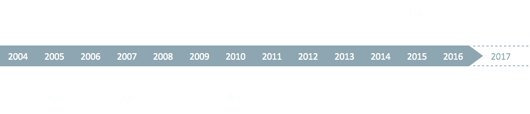
Oracle Application Express
History
1.5
2.0
3.0
4.0
5.0
2.1
3.1
3.2
4.1
4.2
5.1
2.2
Exadata
Service
Schema
Service
DBaaS
Exadata
Express
Oracle Database Cloud Services
with Application Express
2012
2013
2014
2015
2016
2017
Notes:
Originally named HTML DB when first released over 10 years ago.
Application Express is released approximately once a year.
See Statement of Direction for future direction on OTN under Learn More
[http://www.oracle.com/technetwork/developer-tools/apex/application-express/apex-sod-087560.html]

Slide 11
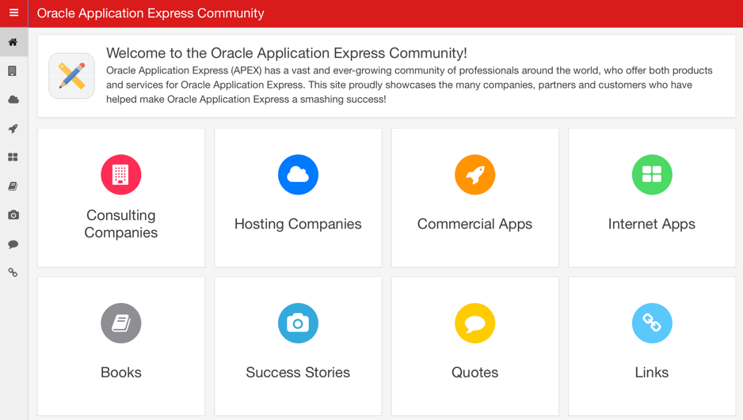
Oracle Application Express
Community
Over 400,00 developers worldwide
Estimated from support requests, downloads, conferences, discussion forum activity
More than 100 active bloggers http://odtug.com/apex
http://apex.oracle.com/community Consulting companies, books, success stories, quotes, commercial apps

Slide 12
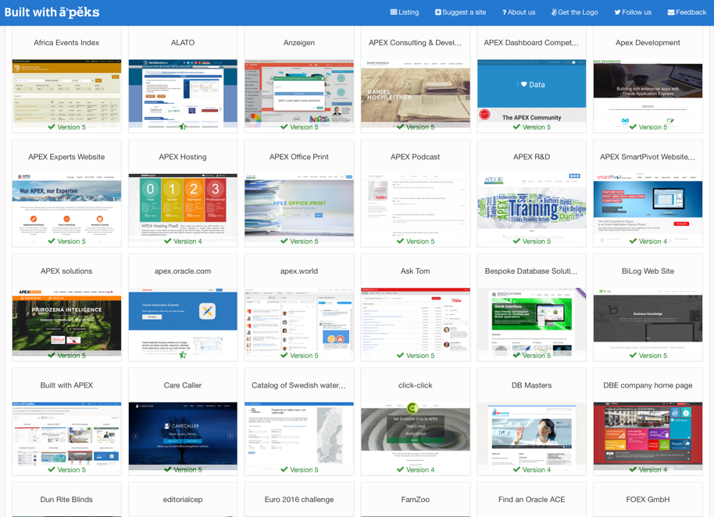
http://builtwithapex.com
Oracle Application Express
Internet Sites built with Oracle APEX
Showcases large diversity of types of applications and different themes
Launched October, 2016
> 100 sites published, more being added daily

Slide 13
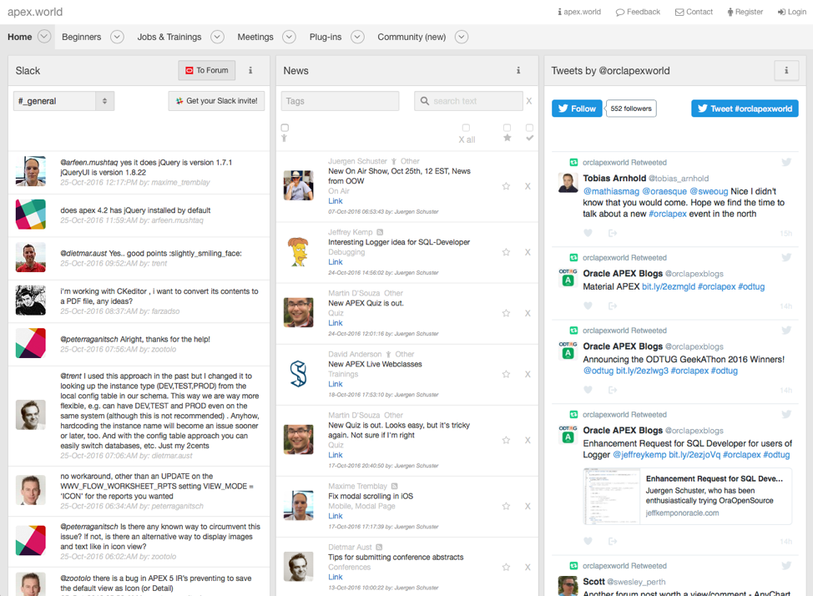
http://apex.world
Oracle Application Express
Community site built by the community for the community
Community-authored site providing:
Plug-ins
Slack discussion channels
Twitter feeds
News
Jobs
Conferences
Meetups

Slide 14
Useful Links
Collateral, Resources and Hosted Services
Oracle Technology Network http://otn.oracle.com/apex
APEX Community http://apex.oracle.com/community
Oracle Learning Library http://www.oracle.com/oll
Hosted evaluation site http://apex.oracle.com
APEX Cloud Service http://cloud.oracle.com
Notes:
These are the primary URLs you need to get more information on Oracle Application Express!

Slide 15
Architecture
Oracle Application Express

Slide 16




Oracle Application Express
3 Tier Architecture
Data
Schemas
Oracle APEX
Engine
Oracle
Database
Browser
Mid Tier
Database Tier
ORDS = Oracle REST Data Services
Notes:
Simple architecture where page requests and submissions made from the browser are tunnelled through the mid-tier to execute in the Oracle Database and returned as HTML responses to the browser.
No data manipulation or processing is performed in the mid-tier, instead the APEX engine (inside the Oracle DB) accepts the page, and interacts with the data schemas in the DB.
The mid-tier can be either the preferred Oracle REST Data Services (ORDS) running in a Java Server {either Oracle Web-Logic Server (WLS), Oracle Glassfish, or Tomcat} or Oracle Embedded PL/SQL Gateway (EPG) which is part of the Oracle DB, or Oracle HTTP Server (OHS) with mod_plsql.
It is common for OHS to be installed in front of ORDS to act as a proxy and serve images.

Slide 17
Web Listener Options
Oracle REST Data Services (formerly APEX Listener)
Written in Java
Runs on J2EE compliant Web Servers
Fully supported on Oracle WebLogic Server / Oracle Glassfish / Tomcat
Embedded PL/SQL Gateway (EPG)
Included with Oracle Database 11gR1 and above
Utilizes XML DB HTTP protocol server within the database
Oracle HTTP Server (OHS)
Utilizes Apache and mod_plsql * (* mod_plsql deprecated in OHS 12c)

Slide 18

Web Listener Architecture
Serving many APEX Instances
apex_1
apex_2
apex_3

Slide 19
Web Listener Architecture
Load Balancing
server_1
server_2
server_3

Slide 20
Browser Requests
Page requests and page submissions
Sample URL f?p=105:12:1675::NO:ARG1:VAL1
Executes Database procedure
‘f’ procedure with parameters ‘p=…’
Called procedure writes HTML to internal buffer using the PL/SQL Web Toolkit (HTP, HTF, OWA, OWA_UTIL)
Results returned from buffer to browser
APEX is built on top of the PL/SQL Web Toolkit

Slide 21
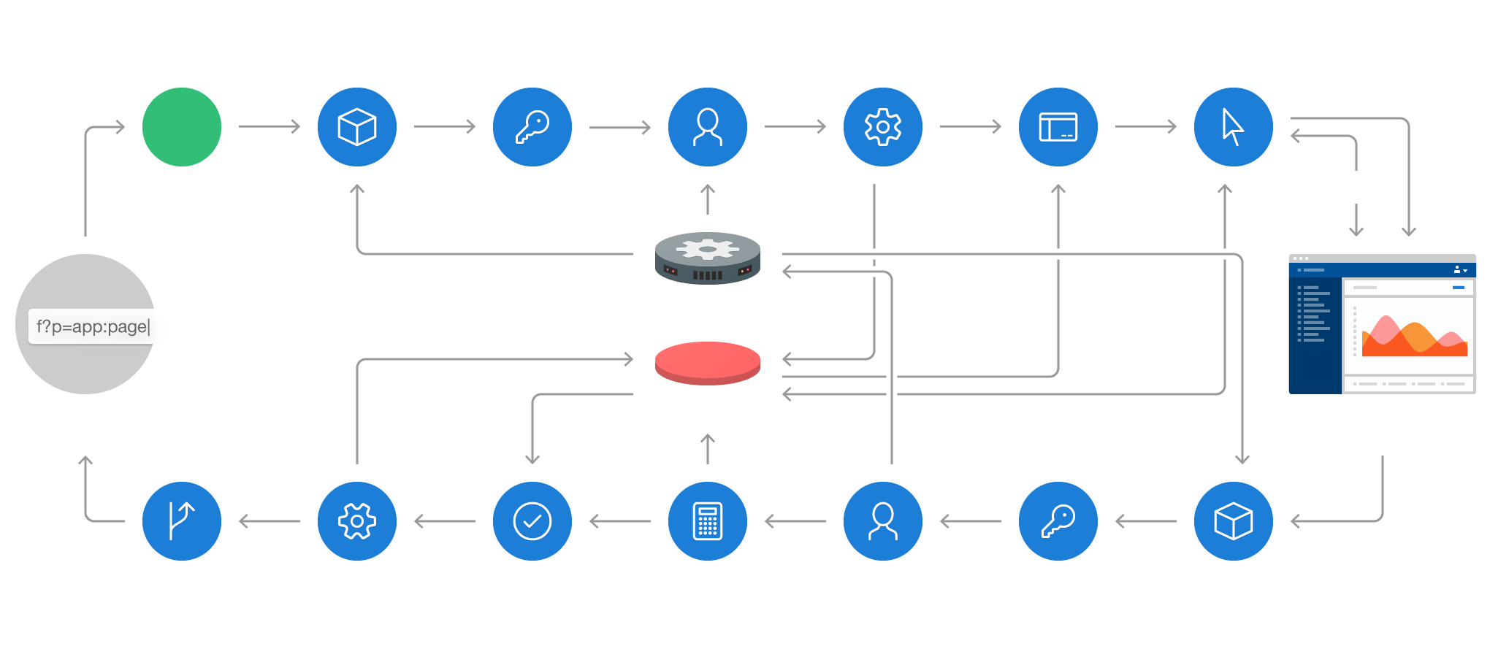
Browser Requests
Detailed processing from URL entered to page returned
Application
Definition
Authentication & Authorization
Session
State
Processes
Regions,
Buttons, Items
Dynamic Actions
START
AJAX
APEX
URL
Schema
Rendered Page
Branch
Processes
Validations
Computations
Session
State
Authentication & Authorization
Application
Definition

Slide 22

Simplistic Overview of an APEX Request
DB Session Pool

Slide 23
Connection Pool
Maintains a pool of database connections
PL/SQL package state reset before every request
Database sessions are ACTIVE only when performing a request, otherwise, connected but INACTIVE
Oracle Rest Data Services
JDBC Connection parameters
Single-threaded Oracle HTTP Server
MinSpareServers / MaxSpareServers / MaxClients
Embedded PL/SQL Gateway (init.ora)
SHARED_SERVERS / MAX_SHARED_SERVERS

Slide 24
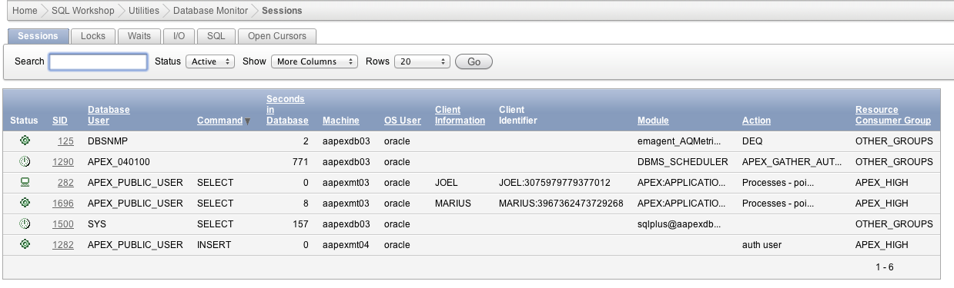
Connection Pool
Reviewing Active Sessions
Only active page requests are consuming resources
Inactive sessions are idle

Slide 25
Parsing of SQL
Physical connection from pool established as APEX_PUBLIC_USER
Minimally privileged database user
An APEX workspace is mapped to one or more database users (schemas)
These DB users parse the SQL of APEX applications
SYS.DBMS_SYS_SQL enables the APEX engine to parse SQL as another user

Slide 26
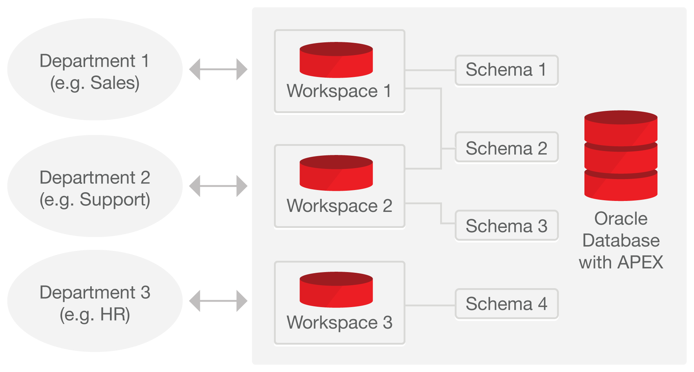
Single Database Instance serving Multiple Departments
Easily managed with optional self-service provisioning
Workspaces used to define application definitions / Schemas hold data
Many-to-many relationship between Workspaces and Schemas
Instance Administrators manage the environment and schema access
Departments can request more space, and access to a new schema
For example, http://apex.oracle.com has over 20,000 Workspaces as of July, 2014
Notes:
There is a many-to-many relationship between workspaces and schemas
Within your organization you can have a single Oracle Database support many departments with each having their own workspaces where they build applications
Each of these workspaces can be granted access to one or more schemas as appropriate
DBAs manage the infrastructure <> Departments responsible for building their own applications

Slide 27
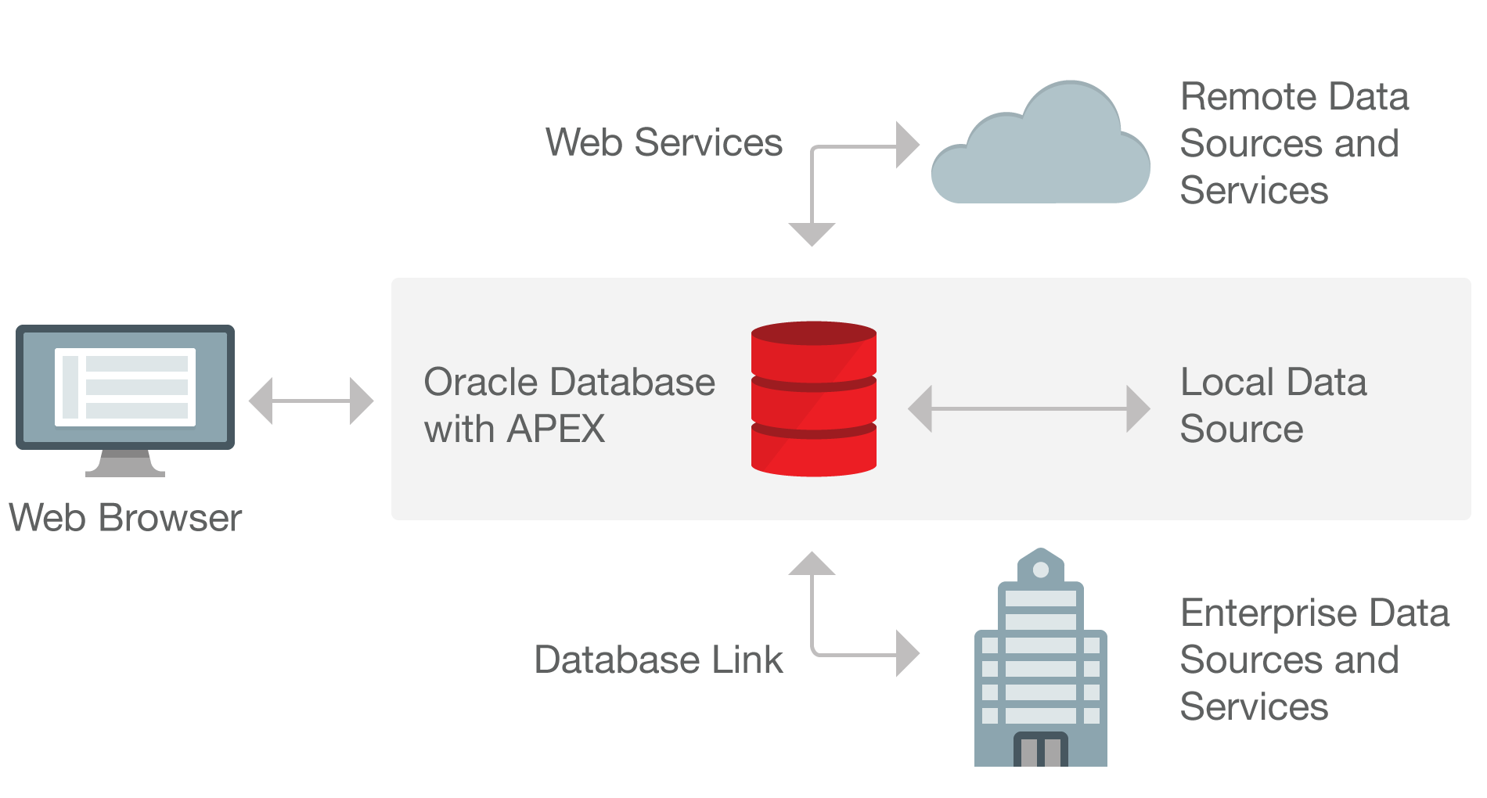
Data Sources
Utilize the Oracle Database / Web Services
Notes:
Application Express is best suited being co-located with the data it is maintaining
Can also integrate into a SOA environment using Web Services or utilize DB Links to other Oracle databases

Slide 28
Minimize use of Database Links
Database links can be “chatty”
Strongly recommend REST Web Servivces, materialized views or refreshable tables
Only use database links when no other option available
apex_util.close_open_db_links – configure in ORDS
<entry key="procedure.postProcess">apex_util.close_open_db_links</entry>
<entry key="procedure.preProcess">apex_util.close_open_db_links</entry>
“Sniper” database job

Slide 29
Database Configuration
Oracle Application Express

Slide 30
Database Settings
Create Tablespaces {Names arbitrary}
APEX_TS_050100 for the Application Express user
Tablespace Name is APEX Version specific (e.g. APEX 5.1 would use APEX_TS_050100)
Upgrade APEX into new Tablespace allows for better management
APEX_TS_FILES for the Application Express files user
APEX_TS_TEMP for temporary tablespace
@apexins APEX_TS_050100 APEX_TS_FILES APEX_TS_TEMP /i/
Define Database Parameters
SHARED_POOL_SIZE
JOB_QUEUE_PROCESSES

Slide 31
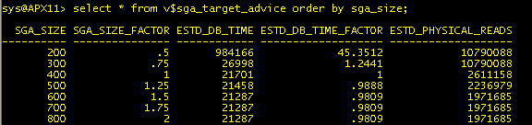
SGA Sizing
Undersized SGA can hamper APEX performance
Insufficient memory in Shared Pool for PL/SQL
Insufficient memory for Buffer Cache for APEX metadata
Advice
V$SGA_TARGET_ADVICE / V$SGA_INFO
V$MEMORY_TARGET_ADVICE
SGA should always fit in real memory

Slide 32
Database Schemas
APEX_050100 → APEX Engine Schema {Name is version specific}
Should be installed into own tablespace and monitored
Holds APEX logs / application definitions (meta-data)
Application Schemas – Configured by Instance Administrator(s)
Specify if New Schema required { Manage Instance > Instance Settings > Storage }
Specify if Tablespace Autoextend = True { Manage Instance > Instance Settings > Storage }
Define Initial Workspace Sizes { Manage Instance > Instance Settings > New Workspace Request Size }
Define Change Request Sizes { Manage Instance > Instance Settings > Workspace Change Request Size }

Slide 33
Database Jobs
ORACLE_APEX_PURGE_SESSIONS
Delete session information from APEX tables for sessions older than 12 hours
Runs every hour
ORACLE_APEX_MAIL_QUEUE
For e-mail messages authored with APEX_MAIL
Send e-mail in queue
Runs every 5 minutes
ORACLE_APEX_DAILY_MAINTENANCE
Archive activity log
Automatic file deletion
Runs at 0100 system time
ORACLE_APEX_WS_NOTIFICATIONS

Slide 34
Database Backup
Use Java programs provided with APEX Installation
Define job to perform nightly application exports to Source Control
Define job to perform nightly application component exports
Standard Oracle Backup of complete database
Can restore “workspace” schemas
Restores the developer defined database objects and data
Does not restore application definitions
Can restore APEX Engine Schema
Restores APEX meta-data for all workspaces and applications
Can NOT restore individual workspaces or applications
Must import APEX Engine Schema into separate database and then export

Slide 35
Database Flashback
Flashback availability based on DB settings and space allocation
Can export application “as of”
Can retrieve report source, etc.

Slide 36
Database Resource Manager
Guarantee minimum amount of resources, regardless of load
Multiple Groups and resource plans among those groups
Automatically switch between groups (HIGH, LOW, BATCH)
Cancel SQL or Kill Session
Can assign a workspace to a Resource Consumer Group in APEX
* EE only feature

Slide 37
Database Resource Manager
Profile used on apex.oracle.com
APEX_HIGH – default group, 70% for 10 seconds
APEX_MEDIUM – 8% for 120 seconds
APEX_LOW – 2% for 1800 seconds
OTHER_GROUPS – 20%

Slide 38
Partition APEX Tables
Typically only relevant for multi-node RAC clusters
Will manifest itself in AWR as GCS / GES wait events (Global Cache Service, Global Enqueue Service)
Only when necessary, partition the “hot” tables of APEX
apex/utilities/apxpart.sql

Slide 39
Managing Instance Settings
Oracle Application Express

Slide 40
Application Express Users
Instance Administrator
Manage Requests (Workspace Provisioning)
Manage Instance (Settings, Shared Components, Meta Data, Messages, ...)
Manage Workspaces
Monitor Activity
Workspace Administrator
Manage Service (Requests, Preferences, Utilization)
Manage Users
Monitor Activity
Developer
End User

Slide 41
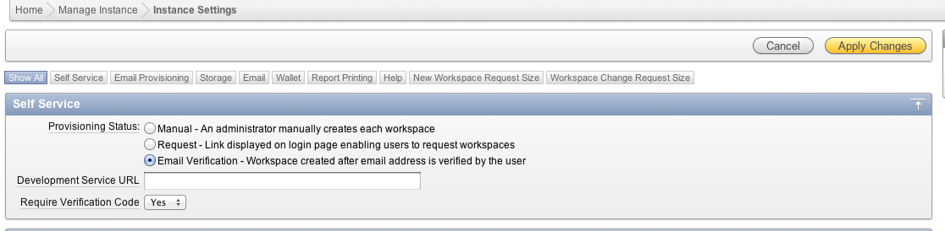
Workspace Request Modes
Manual: Administrator must manually create each workspace
Request: Workspace requests from link on APEX home page, immediately created after Administrator approval
Email Verification: Like Request, but workspace created after e-mail verification (2-step process)

Slide 42
Workspace Request Modes
Manual
Use for complete control over workspaces in your instance
Email Verification
Workspace, tablespace, data file and database user not created until e-mail address is confirmed
Will avoid users requesting workspaces with malformed e-mail addresses, consuming space which will never be used

Slide 43
Workspace Provisioning Steps
* Tablespace and Data File created
* Database User created with unlimited quota on newly created tablespace
Workspace Created in APEX
Database User Mapped to Workspace
* Sample Application installed in workspace
* Email Notification Sent

Slide 44
Workspace Provisioning – Data Files
By default, workspace data files created in same directory as tablespace for APEX (APEX_xxx.DBF)
Oracle Managed Files
Gives DBA complete control over file location
DB_CREATE_FILE_DEST init parameter
o1_mf_%t_%u_.dbf
/u03/oradata/apex/APXPRD/datafile/ o1_mf_flow_25_339bpw79_.dbf

Slide 45
Instance Security
Application Builder User Guide – Chapter 15 : Administrator Security
Use HTTPS { Instance Administration > Manage Instance > Security > HTTPS }
Set Password Complexity and Expiration { Instance Administration > Manage Instance > Security > Workspace Login Control / Password Policy }
Runtime only for Production / QA / Test environments { Installation Guide – Chapter 3.3.2 (6.) Select the appropriate installation option }
Session Timeout { Instance Administration > Manage Instance > Security > Session Timeout }
Enable Network ACL

Slide 46
Feature Configuration
Application Development
Allow PL/SQL editing; Create demonstration objects, Websheet objects; Enable SQL and PL/SQL in Websheets
SQL Workshop
Inactivity time; Max script output; Max workspace output; Max script size; Enable transactional SQL; Enable RESTful Services
Monitoring
Enable Database monitoring; Application Activity Logging; Application Tracing
Workspace Administration
Enable Service Requests

Slide 47
Security Settings
Security
Set Allow PL/SQL editing; Create demonstration objects, Websheet objects; Enable SQL and PL/SQL in Websheets
HTTPS
RESTful Access
Session Timeout
Max Session Length; Max Session Idle Time
Developers can overwrite for each Application
Workspace Login Control
Require User Account expiration and locking; Max login failures; Account password lifetime

Slide 48
Security Settings (cont.)
Workspace Password Policy
Max password length; Min password differences; Must contain at least one Alphabetic character, numeric character, punctuation character, upper case character, lower case character; Must not contain username, workspace name
Must not contain {specified words} – oracle:hello:welcome:guest:user:database
Alphabetic characters {specified characters}
Punctuation characters {specified characters} – !"#$%&()``*+,-/:;<=>?_
Service Administrator Password Policy
Use Workspace password policy or default strong password

Slide 49
Instance Settings
Self Service
Provisioning Status; Require verification code; Notification
Email Provisioning
Storage
Require new schema; Auto-extend tablespaces; Delete uploaded files after
Email
Instance URL; Images URL; SMTP host address, port, authentication username and password; Use SSL/TLS; Default From address; Max emails
Wallet
Path; Password

Slide 50
Instance Settings (cont.)
Report Printing
Print Server; Host address; Server Port; Server Script
Help
URL – Can host Help inside firewall
New Workspace Request Size
Specify size in Megabytes and default size
Workspace Change Request Size
Specify size in Megabytes and default size

Slide 51
Other Settings / Configuration
Workspace Purge Settings
Automatically remove inactive workspaces
Very good on Development instances where many signing up but not utilizing
Define Login Message
Define System Message
Manage Site-Specific Tasks
Manage New Service Sign-Up Wizard
Agreement; Survey questions and answers (formed into radio group); Pre text; Post text

Slide 52
Manage Workspaces
Manage Developers and Users
Unlock user accounts
Create / remove workspace administrators
Manage Component Availability
Allow or disallow access to:
Application Builder
SQL Workshop
PL/SQL Editing
Team Development

Slide 53
Deploying Applications
Oracle Application Express

Slide 54
Development Environment(s)
Install “Full” Application Express
Configure Oracle Access Management (Optional)
Create Workspaces / Schemas
Grant rights to common schemas
Allow Workspace Administrators to manage own workspace:
Define other Workspace Administrators; Developers; End Users
Unlock / reset passwords for workspace accounts
Request space
Request additional Schema(s)

Slide 55
QA / Test and Production
Install “Runtime Only” Application Express
Configure Oracle Access Management (Optional)
Define schemas
Create Workspaces or export Workspaces from Development
Grant rights to common schemas
Import Applications from Source Control
Run DDL Scripts from Source Control
Run DML Scripts from Source Control
[Optional] Create End Users (Application Administrators)
Should manage end users from within application if not using SSO / LDAP / etc

Slide 56
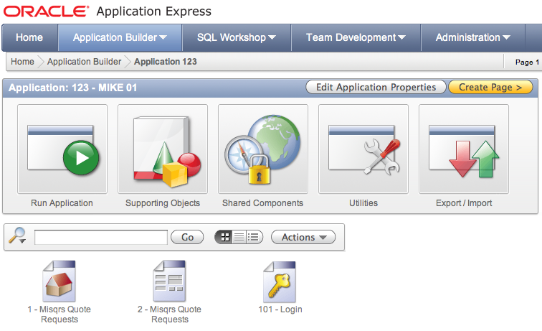




Promoting Applications
1. Developer exports Application
3. Developer adds SQL Script(s) to Source Control
4. Developer provides Run Sheet to DBA
5. DBA obtains files from Source Control
2. Export generates a SQL Script
6. DBA Runs Script(s) in QA / Production
@f123.sql

Slide 57
Copy Workspaces
Export / Import Workspace using APEX Export
From Workspace Administration
From Instance Administration
Manually specify ID during workspace creation select workspace, workspace_id from apex_workspaces
Benefits:
Easily replicate applications and other components between APEX instances
Easily use SQL*Plus to install / upgrade APEX applications
Facilitate import of pages

Slide 58
Use Consistent Application IDs
In all environments, immediately propagate “placeholder” applications
Always import applications using the same Application ID
Benefits:
Easily replicate applications and other components between APEX instances
Easily use SQL*Plus to install / upgrade APEX applications
Facilitate import of pages
Less work for APEX when replacing (upgrading) applications

Slide 59
Development Standards
Application Security
Authorization and authentication standards (can define plug-ins)
Application Naming standards
Application Numbering / Groups
PL/SQL Components
Naming Conventions; Headers; APIs; Use of Common Packages
Deployment standards
Application Exports; DDL Scripts; DML Scripts
Use of Source Control
Change Control
Testing / Sign-Off procedures; Training procedures; Roll-out procedures

Slide 60
How to develop Standards
Author user interface guidelines
Author naming conventions
Author coding standards
Examine code of the APEX Packaged Apps
Install and use Packaged App: Standards Tracker

Slide 61
Schema Isolation / Privileges
Only allow schemas to be assigned to workspaces if required
Don’t assign workspaces to sensitive schemas
Assign grants and synonyms to schema associated with workspace
Grant least privileges on tables
Use views / VPD to restrict access to sensitive columns

Slide 62
Application Security
Application Builder User Guide – Chapter 19 : Managing Application Security
Understand Items of type Password
Understand Cross-Site Scripting protection
About Session State and Security
Understand Session State Protection

Slide 63
Application Security Reviews
Use Application Advisor { Application Builder > Application xxx > Utilities > Advisor }
Utilize 3rd party tool to analyze applications in depth for vulnerabilities
APEXSec Security Tool { https://secure.recx.co.uk/apexsec/ }
APEX-Sert {http://www.oraopensource.com/apex-sert/ }

Slide 64
Operate like a Service Provider
Use source code control (Subversion, GIT)
Establish a nightly build process (Jenkins, Hudson)
Know how to write patch scripts for your applications
Automate installation testing of your application patches
Ensure applications reviewed and tested before release
Benefits:
Established processes in place, can react quickly
Easy to establish a “cadence” for updates

Slide 65
Tuning / Performance
Oracle Application Express

Slide 66
Identifying Performance Issues
98% of the time, the developer-authored SQL & PL/SQL is the culprit
1% of the time, the problem is APEX – and it’s a bug
1% of the time, it’s something else
AWR provides a wealth of information about database performance
Easy to correlate APEX applications to performance issues

Slide 67
Application Express is Slow???
Determine where the bottleneck is
Client
Network
Middle-Tier
Database
Disk / Storage
Check Database Health
SGA
CPU Utilization
Locks
Database Parameters

Slide 68
Slow Running Applications
Determine what else is running
Legacy Applications
Data Warehouse
Batch Programs
Database Jobs
Check the SQL and PL/SQL
Review the data model
Modify the Application
80/ 20 Rule → Dissect business requirements
Use “progress bar”; Prevent “multiple-clicks”
Use collections

Slide 69
Performance Diagnosis Steps
Identify time window
Isolate largest consumers of DB Time (sql_id, module)
Identify APEX workspaces, applications
Correlate SQL with specific location in an APEX application by querying the APEX views

Slide 70
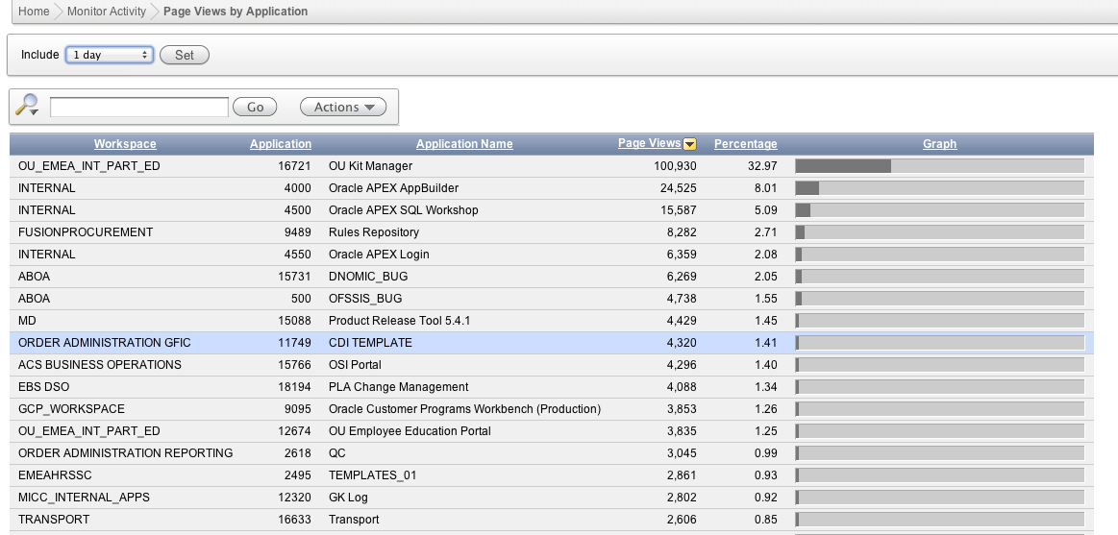
Activity Log and Monitoring
Monitoring by Workspace Administrators, Instance Administrators

Slide 71
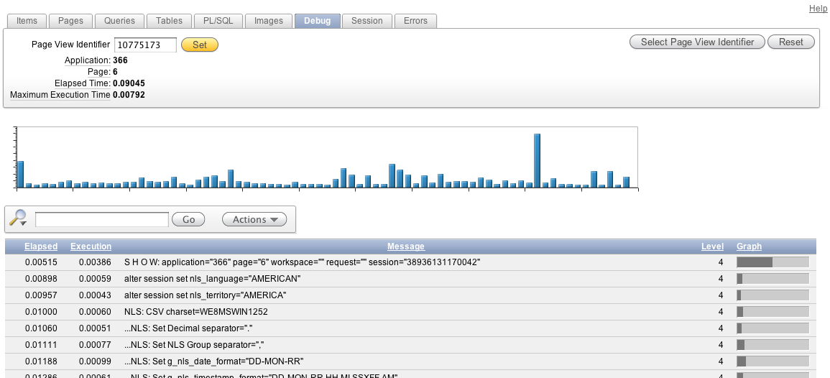
Application Page Performance
Debug within APEX to identify expensive elements within a page or process

Slide 72
Database Traces
TKPROF is an Oracle utility that formats SQL trace files
No graphical interface for TKPROF
Look in the user dump destination directory on the database server file system.
On OFA compliant systems this will be $ORACLE_BASE/admin/$ORACLE_SID/udump

Slide 73
Tracing from Application Express URL
Generate Oracle Trace file for detailed examination of all SQL associated with a page or process
p_trace=YES name/value in URL
f?p=105:12:1675::NO:ARG1:VAL1&p_trace=YES
Instrument code using ALTER SESSION
DBMS_SESSION.SESSION_TRACE_ENABLE
DBMS_SESSION.SESSION_TRACE_DISABLE
Use TKPROF to analyze and format output

Slide 74
Reviewing Traces with APEX Applications
Pay attention to the parsing user_id in tkprof output
Most APEX tables are named with a WWV_ prefix
“Bind Peeking” and Adaptive Cursor Sharing:
Are available for the SQL of the APEX engine
Are not available for user SQL (your application SQL)

Slide 75
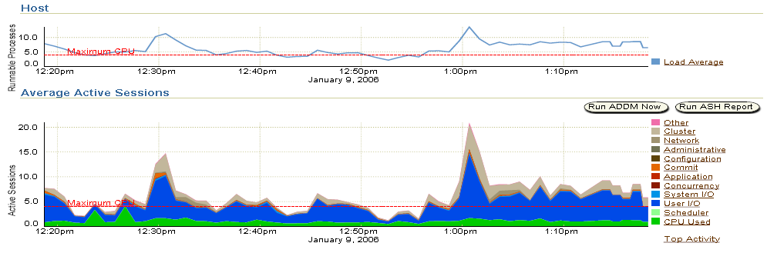
Enterprise Manager Performance Page
Active Sessions by wait class over time
Colored area = amount of DB time

Slide 76
Database Time
Total time in database calls by foreground sessions
Includes CPU time, IO time and non-idle wait time
DB time <> Response time
Database time is total time spent by user processes either actively working or actively waiting in a database call.

Slide 77
How to query Database Time
V$SYS_TIME_MODEL, V$SESS_TIME_MODEL
STAT_NAME = ‘DB time’
Cumulative database processing time
V$SYSMETRIC_HISTORY
“Database Time Per Second”, “CPU Usage Per Sec”
10g units = centi-secs/sec (100xAvg. Active Sessions)
11g new metric “Average Active Sessions”
V$SQL
ELAPSED_TIME and CPU_TIME
Wait class times: APPLICATION, CONCURRENCY, CLUSTER, USER_IO
V$ACTIVE_SESSION_HISTORY

Slide 78
Active Session History (ASH)
All ‘Active’ sessions captured every second
Foregrounds and backgrounds are sampled
Active foregrounds contribute to DB Time
In-memory: V$ACTIVE_SESSION_HISTORY
Sampling interval = 1 second
On-disk: DBA_HIST_ACTIVE_SESS_HISTORY
Sampling interval = 10 second
ASH is a system-wide record of database activity

Slide 79
Automatic Workload Repository (AWR)
Collects performance statistics
By default, every hour and retained for 7 days
Active Sessions
Resource Intensive SQL Statements
Wait events
Can establish baseline and compare with current.
DBA_HIST_SNAPSHOT
Shows top-level numbers about all snapshots in the Workload Repository

Slide 80
Application Express Views
The database catalog of everything APEX
Application definitions, workspaces, logs
Display all views and columns
select * from apex_dictionary
Display all view names
select distinct apex_view_name from apex_dictionary
Can be queried via SQL*Plus, SQL Developer or other command-line tools
If granted APEX_ADMINISTRATOR_ROLE role, can view across entire instance

Slide 81
Application Express Views
APEX_WORKSPACES – all workspaces defined on the instance
APEX_APPLICATIONS – all APEX applications
APEX_WORKSPACE_ACTIVITY_LOG – all logged page views
APEX_WORKSPACE_APEX_USERS – all developers, administrators and end users of a workspace
APEX_APPLICATION_PAGE_REGIONS – HTML regions, class SQL reports

Slide 82
Application Express Activity Logs
APEX_ACTIVITY_LOG shows all page views in a workspace
APEX activity log is circular and does not persist (log switch every N days, default = 14)
Preserve yesterday’s log activity:
INSERT INTO my_activity_log
SELECT * from apex_activity_log
WHERE time_stamp BETWEEN
TRUNC(SYSDATE-1) and TRUNC(SYSDATE)

Slide 83
PL/SQL Hierarchical Profiler
Reports the dynamic execution profile of a PL/SQL program organized by function calls
Accounts for SQL and PL/SQL execution times separately
No special source or compile-time preparation is required

Slide 84
Query Plans and Statistics
APEX is a large number of database applications (PL/SQL)
Cost-based optimizer will develop better query plans with accurate statistics
GATHER_STATS_JOB

Slide 85
Limiting Resources
Resource Profiles
Limit types of system resources (CPU, Logical Reads)
Per Call Level applicable in APEX environment
CPU_PER_CALL
LOGICAL_READS_PER_CALL
Not Applicable: SESSIONS_PER_USER, CPU_PER_SESSION, CONNECT_TIME, IDLE_TIME, LOGICAL_READS_PERS_SESSION

Slide 86
CPU Resource Monitoring
Very fine-grained scheduling
Resource Manager schedules at a 100 ms quantum
Low-priority session will yield to a high-priority session in ~1 quantum
Background processes are not managed
Backgrounds are either high-priority or not CPU-intensive
Maximize CPU utilization
If one consumer group doesn’t use its allocation, it is redistributed to other consumer groups based on the resource plan

Slide 87
Monitor Resource Plan Utilization
V$RSRC_PLAN – Currently active resource plan
V$RSRC_CONSUMER_GROUP – Cumulative amount of CPU stats
V$RSRC_PLAN_HISTORY – History of resource plan, when enabled, disabled or modified
V$RSRC_CONS_GROUP_HISTORY – History of consumer group statistics
V$RSRCMGRMETRIC – Information about resources consumed and wait times per consumer group
V$RSRCMGRMETRIC_HISTORY – History of Resource Manager metrics

Slide 88
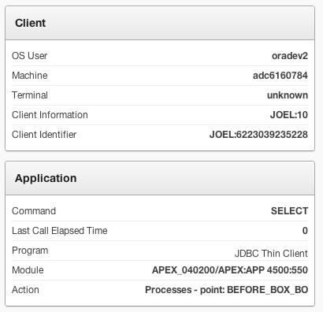
V$SESSION
Client Information: Authenticated Username: Workspace ID
Client Identifier: Authenticated Username: Session ID
Module: Parsing DB User/APEX: APP Application ID:Page ID1

Slide 89
Reference Material
Oracle Application Express

Slide 90
Useful Links
Collateral, Resources and Hosted Services
Oracle Technology Network http://otn.oracle.com/apex
Oracle Learning Library http://www.oracle.com/oll
Hosted evaluation site http://apex.oracle.com
APEX Cloud Service http://cloud.oracle.com
Notes:
These are the primary URLs you need to get more information on Oracle Application Express!

Slide 91
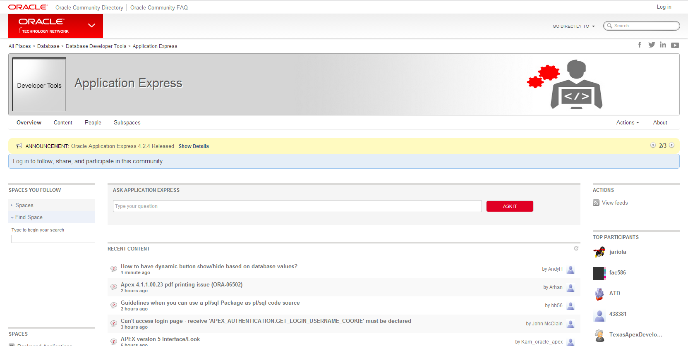
OTN Application Express Forum
https://community.oracle.com/community/database/developer-tools/application_express

Slide 92


Slide 93



