Slide 2


Modernizing Oracle Forms using Oracle APEX
February 2019

Slide 3
Oracle Forms
Review
Notes:
Lets start by reviewing Oracle Forms

Slide 4

Oracle Forms Current Standing
Very stable product, still being developed
Continues to be fully supported by Oracle
Best suited for heavy-duty, back office applications
Can integrate with desktop tools
Highly productive for “Power Users”
Notes:
Oracle Forms has been one of the most widely used application development technologies for more than thirty years
This proven technology has evolved over the years and still remains the technology of choice for thousands of developers worldwide.
Extended support for Forms 12c currently out to 2025
Forms still one of the best tools for data entry operations
Forms provides the ability to integrate directly with desktop
Takes time, but once users familiar with Forms – One of the most productive tools for them to use

Slide 5

Oracle Forms Issues
Browser support (can utilize Java Web Start)
Non-responsive = Not suitable for mobile devices
Difficult to find skilled Oracle Forms developers
Often hard-to-use, non-intuitive runtime user experience
Takes significant time for end users to become productive
Notes:
Forms difficult to install and run enterprise wide
Forms uses fixed coordinate-system positioning = non-responsive
New developers don’t want to learn Forms, and old timers retiring
Complex pages such as Query / results / edit in one page hard to use; Not like a normal Web app
Use of function keys, etc; Need training in how to navigate use app

Slide 6
Should you Modernize?
Are you on a supported version?
Can you easily upgrade?
No
No
Modernize Forms
Using APEX
Yes
Yes
Is Forms meeting all requirements?
Are they net new requirements?
No
No
Yes
Yes
Stay on Oracle Forms
Keep Oracle Forms +
Build new apps in APEX
Notes:
If Forms on supported release and meeting all of the business requirements – Stay on Forms
Otherwise, keep Forms and just do new development in Forms
Alternatively modernize all into APEX

Slide 7
Key Reasons to Modernize
Need modern, responsive user interface running on any device
Need solution for external use (such as customers / partners)
Need simplified UX as extending to corporate-wide
Major functionality needs to be redeveloped
Unable to maintain / enhance existing Forms apps
Notes:
Want apps to work on tablets, smartphones
Forms very hard to deploy to external partners; Need modern apps for customers
Need simple Web apps everyone can easily use
Business requirements changed and old functionality in Forms apps
Hard to get skilled Forms developers

Slide 8
Oracle APEX
The Best “Proven” Alternative
Notes:
Oracle APEX is arguably the best alternative for modernizing Oracle Forms apps

Slide 9
Oracle APEX Similarities
Primarily code in SQL and PL/SQL
Database-centric development
Low-code, declarative platform
Can very easily integrate Oracle packages, functions, procedures
Can fully utilize Oracle Database features
Notes:
Same core languages is huge!
Both build from tables up, not from UI down
Both are designed to quickly build apps based on table definitions
Business logic implemented in the DB can be called from either
Both built on top of Oracle DB and can take advantage of DB features like RAC, HA, Security, etc

Slide 10
Oracle APEX Differences
Oracle Forms | Oracle APEX
Requires full WebLogic Server | Requires Oracle REST Data Services
Requires browser plug-ins or Java Web Start | Any modern web browser
Generates files | Metadata based
Suitable for desktops only | Runs on any device (zero development effort)
Difficult to style | Out of the box theming and theme styles
Notes:
Forms is heavy, costly, and hard to install & maintain / APEX simple and light
Limited browser support / full support with no plug-ins
Generates files must be shipped / deployed to web server or desktop / APEX simple SQL script and URL
Generally won’t run on smartphones without issues / Fully responsive out-of-the-box
Pixel-perfect but hard to consistently style / Universal Theme + them styles + Theme Roller = great flexibility and consistency

Slide 11
Oracle APEX Advantages
No additional licensing cost
Easy to train Forms Developers as key similarities
Re-use all existing Database objects
Can readily co-exist with Oracle Forms
Flexibility in platform for development / deployment
Rapid, low-code, beautiful, intuitive, responsive app dev
APEX Community and Partners
Notes:
Already have a DB License = Any # devs, any # apps, any # end users with no additional cost; Includes full support
Can be fully productive APEX devs in weeks not 6 months ++
No need to rewrite business logic already in the DB as call directly from APEX
Have both running on same DB, same DB objects, no problems
Runs on any Oracle DB -- on-premises or (any DB) cloud
Build modern Web apps your end users will love to use!
Access to a very enthusiastic / helpful community and experienced partners

Slide 12
Considerations
Upfront Planning
Notes:
So now you know why you should modernize using Oracle APEX, lets look at what you need to think about upfront

Slide 13
Key Points
Modernization is non-trivial
Requires significant investment in time and resources
New apps should be modern and intuitive not mimic Forms
The new APEX applications will look and behave differently
Should modernize business processes not just screens
Notes:
Forms apps generally very complex with lots of business rules
There is no silver bullet – plan accordingly
You want to design a modern Web app and not bend to be like the old apps
DO NOT try and replicate the look and feel of the old Forms apps!!!
Review how business SHOULD be done now, not how done when Forms developed

Slide 14
Before you Start
Push as much business logic into the Database as possible
Identify a suitable functional area as Proof-of-Concept
Review how APEX Consulting Companies may add value
Train developers in APEX
Secure SMEs for functional input and reviews
Notes:
more re-use and better co-existence
Start small and get comfortable with APEX and the effort required
Experts help start you on the right footing
More comfortable = less resistance + common objectives
Include SMEs in the project from the start and have them review regularly
= buy-in and business support

Slide 15
Challenges
Availability of Forms developers who know the functionality
Getting buy-in from existing “Power Users”
Managing scope creep
Ensuring new apps implement appropriate business rules
Agreeing on new application look and feel
Notes:
Their knowledge invaluable
Show them the benefits such as reports
Easy to keep adding *new* functionality slows project
Make sure no regressions
“NO you can not have it look the same”

Slide 16
Modernization Steps
How to move to Oracle APEX
Notes:
Although the following sounds very simple, given the complexity of Forms apps this will take time

Slide 17
Overall Strategy
Install APEX into Oracle Database
Convert Forms executables (FMBs, MMBs, etc) into XML
Load XML into APEX Migration Project
Annotate important business logic
Create APEX application(s)
Notes:
Download the latest version of APEX
Should be a simple step
Needed to identify the hidden logic in triggers
Know the logic needed in new app
One Form app may = several APEX apps

Slide 18
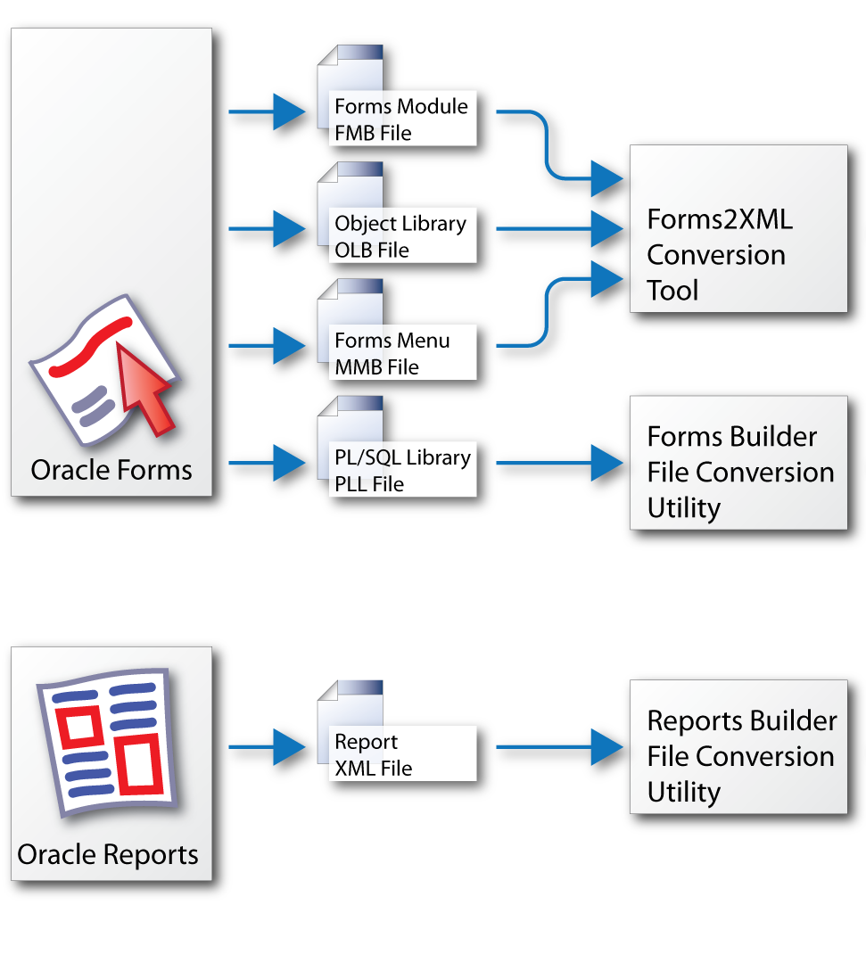
Converting Forms Source to XML
Use Forms2XML Command Line Utility
- Available with Forms 9i and above
OR Forms > Convert
- Available with Forms 12c and above
May convert older Forms versions
such as Forms 6i and 4.x
- If fails will need to upgrade Forms first

Slide 19
Creating APEX Application(s)
1
Use Create App Wizard for “First-Cut”
2
Enhance pages based on annotations
3
Use Create Page Wizard to add additional pages
4
Review with key stakeholders
5
Iterate and repeat from step 2
Notes:
Generate based on tables (not Forms)
Add business logic / improve UI
Add new pages as necessary
Involve SMEs regularly
Continually enhance

Slide 20
Practicing a Migration
  In order to play with the Oracle APEX Migration Project using a few Oracle Forms you can download the sample files below. Using the XML files you can upload them into a project and then review the trigger logic and annotate as necessary. After running the DDL script and inserting the data you can readily generate a simple application.
  https://www.oracle.com/technetwork/developer-tools/apex/application-express/apex-forms-conversion-sample-files-5654921.zip

Slide 21
Useful Links
Primary Site https://apex.oracle.com
APEX Forms Modernization https://apex.oracle.com/en/solutions/oracle-forms/
APEX Shortcuts https://apex.oracle.com/shortcuts
APEX Community https://apex.oracle.com/community
Database Cloud Services https://cloud.oracle.com/database
Oracle Learning Library https://www.oracle.com/oll

