Slide 2

Oracle APEX 18.1
Overview
Presenter’s Name
Presenter’s Title
Organization, Division or Business Unit
Month 00, 2018

Slide 3
Introduction
Oracle APEX

Slide 4



Oracle APEX
Database-centric web application development framework
Develop desktop and mobile web apps
Visualize and maintain
database data
Leverage SQL Skills and database capabilities
Notes:
Used to build desktop and mobile applications for the Oracle Database. Oracle APEX enables you to design, develop and deploy beautiful, responsive, database-driven applications, either on-premises or in the cloud.
Quickly build reports, forms, charts, calendars, etc. on top of the data in your database
IT Developers and "citizen-developers" who know a little SQL can readily build applications.
Oracle APEX can also take advantage of the large majority of Oracle Database features.

Slide 5


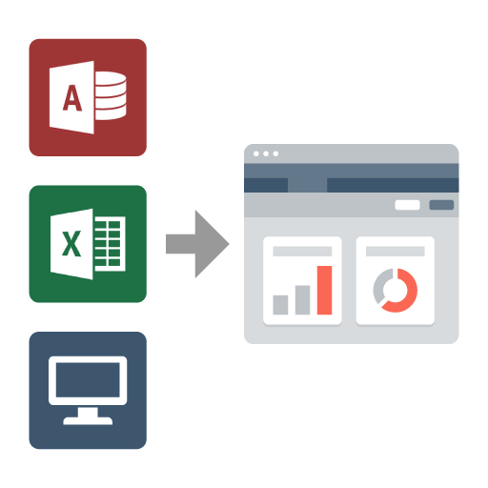
Oracle APEX
Use Cases
Developing opportunistic & self service web apps
Extending enterprise application solutions
Migrating file based and client server apps to the web
Notes:
Application Express is used by large and small customers alike, across a broad number of industries, and is used to solve a vast array of business problems - from simple spreadsheet replacement to multi-thousand user banking and insurance applications. Customers have also found APEX to be an easy way to extend the Oracle eBusiness Suite in a certified and supported fashion.
Widely used to rapidly build applications that are needed ASAP to meet changing business requirements and maximize competitive advantage.
Primarily designed to be used by all employees / partners / customers rather than back-office systems.
Used for extending COTS Software to streamline for your business processes or meet organization specific requirements
Webify spreadsheets and MS Access applications to provide true multi-user, secure, robust, “single-source of truth” applications.
Also commonly used to modernizing old legacy client-server applications
Visualize and maintain database data on desktop and mobile devices
Extending enterprise application solutions
Modernizing legacy applications
Webifying desktop tools and spreadsheets

Slide 6
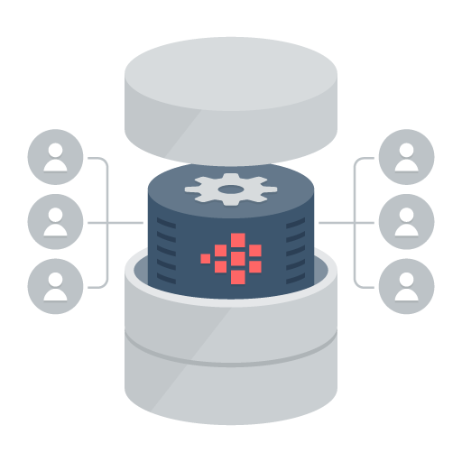
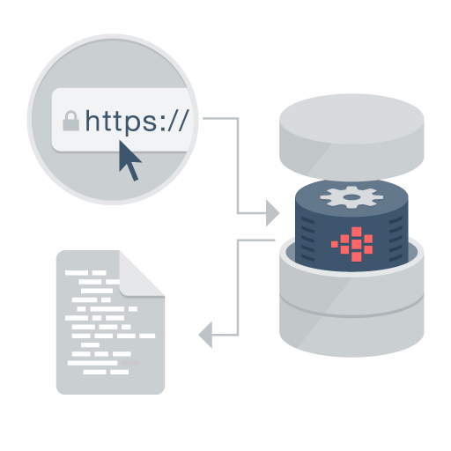

Oracle APEX
Distinguishing Characteristics
Page generation is efficient with only one request and one response.
Data processing done in the Database
App Development IDE is a web browser.
No client software needed
App definitions are stored in the database as meta data.
Declarative – No code generation
Notes:
Simply use a web browser and the URL to access the development environment, or the URL and user credentials to run the application
You don’t need any client software
Declarative framework stores application definitions in Oracle database tables within the APEX Engine
No need for file-based compilation or code generation
All of the data (page) processing is performed by PL/SQL acting directly on the data schemas in the Oracle Database.
Therefore, very efficient as data manipulated directly in the database and results sent back as HTML pages

Slide 7

Oracle APEX
No cost feature of the Oracle Database
No-cost fully supported feature
  Any number of apps, developers & end-users
  Specialized Oracle Support Team
  11gR2, 12c, 18c
  All DB editions: EE, SE, SE1, XE
Included with Oracle Cloud Services
  Schema Service
  Exadata Express Service
  Database as a Service
  No cost evaluation http://apex.oracle.com
Easy to install
  Included by default with all editions of Oracle database
  Download latest release from https://apex.oracle.com/otn
Notes:
Oracle Application Express is a feature of the Oracle Database with no licensing costs for development or deployment of Application Express applications.
The Oracle Database Maintenance Agreement also covers support for Application Express.
When you sign up for the ODCS – Schema Service you are provided with a slice of the Oracle Database with Application Express as the development environment (already pre-configured and ready to start developing with)
Application Express is released more frequently than the Oracle DB so important to get the latest version of Oracle Application Express from OTN.

Slide 8




Oracle APEX
  Rapidly develop, customize, and deliver
Pre-built controls for security, authentication,
database interaction, validation, session management
and more…
Go from prototype to production in minutes
Develop
Customize
Deliver
Notes:
At the core of Application Express is an engine that provides a variety of fundamental application capabilities and operations. Application authentication, page/object-level access control, database interaction (queries/updates etc), form validation, session management and protection, and more is available as standard components that can be utilised from every application without custom development.
Application objects such as forms, reports, charts, navigation etc are defined declaratively, enabling applications to be functionally complete in a short period of time, increasing agility in application development.

Slide 9





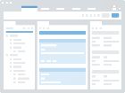







Oracle APEX
Low Code Data First Application Development
Develop Database
Develop Application
Deploy
Database
App Builder
Test Application
Production Application
Existing
Existing
New
New
Markdown
Wizard
Metrics & Feedback
Database
Model
Blueprint
Install & Upgrade
Export
SQL IDE
DML Script
Excel
Source Code Control
Notes:
The benefits of low code development are greater productivity in less time at less cost and with greater consistency. Low code frameworks, such as Application Express, leverage powerful components that provide reporting, data visualization, and form controls. This enables an application developer to focus on solving the business problem and delivering superior solutions, with less time and effort spent on mundane and repetitive lower-level coding typically associated with application development.
Go from idea to production in days not weeks or months
Step 1 – Develop your Database Objects
Step 2 – Develop your apps directly on top of the DB Objects
Step 3 – Deploy the app
Oracle APEX is a low-code, high-productivity platform -- meaning you can start building your first app immediately! There are no pre-requisites, no software to install, and best-of-all, you can get started for free!
Oracle APEX combines the qualities of a low code tool, productivity, ease of use, and flexibility with the qualities of an enterprise development tool, security, integrity, scalability, availability and built for the web.

Slide 10
Oracle APEX
High productivity AppDev components on the no code to highly programmatic spectrum
Components & Data Access
Component Library + Wizards
reports, charts, grids, forms, plug-ins
Component
Properties
SQL
Analytics, Multimedia
Text, Spatial
REST
Business Objects
Plug-in
Development
Navigation & Page Flow
Page Branching
Menu
Navigation
Lists Component
Drill Down
Links
Modal
Dialogs
Conditional Flows & Branching
Punch-outs and
Call Backs
Business Logic
Simple Validations
and Computations
Conditional Display Logic
PL/SQL
Snippets
PL/SQL
Access Control &
Session Management
Authentication
Automatic Session Management
Authorizations
Collections
Custom
Authentication
Browser Client Interaction
Drag & Drop
Layout
Input Fields
text area, select list, checkbox, switches, shuttle, radio group
Declarative Client Actions
JavaScript Snippets
3rd Party JavaScript
Programs + Library Integration
User Interface
User Interface Themes
Icon Library Integration
Declarative Styling
Declarative Theming
CSS Snippets
Template and Theme Development
HTML & CSS
No Code
High Productivity
Business Users
4GL Meta Data Properties
Low Code
More Control
Citizen Developer
Snippets and plugins
Programmatic
High Control
IT Professional
3GL Procedural Code / Libraries
Notes:
Oracle APEX provides a host of “no-code” capabilities which utilize wizards, drag and drop, and simple dialog selections to create an array of different components.
To build more advanced apps it may be necessary to enter small code snippets directly within a page, region, item, validation, or similar.
To meet even more extensive customization or personalization of your app it may be necessary to incorporate 3GL code or an APEX Plug-In.
Importantly as requirements get more advanced APEX development gets gradually more complex, rather than “dropping off a cliff” and requiring huge amounts of 3GL code as soon as go out of tight, pre-defined constraints for the apps.

Slide 11



Oracle APEX
REST, SOAP
3 Tier Architecture
Schemas
HTTPS
JDBC
APEX Engine
SQL & PL/SQL
Oracle REST Data Services
(Weblogic, Jetty, Tomcat)
Oracle Database
(Pluggable or Dedicated, 11g, 12c, 18c)
No Application Logic
Converts HTTP to database API calls
Zero latency database data access
Dynamically driven by APEX metadata
Browser
Mid Tier
Database Tier
Notes:
Simple architecture where page requests and submissions made from the browser are tunnelled through the mid-tier to execute in the Oracle Database and returned as HTML responses to the browser.
No data manipulation or processing is performed in the mid-tier, instead the APEX engine (inside the Oracle DB) accepts the page, and interacts with the data schemas in the DB.
The mid-tier can be either the preferred Oracle REST Data Services (ORDS) running in a Java Server {either Oracle Web-Logic Server (WLS), Oracle Glassfish, or Tomcat} or Oracle Embedded PL/SQL Gateway (EPG) which is part of the Oracle DB.
It is common for OHS to be installed in front of ORDS to act as a proxy and serve images.

Slide 12



Data Sources
Utilize the Oracle Database / ORDS / Web Services
REST, SOAP
HTTPS
Local Data Source
Oracle Database & APEX
Database Link
JDBC
Remote Data Sources & Services
JDBC
Enterprise Data Sources and Services
JDBC
Notes:
Oracle APEX is best suited to being co-located with the data it is maintaining / reporting on.
Oracle APEX provides the ability to execute SQL not only in the "local" Oracle database (where APEX runs in), but also on a remote Oracle instance. This is based on the REST Enabled SQL feature introduced with ORDS 17.4. When the REST Enabled SQL feature is active on an ORDS instance, SQL statements can be passed in JSON format using HTTP POST requests. Execution results are being passed back as a self-describing JSON response. Clients thus can communicate with the Oracle database using open protocols and without SQL*Net. A prerequisite for using REST Enabled SQL is to have at least ORDS 17.4 installed. Older ORDS versions (3.0.x) do not support REST Enabled SQL.
Oracle APEX provides declarative support for REST Services in Application Express components - that means, developers will be able to create a component, for example, an interactive report, directly on an external REST service. You can register an external REST Service as a Web Source Module in Shared Components and then use it as the data source for an interactive report or a classic report.
You can also integrate into a SOA environment by consuming Web Services (both REST and SOAP) or utilize DB Links to other databases.

Slide 13
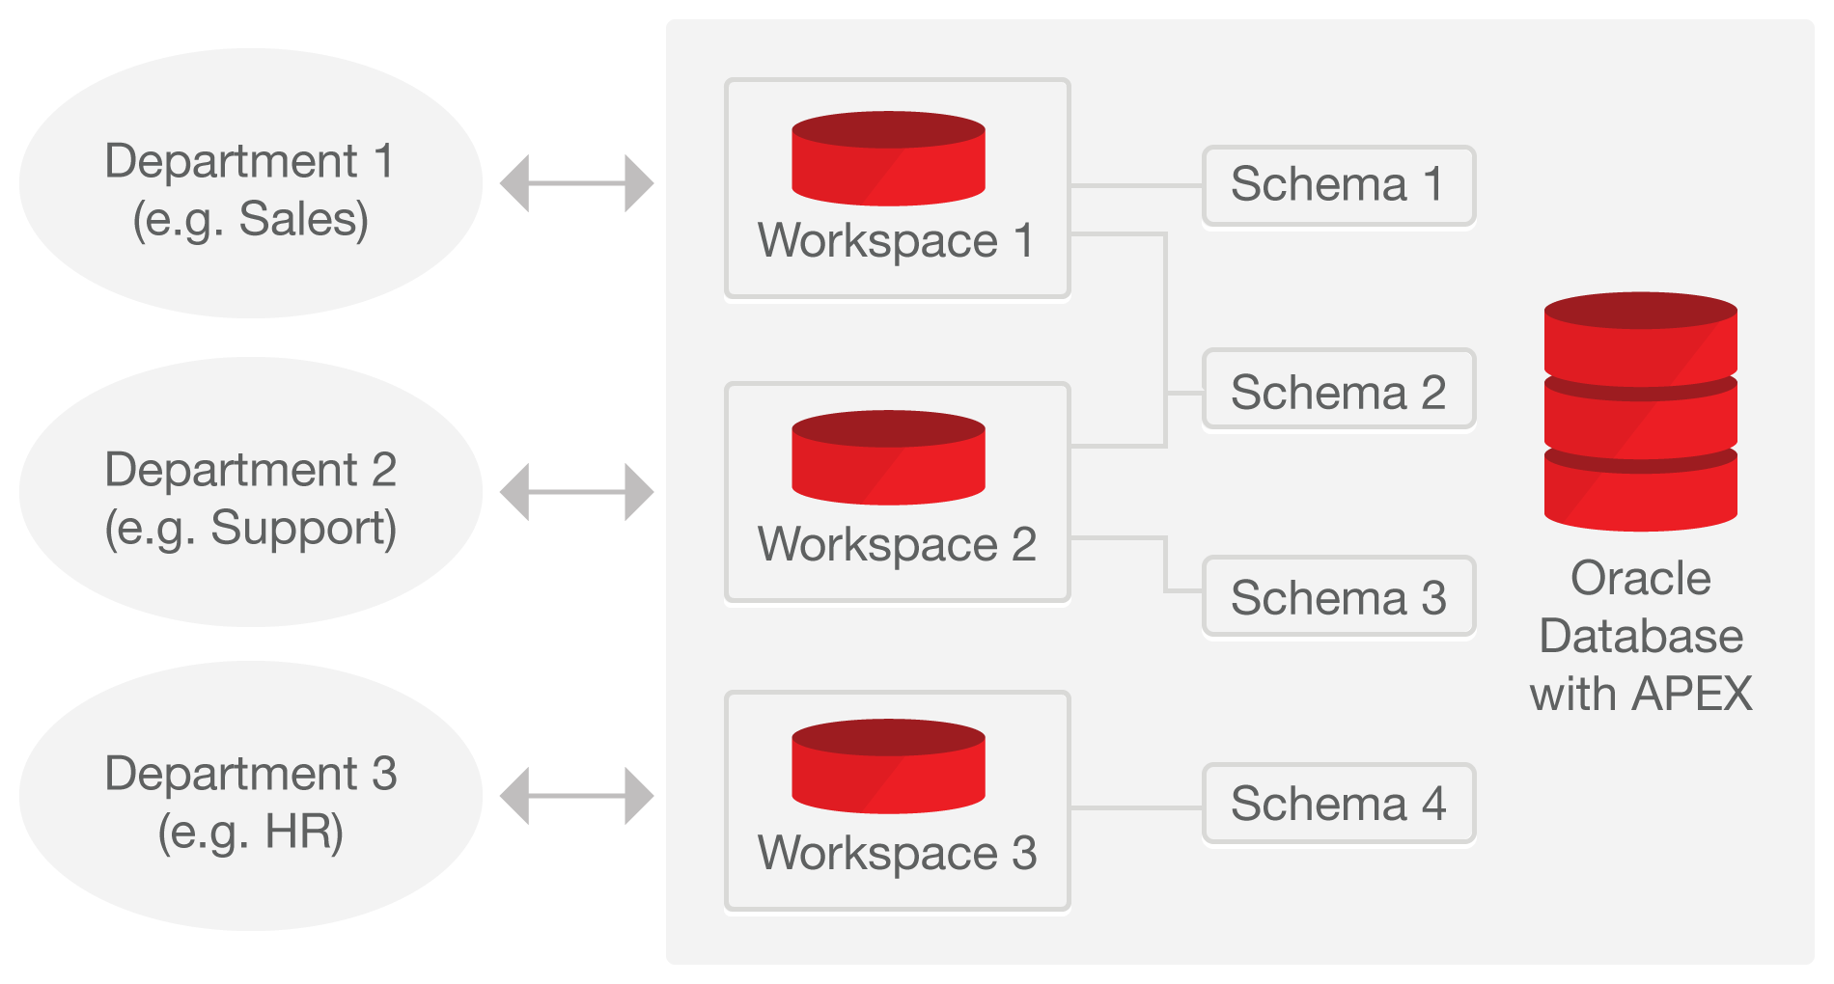
Single Database Instance / Multiple Workspaces
Easily managed with optional self-service provisioning
Workspaces used to define application definitions / Schemas hold data
Many-to-many relationship between Workspaces and Schemas
Instance Administrators manage the environment and schema access
Departments can request more space, and access to a new schema
For example, http://apex.oraclecorp.com
has over 4,000 Workspaces for every line of business in Oracle
Notes:
There is a many-to-many relationship between workspaces and schemas
Within your organization you can have a single Oracle Database support many departments with each having their own workspaces where they build applications
Each of these workspaces can be granted access to one or more schemas as appropriate
DBAs manage the infrastructure <--> Departments responsible for building their own applications

Slide 14



Development / Deployment Options
Local
Install on stand-alone laptops using Oracle Express Edition (XE) or full database version
Simply upgrade APEX to the required version
Can work completely disconnected
On-Premise
Typically run by the IT Department
IT generally both production operations service, and a service provider
Departments responsible for application development
Cloud
Deploy Internet applications
Leveraged for fast application development, user acceptance and training.
Prototyping & Proof-of-Concept
Consulting companies develop for deployment on customer premise
Browser based application development framework enables efficient development & deployment
Shoot someone a URL – Check this out – Application Development
Notes:
Given APEX can run ‘anywhere you can install the Oracle Database’ you have great flexibility → Simply provide the appropriate URL to develop / run applications
Import an APEX application into any other Oracle Database where you have the same version or later of Application Express installed
Start developing on your laptop running Oracle XE or on the cloud and then simply export the application
Deploy on the Oracle Database Cloud Service and then once your application gets wide utilization move it to your private cloud.

Slide 15


Oracle APEX
History
5.0
Page Designer (PD)
Universal Theme
Modal Dialogs
5.1
2016
Interactive Data Grid (IG)
JET Charts
Live Template Options
Improved Universal Theme
Font APEX
Improved Packaged Apps
3.0
Flash Charts
PDF Printing
Access Migration
Tabular Forms
1.5
HTML DB
1.5 - First Release
1.6 – Themes
Hosted free service
apex.oracle.com
3.1
2008
Interactive Reports (IR)
Exadata Express
Cloud Service
Schema
Service
3.2
2009
Oracle Forms to APEX
Conversion
2004
2005
2006
2007
2008
2009
2010
2011
2012
2013
2014
2015
2016
2017
2018
2.0
SQL Workshop
2.1 - Oracle XE
2.2 - Dictionary Views
4.0
Websheets
Dynamic Actions
Plug-Ins
Team Development
4.1
2011
Data Upload
Error Handling
ROWID
4.2
2012
Mobile with JQuery
HTML 5
Packaged Apps
18.1
Create App Wizard
REST & Remote SQL
Oracle JET upgrade
New REST Workshop`
Notes:
<David: To fix the graphic>
Originally named HTML DB when first released.
The current release of Oracle APEX is APEX 18.1, consistent with the release numbering for the Oracle Database as well as Oracle REST Data Services and Oracle Cloud services.
Coincidentally, it has been a little over 18 years since the first line of code was written for APEX. Throughout this time, we have always strived to empower developers with the tools they need to build modern apps fast, with less effort, and with greater consistency.
See Statement of Direction for future direction on OTN under Learn More
[http://www.oracle.com/technetwork/developer-tools/apex/application-express/apex-sod-087560.html]

Slide 16
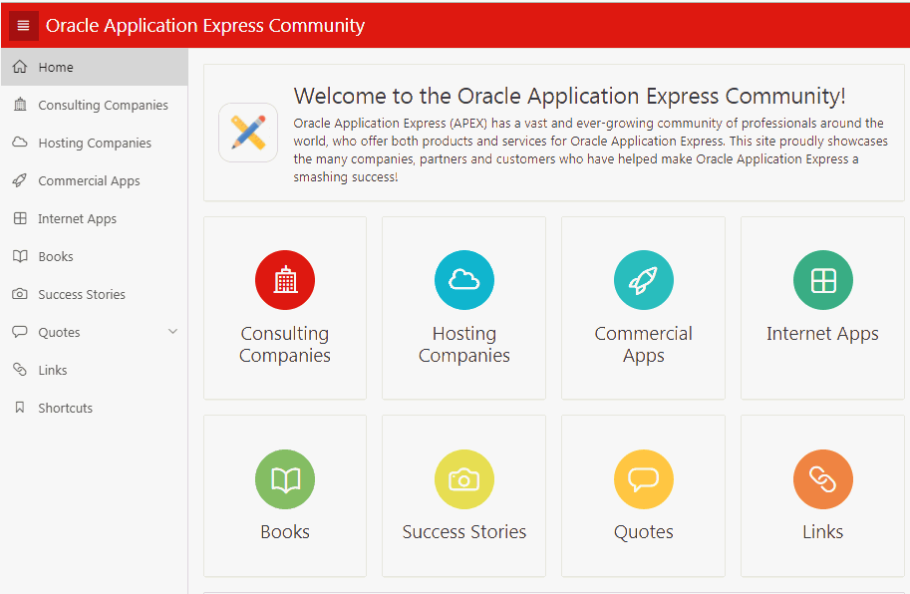
Oracle APEX
Community
Over 500,00 developers worldwide
  Estimated from support requests, downloads, conferences, discussion forum activity
More than 100 active bloggers
http://odtug.com/apex
http://apex.oracle.com/community
Consulting companies, books, success stories, quotes, commercial apps
Notes:
Feeling stuck? want to learn more? share your success? or meet with other like-minded developers? There's everything from books, discussion forums and community-driven websites to local meet-ups and worldwide conferences to cater to your every APEX-related need! Check out our community site, apex.oracle.com/community, for much much more!

Slide 17
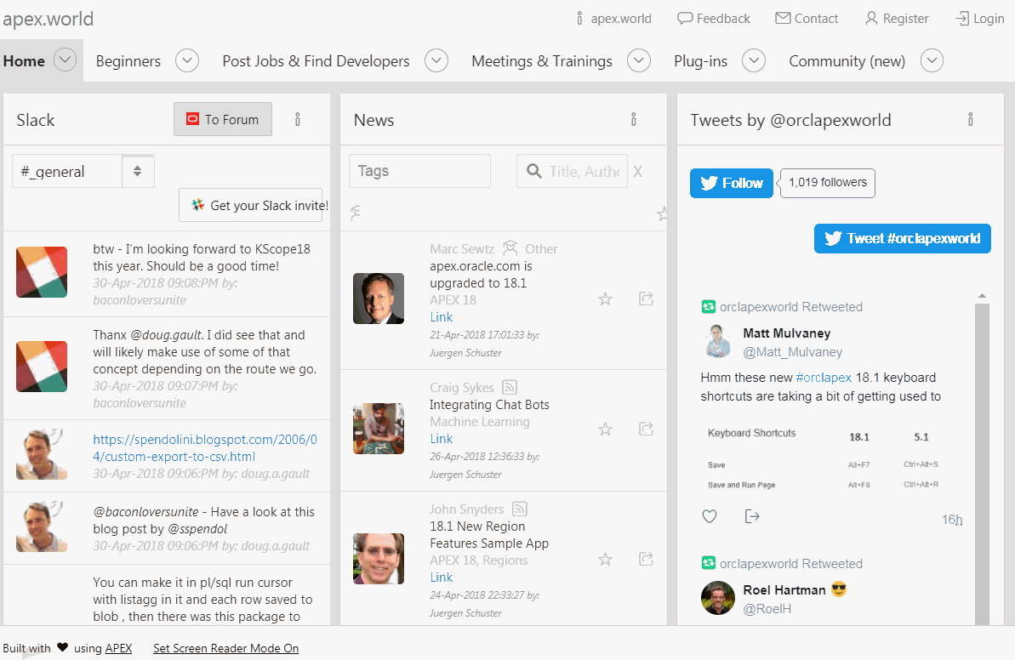
http://apex.world
Oracle APEX
Community site built by the community for the community
Community-authored site providing:
  Plug-ins
  Slack discussion channels
  Twitter feeds
  News
  Jobs
  Conferences
  Meetups

Slide 18
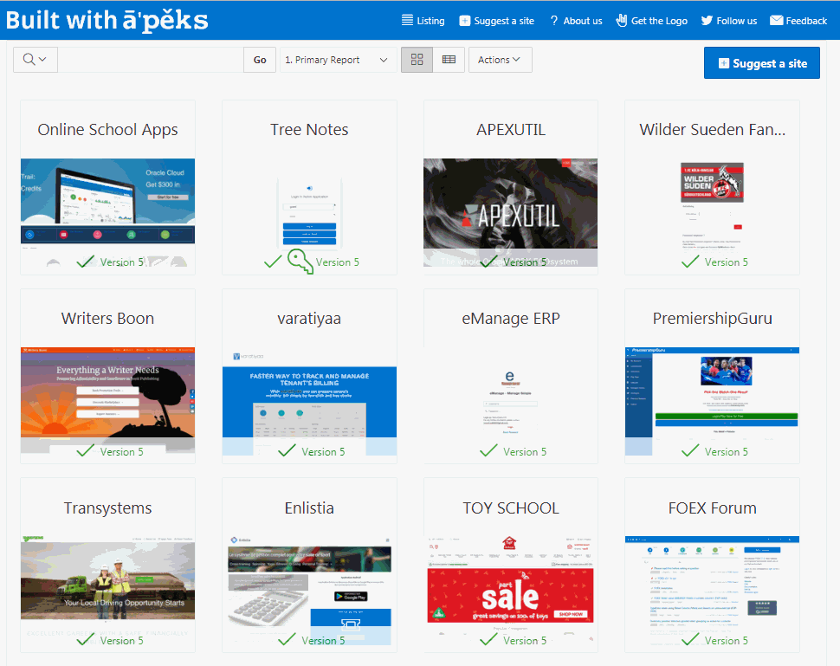
http://builtwithapex.com
Oracle APEX
Internet Sites built with Oracle APEX
Showcases large diversity of types of applications and different themes
Launched October, 2016
> 130 sites published, more being added daily

Slide 19
Useful Links
Collateral, Resources and Hosted Services
Free APEX Service https://apex.oracle.com
Oracle Technology Network https://apex.oracle.com/otn
APEX Community https://apex.oracle.com/community
APEX & Low Code https://apex.oracle.com/lowcode
Quick SQL https://apex.oracle.com/quicksql
Database Cloud Services https://cloud.oracle.com/database
Oracle Learning Library https://www.oracle.com/oll
Oracle APEX Education https://apex.oracle.com/education
Notes:
These are the primary URLs you need to get more information on Oracle Application Express!

Slide 20
Product Components
Oracle APEX
Notes:
Overview of the major APEX Components – What is included in the tool at a high level

Slide 21
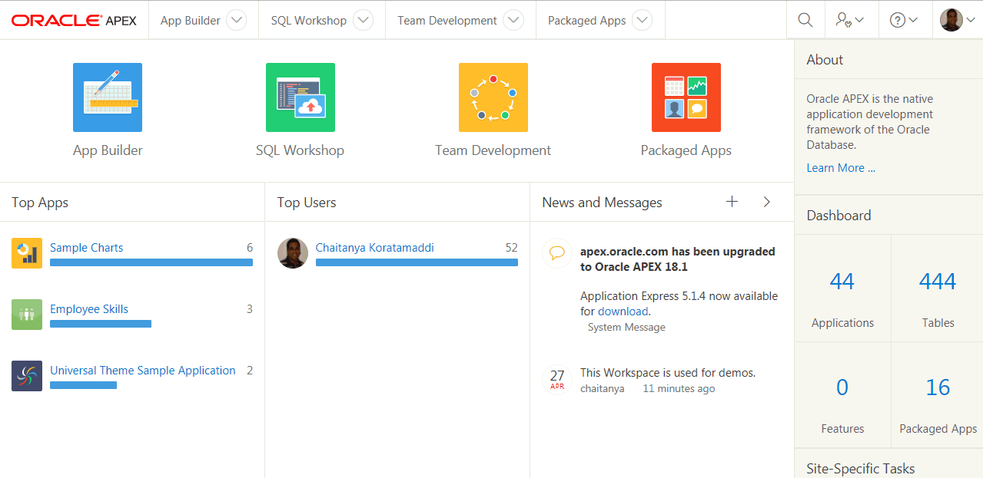
Home Page
Comprehensive Development IDE, Web Application Development, and SQL Database Development
Notes:
Home page where developers can define applications, maintain their database objects, manage the development lifecycle, and maintain Packaged Apps.

Slide 22
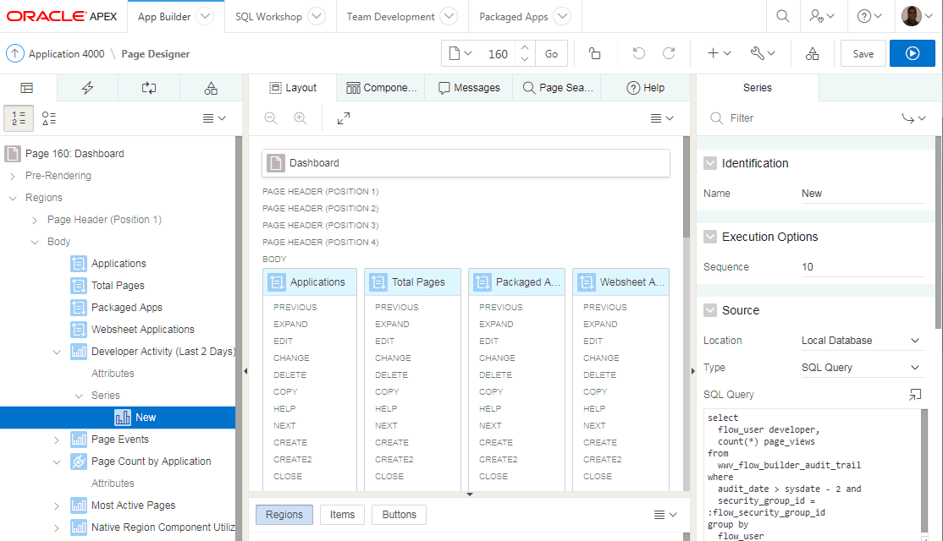
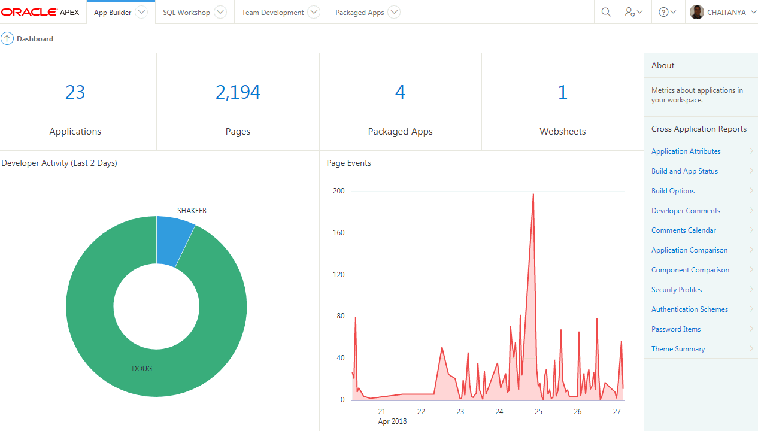
App Builder
Integrated Development Environment (IDE) with Application Development Graphical "Page Designer"
Features tight SQL and PL/SQL integration
Notes:
Developers will spend the majority of their time in the Application Builder defining, enhancing and maintaining applications.

Slide 23
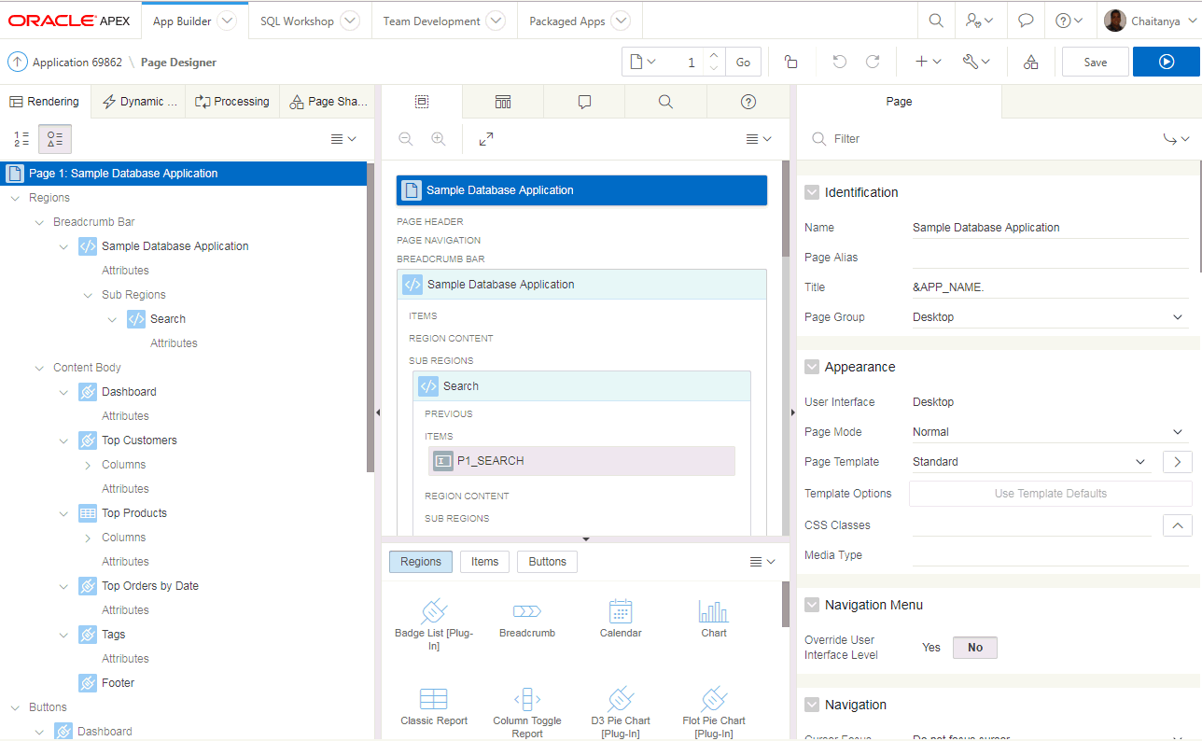
App Builder - Page Designer
Notes:
Design Principles
Create new elements using drag & drop or menu shortcuts
Update multiple page elements at once
Utilize “Undo” and “Redo” to revert changes made
“Save” and “Run” commits all pending changes to database
Left Pane
Rendering, Processing and Shared Components grouped in an accordion in the left panel instead of horizontally across the page
Dynamic Actions introduced as a new grouping
Create, move and duplicate elements using drag & drop or the improved context sensitive menus
All element types can be deleted directly from the tree
Click on one or more elements to highlight elements in the Grid Layout and to populate common element details in the Property Editor
Central Pane
Grid Layout: Create, move, copy and delete components using drag and drop
Gallery: shows components that can be dragged into the page
Messages: Display errors and warnings associated with changes made
Page Search: Allows performing a page search.
Help: Displays context sensitive help based on the current focus
Property Editor - Right Pane
Displays the details for the currently selected element(s)
Bulk editing of common properties when multiple elements are selected
Improved usability for defining properties, including
instant input feedback
cascading context sensitive selections
easier definition of common property types
Improves productivity by making the definition of elements easier and more intuitive

Slide 24
App Builder - Page Designer
Powerful browser-based IDE
Multiple trees to view the page components
Visualization of the page within the Grid Layout, and associated Gallery, allowing you to drag and drop components
Update multiple attributes without leaving the page in the Property Editor
Advanced Code Editor for defining SQL, HTML, CSS and text sections
Highly configurable user interface:
  Customize and refine view of page specific to current focus
  Slideable panels
  Drag and drop tabs
Notes:
Page Designer revolutionizes the way developers can enhance and maintain page definitions within Application Express.
The left pane has numerous trees to show the rendering, dynamic actions, processes and shared components.
The middle pane includes the Grid Layout and Gallery where you can easily drag and drop new components
The right pane holds the Property Editor where you can update any of the select4ed components’ attributes, without needing to bring up a separate page
For text sections used to enter SQL, HTML, CSS or text you can pop-up the Code Editor which includes find/replace, auto-completion and even SQL validation
There are numerous ways you can customize the user interface to make it easier to concentrate on the sections you are currently working on.

Slide 25
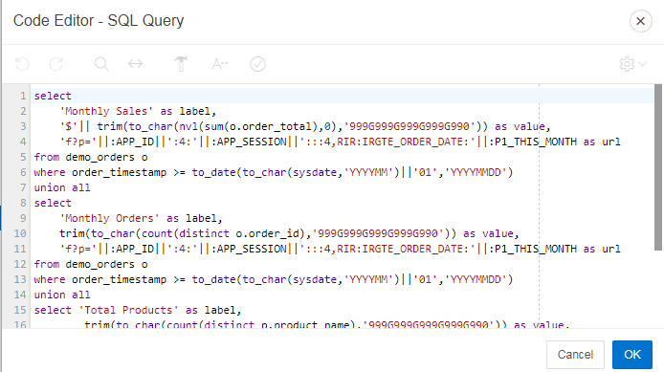
App Builder – Code Editor
Available for maintaining SQL, PL/SQL, JavaScript, HTML, CSS, and large text sections
Syntax Highlighting
Undo / Redo
Find/Replace
Auto completion
Code validation
Used in Page Designer,
Component View and
SQL Workshop
Notes:
Developers will spend the majority of their time in the Application Builder defining, enhancing and maintaining applications.

Slide 26

App Builder - Universal Theme
Overview
Default theme for Oracle APEX applications
Uses responsive HTML5 templates
Grid-layout for HTML forms
Modern flat-look
Ships with a variety of pre-built theme styles
JQuery Mobile Apps can be transitioned to Universal Theme
Notes:
Rather than having numerous themes with a large number of templates in each, there is just a single desktop theme and a consolidated number of templates.
With the Universal Theme it is quicker and easier to build beautiful, responsive, elegant applications out-of-the-box.
In Oracle APEX 18.1, jQuery Mobile and the jQuery Mobile User Interface used in previous releases have been desupported. If you have an existing mobile application that uses the jQuery Mobile User Interface, you should migrate your existing application to the Universal Theme.
Universal Theme is designed to be responsive, so it will look and feel great on any screen size device. For apps that are primarily designed for use on small screen devices, APEX 18.1 introduces three new region types that were ported from the jQuery Mobile User Interface: List View, Column Toggle Report, and Reflow Report.

Slide 27
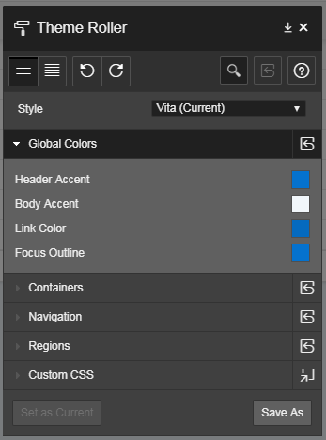
App Builder - Universal Theme
Theme Styles and Theme Roller
Theme Styles provide a variety of different color schemes and styles for a single theme
Defined as CSS file that is included in addition to the theme’s base CSS file
Universal Theme includes several pre-built styles
Additional styles can be easily generated using the built-in Theme Roller utility
Notes:
Theme Styles allow a single theme to have various color schemes.
Developers can readily define different color schemes and modify certain display characteristics, such as button and item rounding using Theme Roller.
They can then readily save the style and apply it to their application without needing to write any CSS.
Developers can even allow end-users to select different styles as shown in P-Track Administration.

Slide 28
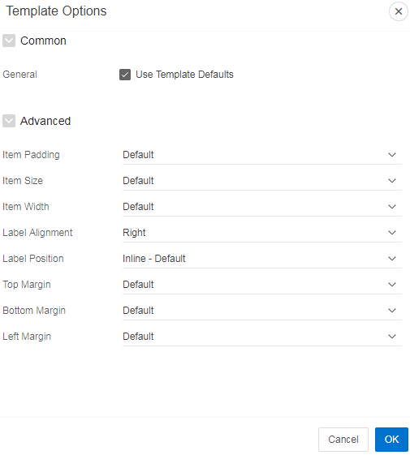
App Builder - Universal Theme
Template Options
Declarative CSS modifiers for HTML5 templates
Enables developers to declaratively apply styles
like borders, padding, icons, colors, size, etc.
Uses easy-to-understand, descriptive names
Available for most template types:
  Page, Region, Report, Breadcrumb, List, Item, Button
Significantly reduces the number of required
templates for a theme
Notes:
Rather than having a large array of different templates, and developers needing to define new templates, to meet how a page is displayed - you can declaratively select different template options to easily meet your layout requirements.

Slide 29
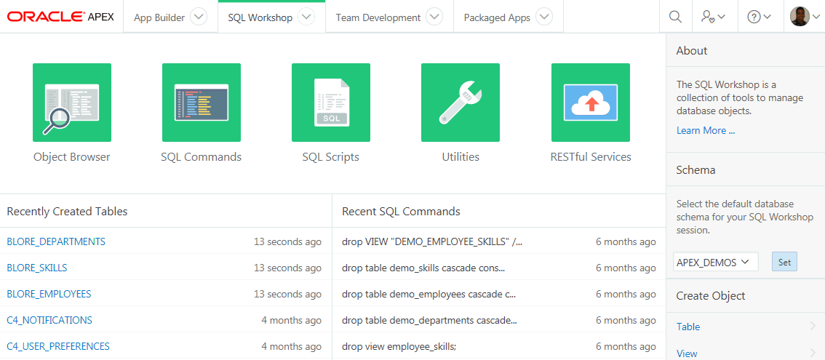
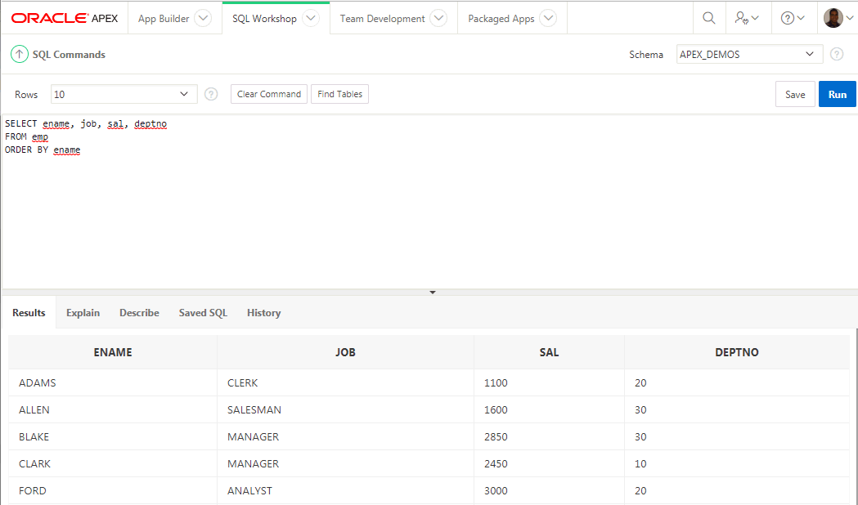
SQL Workshop
Browser based maintenance of database objects and data
Designed to meet application developers’ needs, especially in hosted environments
Notes:
SQL Workshop is sometimes the only means developers can maintain DB objects as they may not have direct access to the schema(s) via SQL*Net, especially if they are using a hosted service.
The functionality available through SQL Workshop is a subset of SQL Developer and is designed specifically for developers to be able to maintain their DB objects.

Slide 30
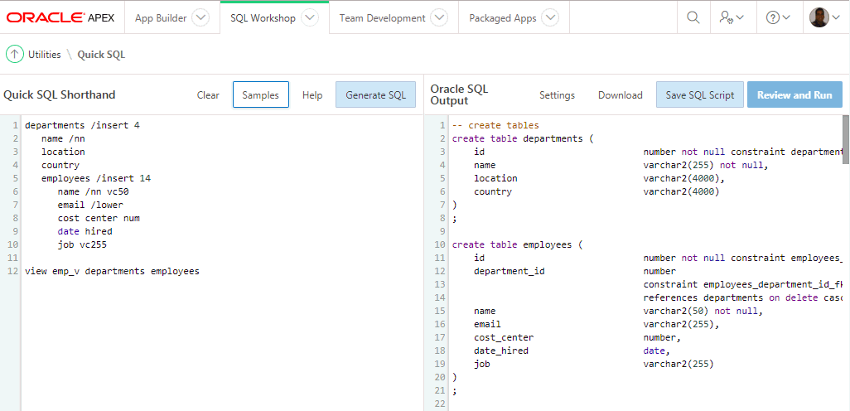
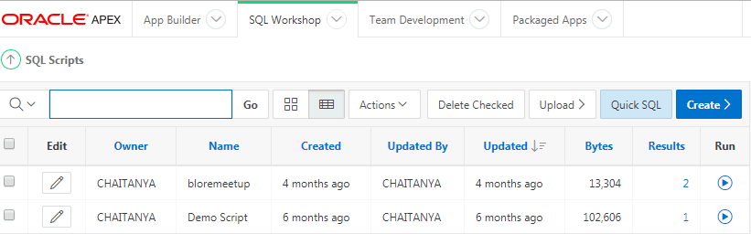
SQL Workshop
Quick SQL
Rapidly design and prototype data models using a markdown-like shorthand syntax that expands to standards-based Oracle SQL.
Notes:
Quick SQL is designed to reduce the time and effort required to create SQL tables, triggers, and index structures.
Quick SQL is not designed to be a replacement for data modeling. It is simply a quick way to develop a script for simple tables and views. Once the SQL is generated it can be tweaked and expanded upon. Quick SQL provides a quick way to generate the SQL required to create a relational data model from an indented text document. You can easily create master detail relationships, check constraints, and even generate sample data.

Slide 31
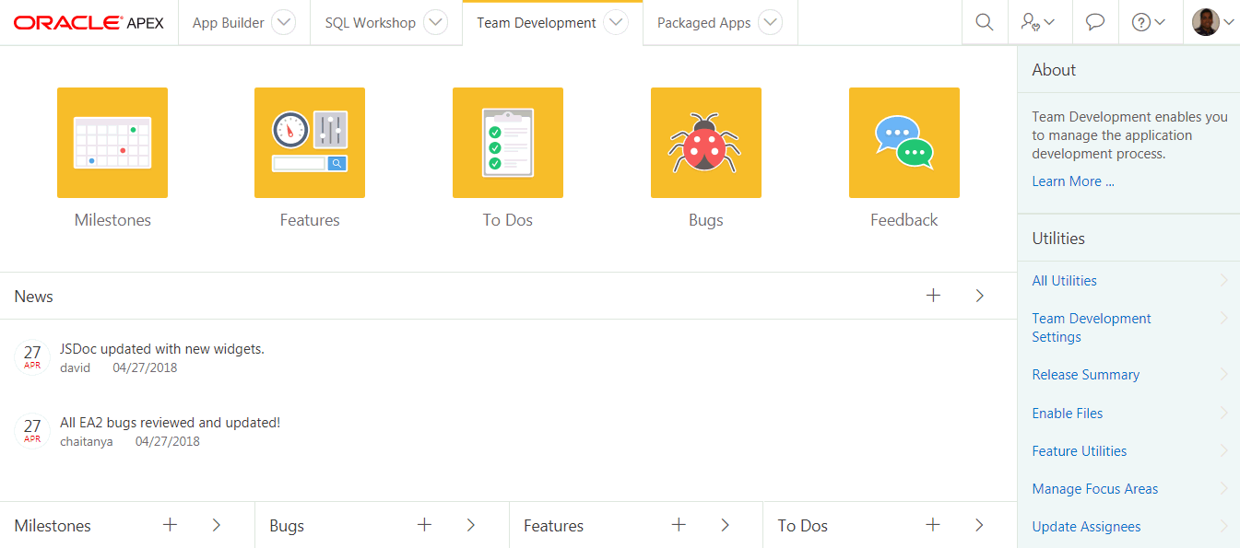
Team Development
Collaborate with colleagues, track project details with associations to application pages.
Life cycle development: design, develop, deploy, view customer feedback, enhance, re-deploy.
Notes:
Team Development provides the ability to manage the full lifecycle of your application development.
Features, To-Dos, and Bugs can be assigned to specific applications and pages.
Feedback allows developers to easily gather comments, enhancements, and bugs directly from their user community and includes important session state information to assist the developers with diagnosis.
Team Development is used extensively by the APEX Development Team to manage the development of new releases of Application Express which itself is built with APEX.

Slide 32
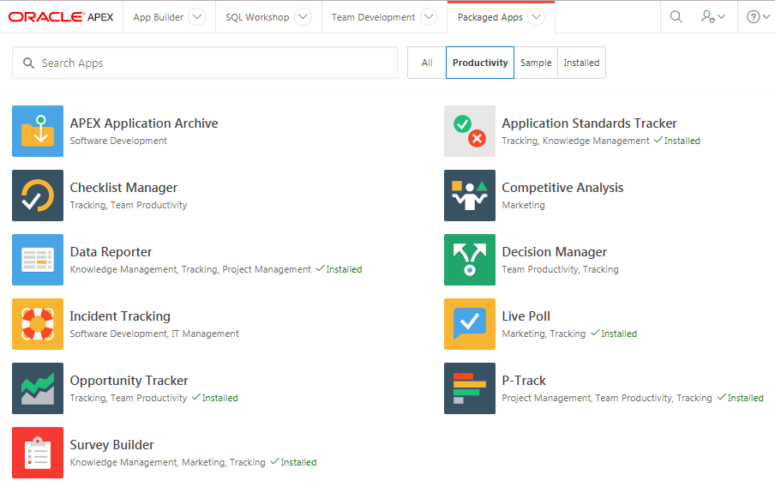
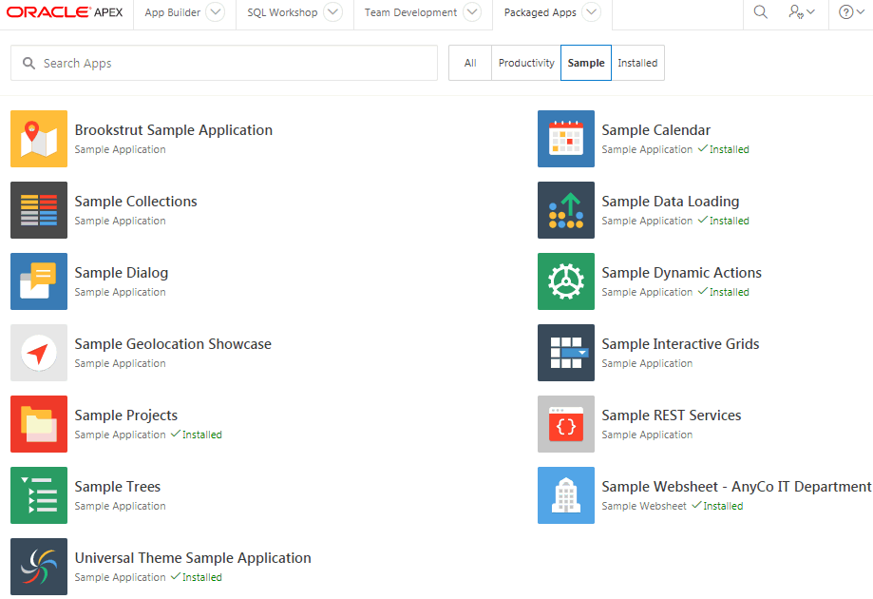
Packaged Apps
Robust suite of productivity and sample applications.
Illustrates best practices and design patterns.
Template to start customization (e.g. unlock your packaged app).
Upgraded with every release.
Notes:
Team Development provides the ability to manage the full lifecycle of your application development.
Features, To-Dos, and Bugs can be assigned to specific applications and pages.
Feedback allows developers to easily gather comments, enhancements, and bugs directly from their user community and includes important session state information to assist the developers with diagnosis.
Team Development is used extensively by the APEX Development Team to manage the development of new releases of Application Express which itself is built with APEX.

Slide 33
Features
Oracle APEX
Notes:
Breakdown of major feature functions within Oracle APEX

Slide 34
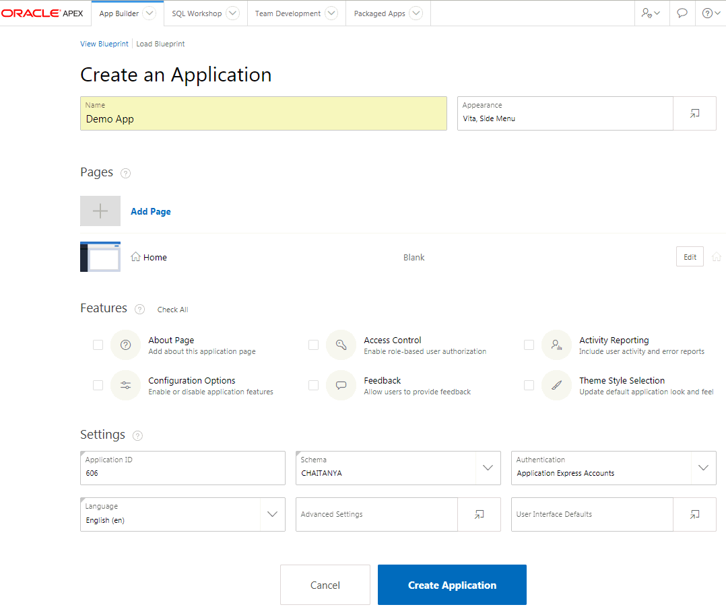
Create Application Wizard
Low Code Development
Simpler and modernized wizards for creating pages.
Allows creation of more advanced pages such as Dashboards, Master-Detail, etc.
Supports adding common frameworks or "Features" when creating an application such as access control, activity reporting, theme selection, and more
Customize user interface options such as Theme Style, application icon and page icons

Slide 35
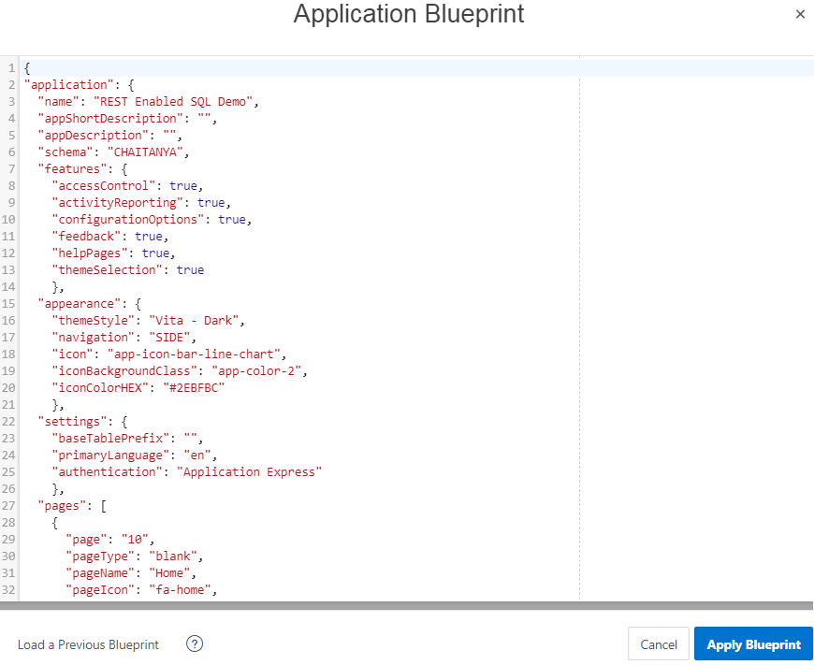
Create Application Wizard
Blueprints
Blueprints represent an application definition in JSON format.
The Blueprint editor allows for editing the JSON based definition and updating application properties.
Copy & paste the JSON code of one page to quickly create a large number of similar pages.
Blueprints of previously generated applications can be loaded again to iterate the application design.

Slide 36
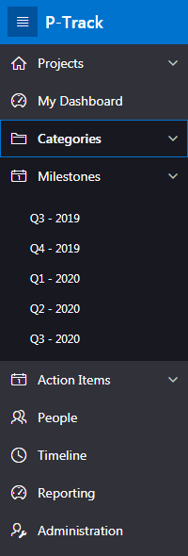
List-based Navigation Menus
Alternative to using traditional tabs
Available as top navigation menu and side menu
Implemented as standard APEX lists
Supports multi-level hierarchical menu structures
Provides accessible pull-down menus
Notes:
Oracle APEX includes the ability to define Navigation Lists. Multi level drop-down menus can be based on either static or dynamic lists.

Slide 37
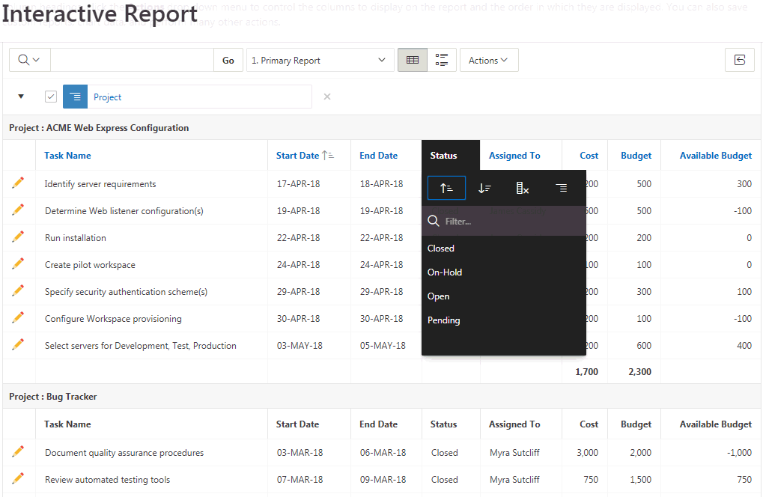
Interactive Reports
Powerful Reporting capabilities → End-user customizable
Notes:
Developers define the base report using a SQL statement.
Then end-user have can readily manipulate the data displayed to meet their own reporting requirements.
They can add filters, computations, aggregations, highlights and breaks.
End users can also define charts, group-by and pivot reports based on the data.
The Oracle Database option Audit Vault replaced 300 reports with just 30 Interactive Reports, yet provided a huge increase in reporting features.

Slide 38
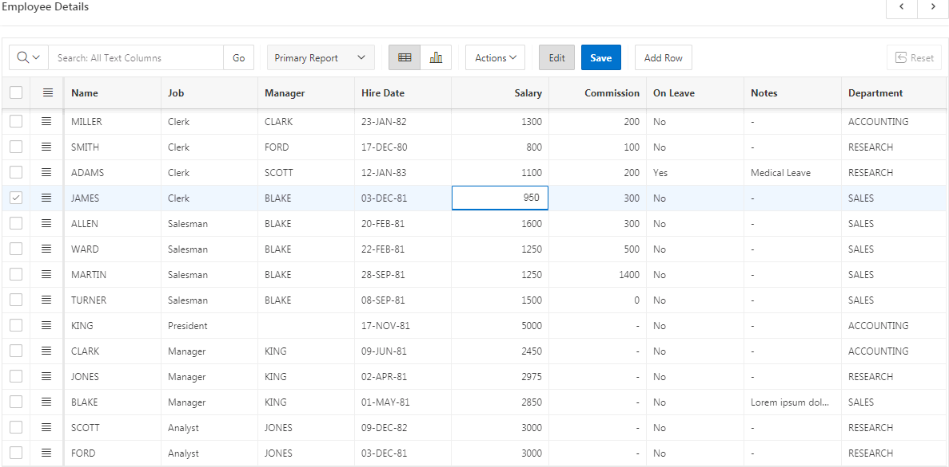
Interactive Grid
Modern, rich & interactive multi-row editing component
Use of existing Item types
Declarative support
for Cascading LOVs
and Dynamic Actions
Upgrade utility for
Tabular Forms
Master Detail / Detail
Notes:
An interactive grid presents users a set of data in a searchable, customizable report. In an editable interactive grid, users can also add to, modify, and delete the data set directly on the page.
Interactive Grid includes numerous capabilities for changing how the data is displayed.

Slide 39
Interactive Grid
Master Detail Layout – N-levels wide or deep

Slide 40

Charting Engine
Declarative support for Oracle JET Data Visualization Components
Based on Oracle JET Data Visualization Components
Oracle Jet (JavaScript Extension Toolkit) is open source
JavaScript-based solution, data being provided in JSON format
Highly Customizable
  Using 'JavaScript code' to provide function to be called when chart is initialized
  Using Dynamic Actions to add interactive behavior
Built-in Accessibility Support
Built-in Responsive Design Support
Notes:
The data visualization engine of Oracle APEX is powered by Oracle JET (JavaScript Extension Toolkit), a modular open source toolkit based on modern JavaScript, CSS3 and HTML5 design and development principles. This JavaScript charting solution is highly customizable, accessible, interactive, and incorporates automatic responsive design support. With Oracle JET integration into Application Express, you can now build charts that are beautiful, fast, highly customizable, and extremely versatile. The Oracle JET data visualization components include customizable charts, gauges, and other components that you can use to present flat or hierarchical data in a graphical display for data analysis.

Slide 41





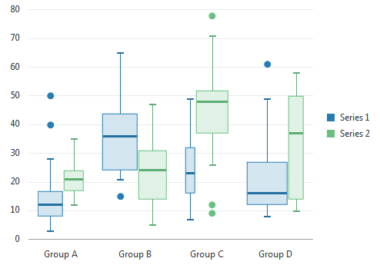


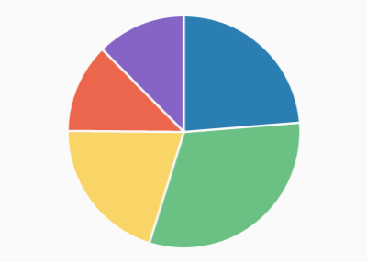
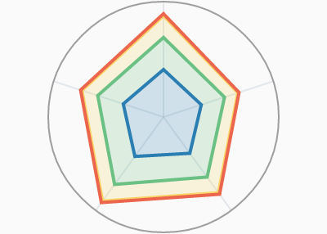


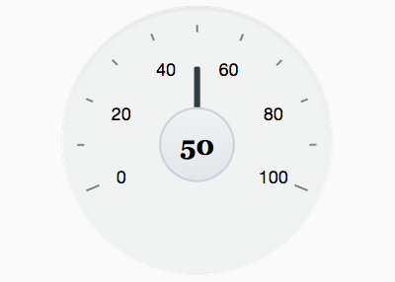
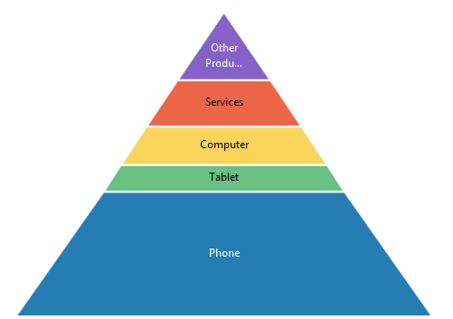

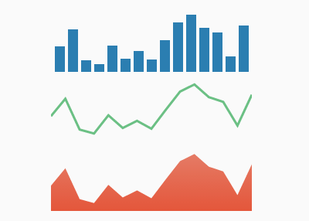
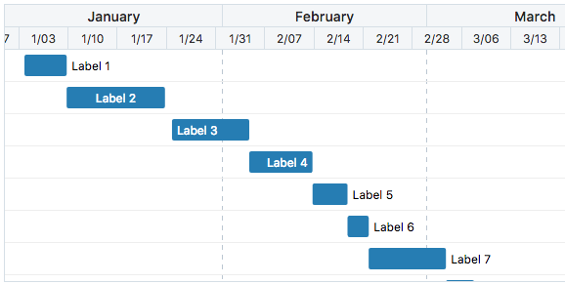
Charting Engine
Declarative support for Oracle JET Data Visualization Components

Slide 42
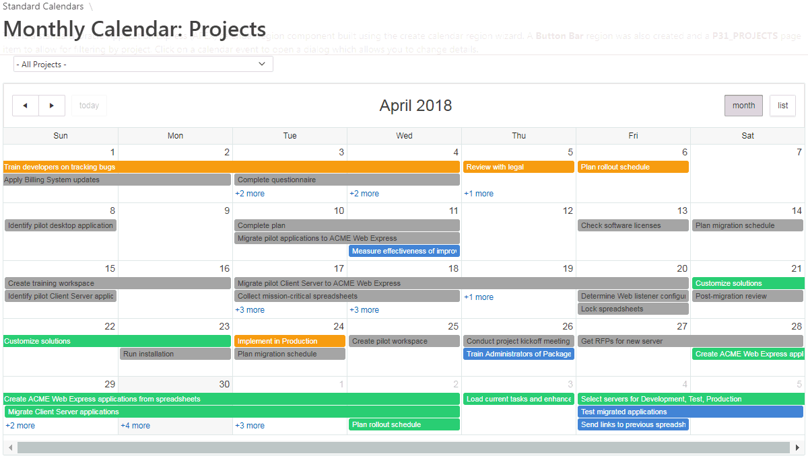
Calendars
Different views, drag and drop capability
Notes:
The built-in Calendar region is based on FullCalendar.
You can define duration based events and use drag and drop to update the underlying table directly from the calendar.

Slide 43
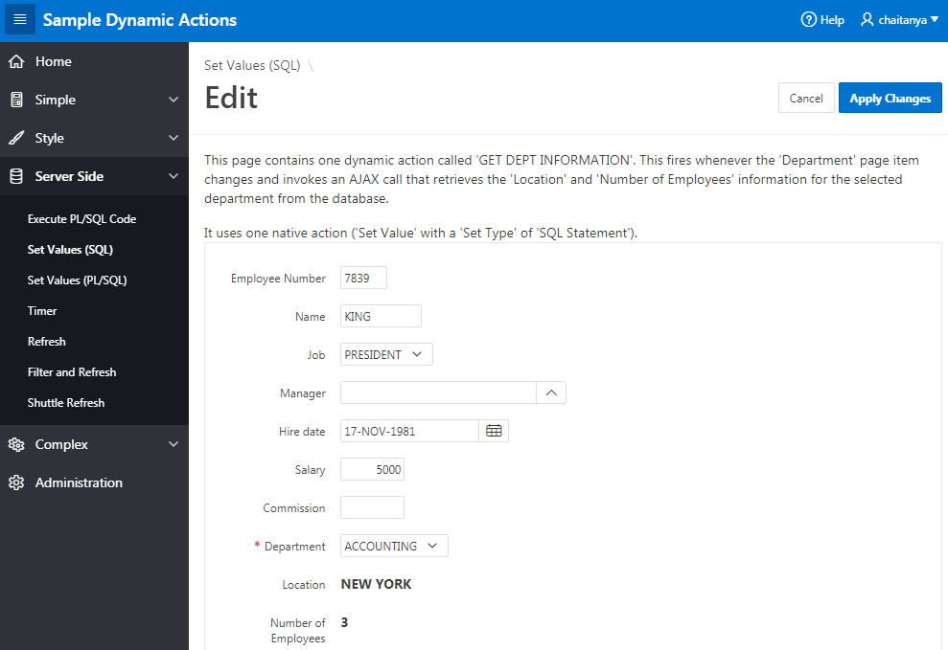
Dynamic Actions
Declaratively define rich client-side interactivity without writing JavaScript or AJAX
Notes:
Not every developer is an expert in JavaScript and AJAX, in fact the majority do not have that skillset.
However, Dynamic Actions allow anyone to *declaratively* define client side behaviors.
Rather than writing numerous lines of JS developers can simply enter conditions, specify the actions, and then select the elements affected.
Behind the scenes the APEX engine defines the required JS and AJAX to implement the desired behavior.

Slide 44
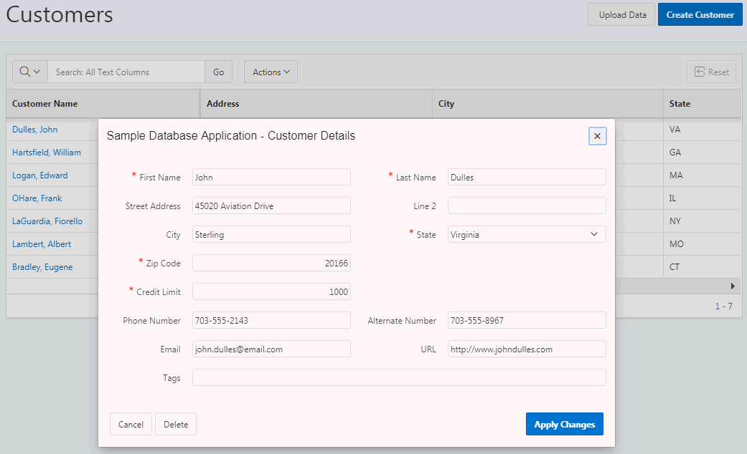
Modal Dialogs
Readily switch between normal, modal, and non-modal page mode
Replacement for Popup Windows
A modal dialog is a stand-alone page, not a region on a page
Any page be created as a dialog page
Supports all the functionality of a regular page, incl. computations, validations, processes, and branches
Notes:
Customizable dimensions and positioning
Dialog pages can branch to full pages (close dialog and standard branch) or to other dialog pages (e.g. wizard)
Dialog pages can open other dialogs (stacked dialogs)
Dynamic actions on parent pages created to refresh content after closing of modal dialog form

Slide 45
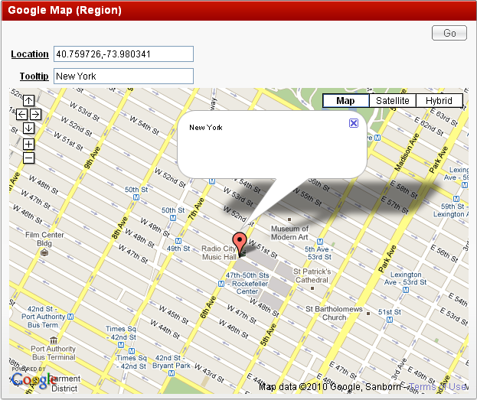

Plug-Ins
Extend applications with custom components such as items and regions
Notes:
Plug-ins allow you to readily incorporate custom item types, regions, authentication, authorization, and dynamic actions.
There are a number provided by the APEX Development Team, and over 150 developed by developers from the APEX Community.

Slide 46
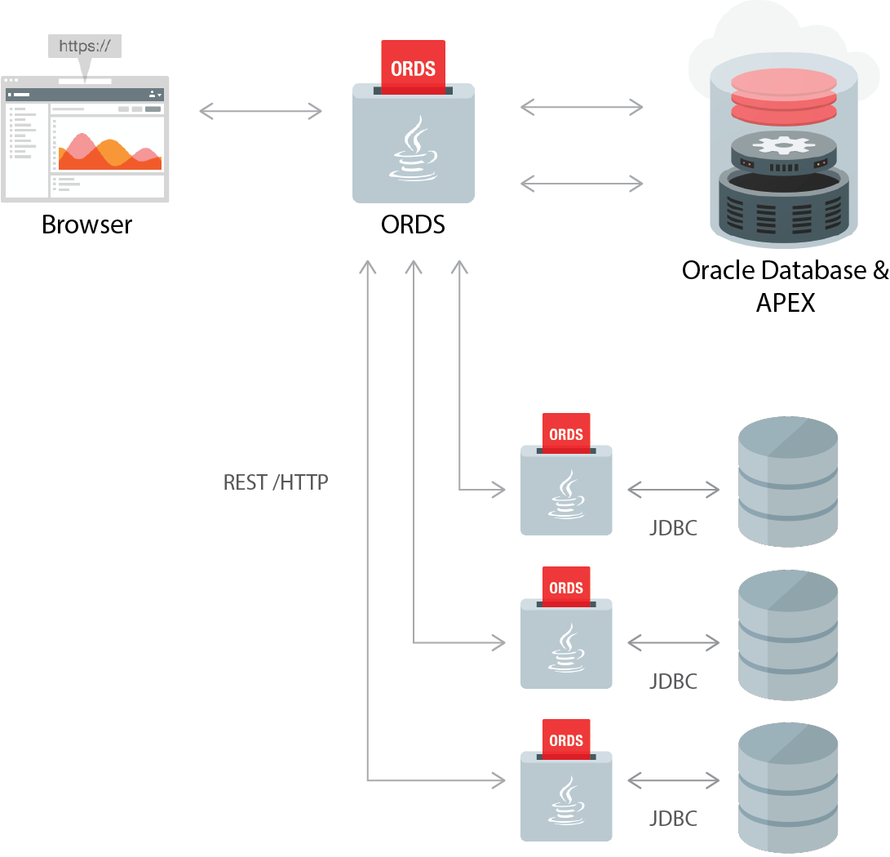
REST Enabled SQL Support
Remote Database Connections
Executing dynamic SQL or PL/SQL on
remote databases using ORDS and REST
  Relies on the ORDS "REST Enabled SQL" feature (ORDS 17.3 or later)
  Requires ORDS instance having a connection pool configured for
  target database.
Oracle APEX passes SQL query to ORDS over REST
Self-describing JSON response
Response contains a JSON object with:
  Result set meta data (column names, data types)
  The result data
  Information about pagination
Notes:
APEX can access data not only from the local database, but also from remote Oracle databases (using REST Enabled SQL) and from arbitrary REST services. APEX components are just built on top of these remote data sources. Plug-In developers can leverage the REST Enabled SQL Support as well.

Slide 47
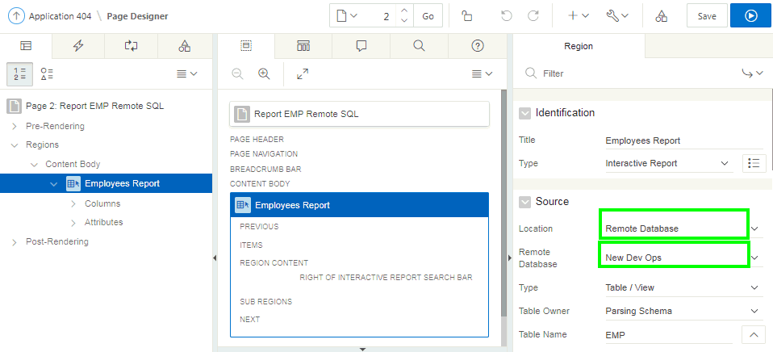
REST Enabled SQL Support
Using Remote Database Connections in Oracle APEX
Create and maintain References to REST Enabled SQL Instances (Oracle REST Data Services) in Shared Components: A name, Endpoint URL, and Authentication information
Use a REST Enabled SQL Service and therefore a remote Oracle database as the Data Source for Oracle APEX components
like:
  Classic Reports, Interactive Reports
  Reflow Report, Toggle Columns Report
  Tree Region, JET Charts
  CSS Calendar
  PL/SQL Process

Slide 48
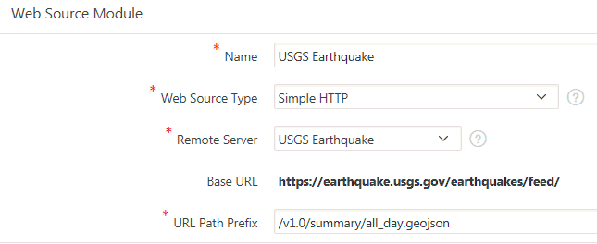
Consuming a REST Service
Web Source Modules
Oracle APEX 18.1 introduces a new data source type called "Web Source Modules", a declarative method to define references to external REST APIs and generic JSON data feeds.
Web Source Modules store additional metadata about how to parse response data and map it as a virtual table with rows and columns.
A module can contain one or many
Web Source Operations which are the
references to a concrete external web service.
Create and maintain Web Source Modules in
Shared Components.
Notes:
Web Source Modules enable developers to access to Representational State Transfer (REST) services or generic JSON data feeds in applications applications and use the data in Application Express components such as reports, interactive reports, and interactive grids.
Web Source Modules act as a reference to one or multiple external web services. A module can contain one or many Web Source Operations which are the references to a concrete external web service.

Slide 49
Consuming a REST Service
Web Source Modules
Use as data sources for Oracle APEX components such as:
  Interactive Report, Classic Report
  JET Chart, CSS Calendar
  Tree Region, Reflow Report, Toggle Column Report
Post Processing SQL modifies data before being processed by an Oracle APEX component:
  Apply SQL functions, aggregations, join to local tables etc.
  Avoid unnecessary HTTP requests by using Caching

Slide 50
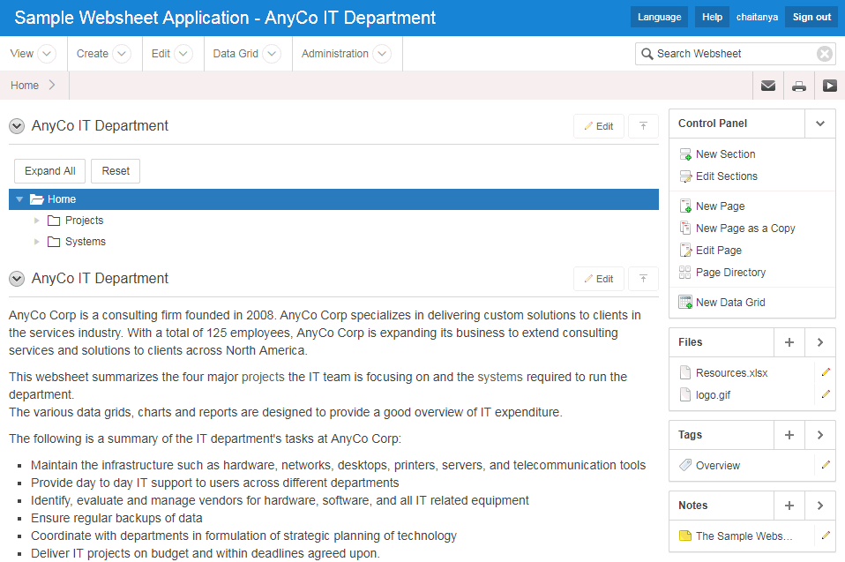
Websheets
Allow end-users to build / maintain WIKI like pages with database capabilities
  Database enabled WIKI
  Annotations
  (easily add files, links,
  notes, and tags)
  Use [[SQL ]] tag
  Presentation mode
  Multi user
Notes:
Websheets are similar to WIKIs in that they are designed for end-users to collaborate on content.
However, Websheets also includes the ability to define reports, and incorporate SQL that runs on the underlying Database schema(s).

Slide 51
Examples of how Oracle uses Oracle APEX
Oracle APEX
Notes:
Application Express is critical to Oracle’s own business practices.
The following are some of the examples of how APEX is used by Oracle itself.

Slide 52
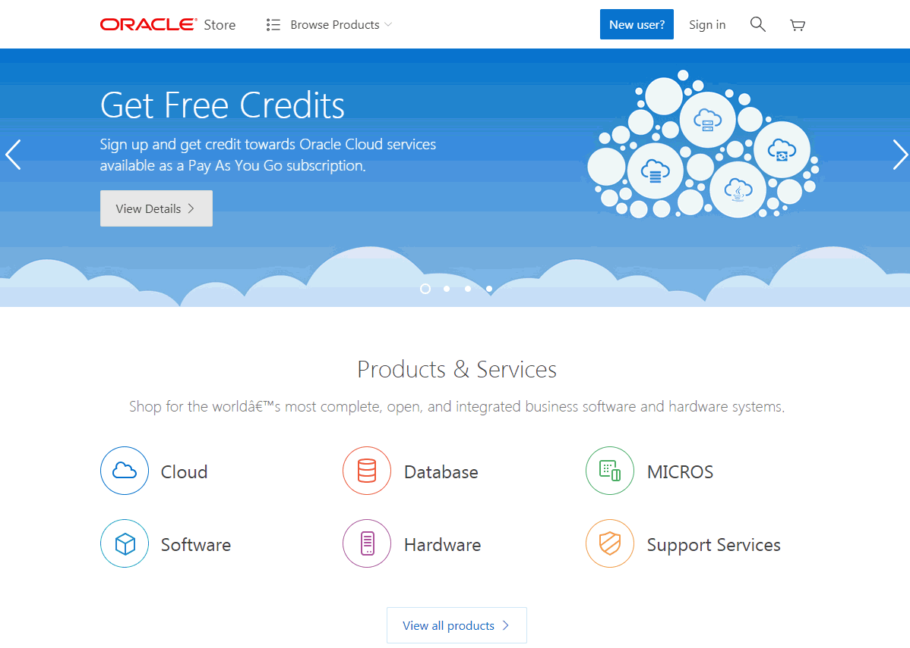
Oracle Store [Internet Application]
https://shop.oracle.com
Notes:
The Oracle Store handles orders for over 150 countries and can be shown in 13 languages.
When you choose a country different business rules are invoked within the ordering process.
The APEX application interfaces with over 12 major back-office systems such as Manufacturing & Distribution, Marketing, EBS, etc.

Slide 53
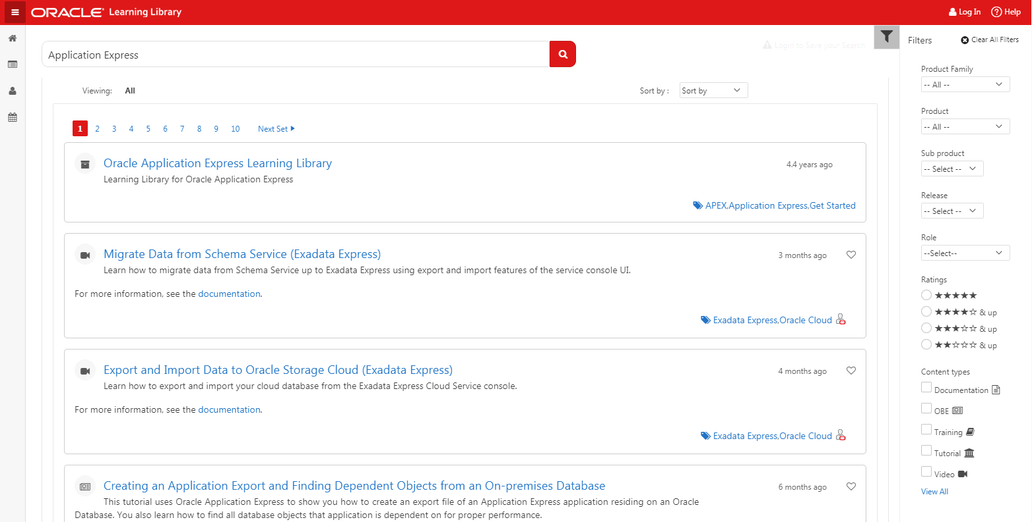
Oracle Learning Library [Internet Application]
https://www.oracle.com/oll
Notes:
The Oracle Learning Library (OLL) is an online resource for content about Oracle products. You can access videos, tutorials, articles, demos, step-by-step instructions, and self-paced interactive learning modules all written by Oracle developers and trusted community members.

Slide 54
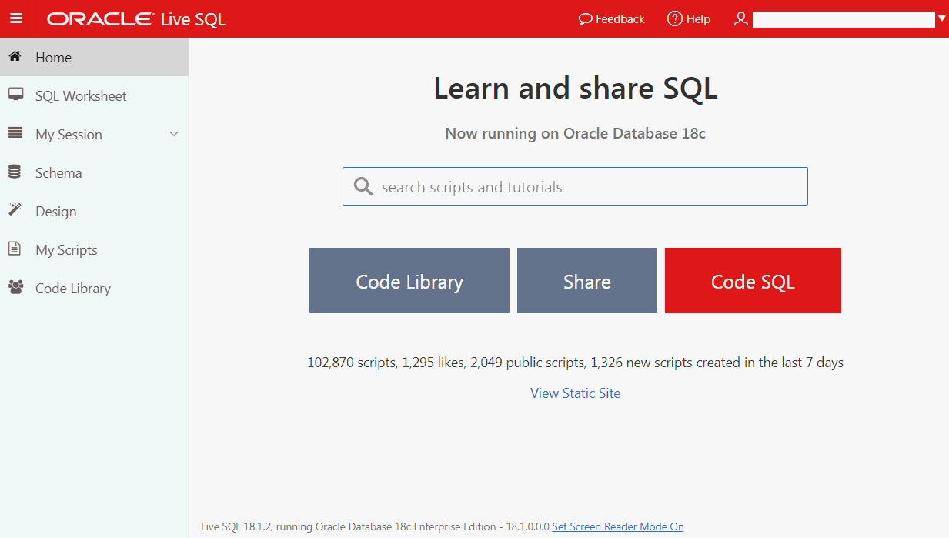
Oracle Live SQL [Internet Application]
https://livesql.oracle.com
Notes:
Use this site to share and learn SQL and PL/SQL. When you use this site you are assigned access to a schema within an Oracle database. As you run SQL and PL/SQL, each statement in your session is recorded. Your access to your assigned schema is temporary and the schema will be initialized and recycled for others after a period of inactivity. To save your work permanently, you will need to save your session as a script. Saved scripts can be replayed, annotated, edited, shared and downloaded.
Features of this site include:
SQL access to an Oracle database schema for a limited period of time
Ability to save collections of statements as a script
Ability to share saved scripts with others
Database schema browser to browse objects in your schema
Embedded educational tutorials
Data access examples for popular languages including Java
Why should you use this site:
Develop and expand your skills with the Oracle database, SQL and PL/SQL
Gain access to SQL and PL/SQL examples shared by the Oracle developer community
Share your SQL and PL/SQL database expertise with others
Develop database schemas for deployment elsewhere
Request help with database syntax from the Oracle community
Live SQL is running on Oracle Database 18c Enterprise Edition - 18.1.0.0.0.

Slide 55
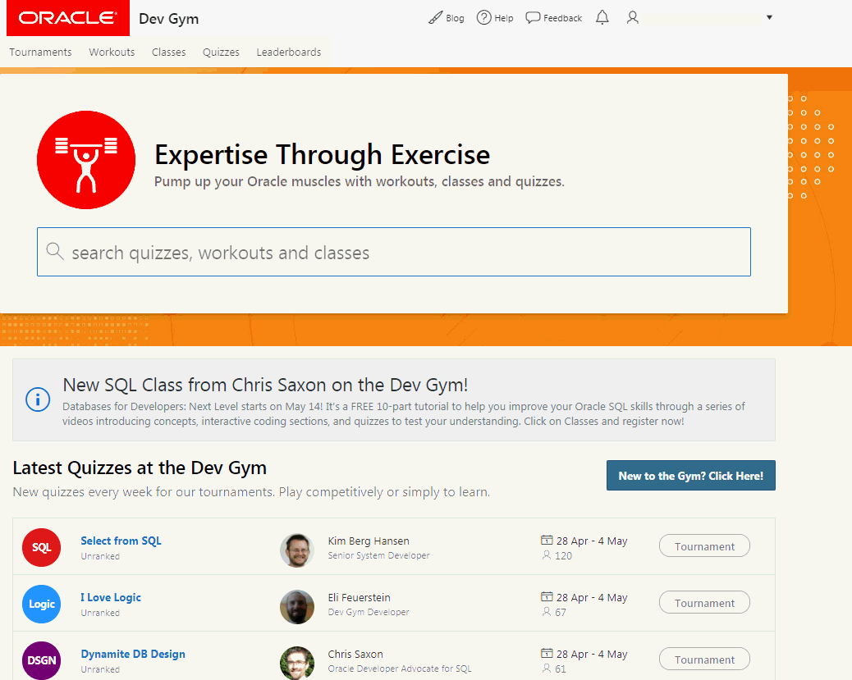
Oracle Dev Gym [Internet Application]
https://devgym.oracle.com
Notes:
The Oracle Dev Gym offers an active learning experience, via a gym workout paradigm. After all, you can’t get stronger just by watching a video on weightlifting. The same with coding. Dev Gym workouts keep your knowledge fresh and your thinking sharp.
At the Dev Gym, you can take individual quizzes - multiple choice questions. Or you can "step it up" and take a workout, which usually consists of a video or article, followed by quizzes that help you validate and reinforce what you just learned. And with over 2,400 quizzes on SQL, PL/SQL, database design and more, there's no shortage of "gym equipment". Oracle Dev Gym also offers an expanding list of "mini-MOOC" classes.
At the Oracle Dev Gym, you develop your expertise through exercise.

Slide 56
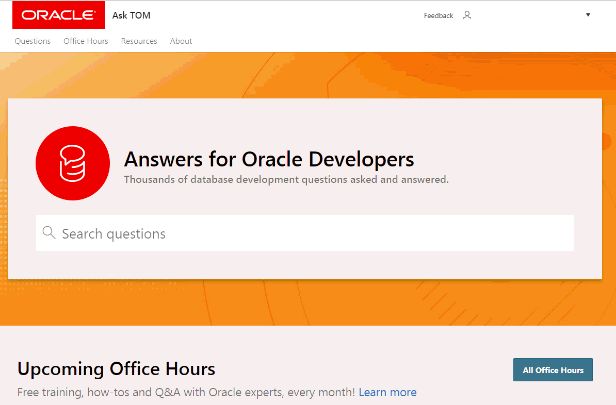
Oracle Ask Tom [Internet Application]
https://asktom.oracle.com
Notes:
Ask TOM is an on-line repository of over 18,400 questions and answers that have been answered by the Ask TOM team. This content covers many topics related to building applications on top of Oracle Database. Ask TOM one of the leading sites online to learn about Oracle Database, so if you have a question about Oracle Database that you can't solve yourself, be sure to ask it here!

Slide 57
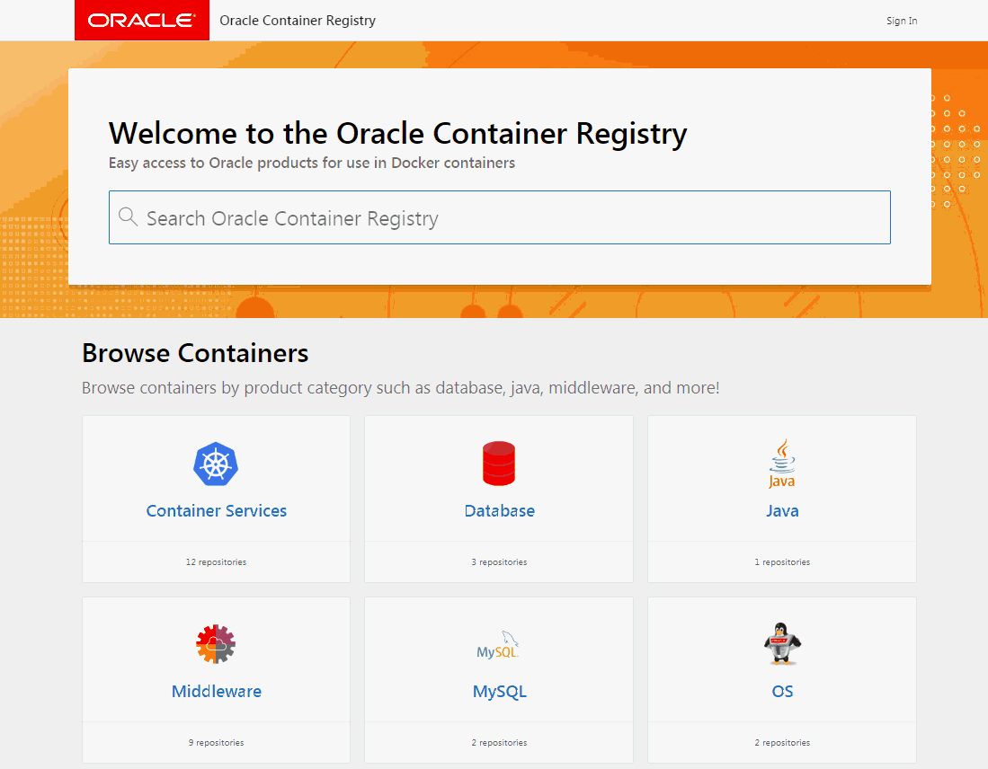
Oracle Container Registry [Internet Application]
https://container-registry.oracle.com

Slide 58
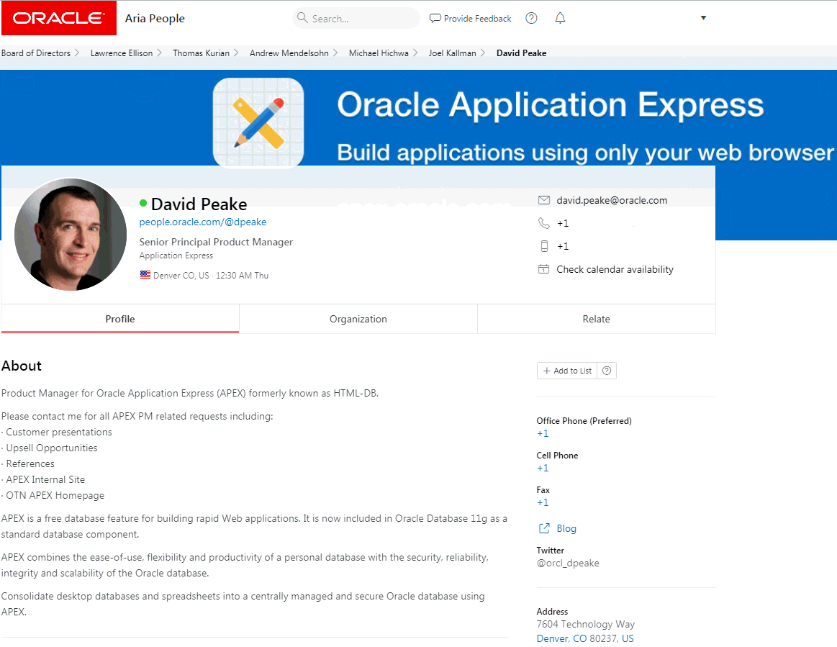
HR Directory [Internal Only – Intranet Application]
ARIA People
Nightly download of HR data
Employees can update profile, upload picture, add links ...
Used to contact employees, see Org. Chart, etc.
Fully responsive, works just as well on smartphones as it does on tablets and notebooks.
Average ~ 1.5 million page views / day
( > 50 page views / sec for hours )
Median execution time of 0.04 seconds
Notes:
Aria People is Oracle's employee directory app where you can easily look up employees, find contact information, create lists, and more.

Slide 59
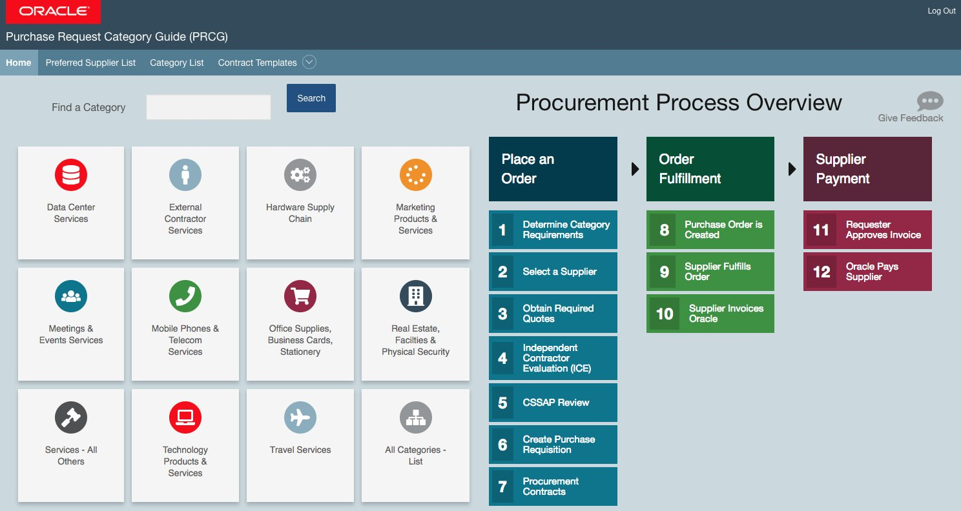
Purchase Request Category Guide
[Internal Only – Intranet Application]

Slide 60
Leveraging Oracle Database Features
Oracle APEX

Slide 61


Oracle APEX
Security features of the Oracle Database
Works with APEX
Transparent Data Encryption
Database Vault
Audit Vault
Database Firewall
Key Vault
Data Redaction
Data Masking
Auditing
Notes:
Oracle Database 18c provides multi-layered security spanning preventive, detective, and administrative controls. This includes transparent data encryption, data redaction, data masking, privileged user controls, privilege usage analysis, conditional auditing and real application security. Combined with Oracle Audit Vault and Database Firewall, Oracle Database 12c provides unprecedented controls to help organizations address existing and emerging security and compliance requirements.

Slide 62






Oracle APEX
High Performance features of the Oracle Database
Works with APEX
Multi version read consistency
Row level locking
In-Memory
Compression
Partitioning
Hadoop, Big Data SQL, R
Cost based query optimizer
Scale-out with Oracle RAC
Exadata Smartscan & Infiniband

Slide 63




Oracle APEX
Simplified consolidation and deployment with Oracle Multitenant
Works with APEX
PDB Deployment
PDB Cloning
PDB Self Service App
PDB Migration
High Density Consolidation
Automated Provisioning and Configuration
PDB Resource Management
Notes:
A feature of Oracle Database, Oracle Multitenant, delivers a architecture that allows a multitenant container database to hold many pluggable databases (PDBs). An existing database can simply be adopted with no application changes required.

Slide 64



Oracle APEX
Database Application Development Features
Works with APEX
SQL and PL/SQL
Java in Database
Analytics
Text
Regular Expressions
Spatial
Pattern Matching
Database XML
SQL
PL/SQL
Database JSON
AQ

Slide 65

Oracle Database as a Service
High Availability features of the Oracle Database
Works with APEX
Real Application Clusters
Data Guard
Active Data Guard
Golden Gate
Secure Backup
Online Reorganization
Edition-Based Redefinition
Flashback, Total Recall
Automated Rolling Upgrade of Database
Failover to the Cloud

Slide 66
Summary
Oracle APEX
Notes:
Closing Summary on key take-aways

Slide 67
Oracle APEX
Summary
Used by real customers for real applications: Used for both opportunistic and mission critical apps that service tens of thousands of users.
Well Established Product : First released in 2004
Most powerful Low Code Application Development Platform: Allows developer to focus on solving the business problem and delivering superior solutions, with less time and effort spent on mundane and repetitive lower-level coding.
Continually growing: Oracle install base is adopting Oracle APEX for increasing numbers of projects, and is increasingly an approved corporate IT standard.

Slide 68
Oracle APEX
Summary
Aligned with industry trends: Strong support for HTML5 development frameworks, Modern & responsive CSS3 UI, integrated JavaScript libraries, Browser-based, self-service provisioning, flexible development and deployment including cloud services.
Consistent with Oracle developers skill set: SQL, PL/SQL, Oracle Database.
Proficiency in the Oracle database easily translates into an ability to develop web applications.

Slide 69


