Slide 1
A Vector API for Java
Ian Graves
ian.l.graves@intel.com

Slide 2
Legal Disclaimers
INFORMATION IN THIS DOCUMENT IS PROVIDED IN CONNECTION WITH INTEL PRODUCTS. NO LICENSE, EXPRESS OR IMPLIED, BY ESTOPPEL OR OTHERWISE, TO ANY INTELLECTUAL PROPERTY RIGHTS IS GRANTED BY THIS DOCUMENT. EXCEPT AS PROVIDED IN INTEL'S TERMS AND CONDITIONS OF SALE FOR SUCH PRODUCTS, INTEL ASSUMES NO LIABILITY WHATSOEVER AND INTEL DISCLAIMS ANY EXPRESS OR IMPLIED WARRANTY, RELATING TO SALE AND/OR USE OF INTEL PRODUCTS INCLUDING LIABILITY OR WARRANTIES RELATING TO FITNESS FOR A PARTICULAR PURPOSE, MERCHANTABILITY, OR INFRINGEMENT OF ANY PATENT, COPYRIGHT OR OTHER INTELLECTUAL PROPERTY RIGHT.
A "Mission Critical Application" is any application in which failure of the Intel Product could result, directly or indirectly, in personal injury or death. SHOULD YOU PURCHASE OR USE INTEL'S PRODUCTS FOR ANY SUCH MISSION CRITICAL APPLICATION, YOU SHALL INDEMNIFY AND HOLD INTEL AND ITS SUBSIDIARIES, SUBCONTRACTORS AND AFFILIATES, AND THE DIRECTORS, OFFICERS, AND EMPLOYEES OF EACH, HARMLESS AGAINST ALL CLAIMS COSTS, DAMAGES, AND EXPENSES AND REASONABLE ATTORNEYS' FEES ARISING OUT OF, DIRECTLY OR INDIRECTLY, ANY CLAIM OF PRODUCT LIABILITY, PERSONAL INJURY, OR DEATH ARISING IN ANY WAY OUT OF SUCH MISSION CRITICAL APPLICATION, WHETHER OR NOT INTEL OR ITS SUBCONTRACTOR WAS NEGLIGENT IN THE DESIGN, MANUFACTURE, OR WARNING OF THE INTEL PRODUCT OR ANY OF ITS PARTS.
Intel may make changes to specifications and product descriptions at any time, without notice. Designers must not rely on the absence or characteristics of any features or instructions marked "reserved" or "undefined". Intel reserves these for future definition and shall have no responsibility whatsoever for conflicts or incompatibilities arising from future changes to them. The information here is subject to change without notice. Do not finalize a design with this information.
The products described in this document may contain design defects or errors known as errata which may cause the product to deviate from published specifications. Current characterized errata are available on request.
Contact your local Intel sales office or your distributor to obtain the latest specifications and before placing your product order.
Copies of documents which have an order number and are referenced in this document, or other Intel literature, may be obtained by calling 1-800-548-4725, or go to: http://www.intel.com/design/literature.htm
Intel, the Intel logo, Intel Xeon, and Xeon logos are trademarks of Intel Corporation in the U.S. and/or other countries.
Intel processor numbers are not a measure of performance. Processor numbers differentiate features within each processor family, not across different processor families: Go to: Learn About Intel® Processor Numbers http://www.intel.com/products/processor_number
*Other names and brands may be claimed as the property of others.
Copyright © 2015 Intel Corporation. All rights reserved.

Slide 3
Legal Disclaimers – Continued
Some results have been estimated based on internal Intel analysis and are provided for informational purposes only. Any difference in system hardware or software design or configuration may affect actual performance.
Software and workloads used in performance tests may have been optimized for performance only on Intel microprocessors. Performance tests, such as SYSmark and MobileMark, are measured using specific computer systems, components, software, operations and functions. Any change to any of those factors may cause the results to vary. You should consult other information and performance tests to assist you in fully evaluating your contemplated purchases, including the performance of that product when combined with other products.
Intel does not control or audit the design or implementation of third party benchmarks or Web sites referenced in this document. Intel encourages all of its customers to visit the referenced Web sites or others where similar performance benchmarks are reported and confirm whether the referenced benchmarks are accurate and reflect performance of systems available for purchase.
Relative performance is calculated by assigning a baseline value of 1.0 to one benchmark result, and then dividing the actual benchmark result for the baseline platform into each of the specific benchmark results of each of the other platforms, and assigning them a relative performance number that correlates with the performance improvements reported.
SPEC, SPECint, SPECfp, SPECrate, SPECpower, SPECjbb, SPECompG, SPEC MPI, and SPECjEnterprise* are trademarks of the Standard Performance Evaluation Corporation. See http://www.spec.org for more information.
TPC Benchmark, TPC-C, TPC-H, and TPC-E are trademarks of the Transaction Processing Council. See http://www.tpc.org for more information.
Intel® Advanced Vector Extensions (Intel® AVX)* are designed to achieve higher throughput to certain integer and floating point operations. Due to varying processor power characteristics, utilizing AVX instructions may cause a) some parts to operate at less than the rated frequency and b) some parts with Intel® Turbo Boost Technology 2.0 to not achieve any or maximum turbo frequencies. Performance varies depending on hardware, software, and system configuration and you should consult your system manufacturer for more information.
Intel® Advanced Vector Extensions refers to Intel® AVX, Intel® AVX2 or Intel® AVX-512. For more information on Intel® Turbo Boost Technology 2.0, visit http://www.intel.com/go/turbo

Slide 4
Code In this Presentation
Is still a rough prototype! Subject to change!
Part of the OpenJDK Project Panama
Licensed Under GPLv2 With ClassPath Exception
Get the code here!
  http://hg.openjdk.java.net/panama/panama/

Slide 5
Overview
Introduction
CodeSnippets
Vector API Design
Wrap Up

Slide 6
Introduction: Vector API Project Team
Oracle
  Vladimir Ivanov
  John Rose
  Paul Sandoz
Intel
  Michael Berg
  Steve Dohrmann
  Ian Graves
  Shravya Rukmannagari
  Sandhya Viswanathan

Slide 7
Terminology
Code Snippets:
  Encoding instructions as data in Java
  Binding to MethodHandle
Vector API:
  API encompassing operations with vector instruction support.
  Implemented on top of Code Snippets.

Slide 8
Motivation
Many popular applications benefit from data-parallel computations
Architectural support remains opaque to the JVM developer
Looking to expose “pure Java” performant solutions that map to the architecture well.
  No JNI interfacing – single language solutions
  Minimized Boilerplate – generated code is good quality

Slide 9
Project Goals
Expose data-parallel vector operations for developer use in Java
Portability and performance
Scalability
Idiomatic

Slide 10
Code Snippets

Slide 11
CodeSnippets as a Substrate
A portable API for expressing primitives
  More flexible than HotSpot intrinsics
  Less technical debt with Graal on the horizon
  ISAs can use the same API
In prototype phase, but good perf observed
  Value objects to registers
  MethodHandle invocation achieves good code quality.

Slide 12
Implementing a Primitive
Primitives Bind to MethodHandle
  Invoked via MethodHandle methods
  MethodHandles library has additional combinators
  Types of CodeSnippets represented as MethodType objects
Vector represented by Long2/4/8 objects
  Wrappers for 128,256,and 512-bit values.
  Wrappers are elided in the best case. Values registerized.
  Escape analysis a work in progress

Slide 13
Binding to Machine Instruction
MethodHandle Type
static final MethodType MT_L4_BINARY =
MethodType.methodType(Long4.class, Long4.class, Long4.class);
private static final MethodHandle MHm256_vaddps = MachineCodeSnippet.make(
"mm256_vaddps", MT_L4_BINARY, requires(AVX),
new Register[][]{xmmRegistersSSE, xmmRegistersSSE, xmmRegistersSSE},
(Register[] regs) -> {
Register out = regs[0];
Register in1 = regs[1];
Register in2 = regs[2];
int[] vex =
vex_prefix(rBit(out),X_LOW,bBit(in2),M_0F,W_LOW,in1,L_256,PP_NONE);
return vex_emit(vex, 0x58, modRM(out, in2));
});
Desired Register Masks
Registers via JVMCI
Feature-checking predicate
Macro-ized x86 encoding

Slide 14
Checked Invocation
Pure Java equivalent function.
private static Long4 vaddps_naive(Long4 a, Long4 b) {
float[] res = new float[8];
for (int i = 0; i < 8; i++) {
res[i] = getFloat(a, i) + getFloat(b, i);
}
return long4FromFloatArray(res,0);
}
public static Long4 vaddps(Long4 a, Long4 b) {
try {
Long4 res = (Long4) MHm256_vaddps.invokeExact(a, b);
assert assertEquals(res, vaddps_naive(a, b));
return res;
} catch (Throwable e) {
throw new Error(e);
}
}
Type-safe invocation point.

Slide 15
A Small Example
public static float[] proc(float[] left, float[] right, float[] res){
if(left.length != right.length){
throw new UnsupportedOperationException("Arrays unequal.");
} else if (left.length % 8 != 0) {
throw new UnsupportedOperationException("Length must be n*8");
}
for(int i = 0; i < left.length; i+=8){
addArrays(left,right,res,i);
}
return res; //Convenience
}
Loop Kernel

Slide 16
Small Example (cont’d)
//Isolated for code quality purposes in prototype
public static void addArrays(float[] left, float[] right, float[] res, int i){
//VMOVDQU ymmX, YMMWORD PTR …
Long4 l = PatchableVecUtils.long4FromFloatArray(left,i);
Long4 rr = PatchableVecUtils.vaddps(l,right,i);
//VMOVDQU YMMWORD PTR …, ymmX
PatchableVecUtils.long4ToFloatArray(res,i,rr);
}
Scaled load
vaddps reg, YMMWORD PTR ...
Scaled store

Slide 17
Generating C2 Code
java -XaddExports:java.base/jdk.internal.misc=ALL-UNNAMED
-XaddExports:java.base/jdk.internal.vm.annotation=ALL-UNNAMED
-XX:+UnlockDiagnosticVMOptions
-XX:-UseSuperWord
-XX:LoopMaxUnroll=1
-XX:PrintAssemblyOptions=intel
-XX:CompileCommand=option,*AddArraysLong4PS::addArrays,PrintAssembly
-cp build
AddArraysLong4PS

Slide 18
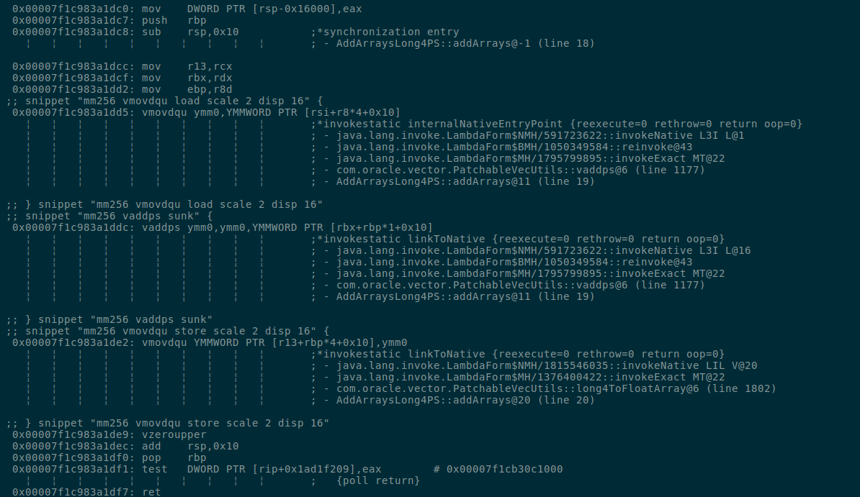
Generated Code
Snippets!!!!!

Slide 19
Performance of This Example
Compared to Scalar implementation
Disabled SuperWord and Loop Unrolling
We see a ~40% reduction in clock cycles spent in the loop kernel with the vectorized version.
  This workload is a prototype PoC, we need more advanced workloads that better leverage vectorization.
  Bigger, more intensive workloads to come
  Wall clock time indicates overhead coming from outside of the loop kernel vs. the scalar version – more work to do!

Slide 20
The Vector API

Slide 21
Java Needs an Abstraction for Vectors
Vector ISA Extensions are powerful, expressive, and deep.
  Most instructions have many different forms and support differing operand sizes
  NxM problems abound for API writers
Needs to be to capture the essence of vectorization in the spirit of Java
  Platform independence – Snippets too low level
  Meaningful static checking
  Familiar patterns to abstract operational complexity

Slide 22
Vector API
Intended API to encompass the CodeSnippets implementation
Proposed by John Rose*. Work continues within the Panama Project
interface Vector<E, S extends Vector.Shape<Vector<?, S>>>
  S - Shape type describes the size of the Vector
  E - The element type of the Vector
  Broadest support for Float, Integer, Double
Draft implementations checked into Project Panama
* http://cr.openjdk.java.net/~jrose/arrays/vector/Vector.java

Slide 23
Structure of the API
Vector<E,S>
Factory methods here.
FloatVector<S>
Factory-Constructed Classes
FloatVector128
FloatVector256
FloatVectorXYZ
…..

Slide 24
Basic Vector-Vector Functionality
interface Vector<E,S extends Shape<Vector<?,S>>> {
…
Vector<E,S> add(Vector<E,S> v2);
Vector<E,S> mul(Vector<E,S> v2);
…
Vector<E,S> and(Vector<E,S> v2);
…
}
Immutability!

Slide 25
More Advanced…
interface Vector<E,S extends Shape<Vector<?,S>>> {
…
E getElement(int i);
Vector<E,S> putElement(int i, E elem);
…
E sumAll();
…
E[] toArray();
fromArray(E[] ary, int offset);
…
}
Scalar/Vector Interfacing
Horizontal Reductions. Multiple snippets.
Loading and storing to arrays

Slide 26
Fully Realized Expressiveness
interface Vector<E,S extends Shape<Vector<?,S>>> {
…
Vector<E,S> map(UnaryOperator<E> op);
Vector<E,S> mapWhere(Mask<S> mask, UnaryOperator<E> op);
…
Vector<E,S> map(BinaryOperator<E> op, Vector<E,S> v2);
Vector<E,S> mapWhere(Mask<S> mask, BinaryOperator<E> op, Vector<E,S> this2);
…
}

Slide 27
Kernel with Vector API
public static void addArrays(float[] left, float[] right,
float[] res, int i){
FloatVector<Shapes.S256Bit> l = float256FromArray(left,i),
r = float256FromArray(right,i),
lr = l.add(r);
lr.intoArray(res,i);
}

Slide 28
Higher Order Components
Highly desirable, modern part of this API
A programmer specifies a loop body
  Minimal thought given to vectorization
  Using regular arithmetic and logical syntactic operators
  Requires a way to “crack” or inspect lambdas at runtime
Ways Forward
  We need better control of our higher order components
  Factories for constructing primitive arithmetic operations
  Need to be composable

Slide 29
Kernel Construction
We can construct our “higher order” operations from existing parts.
We can constrain our support to operations that are vectorizable.
  Arity-one, or arity-two (maybe three) operations
  Restricting to arithmetic and logical operations that are broadly supported
Our existing work on CodeSnippets can form the base!
MethodHandles are highly composable, even with snippets

Slide 30
f = (x,y) -> (x+y) * y;
MethodType mt = MethodType
.methodType(Long4.class,Long4.class,Long4.class);
MethodHandle MHm256_vaddps = CodeSnippet.make(…,mt,…),
MHm256_vmulps = CodeSnippet.make(…,mt,…);
MethodHandle f_pre = MethodHandles
.collectArguments(MHm256_vmulps, 0, MHm256_vaddps);
MethodHandle f = MethodHandles.permuteArguments(f_pre,mt,0,1,1);

Slide 31
Statically Typed Wrappers
A layer over MethodHandles for encapsulating the lower level details and making them type safe will coincide with the existing API spec.
One method proposed is VectorOp
  Proposed on Project Panama*
  Vector Operations explicit and exposed to the user to compose and use as kernels.
Another approach is to use a lightweight syntax tree
  Hand off to a Vector object for interpretation/conversion to an equivalent MethodHandle structure for execution.
  Vector objects visit the tree to compose the according MethodHandles.
  Same syntax trees could be handed off to different Vector types.
Still very much in the works!
* http://cr.openjdk.java.net/~jrose/arrays/vector/VectorOp.java

Slide 32
Quick Thoughts….
Most Vector operations are simple expressions
Expressions are (basically) trees
MethodHandles can be combined together in a tree-like fashion
  permuteArguments()
  collectArguments()
  filterArguments()
  filterReturn()
Method Handles have added benefits (high level models matter!)
  We’ve already observed good code with Method Handles, so let’s try it!
  Coding this way can elide the need to box Long2/4/8…

Slide 33
Expressions Bind to Method Handles.
(x,y) ->
x
y
*
MHm256_vaddps
+
y
AST Visitor
MHm256_vmulps
x
y

Slide 34
There’s more!!
x
y
MHm128_vaddps
(x,y) ->
128_visitor
MHm128_vmulps
*
x
y
MHm256_vaddps
+
y
256_visitor
x
y
MHm256_vmulps
x
y
XYZ_visitor
MHmXYZ_vaddps
MHmXYZ_vmulps
34

Slide 35
Baby’s First EDSL
interface Expression<E> {
default Expression<E> add(Expression<E> right){return new AddExpression<>(this,right);}
default Expression<E> mul(Expression<E> right){return new MulExpression<>(this,right);}
default Expression<E> not(){return new NotExpression<>(this);
…
default Expression<E> trace(Consumer<E> f){return new TraceExpression<>(this,f);}
…
default Expression<Float> fromFloat(Float f){return new ConstExpression<>(f);}
…
<R> R evaluate(ExpressionEvaluator<E,R> e);
}
Careful!

Slide 36
BinaryOperation<Expression<Float>> expr =
(l,r) -> {
Expression<Float> e1 = l.add(r);
return e1.mul(r);
}
expr.apply(Symbol.LEFT,Symbol.RIGHT);
To populate leaf nodes. Symbol non-public.

Slide 37
MethodHandle binaryReduction(float[] left, float[] right, float[] dst,
BinaryOperator<Expr<Float>>);
MethodHandle br = binaryReduction(left,right,dst,(l,r) -> {
Expression<Float> e1 = l.add(r);
return e1.mul(r);
});
//Execute the entire computation
br.invokeExact();
//Making it hot for inspection
for(int i = 0; i < BIGNUMBER; i++)
br.invokeExact()

Slide 38
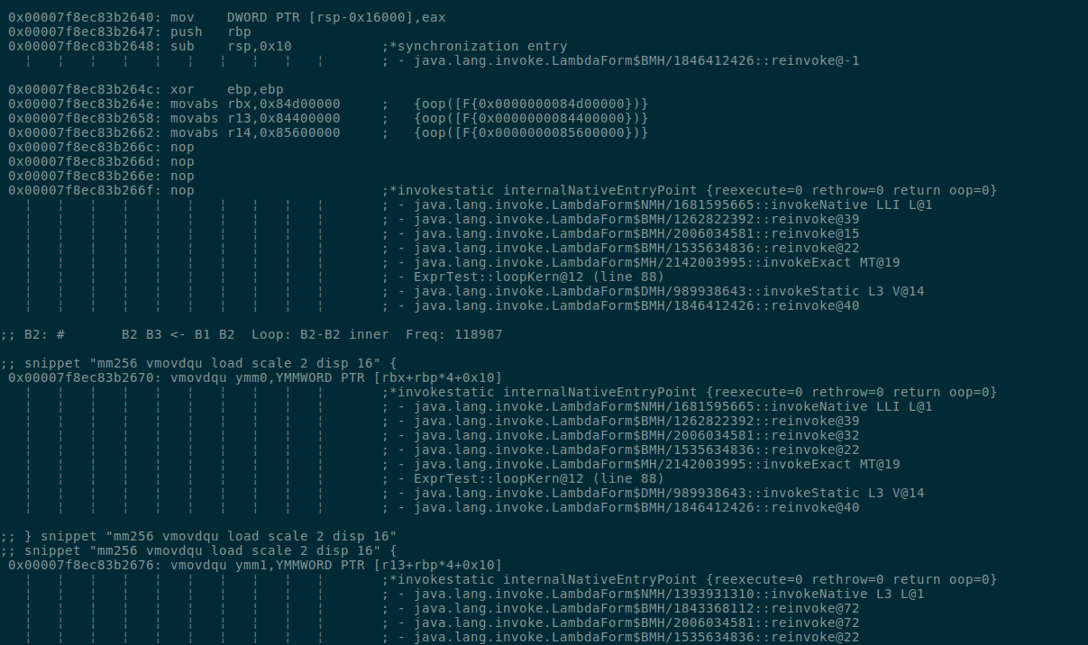
Array Base Addrs
Loads

Slide 39
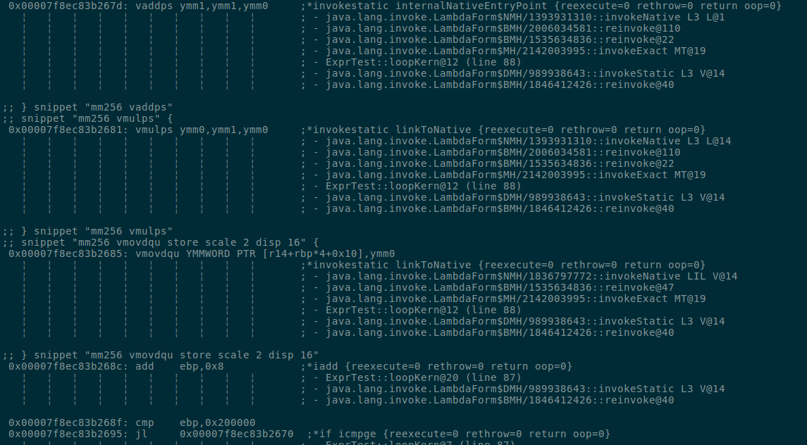
Vectorized Add
Vectorized Mul
Store
Loop Bookkeeping

Slide 40
Why Not Just Expression Trees?
Reasoning about a vector computation in an element-wise fashion is great, but has a tradeoff.
Control flow is tricky
  Branching on element N, but N+1 doesn’t want to branch, and it’s in the same vector!
  Masking operations can help some for ternary-style branching. TBD.
The Vector API remains important for precise control
Fine-grained control with course grained data
Course-grained control with fine grained data

Slide 41
Wrap Up

Slide 42
Challenges to an Idiomatic Design
Elements are (currently) boxed by the (current) nature of generics
  Value types can help
  Hand-specialization to get away from boxing
Immutability is facilitated by new or a constructor encapsulating it
  Escape analysis must work well at all times in the current paradigm.
  Tight loops + large data sets with no escape analysis = a lot of garbage.
  “Optimizations-as-semantics” seems risky, but could bridge us to value types.
“Idiomatic” is a moving target in Java.
  Value types will make our lives easier, but they’re not quite here yet!
  Functional idioms are becoming more common, but APIs need to be approachable

Slide 43
Continuing Work
Enhancing the baseline Vector API
  Removing Excessive boxing and preventing codegen artifacting
  Establishing the “minimum viable” API
Exploring higher order functionality more
  What’s the right approach?
  Analyzing flexibility vs code quality tradeoffs still
Reporting back at JavaOne!

Slide 44
Interested?
Check out the Panama Project!
Discussion on panama-dev.
http://openjdk.java.net/projects/panama/
Vector API Code:
  jdk/test/panama/vector-api-patchable
Prototype Implementation
  Runs on x86-64 ABI-compliant using AVX2
  Unix-based platforms currently

