Slide 1
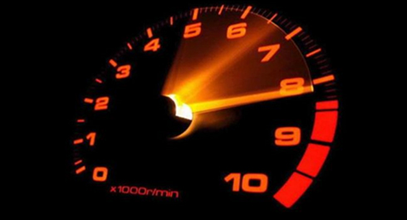
Application Workload Performance Validation for EPM Cloud

Slide 2
Notes:
This is a Safe Harbor Front slide, one of two Safe Harbor Statement slides included in this template.
One of the Safe Harbor slides must be used if your presentation covers material affected by Oracle’s Revenue Recognition Policy
To learn more about this policy, e-mail: Revrec-americasiebc_us@oracle.com
For internal communication, Safe Harbor Statements are not required. However, there is an applicable disclaimer (Exhibit E) that should be used, found in the Oracle Revenue Recognition Policy for Future Product Communications. Copy and paste this link into a web browser, to find out more information.
http://my.oracle.com/site/fin/gfo/GlobalProcesses/cnt452504.pdf
For all external communications such as press release, roadmaps, PowerPoint presentations, Safe Harbor Statements are required. You can refer to the link mentioned above to find out additional information/disclaimers required depending on your audience.

Slide 3
Objective
Simulate customer environment, using customer-provided snapshot, and customer-provided use cases, to measure performance against the customer-provided concurrency and performance requirement
Provide an application workload performance validation suite to the customer so that they can perform the same validations themselves on an ongoing basis

Slide 4
Methodology
EPM Automate replay
Dev Instance
Performance Validation Report and Activity Report
Based on EPM Automate replay feature
Validation performed on a dev instance
Input: Har files created via Fiddler for real customer use cases, using the customer provided-snapshot
Deliverables: Performance Validation Report and Activity Report

Slide 5
Input for Performance Validation
Use cases in the attached template
For every use case, provide:
Exact steps to perform (e.g., open a particular form, set the POV/UDV, update the data, submit the form)
Concurrency requirement (i.e., how many users need to perform this use case at the same time (with different POVs)
Expected UI response time; i.e., within how much time, the user should have the response back
Access to the prod/test instance, or permission to export the snapshot so that the validation can be performed in a dev instance in the same data center
Service Administrator and ID Administrator credentials, or provision the tester E-mail with those roles

Slide 6
Example of Use Cases
Use Case | Number of Concurrent Users | Expected UI Response Time (Seconds)
Load Data | 100 | 60
Create Regional Report | 10 | 120
Load Data:
Open the US Salaries form
Select POV
Refresh the form
Run the business rule Allocate
Change 5 cell values
Submit data
Create Regional Report:
Open the Regional Report report
Select POV
Create the report

Slide 7
Deliverables of Performance Validation
Performance Validation Report
For every use case,
Minimum, maximum and average actual UI response times for the provided number of concurrent users
If the average actual UI response time is more than expected UI response time, number of concurrent users for which the expected UI response time can be achieved
Activity Report for the day(s) when the performance validation was run, with the details to help figure out performance bottlenecks

Slide 8
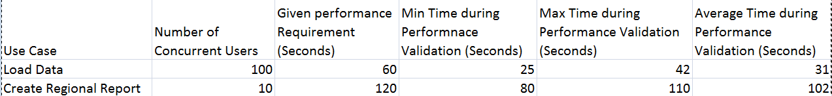
Performance Validation Report

Slide 9
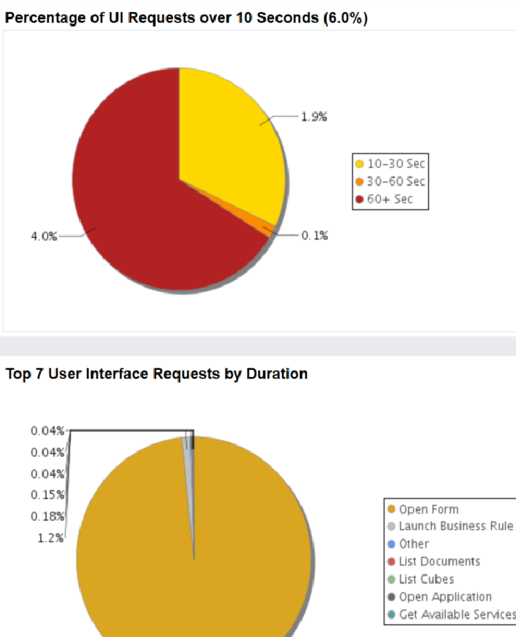
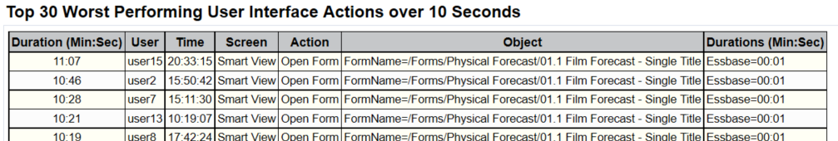
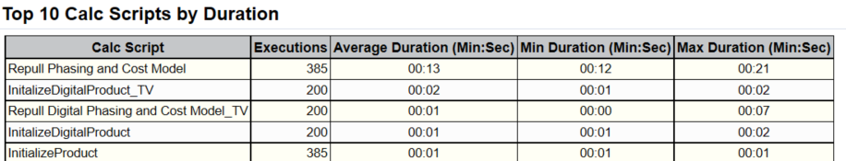
Activity Report

Slide 10
Algorithm
Execution of har files is done for a given number of times, and average time is computed.
As many har files are executed per use case as the customer provided concurrency requirement is.
For example, if the customer indicates that a particular use case is to be executed by 100 users in parallel, 100 executions of har files are done at the same time.
Measured performance is compared against the performance requirement given by the customer.
If the performance requirement is not met, number of concurrent executions is reduced by 1, and validation is performed again.
This continues until either the performance requirement is met or the number of users is simply 1 (which means that the requirement cannot be met even with a single user).

Slide 11
Steps to run Performance Validation
Populate users
Create har files
Run performance validation

Slide 12
Populating Users – 1 of 3
The instance on which the validation has to be performed has to be populated with the maximum number of users, provided for any particular use case.
Example: If there are 6 use cases, to be performed by 10, 20, 50, 100, 150, and 200 users respectively, 200 users should be populated.
Steps:
Get the full snapshot from the customer instance
Unzip the snapshot zip file
Go to HSS-Shared Services\resource\External Directory folder
Open Users.csv file, and add additional users at the end of the file, in the same format as existing users (First Name,Last Name,Email,User Login)
These do not have to be real users with real E-mails. Fake E-mails can be used.
This can be done manually or via a script.

Slide 13
Populating Users – 2 of 3
Go to Roles folder
Open the different role.csv files (e.g., planning Planner.csv file), and add additional users for that particular role at the end of the file, in the same format as existing users (First Name,Last Name,Email,User Login)
These should be the same as added in Users.csv file.
This can be done manually or via a script.
Zip the snapshot

Slide 14
Populating Users – 3 of 3
On the instance on which the validation has to be performed, use the EPM Automate commands to import the snapshot:
Example for Linux:
epmautomate.sh login ServiceAndIDAdminUser ServiceAndIDAdminPassword serviceURL IDMDomain
epmautomate.sh recreate -f
epmautomate.sh uploadfile fullsnapshot.zip
epmautomate.sh importsnapshot "fullsnapshotshot" userPassword=password resetPassword= false
epmautomate.sh deletefile fullsnapshot
epmautomate.sh logout
importsnapshot command will import the users and roles only if the logged in user has ID Administrator role.
If not, the rest of the snapshot will be imported, but the users and roles will not be imported.
If a single user does not have both Service Administrator and ID Administrator roles, use the above commands two times - once for importing the users and once for importing the rest of the snapshot.
If the test is performed directly on the customer’s prod/test instance, recreate and full snapshot import is not needed; instead only HSS-Shared Services\resource\External Directory snapshot can be imported using ID Administrator credentials.

Slide 15
Creating har Files – 1 of 2
Refer to EPM Automate documentation (https://docs.oracle.com/cloud/latest/epm-common/CEPMA/appendix_replay_command.htm) on details on how to create the har files and the replay csv files
Create multiple har files per use case
In each execution, use different POVs, different values of user-defined variables, different rows, different columns, etc so that the actual requests sent to the provider are different per har file.
Ideally, as many har files should be created as the number of concurrent users for a particular use case, but a smaller number of har files can be created in a time-crunched situation, and then, distributed among the number of concurrent users.

Slide 16
Creating har Files – 2 of 2
Create the replay csv file for each use case
This file should have as many lines as the number of concurrent users for this use case.
Each line should have the following entries:
Email,Password,harFileLocation
Each E-mail should match with the E-mails that were added earlier for the role that is valid for this use case.

Slide 17
Running Performance Validation – 1 of 2
Copy the attached performance validation script (epmautomate-performance.sh) to a newly created folder on a Linux system
In the same folder, create two files:
input.properties
usecasefile

Slide 18
Running Performance Validation – 2 of 2
Organize replay har files and csv files in this folder in the following hierarchy:
datafiles
usecase-1
1.har
2.har
…
usecase-1.csv
usecase-2
1.har
2.har
…
usecase-2.csv
…
Update input.properties file for a use case
Run the script:
./epmautomate-performance.sh

Slide 19
Content of input.properties
epmautomatescript=LocationOfEpmautomate.sh
replayfiles=LocationOfReplayCSVFile
targetdurations=PerformanceRequirementInSeconds
iterationsperusecase=NumberOfIterationsForThisUseCase
sendmailprogram=LocationOfSendMail
emailaddress="Comma-separatedListOfEmailsForResult"
logdir=LocationOfLogFiles
usecasesfile=LocationOfUseCaseFile
iterationsperusecase indicates how many iterations of this particular use case needs to be run before the average time is calculated.
emailaddress is a list of E-mail addresses to which the result of the validation is sent.
Nothing to do with the E-mails of the users added to the instance itself

Slide 20
Example of input.properties
epmautomatescript=/scratch/epmautomate/17.01.21/bin/epmautomate.sh
replayfiles=datafiles/usecase-5/usecase-5.csv
Targetdurations=3600
iterationsperusecase=5
sendmailprogram=/usr/sbin/sendmail
emailaddress=“vinay.x.gupta@oracle.com"
logdir=./logs/
usecasesfile=./pbcs.txt
You can specify multiple replayfiles and targetdurations for multiple use cases as comma-separated lists.
Use cases are executed in series.
Example:
replayfiles=datafiles/usecase-5/usecase-5.csv,datafiles/usecase-6/usecase-6.csv
targetdurations=3600,7200

Slide 21
Content of usecasefile
login ServiceAdminUser ServiceAdminPassword serviceURL IDMDomain
replay %ReplayFile
logout
This file location needs to be specified as the value of usecasefile in input.properties file.
Example:
login vinay.x.gupta@oracle.com 0racle123! https://planning5-test-a239463.pbcs.us2.oraclecloud.com a239463
replay %ReplayFile
logout

Slide 22
Output
$ ./epmautomate-performance.sh
Thu Jan 5 13:58:38 PST 2017
Starting EPMAutomate performance testing
[Thu Jan 5 13:58:45 PST 2017] Preparing replay file: /scratch/dteUser/TestSuite/datafiles/usecase-5/usecase-5.csv
[Thu Jan 5 13:58:46 PST 2017] Processing replay file: /scratch/dteUser/TestSuite/datafiles/usecase-5/usecase-5.csv
[Thu Jan 5 13:58:46 PST 2017] Initial number of concurrent users: 150
[Thu Jan 5 13:58:46 PST 2017] Target duration per test: 3600 seconds
[Thu Jan 5 13:58:46 PST 2017] Running EPMAutomate replay command for 5 iterations...
[Thu Jan 5 14:09:55 PST 2017] Average duration of use case test (68 seconds) is less than or equal to target duration (3600 seconds).
[Thu Jan 5 14:09:55 PST 2017] Test passed for /scratch/dteUser/TestSuite/datafiles/usecase-5/usecase-5.csv with 150 concurrent users.
EPMAutomate performance testing completed
Thu Jan 5 14:09:58 PST 2017

Slide 23
Logs – 1 of 2
Two files are created in the log folder in the location specified by logdir in input.properties file:
epmautomate-performance.log: Log of what EPM Automate commands were executed
results:csv: End result for this use case
Example:
$ cat results.csv
Use Case,Result,Avg. Target Duration,Avg. Test Duration,Concurrent Users (start),Concurrent Users (end)
usecase-5,passed,01:00:00,00:01:08,150,150
Validation is considered passed, if it passes the performance criteria; i.e., the time taken is less than or equal to the time specified as the value of targetdurations in the input.properties file.
Value of Concurrent Users(start) is the number of lines in the replay csv file.
Value of Concurrent Users(end) is the value at which the performance criteria has been met (or 1, if the performance criteria could not be met even with a single user).

Slide 24
Logs – 2 of 2
A folder with the same name as folder of the value of replayfiles in input.properties is created.
Example: if replayfiles is specified as datafiles/usecase-5/usecase-5.csv, the folder created will be usecase-5.
In this folder, following files are created:
replayFile.log (e.g., usecase-5.log): Details of each iteration; how long it took, etc.
One file per iteration, named iteration-n.csv (e.g., iteration-1.csv, iteration-2.csv, etc): Output of replay command run in that iteration

Slide 25
Example of replayFile.log
$ cat usecase-5.log
[Thu Jan 5 13:58:45 PST 2017] Preparing replay file: /scratch/dteUser/OracleFinanceTest/datafiles/usecase-5/usecase-5.csv
[Thu Jan 5 13:58:46 PST 2017] Processing replay file: /scratch/dteUser/OracleFinanceTest/datafiles/usecase-5/usecase-5.csv
[Thu Jan 5 13:58:46 PST 2017] Initial number of concurrent users: 150
[Thu Jan 5 13:58:46 PST 2017] Target duration per test: 3600 seconds
[Thu Jan 5 13:58:46 PST 2017] Running EPMAutomate replay command for 5 iterations...
[Thu Jan 5 13:58:46 PST 2017] Iteration: 1
[Thu Jan 5 14:00:39 PST 2017] Duration: 66 seconds
…
[Thu Jan 5 14:09:55 PST 2017] Average duration of use case test (68 seconds) is less than or equal to target duration (3600 seconds).
[Thu Jan 5 14:09:55 PST 2017] Test passed for /scratch/dteUser/OracleFinanceTest/datafiles/usecase-5/usecase-5.csv with 150 concurrent users.
[Thu Jan 5 14:09:55 PST 2017] Email report subject: EPM Cloud Performance Test Report for use case usecase-5.csv
[Thu Jan 5 14:09:55 PST 2017] Email report formatted message: Use case file: /scratch/dteUser/OracleFinanceTest/datafiles/usecase-5/usecase-5.csv<br><br>Initial number of concurrent users: 150<br>Final number of concurrent users: 150<br>Number of EPMAutomate replay tests: 5<br>Target duration per test: 01:00:00<br>Average duration per test: 00:01:08<br><br>Use case test result: passed for 150 concurrent user(s)
[Thu Jan 5 14:09:55 PST 2017] Emailing report results

Slide 26
Example of Iteration Log
$ cat iteration-1.csv
1.har - Completed
-------------------------------------------------------
Duration(sec),User,Time,Status,Screen,Action,Object
-------------------------------------------------------
1.111,"001@oracle.com",13:58:57,200,"Smart View","Connect to Provider"
1.558,"001@oracle.com",13:58:58,200,"Smart View","List Servers"
0.763,"001@oracle.com",13:59:00,200,"Smart View","List Applications“
…

Slide 27
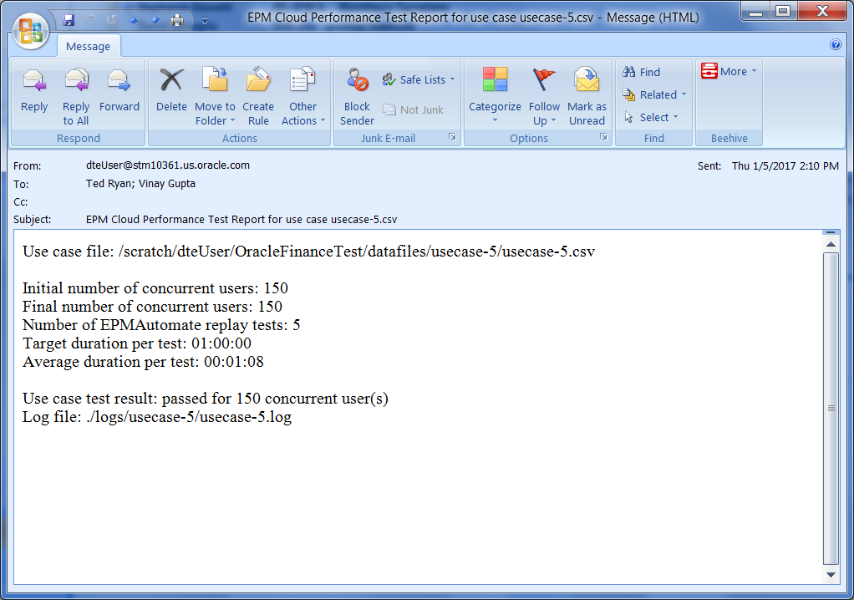
Result E-mail
If E-mails are specified in input.properties, an E-mail is sent at the end of the execution.
Example:

Slide 28
Location of Presentation
http://www.oracle.com/technetwork/middleware/bi-foundation/epm-cloud-app-workload-performance-3673355.pptx

