Slide 1
Agenda
Multicloud goes mainstream – S&P Global 2023 survey
OCI: your best candidate for multicloud
Customer Experience: Belgian Railways with Oracle Database Service for Azure

Slide 2

Melanie Posey
TMT Research Director
Cloud & Services Transformation
S&P Global Market Intelligence

Slide 3
OCI: your best candidate for multicloud
Stephane M. Moriceau
Director, OCI Solutions, JAPAC

Slide 4
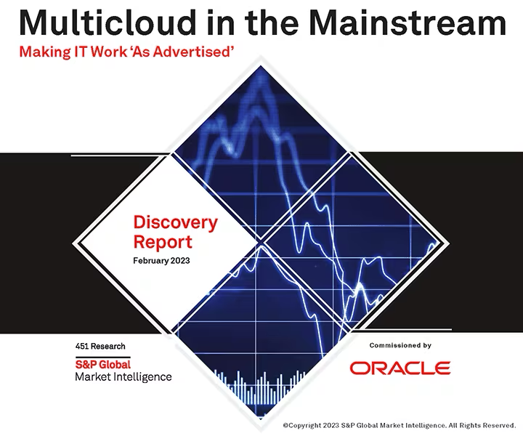

98% of enterprises surveyed are using at least 2 cloud infrastructure providers
Top drivers for multicloud:
data sovereignty (41%)
cost optimization (40%)
business agility and innovation (30%)
S&P Global survey, 2023
Download the S&P Global multicloud survey
4
Copyright © 2023, Oracle and/or its affiliates

Slide 5
What makes OCI special?
Why OCI for multicloud?
What about onboarding?
5
Copyright © 2023, Oracle and/or its affiliates

Slide 6
What makes OCI special?

Slide 7
Lower Cost
Higher Performance
Stronger Security
7
Copyright © 2023, Oracle and/or its affiliates

Slide 8

OCI’s Unique Architecture
Powers New and Existing Workloads
Traditional apps
Performance, elastic benefits without
re-architecture, modernize incrementally
Off-box virtualization | Isolation for security, performance, and predictability
L2 network virtualization | Network optimized for performance and service reliability
Nonblocking networks | Enables native VMware, database, and other clustering architectures
RDMA cluster networking | Microsecond latency clusters for the most compute-intensive workloads
Flex Infrastructure | Precise cloud elasticity
HPC / Machine Learning
Scale up to 20,000 CPUs or 512 GPUs in a cluster.
With supercluster, further scale to 32,768 GPU.
Compute-intensive apps
Bare metal instances for CPU and GPUs
Network-intensive apps
No network contention,
consistent network performance,
lowest cost outbound in the market
Critical databases
Native database clustering, scale up to PBs and thousands of cores
*OCI (Oracle Cloud Infrastructure)
8
Copyright © 2023, Oracle and/or its affiliates

Slide 9






OCI delivers customer outcomes
Predictable
Performance
No Growth Tax
Full
Flexibility
Always On Security
Compute
Simple & Effortless
$0
Choose the exact core and memory size as required
Growth Tax
Legacy Tax
Storage
Deeply Integrated
Network
Complete Control
9
Copyright © 2023, Oracle and/or its affiliates

Slide 10
Why OCI for multicloud?
Notes:
Next, let’s see why OCI for multicloud?

Slide 11











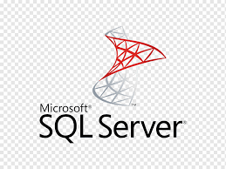



Business Agility and Innovation Platform
Cloud Datastores
Cloud Native Workloads
Enterprise Estate
ML & AI
Complete
Simple
11
Copyright © 2023, Oracle and/or its affiliates

Slide 12








Enabling Multicloud
OCI – Azure Interconnect
App
App
OCI Azure Interconnect
Combine capabilities of OCI and Azure
Available in 12 location, latency < 2ms
Oracle Database Service For Azure
Enable Azure workload with features / performance provided by Oracle Database and MySQL Heatwave on OCI.
No app change required.
Provision from Azure console and run on OCI
12
Copyright © 2023, Oracle and/or its affiliates

Slide 13


Enabling Multicloud
OCI – Azure Interconnect
OCI FastConnect
AWS Direct Connect
App
App
App
OCI Azure Interconnect
Combine capabilities of OCI and Azure
Available in 12 location, latency < 2ms
Oracle Database Service For Azure
Enable Azure workload with features / performance provided by Oracle Database and MySQL Heatwave on OCI.
No app change required.
Provision from Azure console and run on OCI
MySQL Heatwave on AWS
Accelerated AWS MySQL app analytics / ML
Provision from OCI console and run on AWS
Better price performance and less moving parts than RDS, Aurora, Redshift, Glue, SageMaker.
Remove overhead of ETL and a separate analytic database
13
Copyright © 2023, Oracle and/or its affiliates

Slide 14


OCI’s Distributed Cloud Spectrum
Oracle Exadata
Roving Edge
Mongo DB
Compute Cloud@Customer*
Exadata
Cloud@Customer
OCI Public Regions
42 + 9 planned
MySQL Heatwave for AWS
OCI Dedicated Region
OCI DB Service for Azure
DEPLOYMENT SIZE
On Premises Infrastructure
Hybrid Cloud
Public Cloud
Multicloud
 | Oracle Exadata | Roving Edge | Compute Cloud @ Customer | Exadata Cloud @ Customer | OCI Dedicated Region | Commercial Region | AWS Cloud Azure Cloud
Services Supported | Database | Compute / Network / Storage | Compute / Network / Storage | Database | Full Services | Full Services | Database, OLTP, OLAP, ML
Data Residency | On Premises | Remote Edge | On Premises | On Premises | On Premises | Regional | Regional
14
Copyright © 2023, Oracle and/or its affiliates
* roadmap

Slide 15
What about onboarding?

Slide 16







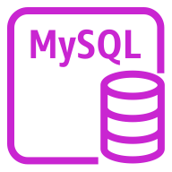
Ramping up OCI Skills
Service Equivalence
OCI for AWS & Azure Architects
Leverage OCLS & Partners
Maps OCI services to AWS, Azure and GCP services
Augment AWS & Azure knowledge to OCI with 3 Hours courses
Oracle Cloud Lift Service (OCLS)
Free assistance for migrating to OCI
Hands-on help & guidance from experienced cloud engineers
OCI Certified Partners for migration, turn-key service, support and maintenance.
Instance
Instance
Object Storage
S3
Topics:
Block Storage
Volume
Global Infrastructure
Identity and Access Management
Networking, Compute & Storage
Database
Security
Application Development
Monitoring & Observability
VCN
VPC
MySQL
Database
Service
RDS for MySQL
Link to the service mappings
Link to the trainings
Link to the partner list
16
Copyright © 2023, Oracle and/or its affiliates

Slide 17
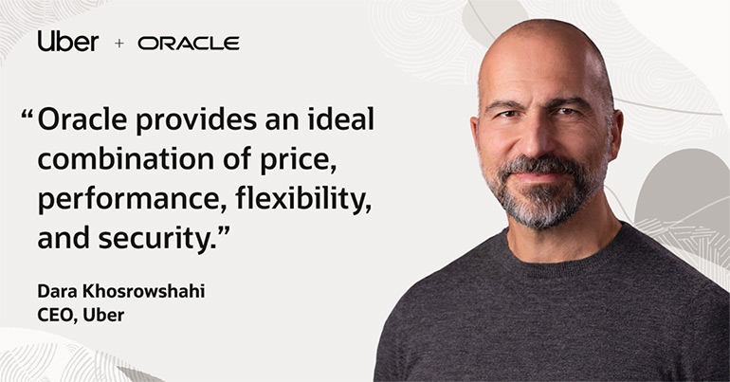
A robust cloud
Where you need it
That works
well with others
17
Copyright © 2023, Oracle and/or its affiliates

Slide 18


Jürgen Coetsiers
Enterprise Infrastructure Architect
Belgian Railways
Vittorio Garbuglio
EMEA Multicloud Leader
Oracle
18
Copyright © 2023, Oracle and/or its affiliates

Slide 19
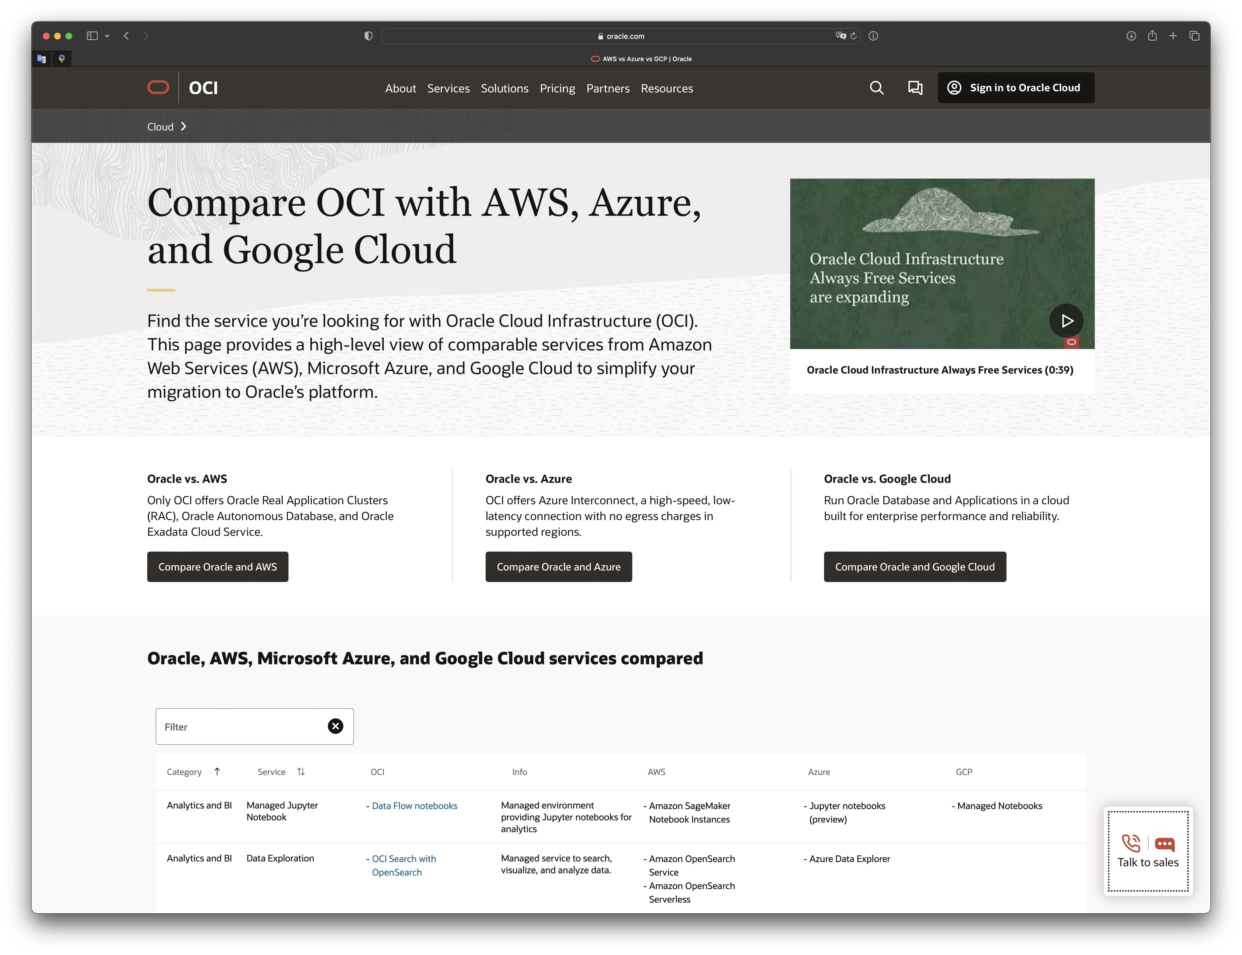
https://www.oracle.com/cloud/service-comparison/
19
Copyright © 2023, Oracle and/or its affiliates

