Slide 1

Certain Check In App
Check In Registrants at Events
August 2016
Dawn Lindgren
Maria Khaleel
Oracle Confidential – Internal
1

Slide 2

What’s the Check In App?
Via manned Apple device Apple devices only
Check in of existing registrations Search and swipe or scan QR code from email
Temporary Access Code Simple, limited access for onsite staff
Resources
Supplier guidelines for device rental
Training materials for onsite staff

Slide 3

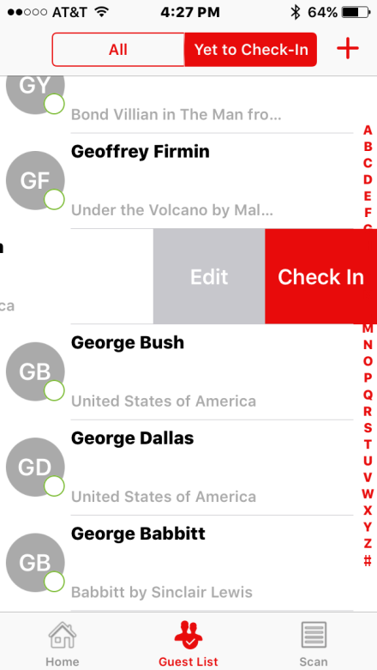
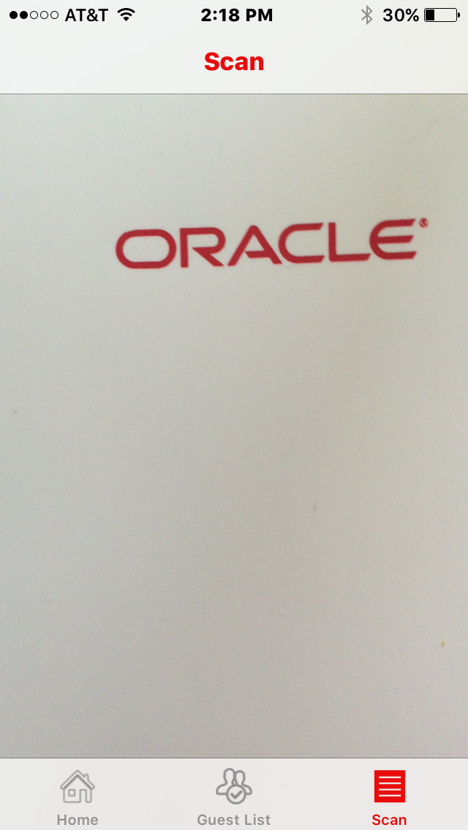
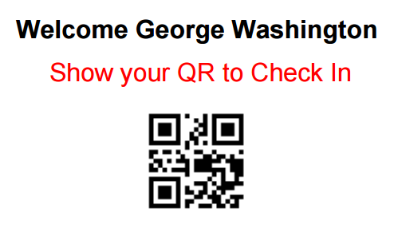

Check In is a swipe or scan away!
What are the benefits?
Improve customer experience
Reduce wait times
Provide modern technology experience
Improve data speed to sales
Reduce Event Manager workload
Reduce manual updates in desktop interface
Avoid manual uploads
OR
Welcome Barack Obama
Show your QR code to check in
Oracle Security approved for Apple devices only
3

Slide 4

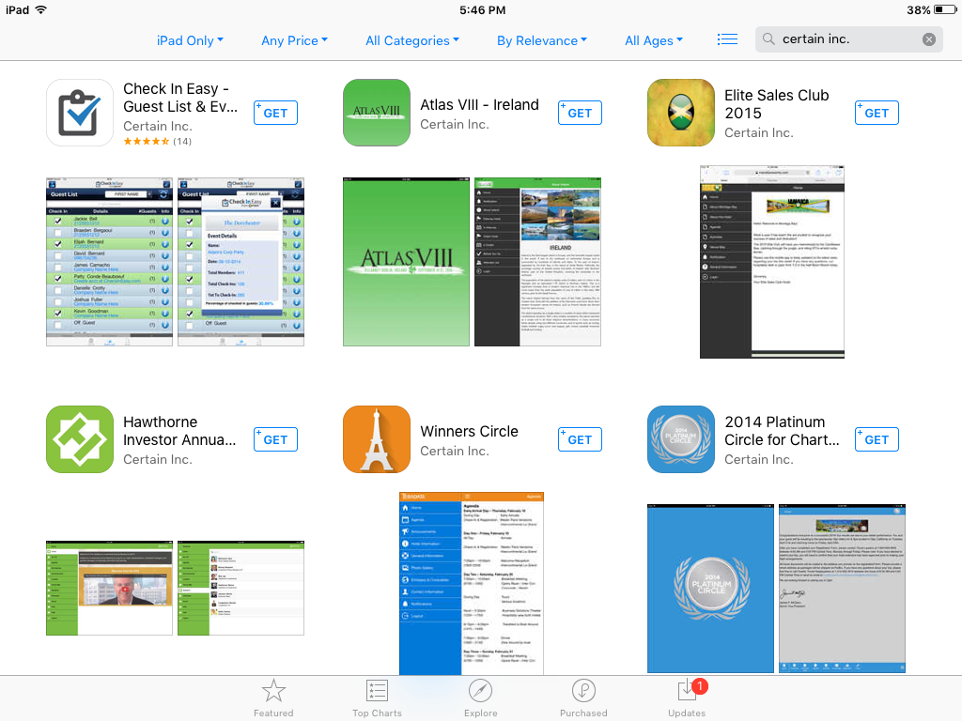
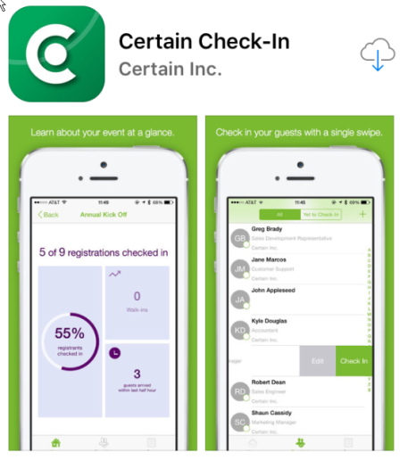
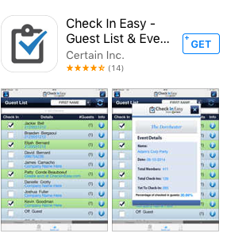




iPad Device Installation
How do I Install the App?
Oracle Privacy & Security (CSARB) approved for Apple
devices ONLY
Apple iStore
Via Direct Link http://itunes.com/apps/certaincheckin
Via Search for Certain Inc.
Locate Certain Check-In Do not be confused by Check In Easy App
When download completes, Certain Check In icon visible
Domain URL = https://eventreg.oracle.com/
Suppliers must uninstall app after event
Oracle Confidential – Internal
4

Slide 5
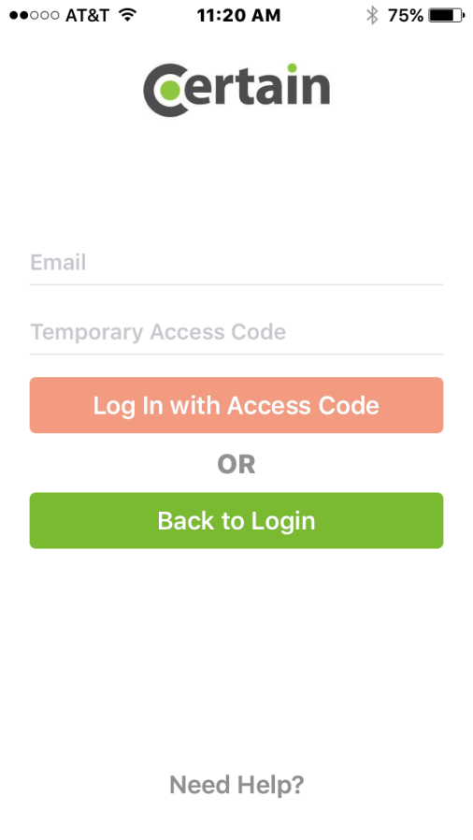
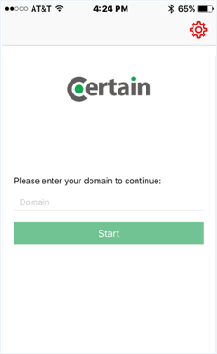
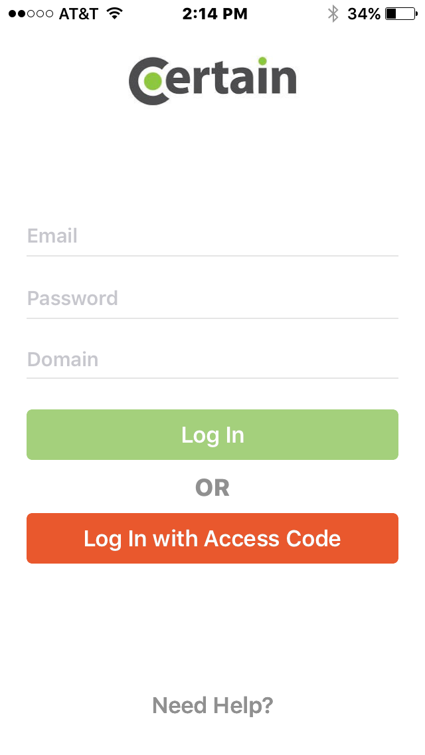
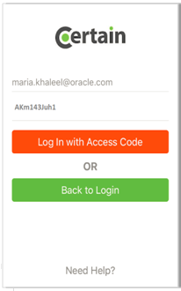
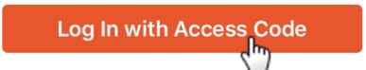
Log In to the Event with your Temporary Access Code!
How do Access my Event?
Click icon
Enter Domain Name as eventreg.oracle.com
Press
Registration staff to enter their own email address
Enter Access Code provided by your DMS Analyst - Each event’s code is unique and each day uses a new code
Press
4
dawn@gmail.com
5
Akm143juh1
6
2
eventreg.oracle.com
2
3
Oracle Privacy & Security (CSARB) approved for Apple devices only
Oracle Confidential – Internal
5
Notes:
SSO Log In is NOT currently an option. Temp Access Code only.

Slide 6
More on Your Event’s Access Code:
Temporary Access Code
Easy Onsite Staff Access
Primary Access method for all in Phase I
Single event view
Onsite support agency staff can check in only on rented Apple devices
Event visible for use in App the day prior to event + the event dates
Initial set up by GMSS Digital Marketing Services with self service updates by Event Manager directly in Certain
Oracle SSO Log In - Coming Soon!
Access to app for Oracle employee Certain Account holders
View is multi-event
dawn@gmail.com
Akm143juh1
Notes:
https://community.certain.com/pagehelp/assets/docs/check-in_quickstart_ios.pdf

Slide 7
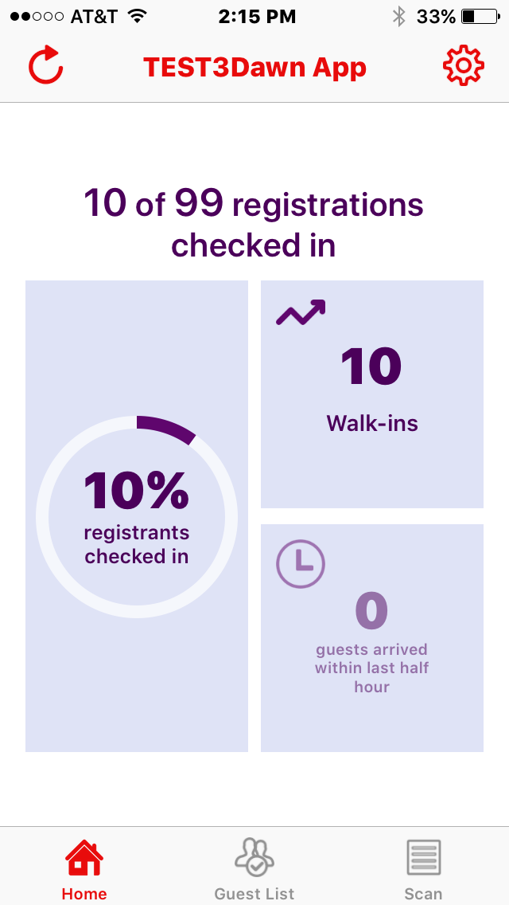
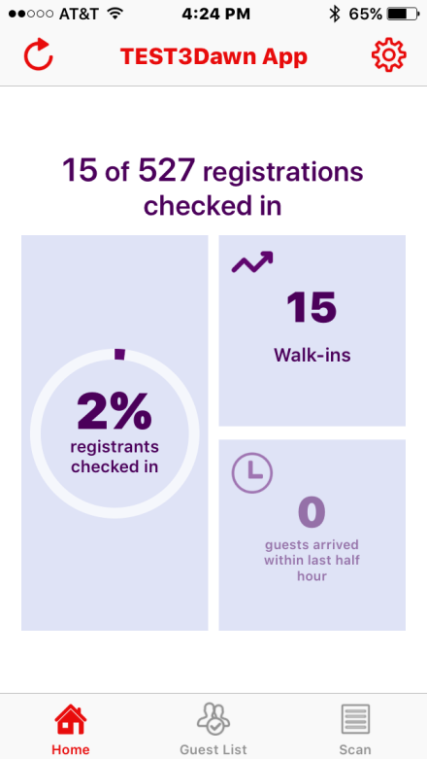
Navigation – Home Page
Refresh
Settings
Event Name
Double click on time to scroll to the top of any page
Live statistics
Navigate to specific page

Slide 8
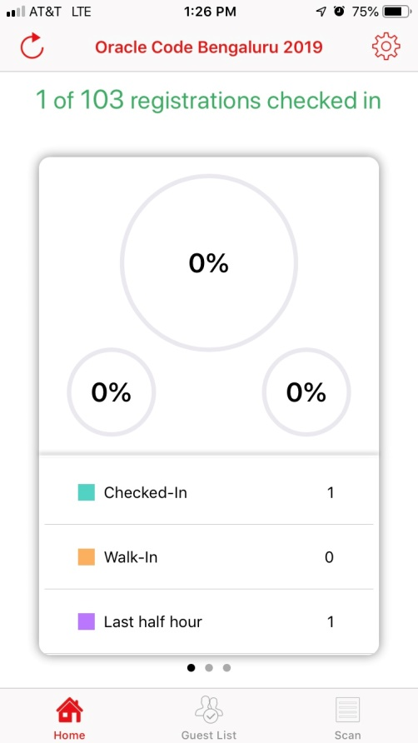
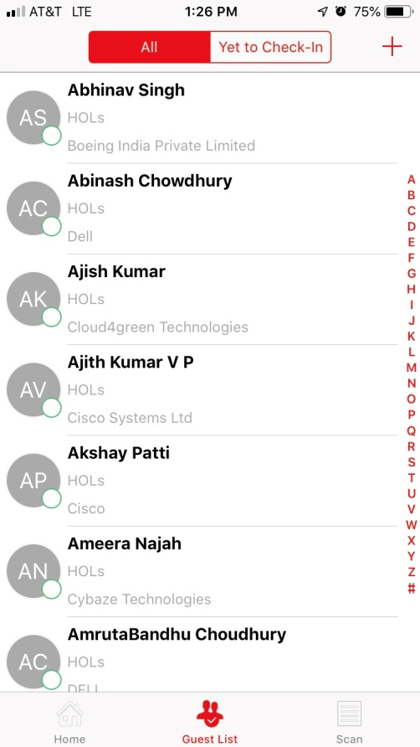
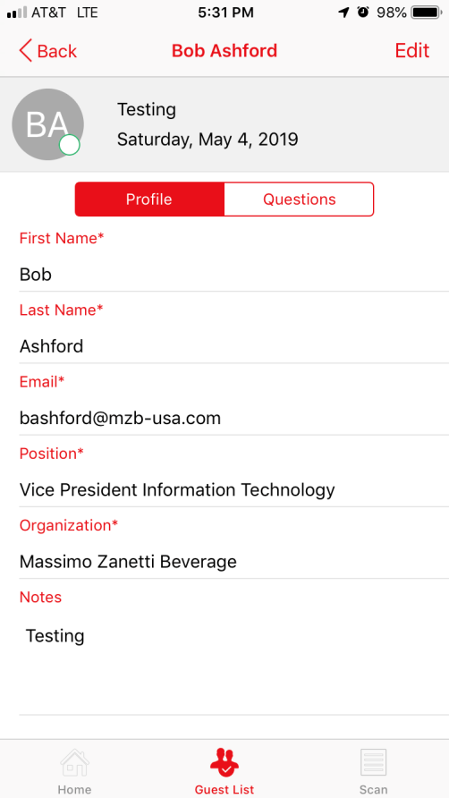
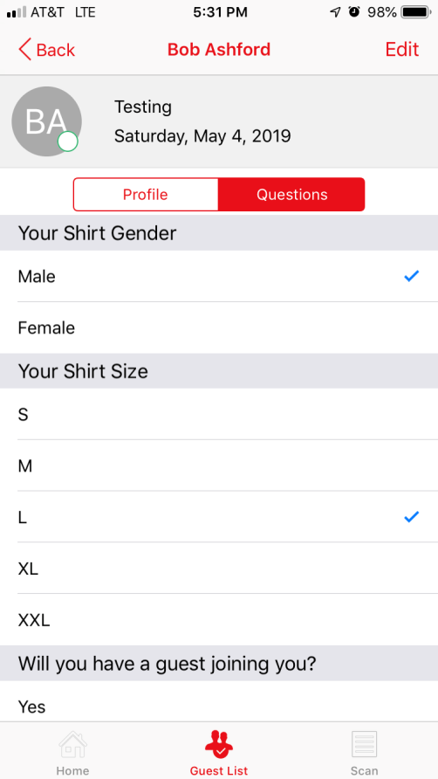
Certain Check In App
8

Slide 9
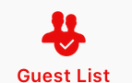
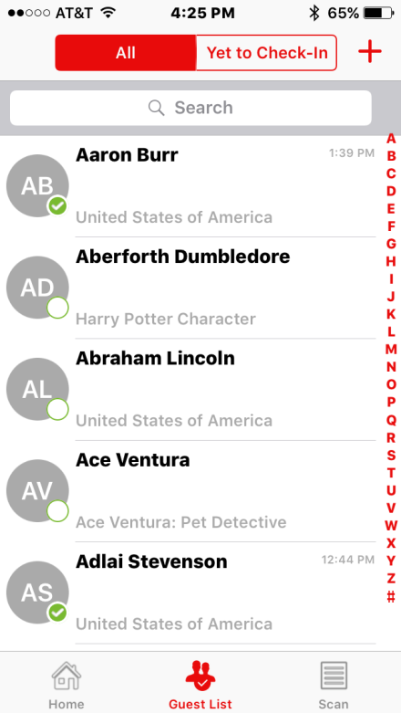
Navigation – Guest List
All All registrations except Denied
Do Not Use Walk in registration managed at Registration Desk
Search Search using First and Last Name, Company
Yet to Check-In
Filters to only registrants that have not yet checked in
Registrants
Sorted by first name
Tap on name or swipe left to Check In
Quick scroll to first letter of first name
Navigate to specific page

Slide 10
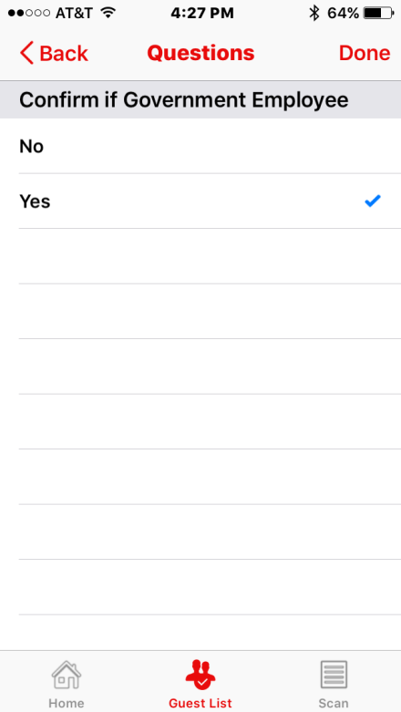
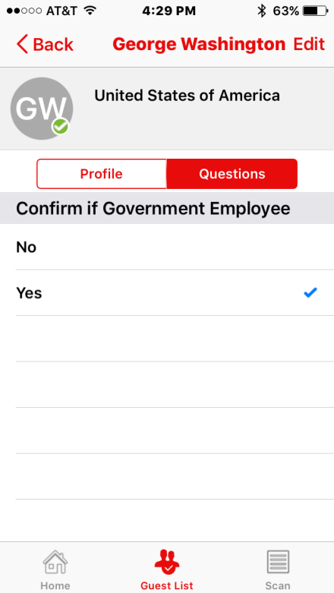
Navigation - Questions
Back Back out of record
Done Click when answer is provided or confirmed
Question Questions are displayed automatically after an attendee is checked in
Selected Answer
If an answer was already provided during registration, it will be checked If no check mark, please tap to select the answer provided
Answer Options Validate or add the answer if not already checked
Dependency: Check In configured with question

Slide 11
Check In existing registrations with a swipe or scan
Check In Options
Swipe/Tap Scan
Additional Check In Question
“Government Employee” *
OR
Welcome Barack Obama
Show your QR code to check in
Oracle Privacy & Security (CSARB) approved for Apple devices only * North America requirement

Slide 12
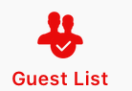

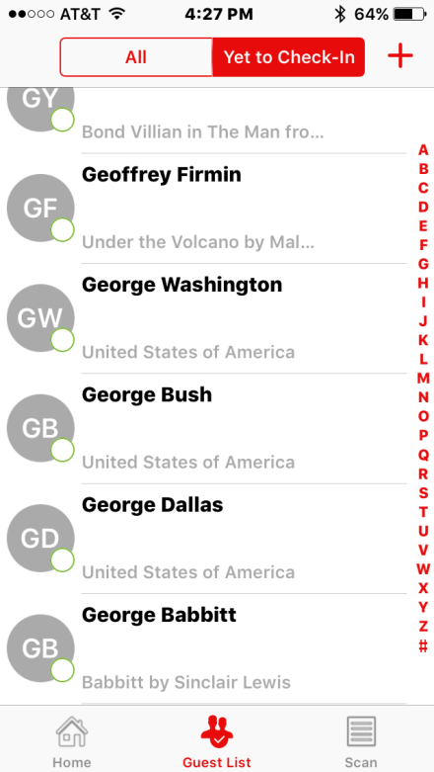
Manual Swipe to Check In
Press Guest List icon on bottom of screen
Press at top of screen
Search options
Swipe up or down
Click on letter for last name on right side of screen
Search by First, Last, Company, or Email
Swipe Left or tap on Name to expose Check In
Tap Check in additional question will display if configured, click answer and done.
2
c
b
a
1
Oracle Confidential – Internal
12

Slide 13
Search for Registered Attendees
Methods to Search
a. Scroll Scroll down through Names are listed in alphabetical order by first name
TIP: Quickly return to top of screen: double tap the time at top of device
b. Filter by first letter of First Name To display only Fast Names beginning with specific letter, click on the alphabet filter on left
c. Search by First or Last Name, Company, or email address To expose Search box scroll up to top record
Oracle Confidential – Internal
13
Notes:
Select the registration records you want to update
Click on the dropdown box below Mass Action and select the action you want to take against those selected

Slide 14
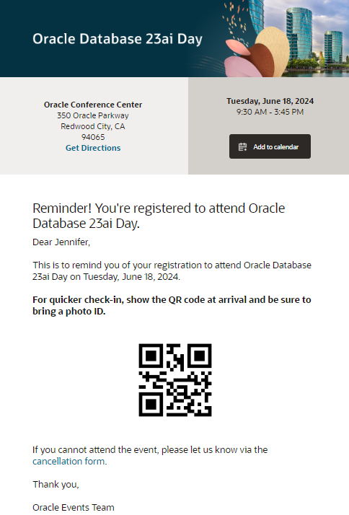
Navigation - Scan
Prerequisite! Requires QR code and instruction to present QR code at check in included
on the confirmation & reminder emails
Scan Attendee QR Code Tap Scan and view the barcode
(which must contain the attendee’s Registration ID)

Slide 15
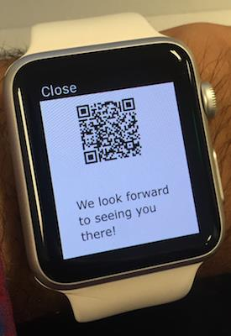
Scan QR Code to Check In
Requires QR code and instruction to present QR code at check in to be included on the confirmation &/or reminder emails
Instructions to scan to check in
Press scan icon
Point device camera to QR code (readable on both paper or mobile device)
App fetches registration record and automatically marks as check in (using Oracle status defined at set up)
Answer any questions if set up
Click Done
Welcome Barack Obama
Show your QR code to check in

Slide 16
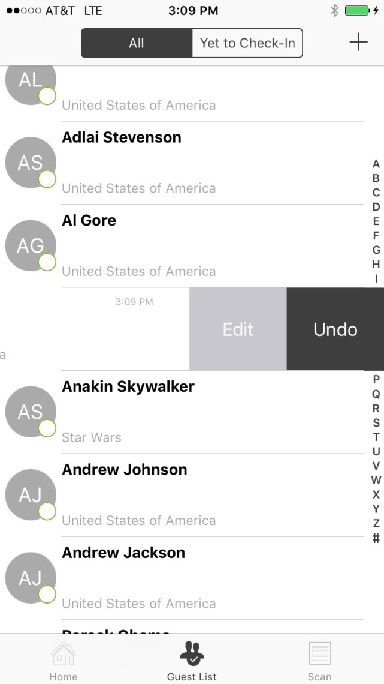
Undo a Mistake
View list of all registrants by clicking the All tab at top of screen
Find the name
Swipe to reverse the check in
When reverted, Registration Status will be set to ‘Pre Registered’ to avoid triggering email notifications
Oracle Confidential – Internal
16

Slide 17
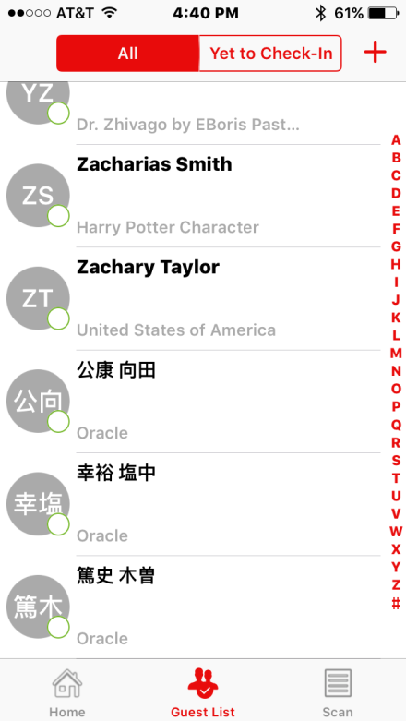
Language Support
Customer information displays in language as entered by customer
Field Labels in English
Search in language as entered using international keyboard setting on Apple mobile device

Slide 18
Event Manager Responsibilities
Use Apple Devices Only Although available for other platforms, Oracle Privacy & Security (CSARB) has only approved Apple
If renting equipment for Agency Staff, Ensure iPad supplier follows
Agency staff is not permitted to use their own personal devices
Guidelines for Suppliers helping with physical marketing events.pdf
Downloads the proper Certain Check In app and supporting onsite training file
Temporary Access Code
Discrete communication
Accurate expiration time
Ensuring new code created for each day of event (per Oracle Security)
Onsite Staff Log & Training Collect the email address and name of each person and iPad assignment
Action plan to address any security concern onsite: immediately act on appropriate process to reset code, find my iPad, or wipe equipment (See slide #22)

Slide 19
Action Plan for Device/Data Security
PREP: Suppliers & Staff
Supplier devices managed by an MDM (Mobile Device Management) solution
Do not use Supplier employee devices
Suppliers comply with the Guidelines for Suppliers helping with physical marketing events.pdf
Onsite Staff Log: Collect the email address and name of each person assigned a device/using temporary access code
Discrete distribution of temporary Access Code
Training: Reminder to turn in device for any break or change of duty
ACTION: Missing Device
Search for physical device only for brief period, then use any or all of the actions below based on severity of situation:
Event Manager log in to Certain, change Access Code and/or Expiration date/time
Alert Mobile Device owner to action
“Find my iphone”
Shut down with MDM
Report any suspected data breach to Oracle Security
ACTION: Staff Issue
Event Manager change the Access Code and/or Expiration date/time
Confidential – Oracle Internal

Slide 20
In App Statistics
In App Statistics reflect
Percent Checked In
Walk-Ins App defines Walk In = Check In count via app
Arrival in past 30 minutes
Advise staff to not be distracted by this page as impacted by refresh times
If the app losses connectivity the statistics would not be refreshed
NOTE: Guests not pre-registered should use the Oracle Walk In process for full data capture (HTML Walk In Registration Form, Paper Walk In form, or manual add in Certain browser view by Event Manager)

Slide 21
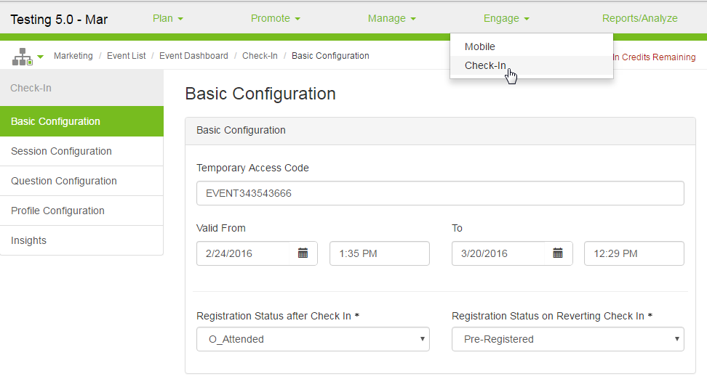
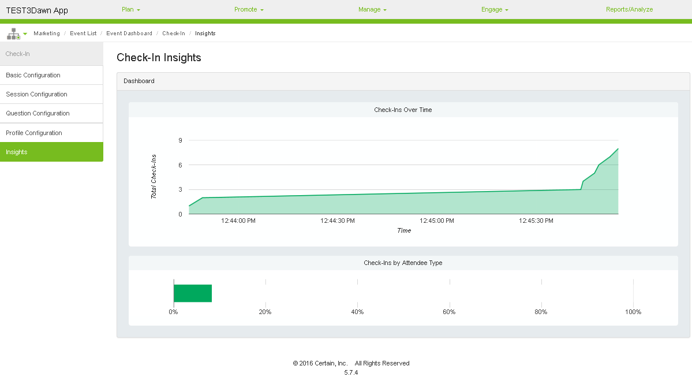
Certain Check-In Insights Certain Main Application Interface
View charts and graphs for insight into how the event went, including:
check-ins over time
check-ins by attendee
Q&A responses (depending on set up) as pie or bar charts
1
2
3

Slide 22
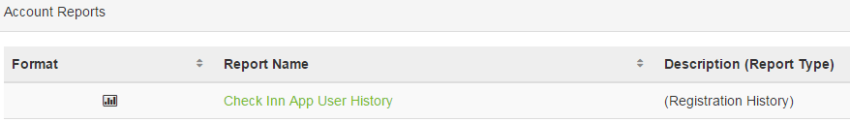
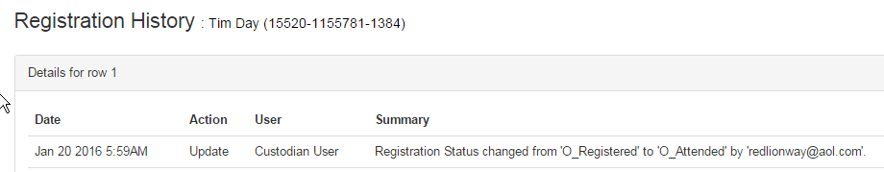
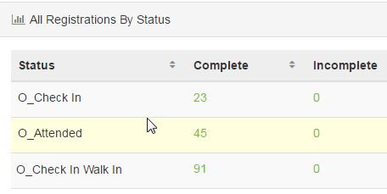
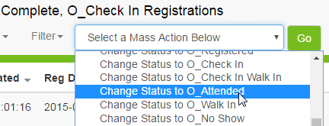
Reports Available
Registration History on Individual Record Each record will reflect the status change in Registration History. Summary field reflects the action and includes detail of User with email address of the person that logged in with the access code.
Check In App User History Event Report of all registrations checked in with Temporary Access Code
Reminder: Final Update to O_Attended* Attendees final status must be updated to O_Attended* If status of O_Check In* used for event, ensure all required actions specific to the event are complete, then use Mass Action to easily change Registration Status from O_Check In to O_Attended
* Reminder: Walk In should use O_Check In Walk In and be changed to O_Walk In
Barack Obama
by ‘dawn@gmail.com’

Slide 23
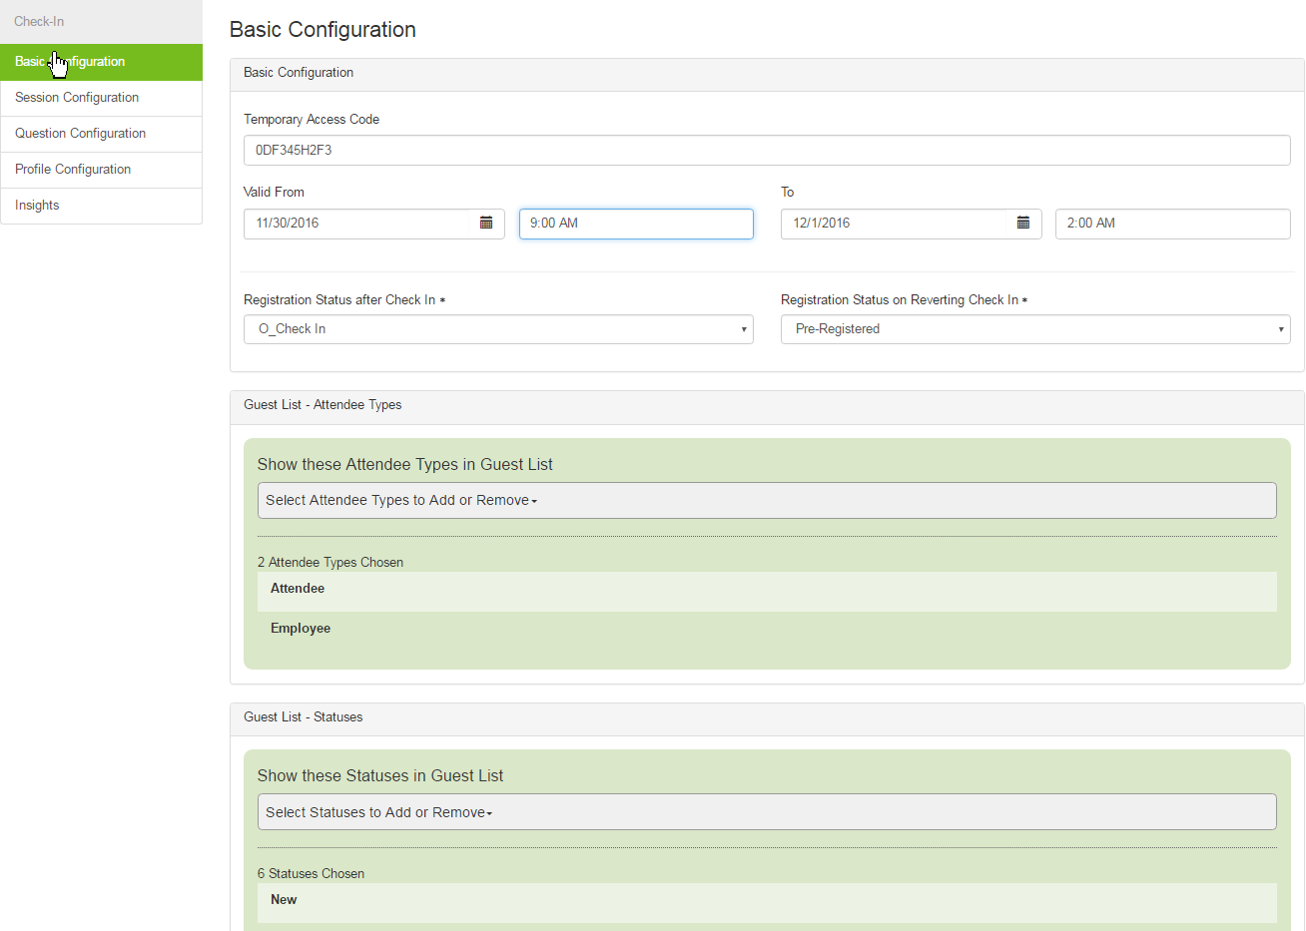
Which Status to Use?
Delayed or Complex Lead Flow
Default status configured to ‘O_Check In’
Mandatory Status to use when
- Agenda / Multi Channel events - Multi Day Events - For Sales Rep ID assignment - Uploads (i.e., Lead Notes)
After onsite Check Ins complete : Perform data checks, manage Agenda status, add data additions (i.e., Sales Rep ID, Lead Notes and ‘No lead Flow’ flag (To Do List))
Best Practice perform data review and additions prior to event
Final Action Required: Status Update to O_Attended / O_Walk In
Reporting and legal record retention requirement
Leads will only trigger in final status AND MRM Lead Flow defined
No uploads and all data management actions performed, Mass Action O_Check In Registration Status to ‘O_Attended’
If uploads, final updates to be made via upload template Registration Status should be included on upload template using O_Attended for O_Check In and O_Walk in for O_Check In Walk In
Quick Lead Flow or No Lead Flow
Check In App status configured to ‘O_Attended’
For standard single FUSC events only
Data checks, Lead Notes and ‘No lead Flow’ flag (To Do List) should be set prior to the event
Default set up Registration Status after Check In = O_Check In

Slide 24


Registration Status Usage O_Check In vs. O_Attended
O_Check In Temporary status default set up
Allows time for data analysis or augmentation, manage agenda status for multi FUSC campaigns, add lead notes, etc.
Control timing of when lead flow journey to sales begins (if set up for lead flow in MRM)
MANDATORY ACTION: O_Check In status later updated to O_Attended (use report to easily action all at once)
O_Attended Final Registration status – Mandatory for all Attendees (irrelevant of lead flow requirements)
Data flow begins journey to CXD CXD – data must flow to CXD with O_Attended for the following reasons
Update interaction information in database
Legal record of attendance
Common event reporting for you, your LOB, and Jason Maynard
Targeted for future campaigns when appropriate
Interaction detail for Oracle Sales in Profiler tool
Topic Scoring
Checks MRM for lead flow selection and begins scoring

Slide 25
Certain Check In App Check List
1. Request Event Set Up
Indicate if Certain Check In App configuration is needed for your event
If scanning to Check In attendees, personalized QR codes have to be added on confirmation emails and/or reminders, indicate the same in comments section
Identify check In status based on Quick Flow or Complex/Delayed flow needed. More info
Provide if any additional questions to be added for Check in App. More info
2. Pre Event Checks
As part of approving event, make sure the Check In App is working as expected
Perform registration data checks, update Lead Notes and mark for ‘No lead Flow’ flag (To Do List) as appropriate
Mandatory for Quick Lead Flow process
Best Practice for Delayed Lead Flow
Follow your standard badging process (pre-printing of badges) (dynamic print not yet available)
3. Onsite: Check In Process
Train Onsite Staff
Protect equipment & data
Data Privacy
Log In/Access Code
Swipe to Check In
Government instruction
Badge pick up instructions
How to revert a check in
Walk In Attendees via Certain HTML Walk In Form (not App)
Denied attendees will not be available on the app to check in, they have to be manually reviewed by the event manager
4. Onsite: Post Check In Process
Returning the device
Make sure the data is synced into the event with good network connectivity
Ensure Data quality
Ensure user is logged out of the Check In app and the data is deleted
Delete App from Device
Return Devices to the Supplier
Registration Management in Certain
If delayed lead flow (see more info)
Ensure Status is set from O_Check In to O_Attended for registered attendees after data checks, no lead flow flag and Agenda status is updated
Ensure status is set from O_Check In Walk In to O_Walk In for Walk ins
Mark No Shows by setting Status to O_No Show
When a check in is reverted via the app, the status is set to ‘Pre-Registered’, mark these as O_No Show
For all accepted statuses like O_Registered, O_Registration Approved, O_Special Approved
Oracle Confidential – Internal
25

Slide 26
Reminders for Onsite Staff Training
Agency staff not allowed to use their own personal devices
Each individual to log in with Access Code and their own email address
Temporary Access Code Security
Do not put the access code on a post it attached to iPad
Do not announce it in the crowd
Check In app only to check in existing registrations on the list
Walk In Registration will be managed by the registration desk (not the app)
Do not leave device unattended
Give device back to the registration desk manage if you require a break or to perform different duties
Oracle Privacy & Security (CSARB) approved for Apple devices only
Oracle Confidential – Internal
26

Slide 27
Requesting Set Up via Portal

Slide 28
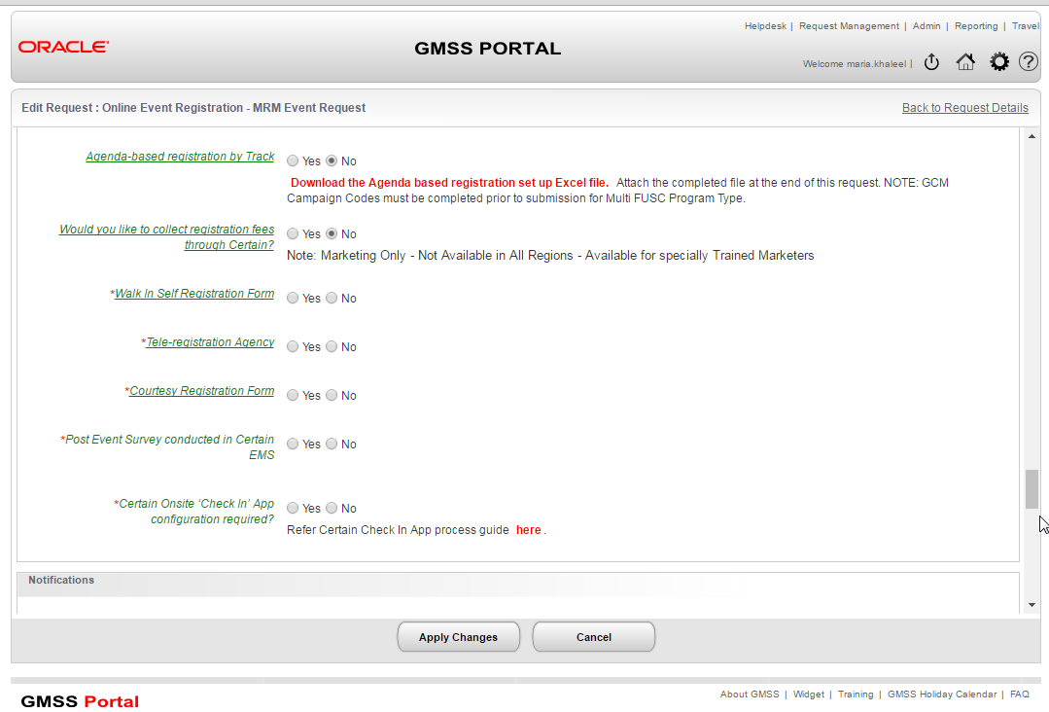
Portal Request > Online Event Registration
Event Manager submits Portal Request: Online Event Registration
Answer 1 question as Yes

Slide 29
Check In App Set Up
Digital Marketing Services completes initial Basic and Question Configuration
Event Manager submits Portal Request > Online Event Registration answer the Check In App question
Default is O_Check In to enable control of data/lead flow
Event Manager manages updates
Temporary Access Code
Valid To and From Dates/Time

Slide 30
How to change to Access Code and Status Configuration
Navigate to Engage > Check In
Temporary Access Code
Auto generated and unique for each event
Minimum 10, max 25 characters
Field is editable - Oracle Security dictates avoiding related event names or program codes
Multi-Day events – Oracle Security requires new code for each day
Valid From and To
Controls availability of Event on App with Code
Default dates a day prior and during event date/s
Update End time as soon as the check in activity has ended to ensure data security
Validate Registration Status set for upon check In
Default: O_Check In
Exception dependant upon event requirements: O_Attended More info
Registration Status on Reverting Check In remains as “Pre-Registered” to avoid email triggers
1
2
3
4
5
Session Configuration is not available yet (Future Privacy & Security (CSARB) & Contract)
Default values included:
All Attendee Type registrations
All Registration Statuses except Denied

Slide 31
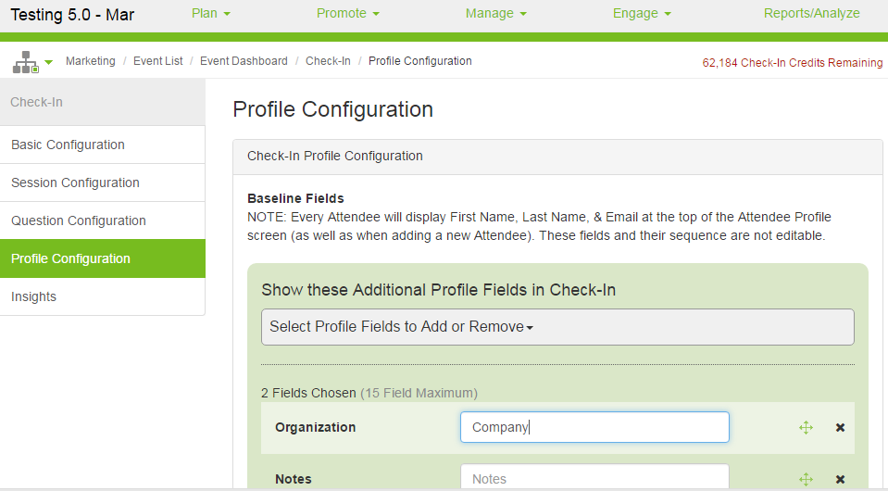
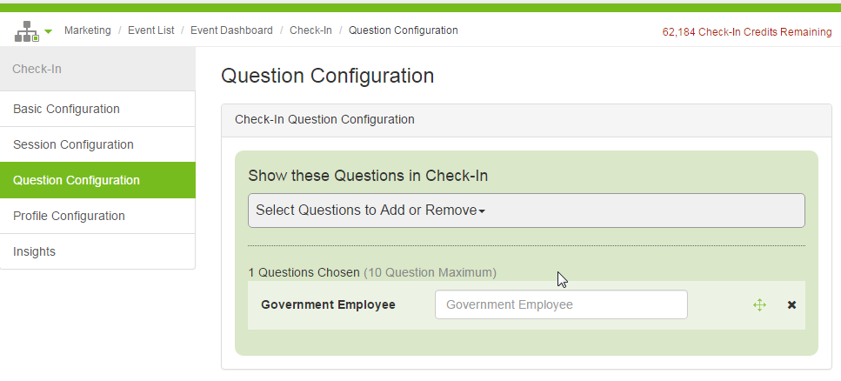
Data fields available via App
Default Fields
First Name
Last Name
Email address
Company
Government (y/n) (North America Events Only: Manually Added - Question Configuration tab)
Additional Fields
Requires exception review and approval
Oracle Privacy limits the data permitted to ask
Question will be considered only if brief question, non-PII data type, yes/no answers
Work with your Digital Marketing Services Analyst to add fields prior to the event date

Slide 32
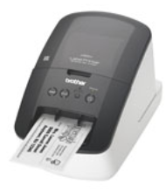
Reminders
What’s Next?
Use Apple Device Although available for other platforms, Oracle Privacy & Security (CSARB) has only approved Apple
Walk In Registration
not managed by app
use Walk in Registration Form or manual add registration function
Update Access Code for Multi-day events Oracle Security requires temporary Access Code to be changed each day
Suppliers not permitted to use personal devices for check in
Dynamic badge print Coming Winter 2016 print badge upon check in using App
Requirement: Wireless printer Recommendations: Any Apple approved wireless printer with “AirPrint” is good best practice. Although Certain is not dictating the specific printer, Certain developed and tested using the following wireless printers: Brother QL-710W, Brother QL-720NW and Zebra GK/GX 420D
Future Phases:
Android and Windows10 device require future review and approval by Oracle Security dependant on device security enhancements
Session Scanning
Oracle Confidential – Internal
32

Slide 33
Resources
Pre-Event
Guidelines for Suppliers helping with physical marketing events.pdf
Onsite
Certain Check In App QUICK REFERENCES:
Onsite App Usage.pptx
Onsite Security Action Plan.pptx
Onsite Event Management:
Badging
To Do list
Manually updating records
Walk In Management
Adding Lead notes
Post Event
Confirm all Registration Status are in appropriate final status:
O_Attended
O_Walk In
O_No Show
Reporting: Events, Contacts, Responses from all Marketing Systems-CXD Analytics

Slide 34
Appendix

