Slide 1
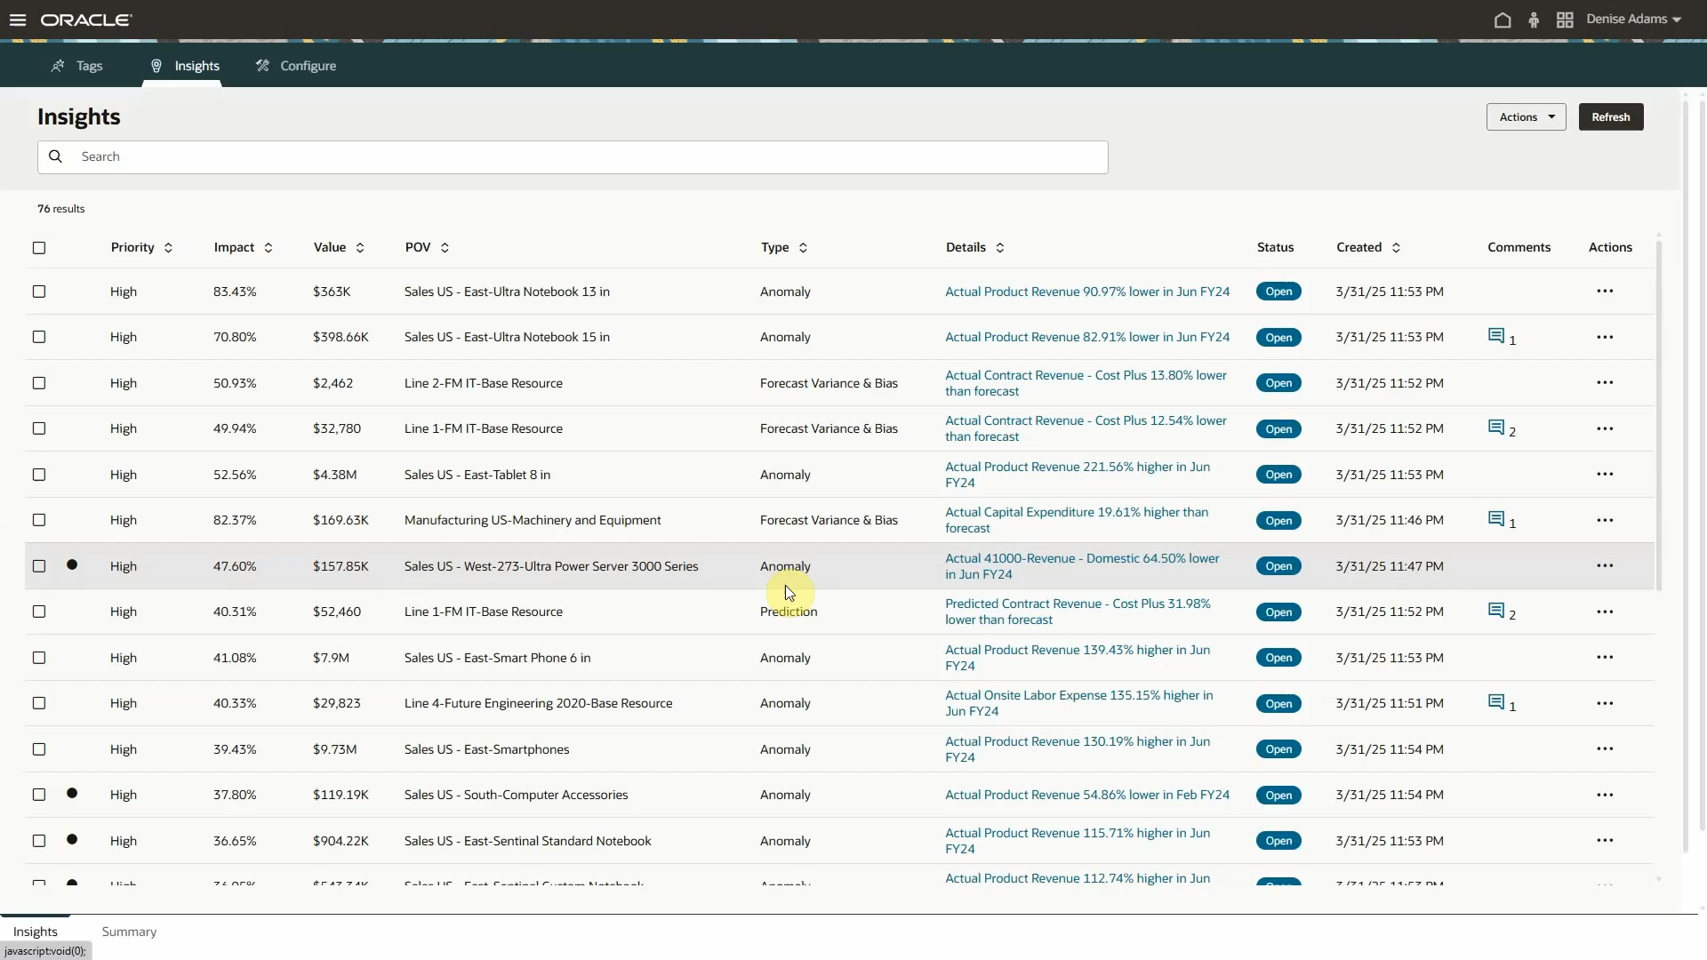
What EPM Customers leverage TODAY

