Slide 1



Oracle Mobile Applications UX Rapid Development Kit
Wireframe Template
For Designing Simplified User Experiences for Oracle Mobile Applications
Oracle Applications User Experience
Spring 2017

Slide 3


Mobile Cloud App Design Support
Free eBooks that support mobile cloud application design:
  Design patterns eBook: Offers guidance on how to design your mobile cloud apps. These design patterns are referenced throughout this mobile wireframe template.
  Technical eBook: Offers guidance on how to use the Rapid Development Kit (RDK) to build and deploy applications that have the same look and feel as Oracle Mobile Applications. This eBook is packaged with the kit.
Video training: Designing the Right Thing and Designing the Thing Right

Slide 4
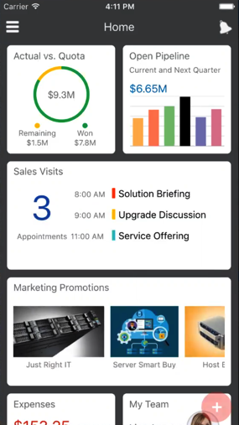
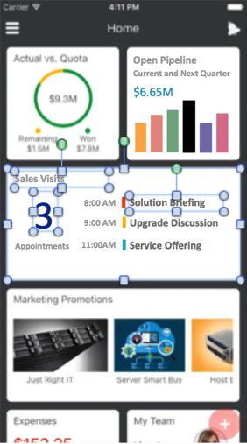
How to Use This Template
This is an editable Microsoft PowerPoint-based wireframe template.
  It will enable you to design high-fidelity wireframes that look and feel like Oracle Mobile Applications.
  Review and use this template in edit mode vs. presentation mode. You can move, edit, or rename almost all design elements that appear in this template.
  The interface backgrounds are embedded in the slide master to make selection and alignment easier.
Determine the outline of your flow, choose appropriate pages and UI components, and then start designing your application.
Annotate your design using callouts and describe the interaction design, open issues, changes and decisions.
Open Pipeline
Current and Next Quarter
$6.65M
Sales Visits
3
8:00 AM
9:00 AM
11:00AM
Solution Briefing
Upgrade Discussion
Appointments
Service Offering
1
Notes:
Good annotations are important. Annotations:
Help stakeholders understand your designs, including the look and layout, as well as the behavior and flow or the “interaction” design.
Capture the key user goals and support the guiding Jobs-to-be-Done practice that outlines why an an organization is “hiring” this particular flow.
Describe open issues, recent changes, and the latest design decisions and other supporting documentation.

Slide 5










































Icon Palette
Make this template your own.
Select a sample application flow to form the basis of your new design flow.
Review the slide backgrounds in the Slide Master to choose the most appropriate layout.
Edit, add, or remove page components for your design needs.
  Use the palette, or create your own slide with commonly used shapes.
  You can create custom palettes by duplicating this page and adding the shapes you most often work with.
  Use the Gridlines & Arrange feature to help with alignment.
  Replace the text with your own, such as page titles, actions, descriptions, and so on.
Use, reuse, and resize these icons in your wireframes. Most of these icons are sized 44px to facilitate selection. You may need to reduce them from 44px x 44px to 16px x 16px.
It is assumed these icons will be used on a color background. These icons will not be visible on a white background.

Slide 6
Common Components
Login, Home, Shuttle, Notifications, and Capture
Notes:
PREREQUISITES
Review our training on Building the Right Thing & Building the Thing Right that covers:
How to define concise job descriptions
Core design principles for Oracle Cloud Applications simplified user interface (UI)
Why and how to use wireframes in your design process, including wireframe practice exercises
Be familiar with key Microsoft PowerPoint actions, such as how to:
Select and duplicate objects
Edit shape properties, size, color, font, alignment, grouping/ungrouping, and bring-to-front/send-to-back
Access and edit slide masters (backgrounds)
Sketch your flows before you wireframe.
Review the Simplified User Experience Design Patterns for Oracle Applications Cloud Service eBook, and use it as a reference.
Developers should also review ADF page overlays to identify technical components.

Slide 7
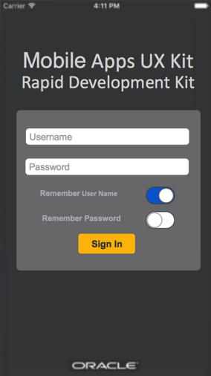

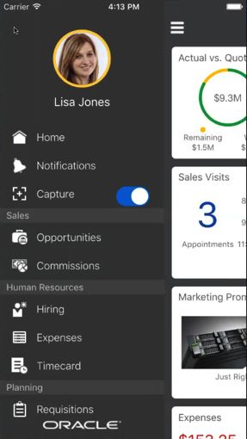
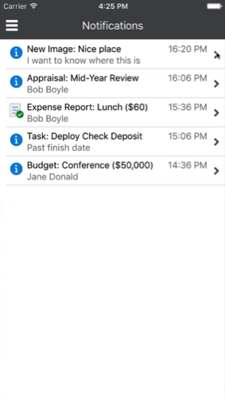
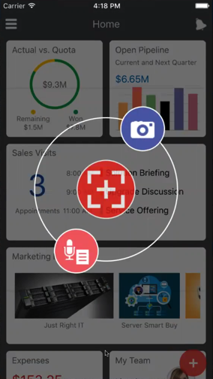
Common Components
Login
Home/Infolets
Shuttle
Notifications
Capture

Slide 8
Login
Component type: Single Purpose Page > Login
Consideration:
  What are the defaults for remembering login credentials?
  Does the user log in once or each time they come back to the app?
Example annotation: The “Remember Password” option is off by default, but it can be enabled by users with the guidance that they have a secure passcode set up on their device.
Mobile Apps UX
Rapid Development Kit
Username
Password
Remember User Name
1
Remember Password
Sign In

Slide 9



Home Experience and Infolets: Portrait View
Component type: Home Experience
Consideration:
  This the first page that a user sees when they log in to their application.
  This page type supports “Glance” interactions.
  See OAUX Design Philosophy Glance, Scan, Commit.
To edit the ratio of the the doughnut chart in an infolet, use the the Format Data Series action to edit the source data of the graph.
  Note the guidance in the eBook on how gauge color changes by percentage: See Percentage Gauge.
Home
1
Actual vs. Quota
Open Pipeline
Current and Next Quarter
$9.3M
$6.65M
Remaining
$1.5M
Won
$7.8M
Sales Visits
40%
3
8:00 AM
9:00 AM
11:00AM
Solution Briefing
Appointments
Upgrade Discussion
Service Offering
Marketing Promotions
Just Right IT
Server Smart Buy
Host

Slide 10

Home Experience Infolets: Landscape View
Component type: Home Experience
Consideration:
  The infolet view supports landscape view when the device is turned.
  The infolet layout adjusts dynamically to this view. Other page types do not adjust to landscape view.
Right-click on the chart to edit chart data, colors, and so on.
Expenses
My Team
Opportunities
$153.25
Lisa Jones
12
Open
Pending Approval
2
4
6
$74.50
My Kudos
Approved, 10/21
Team Kudos
Leads
5
Open
6

Slide 11

Shuttle
Component type: Navigation > Shuttle
Consideration:
  The shuttle allows the user quick access to global features, user actions, and all work area landing pages that the user has access to.
  The shuttle is accessible from work area landing pages.
Shuttle opens from the Actions menu icon, which shifts the current page content to the right.
  Wireframe tip: Crop the relevant landing page image in to the available whitespace.
Notifications, Opportunities, and Hiring are built out flows. Commissions, Expenses, and Timecard are placeholders for work area landing pages, so they contain no content.
1
Lisa Jones
Home
Notifications
2
Capture
Sales
Opportunities
Commissions
Human Resources
Hiring
Expenses
Timecard
Planning
Requisitions

Slide 12
Notifications
Component type: Notifications
Consideration:
  Different row-level actions are exposed by swiping right or left; tap to enable action.
  See also Embedded List, Row-Level Actions section.
Dismiss is the default row-level action for notifications on swipe left. Common actions, such as Approve and Dismiss, can be represented with icons. Custom actions appear as text.
Notifications
New Image: Nice place
I want to know where this is
16:20 PM
Appraisal: Mid-Year Review
Bob Boyle
16:20 PM
Expense Report Lunch ($60)
Bob Boyle
16:20 PM
Task: Deploy Check Deposit
Past finish date
16:20 PM
16:20 PM
Dismiss
1
et: Conference (50,000)
e Donald

Slide 13



Capture
Component type: Capture
Consideration:
  Users tap the Capture icon to open the action wheel to access capture actions, for example, to take a picture or add a note.
  The background is transparent, which allows users to see the page behind the capture layer.
  See also Action Wheel.
Capture icon
Action wheel
2
1

Slide 14
Sales Flow
Review and Edit Sales Opportunity

Slide 15
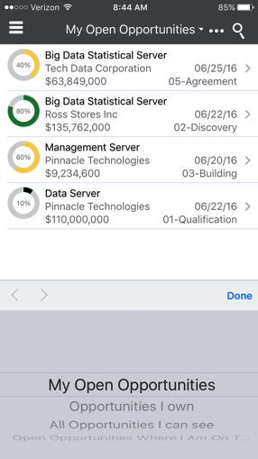
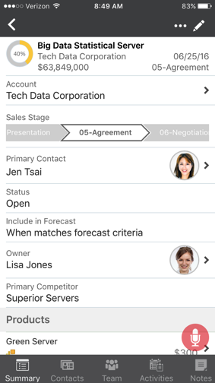
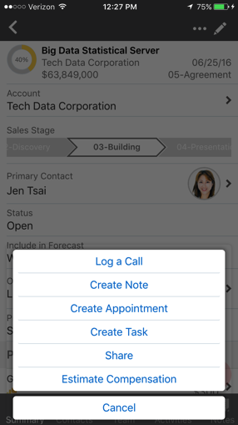
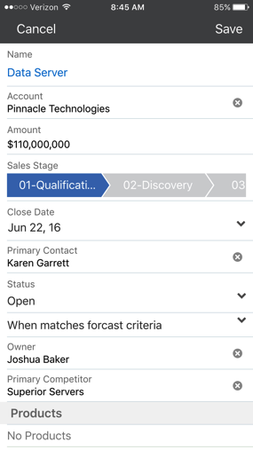
Review and Edit Opportunity
Shuttle
Landing Page
Detail Page
Action Sheet
Edit Page
Lisa Jones
Home
Notifications
Capture
Sales
Opportunities
Commissions
Human Resources
Hiring
Expenses
Timecard
Planning
Requisitions

Slide 16
My Open Opportunities
Component type: List view
Consideration:
  The list view component enables users to quickly view information about multiple objects and to decide whether to take action on an object.
  This page type supports scan interactions.
  See also Percentage Gauge and Glance, Scan, Commit.
Row-level action is a custom action: Log a call
My Open Opportunities
40%
Big Data Statistical Server
Tech Data Corporation
$63,849,000
09/25/16
05-Agreement
80%
Big Data Statistical Server
Tech Data Corporation
$135,762,000
09/25/16
02-Discover
60%
Management Server
Pinnacle Technologies
$9,234,600
09/20/16
03-Building
Log a call
1
ata Server
ana Partners
49,000
12/25/16
01-Qualification

Slide 17


Opportunity Detail
Component type: Detail page
Consideration: This page is read-only until the user taps an edit function.
Edit icon
1
My Open Opportunities
40%
Big Data Statistical Server
Tech Data Corporation
$63,849,000
09/25/16
05-Agreement
Account
Tech Data Corporation
Sales Stage
04-Presentation
05 -Agreement
06-Negotiation
Primary Contact
Jen Tsai
Status
Open
Include in Forecast
When matches forecast criteria
Owner
Lisa Jones
Primary Competitor
Superior Servers
Products
Green Server
Summary
Contacts
Team
Activities
Notes

Slide 18
Opportunity Action Sheet
Component type: Action sheet
Consideration:
  An action sheet is used when access to two or more actions is required from a page.
  The action sheet lists actions that relate to the page content.
  The action sheet is displayed at the bottom of the page.
Actions menu icon
My Open Opportunities
1
40%
Big Data Statistical Server
Tech Data Corporation
$63,849,000
09/25/16
05-Agreement
Account
Tech Data Corporation
Sales Stage
04-Presentation
05 -Agreement
06-Negotiation
Primary Contact
Jen Tsai
Status
Open
Log a Call
Create Note
Create Appointment
Create Task
Share
Estimate Compensation
Include in Forecast
When matches forecast criteria
Owner
Lisa Jones
Primary Competitor
Superior Servers
Products
Green Server
Cancel
Summary
Contacts
Team
Activities
Notes

Slide 19
Edit Opportunity
Component type: Create/Edit page
Consideration:
  The active stage of the ordered choice list is always centered on the page.
  This page type supports commit interactions.
  See also Ordered Choice List and Glance, Scan, Commit.
Ordered choice list: Active stage is shown in blue.
Cancel
Save
Name
Data Server
Account
Tech Data Corporation
Amounts
4110,000,000
Sales Stage
07-Next Phase
1
05 -Agreement
06-Negotiation
Close Date
Jun 22, 16
Primary Contact
Jen Tsai
Status
Open
When matches forecast criteria
Owner
Lisa Jones
Primary Competitor
Superior Servers
Products
No Products

Slide 20
HCM Flow
Hiring

Slide 21








Hiring Flow
Shuttle
Requisitions
Requisition Details
Candidates
Candidate Details
Requisitions
Design Verification Engineer
Candidates
Leslie Holloway
Search
3 1 1 1
Search
Metrics
Lisa Jones
Design Verification Engineer
All Candidates Review Evaluation Selection
Leslie Holloway
Sales Representative
USA, Texas, Dallas
98%
1
Years at Current
Company
3
Total Years Work
Experience
Master’s Degree
Total Years Work
Experience
Posted on Oct 28, 2016
IC01925
Anna Sanchez
Belmont, CA USA
Home
3 1 1 0
Christopher Lemontage
Sales Consultant
USA, CA, San Francisco
95%
Notifications
New Review Evaluation Selection
Design Verification Engineer
New Candidate
Attachments
Capture
IT Account Manager
3/4 Requirements Satisfied
Jason Depaso
Sales Manager
USA, Texas, Dallas
88%
Resume
Cover Letter
Sales
Posted on Oct 23, 2016
MG14095
Experience
Opportunities
1 1 2 0
1
Quality Assurance Engineer
Intel
Jose Eduado
IT Account Manager
USA, CA, San Francisco
88%
External Profiles
Commissions
New Review Evaluation Selection
1
Quality Assurance Engineer
Global Manufacturing Inc.
Samuel Bodoriesak
Sales Representative
USA, Texas, Dallas
See LinkedIn Profile
Human Resources
Done
85%
External Profiles
Hiring
Expenses
Education
Stephane Deslaurier
Sales Manager
USA, CA, San Francisco
85%
Design Verification Engineer
Timecard
Requisitions
MBA, 2012
University of California, Berkeley
IC01925
San Francisco, CA USA
Planning
Candidates
Thomas-Luigis Crimson
Sales Representative
USA, Texas, Dallas
80%
New Submission
Requisitions
Candidates

Slide 22
Planning Flows
Procurement and Shipment Tracking

Slide 23






Shipment Tracking Flow
Shuttle
Self-Service Procurement
Procurement
Shopping Cart
Shipments
Tracking Data
Notifications
Self-Service Procurement
Shopping Cart (0 Items)
Shopping Cart (0 Items)
Shopping Cart (0 Items)
Capture
Search
Items
Wireless headset for home and work
Canada eXpress 11/05/2016
Wireless headset for home and work
Canada eXpress 11/05/2016
Sales
Recent Requisitions
Your cart is empty
Opportunities
Logitech HD Webcam C310
US-8552477 $58.50
Deliver to
Laptop bag for travel
Canada eXpress 11/05/2016
Tracking Number
CPX-74013875
Commissions
Approved
Lisa Jones
Redwood Shores, CA
Cordless Mouse
Canada eXpress 11/05/2016
Human Resources
Expected Delivery Date
CPX-74013875
Hiring
PPW CFS Supplies
US-8552478 $12.75
Expenses
Approved
Delivery Options
Signature Required
Timecard
15.6-Inch Laptop and Tablet Bag
US-8552479 $39.59
Significant Events
Planning
Approved
Procurement
Top Categories
Item successfully delivered
Shipment Tracking
Nov-07-2016
12:23 AST
Settings
About
Laptops Cell Phones Mice Bat
Nov-07-2016
09:00 AST
Item out for delivery
Sign Out
Purchasing News
The Apple iPhone 7 is now available for employees to upgrade
Total $0.00
Submit

Slide 24





Connect with Us
  Oracle.com/OAUX
  OAUXCloud on Facebook
  Twitter: @oauxcloud
  OAUX on LinkedIn

Slide 25
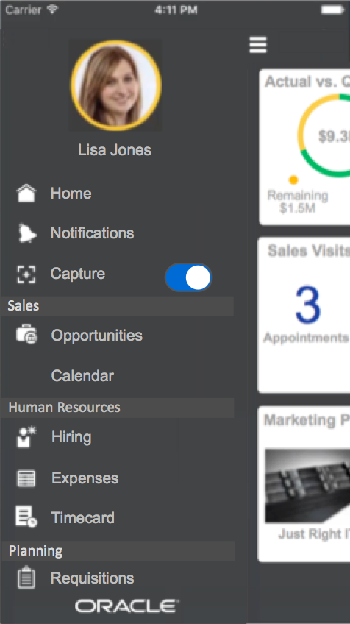
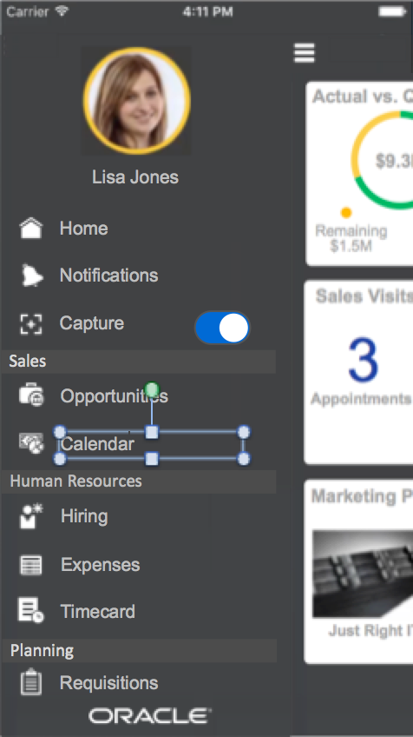
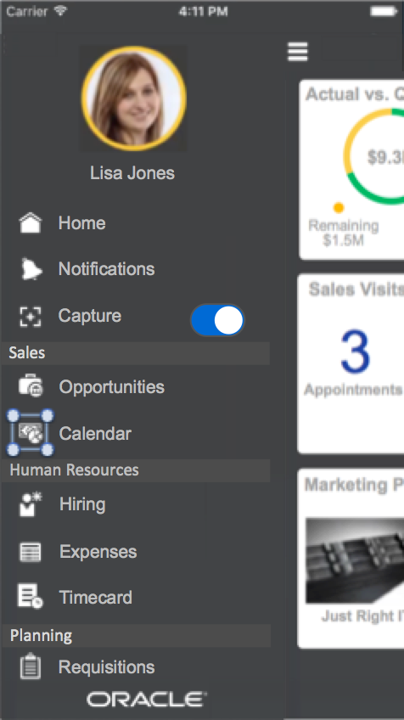
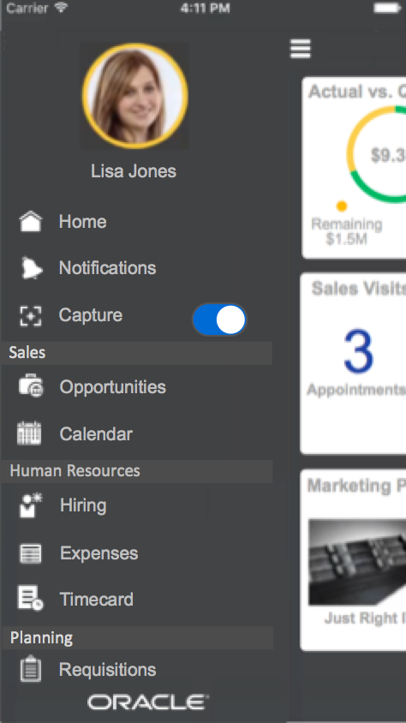
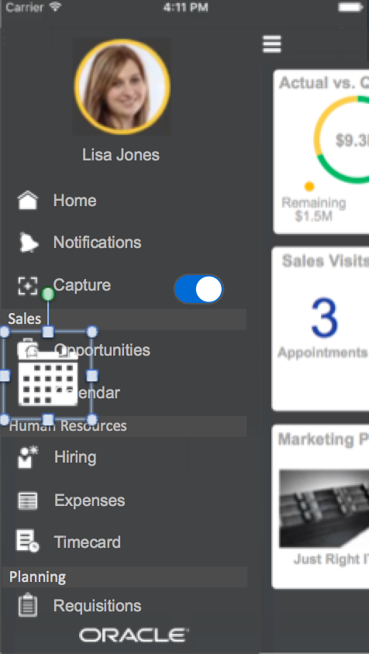

Edit Shuttle Flow (For Tim and Scott’s Demo)
Design scenario: You need to replace Commissions with a custom calendar in your mobile app, so you need to update your wireframes to reflect this planned change.
Steps
Tap the shuttle, and then find Commissions.
Change the text Commissions to Calendar.
Tap the Commissions icon.
Delete the Commissions icon.
Add the Calendar icon from the icon palette.
Resize the icon to 16px x 16px.

